Slide 1
Threat Intelligence Aggregator
Automated IOC Collection & Blocklist Generation
Created by: Raj Bharti

Slide 2
Project Objective
Problem: Cyber threats evolve daily. Manual blocking of malicious IPs/URLs is too slow.
Goal: Build an automated tool to fetch Indicators of Compromise (IOCs) from public feeds.
Outcome: A standardized 'Blocklist' (CSV) ready for firewall integration.

Slide 3
Technical Implementation
Language: Python 3.x
Libraries: 'requests' (HTTP fetching), 'csv' (Data formatting).
Source: URLHaus (Abuse.ch) - Real-time malware URL feed.
Logic: Connect -> Fetch Data -> Parse/Normalize -> Export to File.

Slide 4
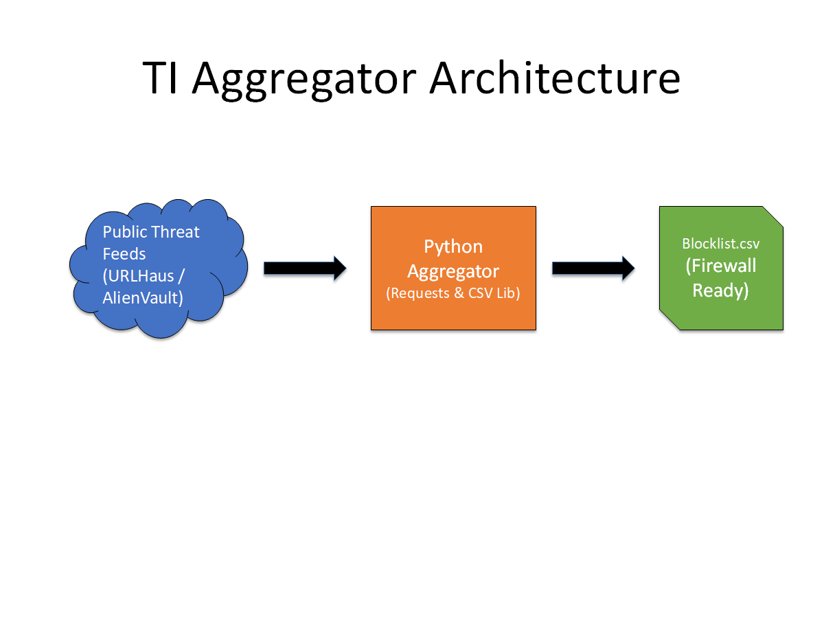
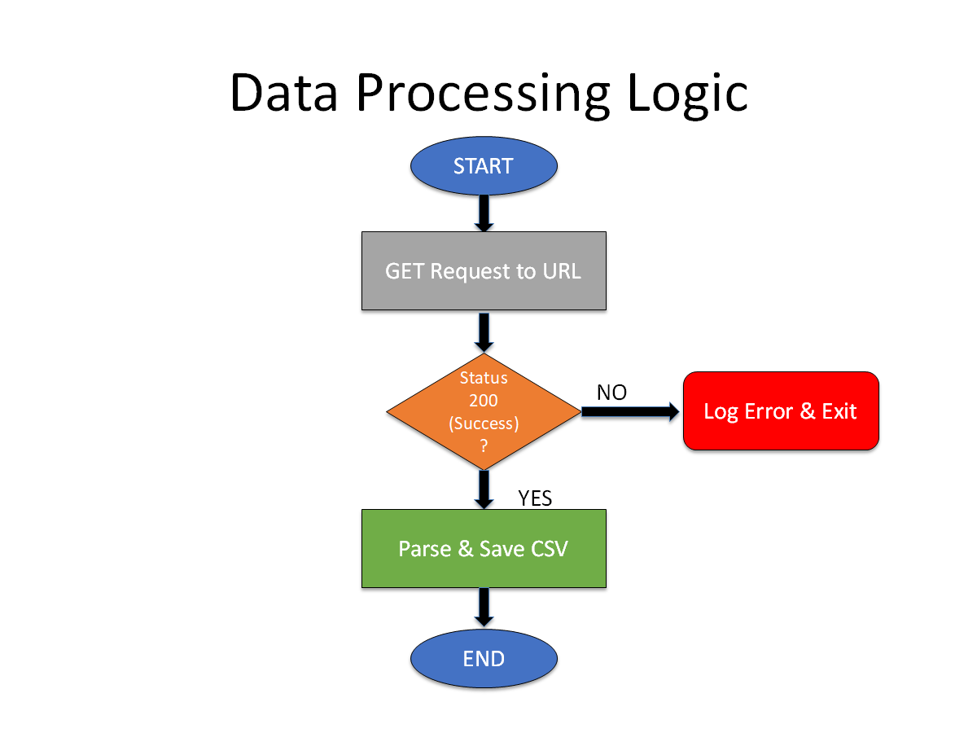
System Architecture
1. 2.

Slide 5
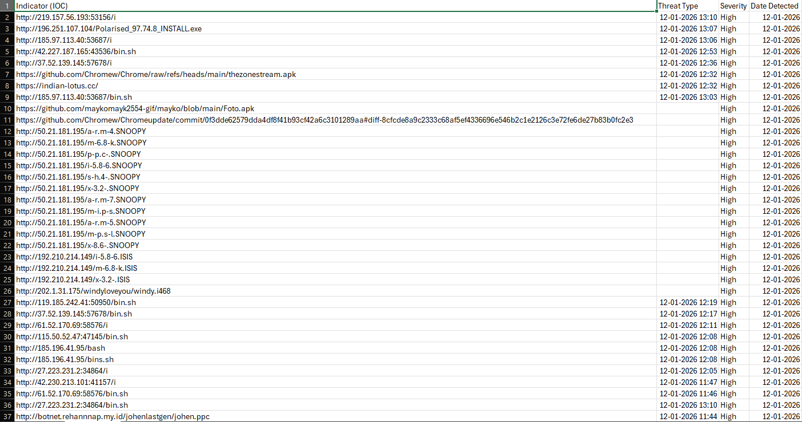
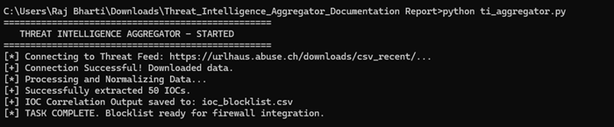
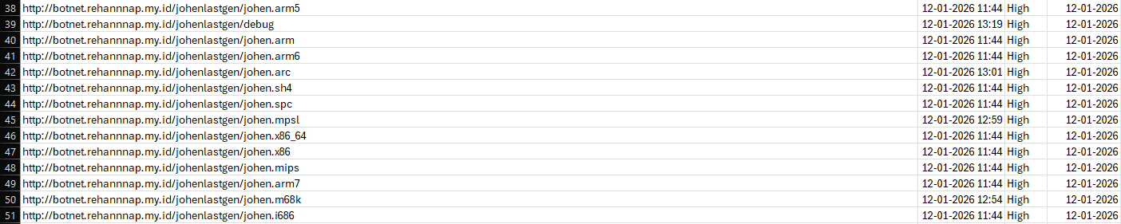
Proof of Concept
Evidence B: Generated Blocklist (ioc_blocklist.csv)
Evidence A: Console Output (Successful Fetch)

Slide 6
Conclusion & Impact
Success: The tool successfully aggregates real-time threat data.
Defense Value: Enables 'Proactive Defense' by blocking threats before they connect.
Scalability: Can easily be expanded to include AlienVault OTX or other feeds.
Final Thought: Automation is the key to modern cybersecurity operations.

