Slide 1
Project 2: USB Device Control & Monitoring System
Automated Endpoint Security Implementation
Created by: Raj Bharti

Slide 2
Objective & Problem Statement
Content:
The Problem: Unauthorized USB storage devices pose a significant security risk to organizations (Data Exfiltration & Malware Introduction).
The Goal: Develop a host-based security control that automatically detects and restricts unknown USB peripherals.
The Solution: A Python-based "USB Firewall" that interacts with the Linux Kernel to enforce a strict whitelist policy.

Slide 3
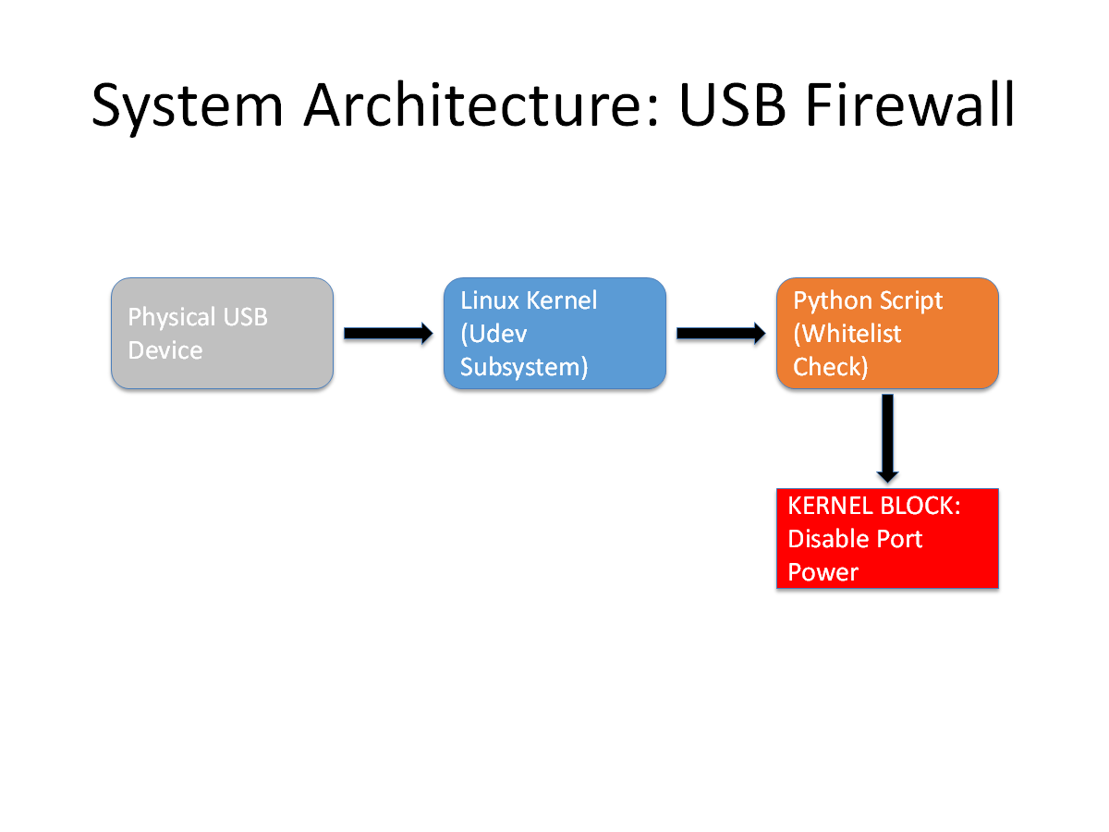
Technical Architecture
Action:
The system intercepts kernel signals via the Netlink socket to control port power.

Slide 4
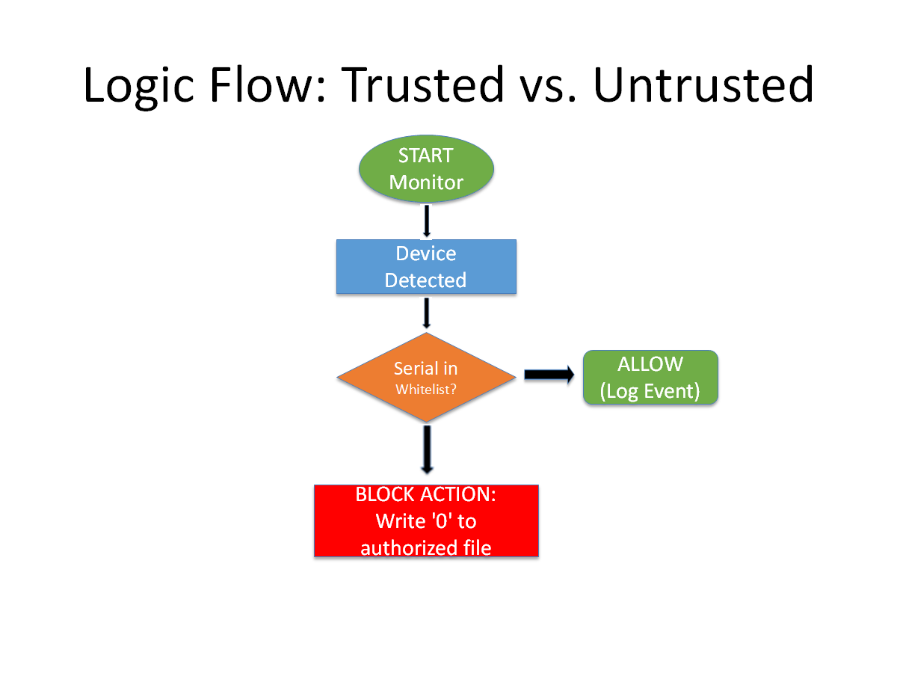
Detection & Blocking Logic
Detection: Uses the “pyudev library to listen for add events in real-time”.
Verification: Extracts the unique Serial Number
and compares it against a secure “USB_WHITELIST”.
Enforcement:
Trusted: Event is logged; device is allowed.
Untrusted:
Script writes “0 to the kernel authorized file, physically disabling the port”.

Slide 5
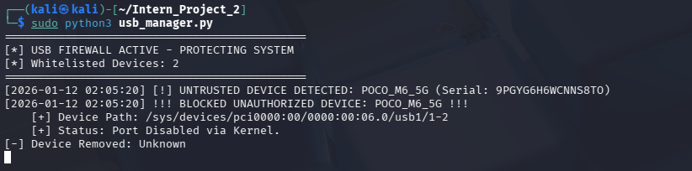
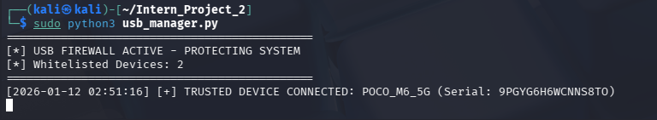
Proof of Concept
Scenario B: Whitelisted Device
Known device (Serial ...8TO) is permitted access.
Scenario A: Untrusted Device
System successfully disables the port upon detection.

Slide 6
Conclusion & Impact
Outcome: Successfully implemented a functioning USB Firewall on Kali Linux.
Key Feature: Granular control based on hardware serial numbers, not just device types.
Impact: Mitigates "BadUSB" attacks and prevents unauthorized data transfer.
Future Work: Enhance system to send alerts to a centralized SIEM dashboard.

