Slide 1
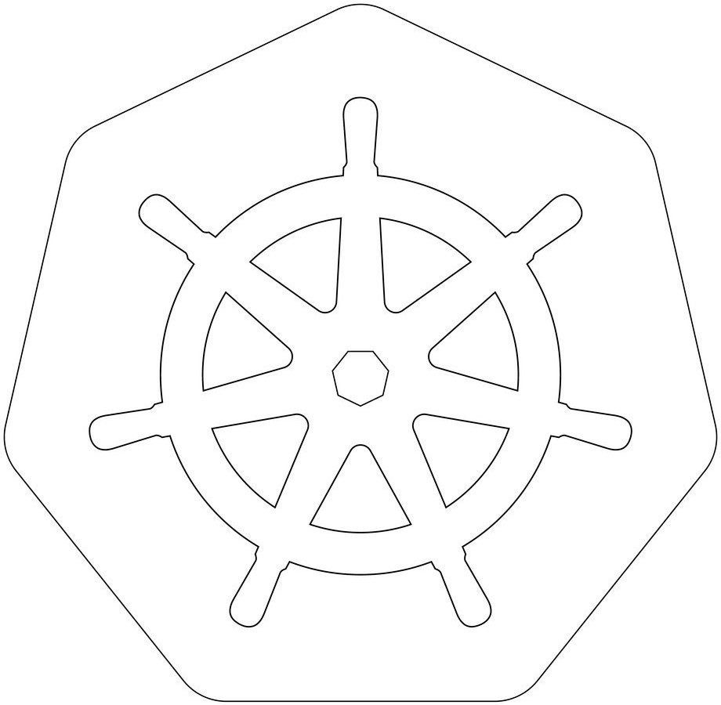


Slide 2
WHY KUBERNETES
Earlier We used Docker Swarm as a container orchestration tool that we used to manage multiple containerized applications on our environments.
FEATURES | DOCKER SWARM | KUBERNETES
Setup Auto Scaling Community GUI | Easy No Auto Scaling Good Community No GUI | Complex Auto Scaling Greater community for users like documentation, support and resources GUI

Slide 3
KUBERNETES:
IT is an open-source container orchestration platform.
It is used to automates many of the manual processes like deploying, managing, and scaling containerized applications.
Kubernetes was developed by GOOGLE using GO Language.
Google donated K8's to CNCF in 2014. 1st version was released in 2015.
why KUBERNETES:
Containers are a good and easy way to bundle and run your applications. In a production environment, you need to manage the containers that run the applications and ensure that there is no downtime. In docker we used docker swarm for this. but any how docker has drawbacks!
so we moved to KUBERNETES.

Slide 4
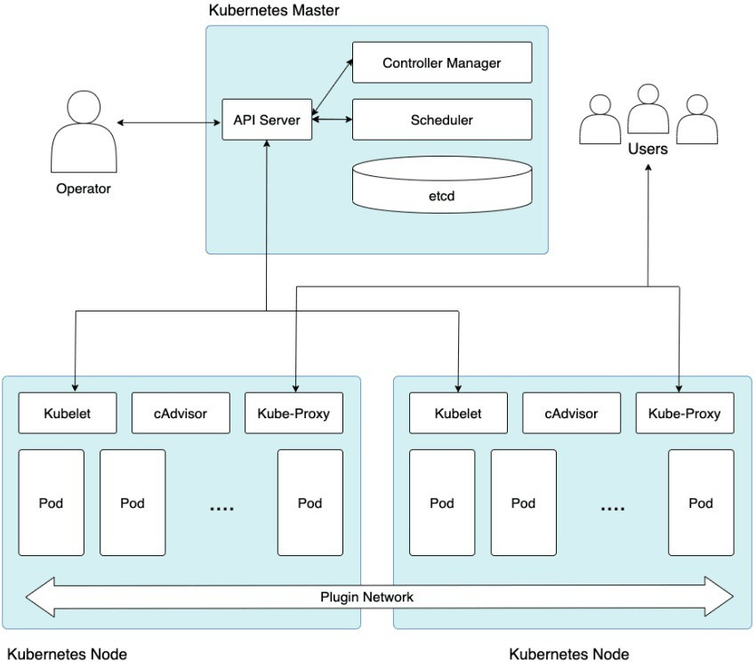
aechitecture:

Slide 5



HOW IT WORKS:
get pods
ETCD CLUSTER
API-SERVER
Authenticate user
Validate Request
Retrieve Data
1
2
3

Slide 6


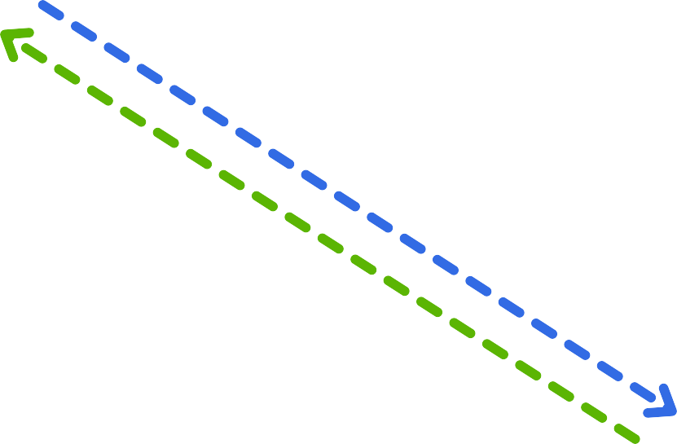




How od creates:
5. Update the pod data
ETCD CLUSTER
create pods
1. Request
API-SERVER
4. Creates a pod in worker node
2. Request
Scheduler
Kubelet
3. Find perfect Node to Create a Pod
Worker Node

Slide 7
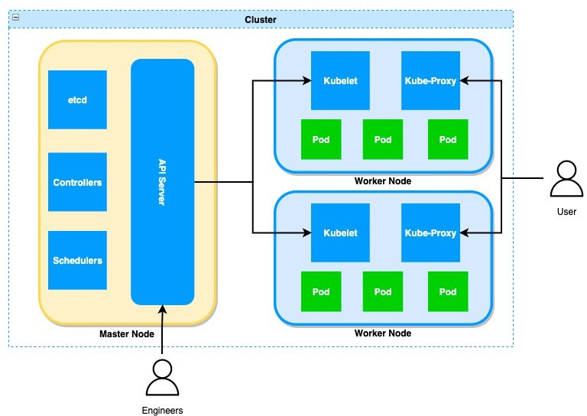

cluster:
It is a group of serversIt will have both manager and worker nodes.
Master Node is used to assign tasks to
Worker Nodes.
Worker node will perform the task.
we have 4 components in Master Node
1.API Server 2.ETCD
3. Controllers-manager
4. Schedulers
we have 4 components in Worker Node.
Kubelet
Kube-Proxy
Pod
Container

Slide 8




a i server:
It is used to accept the request from the user and store the request in ETCD. It is the only component that interacts with the ETCD directly
ETCD:
It is like a database to our k8's
it is used to store the requests of our cluster like pods, nodes, configs, secrets, roles etc..
scheduler:
It is used to search pending tasks which are present in ETCD.
If any pending task found in ETCD, it will schedule in worker node. It will decide in which worker node our task should gets executed. It will decide by communication with the kubelet in worker node Scheduler always monitor API-Server
The scheduler is a crucial component responsible for assigning pods to nodes
This will ensure that pods are scheduled on suitable nodes that meet their resource requirements and constraints

Slide 9

HOW SCHEDULER DECIDES
The scheduler is going to decide the put the right pod in right node based on Size, Memory, CPU etc..
pod-1
pod-3
pod-2
NODE-1
NODE-2
NODE-3

Slide 10
pod 6 cpu
Just assume that we have 1 pod and 4 nodes just like the below image
Node-1 2 CPU’s
Node-2 4 CPU’s
Node-3 10 CPU’s
Node-4 14 CPU’s
Lets see How its decides

Slide 11
pod 6 cpu
It Eliminates Node-1 & Node-2 because Node contains less CPU that pod
Node-1 2 CPU’s
Node-2 4 CPU’s
Node-3 10 CPU’s
Node-4 14 CPU’s

Slide 12
In the rest of these 2 nodes, scheduler decides based on CPU
Ex: If scheduler places the pod on Node-3 then Node-3 contains only 2 CPU’s only If scheduler places the pod on Node-4 then Node-4 contains only 4 CPU’s.
So scheduler selects Node-4 to place a pod.
Node-3 10 CPU’s
pod 6 cpu
Node-4
14 CPU’s
Not only CPU it selects based on different parameters like Resource Requirement limits
Taints & Tolerations Node selector

Slide 13
Scheduler will do the following taks
Pod Creation
Pod scheduling
Selecting Node
Pod Running
Kubelet Action
controllers:
The controller Manager collects the data/information from the API Server of the Kubernetes cluster like the desired state of the cluster and then decides what to do by sending the instructions to the API Server.
Controller will do the following taks
Replication Controller
Node Controller
Service Controller

Slide 14

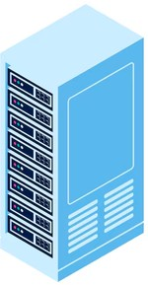
HOW NODE CONTROLLER WORKS:
REQUEST
Node Monitor Period: 5 sec
API-SERVER
Node Monitor Grace Period: 40 sec
NODE CONTROLLERS
Node Controller will checks the nodes for every 5 seconds through API-Server.
It works like a heartbeat for our body.
If Node controller does not get any response from Any Node for 40 seconds then Node Controller marks that node as UNREACHABLE
UnReachable
Node-1
Node-2
Node-3

Slide 15

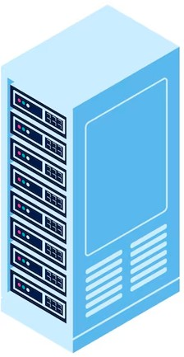
HOW RE LICATION CONTROLLER WORKS:
REQUEST
REPLICATION CONTROLLERS
API-SERVER
Replication Controller is the responsible for monitoring the desired number of pods are running or not.
If a pod deletes then RC will creates new pods
If Node controller does not get any response from Any Node for 40 seconds then Node Controller marks that node as UNREACHABLE
pod
pod
pod
pod
pod
pod

Slide 16
kubelet:
kubelet is the primary component of the Worker Node which manages the Pods and regularly checks whether the pod is running or not.
If pods are not working properly, then kubelet creates a new pod and replaces it with the previous one because the failed pod can’t be restarted hence, the IP of the pod might be changed
kube- roxy
kube-proxy contains all the network configuration of the entire cluster such as pod IP, Services, Deployments etc..
It takes care of the load balancing and routing which comes under networking configuration.
od: A group of one or more containers.
container:
It is a virtual machine which does not have any OS. it is used to run the applications in worker nodes.

Slide 17
kubernetes cluster setu :
There are multiple ways to setup kubernetes cluster.
1.SELF MANAGER K8'S CLUSTER
a.mini kube (single node cluster) b.kubeadm(multi node cluster)
c. KOPS
CLOUD MANAGED K8'S CLUSTER
AWS EKS
AZURE AKS
GCP GKS
IBM IKE

Slide 18
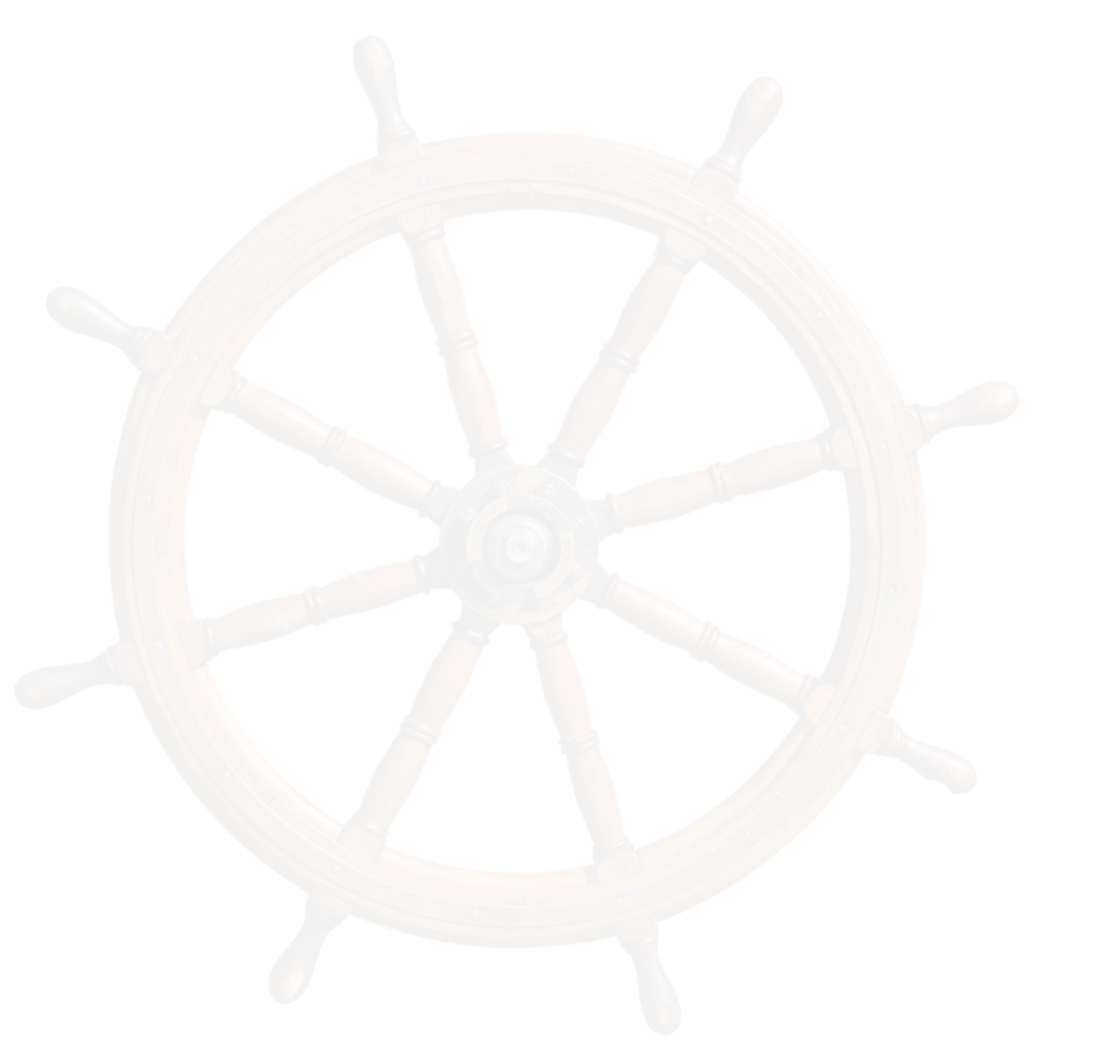
MINIKUBE:
It is a tool used to setup single node cluster on K8's.
It contains API Servers, ETDC database and container runtime It helps you to containerized applications.
It is used for development, testing, and experimentation purposes on local.
Here Master and worker runs on same machine It is a platform Independent.
By default it will create one node only.
Installing Minikube is simple compared to other tools.
NOTE: But we dont implement this in real-time

Slide 19
MINIKUBE SETUP:
REQUIREMENTS:
2 CPUs or more
2GB of free memory 20GB of free disk space Internet connection
Container or virtual machine manager, such as:
Docker.

Slide 20
UPDATE SERVER:
apt update -y
apt upgrade -y
INSTALL DOCKER:
sudo apt install curl wget apt-transport-https -y
sudo curl -fsSL https://get.docker.com -o get-docker.sh sudo sh get-docker.sh
INSTALL MINIKUBE:
sudo curl -LO https://storage.googleapis.com/minikube/releases/latest/minikube-linux-amd64
sudo mv minikube-linux-amd64 /usr/local/bin/minikube
sudo chmod +x /usr/local/bin/minikube
sudo minikube version
INSTALL KUBECTL:
sudo curl -LO "https://dl.k8s.io/release/$(curl -L -s https://dl.k8s.io/release/stable.txt)/bin/linux/amd64/kubectl"
sudo curl -LO "https://dl.k8s.io/$(curl -L -s https://dl.k8s.io/release/stable.txt)/bin/linux/amd64/kubectl.sha256"
sudo echo "$(cat kubectl.sha256) kubectl" | sha256sum --check
sudo install -o root -g root -m 0755 kubectl /usr/local/bin/kubectl
sudo kubectl version --client
sudo kubectl version --client --output=yaml
sudo minikube start --driver=docker --force

Slide 21
KUBECTL:
kubectl is the CLI which is used to interact with a Kubernetes cluster. We can create, manage pods, services, deployments, and other resources We can also monitoring, troubleshooting, scaling and updating the pods. To perform these tasks it communicates with the Kubernetes API server. It has many options and commands, to work on.
The configuration of kubectl is in the $HOME/.kube directory. The latest version is 1.28
SYNTAX:
kubectl [command] [TYPE] [NAME] [flags] kubectl api-resources : to list all api resources

Slide 22
Lets start working on kubernetes!
Note:
Kubernetes will not deploy the containers directly on worker nodes. Kubernetes has a object called POD which contains containers.
Lets learn about PODS

Slide 23
POD:
It is a smallest object that we can create in K8's. It is a group of containers.
Pod acts like a single instance for our application. Pods are ephemeral (short living objects)
Mostly we can use single container inside a pod but if we required, we can create multiple containers inside a same pod.
when we create a pod, containers inside pods can share the same network namespace, and can share the same storage volumes .
While creating pod, we must specify the image, along with any necessary configuration and resource limits.
K8's cannot communicate with containers, they can communicate with only pods. We can create this pod in two ways,
Imperative(command)
Declarative (Manifest file)

Slide 24
SINGLE CONTAINER POD
Pod-1 Pod-2
Container
Container
Node-1
Basically, each pods needs only one container. But sometimes we need 2 containers in one pod.

Slide 25
MULTI CONTAINER POD
Pod
App-Cont
Helper-Cont
Node
Helper containers are additional containers included in a pod to perform some tasks that support the primary container which are running in the pod.

Slide 26
How Helper container works:
A helper container is used to collect the logs from the primary container.
Helper containers can be used to run monitoring and metrics collection agents from the main application container.
Helper containers can assist in syncing files or data between containers in a pod. For example, a pod might have a main application container and a helper container responsible for syncing configuration files or other shared resources.
Security-related tasks, such as handling secrets, encryption, or authentication, can be done by helper container.

Slide 27
POD CREATION:
IMPERATIVE:
The imperative way uses kubectl command to create pod.
This method is useful for quickly creating and modifying the pods. SYNTAX: kubectl run pod_name --image=image_name COMMAND: kubectl run pod-1 --image=nginx
kubectl : command line tool run : action pod-1 : name of pod
nginx : name of image

Slide 28
KUBECTL:
DECLARATIVE:
The Declarativ tive way we need to create a Manifest file in YAML Extension. This file contains the desired state of a Pod.
It takes care of creating, updating, or deleting the resources. This manifest file need to follow the yaml indentation.
YAML file consist of KEY-VALUE Pair.
Here we use create or apply command to execute the Manifest file.
SYNTAX: kubectl create/apply -f file_name
CREATE: if you are creating the object for first time we use create only.
APPLY: if we change any thing on files and changes need to apply the resources.

Slide 29
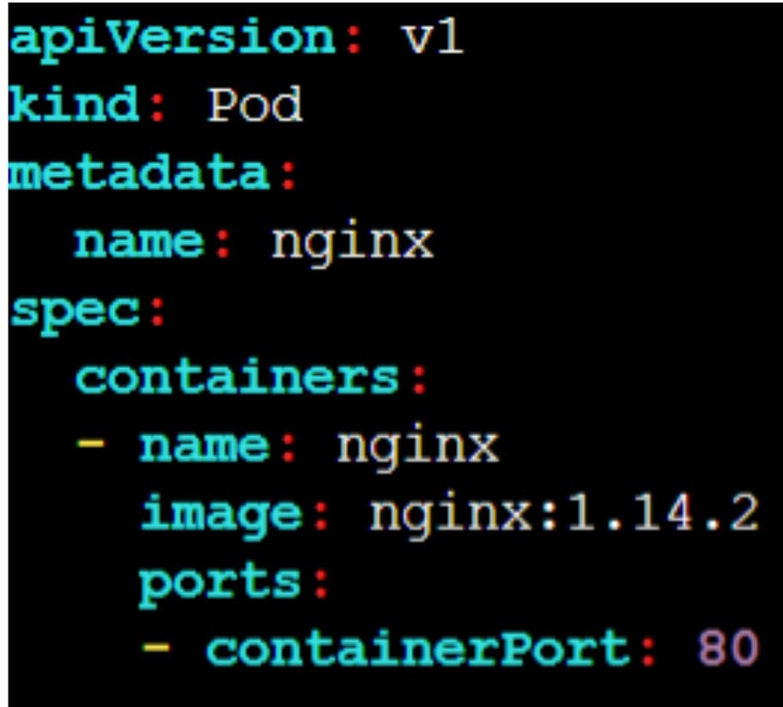
MANIFEST FILE:
apiVersion: This is the version of API from Kubernetes which is used to create objects.
kind: defines the object that we are creating.
metadata: data about the object like names, labels etc ...
spec: It is the specifications of the object

Slide 30
COMMANDS:
To get all the pods: kubetctl get pods (or) kubectl get pod (or) kubectl get po
To delete a pod: kubectl delete pod pod_name
To get IP of a pod: kubectl get po pod_name -o wide
To get IP of all pods: kubectl get po -o wide
To get all details of a pod: kubectl describe pod podname
To get all details of all pods: kubectl describe po
To get the pod details in YAML format: kubectl get pod pod-1 -o yaml To get the pod details in JSON format: kubectl get pod pod-1 -o json To enter into a pod: kubectl exec -it pod_name -c cont_name bash To get the logging info of our pod: kubectl logs pod_name
To get the logs of containers inside the pod: kubectl logs pod_name -c cont-name

Slide 31
KUBERNETES METRICS SERVER:
It is used to monitor the Kubernetes components like Pods, Nodes & Deployments etc...
The Kubernetes Metrics Server measures CPU and memory usage across the Kubernetes cluster like Pods & Nodes.
INSTALLATION:
DOWNLOAD THE FILE: kubectl apply -f https://github.com/kubernetes-sigs/metrics- server/releases/latest/download/components.yaml
SEE THE DEPLOYMENT: kubectl -n kube-system get deploy metrics-server EDIT THE DEPLOYMENT : kubectl -n kube-system edit deploy metrics-server Add these commands under the container args
/metrics-server
--kubelet-insecure-tls
--kubelet-preferred-address-types=InternalIP

Slide 32
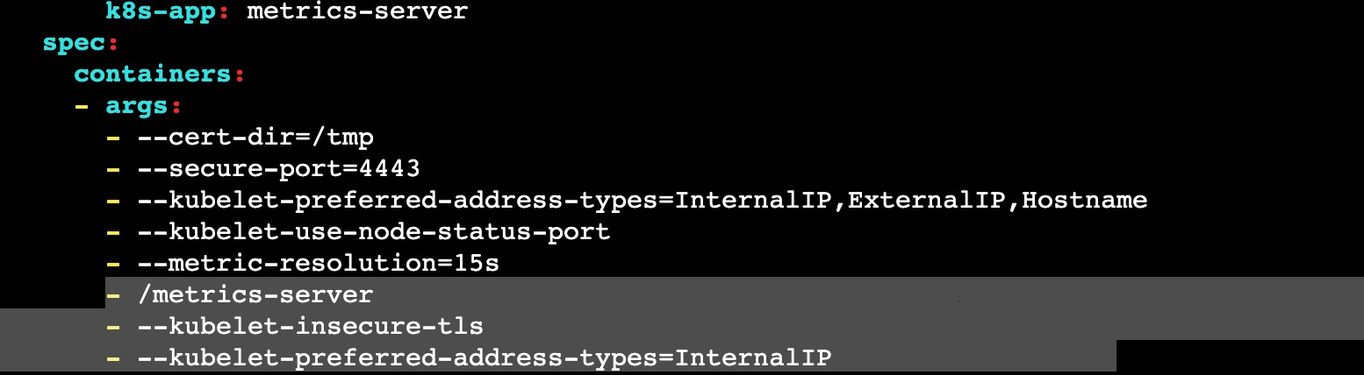
MONITOR:
Check the Node metrics: kubectl top nodes
Now create some pods and check the pod metrics : kubectl top pod

Slide 33
Labels, Selectors, and Node Selectors:
Labels:
Labels are used to organize Kubernetes Objects such as Pods, nodes, etc. You can add multiple labels over the Kubernetes Objects.
Labels are defined in key-value pairs.
Labels are similar to tags in AWS or Azure where you give a name to filter the resources quickly.
You can add labels like environment, department or anything else according to you.

Slide 34
Label-Selectors:
Once the labels are attached to the Kubernetes objects those objects will be filtered out with the help of labels-Selectors known as Selectors.
The API currently supports two types of label-selectors equality-based and set-based. Label selectors can be made of multiple selectors that are comma-separated.

Slide 35
Node Selector:
Node selector means selecting the nodes. Node selector is used to choose the node to apply a particular command.
This is done by Labels where in the manifest file, we mentioned the node label name. While running the manifest file, master nodes find the node that has the same label and create the pod on that container.
Make sure that the node must have the label. If the node doesn’t have any label then, the manifest file will jump to the next node.

Slide 36
apiVersion: v1 kind: Pod metadata: name: pod-1 labels:
env: testing department: DevOps
spec: containers:
- name: containers1 image: ubuntu
command: ["/bin/bash", "-c", "while true; do echo This is our Pod; sleep 5 ; done"]
To see the list of pods with labels: kubectl get pods --show-labels Now, I want to list those pods that have the label env=testing. kubectl get pods -l env=testing
kubectl get pods -l department!=DevOps
As we have discussed earlier, there are two types of label-selectors equality and set-based.
This is the example of equality based where we used equalsTo(=).

Slide 37
Now, Suppose I forgot to add the label through the declarative(via manifest) method. So, I can add labels after creating the pods as well which is known as the imperative(via command) method.
kubectl label pods Pod_name Location=India
As we discussed the type of label-selector, let’s see the example of a set- based label-selector where we use in, notin, and exists.
Lets list all those pods that have an env label with value for either testing or development.
kubectl get pods -l ‘env in (testing, development)’

Slide 38
we are trying to list all those pods that don’t have the India or US value for the Location key in the Label.
kubectl get pods -l ‘Location not in (India, US)’ We can also delete the pods as per the label.
Let’s deleted all those pods that don’t have the Chinda value for the location key in the Label.
kubectl delete pod -l Location!=China

Slide 39


WE DEPLOYED THE POD
LETS ACCESS OUR APPLICATION

Slide 40

I CANT ABLE TO ACCESS MY APPLICATION
The reason why we are not able to access the application: In Kubernetes, if you want to access the application we have to expose our pod. To Expose these pods we use Kubernetes services.

Slide 41
KUBERNETES SERVICES
Service is a method for exposing Pods in your cluster.
Each Pod gets its own IP address But we need to access from IP of the Node.. If you want to access pod from inside we use Cluster-IP.
If the service is of type NodePort or LoadBalancer, it can also be accessed. from outside the cluster.
It enables the pods to be decoupled from the network topology, which makes it easier to manage and scale applications
TYPES:
CLUSTER-IP NODE PORT LOAD BALANCER

Slide 42
TYPES OF SERVICES
ClusterIP: A ClusterIP service provides a stable IP address and DNS name for pods within a cluster. This type of service is only accessible within the cluster and is not exposed externally.
NodePort: A NodePort service provides a way to expose a service on a static port on each node in the cluster. This type of service is accessible both within the cluster and externally, using the node's IP address and the NodePort.
LoadBalancer: A LoadBalancer service provides a way to expose a service externally, using a cloud provider's load balancer. This type of service is typically used when an application needs to handle high traffic loads and requires automatic scaling and load balancing capabilities.
ExternalName: This is a similar object service to ClusterIP but it does have DNS CName instead of Selectors and labels. In other words, services will be mapped to a DNS name. You can view the Service YML file and see how to use this service.

Slide 43
COMPONENTS OF SERVICES
A service is defined using a Kubernetes manifest file that describes its properties and specifications. Some of the key properties of a service include:
Selector: A label selector that defines the set of pods that the service will route traffic to.
Port: The port number on which the service will listen for incoming traffic. TargetPort: The port number on which the pods are listening for traffic.
Type: The type of the service, such as ClusterIP, NodePort, LoadBalancer, or ExternalName.

Slide 44
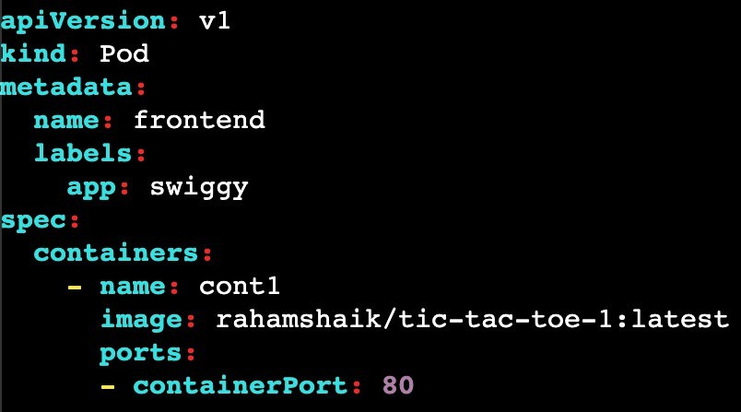
CLUSTER-IP:
To deploy the application we create a container, which stores inside the pod. After container is created we will be not able to access the application.
Because we cannot access the pods and ports from the cluster. To Avoid this we are creating the Services.

Slide 45
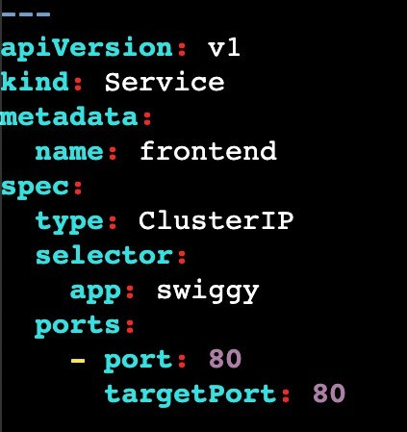

In this code we are exposing the applcation. here we use clusterip service
By using this we can access application inside the cluster only.
But if we want to access the application from outside we need to use nodeport.
ClusterIP will assign one ip for service to access the pod.
Just Replace ClusterIP=NodePort
kubectl apply -f filename.yml

Slide 46
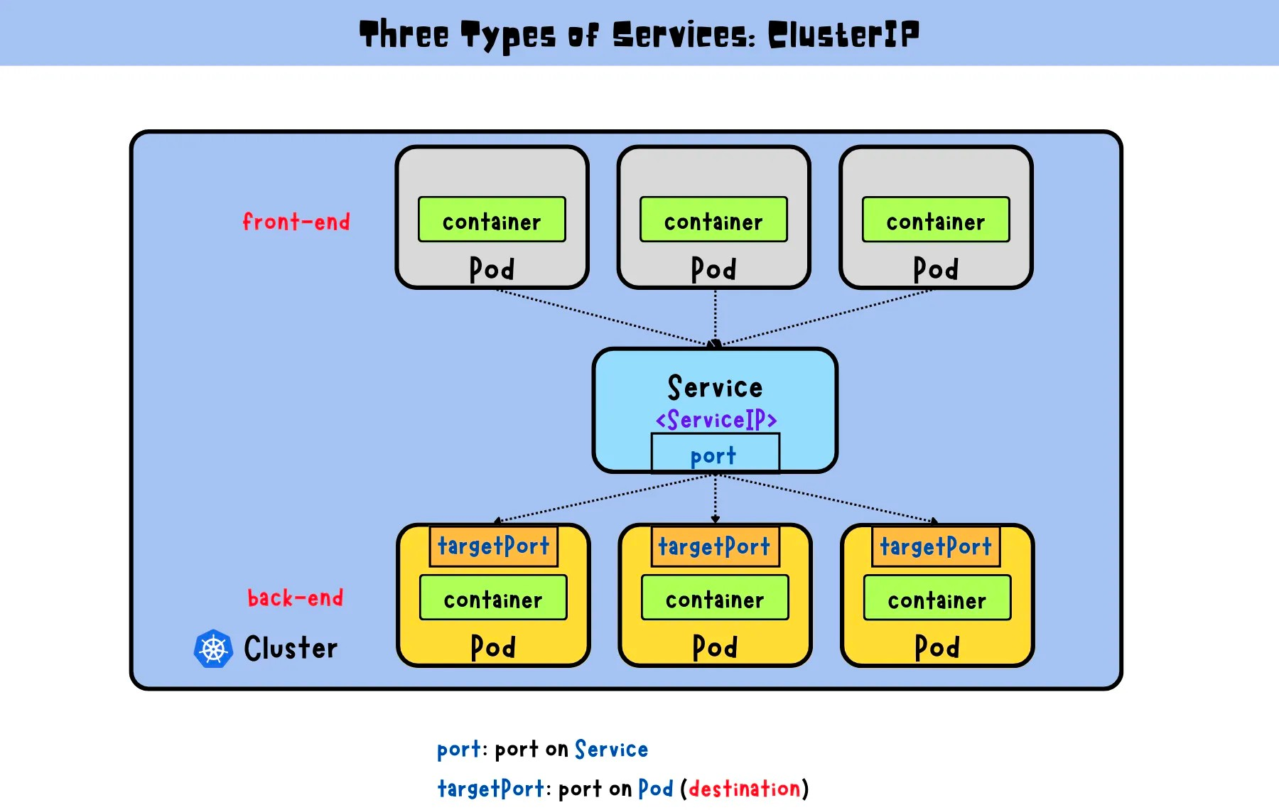

Slide 47
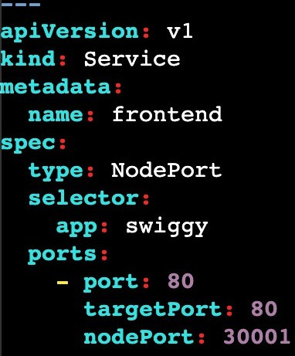
In this code we are exposed the application from anywhere (inside & outside)
We need to Give public ip of node where pod is running.
Node Port Range= 30000 - 32767
here i hae defined port number as 30001
if we dont specify the port it will assign automatically. kubectl apply -f filename.yml.
NodePort expose service on a static port on each node. NodePort services are typically used for smaller applications with a lower traffic volume.
To avoid this we are using the LoadBalancer service.
Just Replace NodePort=LoadBalancer

Slide 48
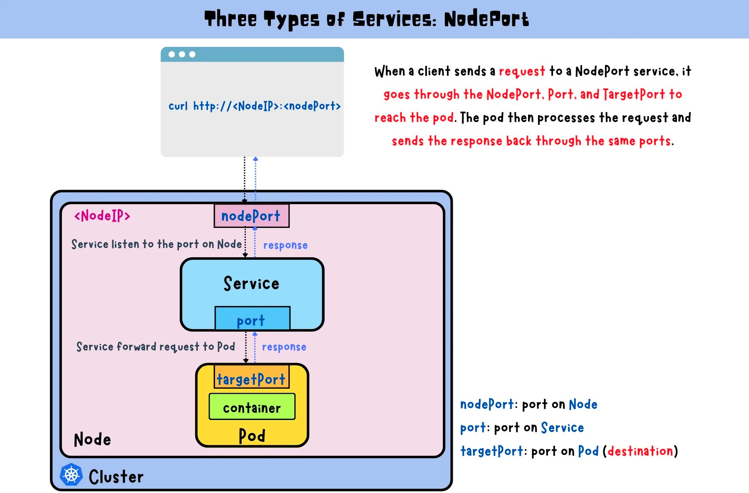

Slide 49
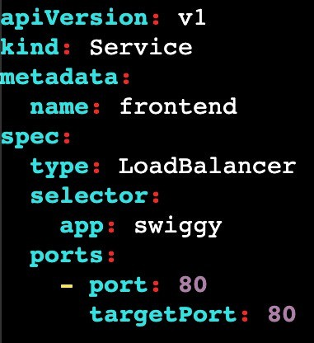
In LoadBalaner we can expose application externally with the help of Cloud Provider LoadBalancer.
it is used when an application needs to handle high traffic loads and requires automatic scaling and load balancing capabilities.
After the LoadBalancer service is created, the cloud provider will created the Load Balancer.
This IP address can be used by clients outside the cluster to access the service.
The LoadBalancer service also automatically distributes incoming traffic across the pods that match the selector defined in the YAML manifest.
access : publicip:port and LB url http://a0dce056441c04035918de4bfb5bff97-40528368.us- east- 1.elb.amazonaws.com/

Slide 50
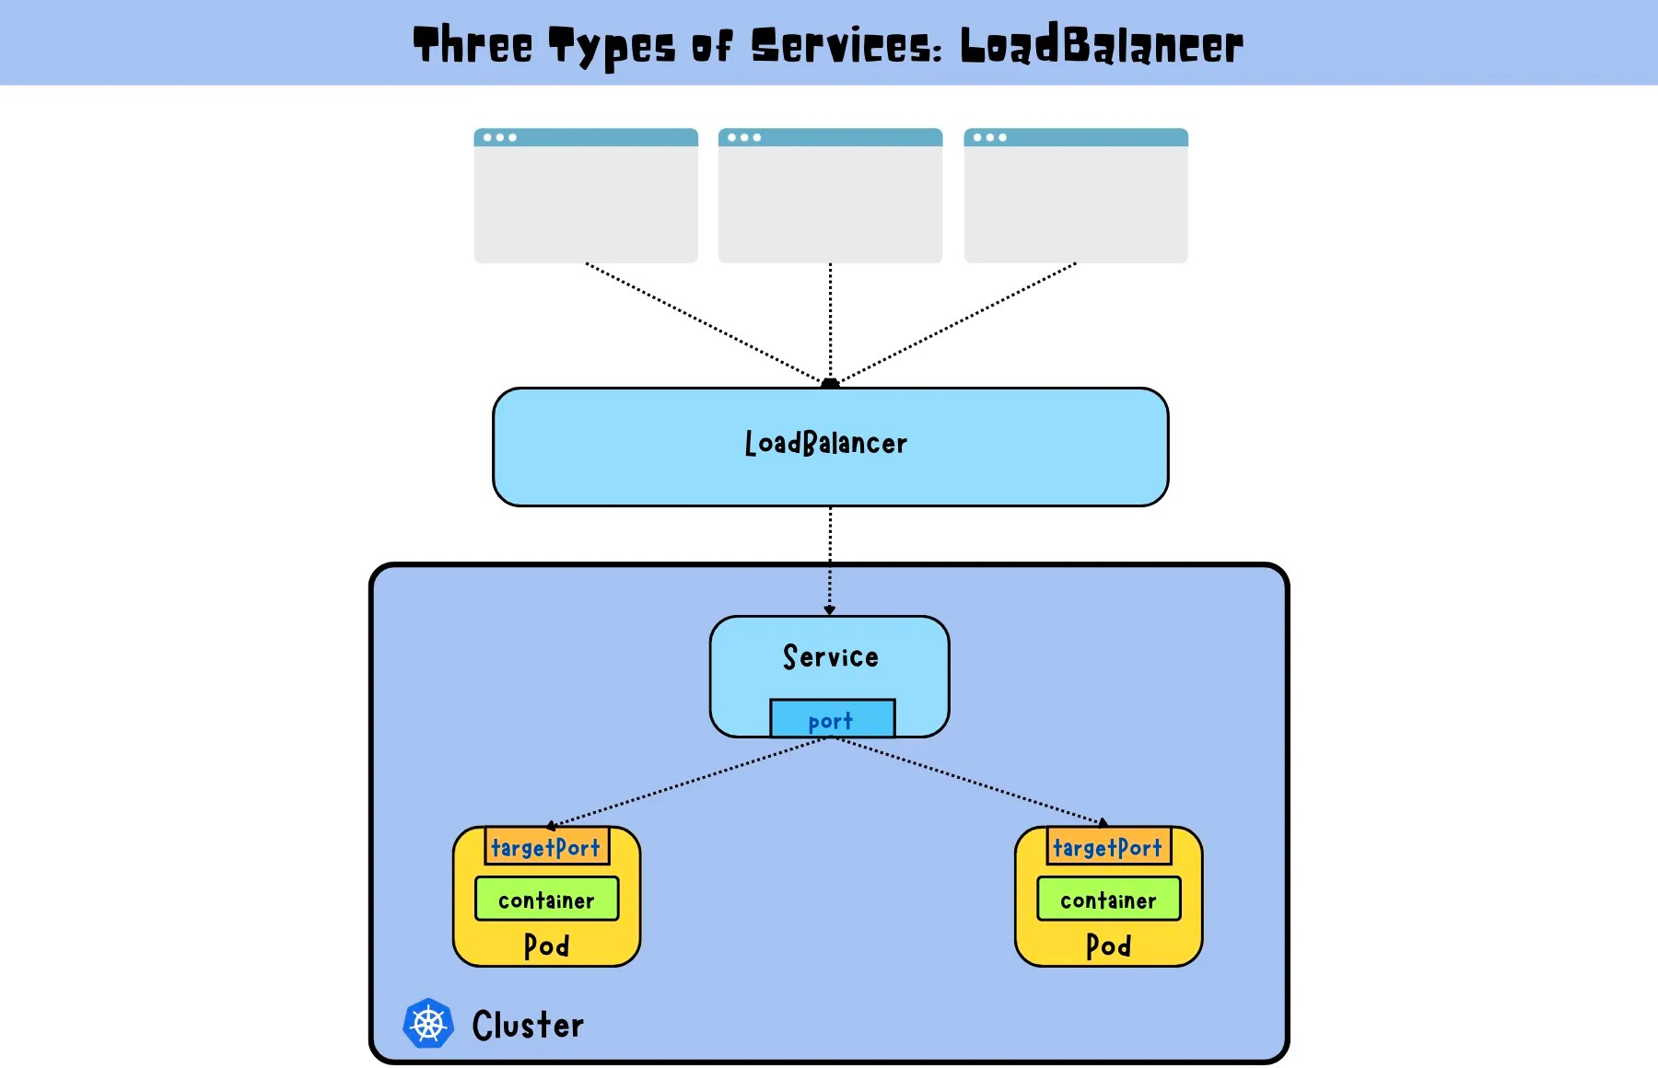

Slide 51
ExternalName:
apiVersion: v1 kind: Service metadata:
name: k8-service namespace: dev spec:
type: ExternalName externalName: k8.learning.com

Slide 52
COMMANDS FOR SERVICES:
Creates a new service based on the YAML file
kubectl create -f filename
Create a ClusterIP service
kubectl create service clusterip <service-name> --tcp=<port>:<targetPort>
Create a NodePort service
kubectl create service nodeport <service-name> --tcp=<port>:<targetPort>
--node-port=<nodePort>
Create a LoadBalancer service
kubectl create service loadbalancer <service-name> --tcp=<port>:<targetPort>

Slide 53
Create a service for a pod
kubectl expose pod <pod-name> --name=<service-name> \
--port=<port> --target-port=<targetPort> --type=<service-type>
Create a service for a deployment
kubectl expose deployment <deployment-name> --name=<service-name> \
--port=<port> --target-port=<targetPort> --type=<service-type>
Retrieve a list of services that have been created
kubectl get services
Retrieve detailed information about a specific service
kubectl describe services <service-name>

Slide 54
THE DRAWBACK
In the above both methods we can be able to create a pod but what if we delete the pod ?
once you delete the pod we cannot able to access the pod, so it will create a lot of difficulty in Real time
NOTE: Self healing is not Avaliable here.
To overcome this on we use some Kubernetes components called RC, RS, DEPLOYMENTS, DAEMON SETS, etc ...

Slide 55
REPLICAS IN KUBERNETES:
Before Kubernetes, other tools did not provide important and customized features like scaling and replication.
When Kubernetes was introduced, replication and scaling were the premium features that increased the popularity of this container orchestration tool.
Replication means that if the pod's desired state is set to 3 and whenever any pod fails, then with the help of replication, the new pod will be created as soon as possible. This will lead to a reduction in the downtime of the application.
Scaling means if the load becomes increases on the application, then Kubernetes increases the number of pods according to the load on the application.

Slide 56
ReplicationController is an object in Kubernetes that was introduced in v1 of Kubernetes which helps to meet the desired state of the Kubernetes cluster from the current state. ReplicationController works on equality-based controllers only.
ReplicaSet is an object in Kubernetes and it is an advanced version of ReplicationController. ReplicaSet works on both equality-based controllers and set-based controllers.

Slide 57
REPLICATION CONTROLLER:
Replication controller can run specific number of pods as per our requirement.
It is the responsible for managing the pod lifecycle
It will make sure that always pods are up and running.
If there are too many pods, RC will terminates the extra pods. If there are too less RC will create new pods.
This Replication controller will have slef-healing capability, that means automatically it will creates.
If a pod is failed, terminated or deleted then new pod will get created automatically. Replication Controllers use labels to identify the pods that they are managing.
We need to specifies the desired number of replicas in YAML file.

Slide 58
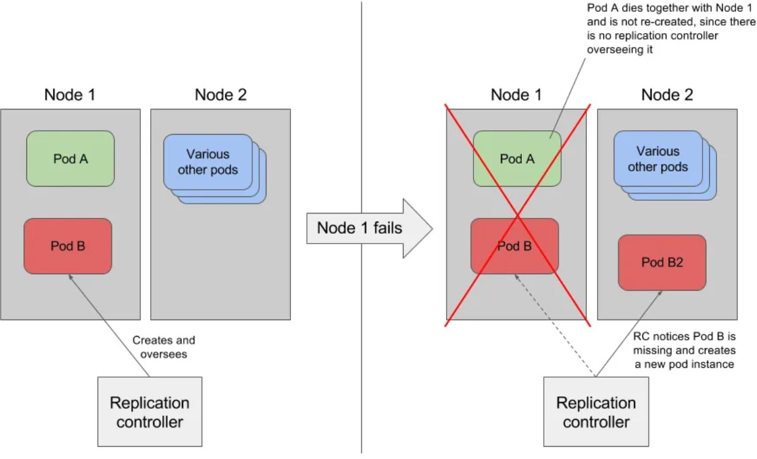
REPLICATION CONTROLLER:

Slide 59
SELECTOR: It select the resources based on labels. Labels are key value pairs.
This will helps to pass a command to the pods with lable app=nginx

Slide 60
apiVersion: v1
kind: ReplicationController metadata:
name: myreplica spec:
replicas: 2 selector: Location: India template: metadata:
name: testpod6 labels:
Location: India spec:
containers:
- name: c00 image: ubuntu
command: ["/bin/bash", "-c", "while true; do echo ReplicationController Example; sleep 5 ; done"]

Slide 61
TO EXECUTE TO GET
TO DESCRIBE TO SCALE UP
TO SCALE DOWN
: kubectl create -f file_name.yml
: kubectl get rc
: kubectl describe rc/nginx
: kubectl scale rc rc_name --replicas 5
: kubectl scale rc rc_name --replicas 2 (drops
from 5 to 2)
: kubectl delete rc rc_name
TO DELETE REPLICA CONTROLLER
IF WE DELETE RC, PODS ARE ALSO GETS DELETED, BUT IF WE DON’T WANT TO DELETE PODS, WE WANT TO DELETE ONLY REPLICA SETS THEN
kubectl delete rc rc_name --cascade=orphan kubectl get rc rc_name
kubectl get pod
Now we deleted the RC but still pods are present, if we want to assign this pods to another RC use the same selector which we used on the RC last file.

Slide 62
THE DRAWBACK
RC used only equality based selector ex: env=prod
here we can assign only one value (equality based selector)
We are not using these RC in recent times, because RC is replaced by RS(Replica Set)

Slide 63
REPLICASET:
it is nothing but group of identical pods. If one pod crashes automatically replica sets gives one more pod immediately.
it uses labels to identify the pods
Difference between RC and RS is selector and it offers more advanced functionality.
The key difference is that the replication controller only supports equality-
based selectors whereas the replica set supports set-based selectors. it monitoring the number of replicas of a pod running in a cluster and creating or deleting new pods.
It also provides better control over the scaling of the pod.
A ReplicaSet identifies new Pods to acquire by using its selector. we can provide multiple values to same key.
ex: env in (prod,test)

Slide 64
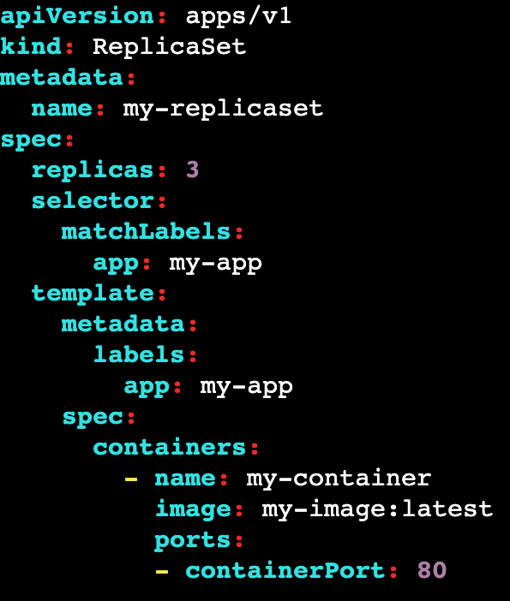
Replicas: Number of pod copies we need to create Matchelabel: label we want to match with pods Template: This is the template of pod.
Note: give apiVersion: apps/v1 on top
Labels : mandatory to create RS (if u have 100 pods in a cluster we can inform which pods we need to take care by using labels) if u labeled some pods a rajco then all the pods with label rajco will be managed.

Slide 65
apiVersion: apps/v1 kind: ReplicaSet metadata:
name: myrs spec: replicas: 2 selector:
matchExpressions:
{key: Location, operator: In, values: [India, US, Russia]}
{key: env, operator: NotIn, values: [testing]} template:
metadata: name: testpod7 labels:
Location: Russia spec:
containers:
- name: container1 image: ubuntu
command: ["/bin/bash", "-c", "while true; do echo ReplicaSet Example; sleep 5 ; done"]

Slide 66
COMMANDS:
TO EXECUTE TO LIST
TO GET INFO
TO GET IN YAML
:
:
:
:
kubectl create -f replicaset-nginx.yaml kubectl get replicaset/rs
kubectl get rs -o wide kubectl get rs -o yaml kubectl get all
TO GET ALL RESOURCES :
Now delete a pod and do list now it will be created automatically
TO DELETE A POD :
TO DELETE RS : TO SHOW LABLES OF RS : TO SHOW POD IN YAML :
Kubectl delete po pod_name kubectl delete rs
Kubectl get po –show-labels Kubectl get pod -o yaml

Slide 67
THE DRAWBACK
Here Replica set is an lower level object which focus on maintaining desired number of replica pods.
To manage this replica set we need a higher-level object called deployment which provide additional functionality like rolling updates and roll backs.
Deployments use ReplicaSets under the hood to manage the actual pods that run the application.

Slide 68
DEPLOYMENT:
It has features of Replicaset and some other extra features like updating and rollbacking to a particular version.
The best part of Deployment is we can do it without downtime.
you can update the container image or configuration of the application. Deployments also provide features such as versioning, which allows you to track the history of changes to the application.
It has a pause feature, which allows you to temporarily suspend updates to the application
Scaling can be done manually or automatically based on metrics such as CPU utilization or requests per second.
Deployment will create ReplicaSet, ReplicaSet will created Pods.
If you delete Deployment, it will delete ReplicaSet and then ReplicaSet will delete Pods.

Slide 69
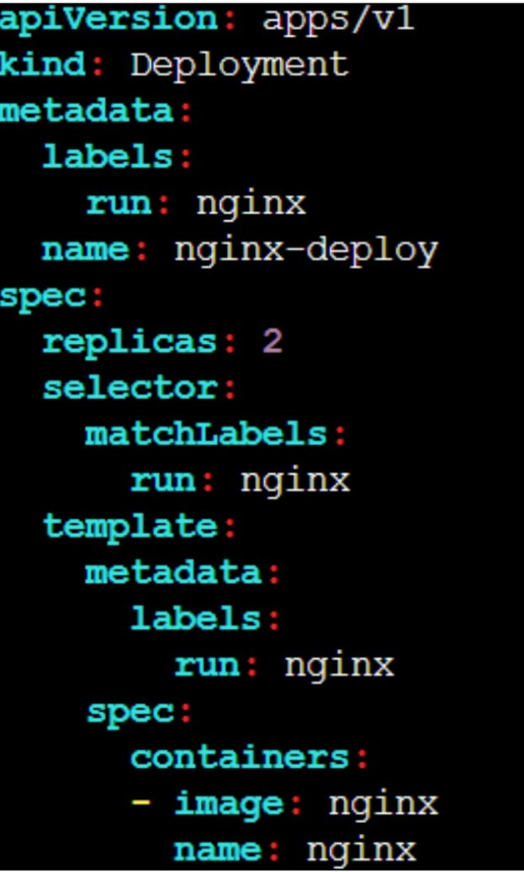
Replicas: Number of pod copies we need to create Matchelabel: label we want to match with pods Template: This is the template of pod.
Labels : mandatory to create RS (if u have 100 pods in a cluster we can inform which pods we need to take care by using labels) if u labeled some pods a rajco then all the pods with label rajco will be managed.

Slide 70
MANIFEST FILE:
To create a replica set : kubectl create -f replicaset-nginx.yaml To see a deployment : kubectl get deployment/deploy
To see full details of deployment : kubectl get deploy -o wide To view in YAML format : kubectl get deploy -o yaml
To get all info : kubectl describe deploy
COMMAND TO CREATE DEPLOYMENT:
kubectl create deployment deployment-name --image=image-name --replicas=4 Now delete a pod and do list now it will be created automatically
To delete a pod: Kubectl delete po pod_name To check logs : kubectl logs pod_name
To delete a deployment : kubectl delete deploy deploy_name

Slide 71
When you inspect the Deployments in your cluster, the following fields are displayed:
NAME lists the names of the Deployments in the namespace.
READY displays how many replicas of the application are available to your users. It follows the pattern ready/desired.
UP-TO-DATE displays the number of replicas that have been updated to achieve the desired state.
AVAILABLE displays how many replicas of the application are available to your users.
AGE displays the amount of time that the application has been running.

Slide 72
UPDATING A DEPLOYMENT:
update the container image:
kubectl set image deployment/deployment-name my-container=image-name or
kubectl edit deployment/deployment-name
To roll back:
kubectl rollout status deployment/deployment-name
To check the status:
kubectl rollout status deployment/deployment-name
To get the history:
kubectl rollout history deployment/deployment-name
To rollback specific version:
kubectl rollout undo deployment/deployment-name --to-revision=number

Slide 73
PAUSE/UNPAUSE A DEPLOYMENT:
To pause a pod in deployment:
kubectl rollout pause deployment/deployment-name
To un-pause a pod in deployment:
kubectl rollout resume deployment/deployment-name
DEPLOYMENT SCALING:
Lets assume we have 3 pods, if i want to scale up it to 10 pods (manual scaling) kubectl scale deployment/nginx-deployment --replicas=10
Lets assume we have 10 pods, if i want to scale down it to 5 pods (manual scaling) kubectl scale deployment/nginx-deployment --replicas=5

Slide 74
KUBERNETES AUTO-SCALING:
As you know, to run the application we need CPU and memory. Sometimes, there will be a chance where the CPU gets loaded, and this might fail the server or affect the application. Now, we can’t afford the downtime of the applications. To avoid this, we need to increase the number of servers or increase the capacity of servers.
Let’s understand with a real-time example:
Just take an example we have some OTT platforms like Netflix, Prime, Aha & Hotstar. If any web show or movie is coming on the platform the audience is eagerly waiting for that. Then, the OTT platform can’t handle the lot of users that might crash the application. This will lead to a loss of business and the OTT platform can’t afford this business loss. Now, they have two options to solve this.

Slide 75
First, The Platform knows that they need a particular amount of servers such as 100. So, they can buy those servers forever but in this situation, when the load decreases then the other servers will become unused. Now, if the server is unused, still they have paid for those servers which is not a cost-effective method.
Second, The Platform doesn’t know when the load will increase. So, they have one option which is autoscaling in which when the CPU utilization crosses a particular number, it creates new servers. So, the platform can handle loads easily which is very cost effective as well.

Slide 76
Types of Autoscaling
Horizontal Pod AutoScaling: In this type of scaling, the number of servers will increase according to CPU utilization. In this, you define the minimum number of servers, maximum number of servers, and CPU utilization. If the CPU utilization crosses more than 50% then, it will add the one server automatically.
Vertical Pod AutoScaling: In this type of scaling, the server will remain the same in numbers but the server’s configuration will increase such as from 4GB RAM to 8GM RAM, and the same with the other configurations. But this is not cost-effective and business-effective. So, we use Horizontal Pod AutoScaling.

Slide 77
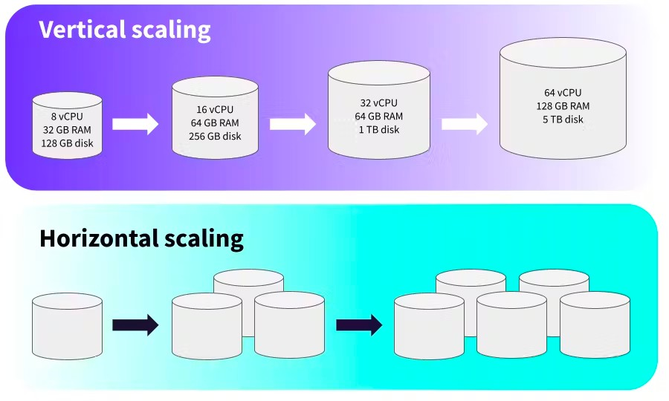

Slide 78
Key Features of Horizontal Pod AutoScaler:
By default, Kubernetes does not provide AutoScaling. If you need AutoScaling, then you have to create hpa(Horizontal Pod AutoScaling) and vpa(Vertical Pod AutoScaling) objects.
Kubernetes supports the autoscaling of the pods based on Observed CPU Utilization.
Scaling only supports Scalable objects like Controller, deployment, or
ReplicaSet.
HPA is implemented as a Kubernetes API resource and a controller.
The Controller periodically adjusts the number of replicas in a replication controller or deployment to match the observed average CPU utilization to the target specified in the manifest file or command.

Slide 79
We can perform HPA through two types:
1. Imperative way: In this way, you will create hpa object by command only.
2. Declarative way: In this way, you will create a proper manifest file and then create an object by applying the manifest file.
To perform HPA, we need one Kubernetes component which is a metrics server. To download this, use the below command.
curl -LO https://github.com/kubernetes-sigs/metrics-server/releases/latest/download/components.yaml
Now, edit the components.yml file
add hostNetwork: true under spec: line and,
add - --kubelet-insecure-tls under the metric-resolutions line, then save the file.

Slide 80


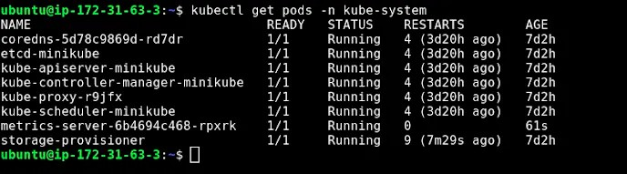
Now, you have to apply this by the below command kubectl apply -f components.yml
To validate, run the command below kubectl get pods -n kube-system
If the metrics-server pod is running then, you are ready to scale.

Slide 83
DEPLOYMENT SCALING:
Lets assume we have 3 pods, if i want to scale it to 10 pods (manual scaling) kubectl scale deployment/nginx-deployment --replicas=10
Assume we have HPA(Horizontal POD Auto-scaling) enabled in cluster.
So if we want to give the min and max count of replicas
kubectl autoscale deployment/nginx-deployment --min=10 --max=15 Now if we want to assign cpu limit for it
kubectl autoscale deployment/nginx-deployment --min=10 --max=15 --cpu- percent=80
Manual scaling means we can define the replicas (--repicas=5) HPA automatically scale the replicas based on cpu metrics

Slide 84
DEPLOYMENT SCALING:
Now run kubectl get rs : you will get the new deployment. kubectl get pod
You see that the number of old replicas is 3, and new replicas is 0. Next time you want to update these Pods, you only need to update the Deployment's Pod template again.
While updating pods, 75% will be available and 25% will be unavailable during updates
Lets assume, if we have 4 pods, while trying to update them atleast 3 of them are available and 1 should be updated in the mean time.

Slide 85
DAEMON-SET:
It is used to run a copy a pod to each worker node.
It is used to perform some tasks like monitoring, Log collection etc.. that need to run on every node of the cluster.
A DaemonSet ensures that all eligible nodes run a copy of a Pod
When you create daemon set k8s schedules one copy of pod in each node. If we added new node it will copy the pod automatically to new node.
If I remove on node from cluster the pod in that node also removed. Deleting a DaemonSet will clean up the Pods it created.
Daemon-set does not contains replicas, because bydefault it will create only 1 pod in each node.
Daemon sets will not used for deployments on real-time, it is only to schedule pods.

Slide 86
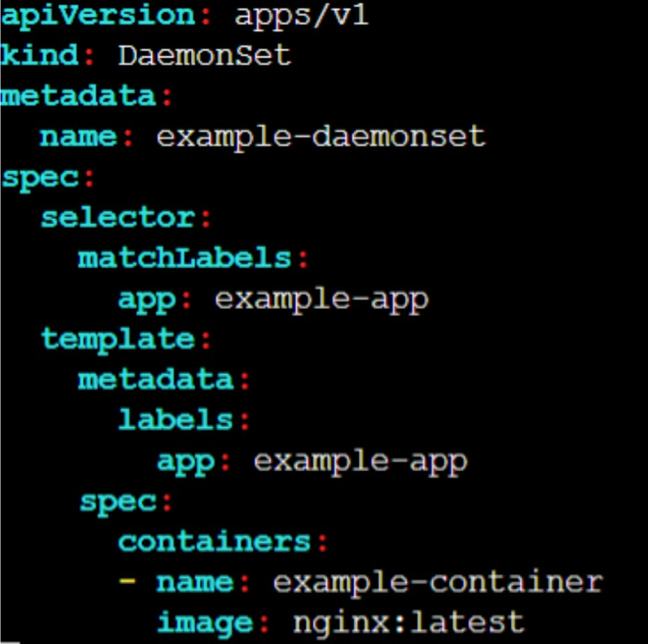

Slide 87
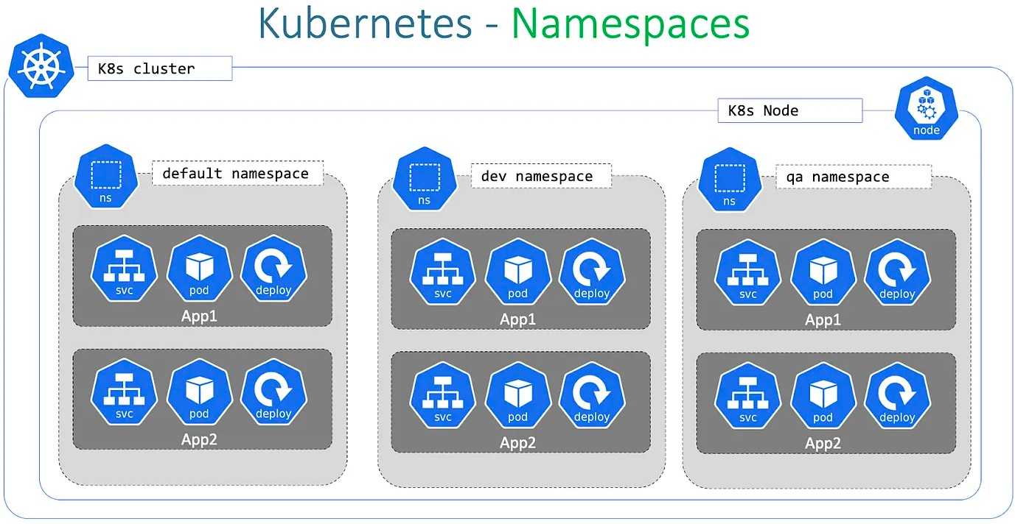

Slide 88
NAMESPACE:
Namespaces are used to group the components like pods, services, and deployments.
This can be useful for separating environments, such as development, staging, and production, or for separating different teams or applications.
In real-time all the frontend pods are mapped to one namespace and backend pods are mapped to another namespace.
It represents the cluster inside the cluster.
You can have multiple namespaces within one Kubernetes cluster, and they are all logically isolated from one another.
Namespaces provide a logical separation of cluster resources between multiple users, teams, projects, and even customers.

Slide 89
Within the same Namespace, Pod to Pod communication.
Namespaces are only hidden from each other but are not fully isolated from each other.
Nodes and Kubernetes Volumes do not come under the namespaces and are visible to every namespace.
One service in a Namespace can talk to another service in another Namespace. The name of resources within one namespace must be unique.
When you delete a namespace all the resources will gets deleted. There are some pre-existed Kubernetes namespaces are present in our cluster.
To see the list of names spaces : kubectl get ns a. default
b. kube-system c. kube-public

Slide 90
Default:
As the name suggests, whenever we create any Kubernetes object such as pod, replicas, etc it will create in the default namespace.
kube-system
This namespace contains the Kubernetes components such as kube- controller-manager, kube-scheduler, kube-dns or other controllers.
kube-public
This namespace is used to share non-sensitive information that can be viewed by any of the members who are part of the Kubernetes cluster.

Slide 91
When should we consider Kubernetes Namespaces?
Isolation: When there are multiple numbers of projects running then we can consider making namespaces and put the projects accordingly in the namespaces.
Organization: If there is only one Kubernetes Cluster which has different environments to keep isolated. If something happens to the particular environment then it won’t affect the other environments.
Permission: If some objects are confidential and must need access to the particular persons then, Kubernetes provides RBAC roles as well which we can use in the namespace. It means that only authorized users can access the objects within the namespaces.

Slide 92
COMMANDS:
kubectl get ns : used to get namespaces
kubectl create ns rajco : used to create new namespace
kubectl config set-context --current --namespace=rajco :to check to namespace
kubectl config view --minify | grep namespace : to verify the name space.
CREATE A POD IN NS (IMPERATIVE):
Create a namespace - kubectl create namespace rajco
create a pod in ns - kubectl run nginx --image=nginx --namespace rajco (or)
kubectl run nginx --image=nginx -n development
To check the pods: kubectl get pod -n rajco (0r)
kubectl get pod --namespace rajco

Slide 93
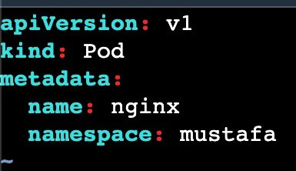
CREATE A POD IN NS (DECLARATIVE):
When you delete a namespace all the resources will gets deleted.
kubectl get pods -n rajco :
used to get pods from namespace
kubectl describe pod nginx -n development : describe a pod in namespace
kubectl delete pod nginx -n development : delete a pod in namespace

Slide 94
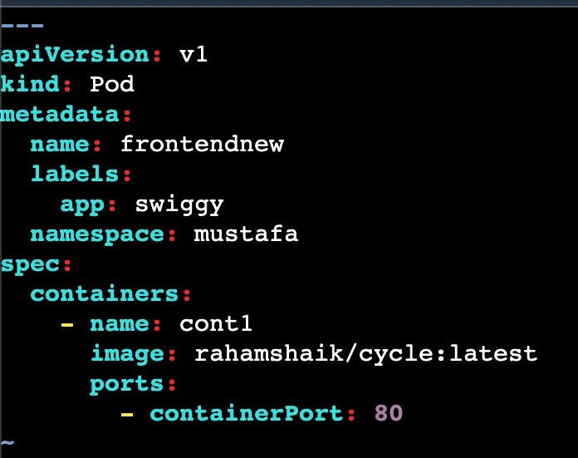
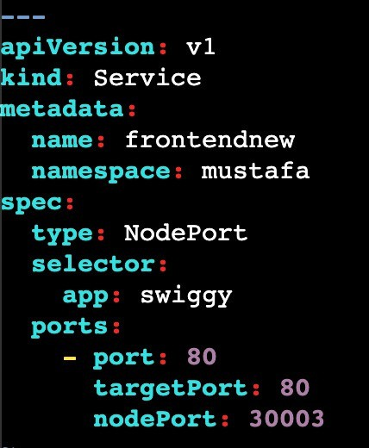
NODEPORT FILE
POD FILE
Before going to deploy this file we need to create rajco namespace. Here i just mentioned namespace in normal manifest file

Slide 95
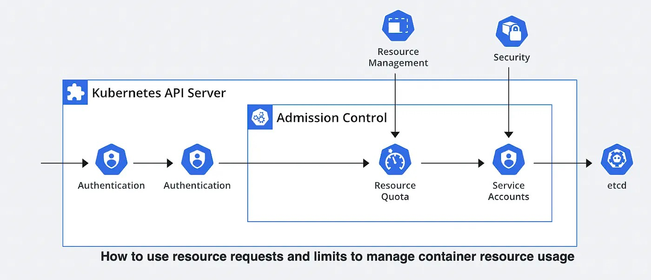
RESOURCE QUOTA:
ResourceQuota is one of the rich features of Kubernetes that helps to manage and distribute resources according to the requirements.

Slide 96



Just assume that we have 2 teams (Team-A & Team-B) who are working on single kubernetes cluster.
Team-A
Team-B

Slide 97
In this situation Team-A needs more CPU’s & Memory because of heavy workload tasks.
Team-A
We need more CPU’s & Memory, Because we have more work to do
Team-B

Slide 98

If the CPUs and other resources go to another team then it might increase the chance of failure.
Team-A
Team-B
To resolve this issue, we can allocate particular CPU cores and Memory to every project.

Slide 99
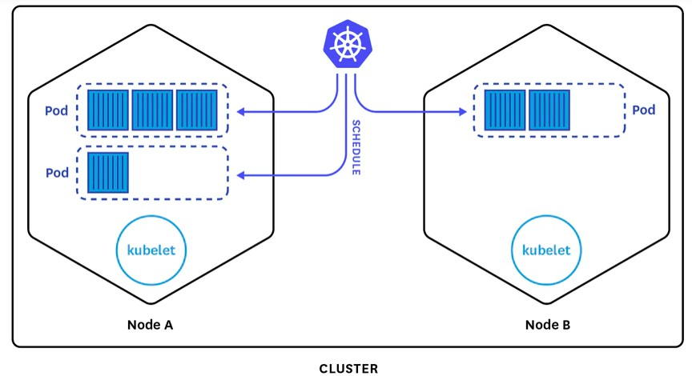
By default pod in Kubernetes will run with no limits on CPU and memory. You can specify the RAM, Memory, or CPUs for each container and pod.
The scheduler decides which node will create pods, if the node has enough CPU resources available then, the node will place the pods.
CPU is specified in units of cores and memory is specified in units of bytes.

Slide 100
As you know, the Kubernetes cluster can be divided into namespaces and if we create a container with no CPU limits then the container will have default limits. A namespace can be assigned to ResourceQuota objects, this will help to limit the amount of usage to the objects within the namespaces. You can limit the computer (CPU), Memory, and Storage.
Restrictions that a resource-quotas imposes on namespaces
Every container that is running on the namespace must have its own CPU limit. The total amount of CPU used by all the containers in the namespace should not exceed a specified limit.

Slide 101



Lets understand the ResourceQuota with funny scenario. Assume that there is medical college which has 25 seats only. So the college management assigned 10 seats for girls and 15 seats for boys who has more than 80% in Intermediate.
15 seats
10 seats

Slide 102
College (cluster)
NameSpace-1 (boys)
NameSpace-2 (girls)
2 cores
50 MB
2 cores
50 MB
2 cores
50 MB
2 cores
50 MB
4 cores
100 MB
2 cores
50 MB
CPU limit = 8 Cores Memory = 200 MB
CPU limit = 6 Cores Memory = 150 MB
Also we have a condition that students must has min 80% in Intermediate. In the same way pod/container must contains the CPU limits. All the pods/containers in the namespace should not exceed a specified limit.

Slide 103
There are two types of restrictions that need to be mentioned while using ResourceQuota
Limit: Limit specifies that the container, pod, or namespace will have the limit resources where if the objects will exceed the limit then, the object won’t create.
Request: The request specifies that the container, pod, or namespace needs a particular amount of resources such as CPU and memory. But if the request is greater than the limit then, Kubernetes won’t allow the creation of pods or containers.
Now, there are some conditions or principles for requests and limit which needs to be understood.
If the requests and limits are given in the manifest file, it works accordingly.
If the requests are given but the limit is not provided then, the default limit will be used.
If the requests are not provided but the limit is provided then, the requests will be equal to the limit.

Slide 104
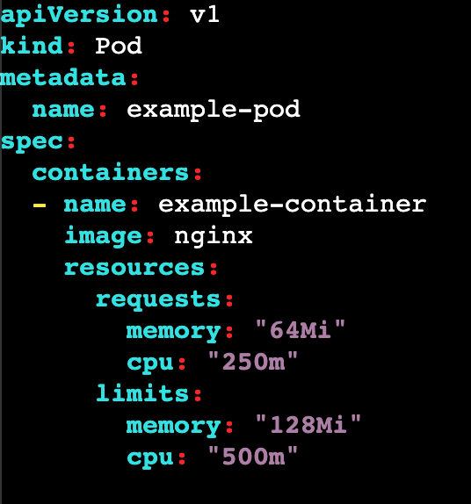
If the requests and limits are given in the manifest file, it works accordingly.
Describe the pod and you will get limits and requests of the container

Slide 105
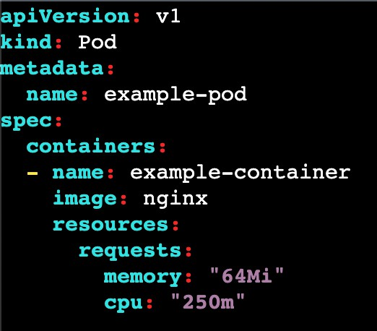
If the requests are given but the limit is not provided then, the default limit will be used.
Describe the pod and you will get only requests of the container

Slide 106
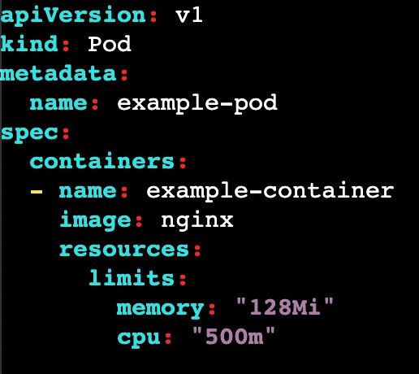
If the requests are not provided but the limit is provided then, the requests will be equal to the limit.
Describe the pod and you will get only limits of the container

Slide 107
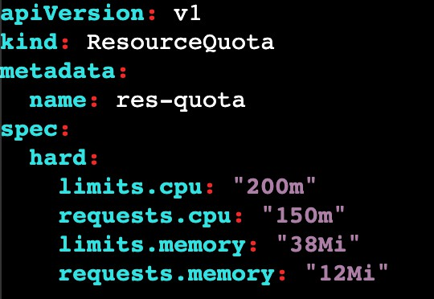
Hands on : Resource Quota
create a ResourceQuota:
That means now we can create the pods within these limits in default namespace
rq.yml
To see list of RQ : kubectl get resourcequota

Slide 108
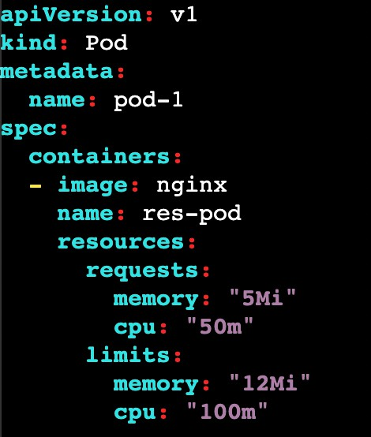
Now lets try to create a pod with then limits an see the resource quota again
We can observer here, my pod occupies the cpu and memory from the resource qouta
pod.yml
To see list of RQ : kubectl get resourcequota

Slide 109
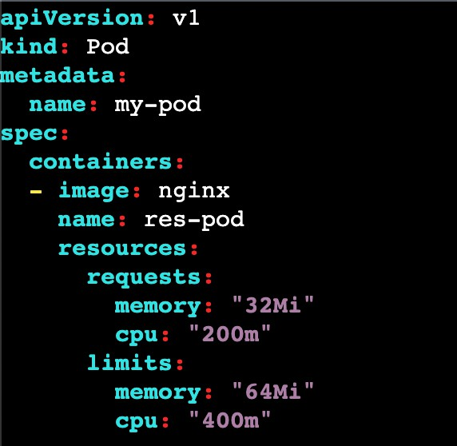
If we execute this pod, we will get an error because the pod limits and requests are greater than the resource quota limits and requests.

Slide 110
CONFIG MAPS:
ConfigMap is used to store the configuration data in key-value pairs within Kubernetes. But the data should be non confidential data.
This is one of the ways to decouple the configuration from the application to get rid of hardcoded values.
Also, if you observe some important values keep changing according to the environments such as development, testing, production, etc ConfigMap helps to fix this issue to decouple the configurations
So we can set the configuration of data of application separately
But it does not provider security and encryption. If we want to provide encryption use secrets in Kubernetes.
Limit of config map data in only 1 MB (we cannot store more than that)
But if we want to store a large amount of data in config maps we have to mount a volume or use a separate database or file service.

Slide 111
USE CASES IN CONFIG MAPS:
Configure application settings: By using this config maps, we can store the configuration data that helps to run our application like database connections and environment variables
Configuring a pod or container: It is used to send a configuration data to a pod or container at runtime like CLI or files.
Sharing configuration data across multiple resources: By using this configuration data multiple resources can access, such as a common configuration file for different pods or services.
We can store the data: By using this config maps, we can store the data like IP address, URL's and DNS etc...

Slide 112
SOME POINTS ABOUT CONFIGMAPS:
Creating the configMap is the first process which can be done by commands only or a YAML file.
After creating the configMap, we use the data in the pod by injecting the pods.
After injecting the pods, if there is any update in the configuration we can modify the configMap, and the changes will be reflected in the injected pod.

Slide 113
Creating ConfigMap from literal:
we have created the configMap through — from-literal which means you just need to provide the key value instead of providing the file with key-value pair data.
kubectl create cm my-first-cm --from-literal=Course=DevOps --from- literal=Cloud=AWS --from-literal=Trainer=rajco
To get Config Maps: kubectl get cm
To descibe: kubectl describe configmap/configmap-name To delete: kubectl delete configmap/configmap

Slide 114
CREATE A CONFIG-MAPS FROM FILE:
We have created one file first.conf which has some data, and created the configMap with the help of that file.
cat config-map-data.txt Name=rajco Course=Python Duration=60 days
command to create config map: kubectl create cm cm-name --from-file=filename To descibe: kubectl describe configmap/configmap-name
To delete: kubectl delete configmap/configmap

Slide 115
CREATE A CONFIG-MAPS FROM ENV FILE:
We have created one environment file first.env which has some data in key-value pairs, and created the configMap with the help of the environment file.
cat one.env Tool=Kubernetes Topic=Config Maps Course=DevOps
command to create config map: kubectl create cm cm-name --from-env-file=one.env To descibe: kubectl describe configmap/one.env
To delete: kubectl delete configmap/one.env

Slide 116
CREATE A FOLDER FOR CONFIG-MAPS:
We have created multiple files in a directory with different extensions that have different types of data and created the configMap for the entire directory.
mkdir folder1
cat folder1/file1.txt key1=value1 key2=23
cat folder2/file2.txt key1=value1 key2=23
command to create config map:
kubectl create cm mummy --from-file=folder1/

Slide 117
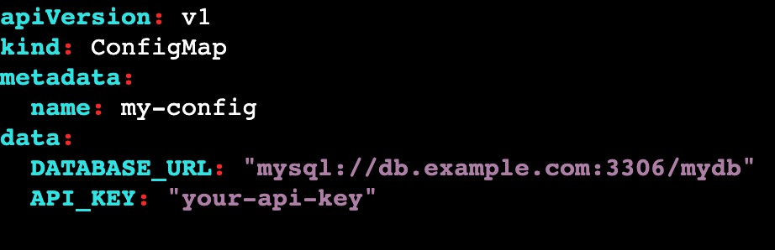
CREATE A YAML FOR CONFIG-MAPS:
The imperative way is not very good if you have to repeat the same tasks again and again. Now, we will look at how to create configMap through the YAML file.
command to create config map: kubectl create -f one.yml

Slide 118
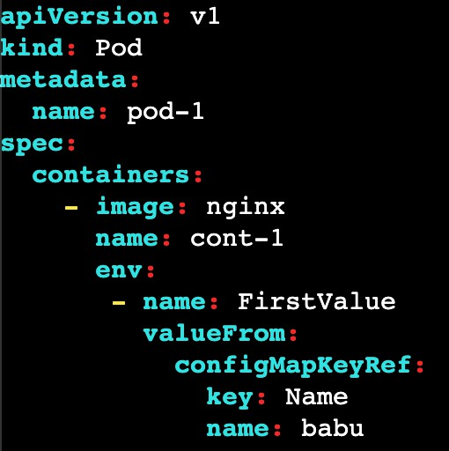
Injecting CM into the pod with specific key pairs:
we have created four types of configMaps but here, we will learn how to use those configMaps by injecting configMaps into the pods.
Create a file for pod and execute it
Inside the pod.yml we have to declare any valuefrom our configmap
After creating the pod, enter into the pod using
kubectl exec -it pod_name /bin/bash
Once you entered into pod give a command env
That will print the list of environments.
POD.YML
kubectl apply -f pod.yml

Slide 119
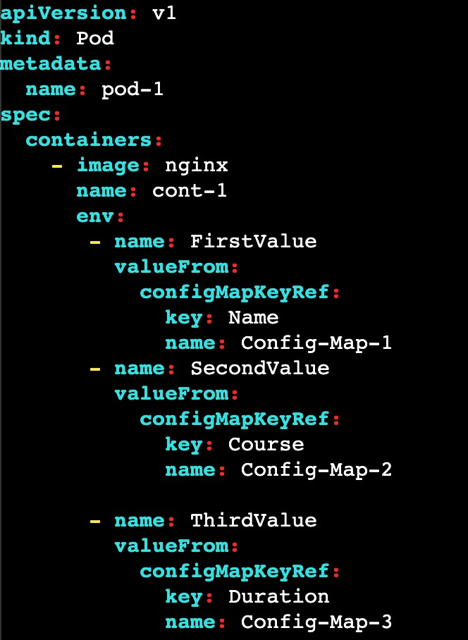
Injecting multiple CMs with specific and multiple values:
Lets add multiple key pairs from different files.
Create a file for pod and execute it
Inside the pod.yml we have to declare any value from any configmaps
After creating the pod, enter into the pod using
kubectl exec -it pod_name /bin/bash
Once you entered into pod give a command env
That will print the list of environments.

Slide 120
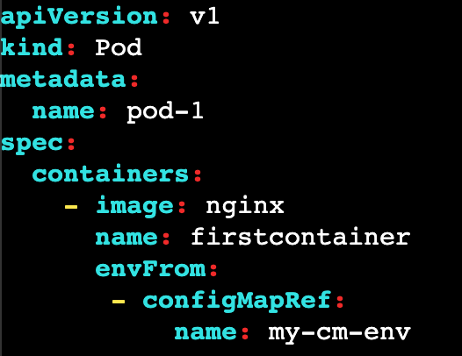
Injecting the environment file cm’s to pod:
Create a file for pod and execute it Inside the pod.yml we have to declare a
configmap name which was created with env file
After creating the pod, enter into the pod using
kubectl exec -it pod_name /bin/bash
Once you entered into pod give a command env
That will print the list of environments.
POD.YML
kubectl apply -f pod.yml

Slide 121
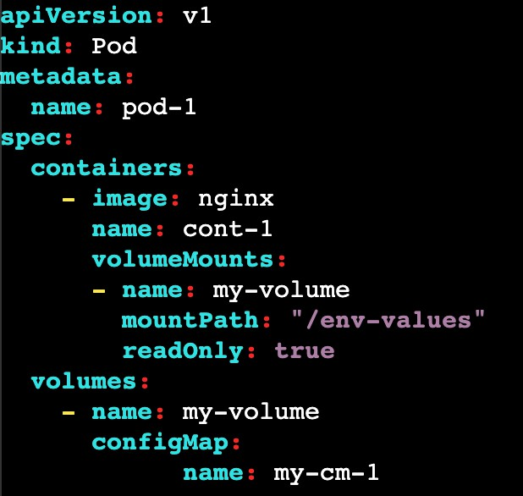
Injecting cm in the pod with the entire proper file:
Create a file for pod and execute it Inside the pod.yml we have to declare a
configmap name which was created with normal file
After creating the pod, enter into the pod using
kubectl exec -it pod_name /bin/bash
Once you entered into pod give a command ls
You will find a folder called env-values.
In side the folder you will get file names as keys open the file using cat then we will get labels
POD.YML
kubectl apply -f pod.yml

Slide 122
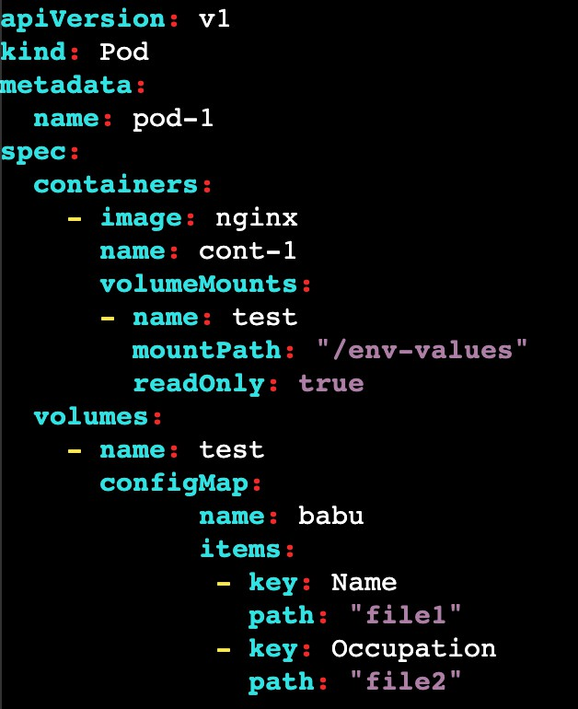
Injecting cm and creating a file in the pod with the selected key pairs
This concept also will works as same as previous topic. But Inside the pod we can declare the filenames by our own inside the env-values folder.
After creating the pod, enter into the pod using
kubectl exec -it pod_name /bin/bash
Once you entered into pod give a command ls
You will find a folder called env-values.
In side the folder you will get file names as file1 and file2.
POD.YML
kubectl apply -f pod.yml

Slide 123
SECRETS:
There are lot of confidential information that needs to be stored on the server such as database usernames, passwords, or API Keys.
To keep all the important data secure, Kubernetes has a Secrets feature that encrypts the data.
Secrets can store data up to 1MB which would be enough. Secrets can be created via imperative or declarative ways.
Secrets are stored in the /tmps directory and can be accessible to pods only. After creating the Secrets, applications need to use the credentials or database credentials which will be done by injecting with the pods.

Slide 124
Creating Secret from literal:
we have created the Secrets through --from-literal which means you just need to provide the key value instead of providing the file with key-value pair data.
you can see the key and encrypted value because Kubernetes encrypts the secrets.
kubectl create secret generic my-secret --from-literal=username=sm7243 To get Config Maps: kubectl get secret
To descibe: kubectl describe secret/my-secret
To Get in yaml : kubectl get secret my-secret -o yaml To delete: kubectl delete secret/my-secret

Slide 125
Secrets from file:
We have created one file first.conf which has some data, and created the Secrets with the help of that file.
cat first.conf username=sm7234 password=admin@123
kubectl create secret generic secret-from-file --from-file=first.conf To get Config Maps: kubectl get secret
To descibe: kubectl describe secret/secret-from-file
To Get in yaml : kubectl get secret secret-from-file -o yaml To delete: kubectl delete secret/secret-from-file

Slide 126
Secrets from env-file:
We have created one environment file first.env which has some data in key-value pairs, and created the Secrets with the help of the environment file.
cat rajco.env Name=rajco Place=Hyderabad Compamy=TCS
kubectl create secret generic secret-from-env --from-env-file=rajco.env To get secrets: kubectl get secret
To descibe: kubectl describe secret/secret-from-env
To Get in yaml : kubectl get secret secret-from-env -o yaml To delete: kubectl delete secret/secret-from-env

Slide 127
CREATE A FOLDER FOR SECRETS:
We have created multiple files in a directory with a different extension that has different types of data and created the Secrets for the entire directory.
mkdir folder1
cat folder1/file1.txt Name=rajco Place=Hyderabad=23
cat folder2/file2.txt database=mysq1 password=mypassword command to create secret:
kubectl create secret generic secret-from-folder --from-file=folder1/
To Get in yaml : kubectl get secret secret-from-env -o yaml

Slide 128
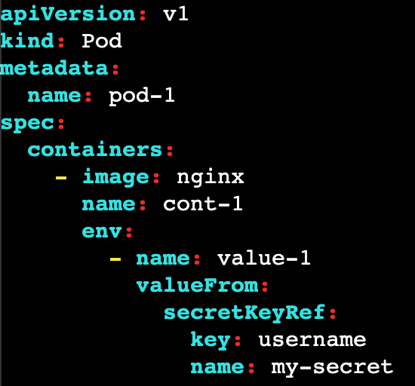
Injecting Secret with a pod for a particular key pairs:
we have created four types of Secrets but here, we will learn how to use those Secrets by injecting Secrets to the pods.
Create a file for pod and execute it
Inside the pod.yml we have to declare any value from our secret
After creating the pod, enter into the pod using
kubectl exec -it pod_name /bin/bash
Once you entered into pod give a command env
That will print the list of environments.
POD.YML
kubectl apply -f pod.yml

Slide 129
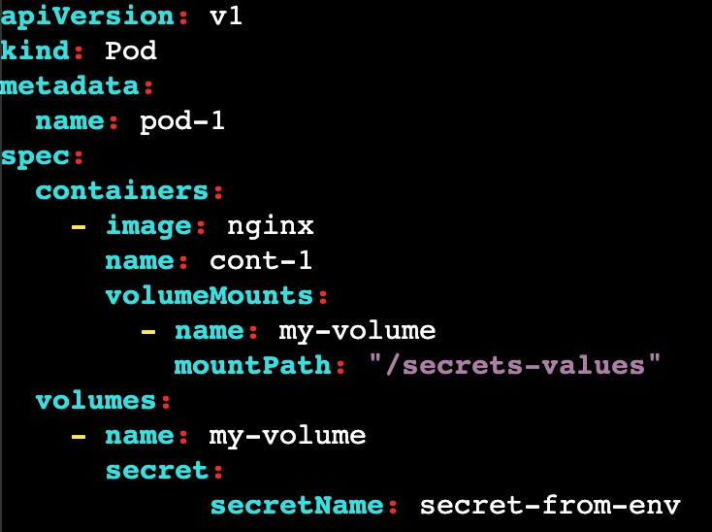
Injecting the environment file secrets to pod:
Create a file for pod and execute it
Inside the pod.yml we have to declare a secret name which was created with env file
After creating the pod, enter into the pod using
kubectl exec -it pod_name /bin/bash
Once you entered into pod give a command ls
You will find a folder called secret-values.
POD.YML
kubectl apply -f pod.yml
In side the folder you will get file names as keys open the file using cat then we will get labels

Slide 130
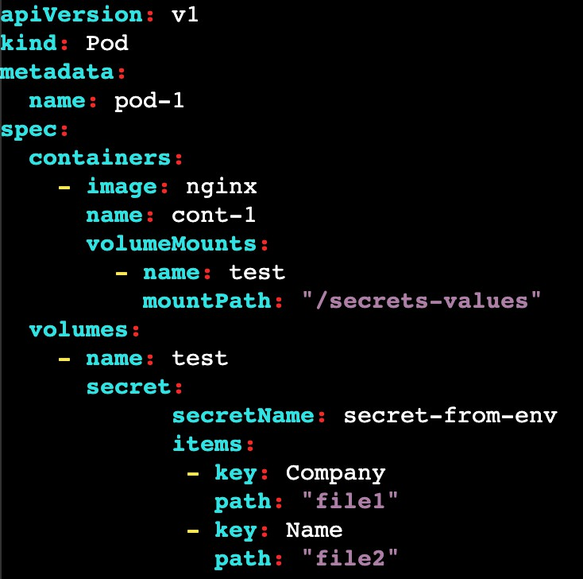
Injecting secret and creating a file in the pod with the selected key pairs
This concept also will works as same as previous topic. But Inside the pod we can declare the filenames by our own inside the env-values folder.
After creating the pod, enter into the pod using
kubectl exec -it pod_name /bin/bash
Once you entered into pod give a command ls
You will find a folder called secret-values.
In side the folder you will get file names as file1 and file2.
POD.YML
kubectl apply -f pod.yml

Slide 131
There are 2 possible ways to store the data in config maps
DATA
Stores data in plain text
used to store configuration, script and other text based data
Encoded in UFT-8 format Decoding in not necessary
BINARY DATA
Stores data in binary data
stores non-text data like images, videos or binary files
Encoded in BASE-64 format
Here you need to decode data from BASE-64 format before using

Slide 132
INIT CONTAINERS:
The init container is a special type of container that runs before the main containers in a pod start.
Its primary purpose is to perform initialization tasks or setup activities that need to be completed before the main application containers start running.
If a pod fails due to Init Containers then, Kubernetes restarts the init Container
until it will succeed.
Use cases:
To Install the dependencies before running the application on the main container
Clone a git repository into the volume Generate configuration files dynamically Database Configuration

Slide 133
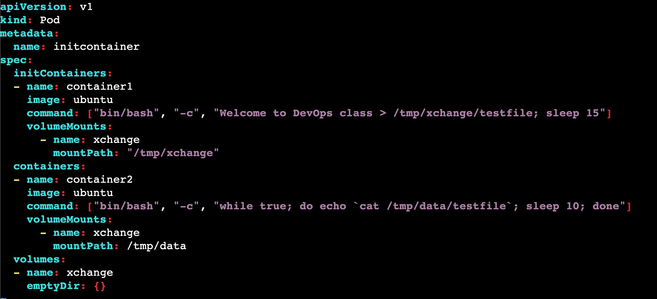
lets create a new pod in which we have created two containers and the first container is initcontainer.
Now check the logs of the pod : kubectl logs -f pod/pod-name we can see 2 containers are running inside the pod

Slide 134
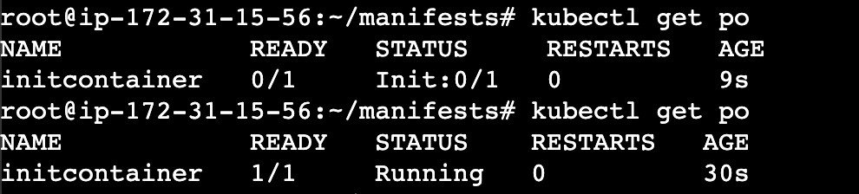
If we execute the above pod file, 2 containers will gets created.
container-1 : prints the data and save the data in /tmp/xchange/testfile file container-2 : prints the data
check the list of pods for every 15 seconds.
when we create the pod, cont-1 command will gets executed and after 15 seconds cont-2 will be in running state then cont-2 command will gets executed.
describe the pods for every 15 sec we will see the difference

Slide 135
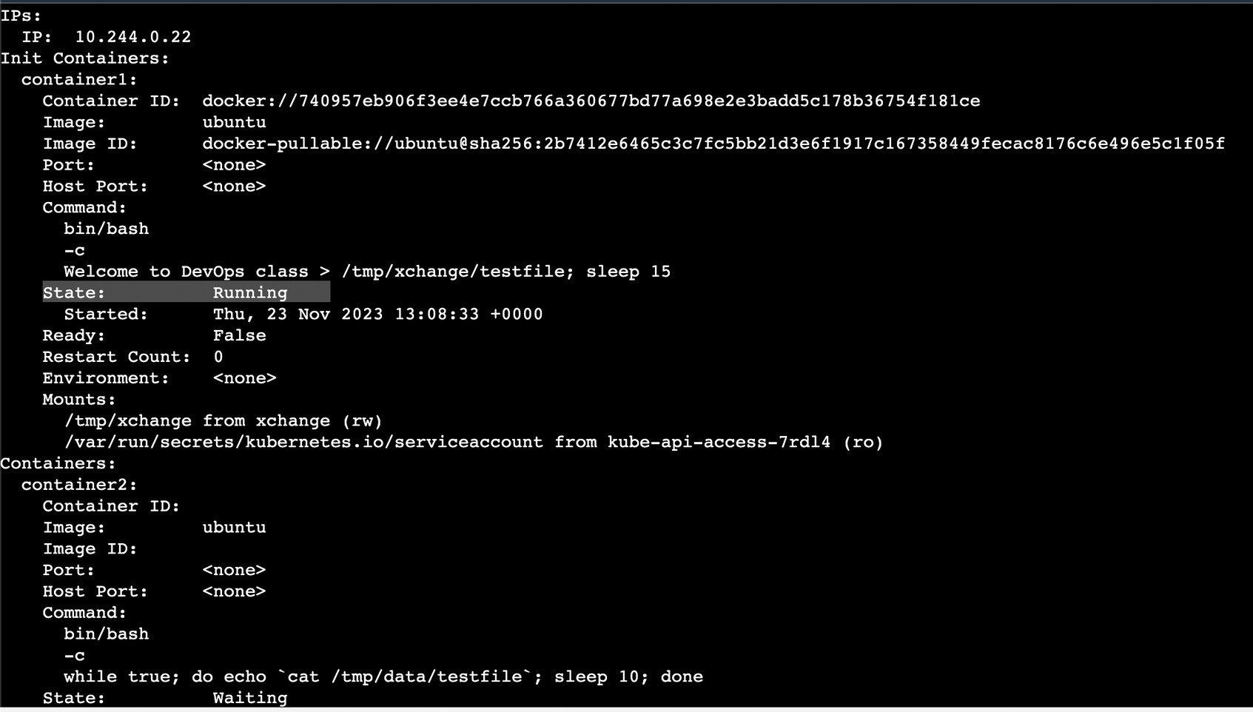
If we describe the pod, we can see cont-1 status is running and cont-2 status is waiting
if we describe the same pod after 15 seconds container-2 is also in running state.
when the container 2 is running check the logs of the pod : kubectl logs -f pod/initcontainer

Slide 136
KUBERNETES JOBS:
It is a resource that is used to achieve a particular work like backup script and, once the work is completed the pod will be deleted.
Use cases:
Database backup script needs to run Running batch processes
Running the task on the scheduled interval
Log Rotation
Key Features:
One-time Execution: If you have a task that needs to be executed one time whether it’s succeed or fail then the job will be finished.
Parallelism: If you want to run multiple pods at the same time.
Scheduling: If you want to schedule a specific number of pods after a specific time. Restart Policy: You can specify whether the Job should restart if fails.

Slide 137
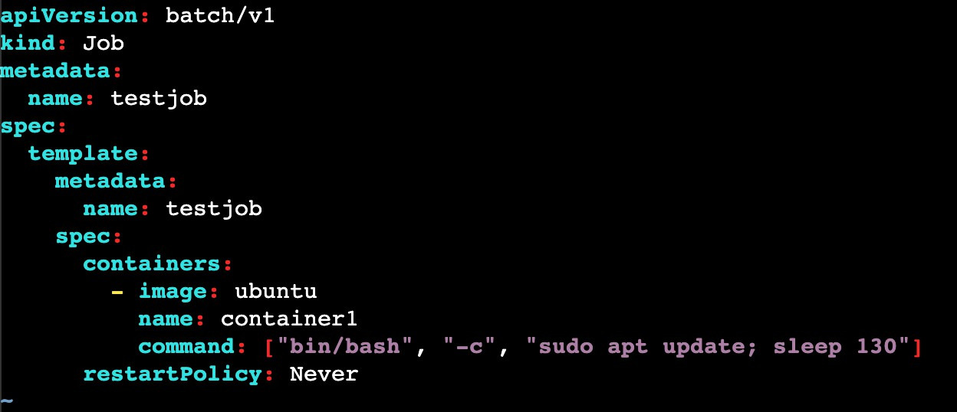
Work completed and pod deleted:
job.yml
kubectl create -f job.yml
By executing the above file, it will creates the job and job will automatically creates pod. check the list of pods and job
kubectl get po
kubectl get jobs

Slide 138
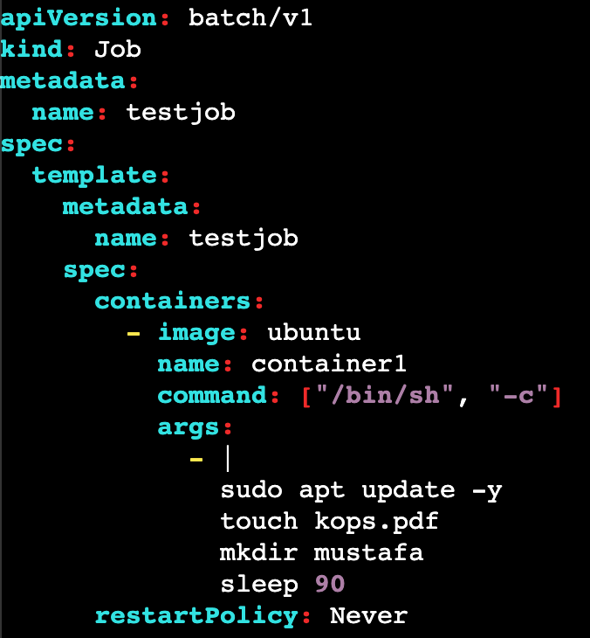
Inside the pod, the container will gets updated and it will sleep for 130 seconds, After 130 seconds then the pod will gets deleted.
To execute the multiple commands, use the below manifest file
This pod will creates the file and folder and after 90 seconds the pod will gets deleted.

Slide 139
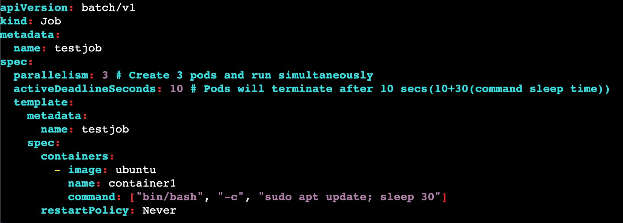
Create and run the pods simultaneously and delete once the work is completed.
The above manifest file will creates 3 pods and it will execute the commands. activeDeadlineSeconds are used to terminate the pods after 10 seconds.
After 30 seconds all the pods will gets deleted.

Slide 140
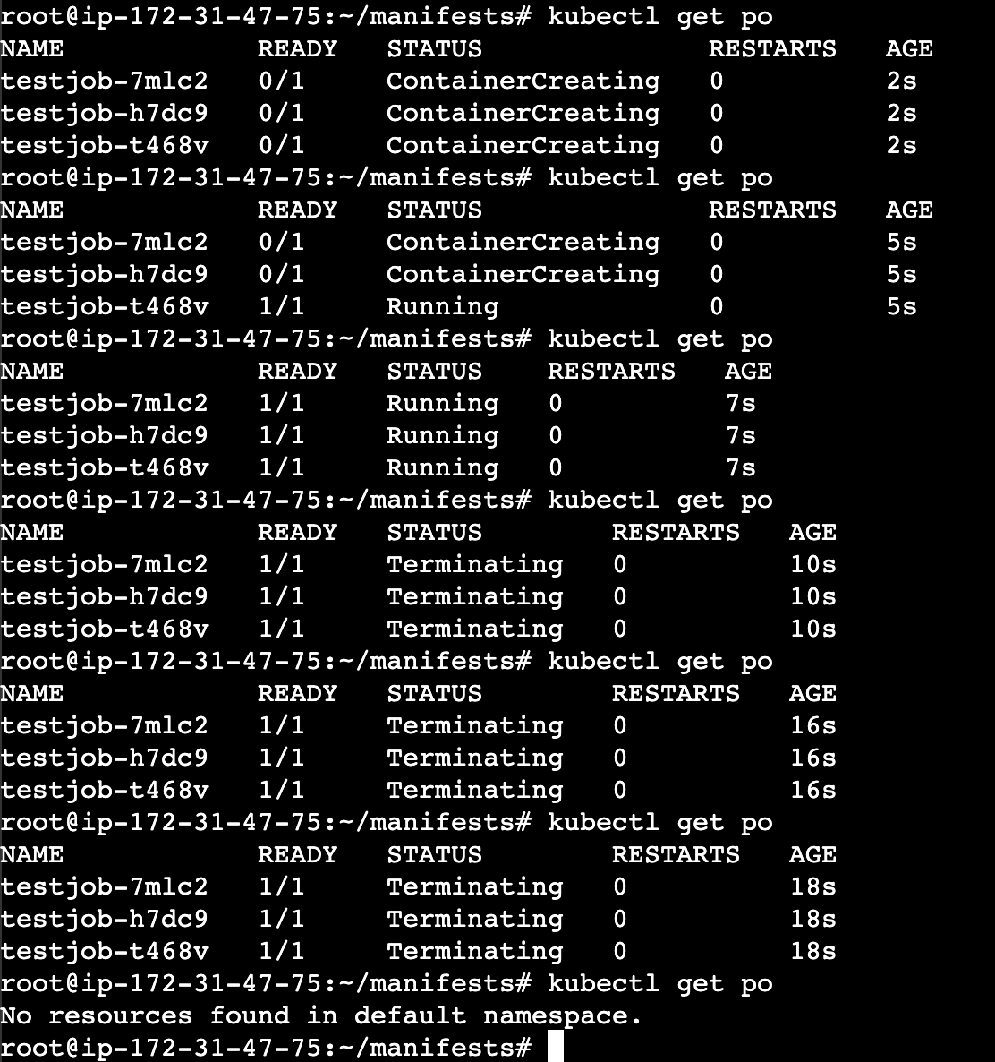
As we can observe the logs here, when i run the manifest file in first 2 seconds the pods are in creating state.
After 7 seconds the pods are in running state.
After 10 seconds the pods are in terminating state
After 40 seconds all the pods will automatically deleted.
Even the pods are deleted, jobs will be present.

Slide 141

Scheduling a pod after each minute:
The above manifest file for every one minute new pod will gets creates and it will execute the commands. After 30 seconds pods will gets deleted. After 1 min new pod created.

Slide 142

As we can observe the logs here, when i run the manifest file one pod is created.
After 30 seconds the pods completes it work
After 60 seconds the new pod will gets created automatically.

Slide 144


STATELESS APPLICATION
Last night i had a call with mobile customer care, and i explained my issue
with her and requested to resolve the issue. She asked to stay on call for some time. Meanwhile the call was dropped due to network issues

Slide 145

Again i called to same number, but this time another person pick the call. He don't know what the conversation we had with the first person. Again i had to repeat the details of my problem to the second person, though it is an inconvenience but it still works out

Slide 146

Kubernetes Deployment suits perfectly here. Let’s assume you deployed your stateless application as a Deployment with 10 Pod replicas running in multiple worker nodes.

Slide 147

If one of those Pods running in a particular worker node got terminated due to some issue
The ReplicaSet Controller takes care of replacing the bad Pod with a new healthy Pod either on the same node or on a different node.
Here replicaSet's will only take care of those 10 pods are running in the cluster or not.
It doesn't take care of in which worker node they are running!

Slide 148
If pod 1 got terminated from node 1, then new pod will gets replaced on either node 2 or node 1 or anywhere in the cluster.
This is possible because, the stateless application Pod 1 hasn’t stored any data on worker node 1, hence can be easily replaced by new pod running on a different worker node 2
If the pod is not storing the data then we called it as STATELESS

Slide 149
STATELESS APPLICATION:
It can't store the data permanently.
The word STATELESS means no past data.
It depends on non-persistent data means data is removed when Pod, Node or Cluster is stopped.
Non-persistent mainly used for logging info (ex: system log, container log etc..) In order to avoid this problem, we are using stateful application.
A stateless application can be deployed as a set of identical replicas, and each replica can handle incoming requests independently without the need to coordinate with other replicas.

Slide 150


Let’s say you want to order some some products in Amazon, you added some products to your shopping cart. After you added the book(s) to your shopping cart, If forgot to switch off the stove in kitchen and you closed the web browser hurry.

Slide 151

Well, you can anytime re-login to amazon portal and resume from where you left last time, as the amazon portal will ensure all items added to the Shopping cart are persisted in database.

Slide 152
Technically, if Amazon is using a ShoppingCart that runs in a Pod,
When i added some products on my cart that will stores on one pod and after some time when i resumed back to the amazon portal that will shows all the products from the different pod.
The interesting thing to understand here is, the StatefulSet Controller managed to bind the exact same Persistent Volume to two Shopping Cart Pods associated to that customer at two different point of time.

Slide 153
STATEFUL APPLICATION:
Stateful applications are applications that store data and keep tracking it.
Example of stateful applications:
All RDS databases (MySQL, SQL)
Elastic search, Kafka , Mongo DB, Redis etc… Any applicaiton that stores data

Slide 154
STATEFUL SET
A StatefulSet is the Kubernetes controller used to run the stateful application as containers (Pods) in the Kubernetes cluster.
StatefulSets assign a sticky identity-an orginal number starting from zero-to each Pod instead of assigning random IDs for each replica Pod.
A new Pod is created by cloning the previous Pod's data. If the previous Pod is in the pending state, then the new Pod will not be created.
If you delete a Pod, it will delete the Pod in reverse order, not in random order.

Slide 155

Lets assume we deployed 3 replicas in a node,
1st pod is primary pod, remaining pods are secondary pods. Primary pod is having both read and write access
But secondary pod is having only read access
If we insert some data in primary pod, we can access the data from any pod i.e.. pod will share the data each other

Slide 156


DEPLOYMENT VS STATEFUL SET
deployment cannot give the numbers or index for resources
but the stateful set will give the sticky identities called index numbers
when we delete pods in stateful set last pod will be deleted first and primary pod deletes last

Slide 157
DEPLOYMENT | STATEFUL SET
It will create POD's with random ID's Scale down the POD's in random ID's POD's are stateless POD's We use this for application deployment | It will create POD's with sticky ID's Scale down the POD's in reverse order POD's are stateful POD's We use this for database deployment

Slide 158
K8'S VOLUME AND LIVENESS PROBES:
Basically these K8's will works on short living data. So lets unveil the power of volumes like EmptyDir, HostPath, PV & PVC.
The data is a very important thing for an application. In K8's, data is kept for a short time in the applications in the pods/containers. By default the data will no longer available. To overcome this we will use Kubernetes Volumes.
But before going into the types of Volumes. Let’s understand some facts about pods and containers' short live data.

Slide 159
The volumes reside inside the Pod which stores the data of all containers in that pod.
pod
cont-1
cont-2
volume (data)

Slide 160
pod
If the container gets deleted, then the data will persist and it will be available for the new container which was created recently.
cont-1
cont-2
new-cont
volume (data)

Slide 161
Multiple containers within a pod can share one volume because the volume is attached to the pod.
pod
cont-1
cont-2
volume (data)

Slide 162
If the Pod gets deleted, then the volume will also get deleted which leads to a loss of data for all containers permanently.
pod
cont-1
cont-2
volume (data)

Slide 163
After deleting the pod, the new pod will be created with volume but this time volumes don’t have any previous data or any data.
pod
cont-1
cont-2
volume (no-data)

Slide 164
Types of volumes:
EmptyDir
HostPath
Persistent Volume
Persistent Volume Claim(PVC)

Slide 165
1. EMPTY DIR:
This volume is used to share the volumes between multiple containers within a pod instead of the host machine or any Master/Worker Node.
EmptyDir volume is created when the pod is created and it exists as long as a pod.
There is no data available in the EmptyDir volume type when it is created for the first.
Containers within the pod can access the other containers' data. However, the mount path can be different for each container.
If the Containers get crashed then, the data will still persist and can be accessible by other or newly created containers.

Slide 166

In the above file, it will creates 2 containers inside a pod. if you create a file in any container, then the file will be available on both the containers.
Kubectl exec -it pod-1 -c container1 /bin/bash
By using the above command create a file in cont-1 and it will be available on cont-2 as well

Slide 167
apiVersion: v1 kind: Pod metadata: name: pod-1 spec: containers: - name: container1 image: ubuntu command: ["/bin/bash", "-c", "while true; do echo Welcome to DevOps classes; sleep 5 ; done"] volumeMounts: - name: myvolume mountPath: "/tmp/container1" - name: container2 image: centos command: ["/bin/bash", "-c", "while true; do echo This is Kubernetes classes; sleep 5 ; done"] volumeMounts: - name: myvolume mountPath: "/tmp/container2" volumes: - name: myvolume emptyDir: {}
Editable Code

Slide 168
Pod
cont-1
cont-2
DATA
volume (data)

Slide 169
2. HOSTPATH:
This volume type is the advanced version of the previous volume type EmptyDir.
In EmptyDir, the data is stored in the volumes that reside inside the Pods only where the host machine doesn’t have the data of the pods and containers. hostpath volume type helps to access the data of the pods or container volumes from the host machine.
hostpath replicates the data of the volumes on the host machine and if you make the changes from the host machine then the changes will be reflected to the pods volumes(if attached).

Slide 170

In the above file, it will creates a pod. if you create a file in container, by using the command docker exec -it pod-1 -c container1 /bin/bash
file will gets created. Now even if you delete the pod then another pods will gets created with same data. Because we are using HostPath which creates local volume in our host machine.

Slide 171
apiVersion: v1
kind: Pod
metadata:
name: hostpath
spec:
containers:
- name: container1
image: ubuntu
command: ["/bin/bash", "-c", "while true; do echo This is Kubernets class; sleep 5 ; done"]
volumeMounts:
- mountPath: "/tmp/cont"
name: hp-vm
volumes:
- name: hp-vm
hostPath:
path: /tmp/data
In the above file, it will creates a pod. if you create a file in container, by using the command docker exec -it pod-1 -c container1 /bin/bash
file will gets created. Now even if you delete the pod then another pods will gets created with same data. Because we are using HostPath which creates local volume in our host machine.

Slide 172
Host
Pod-1
New Pod
DATA
volume (data)

Slide 173
Problem with HostPath
If the pod moves to another node:
Node1 → /tmp/data (has data) Pod rescheduled Node2 → /tmp/data (empty)
💥 Data is lost
So hostPath is not suitable for production clusters
Feature | HostPath
Storage location | Node filesystem
Node dependency | YES
Multi-node support | ❌ No
Production usage | ❌ Not recommended
Data persistence | Only on that node
Use case | Testing, learning

Slide 174
PERSISTENT VOLUME:
Persistent means always available.
Persistent Volume is an advanced version of EmptyDir and hostPath volume types.
Persistent Volume does not store the data over the local server. It stores the data on the cloud or some other place where the data is highly available.
In previous volume types, if pods get deleted then the data will be deleted as well. But with the help of Persistent Volume, the data can be shared with other pods or other worker node’s pods as well after the deletion of pods.
PVs are independent of the pod lifecycle, which means they can exist even if no pod is using them.
With the help of Persistent Volume, the data will be stored on a central location such as EBS, Azure Disks, etc.

Slide 175
PERSISTENT VOLUME:
One Persistent Volume is distributed across the entire Kubernetes Cluster. So that, any node or any node’s pod can access the data from the volume accordingly.
In K8S, a PV is a piece of storage in the cluster that has been provisioned by an administrator.
If you want to use Persistent Volume, then you have to claim that volume with the help of the manifest YAML file.
When a pod requests storage via a PVC, K8S will search for a suitable PV to satisfy the request.
If a PV is found that matches the request, the PV is bound to the PVC and the pod can use the storage.
If no suitable PV is found, K8S then PVC will remain unbound (pending).

Slide 176
PERSISTENT VOLUME CLAIM:
To get the Persistent Volume, you have to claim the volume with the help of PVC. When you create a PVC, Kubernetes finds the suitable PV to bind them together.
Once a user finishes its work, then the attached volume gets released and will be used for recycling such as new pod creation for future usage.
If the pod is terminating due to some issue, the PV will be released but as you know the new pod will be created quickly then the same PV will be attached to the newly created Pod.
After the Persistent Volume is successfully bound to the Persistent Volume Claim, the Pod can mount the PVC as a volume.

Slide 177
FACTS ABOUT EBS:
Now, As you know the Persistent Volume will be on Cloud. So, there are some facts and terms and conditions are there for EBS because we are using AWS cloud for our K8 learning. So, let’s discuss it as well:
EBS Volumes keeps the data forever where the emptydir volume did not. If the pods get deleted then, the data will still exist in the EBS volume.
The nodes on which running pods must be on AWS Cloud only(EC2 Instances). Both(EBS Volume & EC2 Instances) must be in the same region and availability zone.
EBS only supports a single EC2 instance mounting a volume

Slide 178

Create an EBS volume by clicking on ‘Create volume’.
Pass the Size for the EBS according to you, and select the Availability zone where your EC2 instance is created, and click on Create volume.
Now, copy the volume ID and paste it into the PV YML file

Slide 179


PVC file:
PV file:

Slide 180

we have logged in to the created container (kubectl exec -it pod_name -c shell /bin/bash)and created one file with some text.

Slide 181
Cluster
Node
Pod
Pod
Pod
EBS
we have deleted the pod, and then because of replicas the new pod was created quickly. Now, we have logged in to the newly created pod and checked for the file that we created in the previous step, and as you can see the file is present which is expected.

Slide 182
vim pvc.yml
vim pv.yml
apiVersion: v1
kind: PersistentVolumeClaim metadata:
name: my-pvc spec:
accessModes:
- ReadWriteOnce resources:
requests: storage: 10Gi
apiVersion: v1
kind: PersistentVolume metadata:
name: my-pv spec:
capacity: storage: 10Gi
accessModes:
- ReadWriteOnce awsElasticBlockStore:
volumeID: vol-0e5bdf9400dbb7b57 fsType: ext4
kubectl apply -f pv.yml kubectl apply -f pvc.yml kubectl get pv,pvc

Slide 183
kubectl apply -f deploy.yml kubectl get deploy
kubectl get rs kubectl get po
vim deploy.yml apiVersion: apps/v1 kind: Deployment metadata:
name: pvdeploy spec:
replicas: 1 selector:
matchLabels:
app: swiggy template:
metadata:
labels:
app: swiggy spec:
containers:
name: rajco image: centos
command: ["bin/bash", "-c", "sleep 10000"] volumeMounts:
name: mypd
mountPath: "/tmp/persistent" volumes:
name: mypd persistentVolumeClaim: claimName: my-pvc
kubectl exec pvdeploy-86c99cf54d-d8rj4 -it -- /bin/bash cd /tmp/persistent/
ls
vim rajco exit
now delete the pod and new pod will created then in that pod you will see the same content.

Slide 184
Access Modes
access modes determine how many pods can access a Persistent Volume (PV) or a Persistent Volume Claim (PVC) simultaneously. There are several access modes that can be set on a PV or PVC, including:
ReadWriteOnce: This access mode allows a single pod to read and write to the PV or PVC. This is the most common access mode, and it’s appropriate for use cases where a single pod needs exclusive access to the storage.
ReadOnlyMany: This access mode allows multiple pods to read from the PV or PVC, but does not allow any of them to write to it. This access mode is useful for cases where many pods need to read the same data, such as when serving a read-only database.
ReadWriteMany: This access mode allows multiple pods to read and write to the PV or PVC simultaneously. This mode is appropriate for use cases where many pods need to read and write to the same data, such as a distributed file system.
Execute: This access mode allows the pod to execute the data on the PV or PVC but not read or write to it. This mode is useful for use cases where the data is meant to be executed by the pods only, such as application code.

Slide 185
LIVENESSPROBE (HEALTHCHECK):
LivenessProbe is a rich feature in Kubernetes that is used to check the health of your application.
Kubernetes by default doesn’t check the health check of the applications.
If you want to use the livenessProve feature and want to check the health of your application, you have to mention it in the manifest file.
livenessProbe expects a 0 output which means the application is running perfectly. But if there is any other output except 0 then livenessProbe recreates the container and repeats the same process.
livenessProbe repeats the process after particular seconds or minutes(specified by you) to check the health of the application.
If there is a load balancer attached to multiple pods then, livenessProbe checks the health of the application and if the application’s health check status is not healthy then livenessProbe removes the particular pod from the load balancer and recreates the new pod and repeats the same process.

Slide 186


Slide 187
Once you create a pod, then describe this pod using kubectl describe pod pod-name
After that enter into the pod kubectl exec -it pod_name -c cont_name /bin/bash
Check the file is created or not using cat /tmp/healthy
Now check the health status echo $? If it returns 0 then application is running into the container.
there is one condition if the file healthy is not present in /tmp directory then livenessProbe will recreate the container. So, we have deleted that file.
After deleting the file, if you run kubectl describe pod pod-name you will see in the last two lines that the container is failing because the condition is not meeting.

Slide 188




RBAC (Role Based Access Control):
I am a Developer
I want to see the pods
I am a Developer
I want to delete the pods
I am a DevOps Guy
I want to create, delete the pods

Slide 189
Role-Based Access Control (RBAC) is a critical security feature in Kubernetes that allows you to define and manage access to resources based on roles and permissions. RBAC ensures that only authorized users, processes, or services can interact with specific resources within a Kubernetes cluster.

Slide 190


Slide 191
In Kubernetes, there are two types of accounts
User Account
Service Account
User account: User accounts are used to log into a Kubernetes cluster and manipulate resources therein. Each user account is associated with a unique set of credentials, which are used to authenticate the service’s requests.
Service Account: are used to run services in a Kubernetes cluster. Each service account is associated with a unique set of credentials, which are used to authenticate the service’s requests.

Slide 192
Which account type should you use?
Use a user account if:
You need to log into the cluster to administer it
You need to access resources that are owned by the user.
Use a service account if:
You are running a service and need to authenticate its requests You need to access resources that are owned by the service

Slide 193
There are three components to RBAC in Kubernetes: 1. roles
2. role bindings
3. ClusterRoles
1. Roles are the basic building blocks of RBAC. A role defines a set of permissions for a user or group. For example, you might create a role called “admin” that gives the user or group full access to all resources in the cluster.
(or)
Role is a set of permissions that define what actions (verbs) are allowed on specific resources (API groups and resources) within a particular Namespace.
Roles are Namespace-scoped, meaning they apply only to resources within that Namespace.

Slide 194
ClusterRoles are special roles that apply to all users in the cluster. For example, you might create a ClusterRole called “cluster-admin” that gives the user or group full access to all resources in the cluster.
These are not Namespace-specific. They define permissions for cluster-wide resources.
Role bindings connect users/groups to roles. For example, you might bind the “admin” role to the “admin” user. This would give the “admin” user all the permissions defined in the “admin” role.
It grants the permissions to particular namespaces only.
ClusterRoleBindings similar to RoleBindings, ClusterRoleBindings associate ClusterRoles with users/groups across the entire cluster.
These are not Namespace-specific. They grants the permissions for cluster-wide resources.

Slide 195
To use RBAC in your Kubernetes cluster, you first need to create the roles, role bindings, and ClusterRoles that you need. We can create these in 2 ways:
Imperative way
Declarative way
creating a role in imperative way:
Imperative way : kubectl create role admin --verb=get,list,watch,create,update,delete
--resource=pods,services,configmaps,deployments
To see list of roles: kubectl get roles
To see the list of verbs & resources of a role : kubectl describe role role-name To delete a role : kubectl delete role role-name

Slide 196

creating a role in declarative way:
kubectl create -f role.yml

Slide 197
creating a rolebindings in imperative way:
Imperative way : kubectl create rolebinding role-binding-name --role=role-name
--user=user-name
To see list of rolebindings: kubectl get rolesbinding
To see the list users & roles of a rolebinding : kubectl describe rolebinding role-name To delete a role : kubectl delete rolebinding role-name
Command to remove a user from role-binding : kubectl delete rolebinding rolebinding-name
--user=usernmae

Slide 198

creating a rolebinding in declarative way:
kubectl create -f rb.yml

Slide 199
creating a clusterrolebindings in imperative way:
Imperative way : kubectl create clusterrolebinding cluster-binding-name
--clusterrole=role-name --user=user-name
To see list of clusterbindings: kubectl get clusterrolebindings
To see the list users & roles of a rolebinding : kubectl describe clusterrolebindings clusterbinding-name
To delete a role : kubectl delete clusterrolebindings clusterbinding-name

Slide 200

creating a clusterroleBinding in declarative way:
kubectl create -f cb.yml

Slide 201
Now lets check either we have permissions for resources or not:
kubectl auth can-i delete pod kubectl auth can-i create pod
kubectl auth can-i delete deployment kubectl auth can-i create pv

Slide 202
PROJECT ON RBAC
Project Overview
Namespace: We’ll create a Namespace for our project called ‘my-project’.
Teams: We have two teams: ‘frontend-team’ and ‘backend-team’.
Resources: Each team manages their own Pods and Services. The ‘frontend- team’ needs access to Pods with the ‘app=frontend’ label, and the ‘backend- team’ needs access to Pods with the ‘app=backend’ label.

Slide 203
Creating Custom Roles and RoleBindings
1. Define Roles:
We’ll define two custom Roles: ‘frontend-role’ and ‘backend-role’. The ‘frontend-role’ will allow listing and getting Pods with the ‘app=frontend’ label, while the ‘backend-role’ will have similar permissions for the ‘app=backend’ Pods.
# frontend-role.yaml
apiVersion: rbac.authorization.k8s.io/v1 kind: Role
metadata:
namespace: my-project name: frontend-role rules:
- apiGroups: [""]
resources: ["pods"] resourceNames: ["", "frontend"] verbs: ["list", "get"]
# backend-role.yaml
apiVersion: rbac.authorization.k8s.io/v1 kind: Role
metadata:
namespace: my-project name: backend-role rules:
- apiGroups: [""] resources: ["pods"]
resourceNames: ["", "backend"] verbs: ["list", "get"]

Slide 204
2. Create RoleBindings:
Now, let’s create RoleBindings to associate these custom Roles with the appropriate teams. The ‘frontend-role-binding’ will bind the ‘frontend-role’ to the ‘frontend-team’ group, and the ‘backend-role-binding’ will bind the ‘backend-role’ to the ‘backend-team’ group.
# frontend-role-binding.yaml apiVersion: rbac.authorization.k8s.io/v1 kind: RoleBinding
metadata:
name: frontend-role-binding namespace: my-project subjects:
- kind: Group
name: frontend-team
apiGroup: rbac.authorization.k8s.io roleRef:
kind: Role
name: frontend-role
apiGroup: rbac.authorization.k8s.io
# backend-role-binding.yaml apiVersion: rbac.authorization.k8s.io/v1 kind: RoleBinding
metadata:
name: backend-role-binding namespace: my-project subjects:
- kind: Group
name: backend-team
apiGroup: rbac.authorization.k8s.io roleRef:
kind: Role
name: backend-role
apiGroup: rbac.authorization.k8s.io

Slide 205
Applying Roles and RoleBindings:
You can apply the Role and RoleBinding YAML files using ‘kubectl apply’: kubectl apply -f frontend-role.yaml
kubectl apply -f backend-role.yaml
kubectl apply -f frontend-role-binding.yaml kubectl apply -f backend-role-binding.yaml
Testing Access
Now, members of the ‘frontend-team’ will be able to list and get Pods with the ‘app=frontend’ label: kubectl get pods -n my-project --selector=app=frontend
kubectl describe pod <frontend-pod-name> -n my-project
Similarly, members of the ‘backend-team’ will have similar access to ‘app=backend’ Pods.
By creating custom Roles and RoleBindings, you can effectively control access to resources within your Kubernetes cluster based on your project’s needs and organizational structure. This RBAC setup ensures that different teams have the appropriate permissions to interact with their respective components, enhancing security and manageability.

Slide 207

HEML
Helm is a Kubernetes package manager in which the multiple numbers of YAML files such as the backend, and frontend come under one roof(helm) and deploy using helm.
=
+
+
HEML
Frontend
Backend
Database

Slide 208


Slide 209
Lets say if you want to deploy an application called paytm. It contains multiple services. So we need to deploy each service, for that we have to write 2 manifest(deployment & service) files for each service.
At the end we can see multiple YAML files which makes more confusion and messy.
Instead of maintaining those multiple YAML files we can do this by implementing HELM. It will deploy our entire application.
HELM is a package manager for kubernetes which makes deployment simple.

Slide 210
Key Concepts of HEML:
Charts: In Helm, a chart is a collection of pre-configured Kubernetes resources that describe a related set of services. Charts can include deployment configurations, service definitions, ingress rules, and more. Think of a chart as a package that encapsulates everything needed to run a specific application.
Templates: Helm uses Go templating to dynamically generate Kubernetes manifest files from chart templates. This means you can parameterize and customize your resources based on user-defined values or other inputs.
This templating mechanism allows you to create reusable and flexible configurations.

Slide 211
Values: Values are customizable parameters that can be injected into chart templates during deployment. You can define default values in a values.yaml file and override them when installing or upgrading a chart. This allows you to configure your application differently for various environments or use cases.
Repositories: Helm repositories are collections of packaged charts that users can install. The Helm CLI can search, fetch, and install charts from these repositories. You can also create your own private repository to store custom charts.

Slide 212
Advatnages of HEML:
It will save the time
Helps to automate the application deployment Better scalability
Perform rollback at anytime Increase the speed of deployment.
Install HEML:
curl -fsSL -o get_helm.sh https://raw.githubusercontent.com/helm/helm/main/scripts/get-helm-3 chmod 700 get_helm.sh
./get_helm.sh helm version

Slide 213
HELM commands:
To list all helm repos : helm repo list
To download any repo : helm repo add repo_name url (helm repo add myhelm https://charts.helm.sh/stable)
To remove a repo from helm : helm repo remove repo-names

Slide 214

Deploy a sample Nginx page using HELM:
1. Create a helm chart : helm create devops
Now we can see devops folder will gets created.
Enter into the folder and open values.yml file
Change the service type from ClusterIP to NodePort on line 43

Slide 215

4. Now install helm : helm install rajco .
here dot(.) represents that pwd where our Chart.yaml present
rajco is release name
Now we can see pods, deployments, services will be created automatically. Now we can access those nginx page using slaveip:node-port
To get helm release list : helm list (or) helm ls

Slide 216
Now lets scale up the replicas in values.yml (change value from 1 to 4)
To update those changes we will use : helm upgrade rajco .
Now lets see the pods count, it will gets increased from 1 to 4.
Now we can see the release using the command helm list then revision(version) will gets increased from 1 to 2
To rollback to prev revision : helm rollback rajco 1
The above command will rollback to 1st version
Once we perform the above command we can see the pods count will be scaledown from 4 to 1 again.

Slide 217
General commands about HELM:
To uninstall helm : helm uninstall rajco
If you want to dry-run the chart before installation : helm install devops -- debug --dry-run .
Validate all the YAML files in our HELM charts : helm list . To get template of our helm : helm template .
To see the history of a release : helm history rajco

