Slide 1
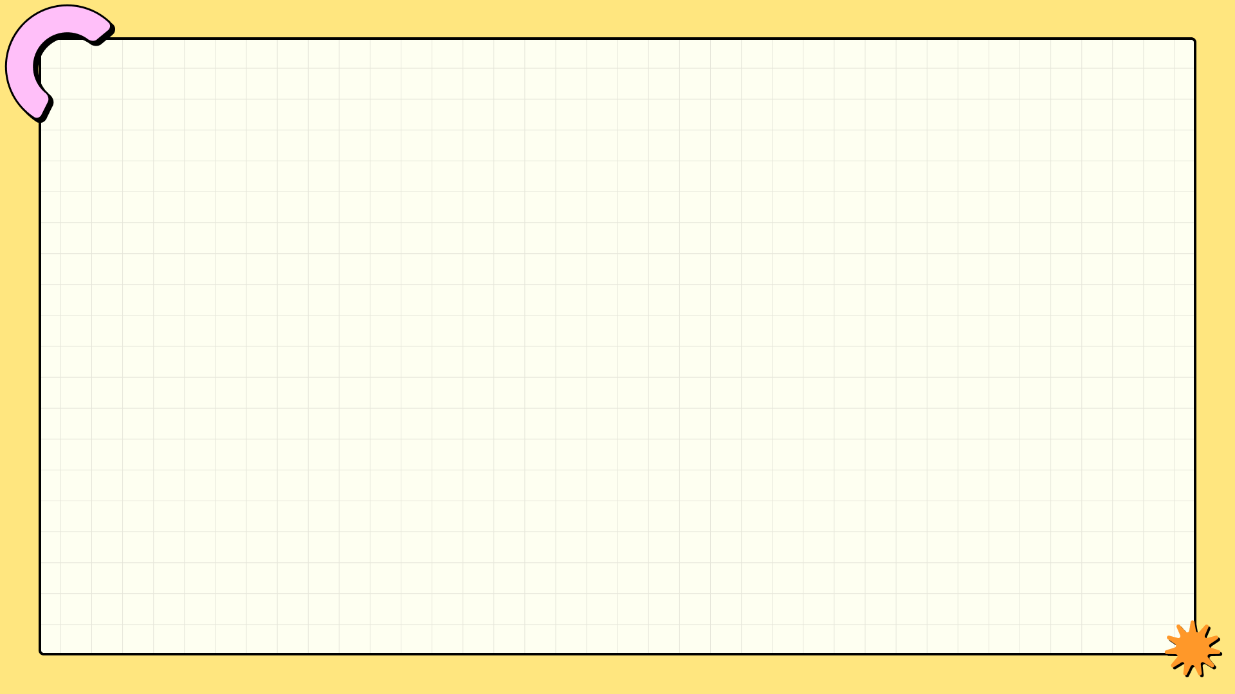
Creating Presentation with AI
AI can automate repetitive and mundane tasks, increasing efficiency and freeing up human workers for more complex activities
AI can automate repetitive and mundane tasks, increasing efficiency and freeing up human workers for more complex activities
AI can automate repetitive and mundane tasks, increasing efficiency and freeing up human workers for more complex activities
AI can automate repetitive and mundane tasks, increasing efficiency and freeing up human workers for more complex activities

