Slide 1

Python - Capstone Project
Title :- OTP Verification System
Name :- Darshan Raj G
Date :- 16-05-2024

Slide 2

Agenda
Introduction
Objective
Project Components
Demo
Code Overview
Future Improvements
Conclusion

Slide 3

Introduction
Welcome to the presentation on OTP (One-Time Password) Verification with Tkinter GUI.
In today's digital age, security is paramount, especially for online transactions, account logins, and sensitive information access.
OTP is a widely used security measure that provides an additional layer of protection by generating a unique password that can only be used once.
This project focuses on implementing OTP verification functionality within a user-friendly Tkinter GUI using Python.

Slide 4

Objective
The primary goal of this project is to implement OTP (One-Time Password) verification functionality within a Tkinter GUI
Key Points
Create a user-friendly interface using Tkinter.
Generate a random OTP for each verification attempt.
Send the OTP to the user's email address.
Allow the user to input the received OTP for verification.
Provide clear feedback on the verification outcome.

Slide 5

Project Components
Tkinter GUI
OTP Generation
Email Sending
Provides the graphical interface for user interaction.
Includes input fields for OTP and email, buttons for sending OTP and verifying it, and labels for displaying status messages.
Generates a random 6-digit OTP for each verification attempt.
Ensures uniqueness and security of the OTP by utilizing random number generation.
Sends the generated OTP to the user's email address using the Simple Mail Transfer Protocol (SMTP).
Utilizes the SMTP library in Python for email communication.

Slide 6
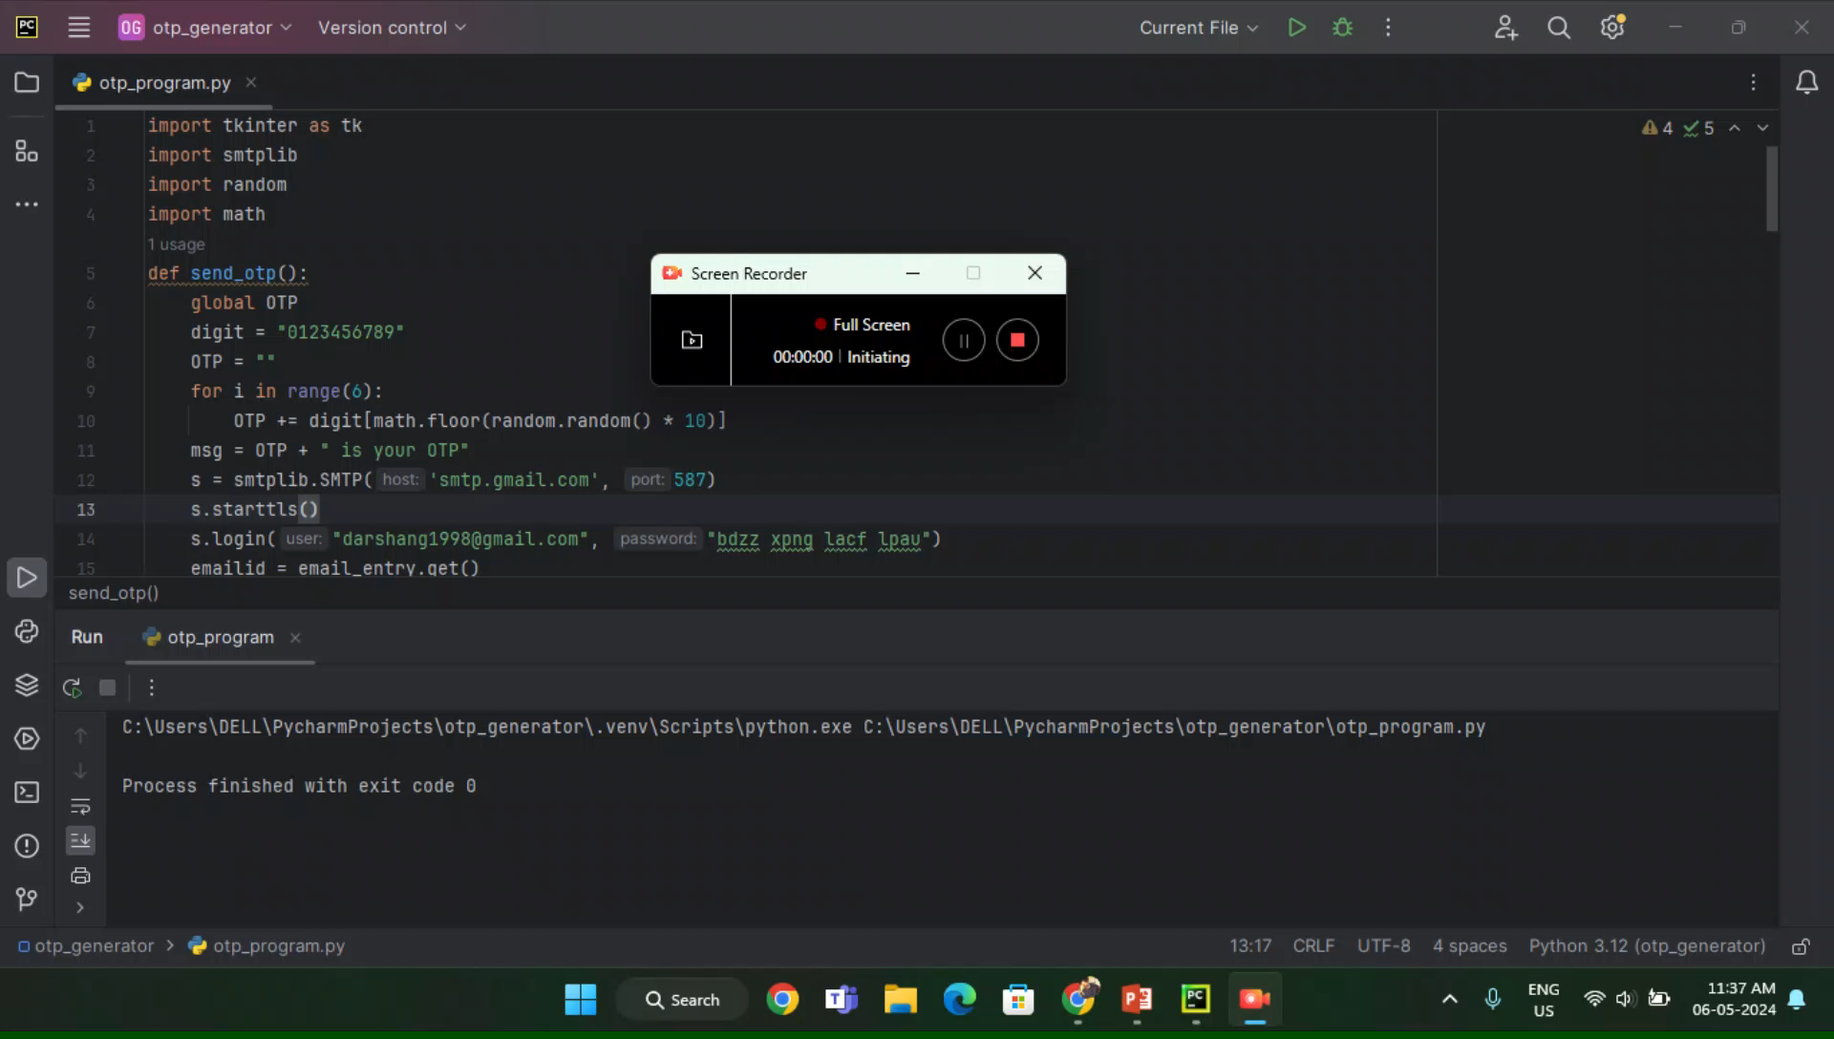
Demo

Slide 7
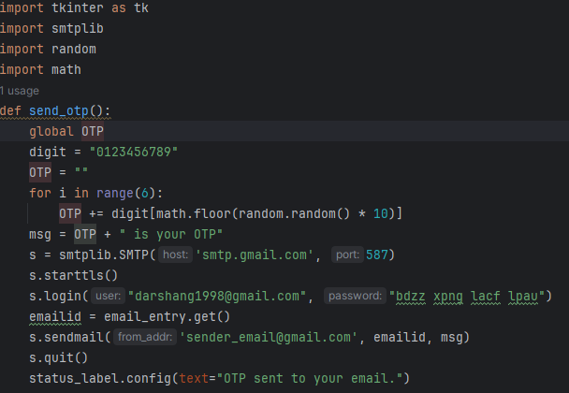
Code Overview
Imports the required modules
The send_otp() function is responsible for generating a random OTP and sending it to the user's email address.
A connection is established with the Gmail SMTP server using smtplib.SMTP() and login credentials provided.

Slide 8
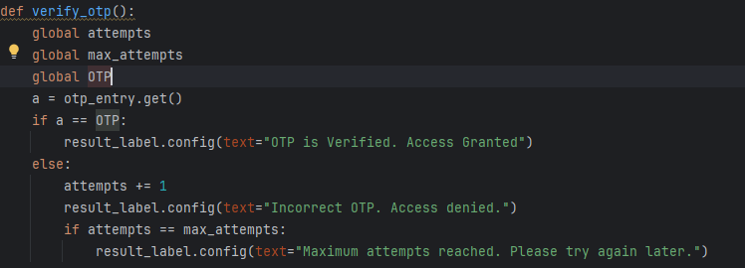
This verify_otp() function is responsible for verifying the OTP entered by the user.
If the entered OTP matches the generated OTP (OTP), it updates the result_label with the message "OTP is Verified. Access Granted".
If the maximum number of attempts (max_attempts) is reached, it updates the result_label with the message "Maximum attempts reached. Please try again later."

Slide 9

Future Improvements
Error Handling
GUI Enhancements
Multi-factor Authentication (MFA)
Logging and Analytics
Customization Options

Slide 10
Conclusion
Secure Authentication: OTP verification provides an additional layer of security, enhancing the authentication process for online transactions, account logins, and sensitive information access.
User-Friendly Interface: The Tkinter GUI implementation simplifies the process of OTP entry and verification, improving the overall user experience.
Future Development: The project offers opportunities for further development and enhancement, including error handling, GUI improvements, multi-factor authentication, and security enhancements.
Continuous Improvement: By incorporating user feedback and implementing future improvements, the OTP verification system can evolve to meet evolving security requirements and user expectations.

Slide 11
THANK YOU

