Slide 1

DATABASE MANAGEMENT SYSTEMS • PROJECT NO. 19 • REVIEW 3
Car Rental Reservation and
Vehicle Return Management System
Review 3 — Application, Final Demonstration,
Report and Viva-Voce.
[ Your Name ]
[ Roll No. / USN ] · [ Class / Section ]
[ College Name ] — Week 16 Review

Slide 2
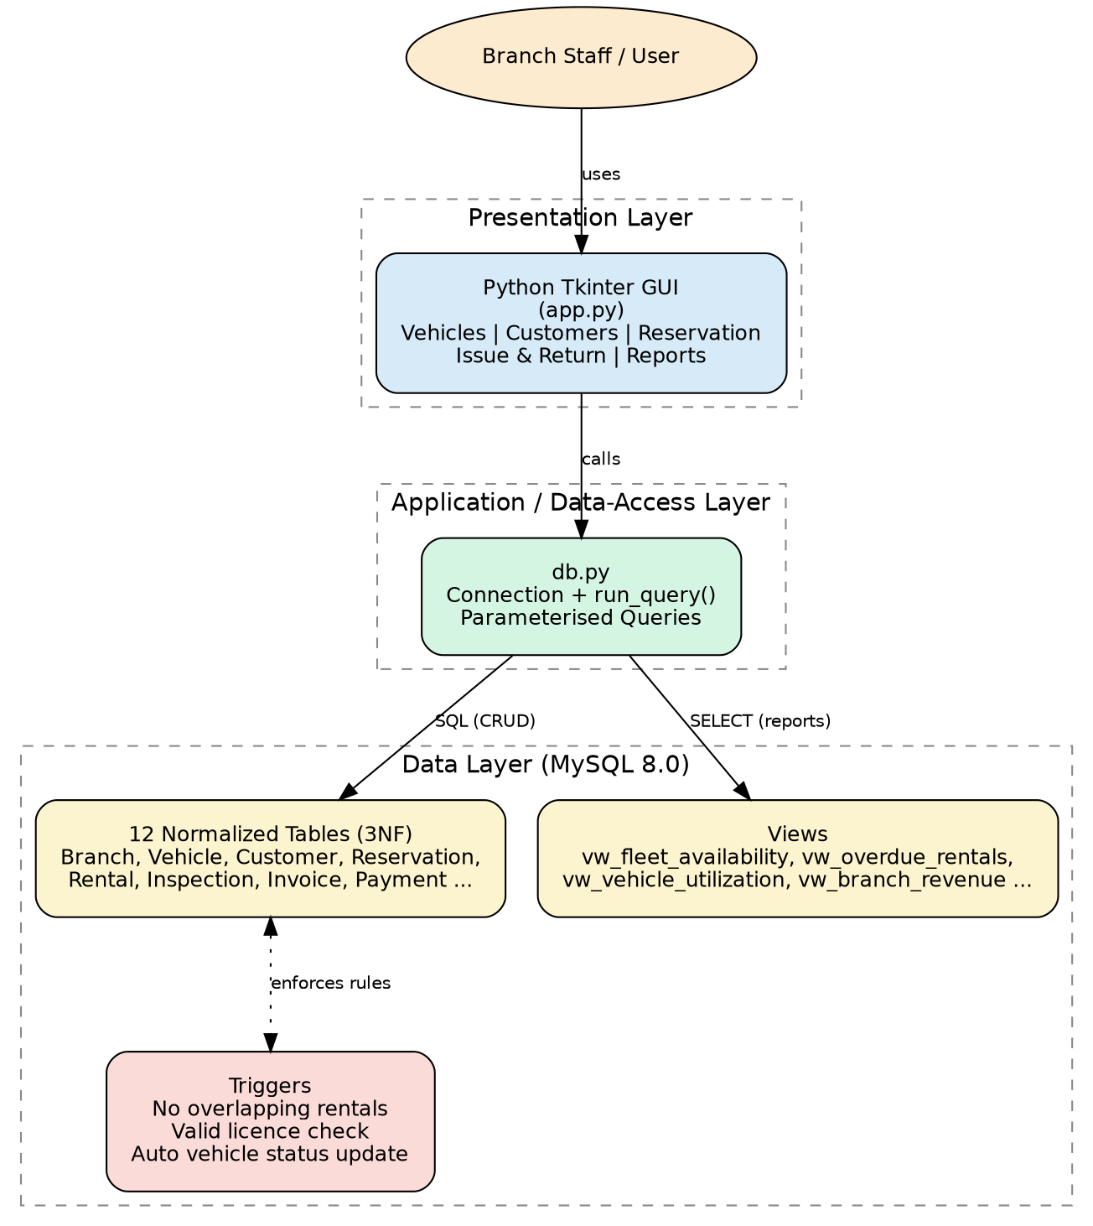
APPLICATION ARCHITECTURE
Three-Tier Architecture
02

Slide 3





Vehicles — full CRUD on the fleet master
Customers — full CRUD with licence validation
APPLICATION
MODULES
Reservation — availability search & booking
Python · Tkinter · MySQL Connector
Issue & Return — inspection and auto-billing
Reports — all 6 views in one dashboard tab
03

Slide 4
IMPLEMENTATION
Issue → Return → Invoice Workflow
All database access goes through one helper module that always uses parameterised queries.
1
Create Rental row for the reservation
2
UPDATE pickup odometer/time → trigger sets Vehicle.status = RENTED
3
Record PICKUP Inspection + FuelReading
4
On return: UPDATE return odometer/time → trigger sets Vehicle.status = AVAILABLE
5
Record RETURN Inspection + optional Damage
6
Compute days × rate + extra-km + late fee + damage + 18% tax → insert Invoice
04

Slide 5
PROJECT STATUS
Where This Stands Today
COMPLETE
IN PROGRESS
Normalized MySQL schema with all constraints & triggers
Sample data loaded and verified
6 reporting views + subqueries tested
Full Tkinter application coded (5 modules)
End-to-end workflow logic implemented
Full live run-through on the lab/demo machine
Screenshot capture for the final report
Edge-case testing (concurrent bookings, large data)
Final polish pass on the written report
05

Slide 6

Thank You
Questions & Viva-Voce
Project 19 · Review 3 — Application, Demonstration & Viva-Voce

