Slide 1

DATABASE MANAGEMENT SYSTEMS • PROJECT NO. 19 • FINAL PRESENTATION
Car Rental Reservation and
Vehicle Return Management System
Normalized Database (3NF), Constraints, SQL Views,
Application, Live Demonstration and Viva-Voce.
BANGLA DEEKSHAN RAJ
Roll No: 25WU0102037 · Class: AIML RHINOS
WOXSEN UNIVERSITY — Reviews 2 & 3

Slide 2
LOGICAL DESIGN
Data Dictionary — Key Tables
Table | Key Columns | Purpose
Branch | branch_id (PK) | Rental office locations
VehicleCategory | category_id (PK) | Hatchback / Sedan / SUV / Luxury
Vehicle | vehicle_id (PK); category_id, branch_id (FK) | Individual fleet vehicles
Customer | customer_id (PK) | Renters, incl. licence details
Reservation | reservation_id (PK); customer/vehicle/branch/rate_plan (FK) | Advance booking
Rental | rental_id (PK); reservation_id (FK, UQ) | Actual pickup / return
Inspection | inspection_id (PK); rental_id (FK) | Condition check at pickup & return
Invoice / Payment | invoice_id / payment_id (PK) | Billing and settlement
02

Slide 3
NORMALIZATION
Verifying Third Normal Form (3NF)
Table | Functional Dependency | Check
Vehicle | vehicle_id → reg_no, category_id, branch_id, model, year, odometer, status | 3NF ✓
Reservation | reservation_id → customer_id, vehicle_id, branch_id, rate_plan_id, dates, status | 3NF ✓
RatePlan | rate_plan_id → category_id, plan_name, daily_rate, extra_km_rate | 3NF ✓
KEY DESIGN DECISIONS
VehicleCategory separated from Vehicle — removes repeated seating/rate data and update anomalies
Inspection kept separate from Rental — avoids a repeating group (pickup + return in one row breaks 1NF)
Invoice charges split into rental / extra-km / late-fee / damage — each traceable to its source rule
03

Slide 4

DATA INTEGRITY
Business Rules — How They're Enforced
Business Rule | Mechanism
No overlapping rentals for the same vehicle | TRIGGER (cross-row check)
Customer's driving licence must not be expired | TRIGGER (cross-row check)
Return date/time must be after pickup | CHECK constraint
Odometer & fuel readings must be valid (0–100%) | CHECK constraint
Charges & payments can never be negative | CHECK constraint
Vehicle status auto-updates on pickup/return | TRIGGER (AFTER UPDATE)
Why triggers?
CHECK constraints validate a single row. Overlap and licence rules need to compare a new booking against every existing row for that vehicle or customer — only a trigger can do that.
Enforced at the database level — holds true no matter which application connects.
04

Slide 5
TEST DATA
Sample Data Loaded
3
4
6
4
3
Branches
Vehicle
Categories
Vehicles
Customers
Reservations
SELECT * FROM Customer; (excerpt)
customer_id | full_name | license_expiry
1 | Rohan Mehta | 2027-05-10
2 | Ananya Rao | 2026-11-20
3 | Karan Verma | 2025-01-15
This rental is still overdue in the sample data —
used to demonstrate the Overdue Rentals report.
Rental #2 — Ananya Rao — Hyundai Creta — status: OVERDUE
05

Slide 6
REPORTING LAYER
SQL Queries & Views
6 REPORTING VIEWS (JOINS + AGGREGATES)
vw_fleet_availability
vw_overdue_rentals
vw_vehicle_utilization
vw_damage_report
vw_branch_revenue
vw_customer_history
NESTED SUBQUERY EXAMPLE
SELECT DISTINCT c.full_name, inv.total_amount
FROM Customer c JOIN Reservation r ON r.customer_id = c.customer_id
JOIN Rental rt ON rt.reservation_id = r.reservation_id JOIN Invoice inv ON inv.rental_id = rt.rental_id
WHERE inv.total_amount > (SELECT AVG(total_amount) FROM Invoice);
Finds customers who paid more than the average invoice total — a correlated aggregate subquery.
06

Slide 7

LIVE DEMONSTRATION
Proving the Rules Actually Work
Demo 1 — Overlapping Booking
Demo 2 — Expired Licence
INSERT INTO Reservation
(customer_id, vehicle_id, branch_id,
rate_plan_id, planned_pickup, planned_return)
VALUES (2, 1, 1, 1, '2026-09-02 10:00',
'2026-09-03 10:00');
UPDATE Customer
SET license_expiry='2020-01-01'
WHERE customer_id=1;
INSERT INTO Reservation (...)
VALUES (1, 4, 2, 1, '2027-02-01',
'2027-02-02');
Expected: rejected with “Overlapping reservation exists for this vehicle in the selected period.”
Expected: rejected with “Customer driving licence is expired before the pickup date.”
Trigger: trg_no_overlap_reservation
Trigger: trg_valid_license
07

Slide 8
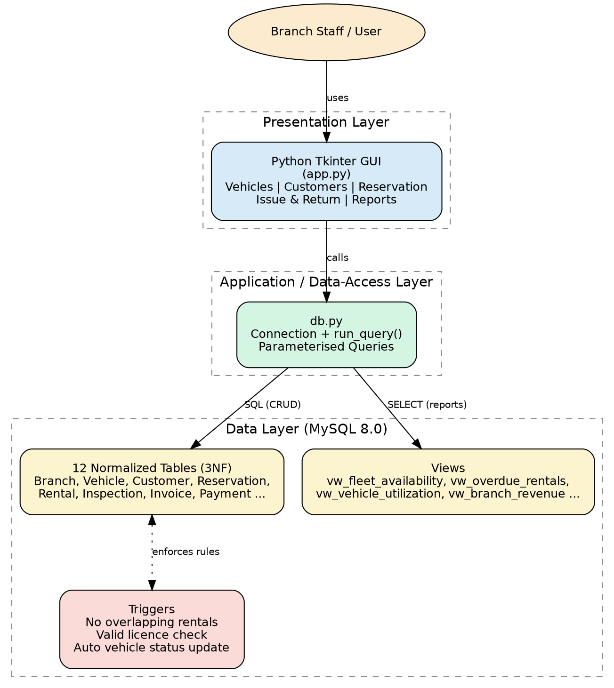
APPLICATION ARCHITECTURE
Three-Tier Architecture
08

Slide 9





Vehicles — full CRUD on the fleet master
Customers — full CRUD with licence validation
APPLICATION
MODULES
Reservation — availability search & booking
Python · Tkinter · MySQL Connector
Issue & Return — inspection and auto-billing
Reports — all 6 views in one dashboard tab
09

Slide 10
IMPLEMENTATION
Issue → Return → Invoice Workflow
All database access goes through one helper module that always uses parameterised queries.
1
Create Rental row for the reservation
2
UPDATE pickup odometer/time → trigger sets Vehicle.status = RENTED
3
Record PICKUP Inspection + FuelReading
4
On return: UPDATE return odometer/time → trigger sets Vehicle.status = AVAILABLE
5
Record RETURN Inspection + optional Damage
6
Compute days × rate + extra-km + late fee + damage + 18% tax → insert Invoice
10

Slide 11
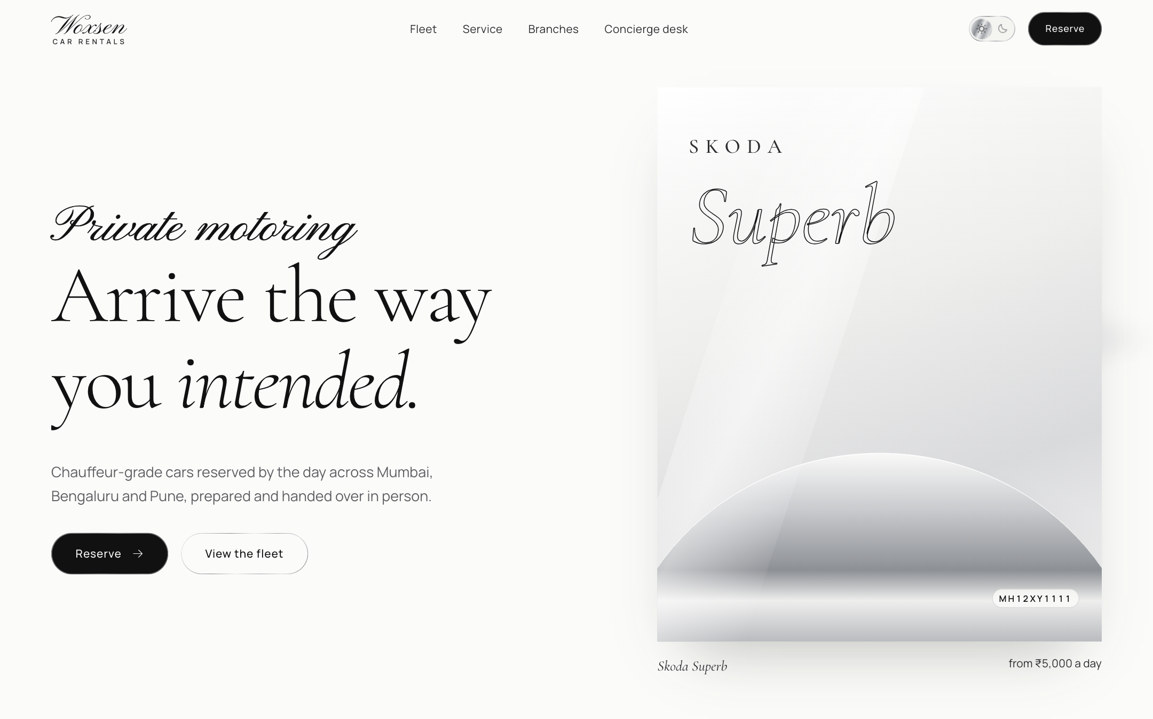
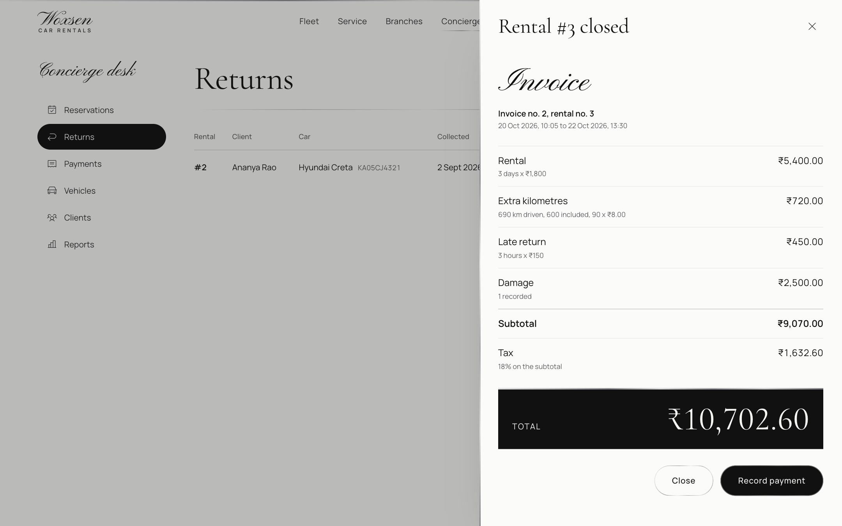
WEB APPLICATION
Woxsen Car Rentals: Live Web Version
Landing page and fleet availability, filtered by date
Return and billing: invoice built line by line
Flask REST API on the same MySQL database. All 3 triggers fire; each action is one transaction. Payments and cancellations added. Runs in any browser with no install.
11

Slide 12
PROJECT STATUS
Final Project Status
COMPLETE
NEXT STEPS
Normalized MySQL schema (12 tables) with constraints and 3 triggers
Sample data loaded and verified
6 reporting views and subqueries tested
Tkinter desktop application (5 modules)
Web application: Flask API + React site
Payments, cancellation and full billing
Live demo online and final report submitted
Shared online database and server for the web version
Login and roles for the admin desk
Real vehicle photos in the fleet
Stress-testing concurrent bookings
12

Slide 13

Thank You
Questions & Viva-Voce
Project 19 · Final Presentation — Reviews 2 & 3

