Slide 1

DATABASE MANAGEMENT SYSTEMS • PROJECT NO. 19 • REVIEW 1
Car Rental Reservation and
Vehicle Return Management System
Review 1 — Problem Statement, Conceptual Design (ER Diagram)
and Relational Schema.
BANGLA DEEKSHAN RAJ
Roll No: 25WU0102037 · Class: AIML RHINOS
WOXSEN UNIVERSITY — Week 7 Review

Slide 2

THE PROBLEM
Manual rental tracking breaks down fast
Small and mid-size car-rental agencies still rely on registers, spreadsheets, and phone confirmations to manage vehicles, bookings, and billing across branches.
Double-booking
Damage disputes
Billing errors
No visibility
The same vehicle gets promised to two customers with no real-time check.
No consistent record of vehicle condition at pickup vs. return.
Rental days, extra km, and late fees calculated manually, inconsistently.
Branch-wise revenue and fleet utilization take days to compile.
02

Slide 3
GOALS
Project Objectives
Identify entities, attributes and relationships through requirement analysis
Design a conceptual ER diagram covering all principal entities
1
2
Normalize the relational schema up to Third Normal Form (3NF)
Implement keys, CHECK constraints and triggers for business rules in MySQL
3
4
Populate the database with realistic, testable sample data
Write joins, aggregates, nested subqueries and views for management reports
5
6
03

Slide 4
SYSTEM DESIGN
Existing System vs. Proposed System
EXISTING SYSTEM
PROPOSED SYSTEM
Paper registers / spreadsheets per branch
No real-time vehicle availability check
No systematic pickup/return condition record
Manual, error-prone charge calculation
No enforcement of licence validity rules
Centralized, normalized MySQL database
Trigger-based real-time overlap prevention
Structured pickup/return inspection records
Automatic invoice calculation with tax & fees
Licence validity enforced at booking time
04

Slide 5
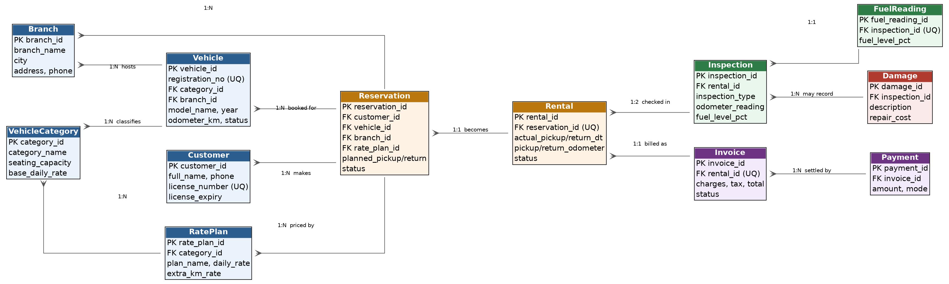
CONCEPTUAL DESIGN
Entity-Relationship Diagram
12 entities · crow's-foot notation for one-to-many relationships
05

Slide 6
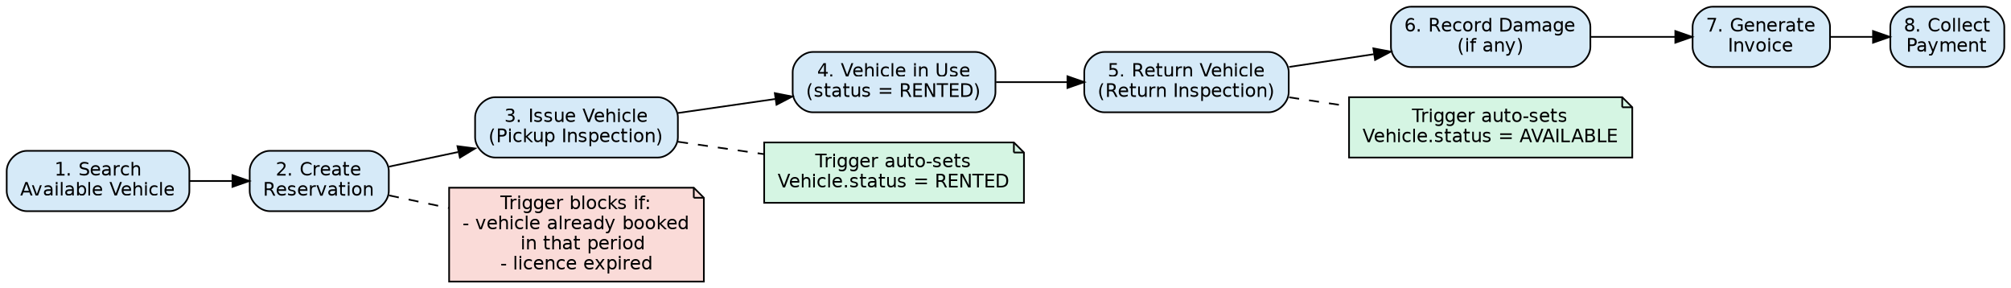
BUSINESS PROCESS
Reservation-to-Payment Flow
How the data model tracks a rental from booking to bill, with rules enforced at each step
06

Slide 7
LOGICAL DESIGN
Initial Relational Schema — Key Tables
Table | Key Columns | Purpose
Branch | branch_id (PK) | Rental office locations
VehicleCategory | category_id (PK) | Hatchback / Sedan / SUV / Luxury
Vehicle | vehicle_id (PK); category_id, branch_id (FK) | Individual fleet vehicles
Customer | customer_id (PK) | Renters, incl. licence details
Reservation | reservation_id (PK); customer/vehicle/branch/rate_plan (FK) | Advance booking
Rental | rental_id (PK); reservation_id (FK, UQ) | Actual pickup / return
Inspection | inspection_id (PK); rental_id (FK) | Condition check at pickup & return
Invoice / Payment | invoice_id / payment_id (PK) | Billing and settlement
07

Slide 8

Thank You
Questions & Viva-Voce
Project 19 · Review 1 — Problem Statement, ER Diagram & Relational Schema

