Slide 1
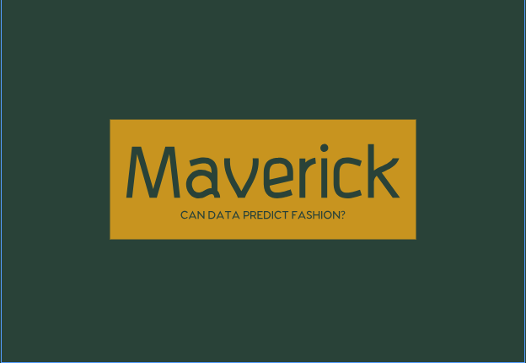
Predicting Fashion Trends using Image recognition and Deep Learning

Slide 2
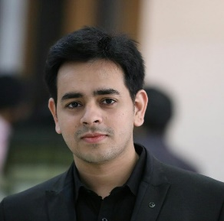
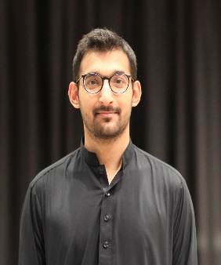
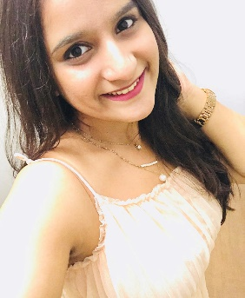



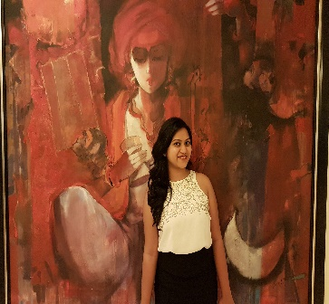

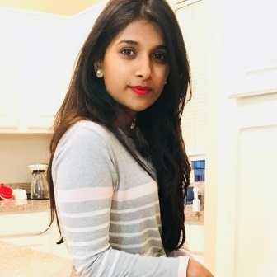

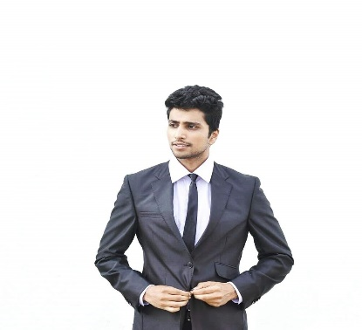

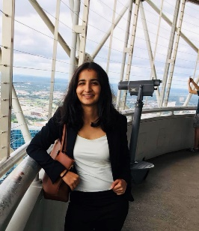
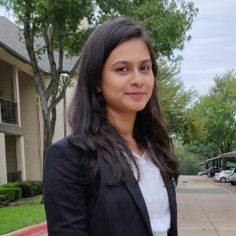
Rajdeep Arora
Ali Abdullah
Sindhu
Shubham Shrotri
Usaid Malik
MEET OUR TEAM
Prakash Hari
Sameera Epari
Anh Phuong Thi
Abinitha
Anusha
Bhavin Shah
Varun
Harkirat Kaur
Navya

Slide 3
About Client
Maverick is a fashion, style, and lifestyle blog based in Orange County, CA, managed by Social Media Influencer Mr. Jacob. Maverick has a great group of real, active, and engaged followers across all social networks. The business demands a tool to be developed which can be used by customers to find deals on eBay and Amazon simply by uploading a picture of the product. The tool will provide all possible deals to the customer and business will earn affiliate income on the product provided the customer has purchased it via the link provided.

Slide 4
Assumptions
The tool will support only images in jpeg format as input from the user. No other format of input will be supported.
The tool will be an app based on native Android/iOS platform.
The tool will only provide clickable deals to the user and will not interact in any other form.

Slide 5
Risks
The tool may offer incorrect product deals to the user due to inaccurate predictions by the backend model.
Impact - Poor user experience.
The tool may offer product deals which may not belong to the same geographic location as the user.
Impact – Users will not be able to order the product due to geographic restrictions.
Users may use the tool to check for product prices online and not purchase the product.
Impact – Revenue will be impacted without conversions.

Slide 6
In-Scope
Identifying features from a single image at a time and displaying the product deals from eBay and Amazon.
The tool will display only the affiliate-fused links from eBay and Amazon, no other platform will be supported.
Current design will only develop an MVP tool and will not focus on performance and accuracy.
The tool will identify fashion apparels only and will operate on a picture which contains only the product.

Slide 7
Out of Scope
Tracking conversion rates of the users based on the purchase summary.
Looking up product listings for multiple images at a go.
Providing product deals based on the user location.
User login portal and preference-based recommendations.
Multiple product detection from single image.

Slide 8
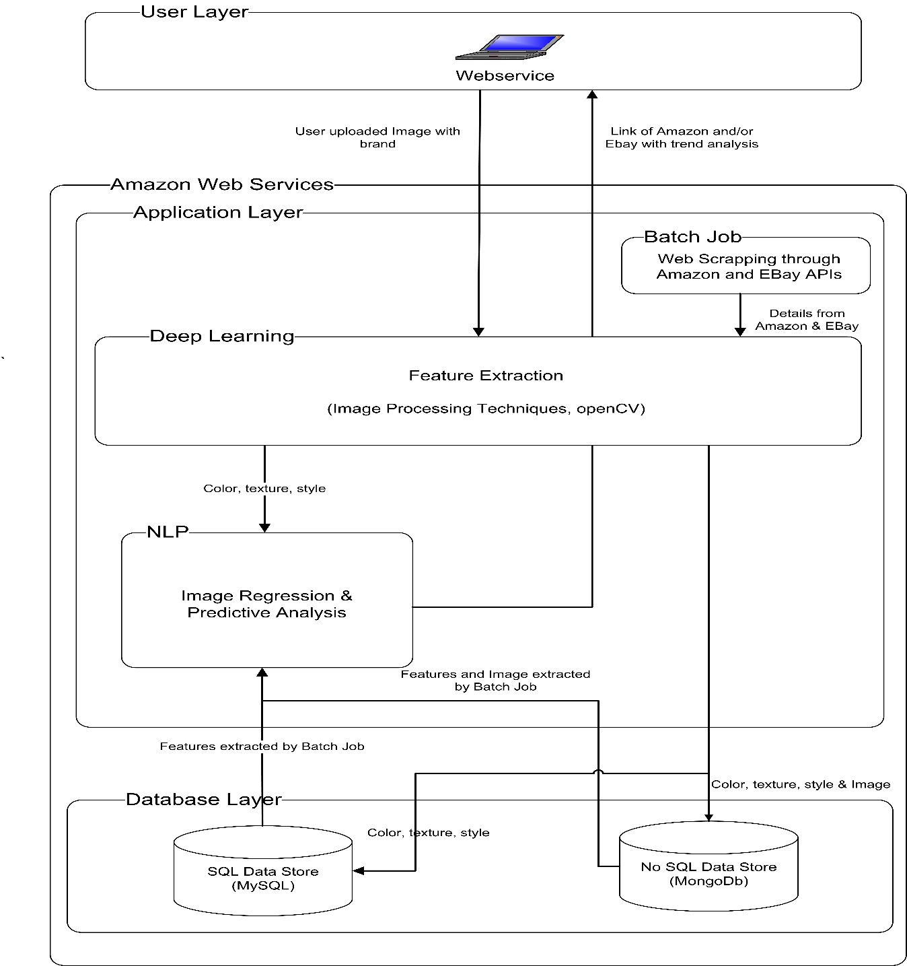
Technical Architecture

Slide 9
Business Process Flow
User opens the tool and clicks a picture
Tool asks if exact product is searched for or similar products
Extract exact product weblinks
Fuse affiliate string and display the links
Picture gets uploaded and fed to the model
Exact product?
Display the links from the API
Construct search keyword and feed to API
Extract image features and logo

Slide 10
Sample UI Design
https://www.fluidui.com/editor/live/project/p_94TBTfrL7Tz7p0VGC1UIiErbVFDbFLMJ

Slide 11
Milestone 1 : Mavericks 1.0 (MVP)
Our first version of product tries to determine a trend by gathering images from Chictopia for a specific timeframe, process the image and finally exporting a report containing the main colors, style with labels and its hex codes as a .csv or .xlsx file for the client to review.

Slide 12
Milestone 2: Mavericks 2.0 …
For future development, the second version makes the use of downloading of the images by seasons and labeling each image by the season. The labelled images are then fed to train a Neural Network deep learning model. The model would finally be able to recommend a season, in which a given ‘look’ (in the new image) can be pulled off.

Slide 13
Mavericks 2.0 ….
The solution can implement a proprietary model which can be trained on different datasets – apparel identification using Fashion MNIST dataset and logo identification using Flickr27 and Flickr32 datasets. The model can then be implemented on cloud or on local storage along with tool. The model will identify the image features and the logo to create a search key string. This key string can then be fed into the eBay and Amazon API to obtain the product deals.
PROS:
Proprietary model which can be tuned and customised as per needs
Can be deployed locally to provide maximum privacy
Low cost maintenance
CONS:
Less accurate and not scalable
Cannot extract weblinks of the product
Cannot look up deals for the exact product

Slide 14
Maverick 2.0 : Future Opportunity
Google Cloud Vision API enables developers to understand the content of an image by encapsulating powerful machine learning models in an easy to use REST API. It quickly classifies images into thousands of categories. Vision API has different functions built in which can be used to extract different types of features. The API offers feature extraction, weblink search and geo-specific meta tags.
Pricing –
1000 free units per month, after which $1.5/1001-5000000 units per month. (1 unit = 1 function)
PROS:
Highly accurate and scalable
Provides features for similar product search and direct web links to the product
Provides geo-specific meta tags which can be used to provide personalised deals to the user
CONS:
Comparatively costlier when it comes to free usage
Need to be deployed using GCP

Slide 15
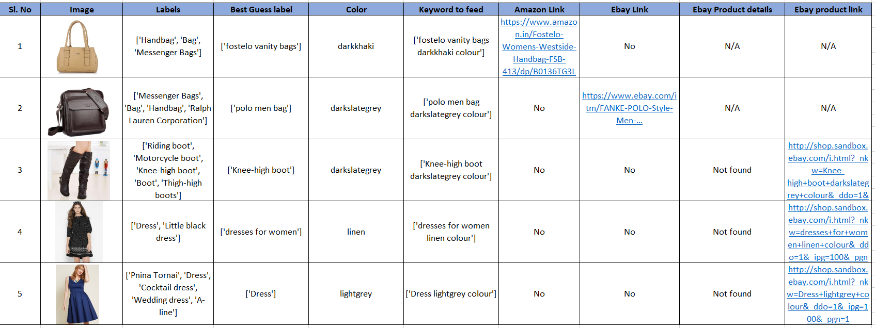
Mavericks 2.0 … (Targeting this data format)

Slide 16
Mavericks 3.0 …
Can user-generated social media content be used to identify fashion trends and predict growth of decline?

Slide 17
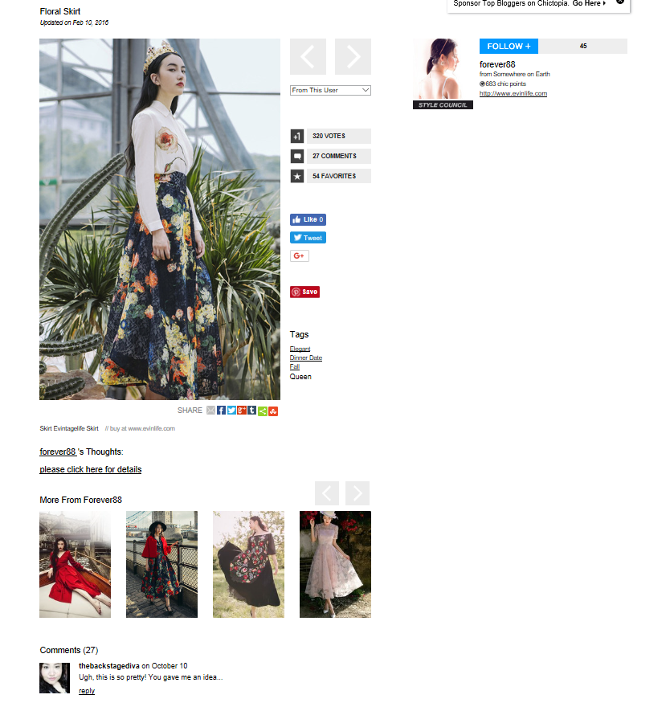
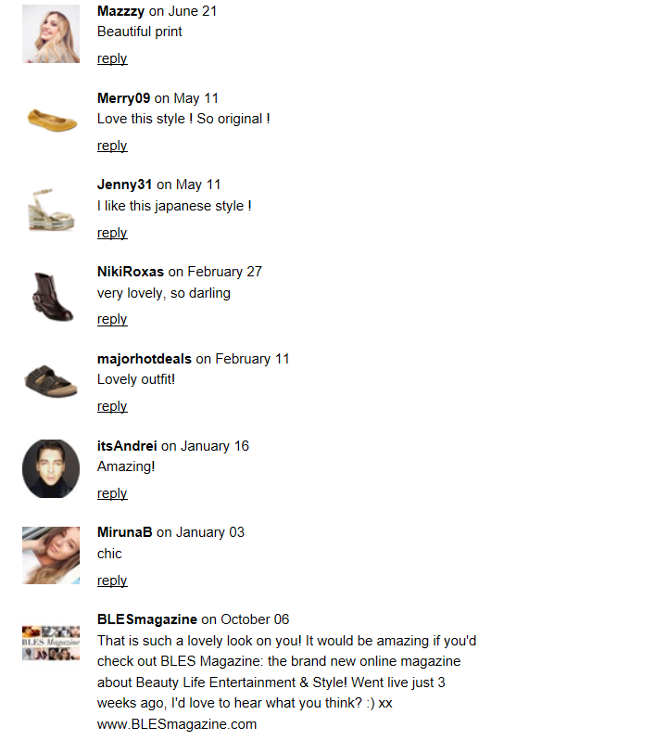
Mavericks 3.0 …
Sample Data Source

Slide 18
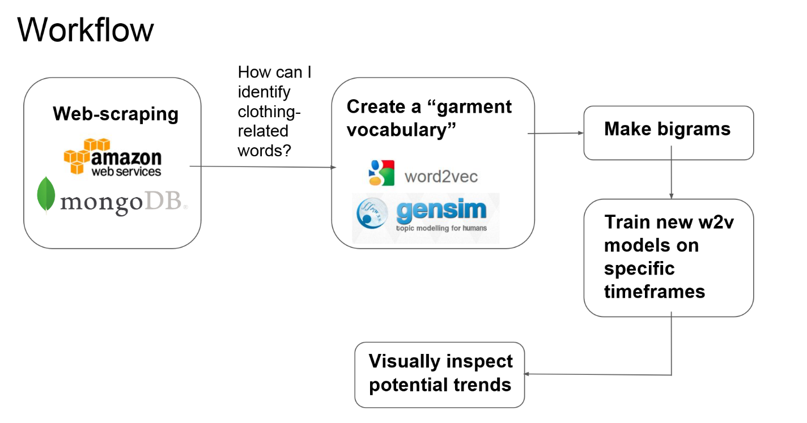
Mavericks 3.0 …

Slide 19
Methodology
Using data from 10 years of user-created posts on the popular fashion site chictopia, specifically, users' textual descriptions of their outfits, we are supposed to create NLP tools to identify references to garments, and created bigrams to extract significant adjective-noun (description-garment, eg 'floral jumpsuit') pairs. Then we are supposed to analyze changes in term frequency year over year to identify specific garments' trend cycles.

Slide 20
Process
First, we will collect data from approximately 1 million photo posts spanning March, 2008 to November, 2018. These posts are composed of one or more photos, a title, date, and a description that might range from a few words to several paragraphs. The data was processed using BeautifulSoup and stored using MongoDB and JSON.
After adding year, quarter and month features to the dataset, and tokenizing the photo descriptions, we will create a Word2Vec model for the data for years 2009-2014. We will use this model to identify approximately 60 'garment words' based on their similarity to six 'basic' garment words: 'dress', 'skirt', 'pants', 'shoes' and 'bag.'
Using ~60 identified garment words, then we create bigrams that paired every occurrence of a garment word with the word that immediately preceded it. Then we will create new W2V models for each year, 2009 through 2014. Treat this as an initial training set.
At the end, perform EDA using my 'bigramified' text. This collects the list of bigrams that the W2V models considered 'most similar' to the basic garments and examined the respective differences in these lists from year to year. Then create similar lists using simple term frequency of bigrams.
Lastly, plot the members of these disjunctive lists to determine whether members of the list could accurately be considered 'trends'. Rather than use a hard definition of 'trend', let’s visually examined the plots for significant peaks.

Slide 21
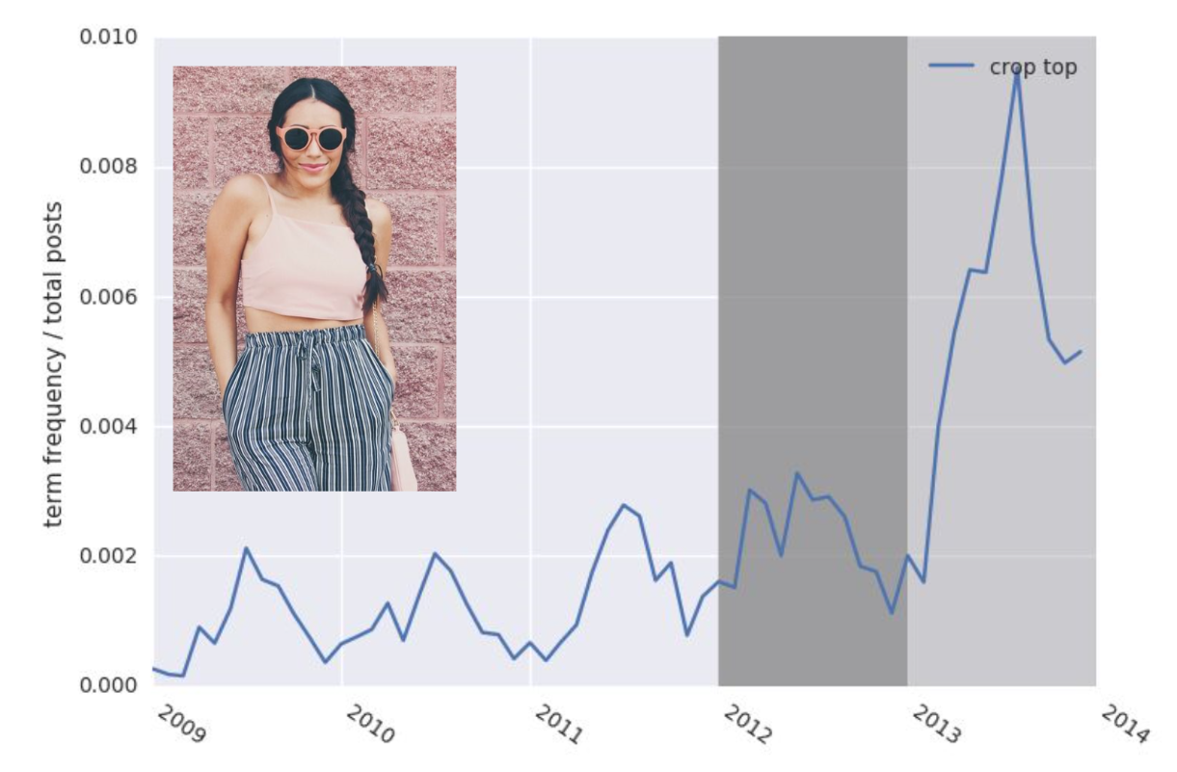
S
A
M
P
L
E
1

Slide 22
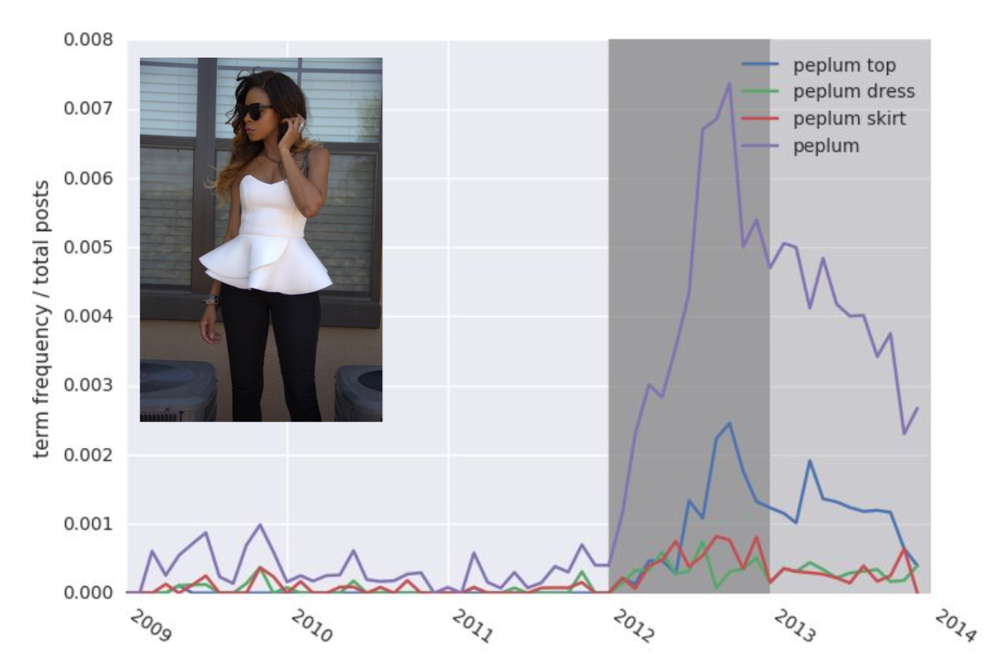
S
A
M
P
L
E
2

Slide 23
Conjoint Analysis
Conjoint analysis is a technique that is used in new product development in marketing
To understand the preferences of consumers and the importance of attributes.
To segment customers
To predict market shares and customer choice

Slide 24
Conjoint Survey
https://qtrial2018q4az1.az1.qualtrics.com/jfe/form/SV_etgvHsMZVutHlEV

Slide 25
Focus Right Now
Each individual is required to take one of the courses mentioned below in the month of November 2018 so that they can start adding value in the project –
Machine Learning with TensorFlow on Google Cloud Platform Specialization (Coursera)
Machine Learning Course by Andrew NG (Coursera) + (Fast.ai)
Deep Learning.ai by Andrew NG (Coursera)
Deep Learning for NLP (https://github.com/oxford-cs-deepnlp-2017/lectures)

Slide 26
Future Opportunities
Once the MVP is ready, then focus is to add more features with different data sources like fashion podcasts, fashion blogs and tweets.

