Slide 1
PID GAIN OPTIMIZATION
INTERNAL COMBUSTION ENGINE AT
IDLE SPEED
RAJDEEP arora & Yi cheng yeh

Slide 2
oVERVIEW
Manual Tuning
Fmincon Optimization
Particle Swarm Optimization – Introduction
Particle Swarm Optimization - Results
Results discussion

Slide 3
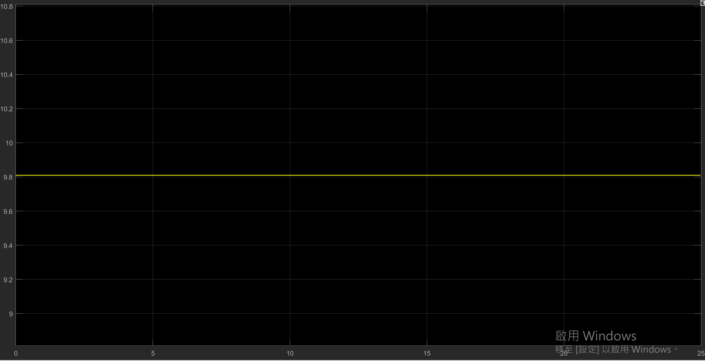
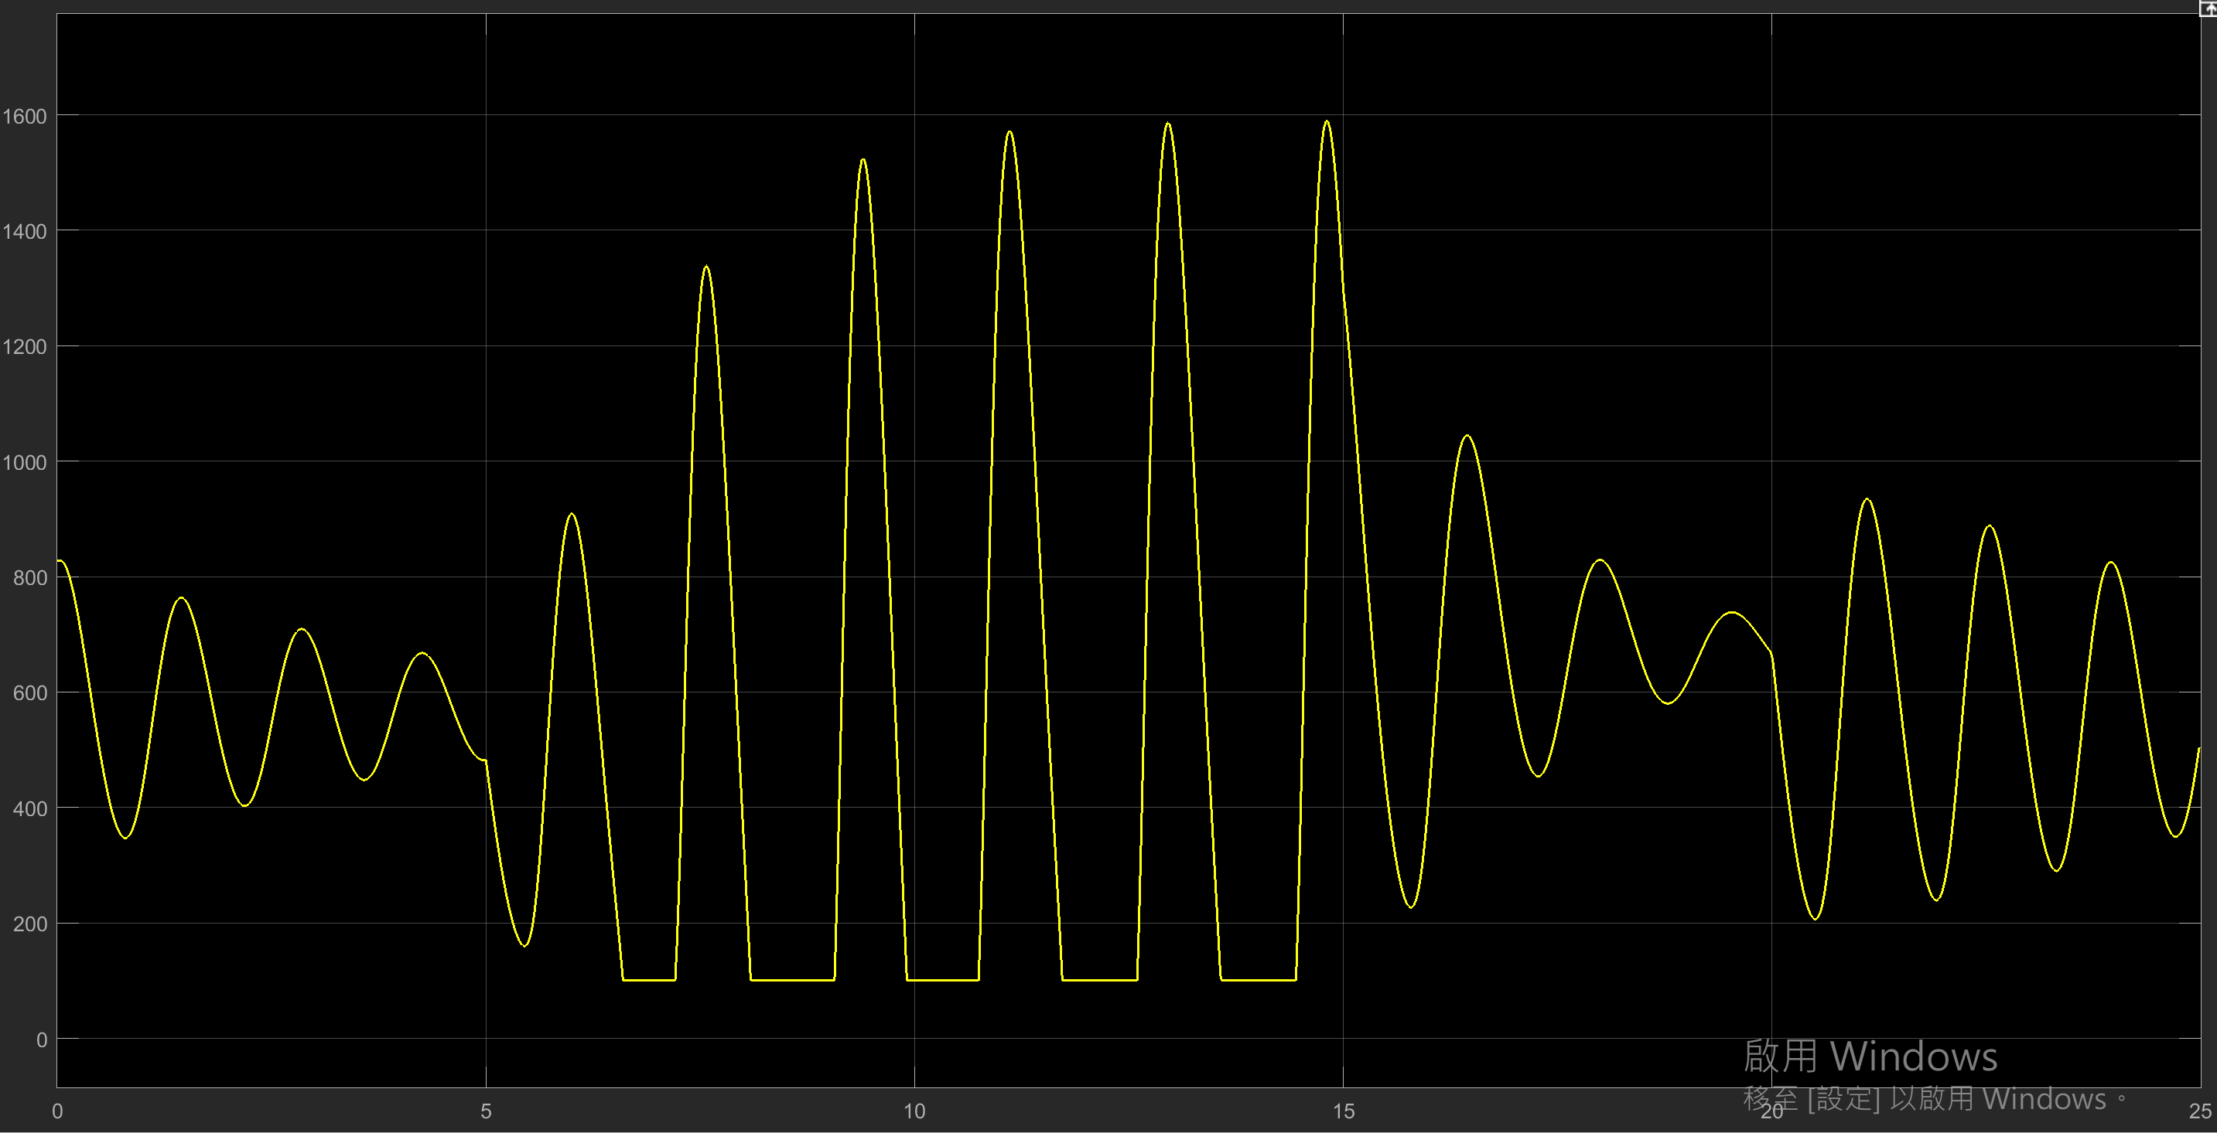
Open loop
Signal Statistics
Throttle angle
ENGINE SPEED
Max : 1590 RPM
Min : 100 RPM
Mean : 766.8 RPM
Signal Statistics
ThROTTLE ANGLE
Max : 9.8◦
Min : 9.8◦
Mean : 9.8◦
Engine speed

Slide 4
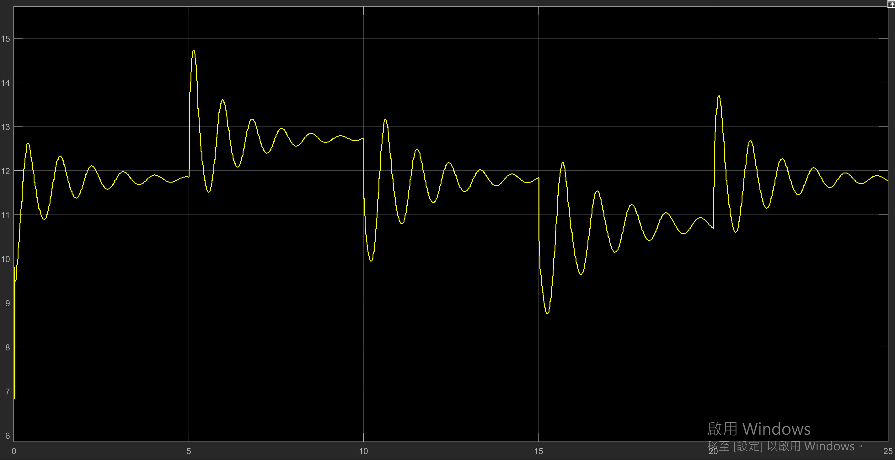
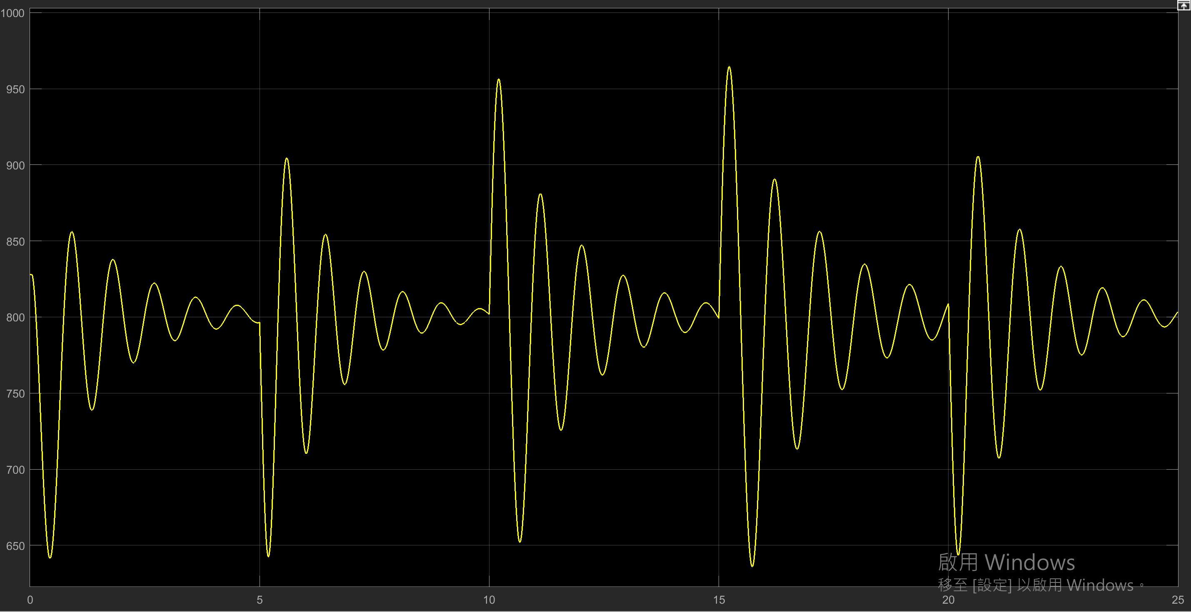
Close loop {kp: 0.1, ki: 0.005, Kd: 1}
Signal Statistics
Throttle angle
ENGINE SPEED
Max : 964.5 RPM
Min : 636 RPM
Mean : 798.8 RPM
Signal Statistics
ThROTTLE ANGLE
Max : 14.7◦
Min : 6.835◦
Mean : 7.9◦
Engine speed

Slide 5
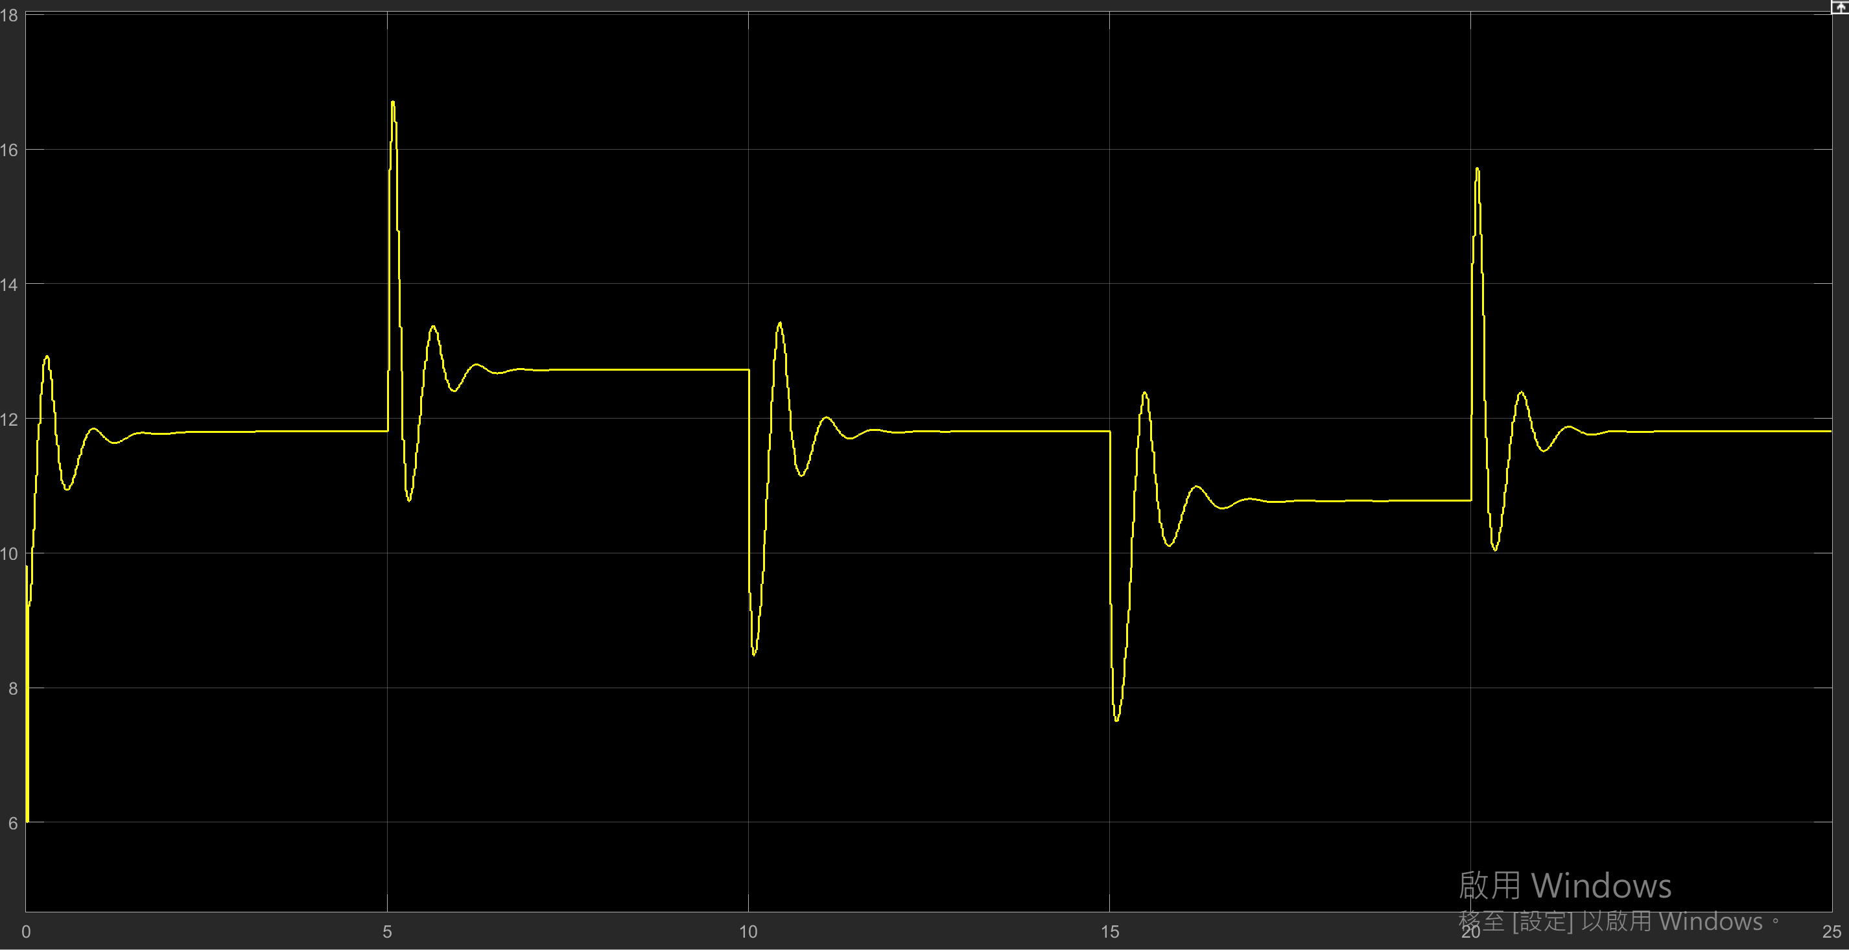
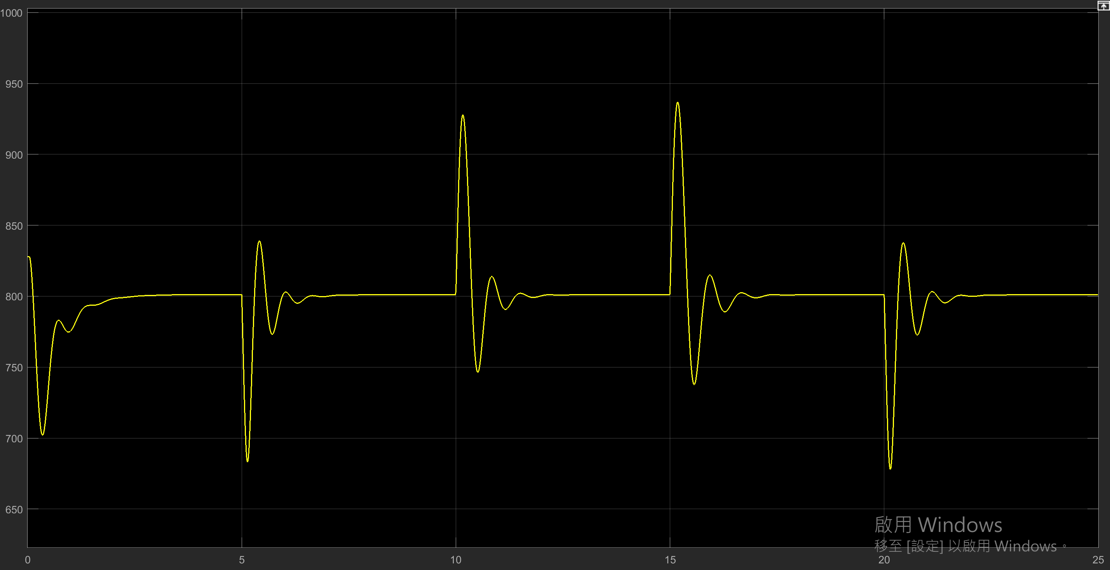
Close loop {kp: 0.2, ki: 0.005, Kd: 2}
Signal Statistics
Throttle angle
ENGINE SPEED
Max : 936.9 RPM
Min : 677.8 RPM
Mean : 799.2 RPM
Signal Statistics
ThROTTLE ANGLE
Max : 16.72◦
Min : 6◦
Mean : 11.73◦
Engine speed

Slide 6
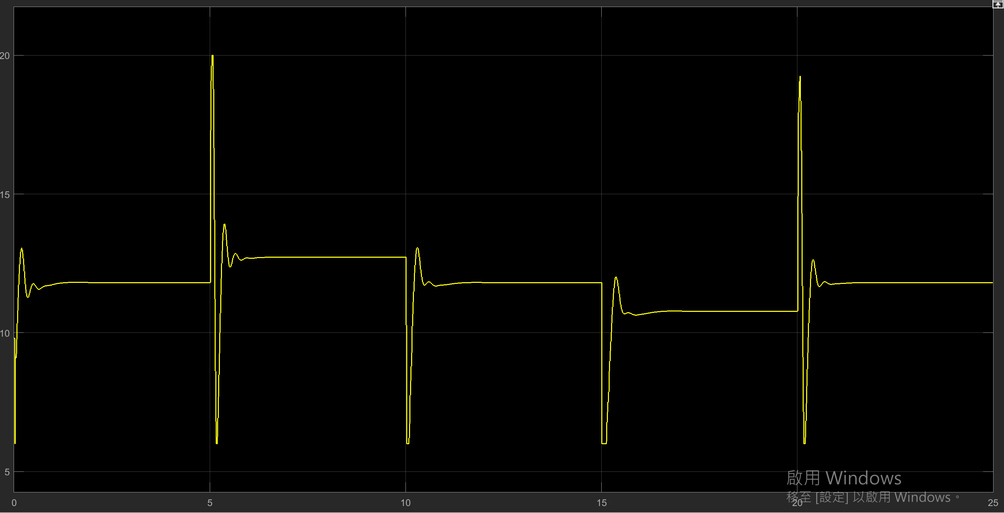
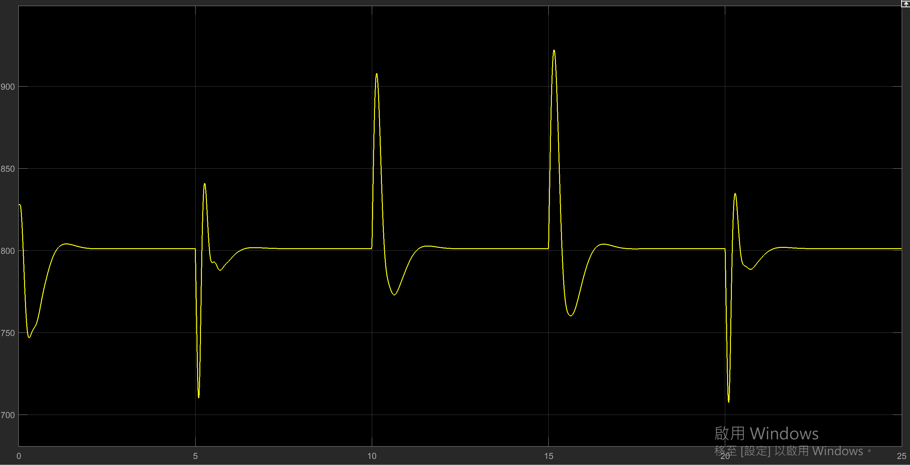
Close loop {kp: 0.225, ki: 0.01, Kd: 4.25}
Signal Statistics
Throttle angle
ENGINE SPEED
Max : 922.2 RPM
Min : 707.4 RPM
Mean : 800.6 RPM
Signal Statistics
ThROTTLE ANGLE
Max : 20◦
Min : 6◦
Mean : 11.71◦
Engine speed

Slide 7
Fmincon
Non-linear optimization

Slide 8
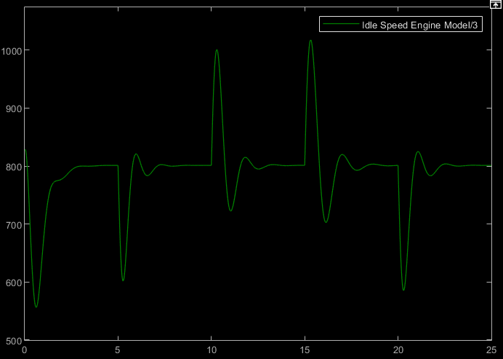
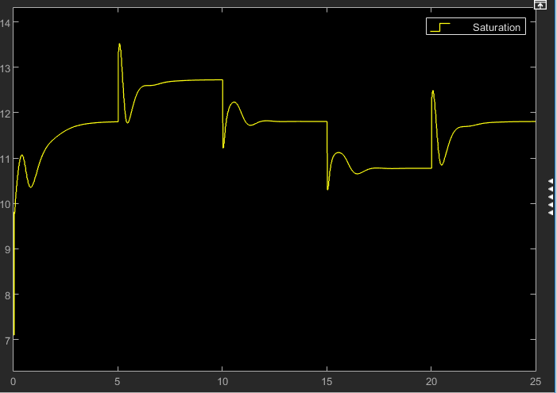
FMINCON : Initial gain {kp: 0.01, ki: 0.001, Kd: 1}
Signal Statistics
ENGINE SPEED
Max : 1017 RPM
Min : 556 RPM
Mean : 796 RPM
Signal Statistics
ThROTTLE ANGLE
Max : 13.37 ◦
Min : 7.37◦
Mean : 11.7◦
Metrics = ∑ Errors
1.17e+07
FMINCON : FINAL gain {kp: 0.01, ki: 0.001, Kd: 0.89 }
OBJECTIVE
FUNCTION
Absolute Error

Slide 9
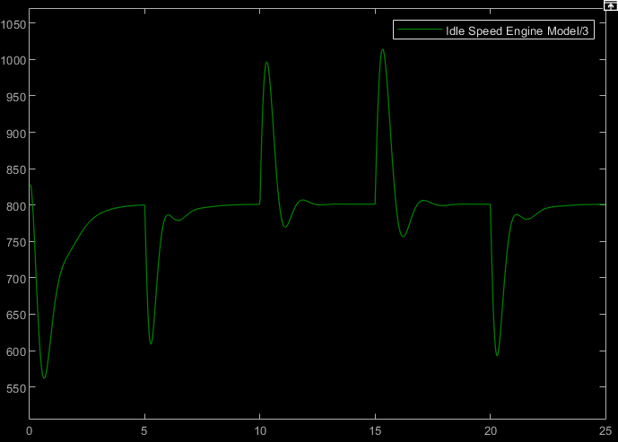
FMINCON : Initial gain {kp: 0.01, ki: 0.001, Kd: 1}
Signal Statistics
ENGINE SPEED
Max : 1014 RPM
Min : 561 RPM
Mean : 794 RPM
Signal Statistics
ThROTTLE ANGLE
Max : 13.37 ◦
Min : 7.37◦
Mean : 11.7◦
Metrics = ∑ Errors
1.24e+07
FMINCON : FINAL gain {kp: 0.01, ki: 0.001, Kd: 1.0}
OBJECTIVE
FUNCTION
Norm Square Error

Slide 10
FMINCON : Initial gain {kp: 0.01, ki: 0.001, Kd: 1}
Signal Statistics
ENGINE SPEED
Max : 1014 RPM
Min : 561 RPM
Mean : 791 RPM
Signal Statistics
ThROTTLE ANGLE
Max : 13.37 ◦
Min : 7.37◦
Mean : 11.6◦
Metrics = ∑ Errors
1.24e+07
FMINCON : FINAL gain {kp: 0.01, ki: 0.001, Kd: 1.0}
OBJECTIVE
FUNCTION
T * Norm Square

Slide 11
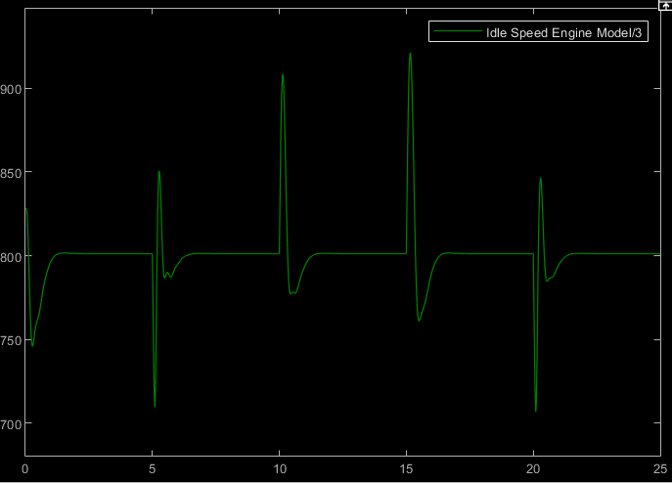
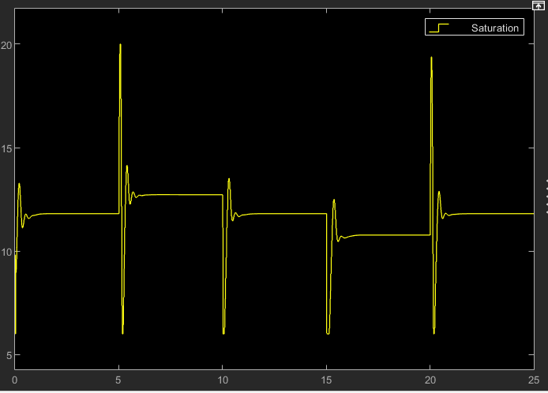
FMINCON : Initial gain {kp: 0.225, ki: 0.01, Kd: 4.25}
Signal Statistics
ENGINE SPEED
Max : 921 RPM
Min : 706 RPM
Mean : 800 RPM
Signal Statistics
ThROTTLE ANGLE
Max : 20◦
Min : 6◦
Mean : 14◦
Metrics = ∑ Errors
2.70e+06
FMINCON : FINAL gain {kp: 0.27, ki: 0.01, Kd: 4.09}
OBJECTIVE
FUNCTION
Absolute Error

Slide 12
FMINCON : Initial gain {kp: 0.225, ki: 0.01, Kd: 4.25}
Signal Statistics
ENGINE SPEED
Max : 920 RPM
Min : 709 RPM
Mean : 800 RPM
Signal Statistics
ThROTTLE ANGLE
Max : 20◦
Min : 6◦
Mean : 14◦
Metrics = ∑ Errors
2.85e+06
FMINCON : FINAL gain {kp: 0.2757, ki: 0.0076, Kd: 4.3738}
OBJECTIVE
FUNCTION
Norm Square Error

Slide 13
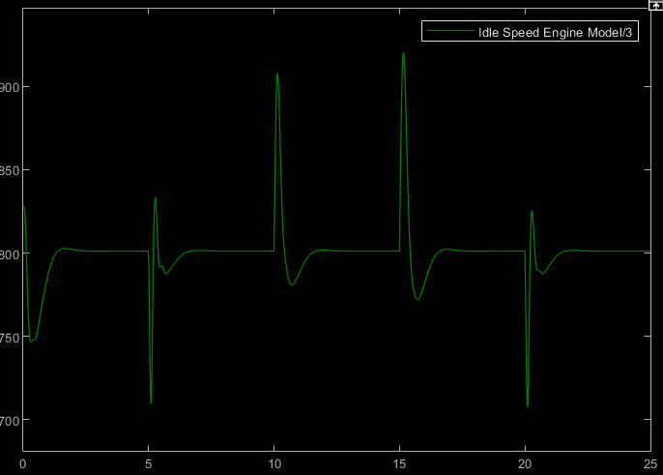
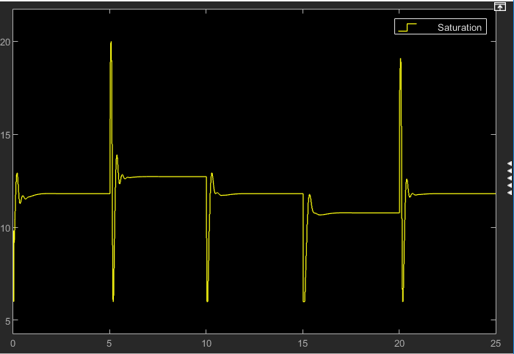
FMINCON : Initial gain {kp: 0.225, ki: 0.01, Kd: 4.25}
Signal Statistics
ENGINE SPEED
Max : 925 RPM
Min : 707 RPM
Mean : 800 RPM
Signal Statistics
ThROTTLE ANGLE
Max : 20◦
Min : 6◦
Mean : 11.7◦
Metrics = ∑ Errors
2.83e+06
FMINCON : FINAL gain {kp: 0.2058, ki: 0.0075, Kd: 4.2415}
OBJECTIVE
FUNCTION
T * Norm Square

Slide 14
Particle Swarm Optimization

Slide 15

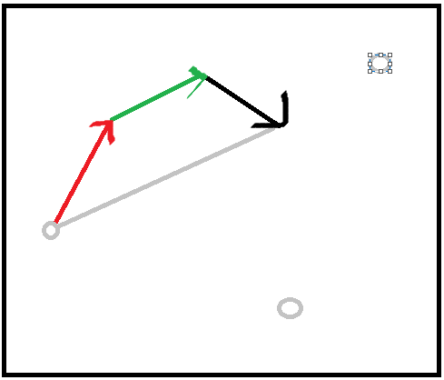
PARTICLE SWARM OPTIMIZATION
Particle’s Randomness in Velocity
Each Particle keeps track of its own best so far position
Particle Direction
Local Minima (Cognitive)
Each Particle keeps track of swarm’s best so far solution
L-Min
Global
Global Minima
(Social)
PD
1
0

Slide 16
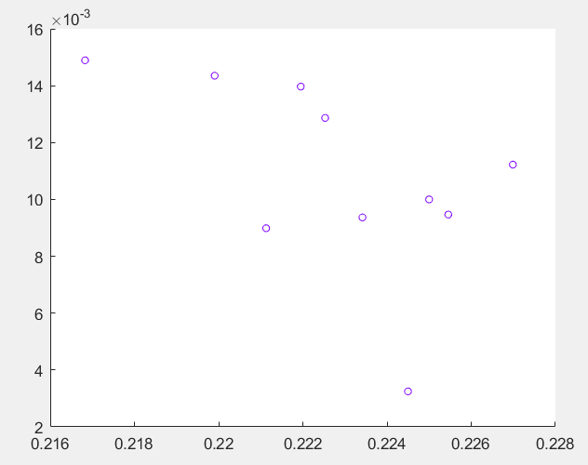
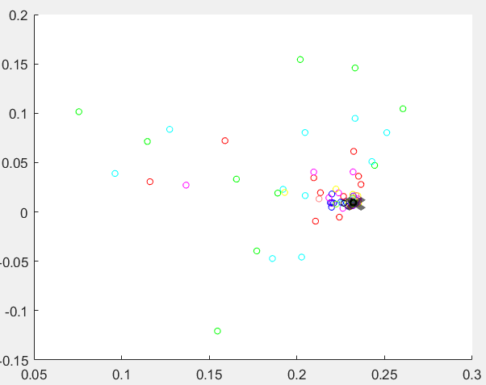
PSO….
Social = 0, Cognitive = 0.8
Social = 0.8, cognitive = 0
Randomness = 0

Slide 17
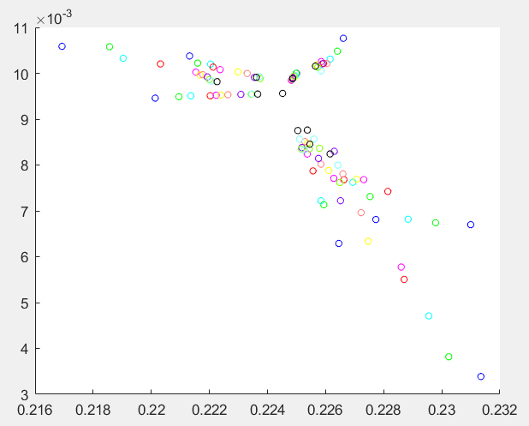
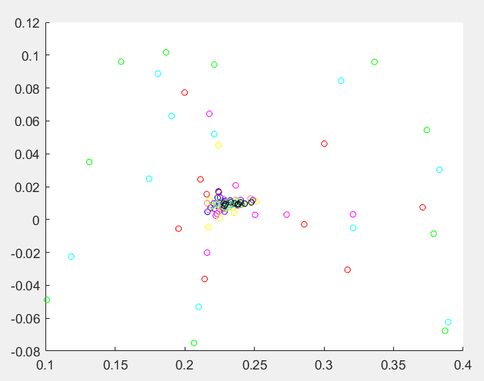
PSO….
Randomness <> 0
Randomness = 0
Cognitive = 0.6, social = 0.3

Slide 18
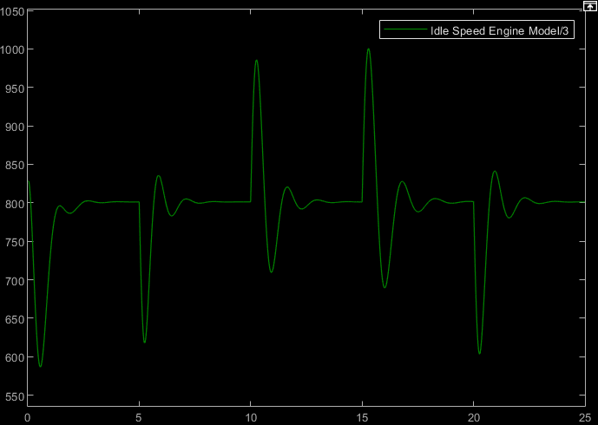
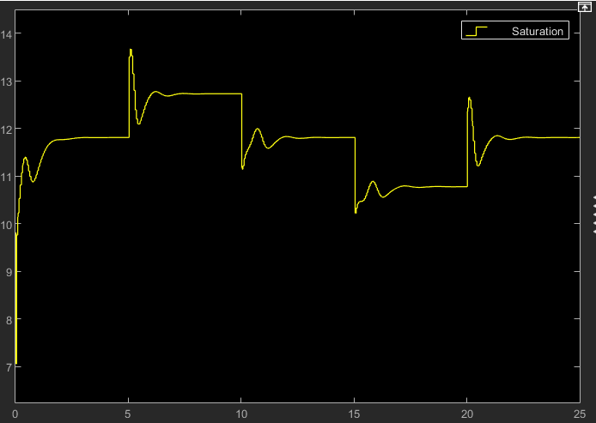
Initial gain {kp: 0.01, ki: 0.001, Kd: 1} HYPER-PARAMETERS {w = 0.2, c1 = 0.3, c2 = 0.6}
Signal Statistics
ENGINE SPEED
Max : 1001 RPM
Min : 586 RPM
Mean : 797 RPM
Signal Statistics
ThROTTLE ANGLE
Max : 13.67◦
Min : 7.05◦
Mean : 11.7◦
Metrics = ∑ Errors
1.0e+07
OBJECTIVE
FUNCTION
Absolute Error
FINAL gain {kp: 0.229, ki: 0.002, Kd: 1.0013}

Slide 19
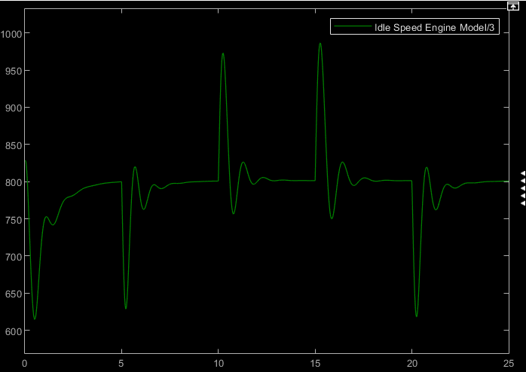
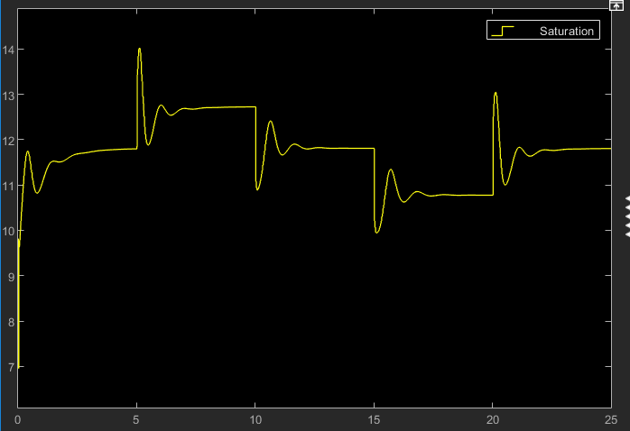
Initial gain {kp: 0.01, ki: 0.001, Kd: 1} HYPER-PARAMETERS {w = 0.2, c1 = 0.3, c2 = 0.6}
Signal Statistics
ENGINE SPEED
Max : 987 RPM
Min : 614 RPM
Mean : 795 RPM
Signal Statistics
ThROTTLE ANGLE
Max : 14◦
Min : 6.9◦
Mean : 11.7◦
Metrics = ∑ Errors
1.0e+09
OBJECTIVE
FUNCTION
Norm Square Error
FINAL gain {kp: 0.06, ki: 0.0015, Kd: 1.0}

Slide 20
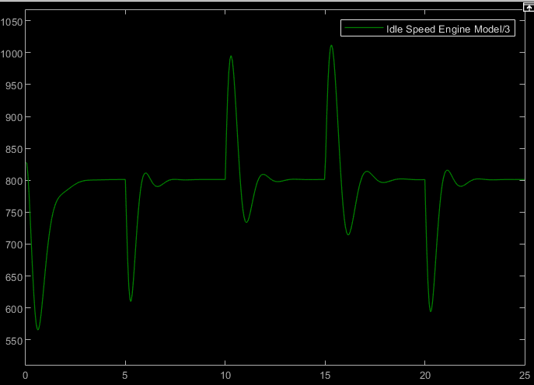
Initial gain {kp: 0.01, ki: 0.001, Kd: 1} HYPER-PARAMETERS {w = 0.2, c1 = 0.3, c2 = 0.6}
Signal Statistics
ENGINE SPEED
Max : 1012 RPM
Min : 565 RPM
Mean : 795 RPM
Signal Statistics
ThROTTLE ANGLE
Max : 13.53◦
Min : 7.1◦
Mean : 11.7◦
Metrics = ∑ Errors
1.0e+10
OBJECTIVE
FUNCTION
T * Norm Square
FINAL gain {kp: 0.0096, ki: 0.0014, Kd: 1.0}

Slide 21
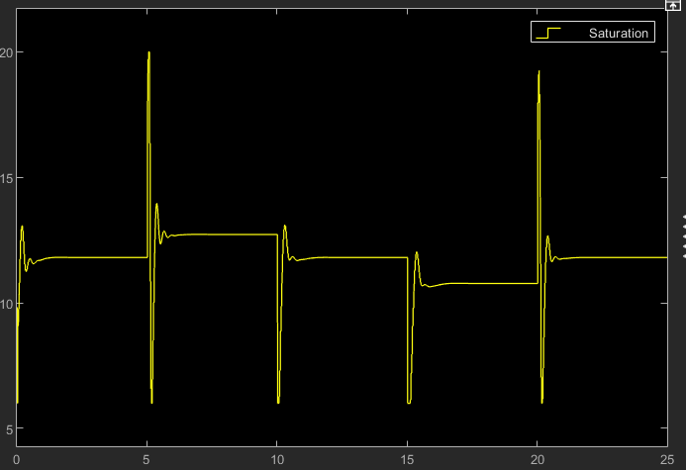
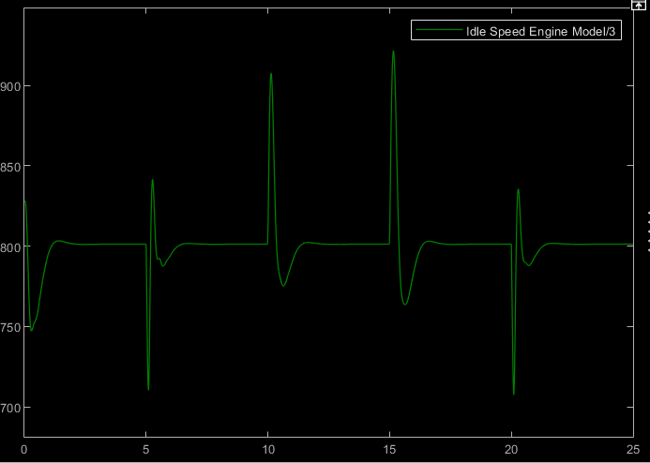
Initial gain {kp: 0.225, ki: 0.01, Kd: 4.25} HYPER-PARAMETERS {w = 0.2, c1 = 0.3, c2 = 0.6}
Signal Statistics
ENGINE SPEED
Max : 921 RPM
Min : 707 RPM
Mean : 800 RPM
Signal Statistics
ThROTTLE ANGLE
Max : 20◦
Min : 6◦
Mean : 14◦
Metrics = ∑ Errors
1.0e+06
OBJECTIVE
FUNCTION
Absolute Error
FINAL gain {kp: 0.024, ki: 0.0096, Kd: 4.2525}

Slide 22
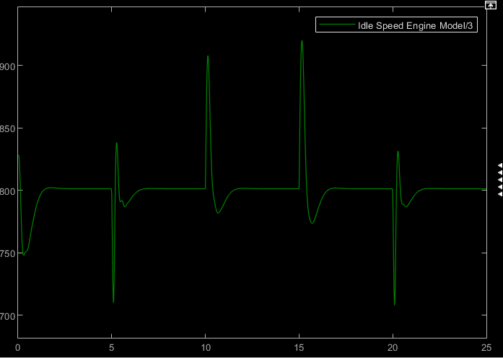
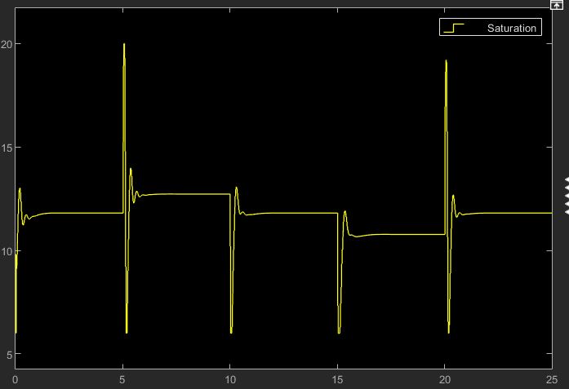
Initial gain {kp: 0.225, ki: 0.01, Kd: 4.25} HYPER-PARAMETERS {w = 0.2, c1 = 0.3, c2 = 0.6}
Signal Statistics
ENGINE SPEED
Max : 920 RPM
Min : 707 RPM
Mean : 800 RPM
Signal Statistics
ThROTTLE ANGLE
Max : 20◦
Min : 6◦
Mean : 11.7◦
Metrics = ∑ Errors
1.0e+07
OBJECTIVE
FUNCTION
Norm Square Error
FINAL gain {kp: 0.223, ki: 0.0077, Kd: 4.2594}

Slide 23
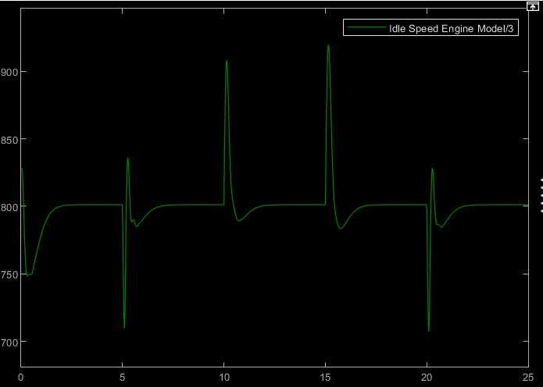
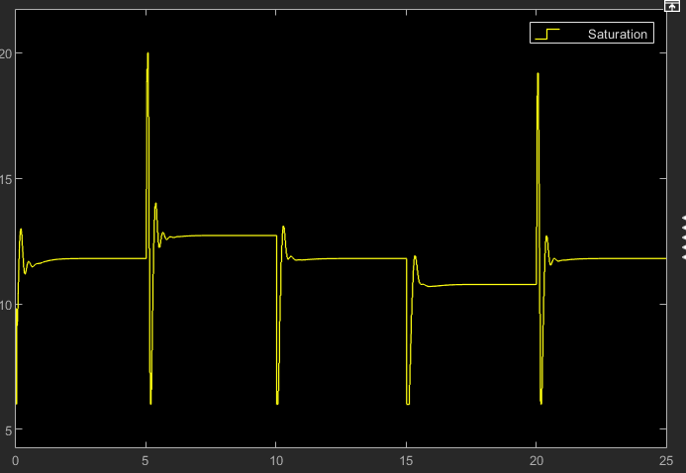
Initial gain {kp: 0.225, ki: 0.01, Kd: 4.25} HYPER-PARAMETERS {w = 0.2, c1 = 0.3, c2 = 0.6}
Signal Statistics
ENGINE SPEED
Max : 920 RPM
Min : 707 RPM
Mean : 800 RPM
Signal Statistics
ThROTTLE ANGLE
Max : 20◦
Min : 6◦
Mean : 11.7◦
Metrics = ∑ Errors
1.0e+08
OBJECTIVE
FUNCTION
T * Norm Square
FINAL gain {kp: 0.2244, ki: 0.0060, Kd: 4.2431}

Slide 24
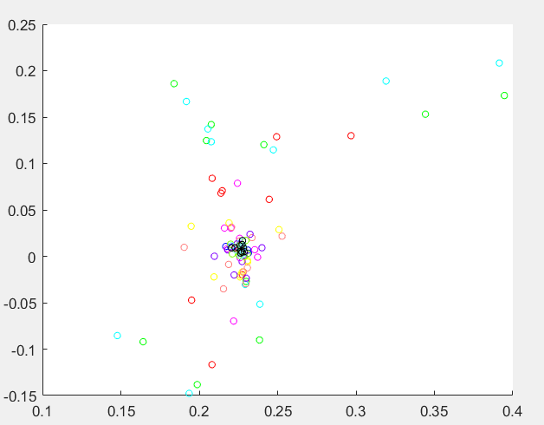
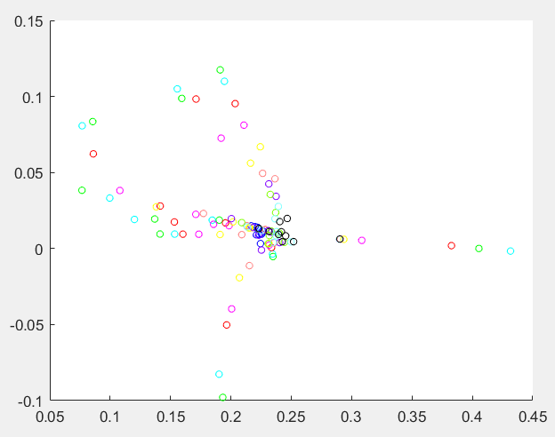
PSO….
OBJECTIVE
FUNCTION
T * Norm Square
Hyperparameters
{w = 0.2, c1 = 0.3, c2 = 0.15}
Hyperparameters
{w = 0.4, c1 = 0.6, c2 = 0.3}
Metrics = ∑ Errors
COSTS
1.0e+08
1.0e+07

Slide 25
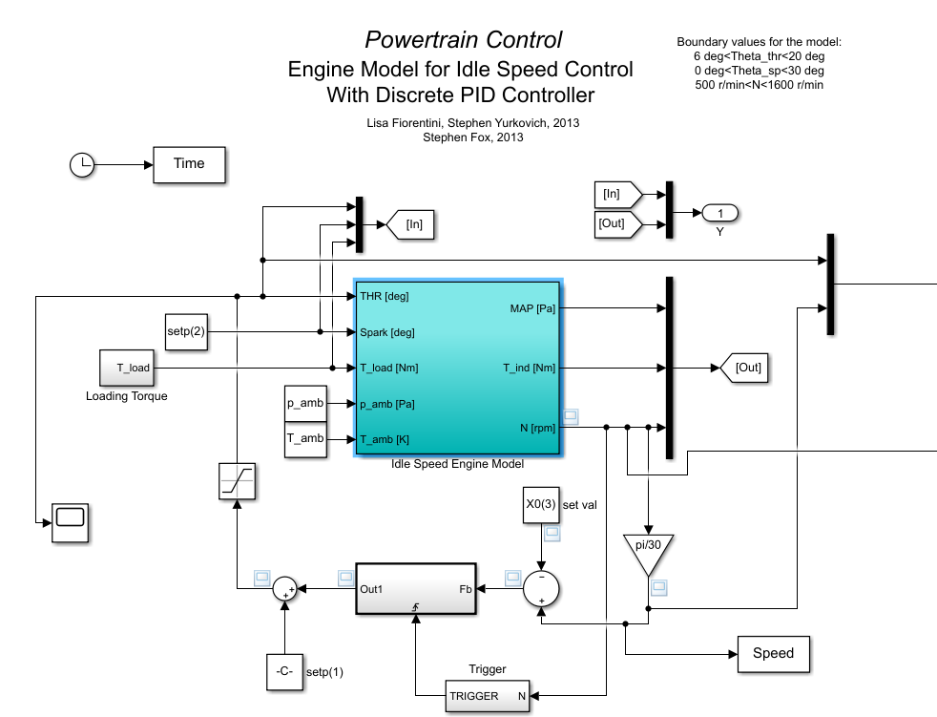
FUTURE SCOPE
There is a scope of hyper-parameter (randomness, cognitive and social) tuning of Particle Swarm Optimization using another non-linear optimization algorithms
Identify which objective function to apply based on use cases
Settling Time should also be taken into consideration for model performance evaluation
PID Gain Optimization for IC Engine

