Slide 2
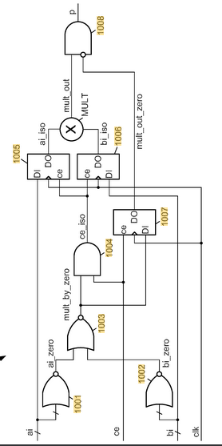
Zero-Skipping Through Operand Isolation
Patent Reference: US20200150924A1 (Samsung Electronics-2019)
Title: Signed multiplication using unsigned multiplier with dynamic fine-grained operand isolation
Proposed Technique & Key Benefits
When either operand is zero, the operand registers hold their previous values, keeping inputs stable and eliminating switching power.
Key Architectural Highlights:
• Input Stabilization: Freezes operand registers 1005 and 1006 during zero-operand states.
• Switching Reduction: Prevents unnecessary dynamic switching inside the internal multiplier array.
• Stale Output Isolation: Output AND gate 1008 suppresses invalid stale calculation results.

Slide 3

Proposed Adaptation: Zero-Skipping in Our Systolic PE
Architecture Summary: Fine-grained zero detection dynamically bypasses multiplier dynamic switching and blocks accumulator updates when either input operand evaluates to zero, maximizing energy efficiency per MAC operation.
Proposed PE Dataflow Architecture
Control Equations & Logic Rules
Input Register A
Input Register B
1. Zero Detection Logic:
Azero = (Aeff == 0)
Bzero = (Beff == 0)
Zero Detector A
Zero Detector B
2. Multiplier Skip Condition:
skip_mult = A_zero | B_zero
skip_mult = Azero | Bzero
Operand Isolation
A_mult = 0 | B_mult = 0
When skip_mult = 1, force both local multiplier inputs to zero. This keeps their values constant, eliminating dynamic switching power inside the multiplier array.
MULTIPLIER
3. Accumulator Update Gating Control:
Product = 0
acc_update = mac_valid & !skip_mult
Skip Accumulator Update

