Slide 1
Real-world Examples
Netflix: Recommends movies and TV shows based on user preferences.
Amazon: Suggests products according to purchase and browsing history.
Google Maps: Provides the fastest route using real-time traffic data.
Banks: Detect fraudulent transactions using data analysis.
Hospitals: Predict diseases and assist doctors in diagnosis.

Slide 2
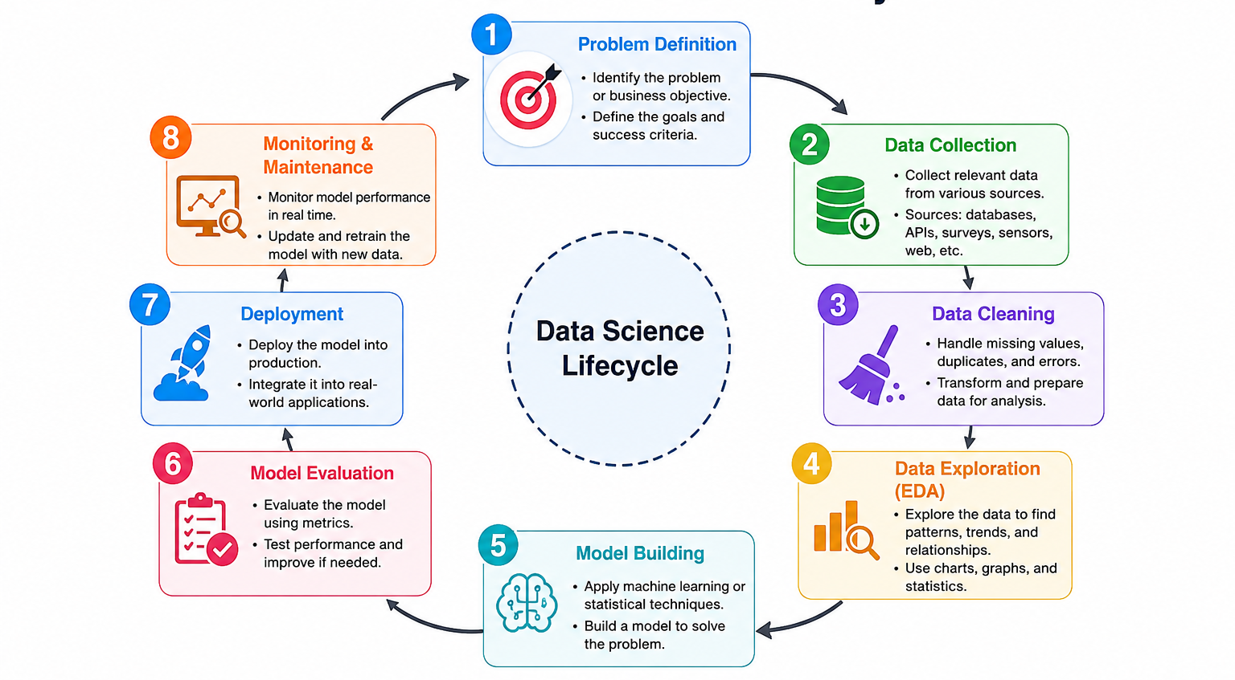
Overview of the Data Science Lifecycle

Slide 3
Types of Data
1. Structured Data
  Structured data is organized in rows and columns and is easy to store and analyze using databases.
Examples:
  Student records
  Employee database
  Bank transactions
  Excel spreadsheets
Characteristics:
  Fixed format
  Easy to search and analyze
  Stored in relational databases (SQL)

