Slide 1




Lifting CDCL
to Template-based Abstract Domains
for Program Verification
Rajdeep Mukherjee Peter Schrammel
Daniel Kroening Tom Melham Leopold Haller
October 2017
ATVA Conference, Pune

Slide 2





Lifting CDCL
to Template-based Abstract Domains
for Program Verification
Daniel Kroening
Tom Melham
Rajdeep Mukherjee
Peter Schrammel
Leopold Haller

Slide 3
Model Checking vs Static Analysis
Model Checking using
SAT Solvers
Static Analysis using
Abstract Interpretation
Both operate over non-distributive Abstract Domain
a
b
a
b
⊔
c
c
c
Non-distributive Abstract Domain
3

Slide 4
Problem Statement
Question:
Can we combine efficiency of abstract domains used in static analysis
and precise partitioning strategies of SAT Solvers to reason about programs?
Idea:
Partition the program traces using SAT architecture
so that we can prove correctness for each partition.
Solution:
To be efficient, we want partitions that are just precise enough.
Benefit:
No need for specialized domains like trace partitioning.
Decisions and learning perform automatic partitioning.
4

Slide 5
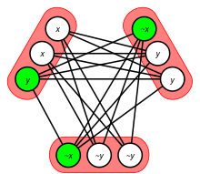
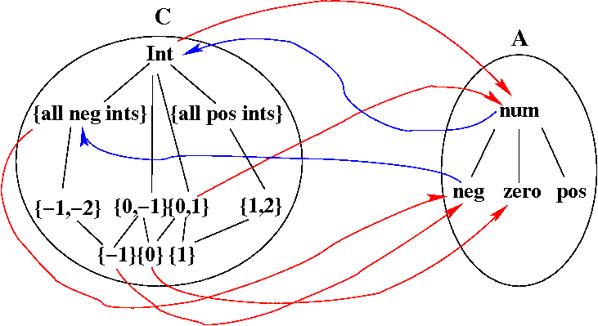
SAT Solvers are Static Analyzers
(Haller et al SAS‘12, POPL’13, POPL’14)
Shows an Abstract Interpretation perspective of CDCL-based SAT solvers
Perceived in two ways
SAT Community
Abstract Interpretation
Community
How to make Abstract Interpretation more precise?
Wrap them in the SAT architecture!
How to make SAT solvers more efficient?
Choose a domain that’s better suited to your problem than the Boolean domain!
Our goal: Lift CDCL to program traces and relational domains
5

Slide 6
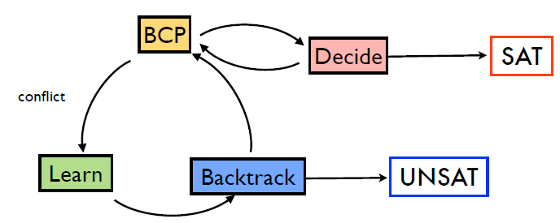
Conflict Driven Clause Learning
deduce
make assumptions
unsafe
restore consistent
state
safe
refine formula
Partial assignments are main data structure in SAT solvers,
Partial function: (Var -> B), where B is a Boolean Domain
Unit Rule: If all literals but one in a clause are FALSE in a partial assignment, that
literal must be TRUE.
BCP (boolean constraint propagation): repeatedly apply Unit Rule
6

Slide 7
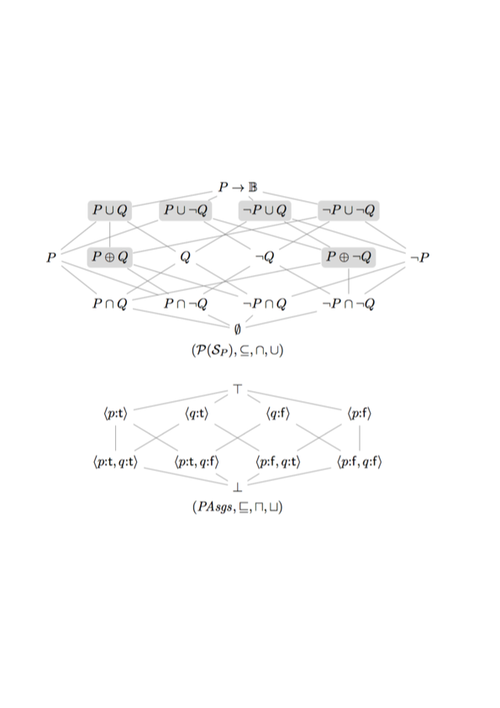
Abstract Domain of Partial Assignments
P: Set of Assignments where p is TRUE
Q: Set of Assignments where q is TRUE
Concrete Domain
over {p,q}
Abstract Domain
7

Slide 8
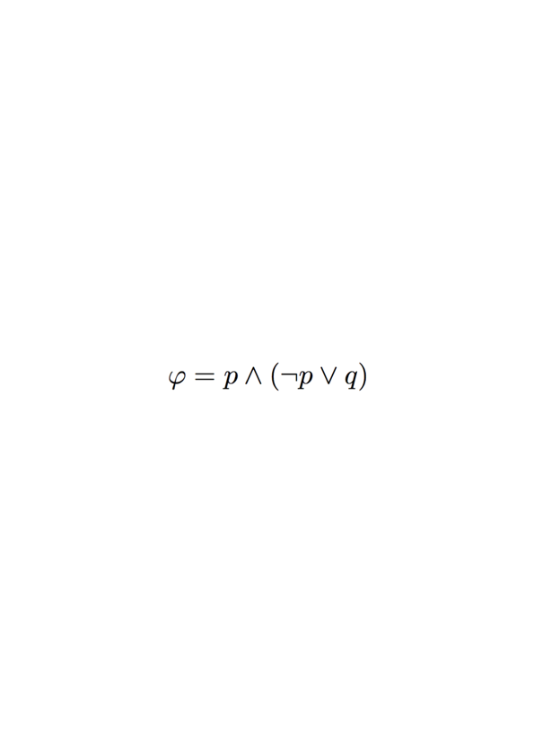
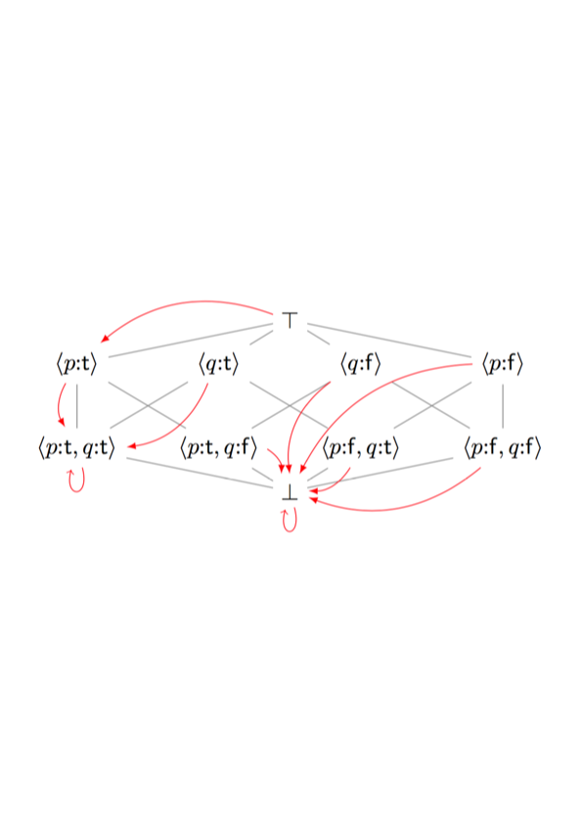
BCP is GFP Computation
Lattice of Partial Assignments over {p,q}
(arrows in red denote result of application of unit rule)
8

Slide 9
Learning
Partial assignment (A) is conflicting
A
A
CONFLICT
CONFLICT
M
M
Requires precise complementation to drive search away from conflicting region.
9

Slide 10
Learning
Partial assignment (A) is conflicting
A
A
CONFLICT
CONFLICT
M
M
Requires precise complementation to drive search away from conflicting region.
x – y ≤ 2
Decomposition into
meet irreducibles
x – y ≥ 3
9

Slide 11
DPLL Architecture and its Derivatives
CDCL Architecture
Learned Clause
Model
Search
Conflict
Analysis
> Interplay between Model Theoretic and
Proof theoretic Search Procedure
Conflict
DPLL(T) Architecture
Propositional CDCL
> CDCL solver enumerate the assignment of the
Boolean abstraction of the formula.
> The candidate Boolean assignment is then
either confirmed or refuted by a theory solver.
Theory
Solver
Model
Search
Conflict
Analysis
Natural Domain SMT
Over time, theory solvers have become
more and more closely integrated
into the CDCL process.
CDCL-like algorithm for SMT solving
in which the search takes place
over the natural domain of the variables.
Learned Theory
Lemmas
Theory
Model
Search
Theory
Conflict
Analysis
Conflict
10

Slide 12
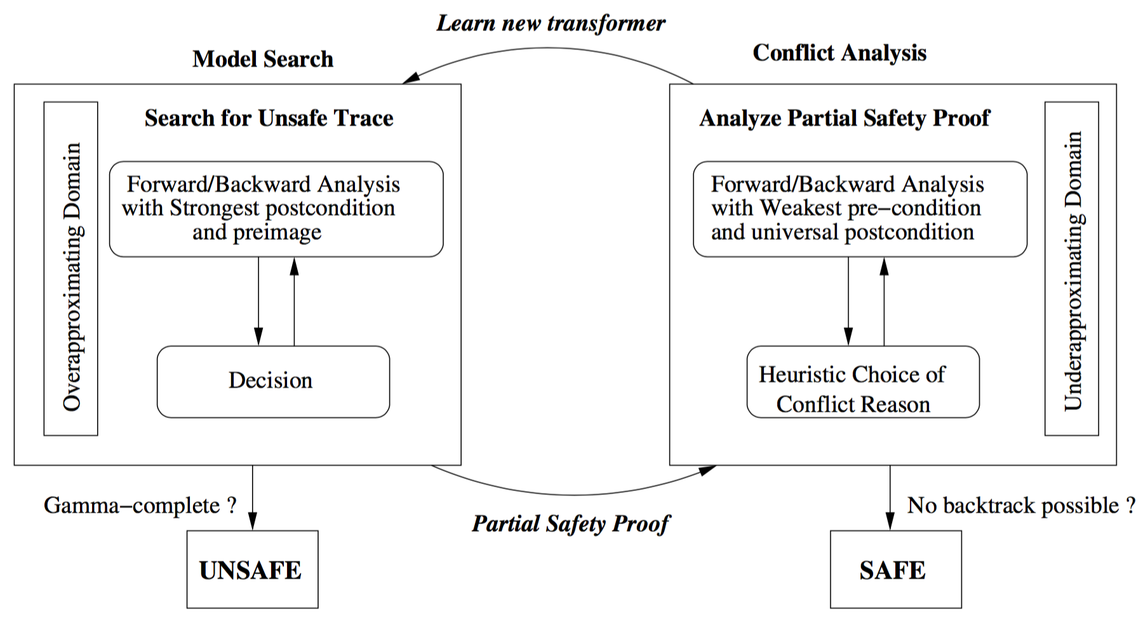
Abstract Conflict Driven Learning for Programs
ACDLP is a CDCL solver over bounded program traces.
11

Slide 13
Model Search and Conflict Analysis with Abstract Domains
Coarse over-approximation of set of models
┬
•
gfp
M
┴
12

Slide 14
Model Search and Conflict Analysis with Abstract Domains
Iteratively refine the abstraction
Deduction
┬
gfp
•
M
┴
12

Slide 15
Model Search and Conflict Analysis with Abstract Domains
Deduction
┬
Cannot refine
further,
make decision
•
M
┴
12

Slide 16
Model Search and Conflict Analysis with Abstract Domains
Iteratively refine the abstraction
Deduction
┬
Decision
Deduction
•
M
┴
12

Slide 17
Model Search and Conflict Analysis with Abstract Domains
Deduction
┬
Decision
Deduction
Conflict
M
•
┴
12

Slide 18
Model Search and Conflict Analysis with Abstract Domains
Deduction
┬
Decision
Deduction
Conflict
M
Abduction
•
•
┴
12

Slide 19
Model Search and Conflict Analysis with Abstract Domains
Deduction
┬
Decision
Deduction
Conflict
M
Abduction
Heuristic choice
•
┴
12

Slide 20
Model Search and Conflict Analysis with Abstract Domains
Deduction
┬
Decision
Deduction
Conflict
M
Abduction
Heuristic choice
•
•
Generalization
•
┴
12

Slide 21
Model Search and Conflict Analysis with Abstract Domains
Deduction
┬
Decision
Deduction
Conflict
M
Abduction
Heuristic choice
•
Generalization
Heuristic choice
┴
12

Slide 22
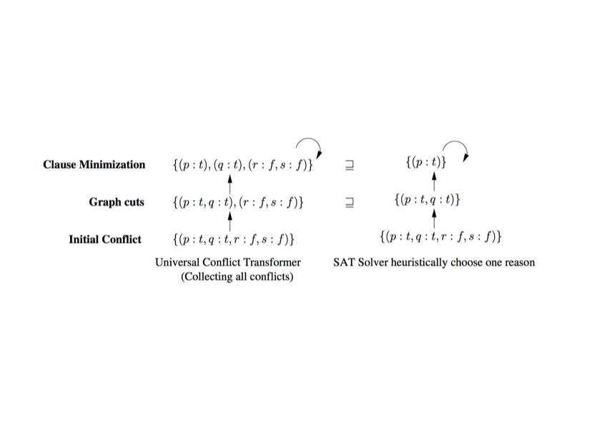
Abstract UIP Cut
CDCL Records Decisions and Deductions in an Implication Graph
cut3: <p:t>
q:t
cut2: <q:t,r:f>
cut1: <s:f>
CONFLICT
p:t
s:f
r:f
r:t
Apply First-UIP Cut Algorithm to find Conflict Reason
Heuristic Generalization
14

Slide 23
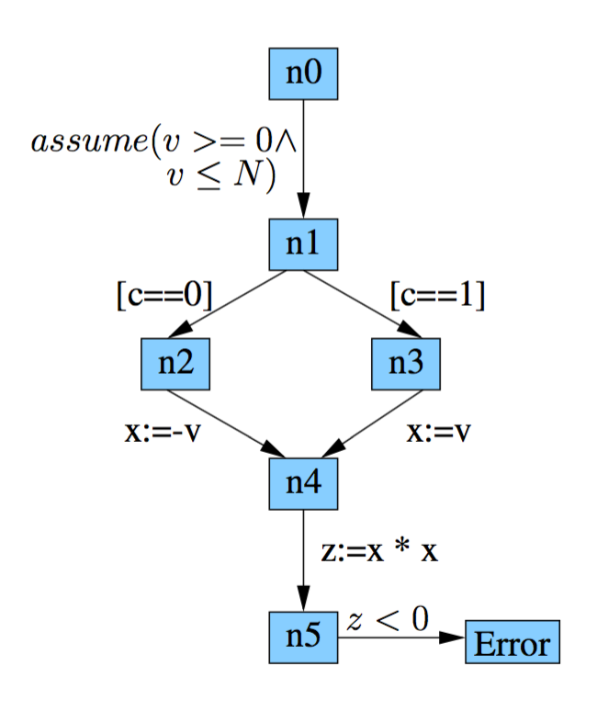
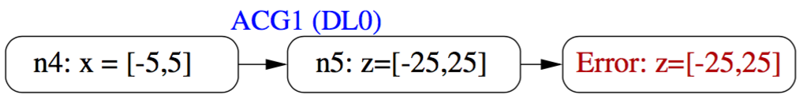
Example
Propagate
Forward/backward analysis
with intervals
Error: z=[-25,-1]
13

Slide 24
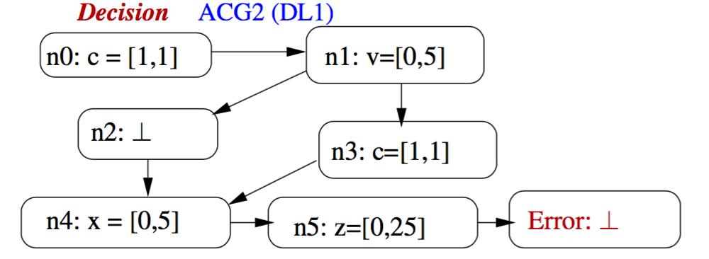
Example
Decide and propagate
Forward/backward analysis
with intervals
>> Decisions and deductions refine the abstract element
>> Deductions compute a GFP
13

Slide 25
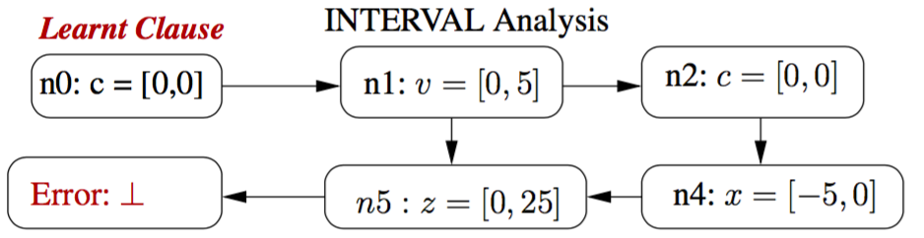
Example
Propagate with learnt clause (Last UIP)
Forward/backward analysis
with intervals
>> Learning generates constraints that preserve error reachability.
>> ACDLP adds the learnt clause to the initial set of transformers
13

Slide 26
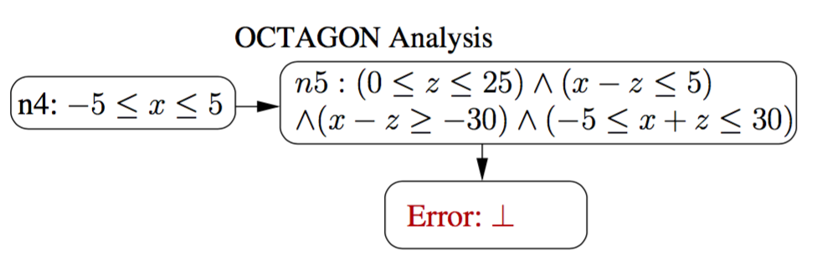
Example
Forward/backward analysis
with octagons
13
** Astree failed to verify with interval domain, require external hint to recover from imprecision

Slide 27
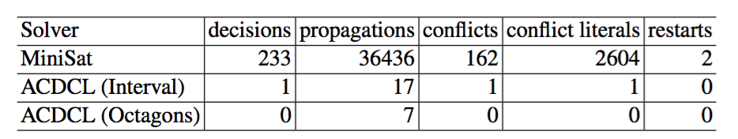
Example
Forward/backward analysis
with octagons
Comparison of ACDLP versus SAT-based BMC
13
** Astree failed to verify with interval domain, require external hint to recover from imprecision

Slide 28
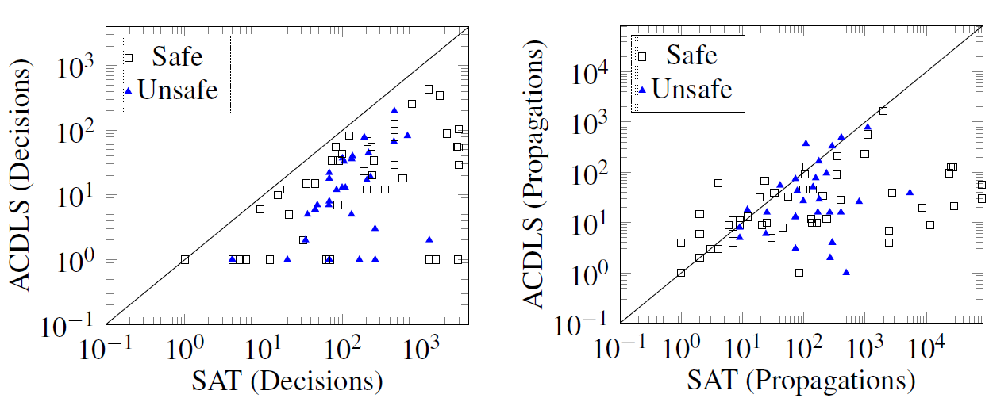
ACDLP versus CDCL
Implementation in 2LS analyzer with template polyhedra over bitvectors
Evaluation on Verilog RTL designs translated to C using v2c tool
ACDLP
ACDLP
16

Slide 29
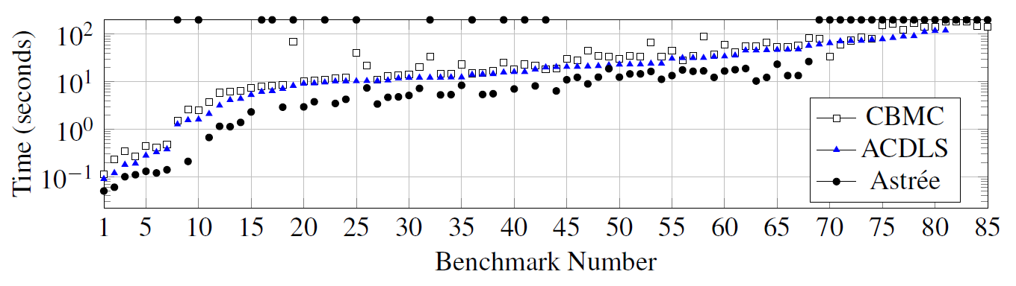
ACDLP versus CBMC and Astrée
inconclusive
ACDLP
17

Slide 30
Summary
ACDLP is a CDCL solver over bounded program traces.
Generalisation of propositional CDCL to relational domains.
Instantiation with template polyhedra over bitvectors.
18

Slide 31
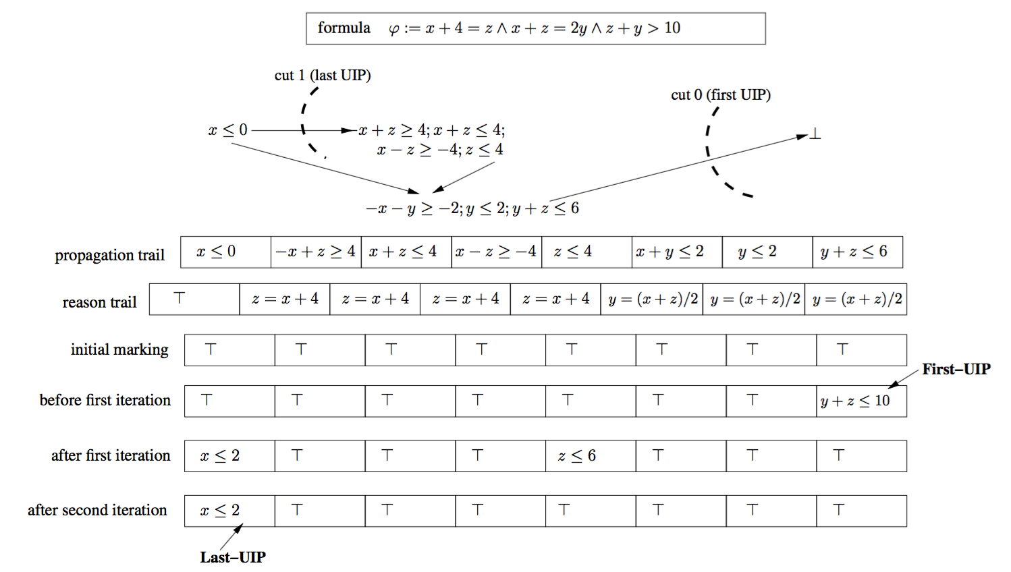
Abstract Learning in the Octagon Domain
15

Slide 32
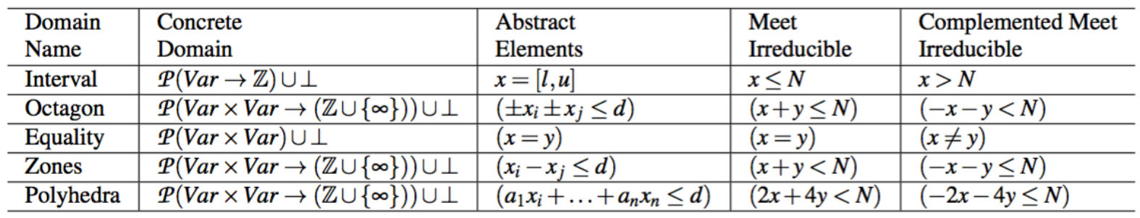
Properties of Abstract Domain Elements for Learning
Property of Numerical Abstract Domains:
Abstract domains such as Intervals and Octagons
are decomposable into half-spaces which have precise complements.
decomp(2 ≤ x ≤ 4 ∧ 3 ≤ y ≤ 5) = {x ≥ 2, x ≤ 4, y ≥ 3, y ≤ 5}

