Slide 1
Data analysis and visualization (CS306) lab

Slide 2
Lab 6
For all the experiments, you will need to submit a pdf file that should include
all plots/images/figures
the analysis as part of your answer to questions
your code/script
All plots/figures should be labeled properly (x-axis, y-axis, title etc.)
You can use Matlab/Python for programming

Slide 3
Lab 6
Objectives:
To study how t-test can be applied to compare data, and make informed decisions about the given problem

Slide 4
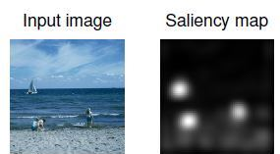
Lab 6
Visual attention mechanisms guide where a typical human being will focus his/her attention to when looking at a real world scene (or an image). In digital video processing, this is represented by a saliency map in which a higher value indicates that the corresponding region in the image attracts more attention (likewise, a smaller value in saliency map implies that the corresponding area attracts lower eye attention). An example is shown below. The ‘input image’ represents a real-world scene while the ‘Saliency map’ shows the corresponding regions of attention. Notice how human eyes tend to focus only on certain objects (eg. people, boat etc.) and ignore others (eg. sea, skyline).
in these regions, the value
in saliency maps will be
higher (closer to 1)
Image courtesy: Mathworks.com

Slide 5
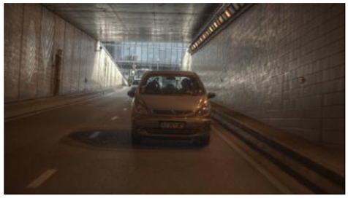


Lab 6
In this experiment, your goal is to analyze if processing of video frames affects where humans will look at.
Original frame corresponds to the real scene. The first saliency map is obtained when the original frame processed by algorithm 1 is viewed by observers. Similarly, the second saliency map is obtained when the original frame processed by algorithm 2 is viewed by the same set of observers.
Original frame (Tunnel)
saliency_map_Tunnel_processing1
saliency_map_Tunnel_processing2

Slide 6
Lab 6
Your goal is to find if the saliency map due to algorithm 1 is statistically different from that due to algorithm 2. Load data_lab6.mat. You will see the data ‘saliency_map_Tunnel_processing1’ and ‘saliency_map_Tunnel_processing2’.
Which t-test, paired or unpaired is suitable, in this case? Give reasons for your answer.
Based on your answer, perform the t-test and analyze the differences between the two saliency maps.
Does your answer in previous part agree with visual inspection of the saliency maps?
Notwithstanding your answer in part 1, suppose you are asked to perform an unpaired t-test to compare the two given saliency maps. What possible information can this provide?

Slide 7
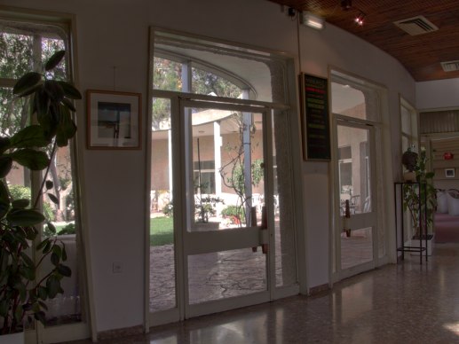


Lab 6
Repeat all 4 parts for the following data.
In this case, we have a new image which was again processed by algorithm1 and 2, and saliency maps were obtained. Load data_lab6.mat. You will see the data ‘Saliency_Map_dani_belgium_processing1’ and ‘Saliency_Map_dani_belgium_processing2’.
Original image(dani_belgium)
Saliency_Map_dani_belgium_processing1
Saliency_Map_dani_belgium_processing2

Slide 8
Lab 6: submission
Submit a single pdf file (per group) on Moodle
Deadline: 21/02/2017 (9 pm)

