Slide 1
OpenMax IL
Bellagio
清大資工 許宏榮

Slide 2
Outline
Bellagio Introduction
Bellagio IL core
Bellagio States and Command
Bellagio work flow

Slide 3
Bellagio Introduction

Slide 4
Bellagio執行環境
OpenMax IL 實作
Run on Linux (FC4)
安裝ffmpeg library
  Have to enable shared libraries (--enable-shared)
執行omxregister註冊Components
Run your application

Slide 5
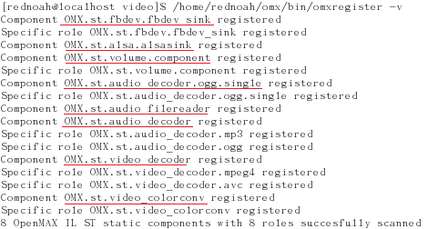

Slide 6
Bellagio 檔案結構
omxcore.c : Core functions, implements at st_static_component_loader.c.
/src/component/yourcomponents: 將自己的components實作在此 (ㄧ定要有library_entry_point.c)
omxregister.c: 註冊component
/test/ : Your application (IL Client)
/src/base
  omx_base_filter.c
  omx_base_port.c
  omx_base_component.c
  …

Slide 7
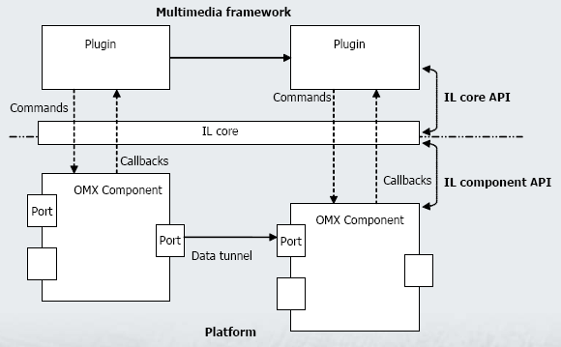
IL 架構

Slide 8
Bellagio IL core

Slide 9
Bellagio – IL Core
Provides the functions to build and destroy each component.
It gives all the information functionalities needed
  List of components
  List of capabilities (roles) where supported
It tries to set up the direct connection between two components

Slide 10
Bellagio – IL Core functions omxcore.c
OMX_Init() / OMX_DeInit()
  初始化 Core 環境
  st_static_InitComponentLoader(): Load ST_static_loader functions to ComponentLoader.
  BOSA_InitComponentLoader(loadersList[i]): Load所有的Component，依照omxregister file中所註冊的shared libraries name取出omx_component_library_Setup()執行.
  omx_component_library_Setup(): 初始化該Component的role,name等參數並把資料存進loader
  (每個componentㄧ定要自己實作此function).

Slide 11
Bellagio – IL Core functions omxcore.c
OMX_GetHandle() / OMX_FreeHandle()
  呼叫BOSA_ST_CreateComponent() scan 所有存於loader的Components，找出request的Component，執行該Component的Constructor，最後把所有資訊存入OMX_HANDLETYPE hComponent資料結構。
  omx_final_constructor()
    All about Component (eg. codec’s format, ffmpeg init, BufferMgmtcallBack).
  omx_base_port_Constructor()
    All about port
  omx_base_constructor()
    All about state change, callbacks.
    Create compMessageHandlerFunction() thread: 負責接收並處理IL Client所下的命令(Command).

Slide 12
Bellagio – IL Core functions omxcore.c
OMX_SetupTunnel()
  Establish a tunnel between two ports of two components.
  ㄧ定要在StateLoaded執行
  OMX_SetupTunnel(appPriv->videodechandle, 1, appPriv->colorconv_handle, 0);
  OMX_SetupTunnel(appPriv->colorconv_handle, 1, appPriv->fbdev_sink_handle, 0);

Slide 13
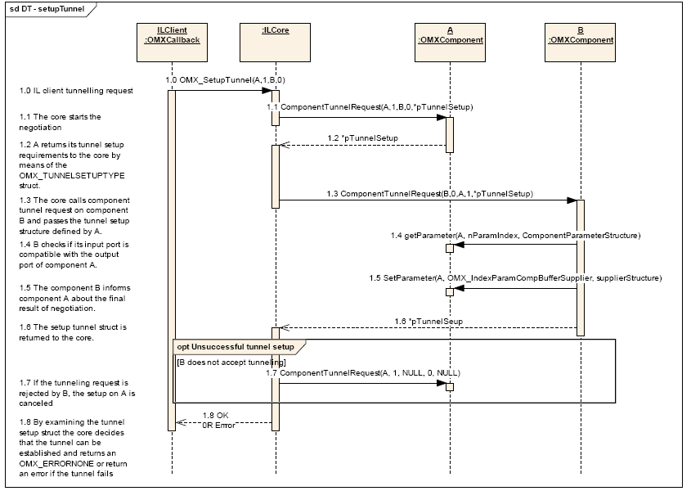
  有關Tunnel setup的detail可以見IL spec p119 – “Tunneled Initialization”

Slide 14
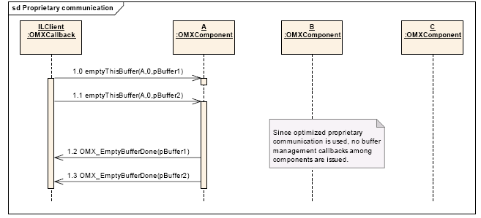
Data flow with tunneled components
只要在”A”呼叫一次OMX_EmptyThisBuffer()，Components間就會自動完成data的傳輸與同步的動作。
只會回傳”A”的callbacks。

Slide 15
Bellagio States and Command

Slide 16
Bellagio – Command type
Sendcommand(): command放入message queue等待message handler做處理.
OMX_CommandStateSet
  Change the component state.
  OMX_SendCommand(appPriv->videodechandle, OMX_CommandStateSet, OMX_StateIdle, NULL);
OMX_CommandFlush
  Flush the queue of buffer on a port of component.
OMX_CommandPortDisable
  Disable a port on a component.
  OMX_SendCommand(appPriv->fbdev_sink_handle, OMX_CommandPortDisable, 0, NULL);
OMX_CommandPortEnable
  Enable a port on a component
  OMX_SendCommand(appPriv->videodechandle, OMX_CommandPortEnable, 1, NULL);
OMX_CommandMakeBuffer
  Make a buffer

Slide 17
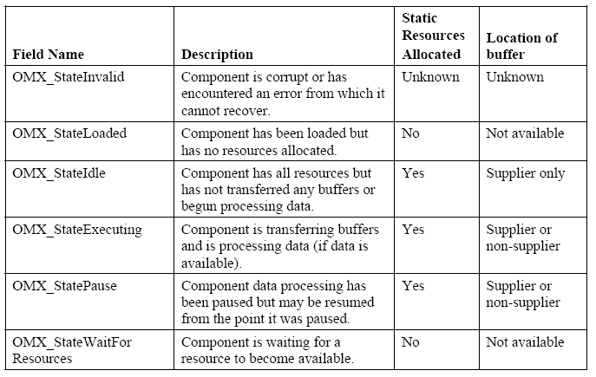
Bellagio – Component States
各state的敘述

Slide 18
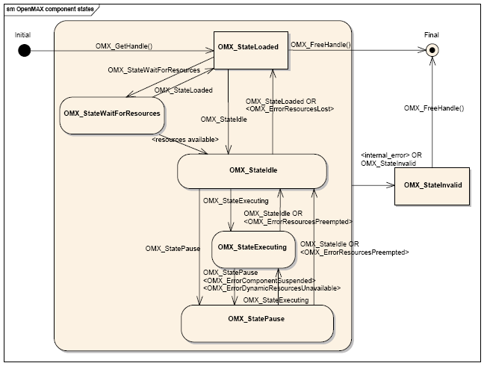
Bellagio – Component States
State flow

Slide 19
Bellagio – State change
StateLoaded → StateIdle
  Starting buffer management thread.
  Allocate here the buffers needed for the tunneling.
StateIdle → StateExecution
  Send Tunneled Buffer to the Neighboring Components.

Slide 20
Component Callbacks
Components完成任務後(eg. State change , fill buffer , empty buffer)會呼叫callback通知IL Client，目的是要達到同步(Use wait and signal)。
3 kind of callback function
  EventHandler : this function is executed by the component when a SendCommand request has been completed.
  EmptyBufferDone: when the buffer is input has been
  totally consumed.
  FillBufferDone: when a buffer in output has been totally
  filled

Slide 21
Bellagio work flow

Slide 22
Bellagio – Video application
Video decoder component
  Mpeg4 , H.264
Color convert component
  OMX_COLOR_Format24bitRGB888 (default format)
  OMX_COLOR_Format24bitBGR888
  OMX_COLOR_Format32bitBGRA8888
  OMX_COLOR_Format32bitARGB8888
  OMX_COLOR_Format16bitARGB1555
  OMX_COLOR_Format16bitRGB565
  OMX_COLOR_Format16bitBGR565
Frame buffer Sink component
  If requested, then play the video directly.
Tunnel or No-tunnel

Slide 23
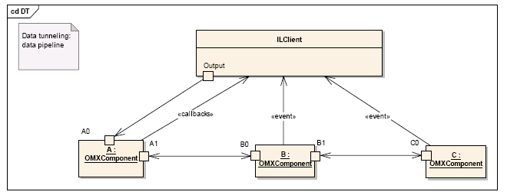
Bellagio – Video application

Slide 24
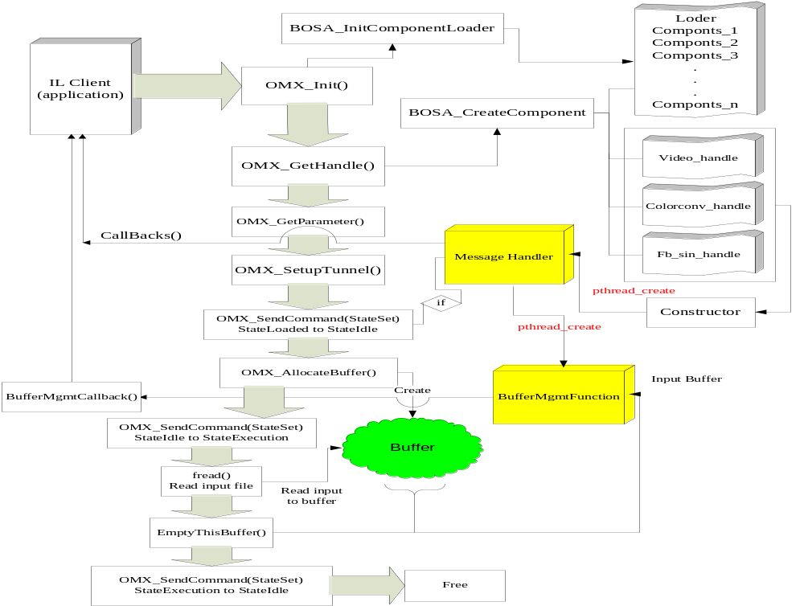

Slide 25
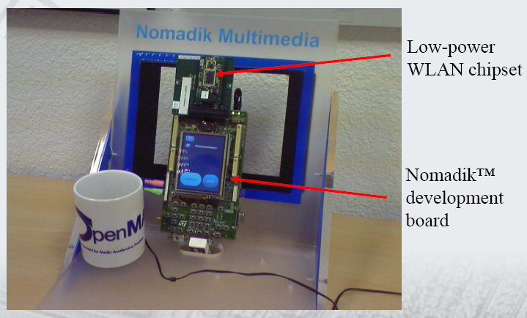

到目前為止還OK嗎？
STn8815採用多核分布式架構，並在視頻編碼效率上展現一系列突破，實現了多種創新算法，使智能手機、多功能多媒體設備及播放器、手持網絡電視、便攜導航儀和移動電視能夠播放電視廣播，拍照錄像，以及與其它系統進行實時雙向可視電話通信。
在STn8815的軟硬件平台內預裝業內主流的OS和應用框架，有助於手機制造商加快產品上市時間，降低開發移動多媒體消費產品的成本 。
STn8815包含一個ARM9核心及四個多媒體加速器，並增加了L2快取記憶體。

