Slide 1
Problem Statement:
You work for a consumer finance company that specialises in
providing various types of loans to urban customers. When the
company receives a loan application, it has to decide whether
to approve or reject it based on the applicant’s profile.
Two types of risks are associated with the bank’s decision:
• •
If the applicant is likely to repay the loan, then not approving
the loan results in a loss of business to the company.
If the applicant is not likely to repay the loan, i.e., they are
likely to default, then approving the loan may lead to financial
loss for the company.

Slide 2
OBJECTIVE OF THE CASE STUDY
• This case study aims to leverage Exploratory Data Analysis
(EDA) techniques on real-world banking data related to loan applications. By analyzing these factors,
we will develop a data-driven approach to assess an individual's creditworthiness and
predict their ability to repay a loan.
This will ultimately help financial institutions:
• Reduce Risk:
Identify potential loan defaults early on, minimizing financial losses.
• Informed Decisions:
Make data-backed decisions about loan approvals, fostering responsible lending practices.
• Improved Customer Experience:
Offer appropriate loan products to qualified applicants, ensuring financial stability for both parties.

Slide 3
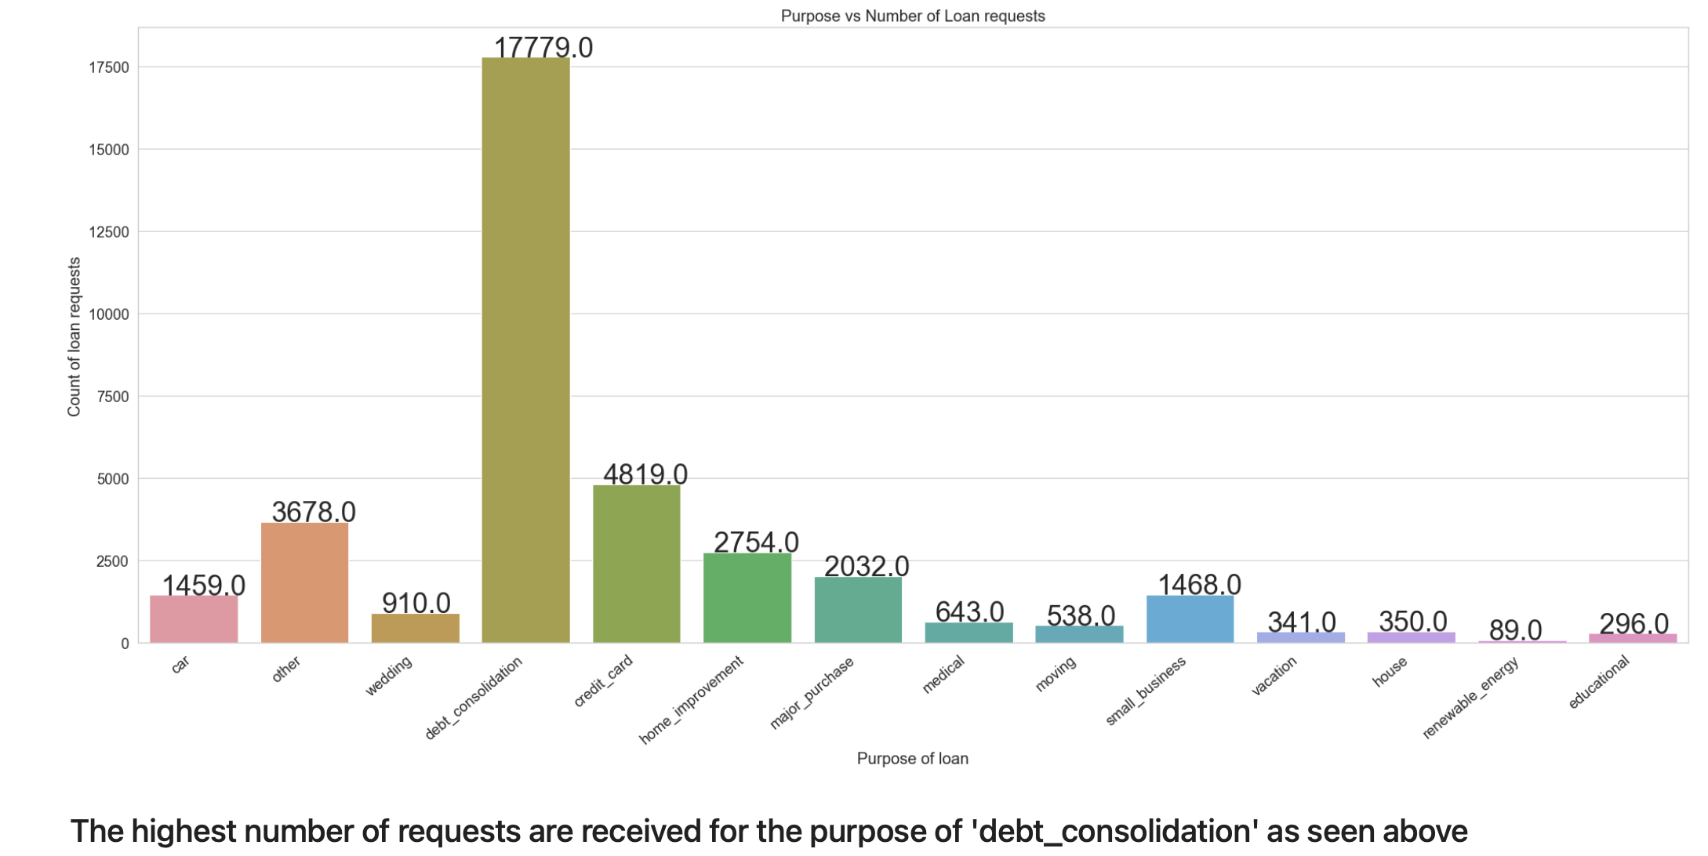
"Purpose vs Number of Loan requests".
The chart shows the number of loan requests received for various purposes.
Here are some observations you can make from the data in the chart:
Debt consolidation is the most popular purpose for loan requests, with nearly 18,000 requests.
Credit card consolidation is the second most popular purpose, with around 4,800 requests.
Home improvement loans are the third most popular, with close to 3,700 requests.
Loan requests for other purposes are much less frequent, with fewer than 1500

Slide 4
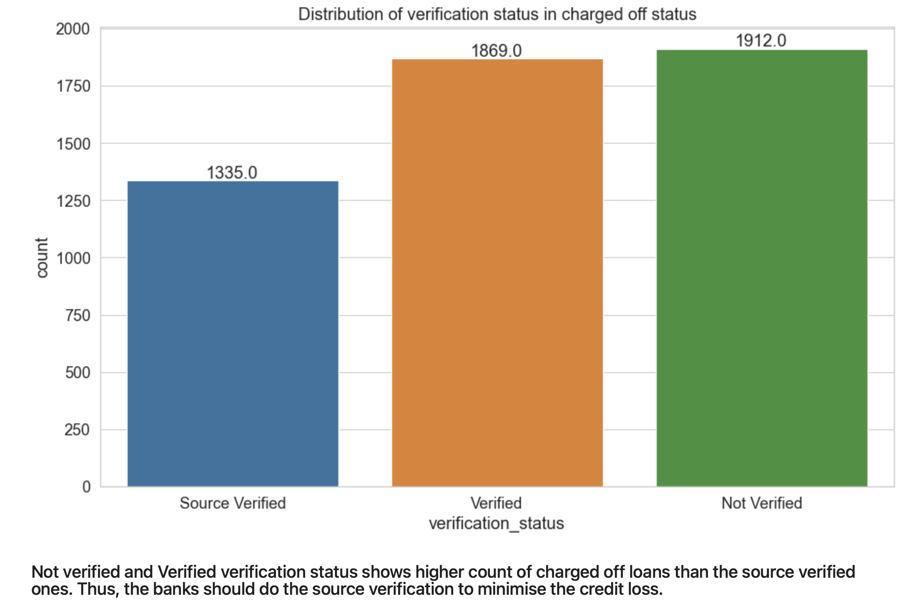
bar chart showing the distribution of verification status in charged off accounts.
The x-axis shows the verification status (Source Verified, Verified, Not Verified) and the y-axis shows the count.
Here are some observations you can make from the data in the chart:
Accounts with Not Verified and Verified verification status have a higher number of charged off loans compared to Source Verified.
There are around 1912 charged off loans with Not Verified verification and 1869 with Verified verification status.
Source Verified verification status has the least number of charged off loans, at around 1335.
The text overlaying the chart suggests that this trend might be due to source verification helping banks minimize credit loss.pen_spark

Slide 5
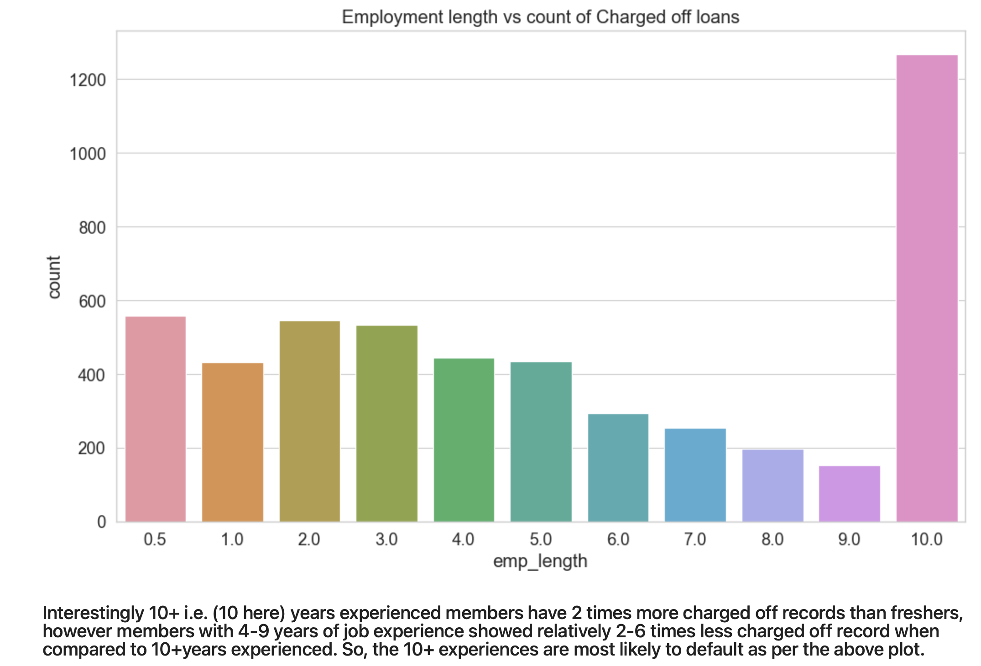

Slide 6
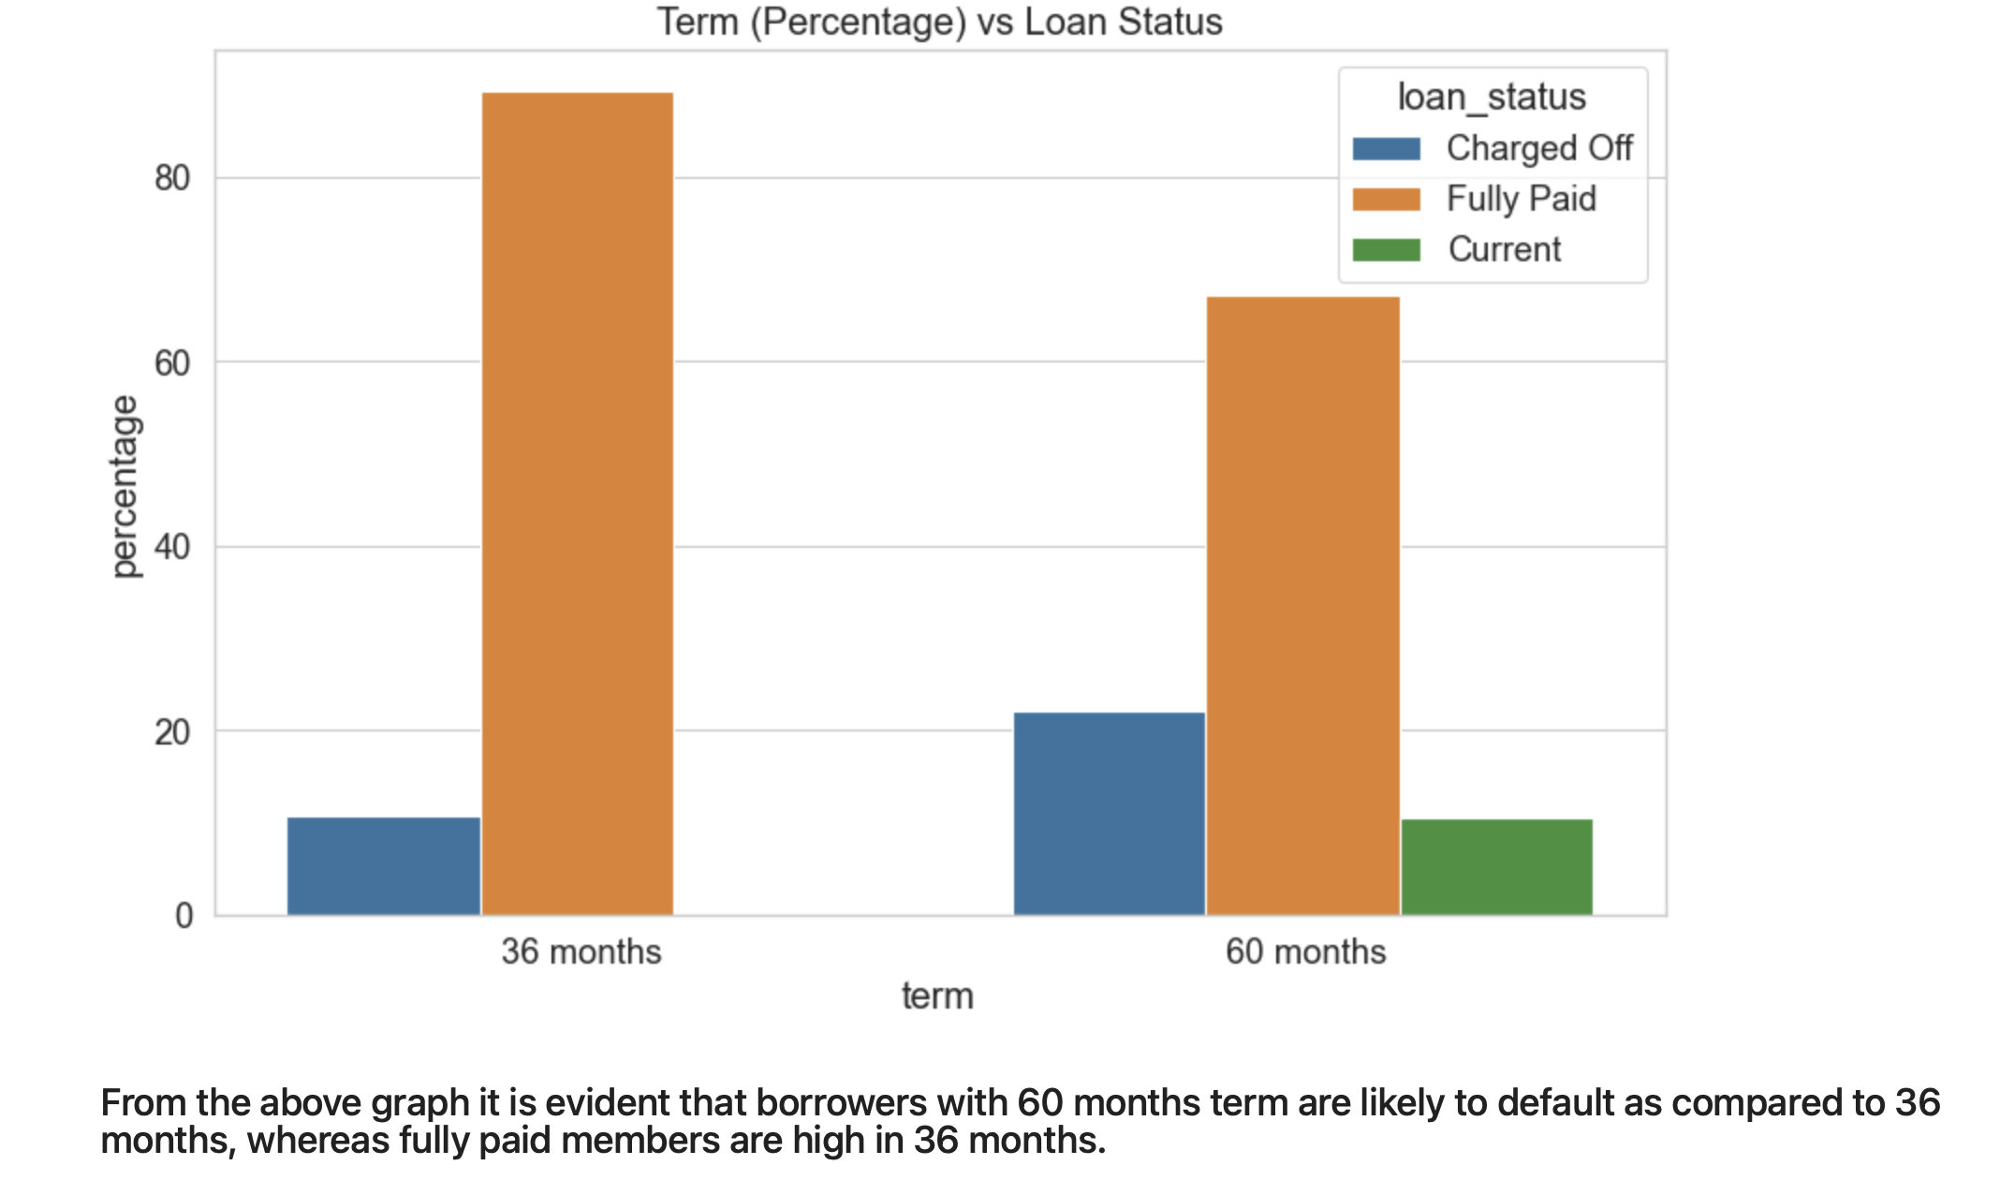

Slide 7
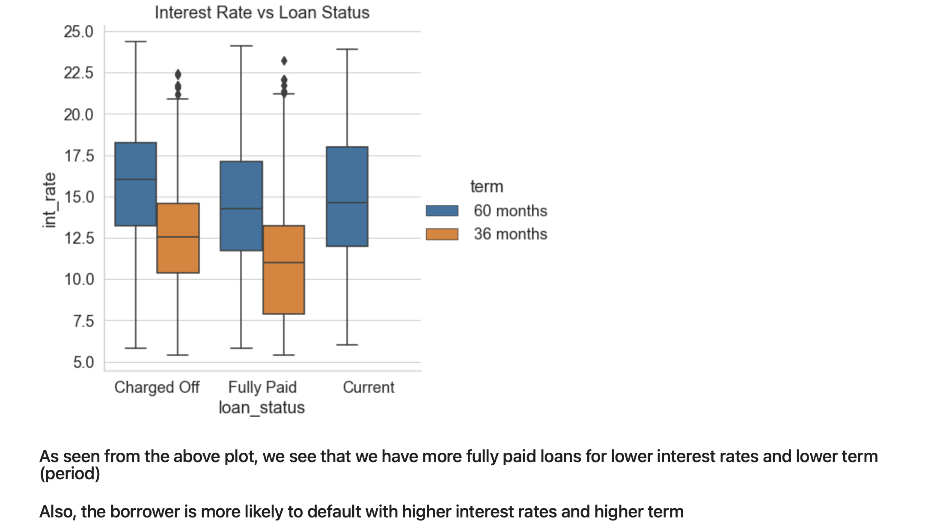

Slide 8
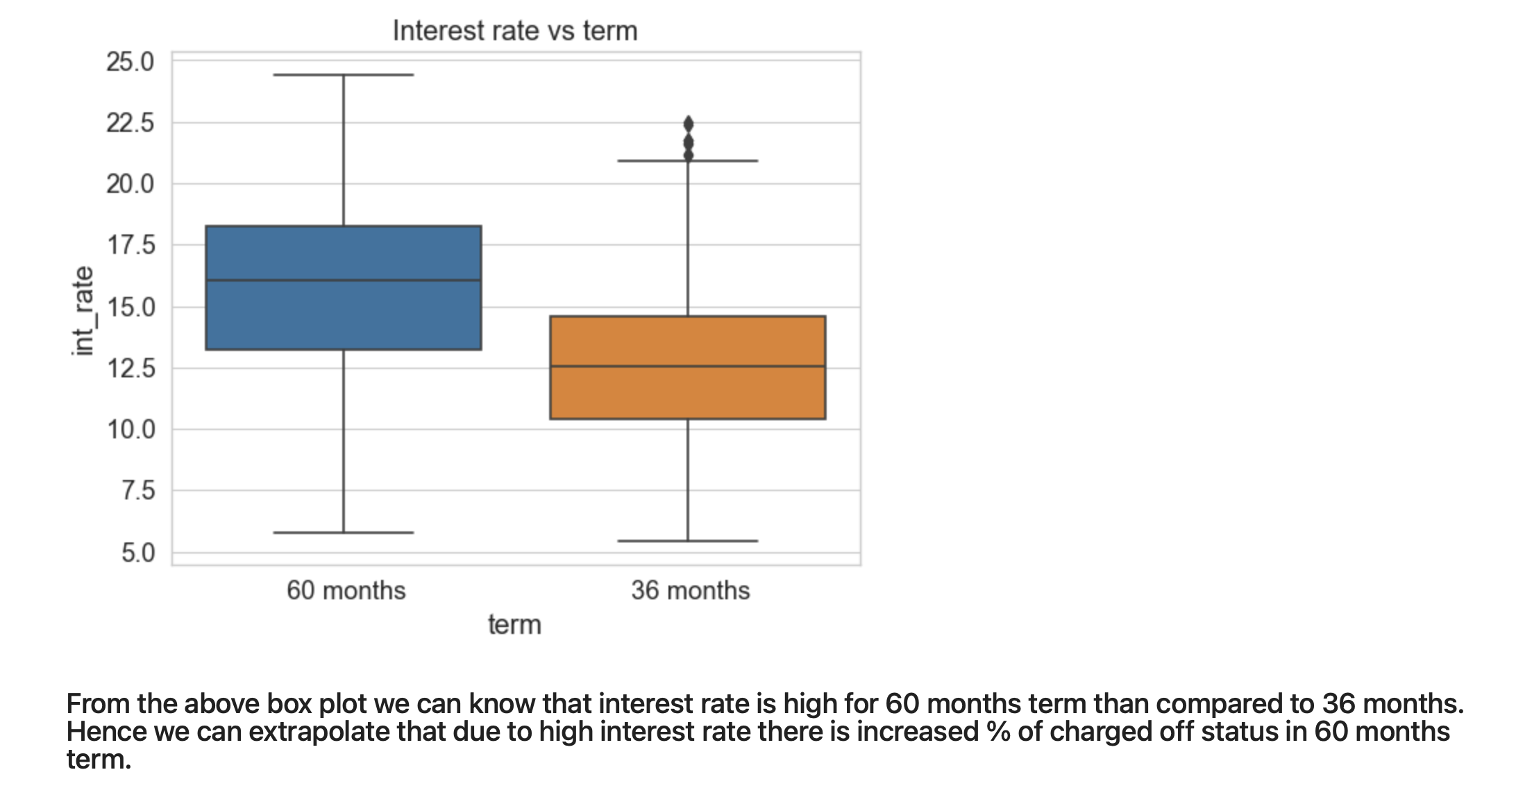

Slide 9
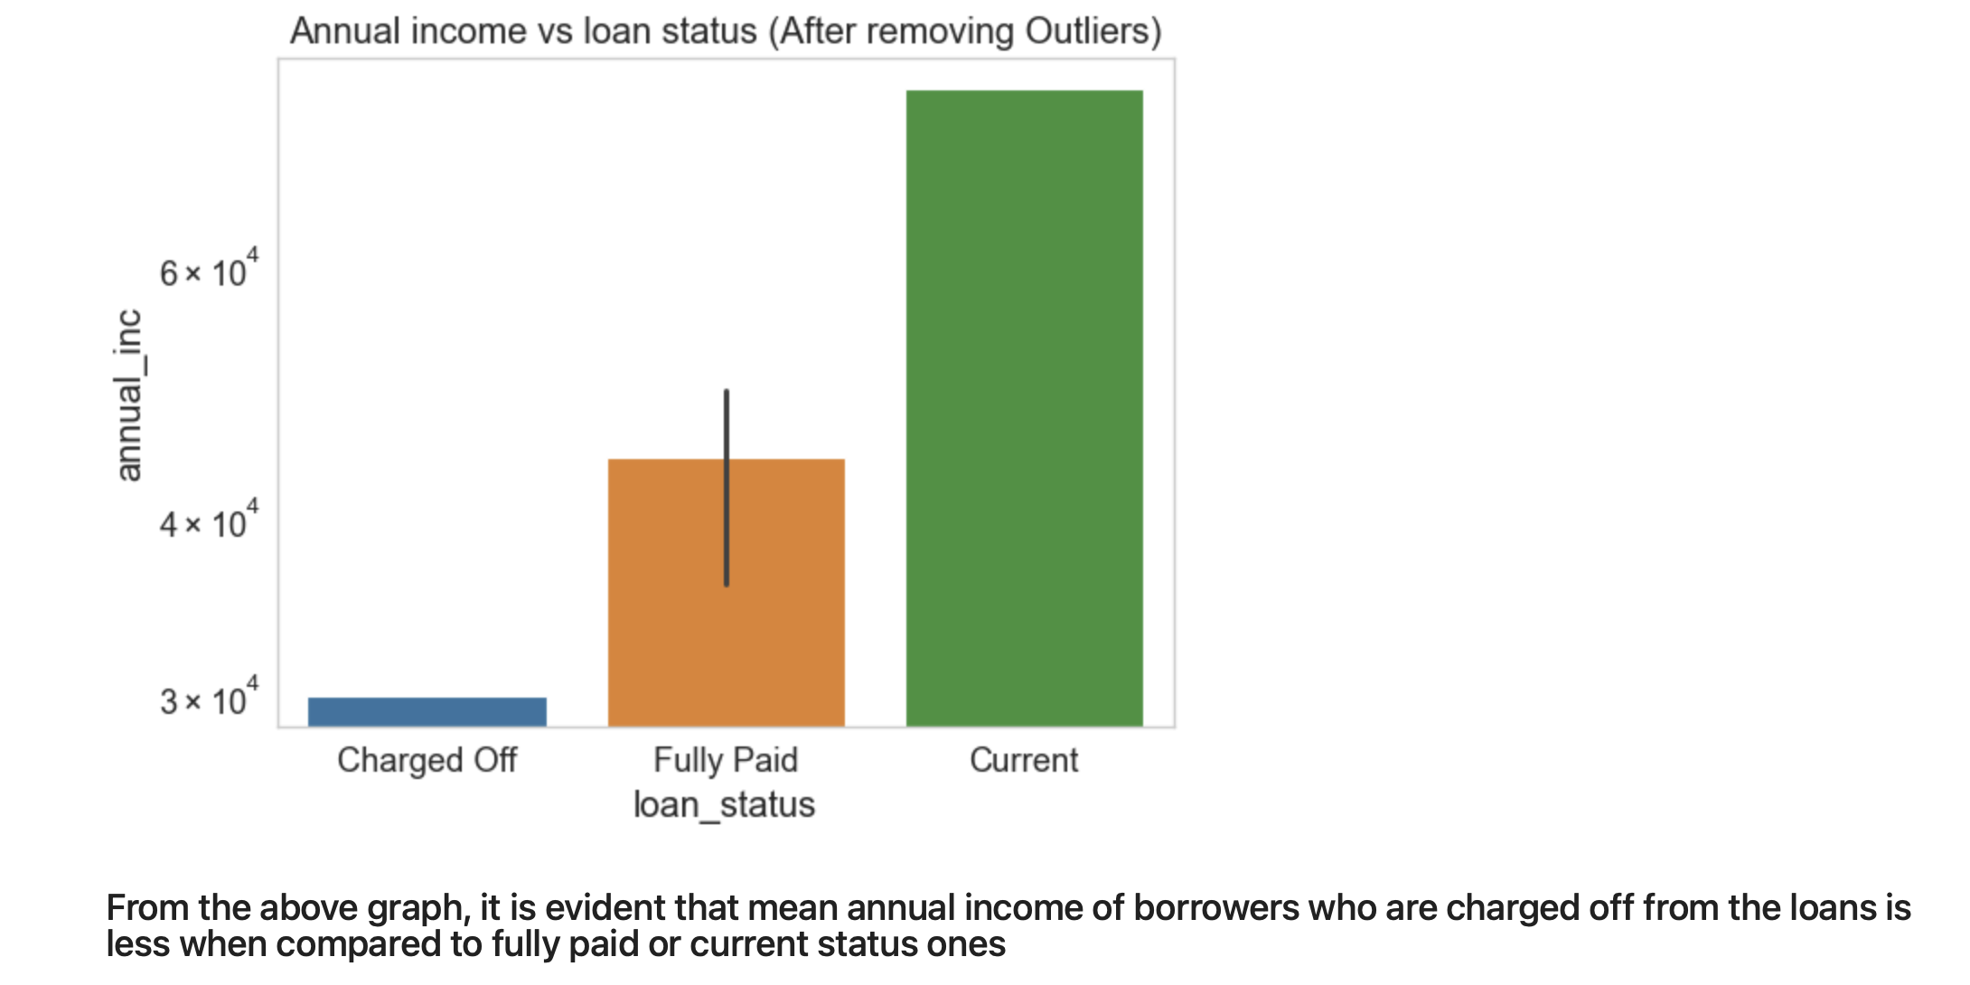

Slide 10
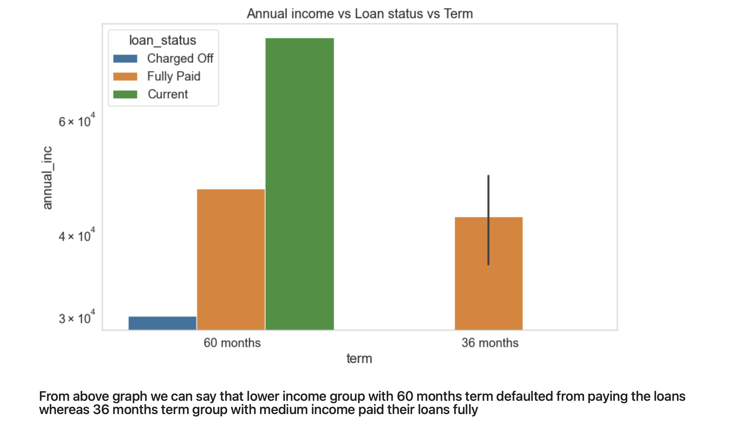

Slide 11
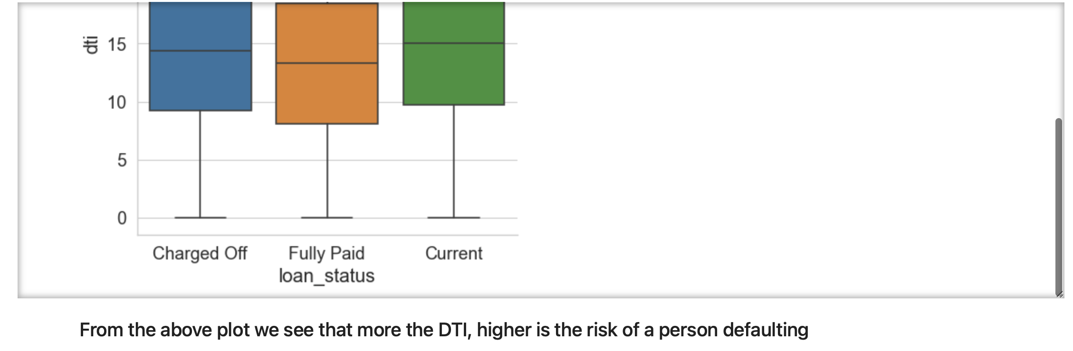

Slide 12
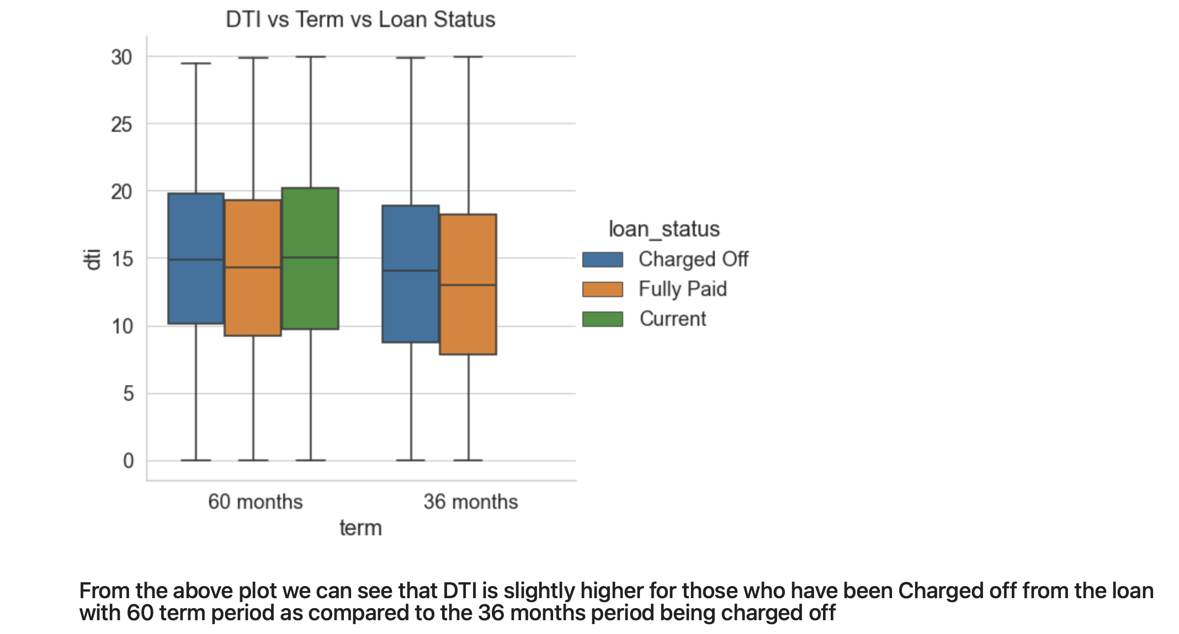

Slide 13
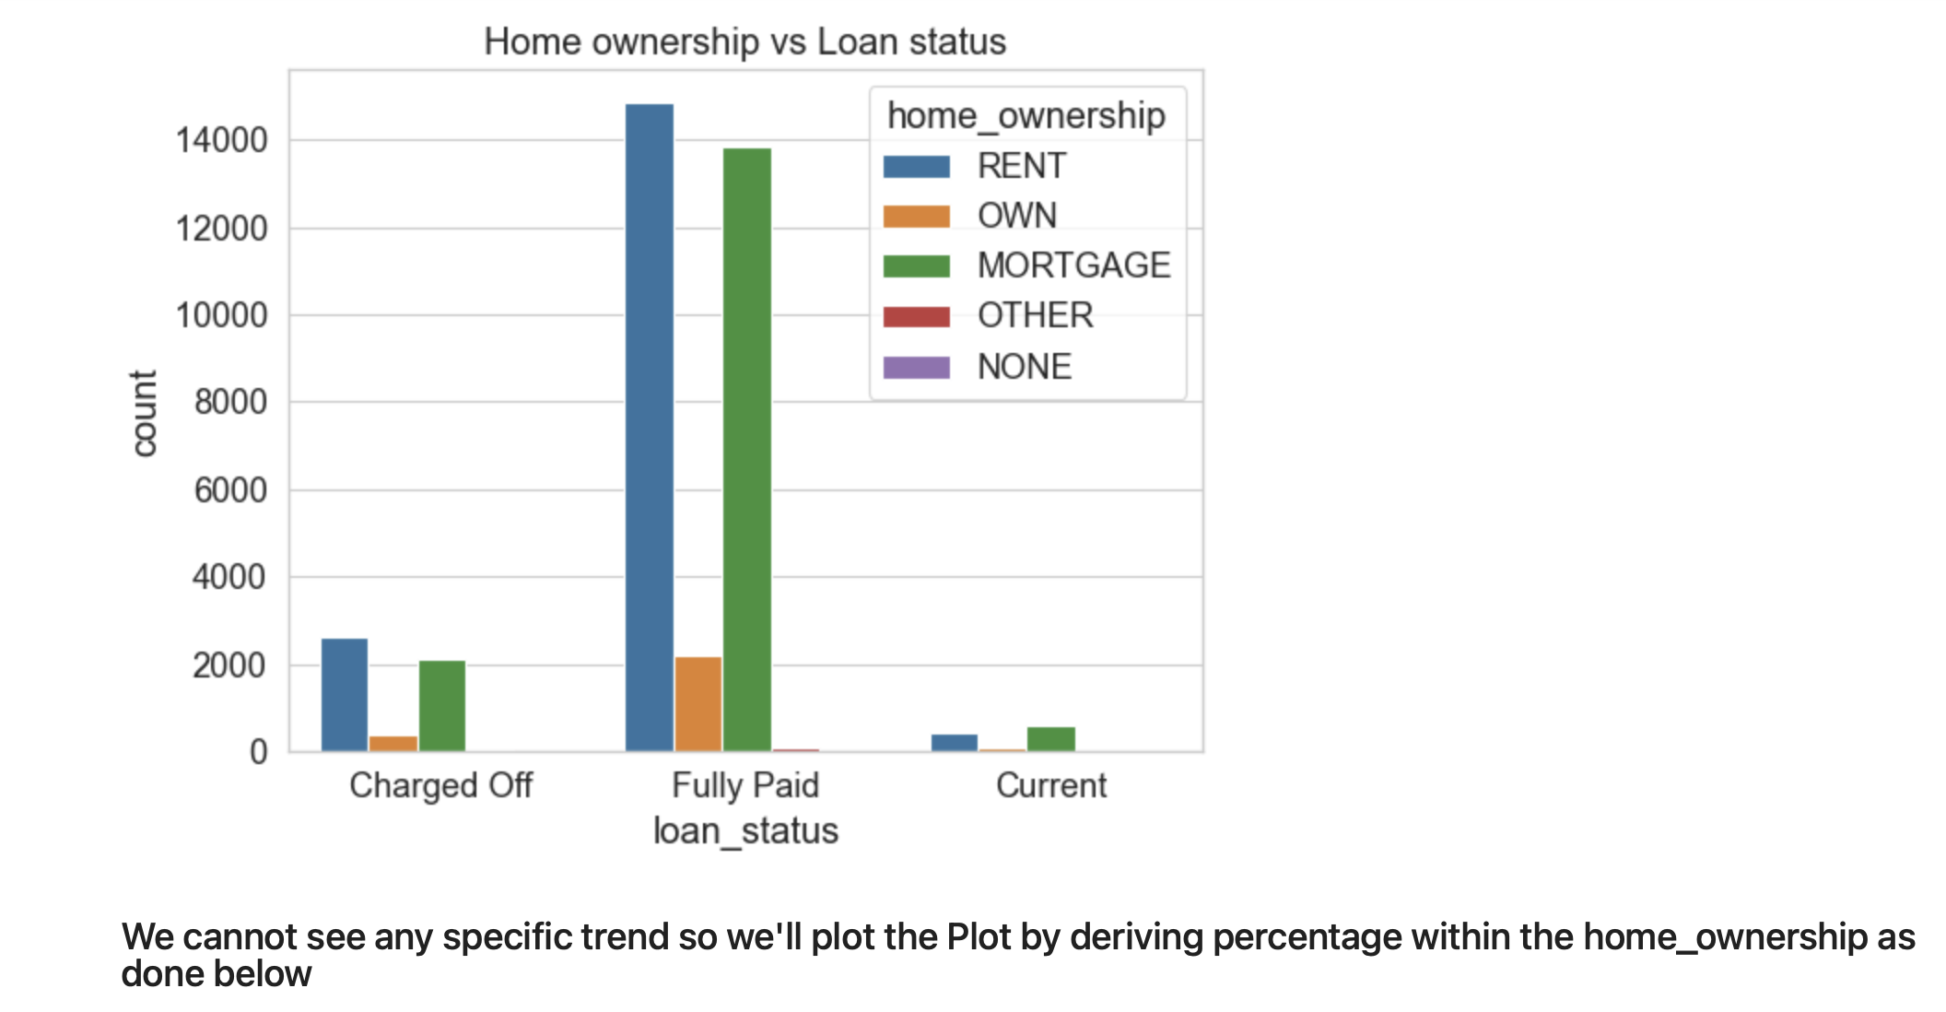

Slide 14
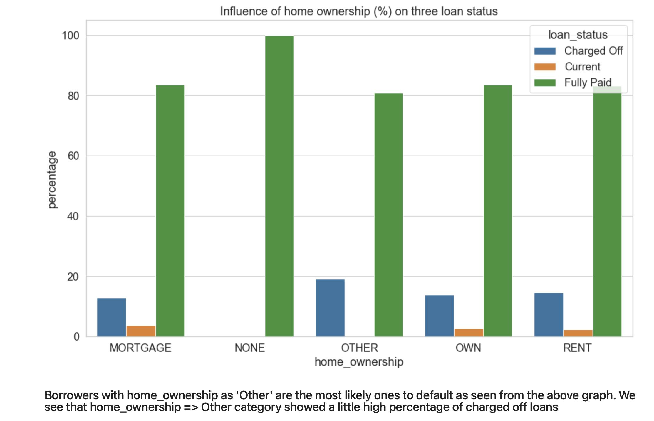

Slide 15
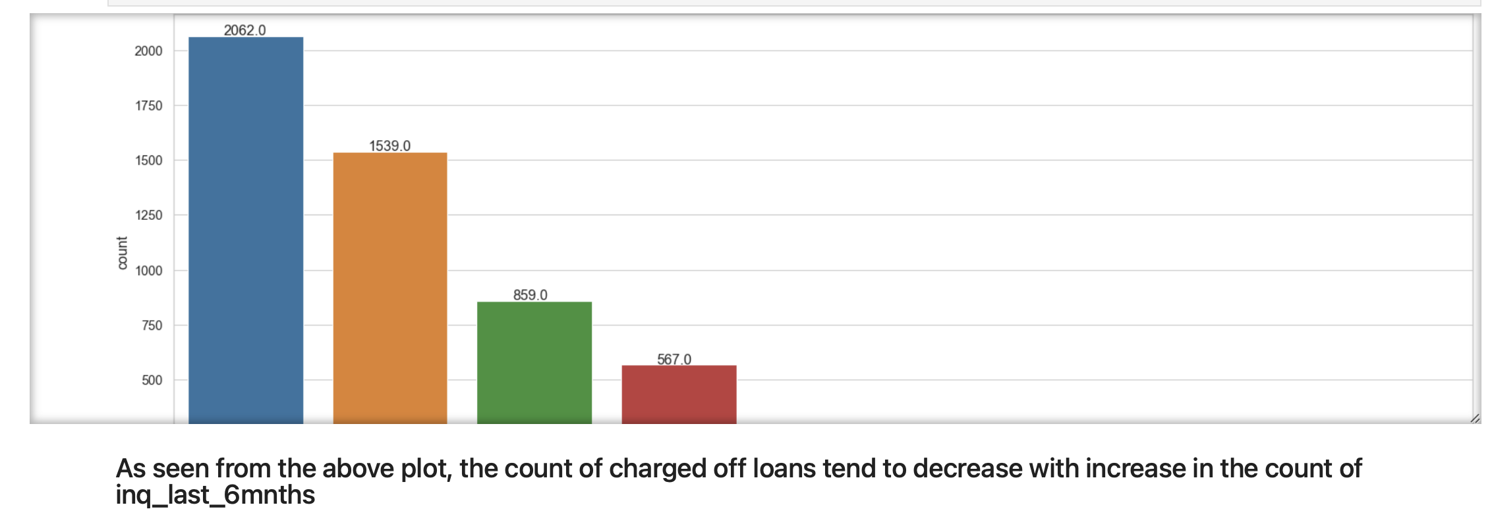

Slide 16
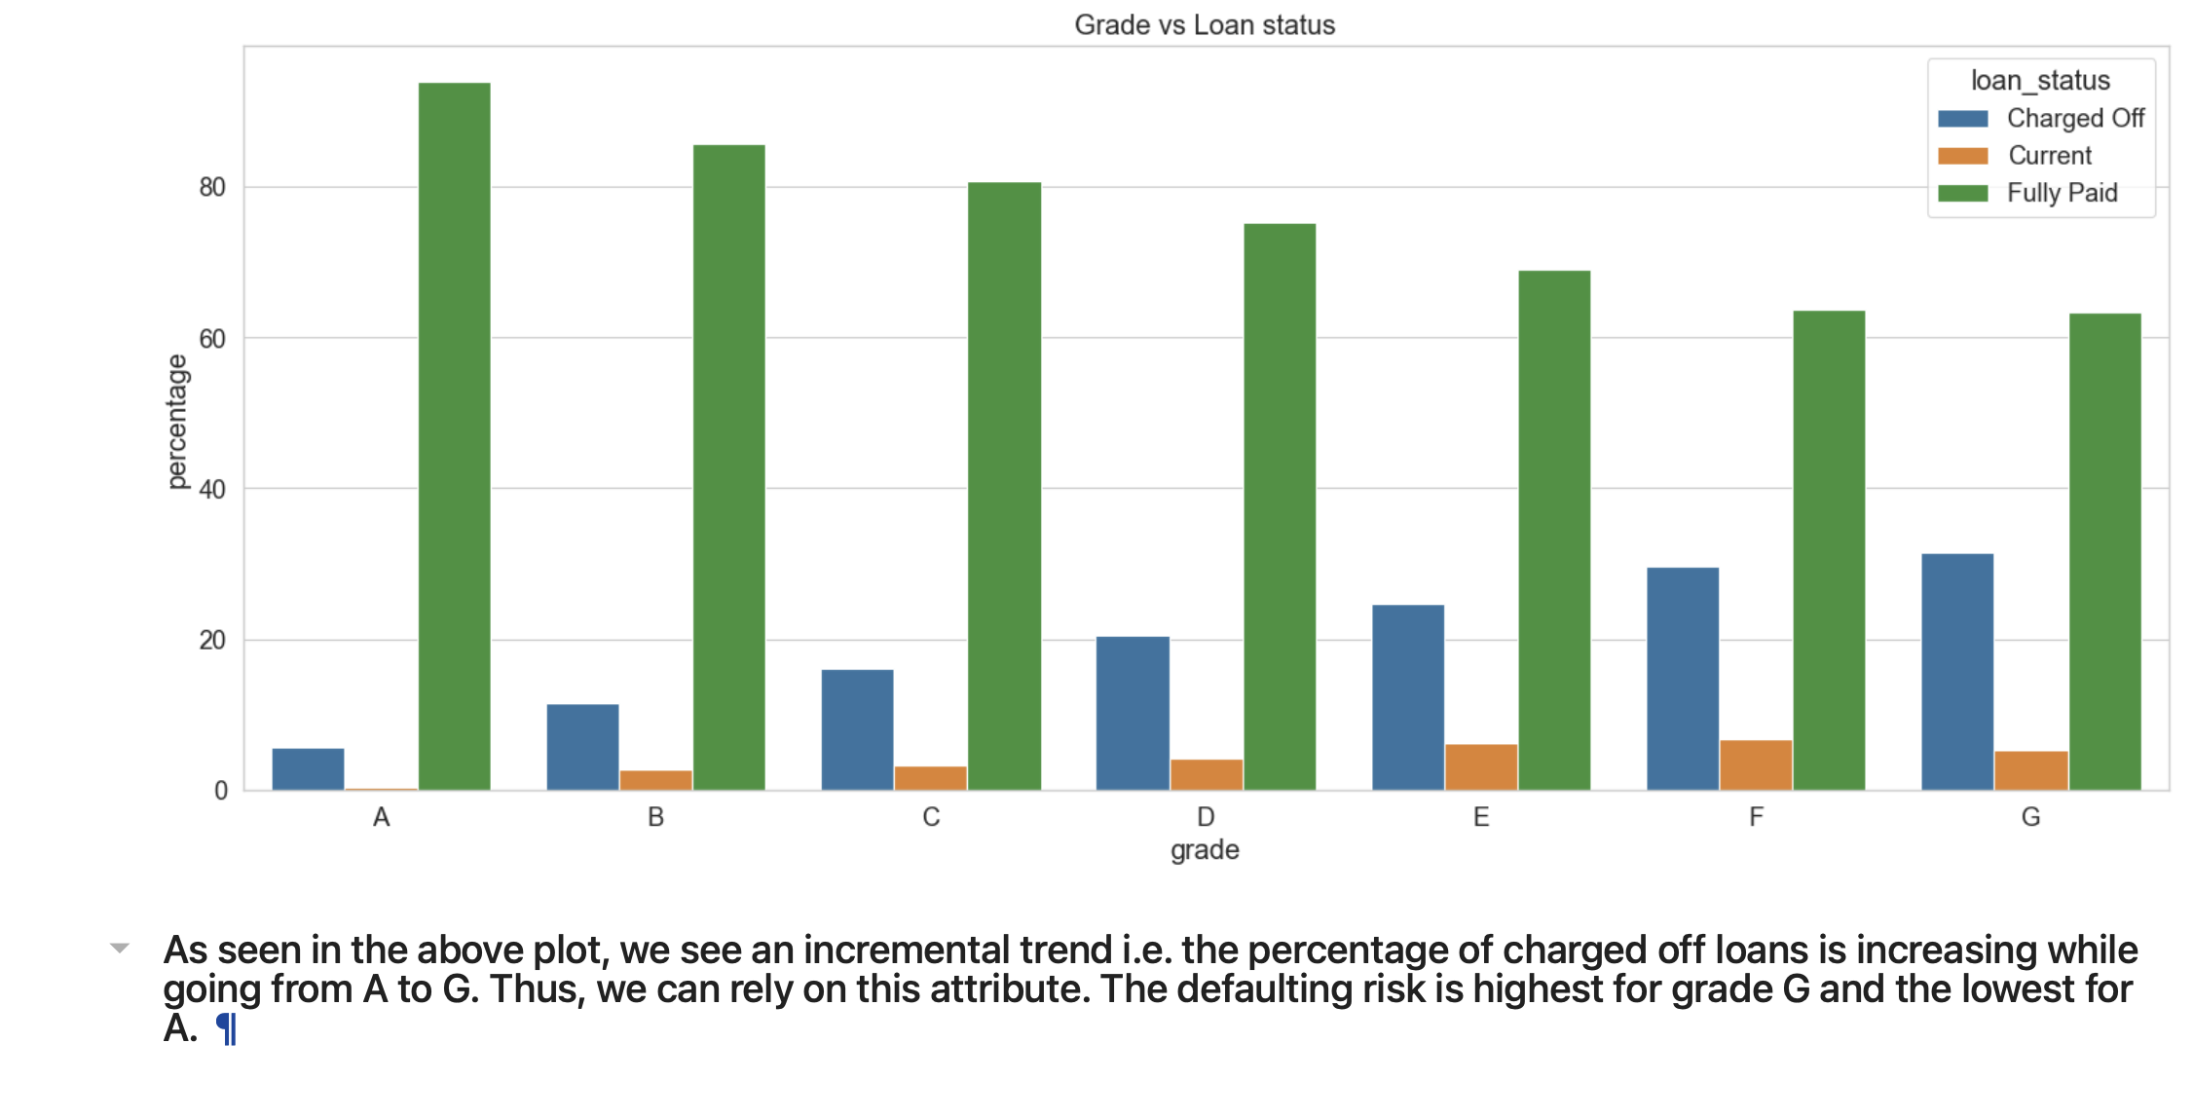
Conclusion : we see an incremental trend i.e. the percentage of charged off loans is increasing while going from A to G.
Thus, we can rely on this attribute.
The defaulting risk is highest for grade G and the lowest for A.

