Slide 1
Brazilian E-Commerce, OLIT Sales & Customer Insights Analysis
Divyam Raj

Slide 2
Business Context
Olist is one of Brazil's largest e-commerce marketplaces, connecting thousands of independent sellers with customers nationwide. As the business scales, managing performance across sales, customers, sellers, and delivery becomes increasingly critical
The client has provided us with sales data from 2016 to 2018, spanning across 9 tables providing data of 99,441 customers, 3095 sellers & 32,951 products
We are expected to provide data driven analysis of key metrics at product level, customer level, sales level, supplier level, etc.

Slide 3
Problem Statement
The client is facing problems seeing valuable insights which are hidden in the interconnected tables. They need our expertise in the following:
Understand sales performance
Improve customer satisfaction
Monitor seller performance
Reduce delivery delays
Identify profitable categories
Support data driven decisions

Slide 4
Objectives
Analyze sales, customer behavior, seller performance, and delivery operations.
Identify trends in orders, revenue, and product categories.
Evaluate customer satisfaction using reviews, delivery time, and payment methods.
Analyze regional sales performance across states and cities.
Perform data cleaning and EDA
Build interactive Power BI dashboards for business insights
Develop a predictive model to forecast customer review scores.
Provide actionable recommendations to improve business performance.

Slide 5
Tools & Technologies used
SQL Server: Data Importing, Data Audit, Data Consistency Checks & Analysis.
Python: Descriptive, Diagnostic & Predictive Analytics, Streamlit applications.
Power BI Desktop: Visualization and Interactive Dashboard Development.
Power BI Service: Publishing Dashboards for stakeholder access.
PowerPoint: Presentation of findings, insights, and recommendations.

Slide 6
Review data sources (1/3)
Table Name | Total columns | No. of rows | Granularity | Primary key | Foreign key | Details
Customer | 5 | 99,441 | Customer level data | customer id | NA | customer_id, customer_unique_id, , customer_city, customer_zip_code_prefix, customer_state Total data given for 96,096 customers.
Orders | 8 | 99,441 | Order level data | order Id | customer id | order_id, customer_id, order_status, order_purchase_timestamp, order_approved_at, order_delivered_carrier_date, order_delivered_customer_date, order_estimated_delivery_date Total orders provided for 99,441 orders
Order payments | 5 | 1,03,886 | Order level data | NA | order Id | order_id, payment_sequential, payment_type, payment_installments, payment_value Total data provided for 1,03,886 orders, with 5 payment types

Slide 7
Review data sources (2/3)
Table Name | Total columns | No. of rows | Granularity | Primary key | Foreign key | Details
Geolocation | 5 | 10,00,163 | Location level data | geolocation zip code prefix | NA | geolocation_zip_code_prefix, geolocation_lat, geolocation_lng, geolocation_state, geolocation_city Total locations provided for 19,015 locations, 8,010 cities & 27 states
Orders Items | 7 | 1,12,650 | Order level data | NA | order id, product Id, Seller id | order_id, order_item_id, product_id, seller_id, shipping_limit_date, price, freight_value Total orders provided for 98,666 order Ids, 3,095 sellers & 32,951 products
Order Reviews | 7 | 99,224 | Order level data | review id | order Id | review id ,order_id, review_score, review_comment_title, review_comment_message, review_creation_date, review_answer_timestamp Total review ids are 98,410 giving rating between 1-5.

Slide 8
Review data sources (3/3)
Table Name | Total columns | No. of rows | Granularity | Primary key | Foreign key | Details
Product category name translation | 2 | 72 | Product level data | NA | NA | product_category_name, product_category_name_english Total name translations provided for 72 products from Latin to English
Products | 9 | 32,951 | Product level data | product_id | NA | product_id, category_name, product description length, product photos quantity, product weight & product dimensions Products in total, 32,951.
Sellers | 4 | 3,095 | Seller level data | seller id | NA | seller_id, seller_zip_code_prefix, seller_city, seller_state Total 3,095 sellers from 611 cities & 23 states.

Slide 9

Data Dictionary

Slide 10
Data Dictionary (Customer)
Column Name | Data Type | Field Length | Constraint | Description
customer_id | nvarchar | 50 | Primary Key | Customer id generated for each order. Auto-generated
customer_unique_id | nvarchar | 50 | Not Null | Unique customer id provided to each customer at the time of account creation. One unique id per customer.
customer_zip_code_prefix | int | - | Not Null | Zip code for customer city
customer_city | nvarchar | 50 | Not Null | Customer City in Brazil
customer_state | nvarchar | 50 | Not Null | Customer state in Brazil

Slide 11
Data Dictionary (Geolocation)
Column Name | Data Type | Field Length | Constraint | Description
geolocation_zip_code_prefix | int | - | Primary Key | Zip code for cities.
geolocation_lat | float | - | - | Location Latitude
geolocation_lng | int | - | - | Location Longitude
geolocation_city | nvarchar | 50 | Not Null | City names in Brazil
geolocation_state | nvarchar | 50 | Not Null | State names in Brazil

Slide 12
Data Dictionary (order_items)
Column Name | Data Type | Field Length | Constraint | Description
order_id | nvarchar | 50 | Foreign Key | Order id for items that have been bought per customer.
order_item_id | tinyint | - | Not Null | Sequential line number of an item within a single order.
product_id | nvarchar | 50 | Foreign Key | Unique product id for each product.
seller_id | nvarchar | 50 | Foreign Key | Unique seller id for each seller.
shipping_limit_date | datetime | - | Not Null | Maximum date before which the order should be shipped.
price | float | - | Not Null | Price per item in Brazilian Real
freight_value | float | - | Not Null | Shipping or delivery cost per item/product

Slide 13
Data Dictionary (order_payments)
Column Name | Data Type | Field Length | Constraint | Description
order_id | nvarchar | 50 | Foreign Key | Order id linking back to orders table providing the unique id for each order.
payment_sequential | tinyint | - | Not Null | Sequential line number for a payment per order.
payment_type | nvarchar | 50 | Not Null | Payment method used for making the purchase.
payment_instalments | tinyint | - | Not Null | Number of parts in which a payment was made.
payment_value | float | - | Not Null | Total amount received per order.

Slide 14
Data Disctionary (order_reviews)
Column Name | Data Type | Field Length | Constraint | Description
review_id | nvarchar | 50 | Primary Key | Unique id for each review.
order_id | nvarchar | 50 | Foreign Key | Unique id per order.
review_score | tinyint | - | Not Null | Customer rating between 1-5, 1 being lowest score and 5 being highest.
review_comment_title | nvarchar | 50 | - | Review title for the feedback of the order.
review_comment_message | nvarchar | 250 | - | Detailed review provided by the customer.
review_creation_date | datetime | - | Not Null | Date on which the company created the review link.
review_answer_timestamp | datetime | - | Not Null | Date & time when the customer answered the review.

Slide 15
Data Dictionary (orders)
Column Name | Data Type | Field Length | Constraint | Description
order_id | nvarchar | 50 | Primary Key | Order id for items that have been bought per customer.
customer_id | nvarchar | 50 | Foreign Key | Unique customer id per order for each customer.
order_status | nvarchar | 50 | Not Null | Order status about the current position of the order.
order_purchase_timestamp | datetime | - | Not Null | Date and time on which the order was placed.
order_approved_at | datetime | - | - | Date & time when the order got approved by the seller.
order_delivered_carrier_date | datetime | - | - | Date & time when order got delivered to carrier
Order_delivered_customer_date | datetime | - | - | Date & time when customer received the order.
order_estimated_delivery_date | datetime | - | - | Date & time of expected delivery date for the order.

Slide 16
Data Dictionary (product_category_name_translation)
Column Name | Data Type | Field Length | Constraint | Description
product_category_name | nvarchar | 50 | - | Product category name in Latin.
product_category_name_english | nvarchar | 50 | - | Product category name in English.

Slide 17
Data Dictionary (products)
Column Name | Data Type | Field Length | Constraint | Description
product_id | nvarchar | 50 | Primary Key | Unique id per product.
product_category_name | nvarchar | 50 | - | Product category name per product id
product_name_length | tinyint | - | - | Number of character in the name title of the product
product_description_length | int | - | - | Number of characters in the product description.
products_photos_qty | int | - | - | Number of photos uploaded for each product.
product_weight_g | int | - | - | Weight of product in grams.
product_length_cm | tinyint | - | - | Length of the products in centimeters.
product_height_cm | tinyint | - | - | Height of the products in centimeters.
product_width_cm | tinyint | - | - | Width of the product in centimeters.

Slide 18
Data Dictionary (sellers)
Column Name | Data Type | Field Length | Constraint | Description
seller_id | nvarchar | 50 | Primary Key | Unique identification key for each seller.
seller_zip_code_prefix | int | - | Not Null | Zip code from where each seller is.
seller_city | nvarchar | 50 | - | City name of the seller.
seller_state | nvarchar | 50 | - | State name of the seller.

Slide 19
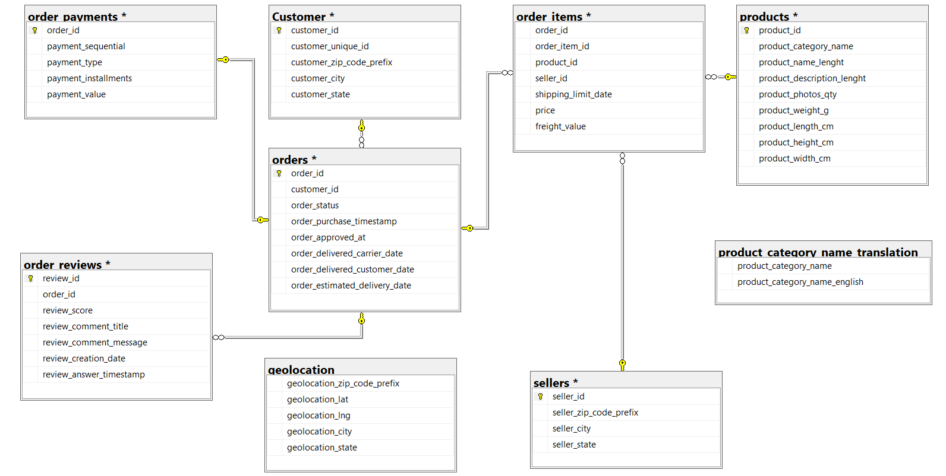
Entity relationship diagram

Slide 20
Initial Observations
One customer has multiple orders
One order id has multiple payment methods (Credit card & Vouchers)
One order has multiple products under the same order id
Certain city names are repeated with different spellings each in Latin and English
Single order id has multiple seller ids, indicating different products are being sold to one customer through multiple sellers.
Each customer has a unique customer id which is created at the time of account creation, and customer_ids are created for each order.

Slide 21
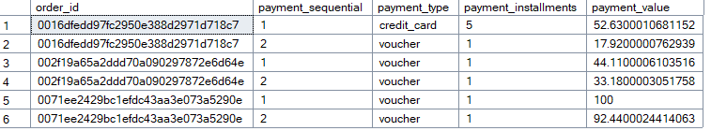
Data discrepancies (1/7)
Data discrepancies in “order_payments” Table
Same order_id has multiple payments with different payment types and values
There are payment_type which are mentioned as “not_defined”

Slide 22
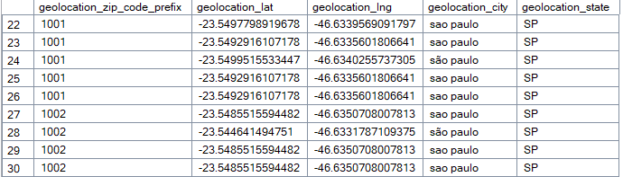
Data discrepancies (2/7)
Data discrepancies in “geolocation” Table
Same geolocation_zip_code_prefix is mentioned for same geological_city & geological_state with slight variation in latitudes and longitudes.
Some geological_city have spelling variation while still representing the same city

Slide 23
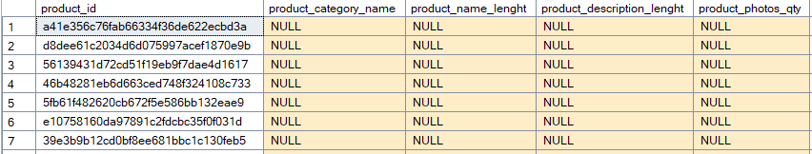
Data discrepancies (3/7)
Data discrepancies in “products” Table
610 product_ids do not have product_category_name & product descriptions.
There are no translations available for the same 610 records.

Slide 24
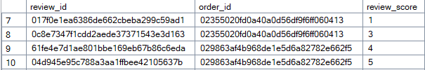
Data discrepancies (4/7)
Data discrepancies in “order_reviews” Table
There are around 1089 entries where one order_id has multiple review_ids with different review_scores.
For majority of reviews, there is no review comment title & no review comment description.

Slide 25
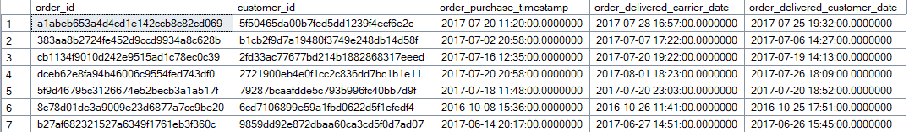
Data discrepancies (5/7)
Data discrepancies in “orders” Table
14 records in orders table have missing “order_approved_at” despite being delivered or shipped.
Few orders have been delivered to customers before it got delivered to the carrier. There are 23 such records.
There are null values present in “order_delivered_customer_date” and “order_delivered_carrier_date”.

Slide 26
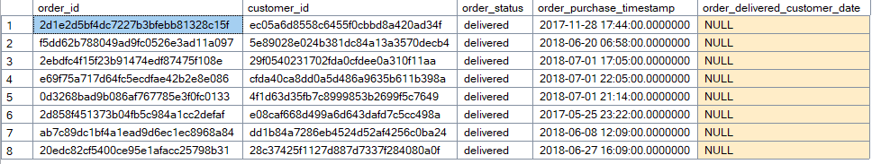
Data discrepancies (6/7)
There are two records which have missing “order_delivered_carrier_date” despite being delivered.
8 records have null “order_delivered_customer_date” despite being delivered.
There are total 1381 records which have date time inconsistency where the predecessor event’s date is greater than the successor event. This is roughly 1.38% of total records.

Slide 27
Data discrepancies (7/7)
Data discrepancies in “geolocation” Table
There are 1,28,270 entries which are exact duplicates.
Same “geolocation_zip_code” has multiple latitudes & longitudes with minor variations which would create multiple extra rows if a join is performed without cleaning.
“geolocation_city” has different spellings for the same city in Latin or English.
Date time values need to be converted to proper formats.
Notes:
128270

Slide 28
Data Cleaning

Slide 29
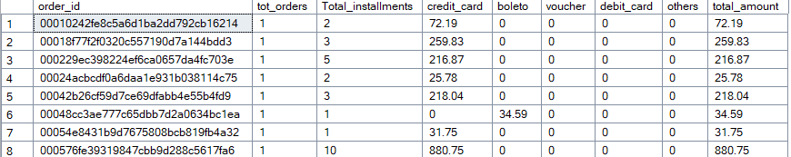
Data cleaning recommendations (1/6)
“order_payments” Table
Convert “payment_type” column to wide format to accommodate multiple payments into one row, this will remove
duplicate “order_ids” and provide better insights.
Group by “order_id” and aggregate by sum of payment_value.
Cleaned “order_payments” table

Slide 30
Data cleaning recommendations (2/6)
“orders” Table
Create a inconsistent flag for date time values which are in the wrong order and filter them out during analysis or do the next mentioned cleaning in separate table.
It is normal to have null values for "order_delivered_carrier_date","order_delivered_customer_date"
and "order_approved_at" for cancelled orders and no imputation is needed.
For "shipped" order_status, it is expected to have null "order_delivered_customer_date".
We can segregate them into a different table for analysis purpose. It is advised to keep the null values
as it shows valuable insights.
Orders that are "unavailable","processing" and "invoiced" will have null value for
"order_delivered_carrier_date“ and "order_delivered_customer_date". We should keep them as null for
analysis of KPIs and trends related to incomplete or cancelled orders.
Calculate median time in hours it takes for an order to get approved, then add that to the
"order_purchase_timestamp" to impute missing values in “order_approved_at”. And do the same for the rest date
time inconsistencies.

Slide 31
Data cleaning recommendations (3/6)
for orders which have delivery date before approved date, we need to confirm with the client for correct data or assuming these values got exchanged, we can interchange these values to get them in the correct orders.
For orders missing “order_delivered_carrier_date”, we will calculate average time it takes from an order to be delivered to the carrier and add that to our “order_approved_at”
Same approach will be used for imputing “order_delivered_customer_date”. We will calculate average time in hours or days it takes for an order to be delivered to a customer after being delivered to a carrier grouped by state or seller then add it to the carrier delivered date.

Slide 32
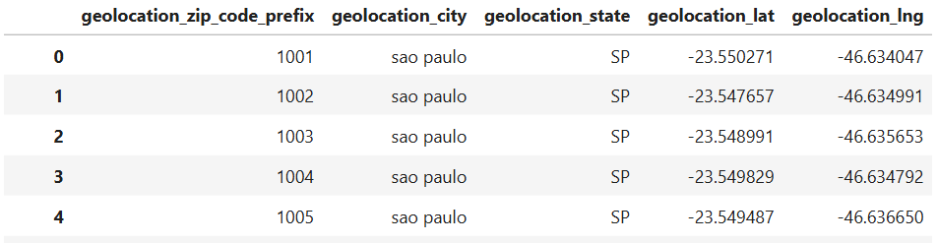
Data cleaning recommendations (4/6)
“geolocation” Table
Average “geolocation_lat” & “geolocation_lng” and group them on the zip codes.
Use max() window function to group rows by “geological_zip_code_prefix” to have consistent spellings for “geological_city” which gives record of 19,015 zip_codes with one spelling for each “geological_city”.
Change the spellings to English for better understanding.
Cleaned “geolocation” table

Slide 33
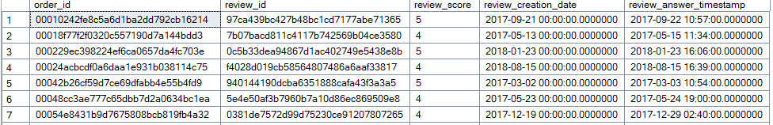
Data cleaning recommendations (5/6)
“order_reviews” Table
For “order_id” which have multiple reviews. It is better to consider the latest review since it offers better understanding of customer review.
For null values in "review_comment_title" & "review_comment_message" we can simply replace them with "not_mentioned" or "N/A" since it is common for customers to simply rate and not provide any comment.
For our current analysis we can even remove these two columns as they do not provide any insight apart from sentiment analysis.
Cleaned “order_reviews” table

Slide 34
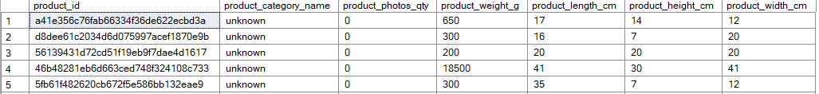
Data cleaning recommendations (6/6)
“products” Table
There are 610 "product_ids" which do not have "product_category_name" & three other product descriptions. Removing these products which have no “product_category_name” would affect "orders" table and other connected tables, generating more null values when joins are made for our analysis, we would change it to “unknown”
For the purpose of analysis and business insights, product name descriptions do not serve much purpose, we can take them out and just keep "product_id","product_category_name" ,"product_photos_qty“ & other product dimensions and weight.
If we want to still keep them then it is better to change the null values to "unknown".
For imputing "product_photos_qty", replace null values with 0.

Slide 35
EDA Plans

Slide 36
Exploratory Data Analysis Plan (1/2)
Expected KPIs – Total customers, Total Cities, Total States, Total Sellers, Total Products, Avg. Delivery time, Avg. Delivery to carrier, Avg. Rating, Avg. Review answered time, Total revenue, Customer retention rate.
Expected KRAs – Customer retention rate, Customer acquisition, Gross Sales revenue, Avg. Transaction value, Gross and net revenue, Shrinkage rate due to cancelled/returned orders, Customer Basket size, Customer lifetime value, Churn rate, Order delivery lead time etc.
EDA Plan:
Month wise analysis of total revenue/orders
Revenue generated per state
Orders per payment type.
Count of orders per order status
Total orders per state.
Average instalment per payment type.
Month wise customer acquisition.
Monthly revenue generated by new customers.
Classify customers based on order volume in low, medium high

Slide 37
Exploratory Data Analysis Plan (2/2)
EDA Plan:
10. RFM segmentation of customers.
11. Behaviour of one-time buyers based on state.
12. Customer preference for product category and payment method.
13. Category penetration of products
14. Top 10 highest ordered products
15. Sales contribution per each category
16. Most and least profitable/revenue generating product categories.
17. Category wise sales ( Pareto analysis )
18. Product wise average rating score.
Etc.

Slide 38
Predictive Analysis plan

Slide 39
Predictive analysis (1/2)
For this analysis, the best predictive model is a rating classification model using Logistic Regression.
We will predict customer ratings between 1 to 5 based on certain features.
Feature selection: We will select features which directly affect customer ratings. For example,
Delivery time
Order processing time
Price
Freight value
Payment type
Order dimensions
Payment instalments
Payment sequential

Slide 40
Predictive analysis (2/2)
Evaluation metrics:
We will create a classification report and confusion matrix to evaluate the accuracy of our model in predicting the ratings.
We can also do segmentation using ML models, classifying customers into different segments based on their revenue generated or orders placed.
Recall
Precision
Accuracy
F1 score

Slide 41
Exploratory
Data Analysis

Slide 42
KPIs
Total customers: 96,096
Total customer cities: 4,119
Total customer states: 27
Average rating: 4
Average review response time:3.22 Days
Average orders per customer: 1.08
Total sellers: 3095
Total seller cities: 611
Total seller cities: 23
Total geolocation cities: 5,756
Total zip codes: 19,015
Average product price: BRL 120.65
Average freight value: BRL 19.90
Total revenue: BRL 1,60,08,872.12
Total orders: 99,441
Total payment methods: 4
Total products: 32,951
Total product categories: 73
Median approval hours: 0.33 Hours
Median carrier delivery: 1 Day
Median customer delivery: 7 days

Slide 43
Exploratory
Data Analysis
Customer level

Slide 44
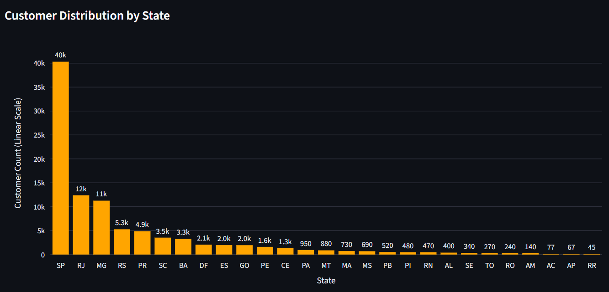
Customers per state
Observations:
Majority of customer are from SP state (over 40K).
States AM, AC, AP & RR have less than 200 customers per state
Recommendations:
Check population density of states with low customers and try to isolate if low density is the reason for low customer count.
Check for any local competitions present in such cities and introduce targeted offers for such states.

Slide 45
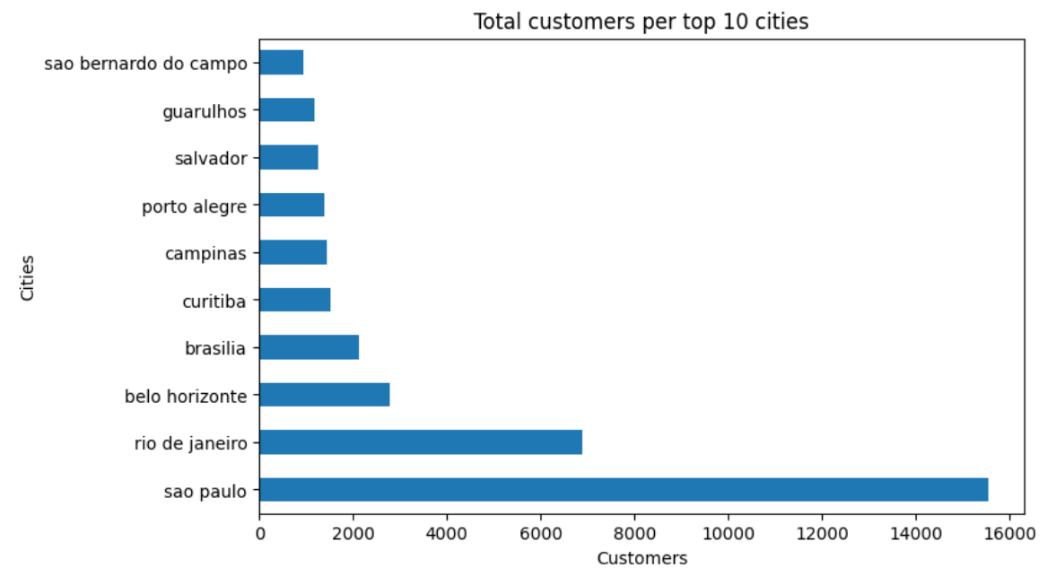
Customers per city (Top 10 cities)
Observations:
More than 15K customers belong to Sao Paulo city alone followed by Rio De Janario.
More than 4100 cities have less than 2000 customers.
Recommendations:
Same approach as for the states should be implemented for such cities having low customers.
Check how many sellers belong to these states and see if low count of sellers is the primary reason for less customers ordering from these cities.

Slide 46
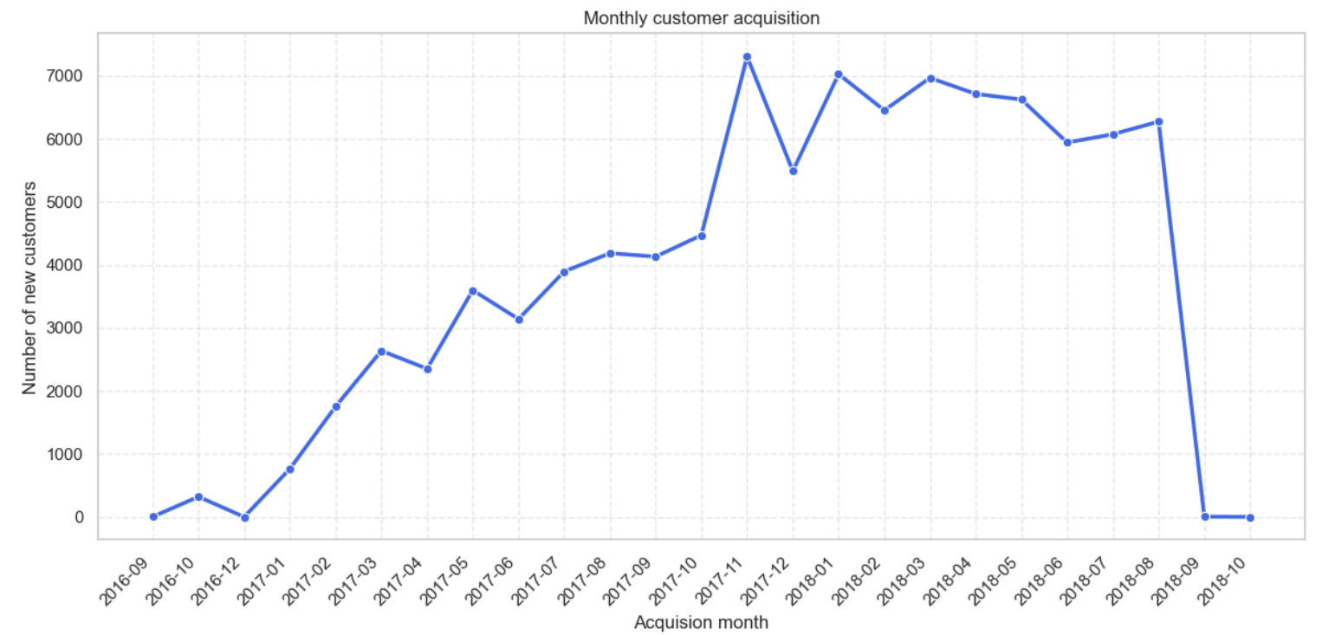
Monthly Customer acquisition
Observations:
We observe a positive trend in customer acquisition till march 2018, after which it falls till June 2018 and again picks up a positive pace.
Recommendations:
Identify the reason for this fall. A slight fall is seen every 6 months. Sales can be introduced during such months offering better prices.

Slide 47
RFM Segmentation Analysis
Recency (R): How recently a purchase was made by customer.
Frequency (F): Over a certain period, how many times does a customer make a purchase.
Monetary (M): How much money does a customer spend on all purchases.
Each unique customer was assigned a score for Recency, Frequency & Monetary from 1 to 5 using pandas qcut function in python. Having the maximum score of 15 (5+5+5) and minimum score of 3 (1+1+1).
Recency_score: More recent purchases get higher score.
Frequency_score: More frequently ordering customers get higher score.
Monetary_score: High spending customers get a higher score.
Based on these scores customers were segmented into group of 4, Bronze, Silver, Gold and platinum. Where bronze customers have lower RFM score and platinum customers have higher RFM scores.

Slide 48
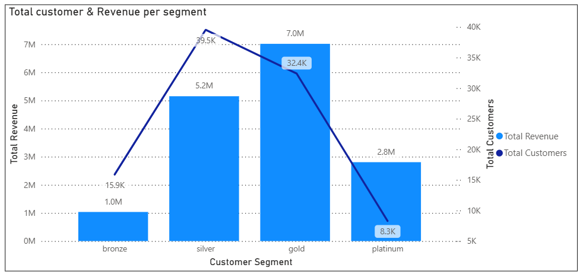
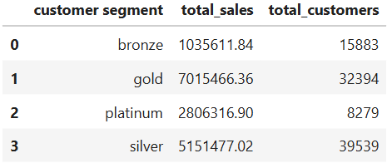
Customer segmentation
Customer Classification:
Platinum: RFM score above 12
Gold: RFM score between 10 & 12
Silver: RFM score between 7 & 9
Bronze: RFM score below 7

Slide 49

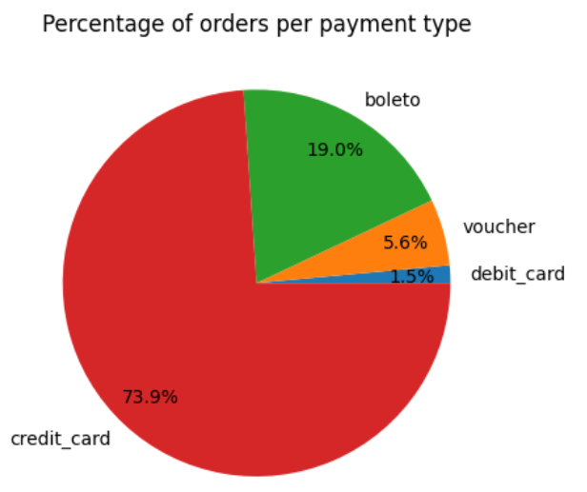
Customer preference
Total Customers: 96,096
Customers preferring Credit card: 76,795
Customers preferring Debit card: 1,529
Customers preferring Boleto: 19,784
Customers preferring Voucher: 5,775

Slide 50
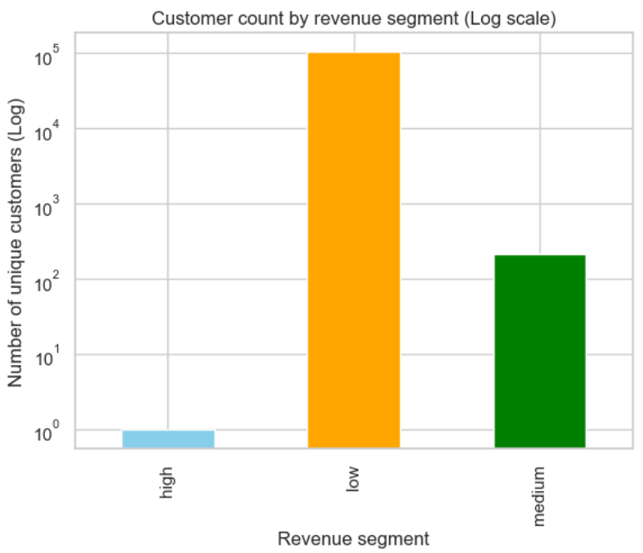
Customer revenue segmentation
Total Customers: 96,096
Low revenue customers: 103671
Medium revenue customers: 214
High revenue customers: 1

Slide 51
Customer behavior observations
One-time buyers: 93,098
One-time buyers percentage: 96.88%
Repeat buyers: 2,997
Repeat buyers percentage: 3.12%
Revenue generated by one-time customers: BRL 1,50,64,849.41
Revenue generated by repeat customers: BRL 9,44,022.71
One time buyers contribute to almost 97% orders and nearly 94% revenue.
Majority of customers lie in Silver segment and least in Platinum.
Majority of revenue is being generated by Gold segment customers and least by Bronze.
Most customers belong to low revenue segment.

Slide 52
Customer analysis Recommendations
Nearly 97% customers buy only once and never return. It is recommended to create loyalty programs and customer specific promotions that target them individually and promote future ordering. Also, retention programs for repeat buyers should be introduced along with specific offers that increase their retention.
Majority of revenue comes from these customers, therefore their conversion to repeat buyers would be beneficial for the company which would increase the profit by many folds.
Few states and few cities contribute to majority of customers. An analysis should be made if population density is the reason of others being less popular or is there any competition present in the respective city or state.
RFM segmentation shows that silver tier customers are the majority. Personalized offers should be made to improve their RFM score and enhance their tiers.
Gold customers generate maximum revenue, they should be rewarded with cyclic offers and membership benefits meanwhile other less revenue generating customers should be checked and personalized offers should be given to them to promote their orders.
Customer acquisition saw a steady increase up until August 2018, after which there was a sharp decline. Investigate the reason and eliminate it so that a steady pace can be maintained again. Check if this is a cyclic trend or just one time thing.
Majority of customers belong to low revenue generators and far lower belong to others. Measures should be taken to retain medium revenue customers and provide them options to enourage them into shifting to high revenue customers.

Slide 53
Exploratory
Data Analysis
Orders & Sales Trends

Slide 54
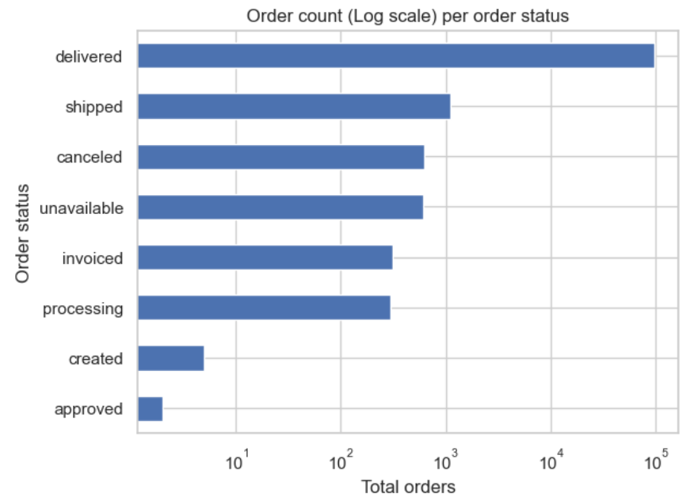
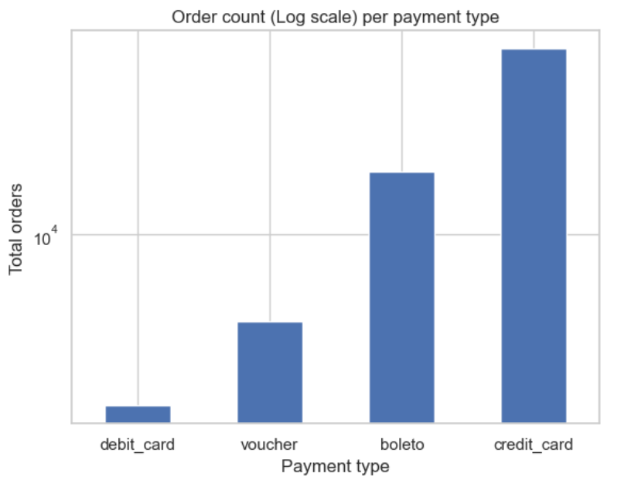
Orders data analysis

Slide 55
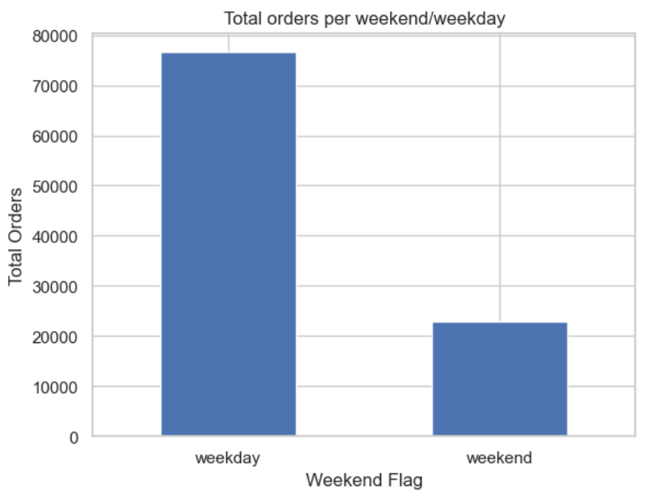
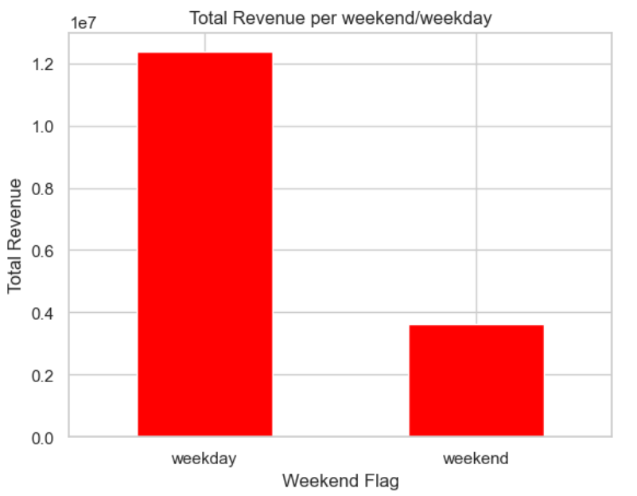
Orders & Revenue per weekday flag

Slide 56
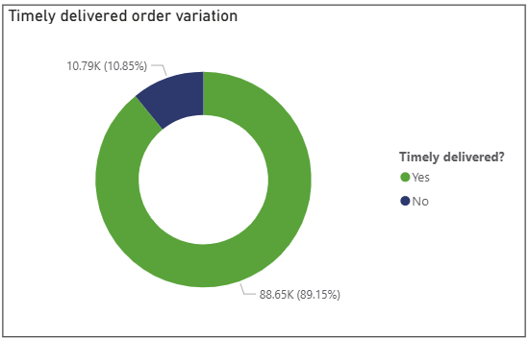
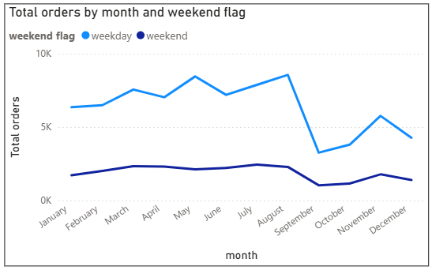
Orders analysis

Slide 57
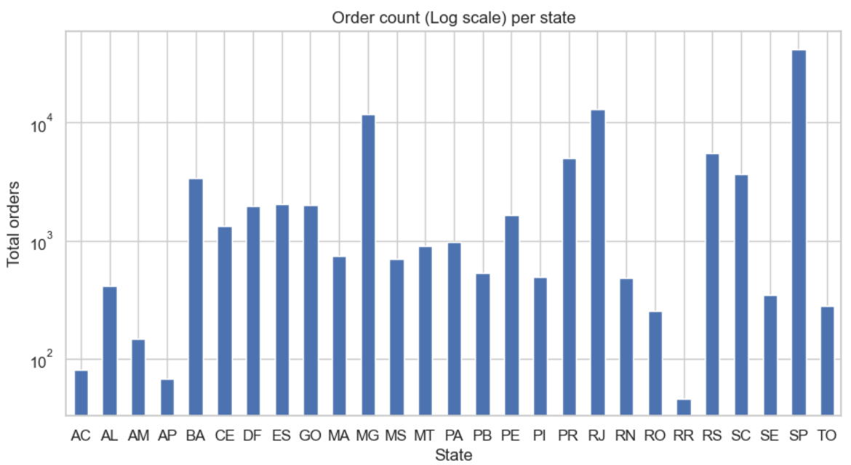
Orders demographics analysis

Slide 58
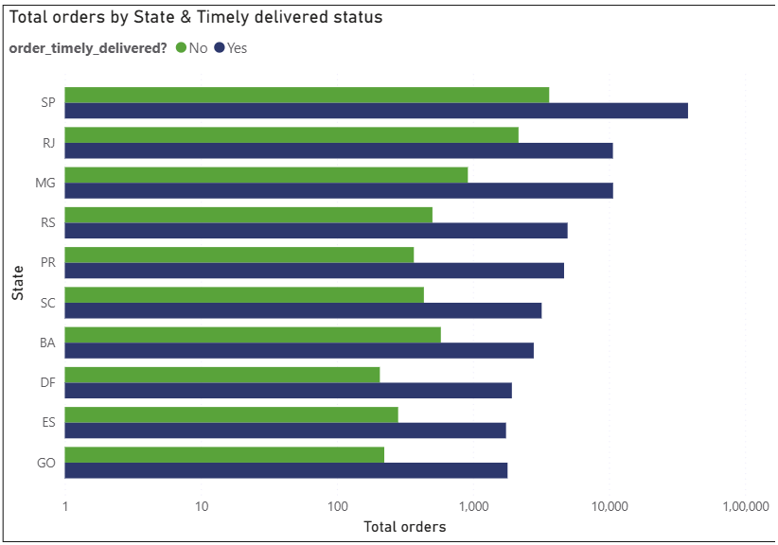
State wise timely delivered status

Slide 59
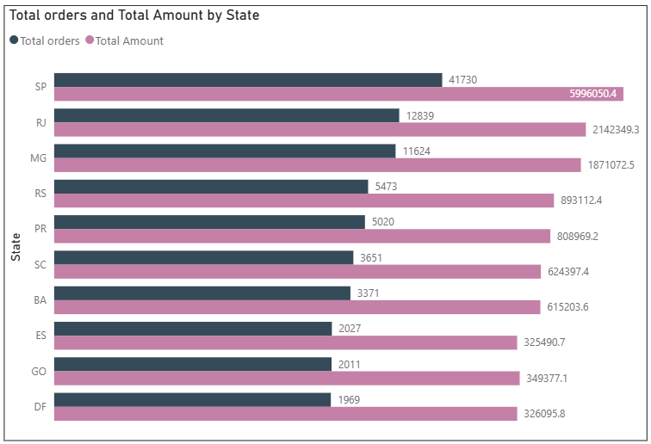
Order & Revenue demographics analysis (Top 10 States)

Slide 60
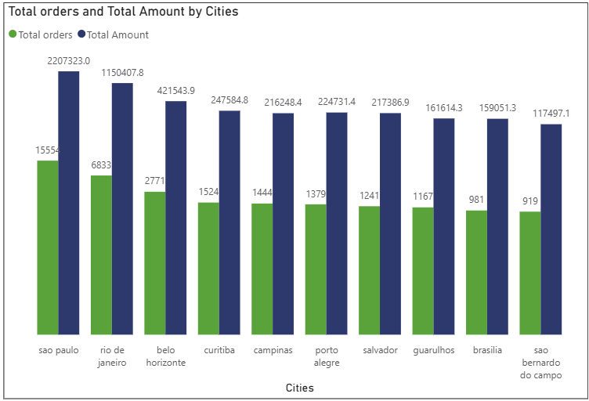
Order & Revenue demographics analysis (Top 10 Cities)

Slide 61
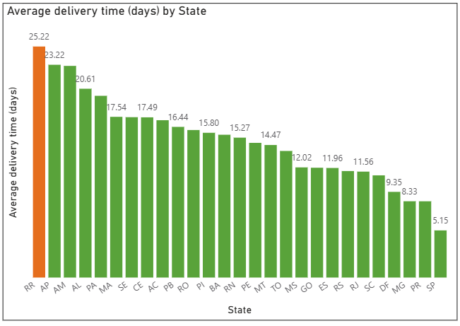
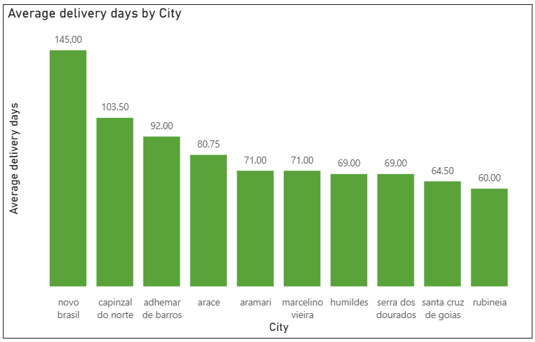
Delivery days by state and city

Slide 62
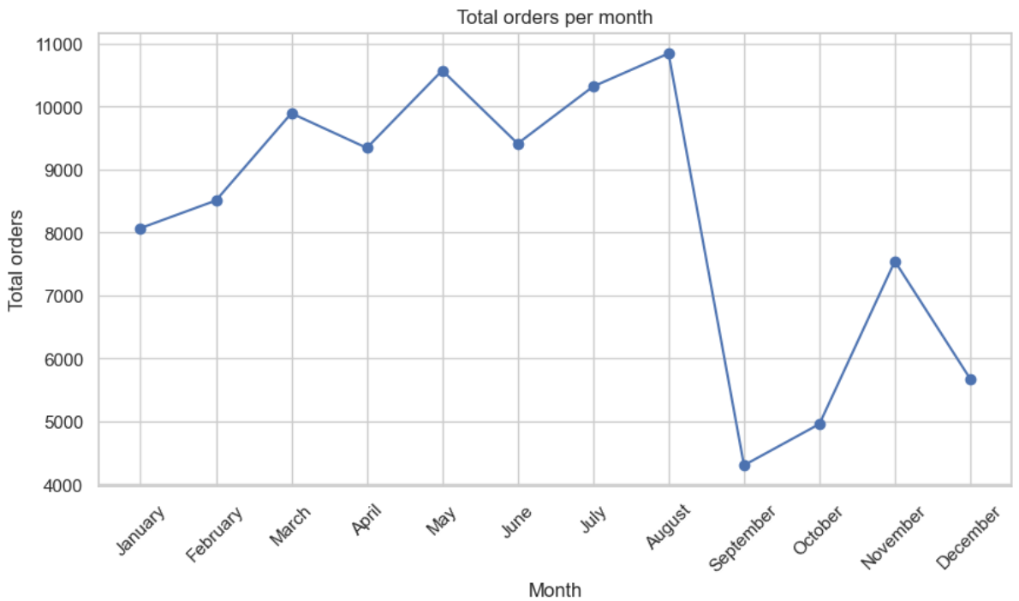
Total orders per month

Slide 63
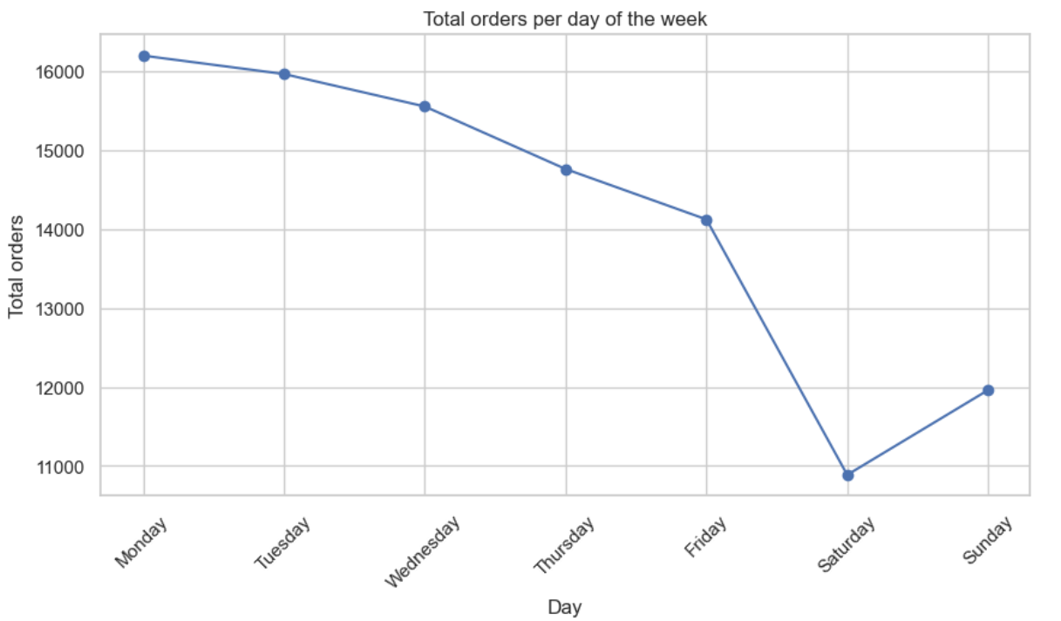
Total orders per day of the week

Slide 64
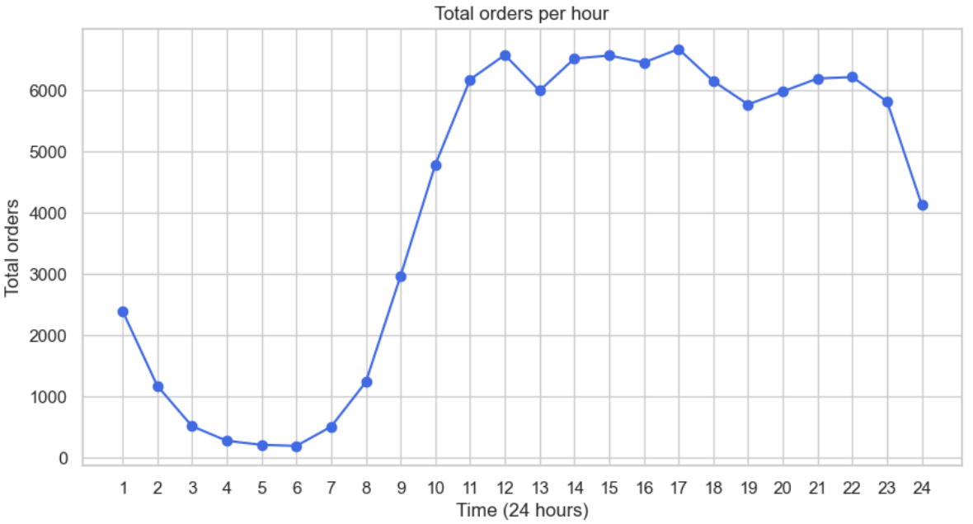
Orders variation by hour

Slide 65
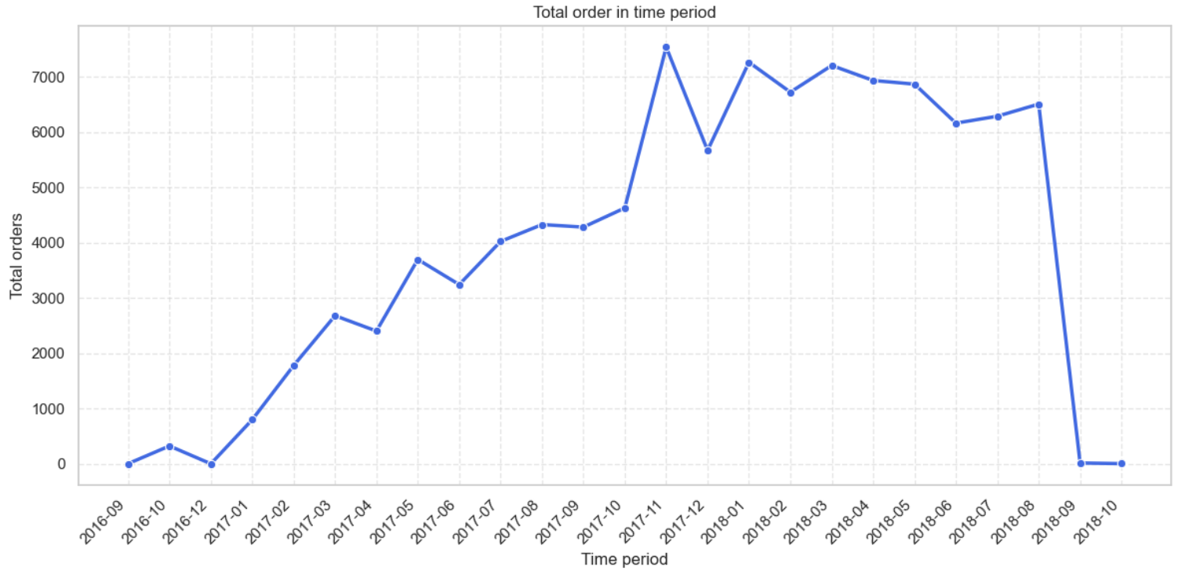
Total orders trend

Slide 66
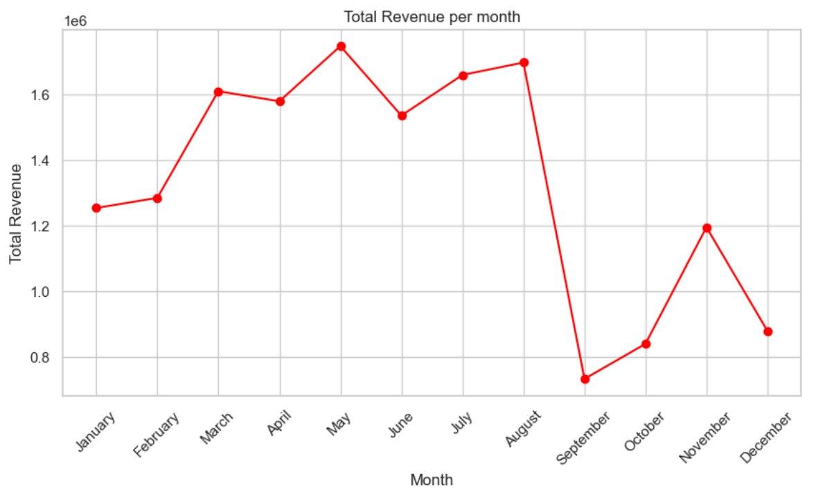
Revenue per month

Slide 67
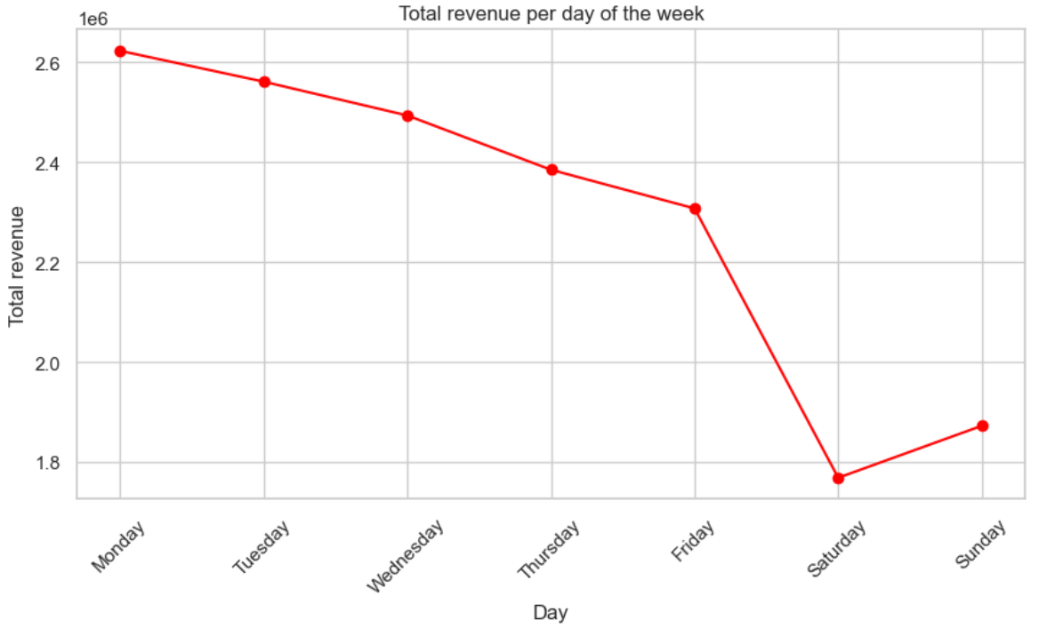
Total revenue per day of the week

Slide 68
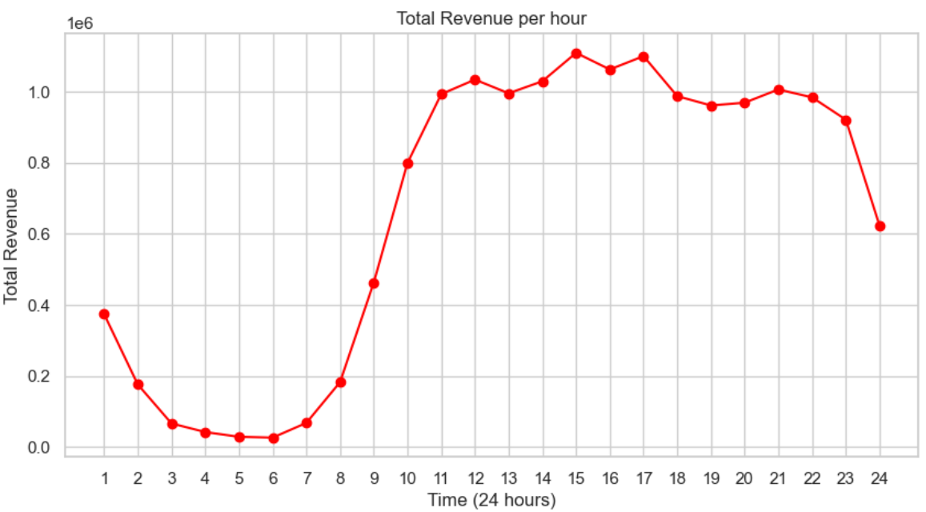
Revenue variation by hour

Slide 69
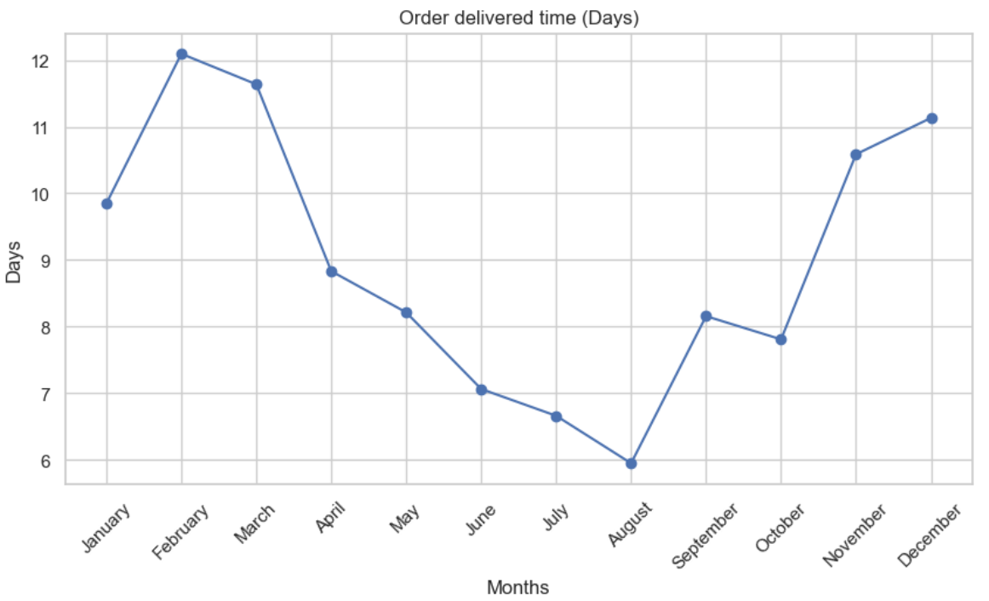
Average order delivery time per month

Slide 70
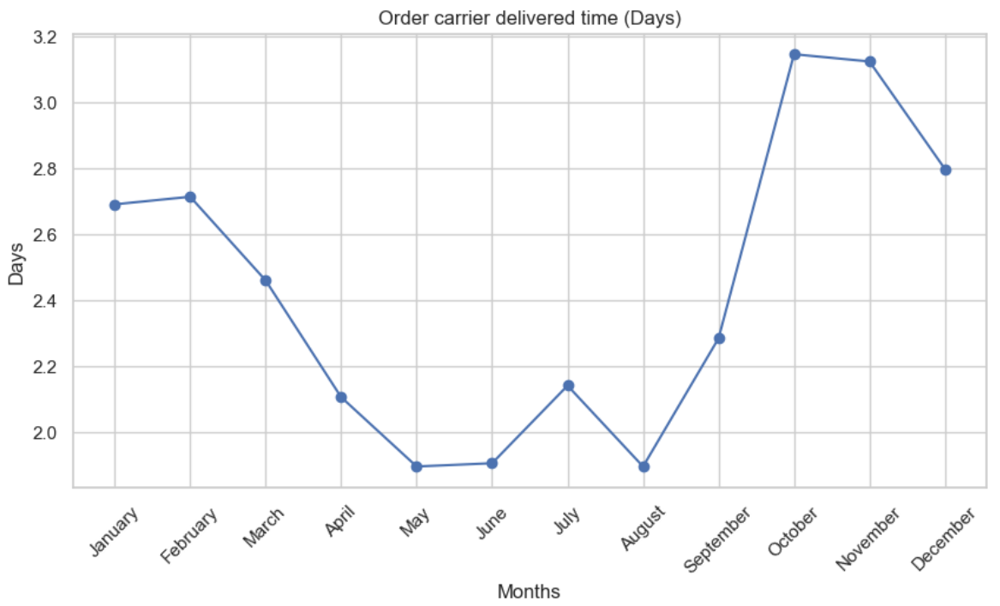
Average order carrier delivered time (days)

Slide 71
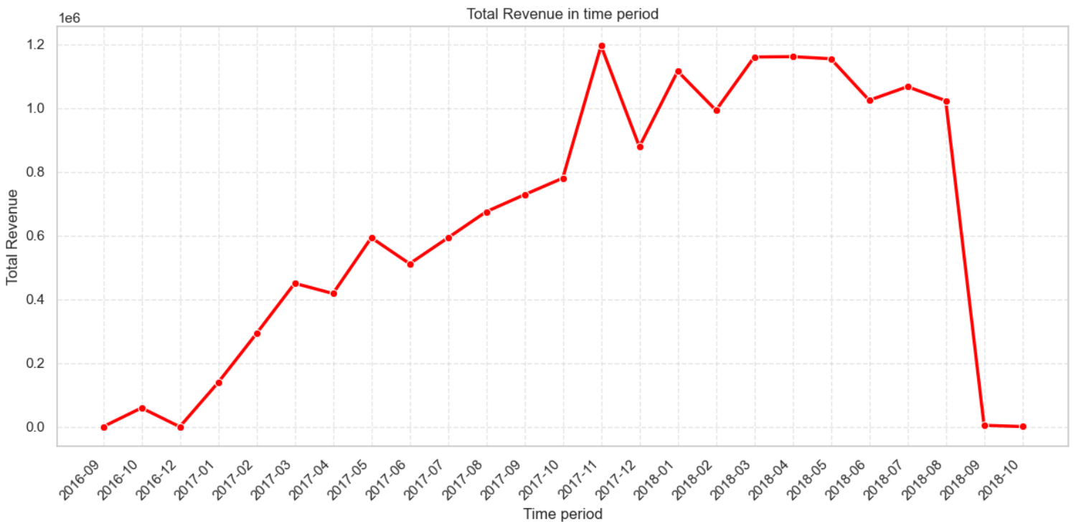
Total revenue trend

Slide 72
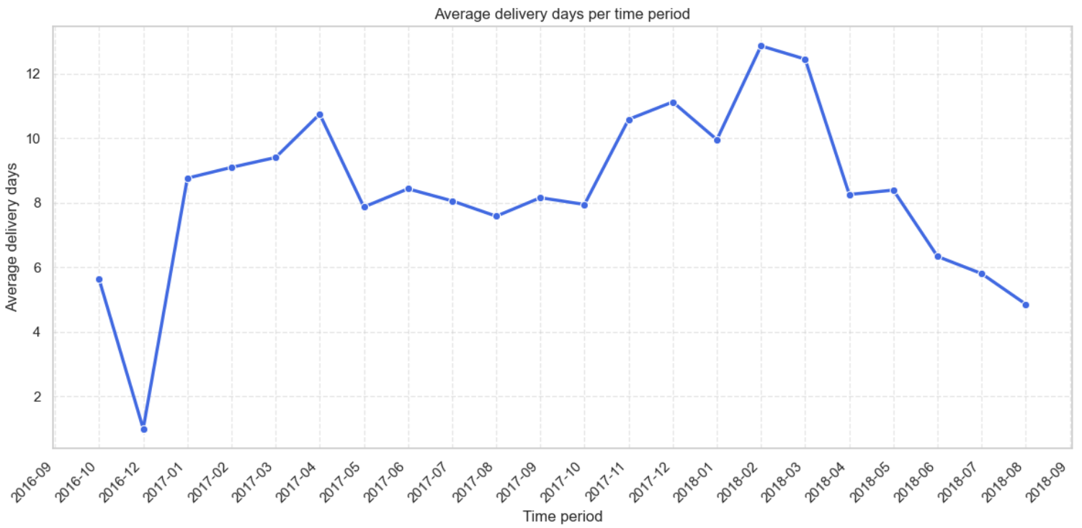
Average delivery time per time period

Slide 73
Order analysis observations
Weekday sales and generated revenue surpass weekend sales and revenue by a big margin. Weekend & weekday sales both decline sharply after August and keeps falling until December.
More than 89% orders are timely delivered.
State SP contributes to the highest number of orders and highest revenue generated, while state RR contributes to the lowest number of orders and revenue.
State RR has the highest average delivery time while SP has the lowest delivery time.
Certain cities like Novo Brazil, Arace, Aramari etc. have an average delivery time crossing over 2 months with maximum being over 3 months.
Total order and Total revenue trend shows a steady upward trend up until August, then had a deadly dip in September then again following the same trend.
It was observed that both sales and revenue dropped as the weekend approaches with them being lowest on Saturday and Sunday.
Majority of orders are placed between 11 AM and 9 PM.
Total voucher amount: 379436.87 (Potential revenue)
Notes:
25.22 5.5

Slide 74
Order Analysis recommendations
Logistics & Regional Delivery: Proactively monitor fulfilment bottlenecks for remote states experiencing extended delivery windows (up to 2 months). Prioritize carrier contract renegotiations in high-delay regions to protect customer satisfaction.
Holiday Seasonality: Average delivery times spike during the Q4 peak holiday season (Black Friday, Christmas and New Year). Mitigate carrier strain by onboarding temporary logistics staff and introducing performance incentives ahead of Q4.
Targeted Marketing & Acquisition: Deploy targeted digital acquisition and competitive first-order incentives in underperforming regions to stimulate localized demand.
Demand & Inventory Planning: Capitalize on early-week shopping momentum by ensuring high-demand inventory is fully restocked by Monday morning, supported by weekend promotional push notifications.

Slide 75
Exploratory
Data Analysis
Products level

Slide 76
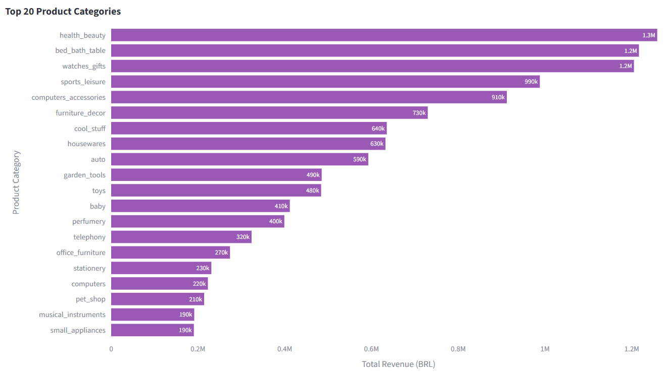
Top 20 Product categories by total revenue

Slide 77
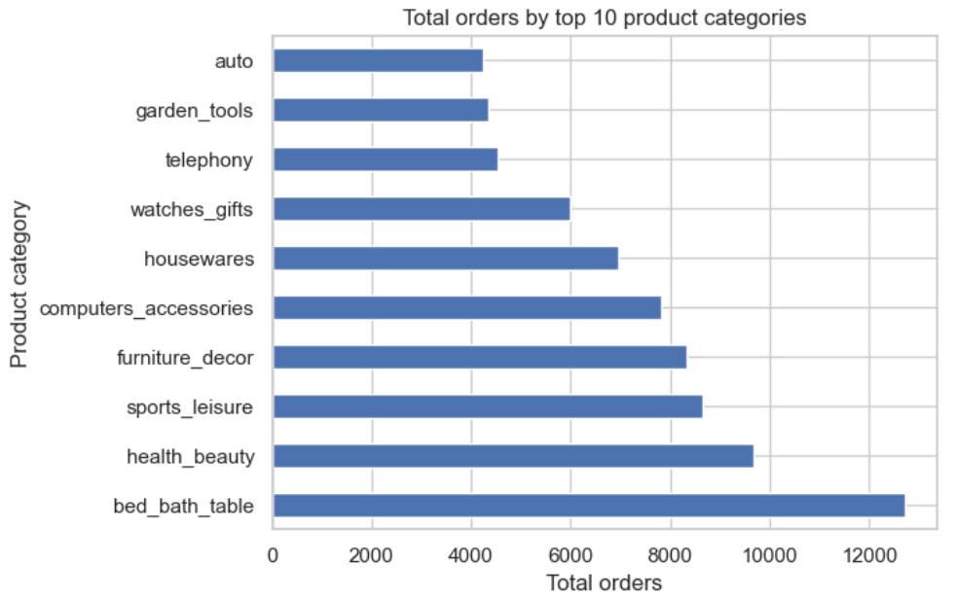
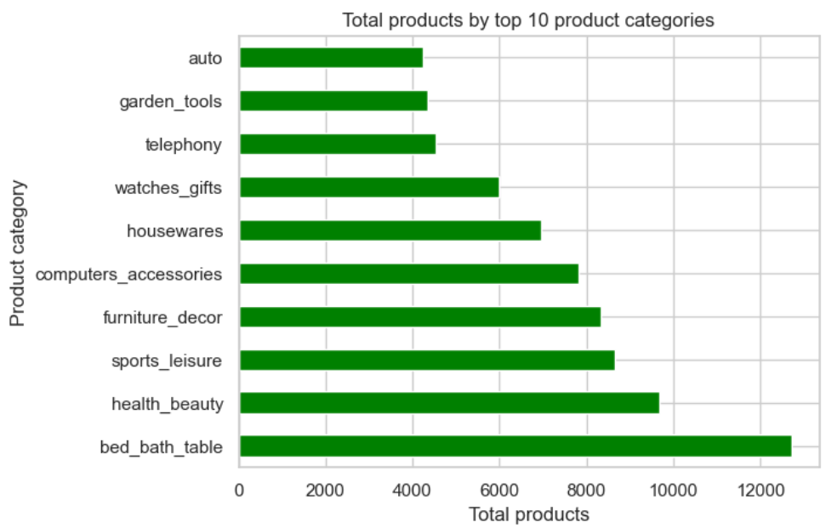
Top 10 Product categories

Slide 78
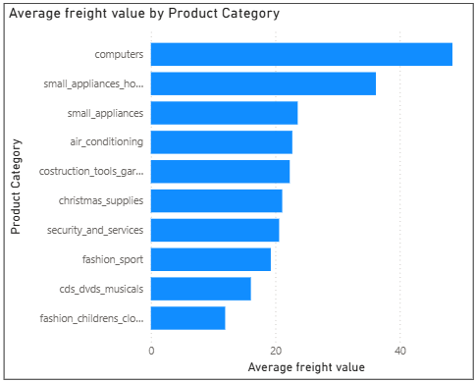
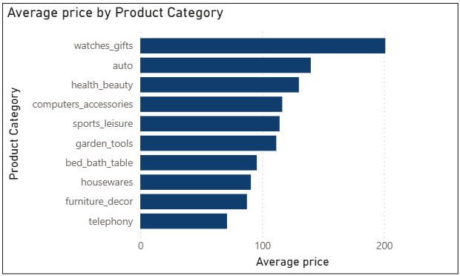
Product Categories (Top 10)

Slide 79
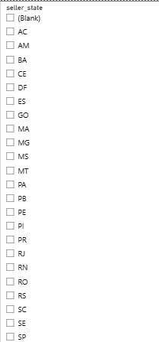
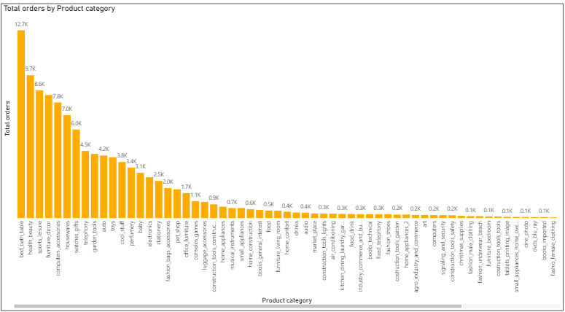
Popular products state wise

Slide 80
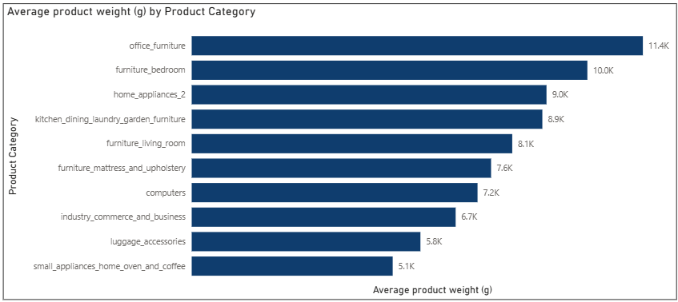
Product Categories (Top 10)

Slide 81
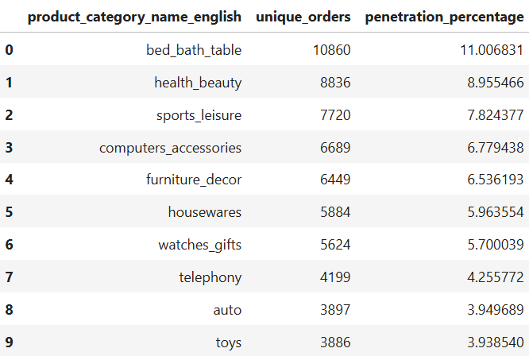
Product category penetration
No. of orders having that category
Category Penetration = ---------------------------------------------- X100
(%) Total number of orders

Slide 82

Product category penetration

Slide 83
Pareto Analysis
Pareto Analysis: Pareto analysis, also known as the 80-20 analysis rule.
It states that 80% of the effect comes from 20% of the causes.
In this analysis we observed that 20% of categories contribute to roughly 78% of the sales over the time period of 2 years

Slide 84

Pareto analysis

Slide 85

Product price and freight value relationship

Slide 86

Cross selling products (with respect to bed_bath_table)

Slide 87
Product analysis observations
Health beauty category is the highest revenue generating category followed by bed_bath_table and watches_gift. Health beauty generates 1.22M in revenue.
Bed bath table category dominates in number of orders and is also the category with most number of products (over 12000) across all states.
Watches gift category has the most expensive products with an average price of BRL 200.
Office and household furniture constitute the largest orders in terms of average dimensions and weight, whereas garden supplies have the highest average freight value.
Bed bath table have the highest category penetration with roughly 11% products per orders belonging to bed bath table.
Pareto analysis showed that roughly 20% of categories contribute to nearly 78% of all orders.
Considering the highest selling category (bed_bath_table), the highest cross selling products are furniture_decor, home_comfort,homewares, baby & health_beauty.

Slide 88
Product analysis recommendations
Concentrate on Class A Categories: Focus promotional spend and seller acquisition programs on the top Pareto categories that drive the majority of platform revenue, ensuring high stock availability for high-demand items.
Leverage High-Penetration Anchors: Use high-penetration categories (such as Bed, Bath & Table and Health & Beauty) as traffic drivers on landing pages, cross-promoting complementary lower-penetration items to lift overall catalogue visibility.
Mitigate Regional Shipping Drag: Address disproportionately high freight-to-price ratios in remote states by partnering with regional carriers or offering localized warehousing options for bulky inventory to protect conversion rates.
Proactive Q4 Capacity Planning: Average delivery times spike during peak holiday windows due to high order volume. Combat seasonal fulfilment delays by securing advance carrier agreements and onboarding temporary logistics personnel ahead of Q4.
Automated "Frequently Bought Together" Bundles: Implement data-driven cross-selling modules at checkout based on co-occurrence and association rules (e.g. pairing home decor with furnishing items) to increase Average Order Value (AOV).
Strategic Product Bundling: Create bundled pricing packages for low-cost, high-freight items where shipping costs otherwise deter single-unit purchases.

Slide 89
Exploratory
Data Analysis
Seller level

Slide 90

Seller level analysis

Slide 91

Worst performing sellers in terms of Delivery times

Slide 92

Seller product diversity

Slide 93

Orders and revenue per seller state

Slide 94

Seller delivery performance state wise (Top 10)

Slide 95

Seller delivery performance state wise (Top 10)

Slide 96
Observations and Recommendations (Seller Analysis)
State SP has the most number of sellers and also have the highest orders fulfilled by these sellers. On the same scale states like AM, MA, PA and PI have less number of sellers despite fulfilling more orders than some other states.
State SP also have the highest revenue generated by sellers followed by MG, PR & RJ.
Few sellers have order fulfilment and delivery days more than 20 days with maximum being above 6 months. The constitute the worst performing sellers.
There are certain sellers which have high volume of orders and still manage to keep their median delivery time under 8 days.
There is only one order from state AC in 2 years.

Slide 97
Recommendations (Sellers)
Geographic Expansion & Regional Hub Optimization
  Decentralize fulfilment from State SP: Given that State SP concentrates the highest density of sellers and order volume, establish localized regional fulfilment hubs or warehouses in underrepresented states (such as AM, MA, PA, and PI) where demand outpaces local seller representation. This will reduce shipping distances and transit bottlenecks.
Sellers SLA Enforcement & Performance Governance
  Implement Strict Delivery Thresholds: Identify and penalize the underperforming tail of sellers whose fulfillment and delivery cycles stretch beyond 20 days (and up to 6 months). Establish automated warning flags, penalize low SLA compliance with lower search visibility on the marketplace, or suspend chronically delayed vendors to protect customer satisfaction.
Benchmark & Scale High-Performing Vendor Practices
  Study & Replicate Efficiency: Conduct a best-practice audit on high-volume sellers who successfully maintain a median delivery time under 8 days despite heavy order loads. Create incentive structures or priority placement programs for these high-efficiency vendors and share their operational playbooks across the platform.

Slide 98
Exploratory
Data Analysis
Customer Satisfaction

Slide 99

Average review score per state

Slide 100
Observation & Recommendation
Observations
State AC and AM have the least average rating, whereas states MS and PA have the highest rating of 4.5 indicating high customer satisfaction.
States like SP, SC & RS also show good review score of around 4. showing consistent good score.
Recommendations:
Prioritize improvement in low-performing states like AC & AM by identifying specific customer dissatisfaction points and implementing targeted efforts to improve customer satisfaction.
Analyse and replicate the strategies and services contributing to high customer satisfaction in MS and PA to maintain high satisfaction levels and consider implementing similar approaches in other states.
Enhance customer engagement, service consistency, and introduce customer feedback loops in mid performing states like SP, SC & RS to prevent ratings from falling below the 4 threshold.

Slide 101


Average review score across cities (Top & Bottom 10)
Top 10 review score
Bottom 10 review score

Slide 102


Average review score by Order count & Sellers

Slide 103
Observations & Recommendations
Observations:
Review score of 5 dominates majority of orders while rating 2 is the least provided review. There are about 60,000 records which were given 5 rating while there were around 11,000 records with review score of 1.
More than 1600 sellers have an average rating of 4. While around 180 sellers have an average rating of 1. Around 900 sellers have an average rating of 5.
Recommendations:
Orders with low rating should be analyzed based on the their review title and title description ( if provided ) to understand the reason for low rating.
A customer feedback report should be created after asking the customer for the low rating and rectify the issue to prevent future lower ratings.
For sellers having a low rating, stricter checks should be done on them and they should be provided with measures to improve.

Slide 104

Average rating per category (Top 10)

Slide 105

Average rating per category (Bottom 10)

Slide 106

Average category per time period

Slide 107
Observations and recommendations
Observations:
“Cds_dvds_musicals” is the highest rated category with an average rating of about 4.5 meanwhile “security_and_services” is the least rated category with average rating of 2.5.
December 2016 had the highest rating of 5 across all orders while October and November 2016 received the lowest average rating of 1 across all orders. All other months in both years have had an average rating of 4 showing majority of orders across months have a consistent high rating.
Recommendations:
Consider improving product quality, delivery times, or customer service in the to boost satisfaction.
Sustain high performance in musicals, fashion and books by rewarding loyal customers with promotions or discounts to strengthen loyalty.
Launch customer satisfaction improvement programs across all categories with a focus on personalization, better customer service, and optimized shopping experiences.

Slide 108
Dashboard Previews

Slide 109


Slide 110
Customer level dashboard
The dashboard shows report at customer level. It consists of the following:
Relevant KPIs: Unique Customers, Total states, Total cities & Total zip codes of locations.
Dynamic slicers: Month and cities.
Relevant charts: Total customers by time period, RFM Segmentation, Payment preference by customers, Customers per revenue segment and Total customers per state.
Insights shown: Customer demographics and preferences along with customer categorization.

Slide 111


Slide 112
Order level Dashboard
The dashboard shows report at Orders level. It consists of the following:
Relevant KPIs: Total orders, Total revenue, Total payment types
Dynamic slicers: Months
Relevant charts: Total orders & Total revenue by cities, Average delivery time by state, Percentage variation of order delivery status, Total orders by state, Month-wise total orders per weekend flag.
Insights shown: Order variation across different demographic sectors, Total revenue generated by orders & how orders vary across time period

Slide 113


Slide 114
Sales trend Dashboard
The dashboard shows report of sales trends. It consists of the following:
Dynamic slicers: State, City, weekend flag, timely delivered status.
Relevant charts: Total orders by month, Total orders by day of week, Average delivery days by month, Average delivery days by time period (Month & Years).
Insights shown: This dashboard shows how orders, revenue, delivery days etc vary across time at different levels.

Slide 115


Slide 116
Product level Dashboard
The dashboard shows report at Products level. It consists of the following:
Relevant KPIs: Total products, Total product categories, Average product price & freight value
Dynamic slicers: Months
Relevant charts: Average price by product category, Revenue generated by product categories, Total orders per category, Category penetration & Correlation between freight value and product price.
Insights shown: High value products and categories along with which products contribute more to orders and revenue. Category penetration showing percentage contribution of each category to sales and revenue. Also shows products to be bundled together considering that such products have high freight value to price ratio.

Slide 117


Slide 118
Seller level Dashboard
The dashboard shows report at Sellers level. It consists of the following:
Relevant KPIs: Total sellers, Median carrier delivery days, Median customer delivery days & Median approval hours
Dynamic slicers: Seller cities and Seller states
Relevant charts: Worst performing sellers by average delivery time, Total orders received and total sellers available per state, Average delivery days by sellers per state & Sellers diversity in terms of unique products and categories they fulfil.
Insights shown: Shows seller performance and number of sellers per location to isolate states that need more sellers and which needs more visibility at the marketplace.

Slide 119


Slide 120
Customer Satisfaction Dashboard
The dashboard shows report of Customer Satisfaction. It consists of the following:
Relevant KPIs: Total reviews, Average review score, Review time in days.
Dynamic slicers: Order timely delivered status, Cities
Relevant charts: Monthly average review score, Average review score by state, Product category wise average rating, Seller distribution by average rating, Total orders per rating score.
Insights shown: Provides analysis about how products and seller performance affect customer reviews and which products and sellers per state require better checks or rewards. Also analyses which demographic sectors, sellers & products are better or worst performing.

Slide 121


Slide 122
Predictive Modelling- Customer Rating Prediction

Slide 123
Predictive Modelling
Goal: Predict customer satisfaction rating from 1 to 5 with 5 being the highest rating showing high customer satisfaction and 1 showing low customer satisfaction.
Models Tested: Logistic Regression, AdaBoost Classifier, Decision Tree Classifier. Random Forest Classifier, Gradient Boost classifier, Multinomial Naïve Bayes.
Variable reduction: Variance inflation factor & Recursive feature elimination.
Evaluation metrics: Accuracy, Precision, F1 score, Recall
Highest Accuracy model: Logistic Regression using Recursive feature elimination.
Highest accuracy observed: 61%

Slide 124


Predictive Modelling
Classification Report (Train) Classification Report (Test)
Observations:
Model has low accuracy of 61% and performs poorly in other metrics.
Reason for that is high class imbalance. Majority of ratings are 5 followed by 1.
Even with imbalance techniques like SMOTE, the model did not improve with current features.

Slide 125
Final Observations

Slide 126
Customer level
New customers acquisition showed a positive trend for the majority of analysis but slowed down around August 2018.
One time buyers were responsible for most of the orders and maximum revenue generated.
Certain states had more customers who ordered and majority of states had very less number of customers. Same with the cities.
RFM segmentation showed that majority of customers belong to the silver category and there were far less customers in gold and platinum.
Most of the customers belong to the low revenue generating segment.
Customers prefer to pay using credit cards and majority pay with only one method while few paid with vouchers and other payment methods.

Slide 127
Orders level
Over 73% of orders were paid through credit card and least is debit card.
Weekday sales contribute to majority of the sales and revenue whereas weekend sales has very less contribution.
Over 89% orders were timely approved, processed and delivered. Certain states are performing bad in terms of order volume and delivery times. Certain orders in cities have average delivery time above 3 months.
High volume of orders are received during 10AM and 11PM which marks this time as high productive time for increased revenue.
Average order delivery time increased substantially in Q4. Christmas, Halloween and New year time shows increased order volume which is likely the reason for extended delivery days.
Certain cities and states are performing worst while handling order volume and the lowest revenue generators.

Slide 128
Products level
Certain orders perform well compared to others in terms of order volume and revenue. They hold the majority of market share in the entire dataset.
A similar pattern was observed across state, regions and product categories.
Probable Reason: Variations in store management, location demographics, or product availability could influence these differences.
Category penetration was observed to be higher for a few categories while rest had low category penetration
Pareto analysis showed that roughly 20% of categories contribute to nearly 78% of all orders.
Correlation analysis between fright price and product price showed that certain products despite having less price had more freight value. Considering to bundle such orders is recommended.

Slide 129
Seller level
Out of 3095 sellers, a few of them were performing really bad in terms of order volume and average delivery days with few of them having average delivery days in months.
Seller diversity in terms of product categories is low for majority of sellers with only a few of them selling more than 5 unique products/product categories.
Certain states have low number of sellers despite handling high order value meanwhile few states have less number of sellers altogether.
Few sellers performed worst in terms of order delivery times and revenue generated with sellers from SP outperforming the rest.

Slide 130
Customer satisfaction level
Majority of states performed well in terms of review rating while a small fraction performed worst in terms of average rating.
Majority of orders were rated 5, followed by rating 4 and a few intermediatory 2 and 3 rating. Review score 1 has substantial number.
Certain sellers performed better than others and received higher rating than those sellers.
Certain product categories receive consistent poor reviews and others receive consistent higher review scores.

Slide 131
Final recommendations (1/3)
For customer retention:
Retail chain can try personalized marketing strategies to retain customers. They could collect Email address of the customer if they are willing to provide. Thus, retail chain can remind them of any new products or upcoming offers.
Loyalty rewards can be given for retained customers like coupons, discounts etc.
Credit points can be given for each purchase and when customer reaches a certain threshold, they can get selected products for free
For less popular categories:
For categories with fluctuating penetration rates, run targeted promotions or bundle these with top-selling categories to increase their appeal. Offer discounts or perks for purchasing these bundles.
Stock Optimization: Ensure that frequently cross sold items are well-stocked to meet customer demand and avoid stockouts.
Warehouse Layout: Arrange the warehouse layout to place frequently cross-sold items closer together to streamline the picking process.

Slide 132
Final recommendations (2/3)
For low sales
Enhance Weekend Sales: Since weekend sales are lower, consider implementing special weekend promotions or discounts to attract more customers.
Target low revenue customers and customers with low RFM scores by offering personalised offers and bundles.
Explore activities or events that can drive more traffic to your business during weekends.
Analyse the factors contributing to the sharp decline in sales and sudden growth spurt.
Consider external factors like economic conditions, industry trends, or competitive pressures. Understanding these factors can help to enhance future growth.
For underperforming products
Bundle underperforming products together and have a clearance sales on specific times when sales are lowest.
Offer higher profit margin to sellers for such products.

Slide 133
Final recommendations (3/3)
For poor performance of sellers
Establish localized regional fulfilment hubs per state where demand is more than what the sellers can handle. It will reduce the distance between customers and sellers and ensure higher delivery speed.
Automated warning flags should be there to penalize seller which are performing less than the SLA compliance by lowering their visibility. Meanwhile high performing sellers should be rewarded with more visibility.
Create an audit report for such underperforming sellers and offer them implementation practices from high performing sellers.
For better customer satisfaction
Analyze review score and comments in comparison to customer 360 and understand if reviews are from genuine customers or bots.
Understand competitions and implement their strategy for better customer satisfaction.
Send a follow up survey on email or phone number of low rating customers and understand the reason in depth. Reward them for taking this survey by offers for next orders.
States having consistent lower rating should be audited and the sellers and logistics hub there should be kept in check.

Slide 134
THANK YOU!

