Slide 1


Zomato Restaurant Analysis
Rajeeb Kumar Sahu
16 August, 2024

Slide 2

Introduction:
Hook: "Did you know that the global food delivery market is projected to reach $320 billion by 2029? With competition intensifying, understanding the dynamics of restaurant ratings and customer preferences has never been more critical." Context: This project focuses on analyzing restaurant data from Zomato, one of the leading food delivery platforms, to uncover valuable insights that can guide strategic decision-making.
Objectives:
Identify High-Potential Areas: The primary goal is to pinpoint cities and regions with the highest potential for restaurant expansion, based on customer satisfaction and market conditions.
Understand Market Trends: Analyze restaurant
ratings and openings over time to identify trends and shifts in customer preferences.
Enhance Competitive Positioning: Provide data-driven recommendations to improve Zomato's
market share by focusing on high-rated areas and addressing weaknesses in lower-rated regions.

Slide 3

Objectives:
Identify Potential Areas for Expansion: Uncover regions with high customer demand but low restaurant supply, paving the way for strategic growth.
Understand Market Trends: Analyze customer behaviour and preferences to predict emerging dining trends.
Evaluate Competitive Position: Assess Zomato’s market standing in various regions, identifying key strengths and potential areas for improvement.

Slide 4

Content: Summary of the Dataset
Total Records: 9,551 restaurant entries.
Data Points: 23 columns, including key details like:
Restaurant Information: ID, Name, Location (City, Address, Locality).
Geographical Data: Longitude, Latitude.
Operational Details: Whether the restaurant offers table booking, online delivery, or current delivery status.
Financial Information: Price range, Average cost for two, Currency.
Customer Interaction: Votes, Rating.
Timeline: Opening date, Year, and Month of record creation.

Slide 5

Data Cleaning & Preprocessing:
Null Values Handling: Ensured minimal missing values, primarily focusing on the 'Cuisines' column (9 missing entries).
Data Consistency: Standardized date formats and veriﬁed
geographical coordinates to ensure accuracy.
Outlier Detection: Reviewed and adjusted outliers in rating and average cost data to maintain analytical reliability.

Slide 6

Methodology
L. Data Cleaning:
Missing Values: Identiﬁed and handled missing entries, particularly in the 'Cuisines' column, ensuring
the dataset was complete for accurate analysis. Outlier Detection: Reviewed ratings and cost data to identify and manage outliers, ensuring they did not skew results.
3. Tools and Functions Used:
Excel: Utilized pivot tables for quick data summarization and trend analysis.
VLOOKUP: Employed for efﬁcient data cross-referencing and enrichment.
Conditional Formatting: Highlighted key trends and outliers in the dataset for better visualization and understanding.
2. Data Enrichment:
Geographical Insights: Used latitude and longitude data to map restaurant locations, enabling geographical trend analysis.
Categorical Grouping: Grouped restaurants by city, locality, and cuisine type to facilitate
comparative analysis.

Slide 7
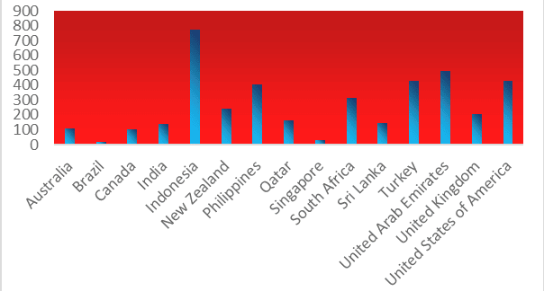
Average votes per country
Average Votes per Country: A Comparative Overview
A Comparative OverviewIn our analysis of Zomato's restaurant data, we observed notable differences in the average number of votes across various countries. These differences can largely be attributed to factors such as population size, market strategies, and overall restaurant ratings.
Indonesia & The Philippines: These countries lead in average votes per restaurant. The higher vote counts can be linked to their large populations and strong engagement with online platforms. Moreover, effective market strategies, such as promotions and user incentives, have successfully driven customer interaction and feedback, leading to more votes on Zomato.
Brazil & Singapore: In contrast, Brazil and Singapore have comparatively lower average votes per restaurant. This trend can be attributed to smaller populations and lower user engagement on the platform. Additionally, these countries often feature restaurants with lower ratings, which might discourage users from leaving feedback, further contributing to the reduced vote count.

Slide 8
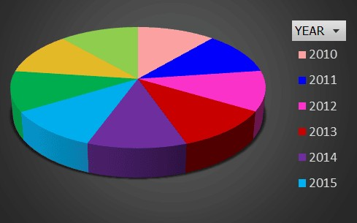
Annual Restaurant Openings Overview:
The data reﬂects a generally stable growth pattern in the restaurant industry, with occasional ﬂuctuations likely due to economic conditions or market dynamics. The peak in 2018 suggests a strong end to the decade, with signiﬁcant market expansion and consumer demand for new dining experiences.
Analyzing the data, we can observe the trends in restaurant openings across different years:
2010: 1,080 new restaurants were established, marking a strong start in the early part of the decade.
2011: The momentum continued with 1,098 new openings, showing a slight increase from the previous year.
2012: There was a small dip, with 1,022 restaurants opening, suggesting a slight market saturation or economic factors at play.
2013: The market rebounded with 1,061 new openings, indicating renewed growth in the restaurant sector.
2014: A slight decrease to 1,051 new restaurants, maintaining a steady pace despite minor ﬂuctuations.
2015: 1,024 new restaurants opened, reﬂecting a consistent demand for new dining options.
2016: The trend remained stable with 1,027 new establishments, showing resilience in the industry.
2017: There was a noticeable uptick, with 1,086 new openings, possibly driven by renewed consumer interest and market expansion.
2018: The decade closed on a high note, with 1,102 new restaurants, the highest number in the given year,
indicating robust growth and market conﬁdence.

Slide 9
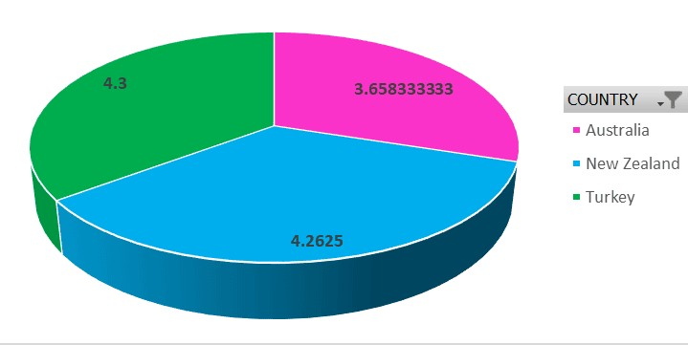
Current Quality of Restaurant Ratings Across Key Countries
The analysis of restaurant ratings across the countries in our dataset reveals signiﬁcant variations in customer satisfaction, which can be attributed to local dining preferences and cultural factors. In Indonesia and the Philippines, where we see a high volume of user engagement, the average ratings tend to be moderate to high, reﬂecting a well-developed food delivery market with diverse dining options that generally meet customer expectations. However, Brazil and Singapore present a different picture.
Recommendations:
Focus on High-Rating Areas: Consider expanding in cities or regions with higher average ratings as they indicate better market conditions and customer satisfaction.
Improve in Low-Rating Areas: Identify and address the reasons for low ratings in certain areas, Focus on improving service, food quality, and overall customer experience.
Customer Feedback: Regularly gather and analyse customer feedback to understand their preferences and expectations better.
Training and Quality Control: Invest in staff training and quality control measures to maintain high standards and improve customer satisfaction.

Slide 10
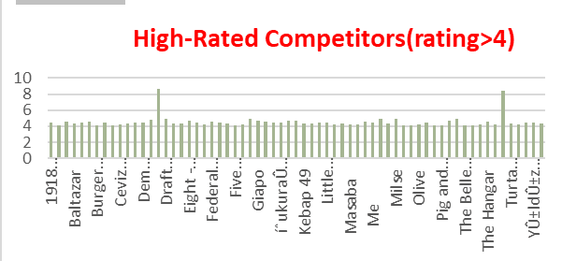
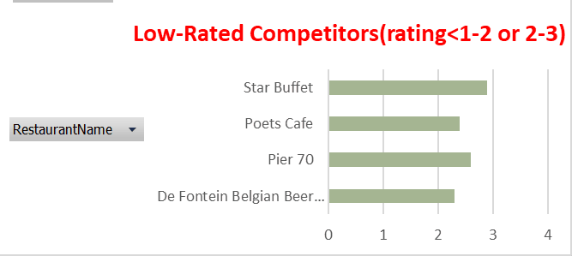
High-Rated Competitors:
These are restaurants within your target markets that consistently receive high ratings from customers. These ratings reﬂect strong customer satisfaction, likely due to factors such as excellent food quality, superior service, appealing ambiance, or effective marketing strategies. By benchmarking against these high-rated competitors, you can gain valuable insights into what makes these restaurants successful. Understanding their strengths allows you to adopt similar best practices, reﬁne your offerings, and enhance your competitive edge in the market.
To strengthen your restaurant's market position, it's essential to conduct a thorough competitive analysis by studying high- rated competitors. Understanding their strengths—such as menu offerings, service quality, and marketing strategies—can provide valuable insights for your business. Additionally, analysing low-rated restaurants helps identify common complaints and areas of weakness, allowing you to avoid similar issues and ensure a better customer experience.
Low-Rated Restaurants:
Conversely, restaurants with lower ratings often struggle with common issues that lead to customer dissatisfaction, such as poor service, inconsistent food quality, or an unattractive atmosphere. Analyzing these low-rated restaurants can reveal the pitfalls and challenges that other businesses have faced. By identifying these areas of weakness, you can ensure that your restaurant avoids similar mistakes. This analysis also provides an opportunity to differentiate your restaurant by focusing on the aspects where others have failed, ultimately offering a superior customer experience that sets you apart in the market.

Slide 11


E pand in High-Rating Areas
Recommendation:
Focus on expanding operations in cities and regions with consistently high average ratings.
Data-Driven Reason:
High ratings indicate strong customer satisfaction and favourable market conditions, making these areas ideal for new restaurant ventures.
Expected Impact:
Increased Market Share: By capitalizing on positive customer sentiment, Zomato can capture a larger share of the market in these regions.
Higher Proﬁtability: Successful new openings in high-rating areas are likely to drive higher revenues due to established customer loyalty and demand.

Slide 12

Improve Performance in Low-Rating Areas
Recommendation:
Identify and address the issues in regions with lower average ratings.
Data-Driven Reason:
Analysis of low-rated restaurants can reveal common pitfalls such as poor service, food quality, or ambience, which need to be rectiﬁed
Expected Impact:
Enhanced Customer Satisfaction: By addressing these issues, Zomato can improve overall customer experience, leading to better ratings and reviews.
Strengthened Market Position: Elevating performance in low-rated areas can reduce the risk of losing customers to competitors and improve Zomato's reputation in these regions.

Slide 13

Leverage Customer Feedback and Benchmarking
Recommendation 1:
Regularly gather and analyze customer feedback to make data- driven improvements.
Data-Driven Reason:
Continuous feedback helps identify shifting customer preferences and areas that require immediate attention.
Expected Impact:
Improved Customer Loyalty: Responding to feedback fosters trust and can lead to repeat business and positive word-of-mouth.
Recommendation 2:
Use high-rated competitors as benchmarks to set service and quality standards.
Data-Driven Reason:
Benchmarking against top-performing restaurants ensures that Zomato maintains or exceeds industry standards.
Expected Impact:
Consistency in Excellence: Adopting best practices from high-rated competitors can lead to consistent service quality, enhancing Zomato’s brand image and customer satisfaction across all regions.

Slide 14
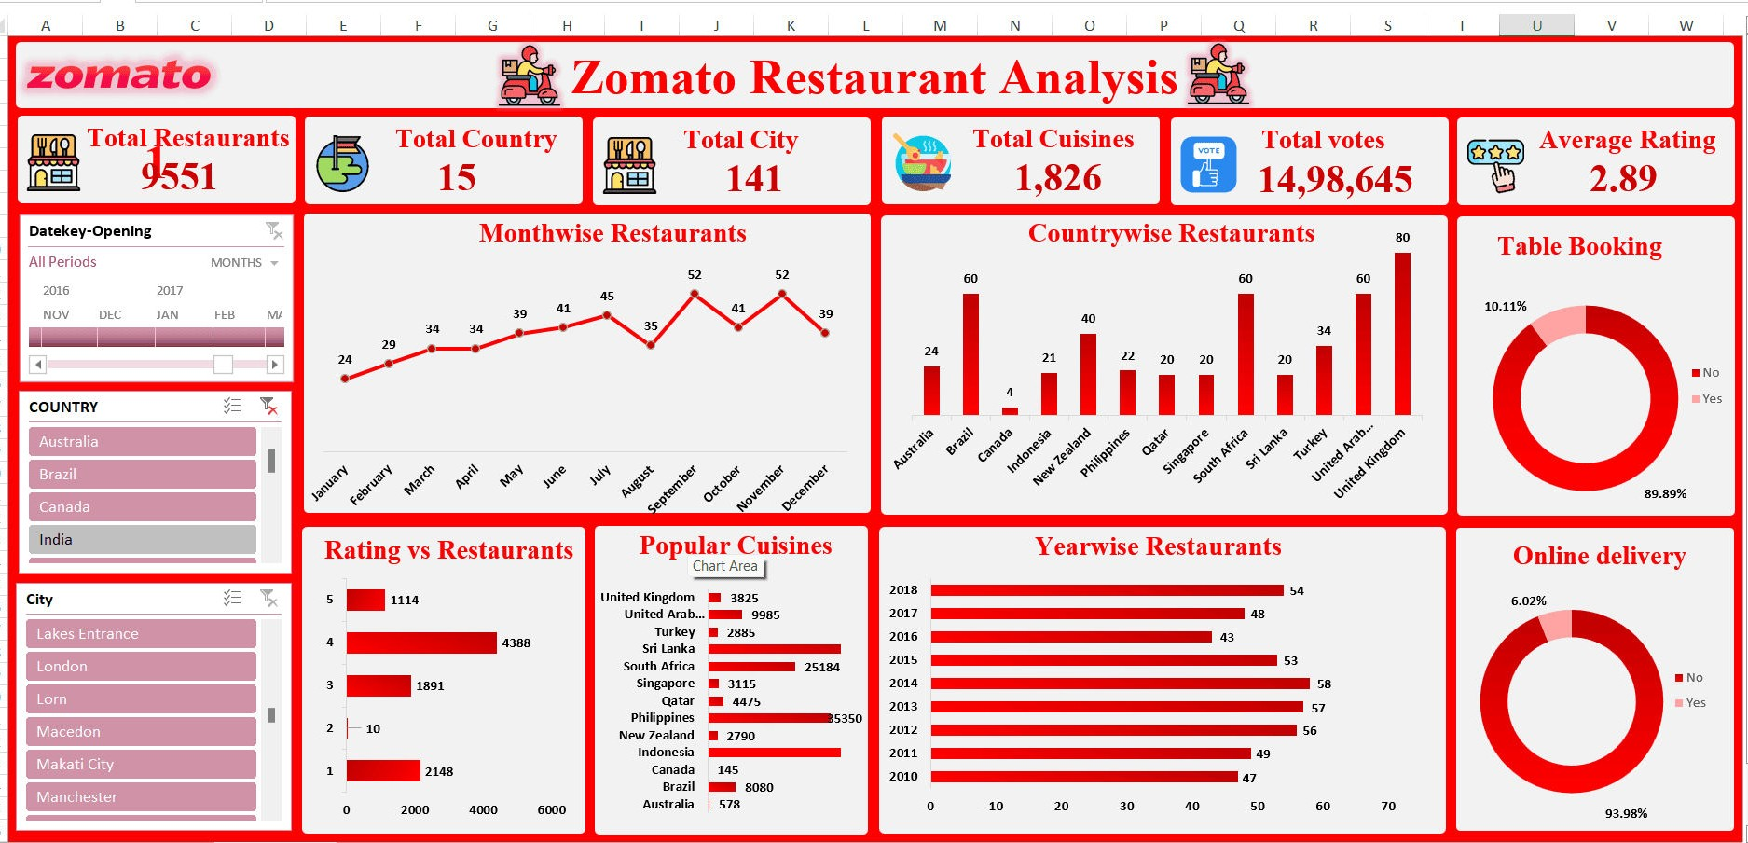
Dashboard and Visualizations

Slide 15
Showcase:
This dashboard provides a comprehensive overview of Zomato restaurant analytics, capturing key metrics across various dimensions. Here’s a breakdown of the dashboard elements:
Total Restaurants, Countries, Cities, Cuisines:
Displays a high-level summary of the Zomato dataset, showing the total number of restaurants (9,551), countries (15), cities (141), and cuisines (1,826) represented in the data. This gives a quick snapshot of the scale of operations.
Total Votes and Average Rating:
Summarizes user engagement through total votes (14,98,645) and provides an overall average rating (2.89). These metrics indicate customer interaction and satisfaction levels.
Month-wise Restaurants:
A line chart shows the number of restaurants added each month. The trend helps in understanding the growth over time and identifying peak periods.
Country-wise Restaurants:
A bar chart representing the distribution of restaurants across different countries, with the United Kingdom leading with 80 restaurants. This can inform market penetration and regional focus.
Table Booking and Online Delivery:
Donut charts provide insights into customer behavior, with high percentages for online delivery (93.98%) and table booking (89.89%). This highlights the importance of these services.
Rating vs. Restaurants:
A bar chart mapping the number of restaurants against their ratings. This helps in identifying how many restaurants fall within specific rating brackets, useful for quality assessment.

Slide 16
Popular Cuisines: A bar chart showcasing the popularity of different cuisines, with Turkey and Brazil being particularly notable. This insight can guide menu decisions and marketing strategies.
Year-wise Restaurants: A bar chart that tracks the number of restaurants opened each year, providing a historical perspective on business expansion.
Interpretation:
How to Read the Dashboard:
City and Region Analysis: The dashboard's heatmap shows areas with the highest average ratings, helping decision-makers identify potential regions for expansion.
Rating Distribution: Bar charts and scatter plots segment restaurants by ratings, allowing for a quick assessment of where the majority of high and low-rated establishments are located.
Time Series Analysis: Line charts track the number of new restaurant openings by year, offering insights into market growth and saturation points.

Slide 17
Interactivity:
Filters and Slicers: The dashboard includes ﬁlters for selecting speciﬁc cities, years, or rating ranges, making it easier to drill down into the data for more detailed analysis.
Example: Users can ﬁlter the dashboard to view only high-rated restaurants in a particular city, helping to focus on top-performing areas for strategic decision-making.
Relevance to Decision-Making:
Informed Strategy: These visualizations provide a clear understanding of market dynamics, enabling data-driven decisions for expansion, quality improvement, and competitive analysis.
Real-Time Insights: Interactive features allow stakeholders to explore different scenarios, ensuring that the recommendations are aligned with the latest data trends.

Slide 18


Conclusion
This analysis of Zomato’s restaurant data reveals several critical insights:
L. Global Reach and Diversity: With over 9,500 restaurants across 15 countries and 141 cities, Zomato has established a signiﬁcant global presence. The diverse range of 1,826 cuisines underscores its appeal to a wide variety of customers.
Customer Engagement: The platform's substantial user engagement is reﬂected in nearly 1.5 million votes. However, the relatively low average rating of 2.89 suggests room for improvement in customer satisfaction, particularly in speciﬁc regions or cuisines.
Key Trends: The growth trend shows a consistent increase in
restaurant additions month over month, peaking in mid-year. The UK and UAE are leading markets, with the highest number of restaurants. Additionally, online delivery and table booking services are essential, with extremely high adoption rates among users.
“. Strategic Focus Areas: The popularity of certain cuisines like Turkish and Brazilian offers a pathway for targeted marketing and expansion. Meanwhile, the distribution of restaurant ratings calls for quality improvement initiatives, especially for restaurants with lower ratings.

Slide 19

Thanks!

