Slide 1
Machine Learning
Predicting how long an employee is going to stay in a company

Slide 2
Data gathering and preparation
Python script to search employees (TCS)
Another python script to save data for each employee
Python script to arrange all employee data in a csv
Manual preparation of data

Slide 3
Features
Degree: [Bachelors, Masters, MBA, Others]
College-Type: [International, IITs/IIMs, NITs/BITS/XLRI/etc, Others]
TCS-Joining-Date:
Experience while joining TCS
TCS Job profile: [Leader, Manager, HR, Developer/QA]
Gender

Slide 4
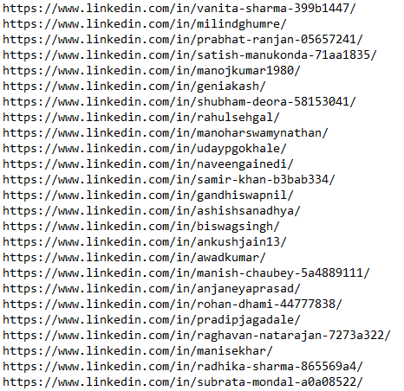
Employee profile URL List

Slide 5
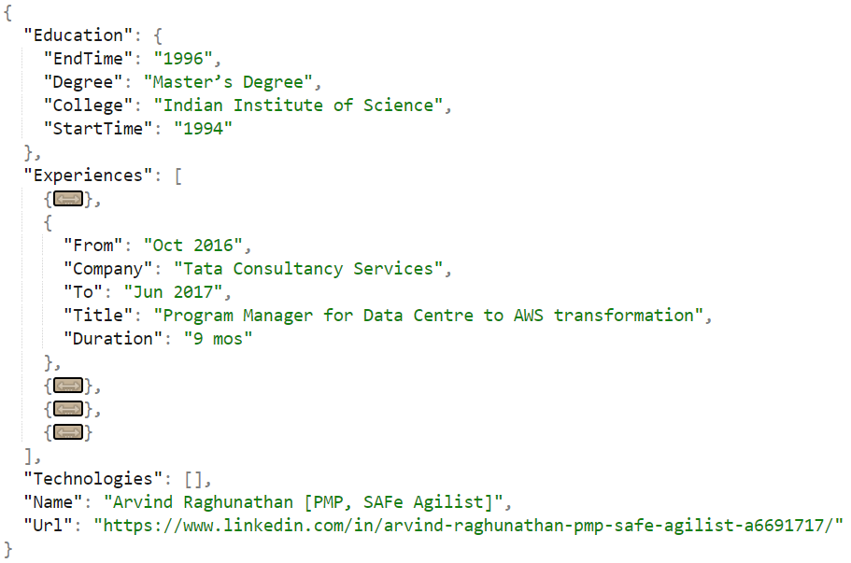
Sample data from LinkedIn

Slide 6
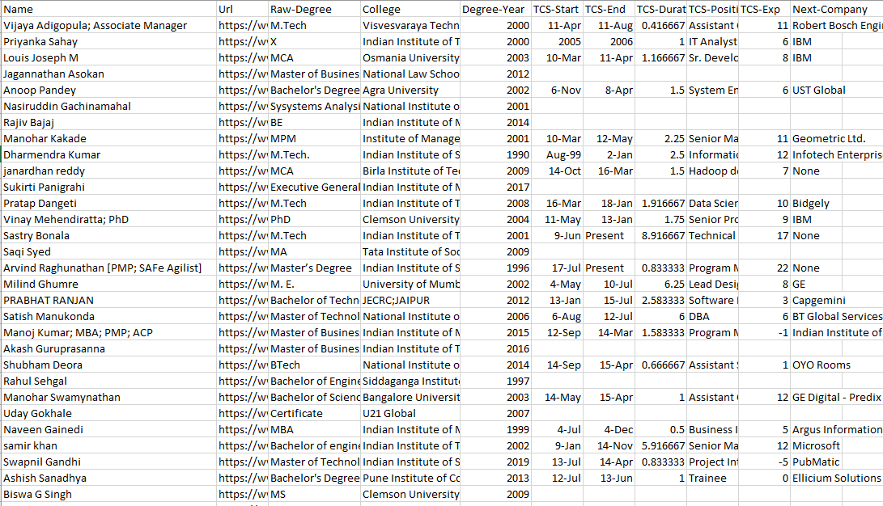
Raw Data

Slide 7
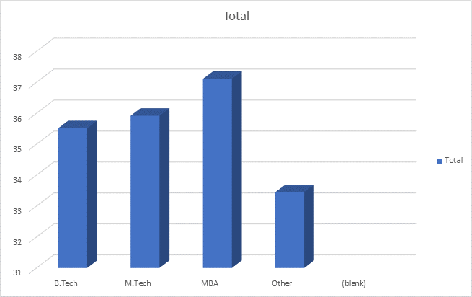
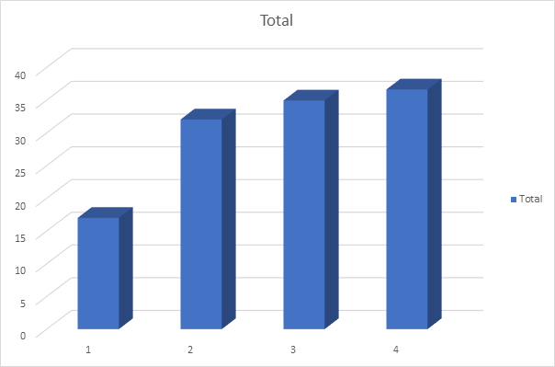
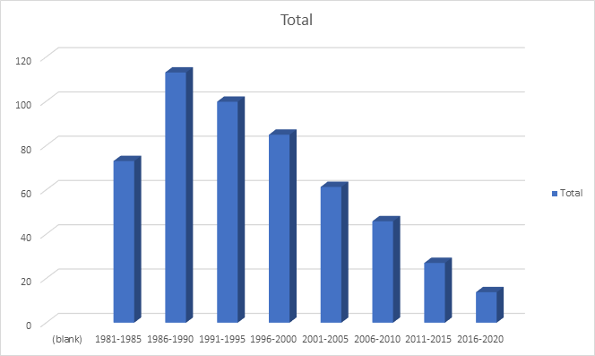
Understanding Problem

Slide 8
Understanding Problem
A pattern was there but only in the averages
Individual data are not corelated
Regression gave only 50 percent accuracy
This was a categorical problem

Slide 9
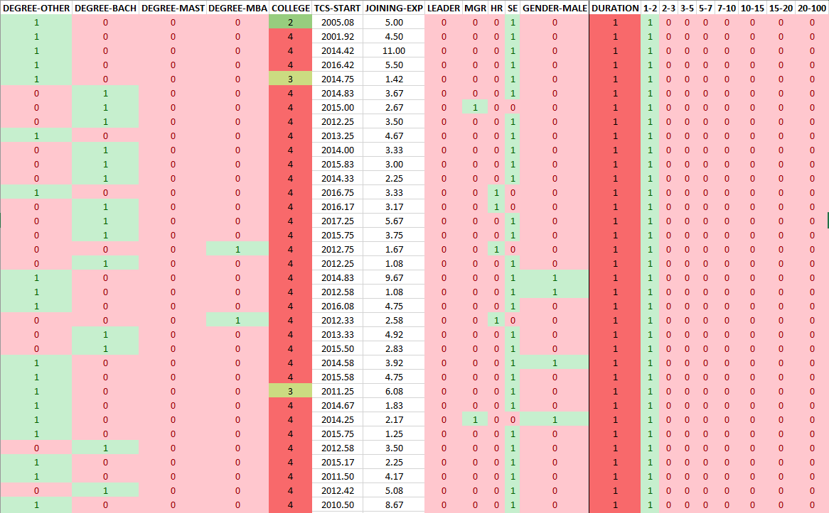
Prepared Data

Slide 10
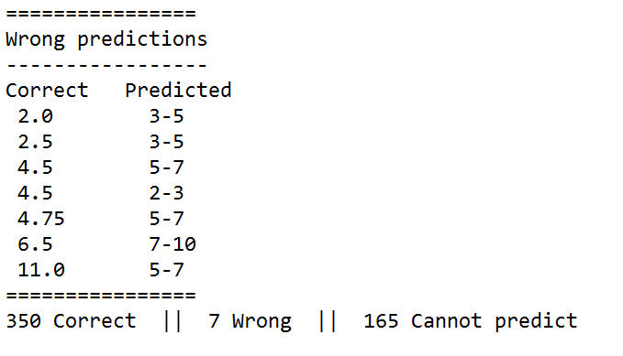
Result

Slide 11
Challenges / Problems
Converting a continuous Y to categorical Y creates confusion near boundaries
There is a possibility of error in data interpretation
Too less data
Too less features

Slide 12
Thank you

