Slide 1
Customer Retention by Bank Telemarketing Analytics
Team Details
Kamalesh reddy
Soumik Chatterjee
Ramadurgam Rajeev Kasyap
Subhashree Panda
Sadashivuni Sushant

Slide 2
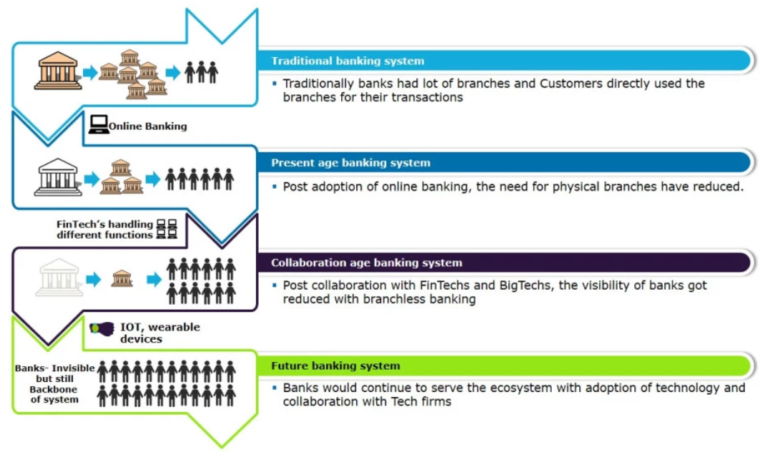
Future of Banking

Slide 3
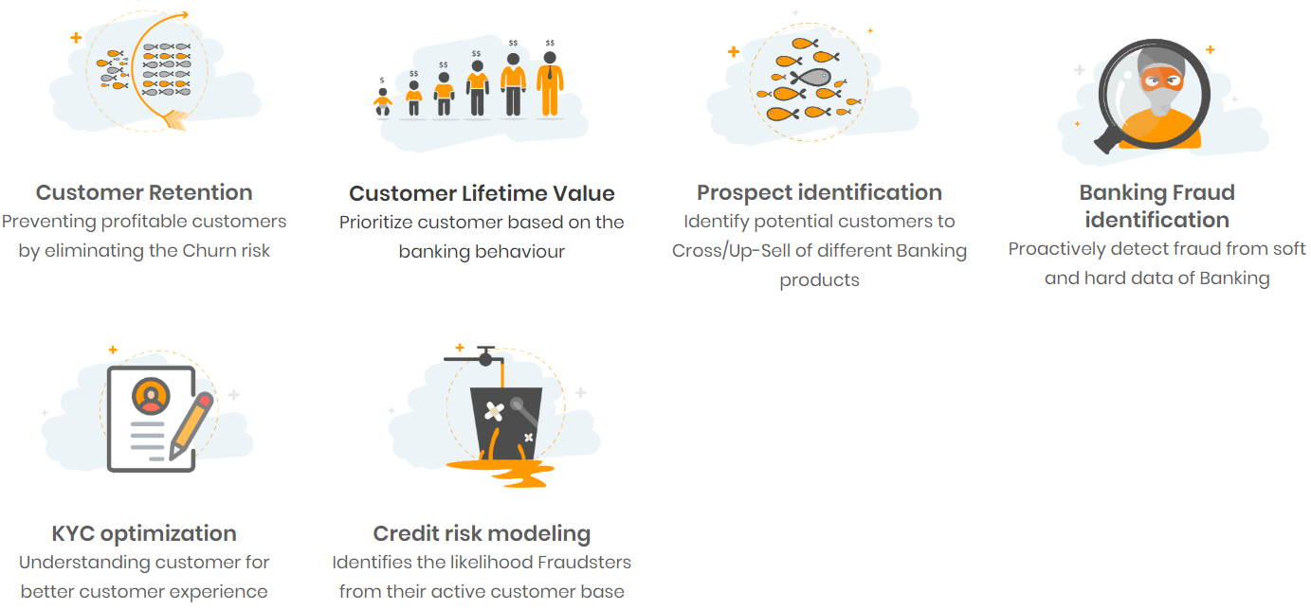
Role of Analytics in Banking

Slide 4
Dataset Description (6 Numerical Features)
Serial No | Numeric Variable/Feature/ Column | Feature Description | Min / Max Values
1 | age | Age of bank customer collected on calling; ranges right from the very young to the very old | Min- 18years; Max-95years
2 | balance | Avg yearly balance of customer (client) at the specific moment of telemarketing; currency = Euros | Min: -8019 (negative) euros; Max: 102127 euros
3 | duration | Amount of time spent with the client(customer) over the call during the telemarketing process (in sec) | Min- 0 ;Max- 4918 (82 minutes~ 1hour22minutes)
4 | campaign | How many times reached out to the same client for the telemarketing purposes in current campaign | Min- 1; Max-63
5 | pdays | Number of days that passed by after the specific bank client was reached out to in any of the last campaigns; -1 value means client was never made contact with | Min - 1 ; Max - 871 (2.3 years); -1 = No past contact
6 | previous | Number of contacts made before current campaign for specific client | Min- 0 ; Max- 275
Dataset Description:
NUMERICAL FEATURES

Slide 5
Dataset Description(12 Categorical Features)
Serial No | Categorical Variable/Feature/ Column | Feature Description
1 | job | Type of job held by client (Categories: admin, management, housemaid, entrepreneur, student, blue-collar, technician, services, self-employed, unemployed, unknown) (11)
2 | marital | Marital status of client. (Categories: single, married, divorced; divorced can be either divorced or widowed) (3)
3 | education | Highest education attained (Categories: primary, secondary, tertiary, unknown) (4)
4 | default | Whether client has credit in default or not; meaning defaulter (Yes/No) (2)
5 | housing | Has housing loan or not? (Yes/No) (2)
6 | loan | Has personal loan or not? (Yes/No) (2)
7 | contact | Contact communication type (Cellular/telephone/unknown) (3)
Dataset Description:
NUMERICAL FEATURES

Slide 6
Serial No | Categorical Variable/Feature/ Column | Feature Description
8 | day | Last contact day of the month
9 | month | Last contact month of year.
10 | education | Highest education attained (Categories: primary, secondary, tertiary, unknown) (4)
11 | poutcome | Outcome of the previous marketing campaign (Success/Failure/Other/Unknown) (4)
12 | Y | Target variable (Customer subscribed / Customer Not subscribed) (Yes/No) (2)
Dataset Description:
NUMERICAL FEATURES

Slide 7
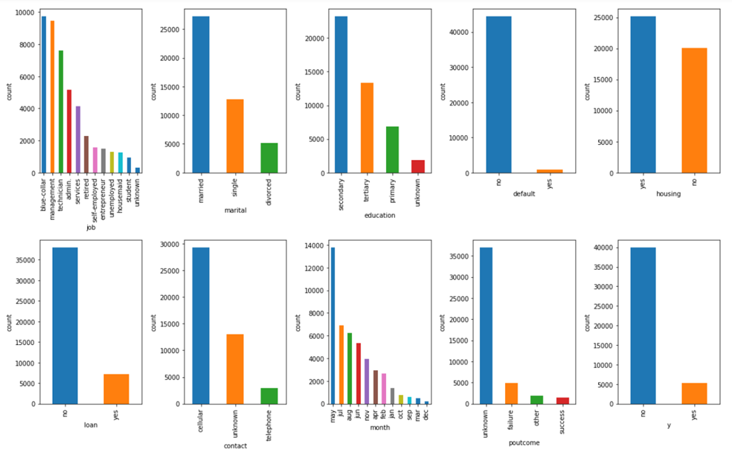
Exploratory Data Analysis
Univariate Analysis(Categorical Features):

Slide 8
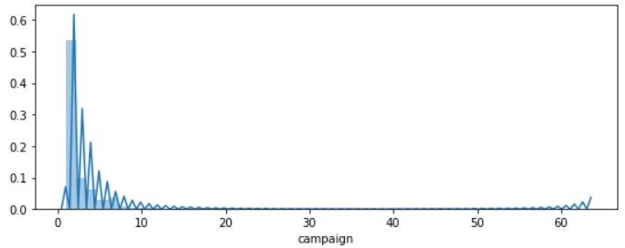
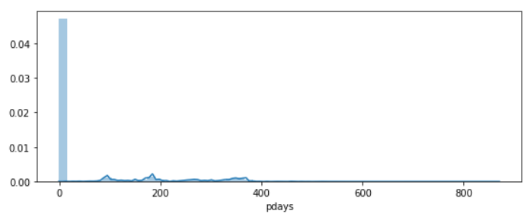
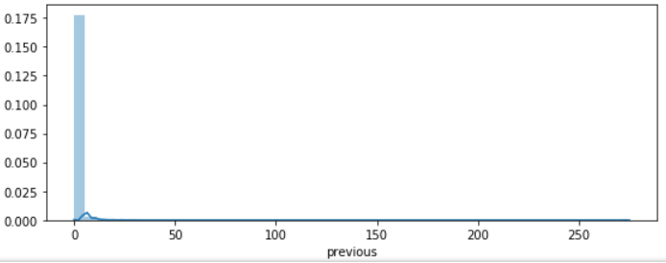
Numerical Features:

Slide 9
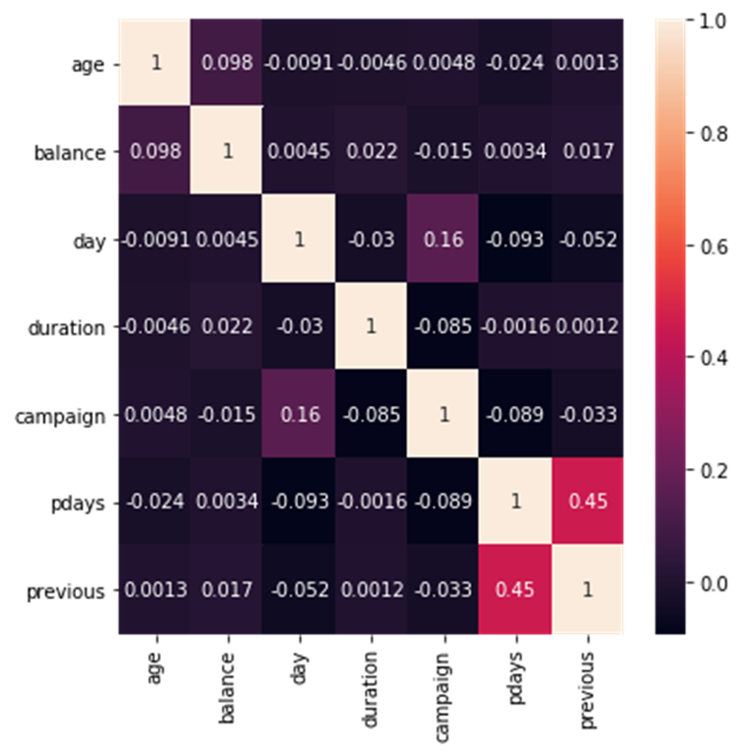
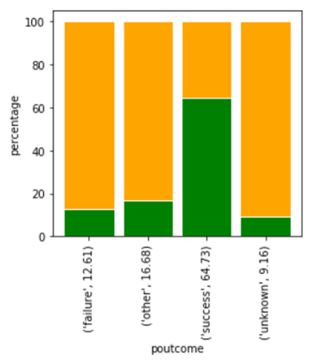
Co-relation and Analysis dive

Slide 10
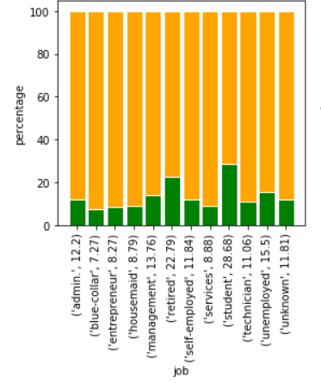
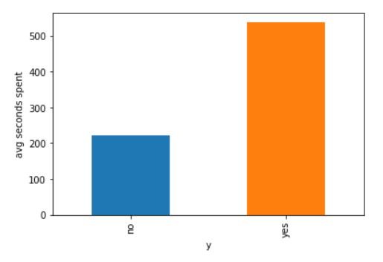
So, Those who subscribed for the term deposit. Spent an average of 500+ seconds on the means of communication
We can see that mostly it’s retired or the students who subscribed for the term deposit.

Slide 11
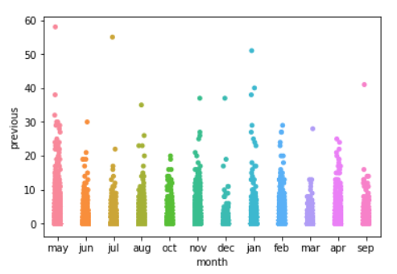
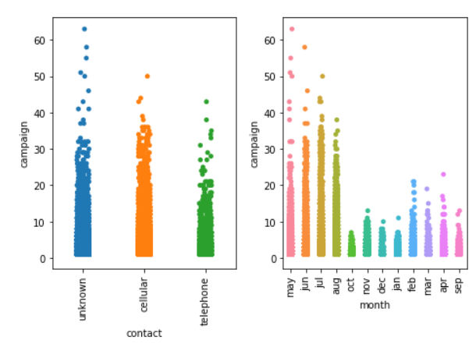
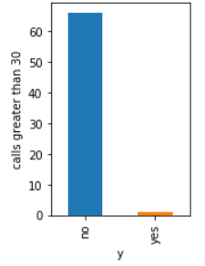
Month: So, Here the campaign is mostly carried out in the months of May, July, August and June. Moderately in the months of September, October and March. Less in the months of January, February, April, November and December
Surprised even though the calls are made frequently, the campaigners could not make customers subscribe for the term deposits.

Slide 12
Data Preprocessing/ Feature Selection, Engineering
Checking for null values in the dataset.
Grabbing the categorical columns and converting the object datatype to Category.
Outlier removal is not being carried out since the bank cannot afford losing its valuable customer data.
We performed scaling on the numeric features of the dataset, this yielded the same overall performance of the model as before scaling. But, Improved the perform of KNN.
We performed chi-square test for every categorical variable with the target 'y' categorical variable to check for the independence. All the features were showing equal importance.
We created new features and also performed Label, One Hot Encoding.

Slide 13
Base Model Building
We have taken our base model as logistic regression, because logistic regression is a machine learning algorithm which is used for the classification problems. It is a predicative analysis algorithm and based on the concept of probability.
It does not require input features to be scaled and there is no need for tuning. Because of the simplicity it can be implemented easily and quickly so logistic regression is a good baseline model.
We can call a Logistic Regression a Linear Regression model but the Logistic Regression uses a more complex cost function, this cost function can be defined as the ‘Sigmoid function’ or also known as the ‘logistic function’ ” so that all the values come under 0 to 1.
We can set threshold in logistic regression so that the value above the threshold will be predicted as positive class or 1 and the value below the threshold will be predicted as negative class or 0. For example we have set threshold as 0.5 then if output of the sigmoid function is more than 0.5, we can classify the outcome as “yes” or 1. If it is less than 0.5, we can classify as “No” or 0.

Slide 14
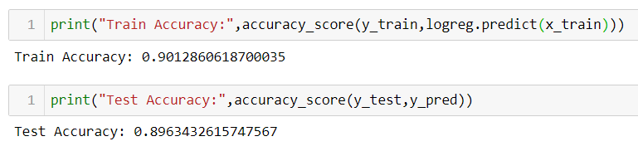
Train test split:
We can consider all independent features as X and one dependent feature as y by using train test split we can split the data into 80/20 or 70/30 or whatever ratio we want i.e. for 70/30 70% of the random data goes in to training and remaining 30% of the data goes in to test or validation set. Since we are having imbalance in the data, to capture it we can train the model on more training records i.e. 80/20.
After splitting we are training the model with training data and evaluating model performance using validation set.
By seeing 90 % training and testing accuracy we should not judge that our model is working well when our data is imbalanced. We need to check important metrics such as f1score, precision, recall (precision and recall can be referred from confusion matrix) and then come to a conclusion.

Slide 15
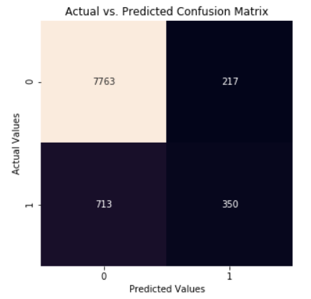
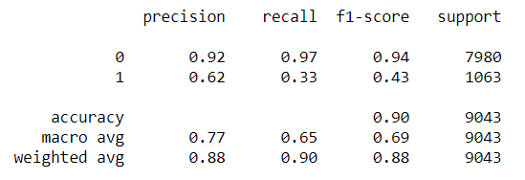
Confusion matrix
Confusion matrix not only indicates about the error made by our classifier but also let us know what type of error it is.
It tells us about precision, recall and f1_score of both the classes
So we choose f1_score as a metric for our evaluating our model performance rather than accuracy
But f1_score is too low for the class 1 which tells us the model is biased toward class 0 due to data imbalance.

Slide 16
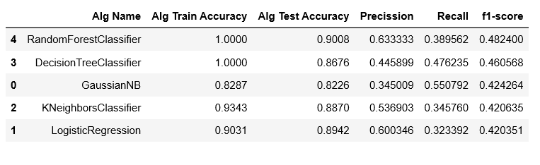
A Tabular representation of various metrics for different algorithms

Slide 17
Data Imbalance
We at least expect our binary class in the target variable to be in the ratio of 70:30 so that the minority class would be captured as well
But our data is suffering with imbalance (ratio:- 88:12)
So training our model with this imbalanced data leads to biased results. Majority class in the predicting variable would be captured more.
Model predicted clients who subscribed for term deposit as not subscribed( 713 False negative)(Type 2 error) which are costly.
In order to overcome this problem resampling of data must be done (over sampling or under sampling)
To prevent loss of data and to train the model with more samples of data we would like to implement over sampling rather than under sampling.

Slide 18
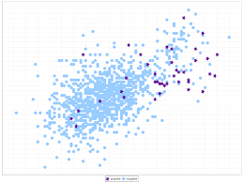
Resampling techniques
Since we are having imbalance in data we are going to apply resampling techniques to our data making our binary class target variable in equal proportions
Used techniques:- smote, random under sampling, smotetomek.

Slide 19
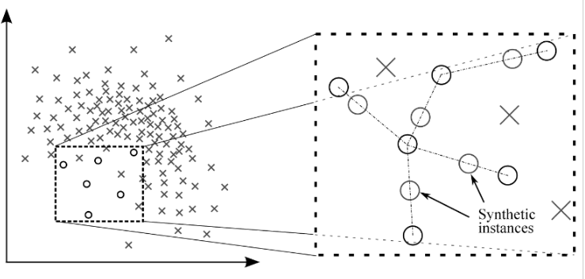
smote
Smote: It generates synthetic minority examples to over-sample the minority class. Its main idea is to form new minority class examples by interpolating between several minority class examples that lie together

Slide 20
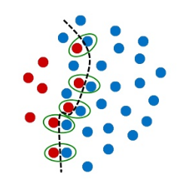
smotetomek
Smotetomek : Also known as oversampling with under sampling. smote will over sample minority where as Tomek links can be used as an under-sampling method or as a data cleaning method. Tomek links to the over-sampled training set as a data cleaning method

Slide 21
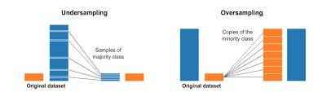
Random under sampling
Random under sampling : Random under-sampling is a non-heuristic method that aims to balance class distribution through the random elimination of majority class examples

Slide 22
selecting best sampling technique
Now to choose the best sampling technique to our data we have resampled our data using all three techniques and fitted our resampled data to al eight models and taken the mean of f1_score of all eight models to check which sampling is performing better

Slide 23
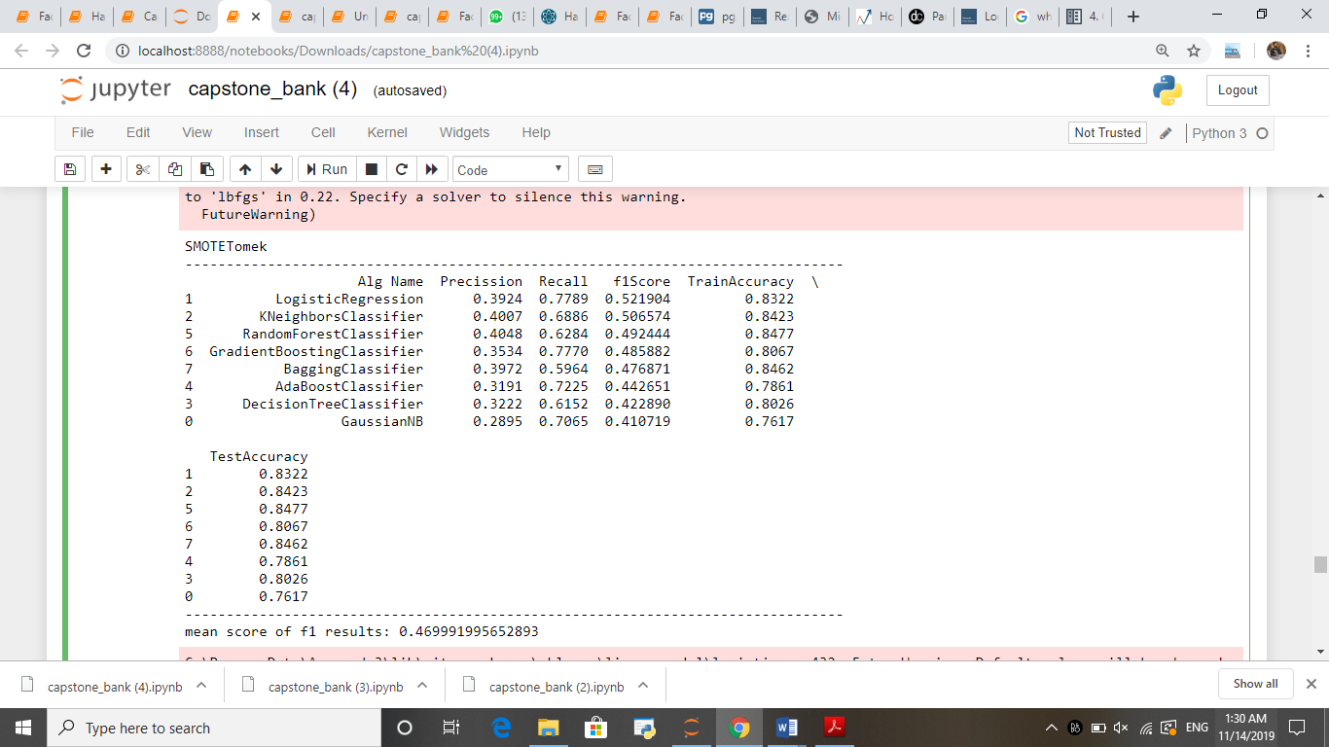

Slide 24


Slide 25
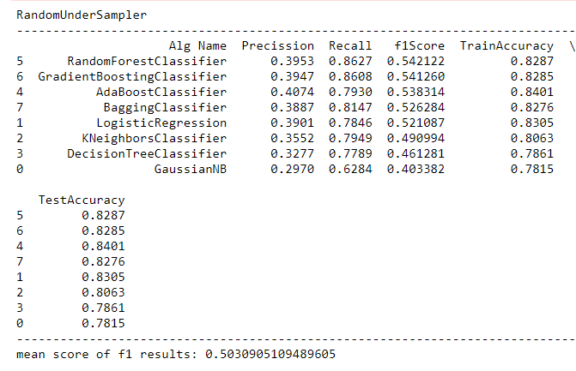

Slide 26
By looking at the above mean f1_scores we obtained better f1_score for random under sampling.
By using random under sampling with random forest along with hyper parameter tuning model we landed with descent f1_score and good recall score around 90

Slide 27
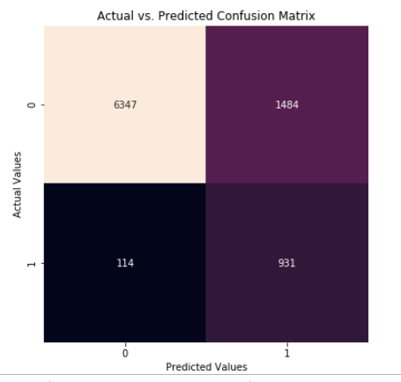
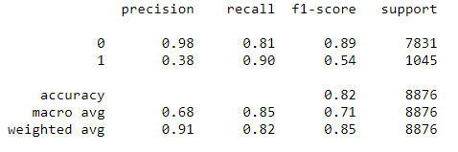

Slide 28
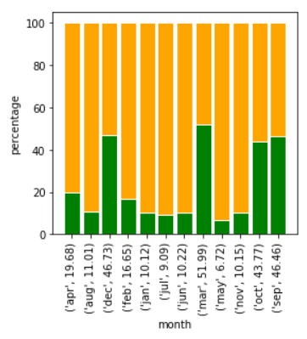
Solutions to the business:
Though the campaign is in high volume for the month may. The customers did not subscribe much for the term deposits. Months March, October, September and December are the potential months . Future campaigns can be carried during these months .
Can target old customers.
An average contact duration of 500 seconds is resulting in positive outcomes.
Target retired and students during the campaigns .

Slide 29
Thank You!!!

