Slide 1
What is ASP.NET MVC?
A new Web Application Project type
Simply an option
    Not a replacement for WebForms
Notes:
MGB 2003
© 2003 Microsoft Corporation. All rights reserved.
This presentation is for informational purposes only. Microsoft makes no warranties, express or implied, in this summary.

Slide 2
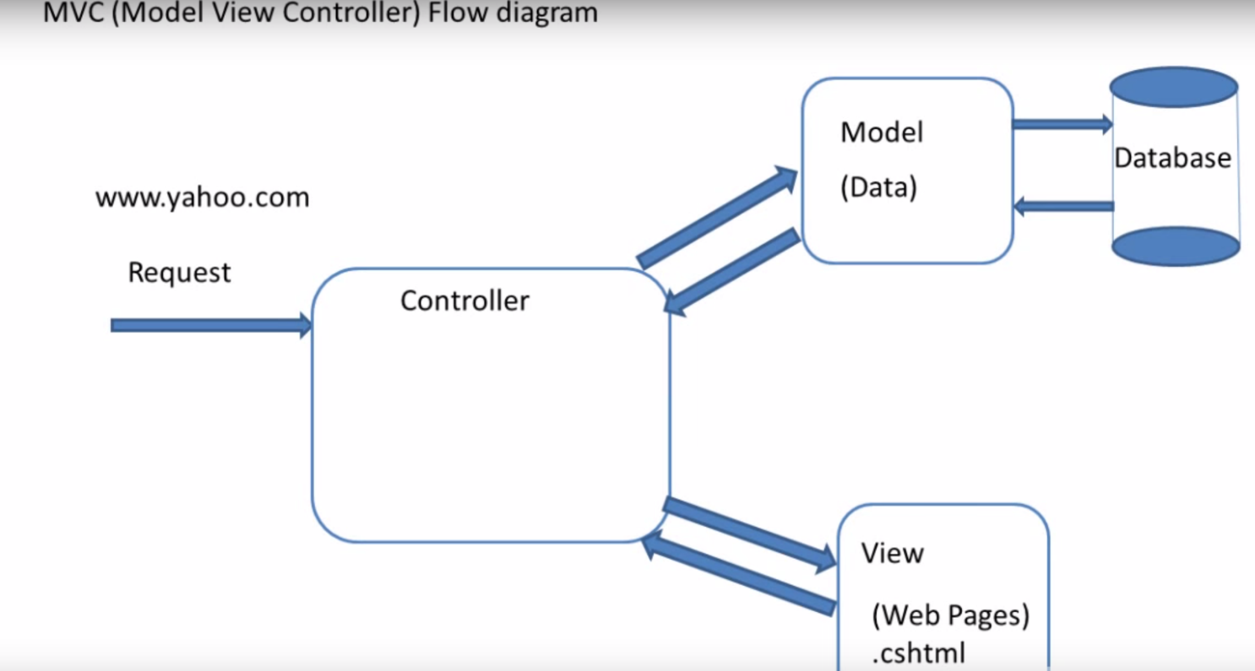
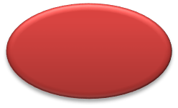


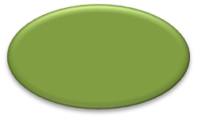
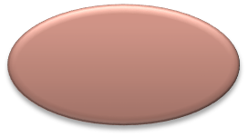

What is MVC?
Model
View
Controller
Notes:
MGB 2003
© 2003 Microsoft Corporation. All rights reserved.
This presentation is for informational purposes only. Microsoft makes no warranties, express or implied, in this summary.

Slide 3
What MVC is not ?
Not the new Web Forms 4.0
Not replacing Web Forms, but Adds to it
It can not use Web Controls
Not a whole new engine but sits on ASP.NET engine
Not the best solution for REST

Slide 4

Maintain Clean Separation of Concerns
Extensible and Pluggable
Enable clean URLs and HTML
Great integration within ASP.NET
Tooling Support
Notes:
Microsoft ASP.NET Connections
Updates will be available at http://www.devconnections.com/updates/LasVegas _06/ASP_Connections

Slide 5
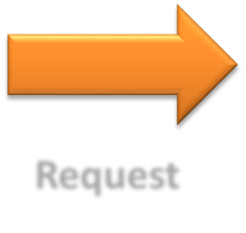
MVC Flow
Controller
Request
Step 1
Incoming request directed to Controller
Notes:
MGB 2003
© 2003 Microsoft Corporation. All rights reserved.
This presentation is for informational purposes only. Microsoft makes no warranties, express or implied, in this summary.

Slide 6


MVC Flow
Controller
Model
Step 2
Controller processes request and forms a data Model
Notes:
MGB 2003
© 2003 Microsoft Corporation. All rights reserved.
This presentation is for informational purposes only. Microsoft makes no warranties, express or implied, in this summary.

Slide 7

MVC Flow
Controller
View
Step 3
Model is passed to View
Notes:
MGB 2003
© 2003 Microsoft Corporation. All rights reserved.
This presentation is for informational purposes only. Microsoft makes no warranties, express or implied, in this summary.

Slide 8


MVC Flow
Controller
View
Step 4
View transforms Model into appropriate output format
Notes:
MGB 2003
© 2003 Microsoft Corporation. All rights reserved.
This presentation is for informational purposes only. Microsoft makes no warranties, express or implied, in this summary.

Slide 9
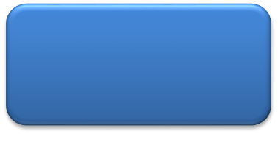
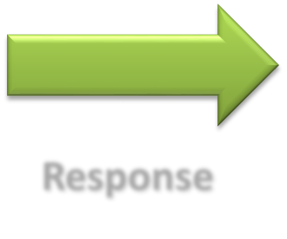
MVC Flow
Controller
View
Response
Step 5
Response is rendered
Notes:
MGB 2003
© 2003 Microsoft Corporation. All rights reserved.
This presentation is for informational purposes only. Microsoft makes no warranties, express or implied, in this summary.

Slide 10

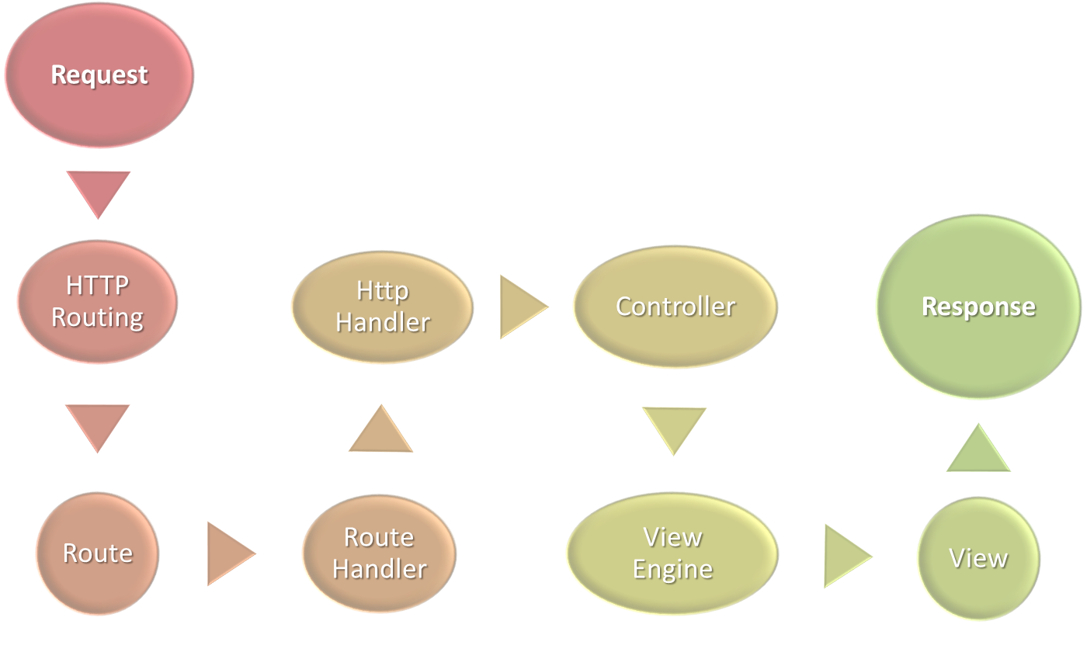
Notes:
Microsoft ASP.NET Connections
Updates will be available at http://www.devconnections.com/updates/LasVegas _06/ASP_Connections

Slide 11
Forms & Action Filters
Inject code interceptors into the request of a MVC controller
Package-up and re-use functionality in a clean declarative way
Predefined Action Filters
Custom Filters
Notes:
Microsoft ASP.NET Connections
Updates will be available at http://www.devconnections.com/updates/LasVegas _06/ASP_Connections

Slide 12
To MVC or not To MVC, That’s the <?/>
MVC | Web Forms
You want full control over markup | You like programming against the reusable control abstraction that encapsulate UI and logic
You want a framework that enforces separation of concerns | You like using the WYSWIG designer and would rather avoid angle brackets
TDD/Unit Testing is a priority for you | You like keeping logic on the server rather than hand writing Javascript
Control abstractions get in your way more than they help | Unit testing with the MVP pattern is sufficient for your needs
You like writing Javascript

Slide 13
