Slide 1
Sentiment Analysis based stock market recommendations
Rajeev Aravindakshan Nair
06/Apr/2020

Slide 2
20
Rajeev Aravindakshan Nair

Slide 3
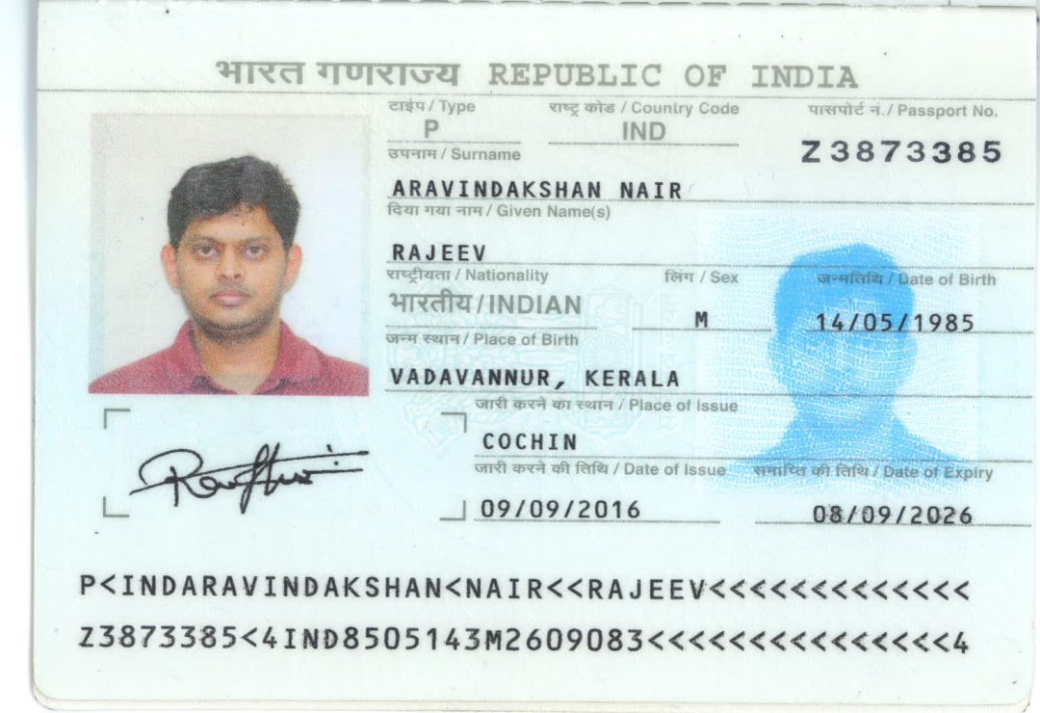
Government Issued Photo ID

Slide 4
Project Goal and Importance
The Goal of the project is to create a Minimum Viable Product (MVP) that leverages NLP technique to recommend buy/sell/hold action on various stocks.
I believe, that this is a promising project on account of two things :
First, the goal of this project is to build a scalable model on top of the large tranche of primary research available on internet. This we call wisdom of the ‘informed’ crowd.
Secondly, In Deep Learning, NLP, is a fast emerging field of study. In medium-to-long term roadmap of this product, I want to build a rigorous NLP based classification and prediction capability to the product and build a SAAS business model on top of it.

Slide 5
Literature Review/Background
There are a lot of original research on the topic. Both in NLP as an independent domain and NLP specifically for doing sentiment analysis for stock trading.
My project (though in its MVP stage uses only one website, finviz.com, to analyze sentiment of various stocks) envisages to use a multitude of other data sources such as tweets, google search, key blog commentaries and headlines to predict ticker movements of important stocks.

Slide 6
Assumptions and Choice of Technology
I have used Finviz.com as the sole source of news data.
Python was used as the scripting language. Also used packages such as NLTK, Pandas, Beautifulsoup, os and progressbar.
I have used NLTK as the NLP package and relied solely on the vader module to get corpus of positive and negative words. (We will have to build a better custom corpus to fine tune the model).
Analyses was limited to FAANG stocks.

Slide 7
Peer Review Feedback
One key suggestion was to focus on emerging markets. However, I couldn’t implement this for the lack of time.
There was a comment on lack of clarity. With the first version of MVP, I think I have set some direction for the final product.

Slide 8
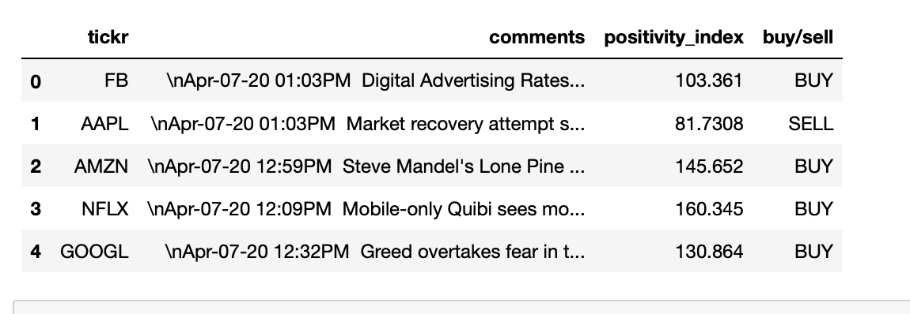
Summary of Results (1/2)
Output of FAANG sentiment analysis is as shown below :

Slide 9
Summary of Results (2/2)
Clearly outline:
The initial goal was to develop a minimum viable product that uses some of the predefined python packages to perform sentiment analysis based on some publicly available blog/website.
Novelty : I have endeavoured to define a new metric of positivity_index. A positivity index of 100 represents neutral (/hold) position and a positivity_index of > 100 corresponds to buy and a positivity_index < 100 corresponds to sell.
Lessons learned : Need to build a better corpus of positive and negative words and need to spend significant amount of time in scraping and cleaning data from a variety of websites.

Slide 10
Your Contribution
I am the sole member of the team.

Slide 11
Conclusions
My final conclusion is that using NLP for making trading decisions is a promising endeavor.
I wanted to establish a more complete product. However, it would mean that I need to do a lot of backdated scraping. Couldn’t cover that as part of the project scope. I believe the MVP submitted could have been better and broader in scope.

Slide 12
Future Scope of Work
Curate a list of websites that’s relevant for doing sentiment analysis.
Scrape and create a repository of comments for a longer period of time.
Build a corpus of positive and negative words that’s mostly seen in stock market commentaries.
Quantify the weightage of various buy/sell trades based on positivity_index. This would involve a lot of back-testing.

Slide 13
Thank You.

