Slide 1
INVESTMENT ASSIGNMENT SUBMISSION
Name: Rajeev Suresh Badgujar

Slide 2
Objectives
Investment amount target
between 5 to 15 million USD
Funding type
One of the seed, angel, venture or private equity type
Targeted demography
Countries with English as official language
Follow smart money
Invest in companies/sector where investment is flowing

Slide 3
Approach
Data Understanding & Cleaning
Understand Data
Clean
Data
Prepare Data
Domain Understanding
Propose Funding Type
Propose Countries
Business Case
Propose Sectors for Investment

Slide 4
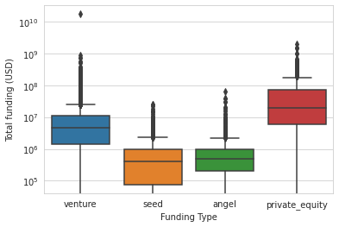
Type of Funding
The median deals in seed and angel funding are less than the Funds target amount
For private equity the deal sizes are higher than the Funds target amount
The Fund should consider venture type of funding as it suits the Funds investment target

Slide 5
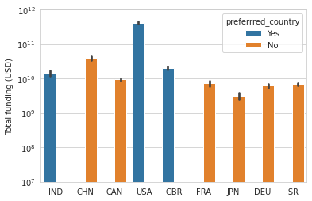
Countries to look for
The countries to consider for investment are
USA
Great Britain
India
English not official in China

Slide 6
Sectors to look for
Select sectors which received most number of investments
In USA the Fund should invest in
Social, Finance, Analytics, Advertising: 2714 investments
Cleantech / Semiconductors: 2350 investments
News, Search and Messaging: 1783 investments
In Great Britain the Fund should invest in
Social, Finance, Analytics, Advertising: 133 investments
Cleantech / Semiconductors: 130 investments
News, Search and Messaging: 73 investments
In India the Fund should invest in
Social, Finance, Analytics, Advertising : 60 investments
News, Search and Messaging : 52 investments
Entertainment : 33 investments
Note: To get better clarity on sectors we skipped the sector ‘Others’ from analysis

Slide 7
The funding type

Slide 8

Top three countries

Slide 9
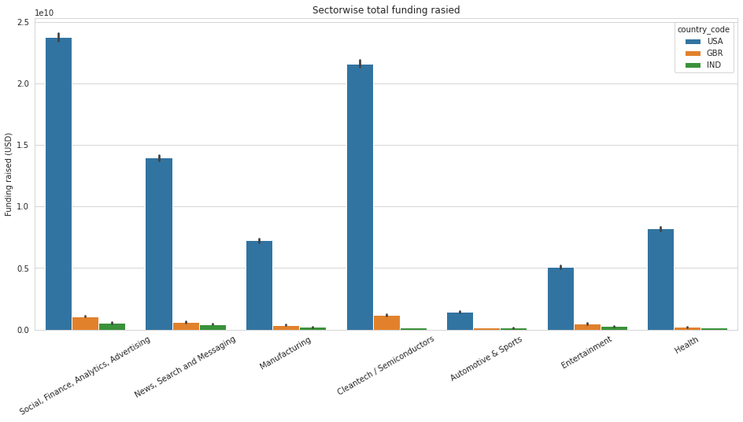
Sector wise total investment

Slide 10
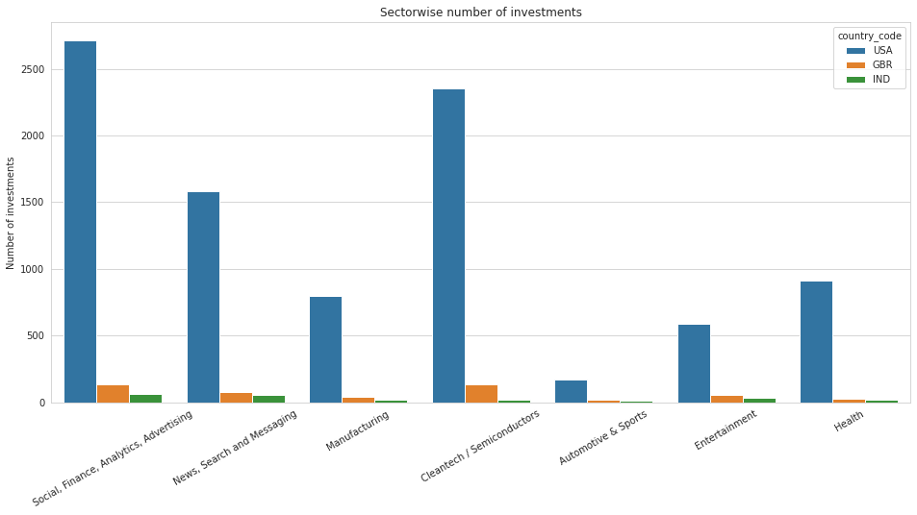
Sector wise number of investments

Slide 11
Conclusions
The venture type is most suitable to investment style for the fund
The Fund should invest in top English speaking countries – USA, Great Britain and India
The Fund should target below sectors for investment
Social, Finance, Analytics, Advertising
Cleantech / Semiconductors
News, Search and Messaging
Entertainment

