Slide 1
MULTIPLAYER GAME
USING NODE, EXPRESS AND SOCKET.IO
A Project By:
Shekhar Tiwari
Yadav Saurav Shivshanker
Rajeev Lochan Pandey
Under The Guidance of Dr Nishant Shrivastav

Slide 2
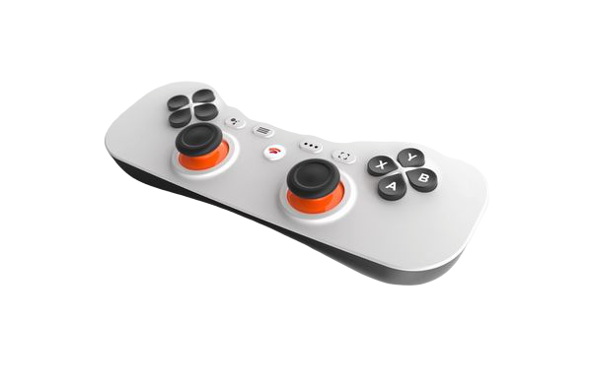
What And Why
Multiplayer
Tank Game
Uses Node as Backend
Upto 10 Players Can Play Locally
A Childhood Dream

Slide 3

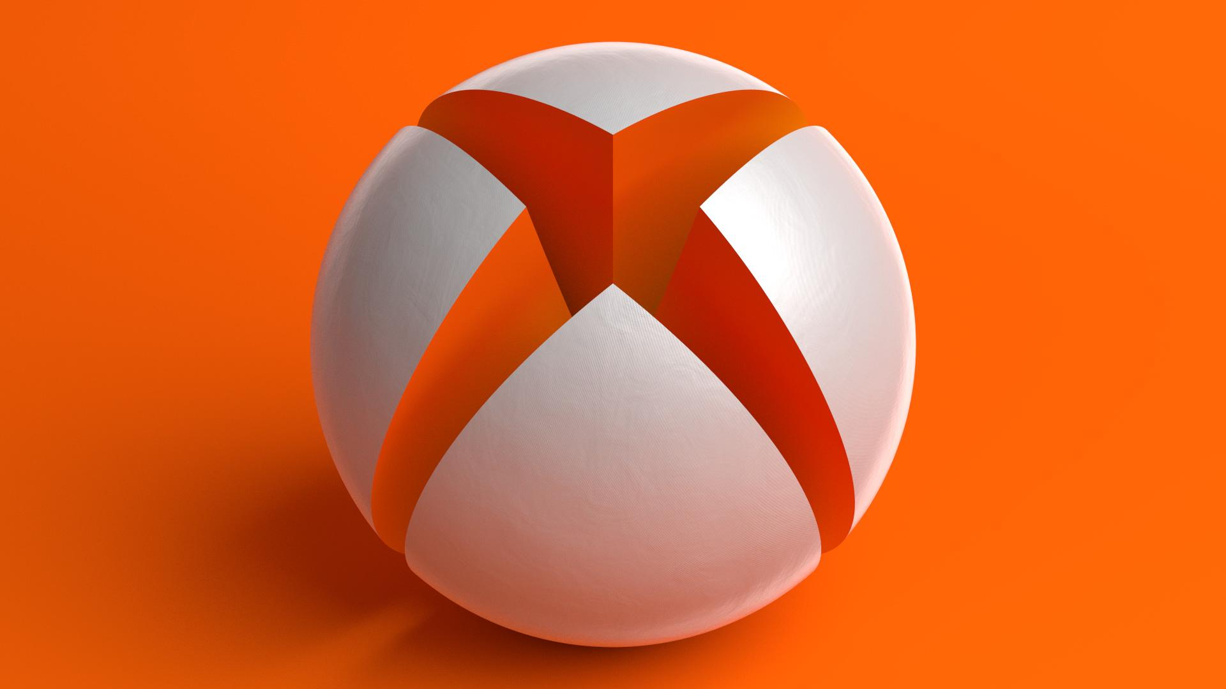
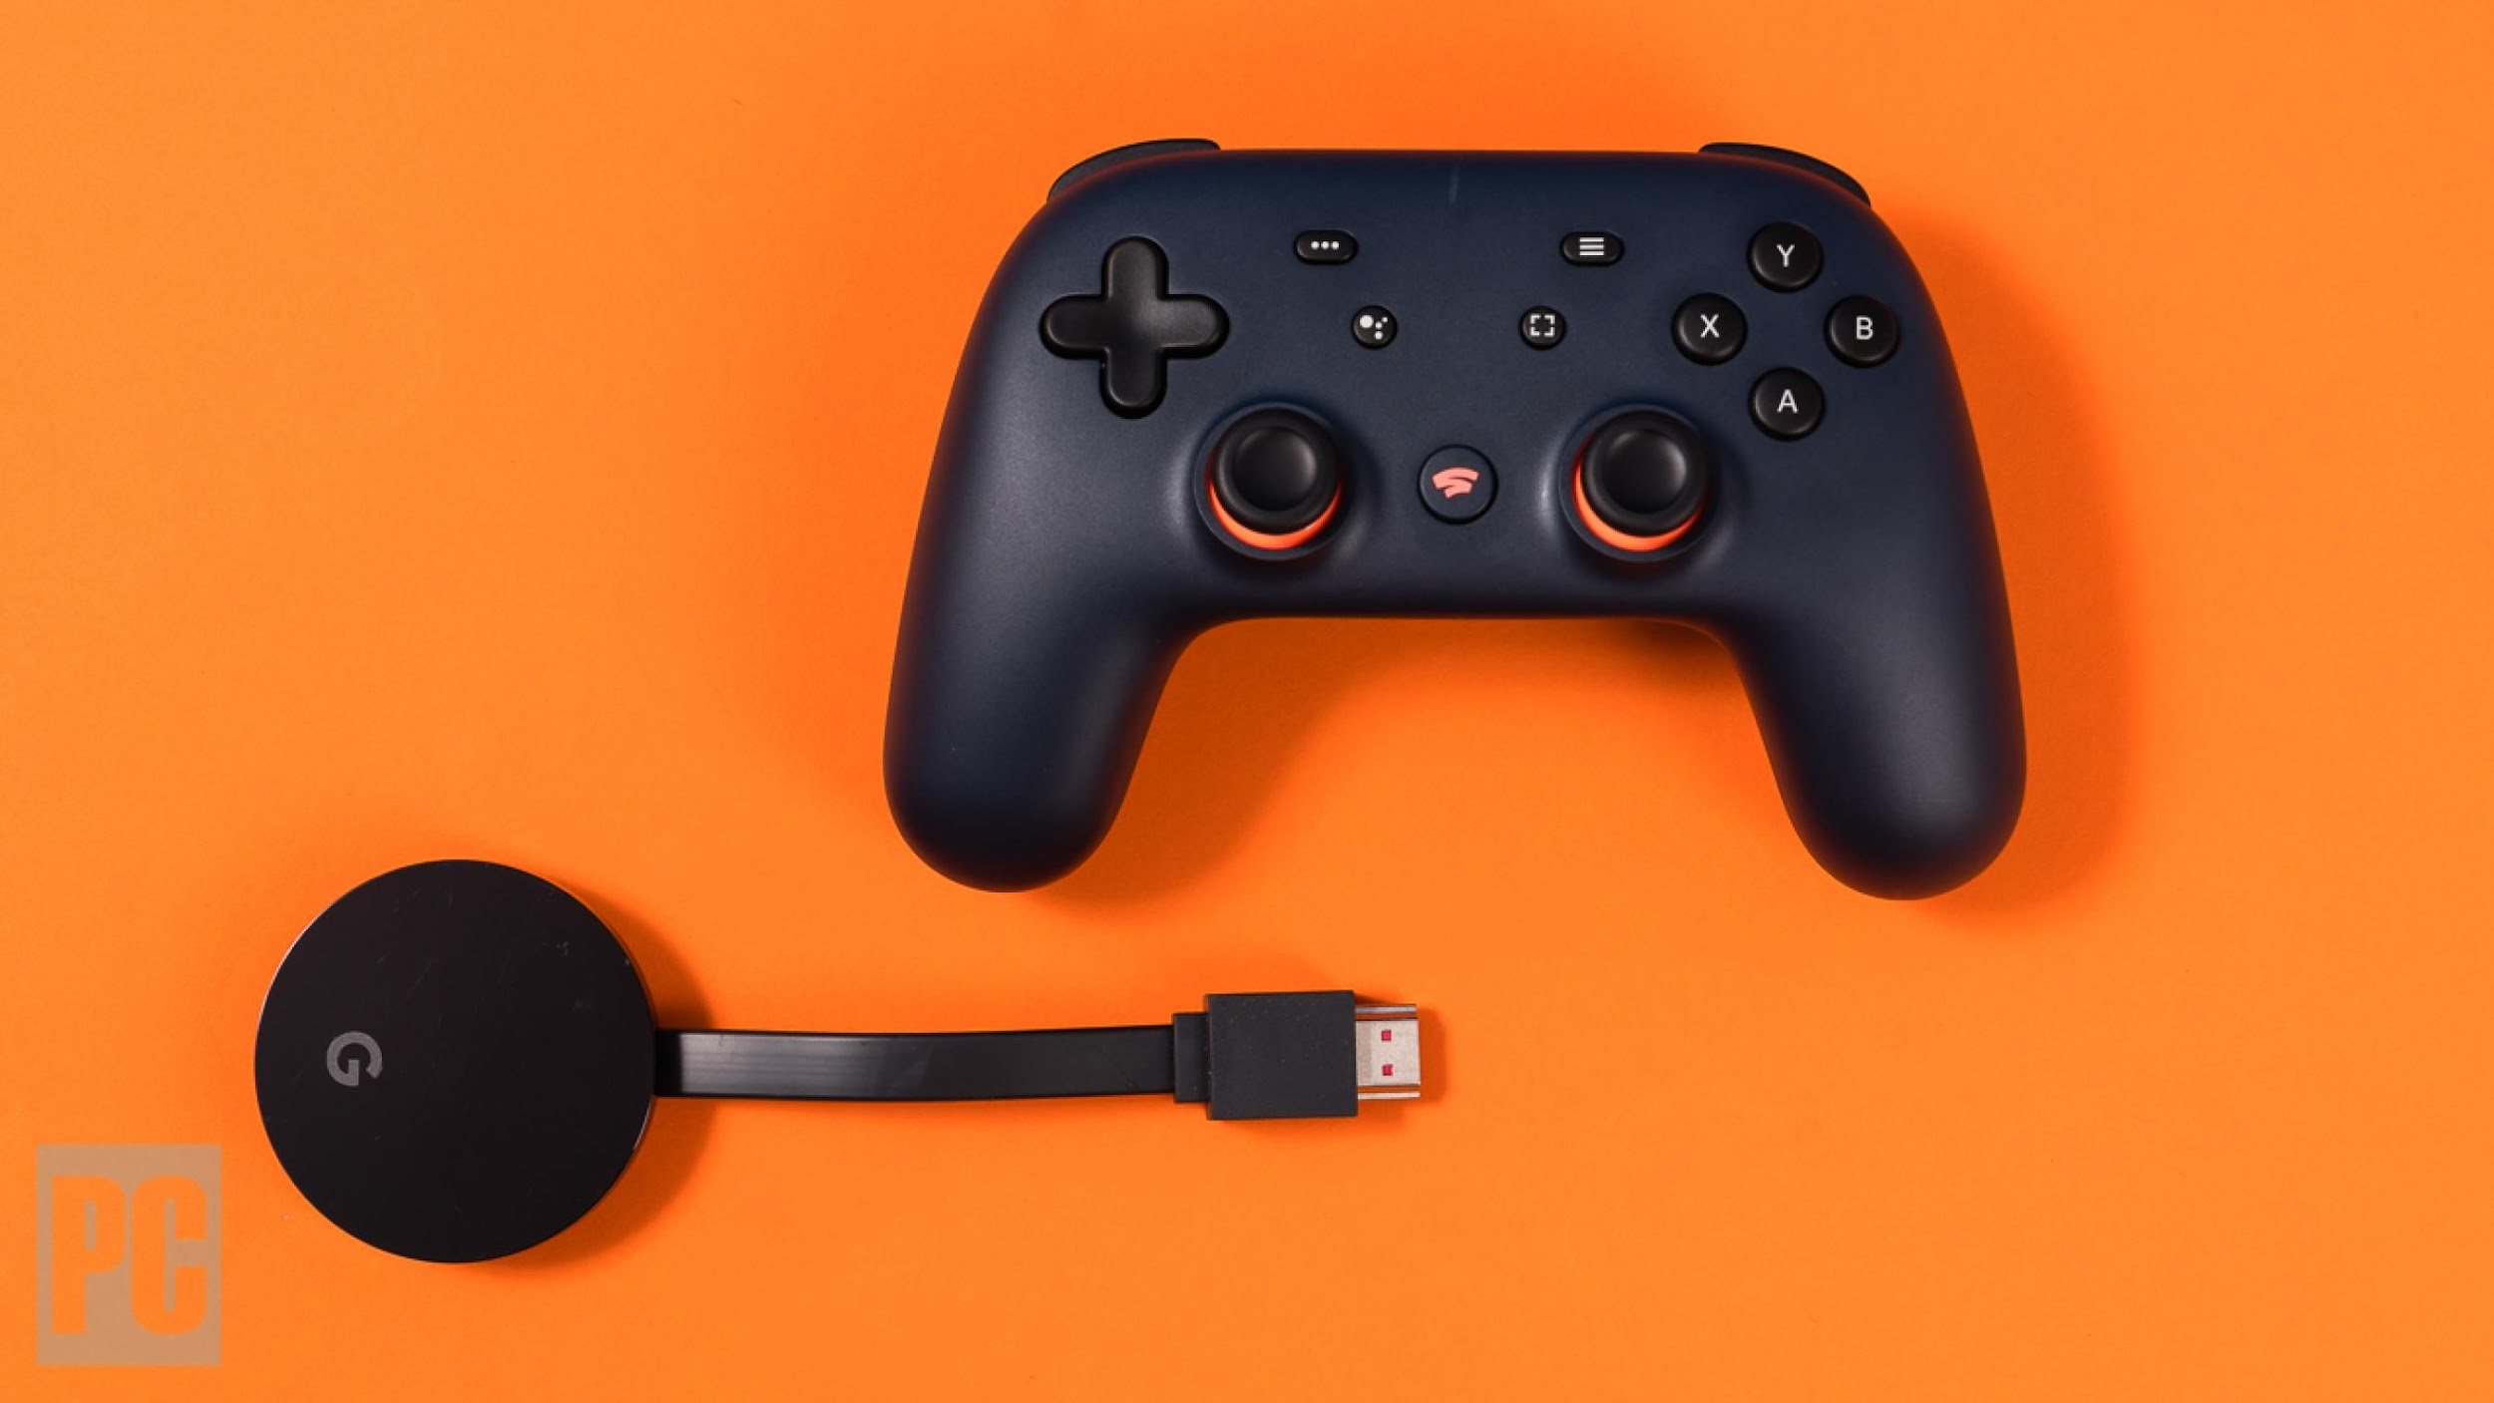
ONLINE GAMES ARE THE FUTURE
WORTH $120 BILLION INDUSTRY
GOOGLE STADIA
PROJECTx CLOUD

Slide 4
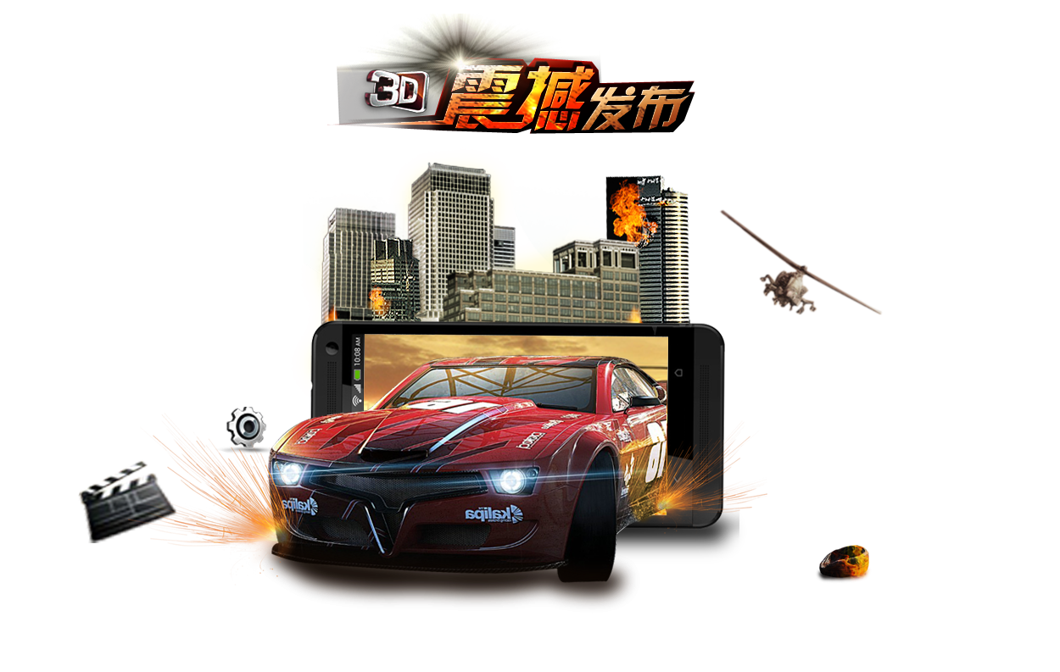
TYPE OF GAMES
Games are mainly of two types:
2D Games
Parallel Projection
Top Down Perspective
Side Scrolling
3D Games
First Person Perspective
Third Person Perspective

Slide 5



OBJECTIVES
TO CREATE A SIMPLE MULTIPLAYER GAME
UNDERSTAND THE FUNDAMENTALS OF GAME DEVELOPMENT
TO UNDERSTAND HOW CLIENT AND SERVER COMMUNICATE

Slide 6






TECHNOLOGIES
USED

Slide 7



SOFTWARES USED

Slide 8
WHY JAVASCRIPT
SIMPLE YET POWERFUL
CAN BE USED BOTH ON FRONTEND AS WELL AS BACKEND
SELECTION OF NODE

Slide 9
WHY NODE
NODE IS FAST
ONE LANGUAGE FOR ALL
PERFECT FOR IO INTENSIVE
NPM SUPPORT
Story for illustration purposes only

Slide 10
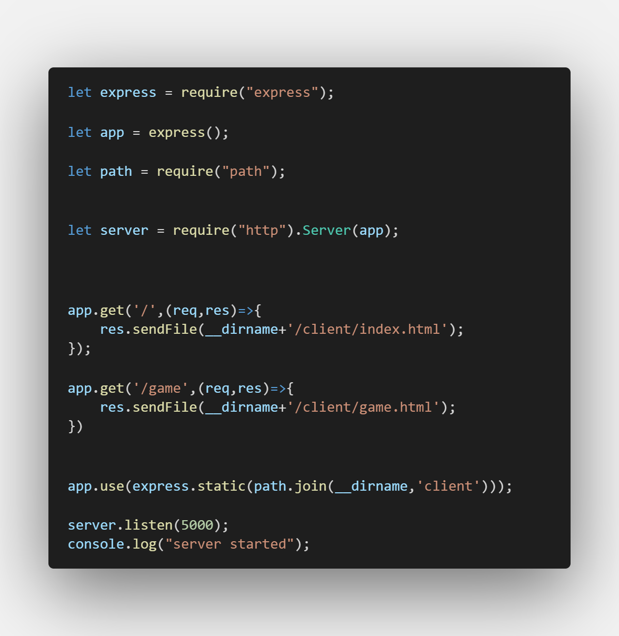

Slide 11
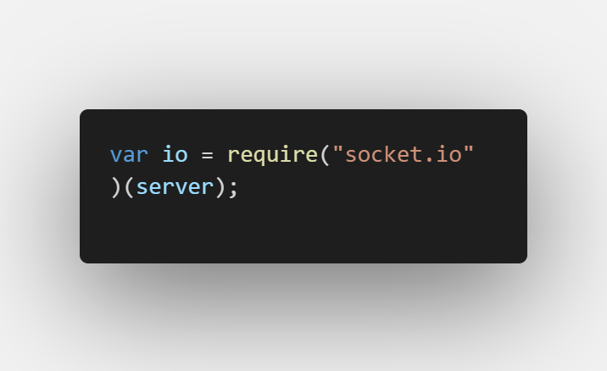

Slide 12
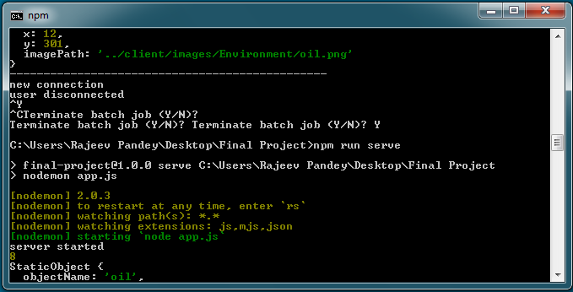

NODEMON

Slide 13
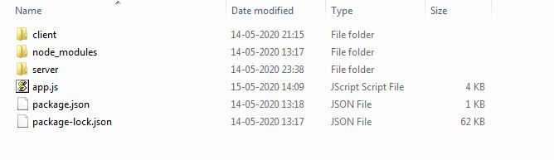
FOLDER STRUCTURE

Slide 14
GAME LOGIC

Slide 15
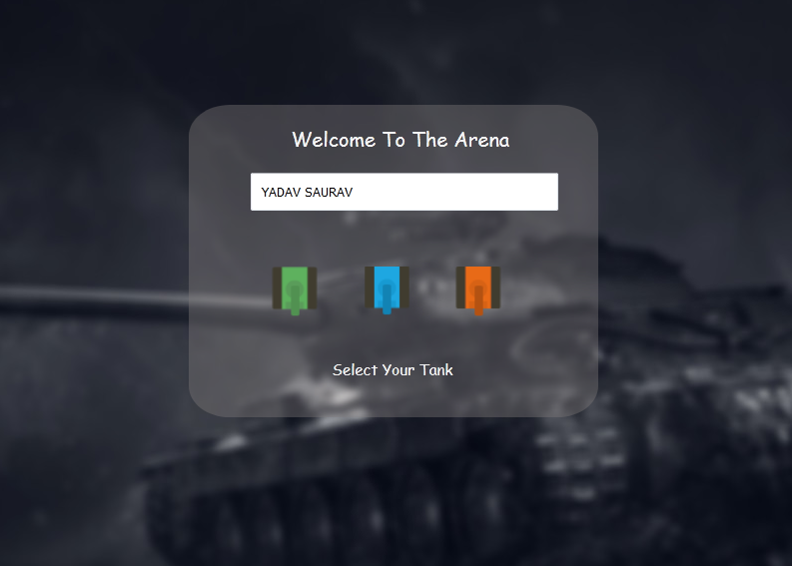
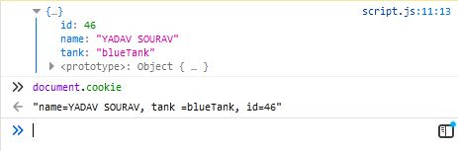
ENTERING THE GAME

Slide 16

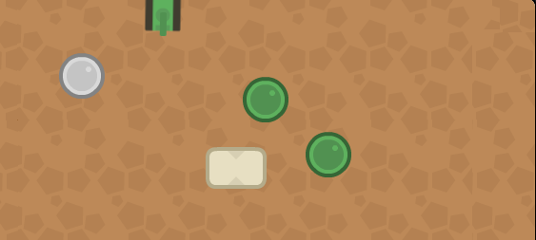
THE PLAYGROUND

Slide 17
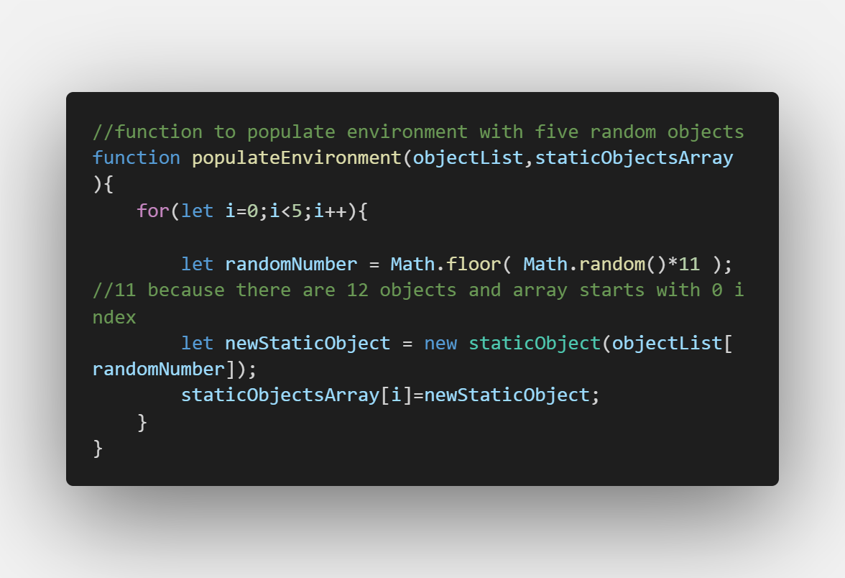
A DYNAMIC PLAYGROUND

Slide 18
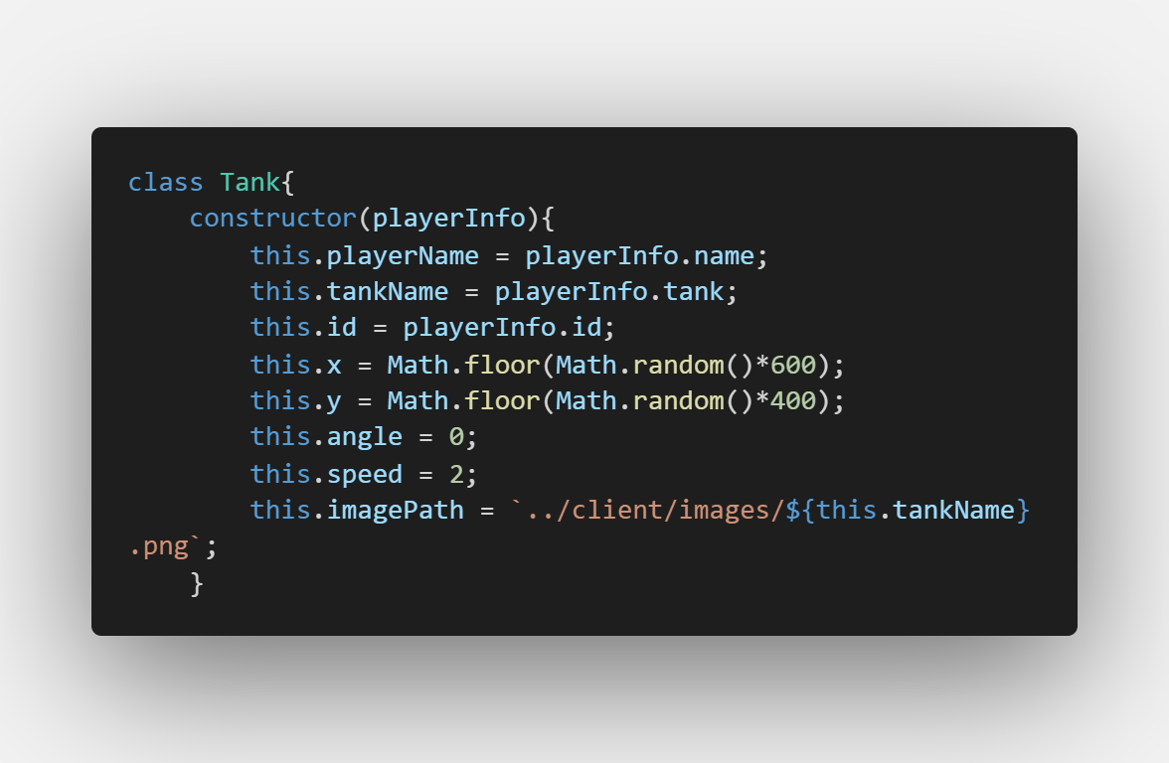
THE TANK CLASS

Slide 19
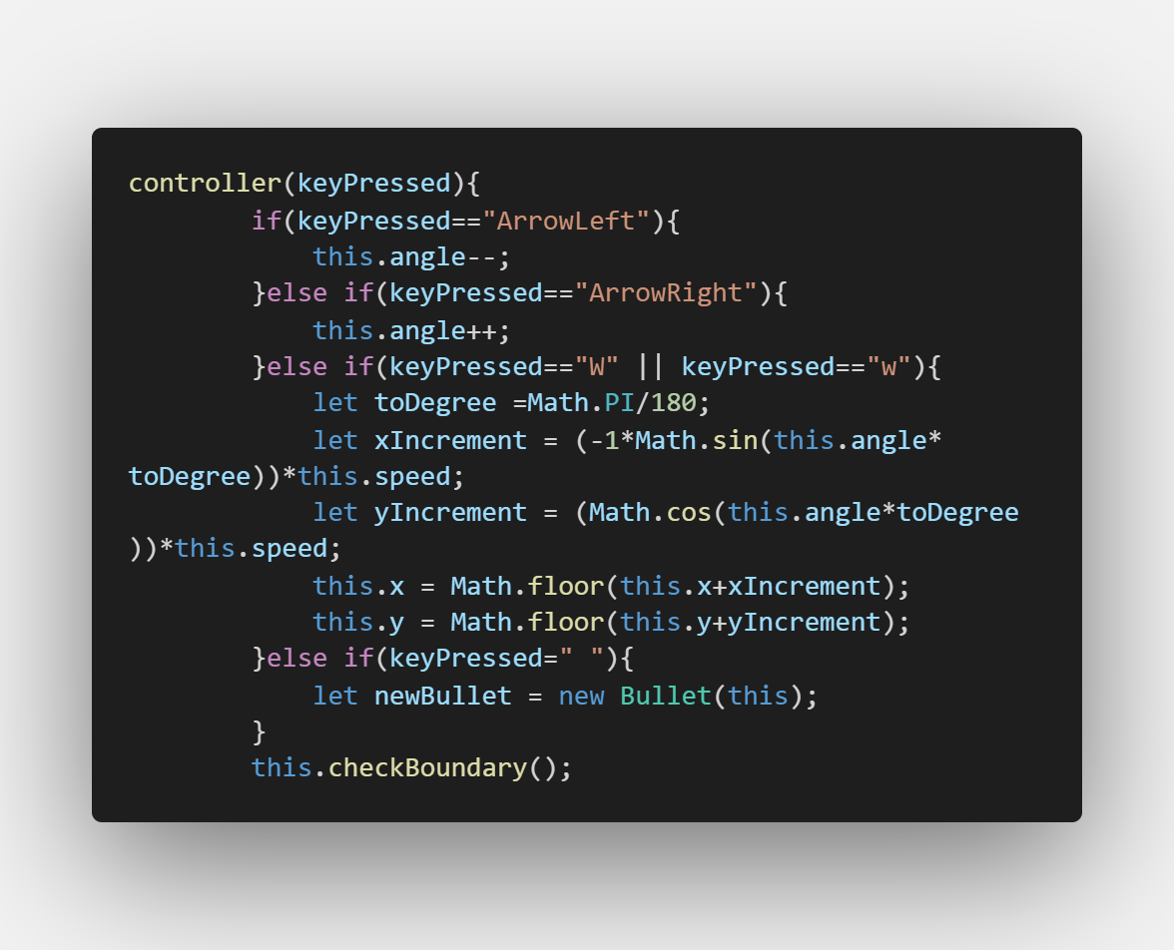
HANDLING KEYBOARD INPUTS

Slide 20
CHALLENGES FACED
Collision Detection
Frame Rate

Slide 21
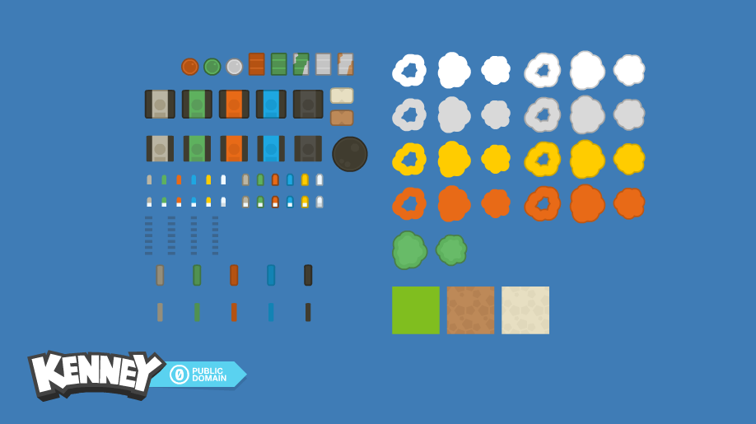
SPRITE SHEET

Slide 22
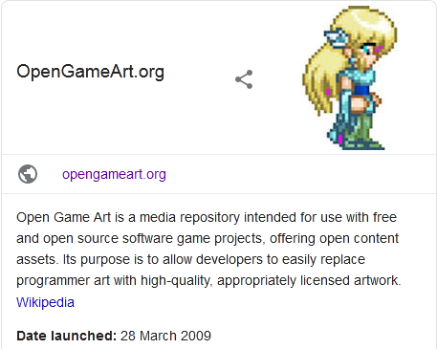
OPENGAMEART.ORG

Slide 23
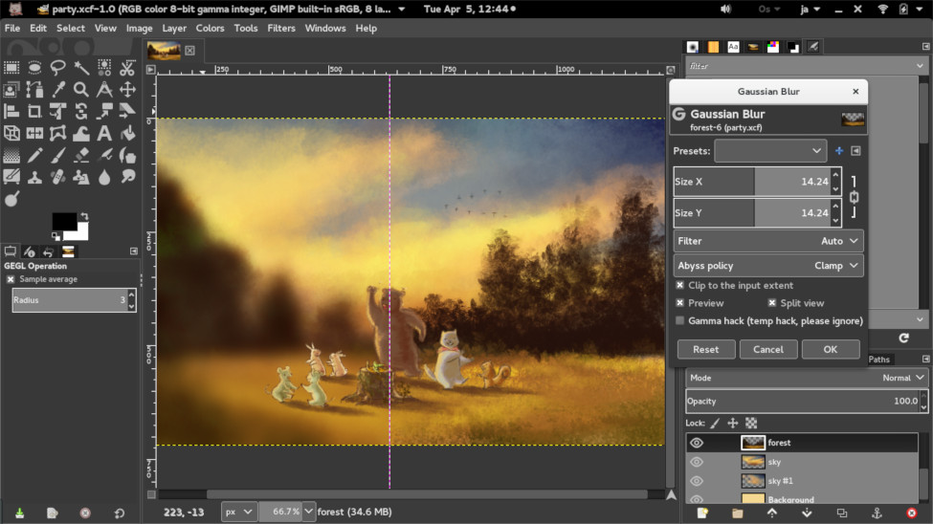
GIMP
UNLIKE PHOTOSHOP ITS OPEN SOURCE

Slide 24

WHAT HAVE WE LEARNT
HOW TO DEVELOP A GAME
HOW SERVER AND CLIENTS COMMUNICATE
HOW GAME ANIMATION WORKS
USE OF EXPRESS AND SOCKET.IO

Slide 25
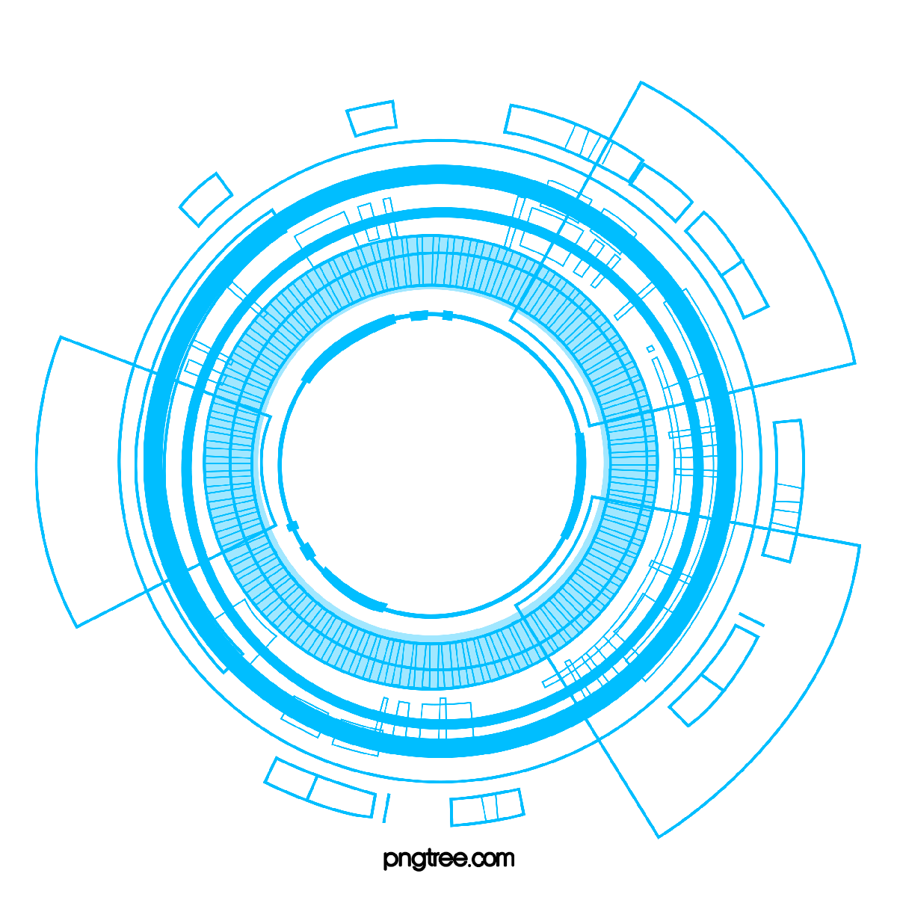
FUTURE SCOPE
NOTHING IS PERFECT , AND THIS PROJECT IS SAME
BETTER GRAPHICS
DEPLOYMENT TO HEROKU
SCALING FOR LARGE NUMBER OF USERS

