Slide 1
Voice Mail Transcription
By Team Nirakaar
- Rajeev Kumar Dave
- Yogendra Kumar

Slide 2
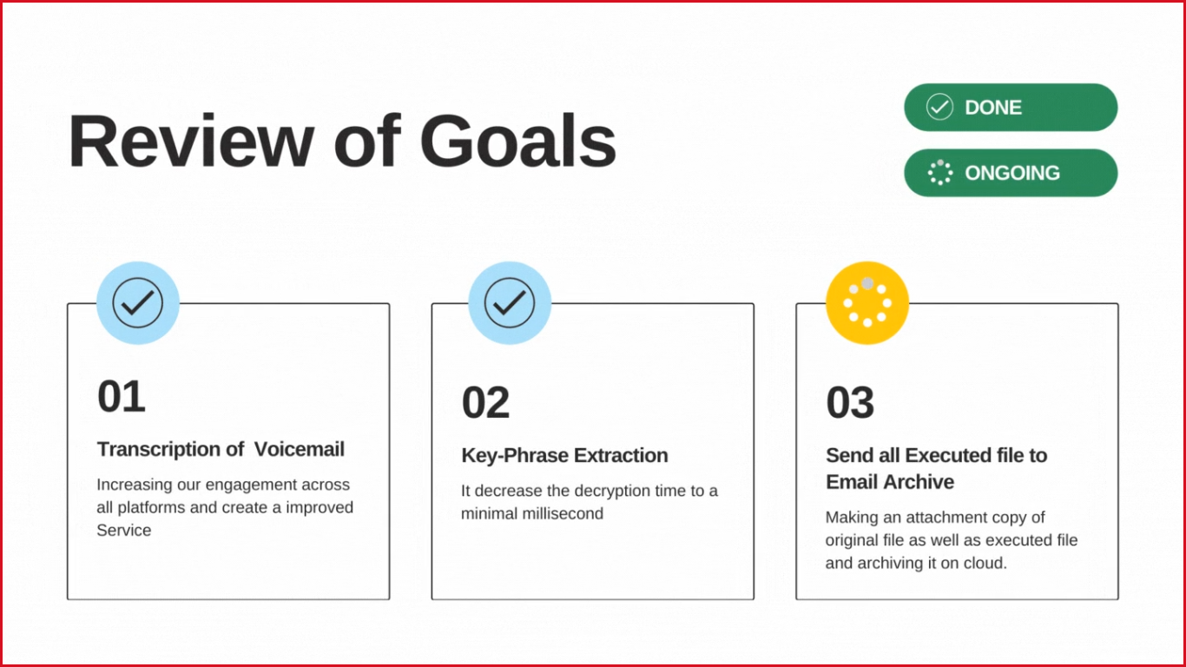

Slide 3


Slide 4
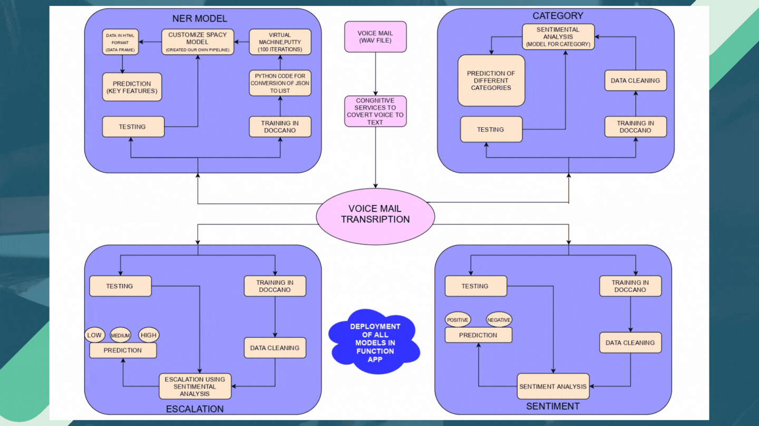

Slide 5
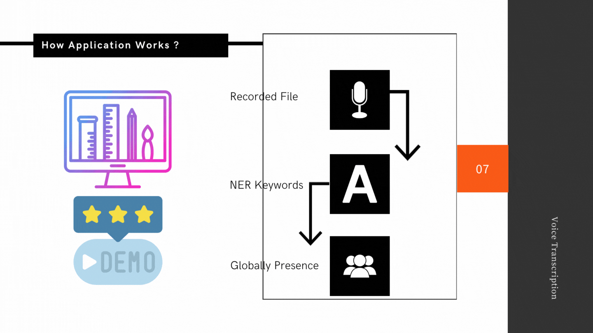

Slide 6
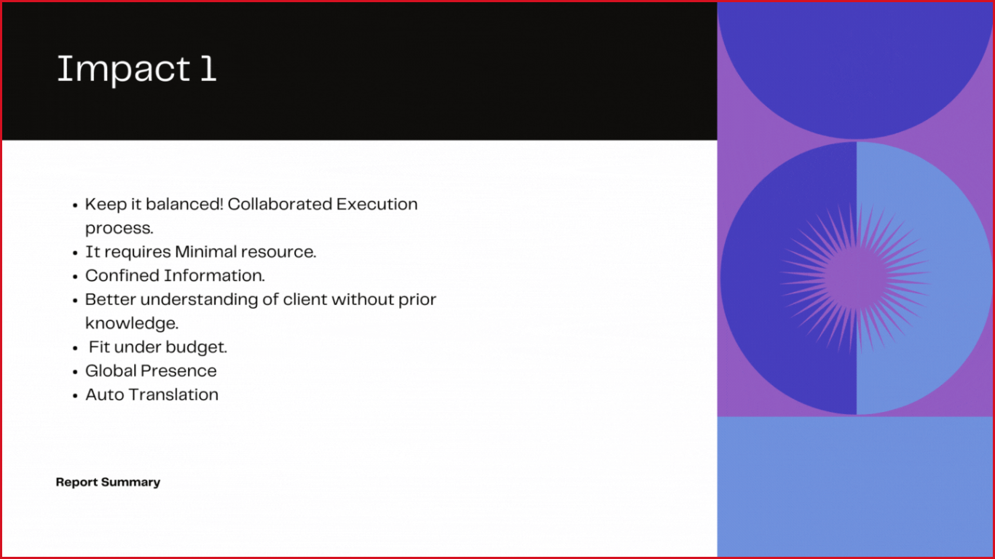



Slide 7


Slide 8
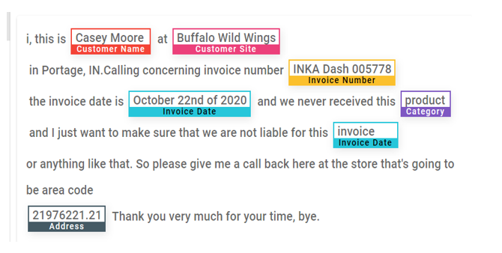

Slide 9
