Slide 1
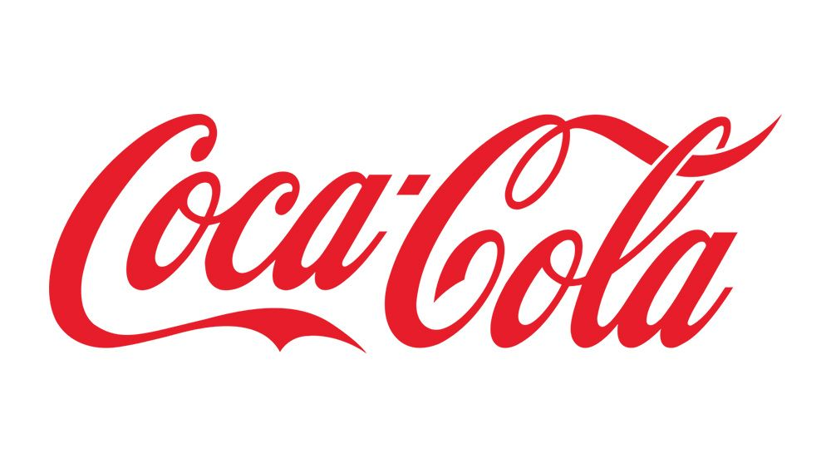

Coca-Cola - Sales & Profit Analysis

Slide 2
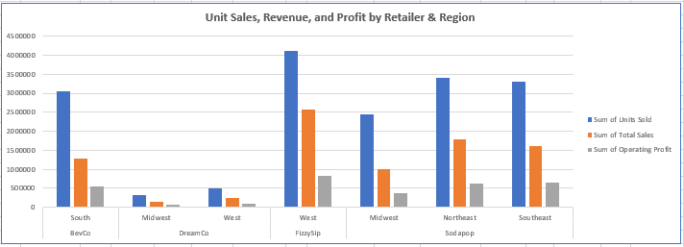

Sales & Profitability Analysis

Slide 3


Sales & Profitability Analysis

Slide 4


Sales & Profitability Analysis

Slide 5
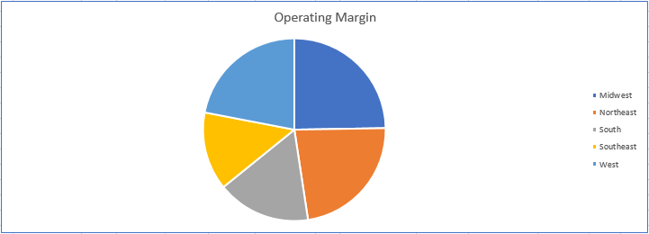
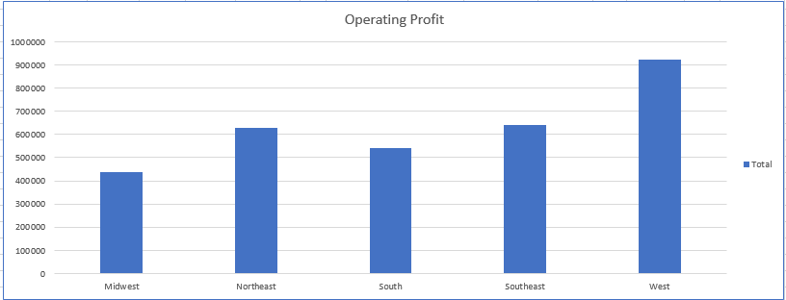


Sales & Profitability Analysis

Slide 6


Time-Based Sales Trends

Slide 7


Time-Based Sales Trends

Slide 8

Time-Based Sales Trends

Slide 9

Time-Based Sales Trends

Slide 10
Thank You

