Slide 1
Sprocket Central Pty Ltd
Data Exploration and insights
Rajeev Kumar Maram
Data Scientist

Slide 2
Introduction
I have given four datasets: transactions, new customer list, customer demographics and customer address. Aim is to target 1000 new customers based on analysis done on old customers.
My Analysis is based on following points:
Age-gender distribution
Job industry category
Gender- wealth segment
Owns car or not

Slide 3
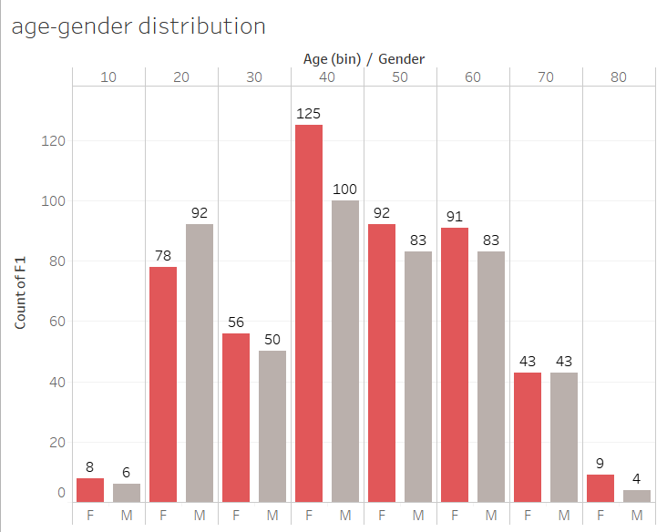
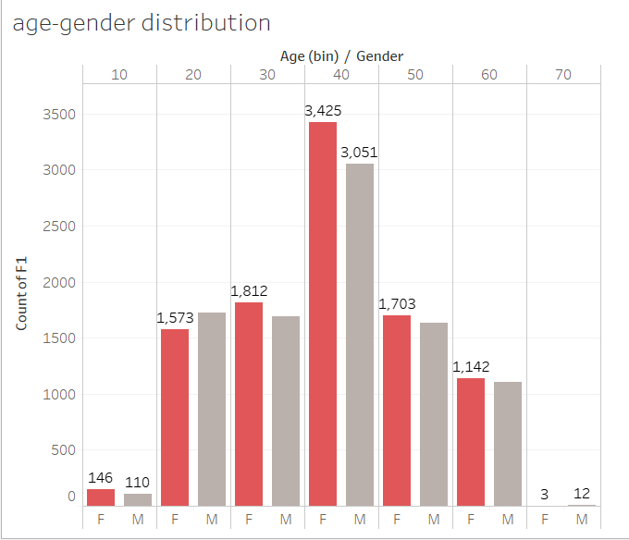
Data exploration1
As we can see that more number of customers fall in 40-50 years age bracket in both the datasets with more number of females than males
So while targeting it is better to focus on females of 40-50 years for more profits.
New
old

Slide 4
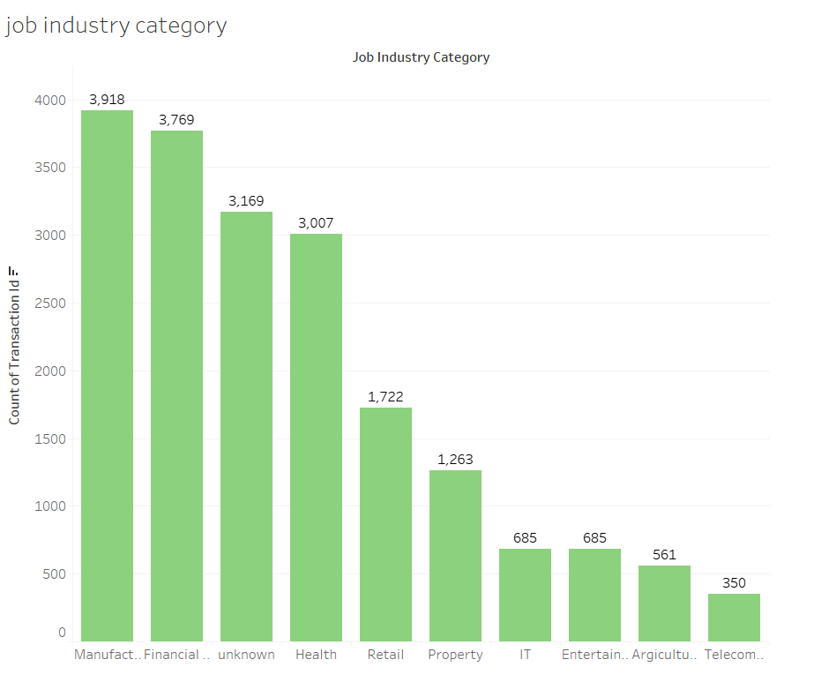
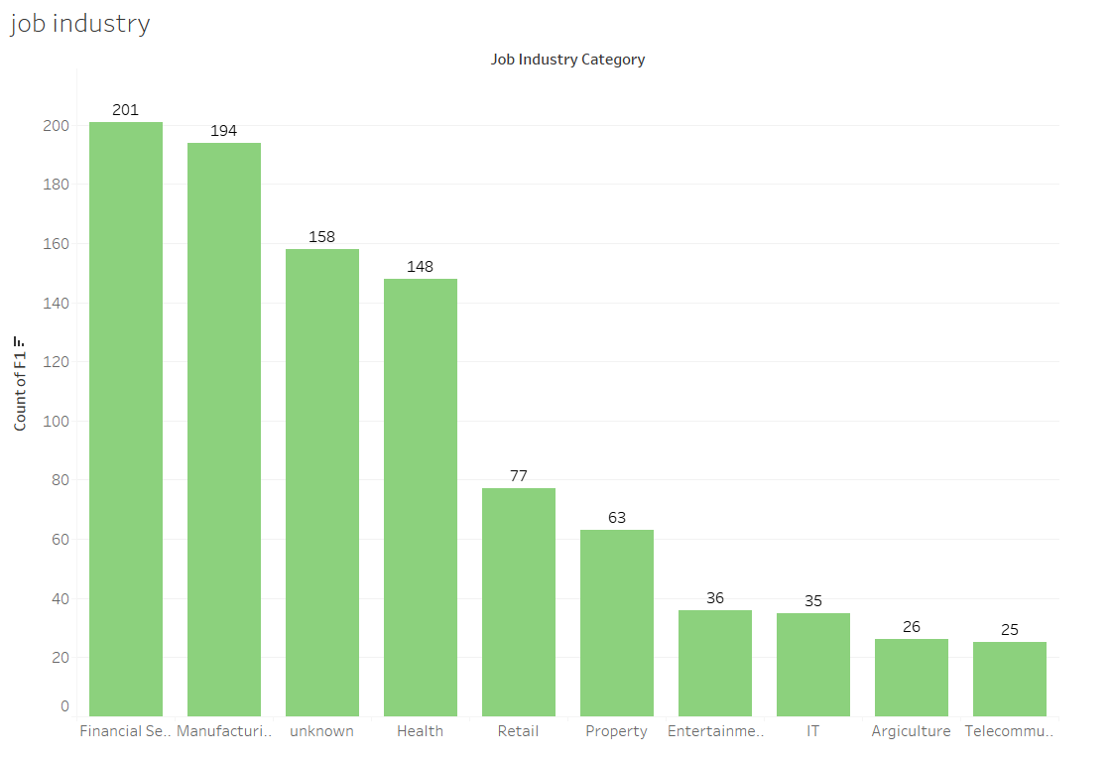
Data exploration2
In order to target customers based on job industry category they fall into, we need to target customers who work in Manufacturing and financial departments.
Industries like IT, entertainment, telecommunication are the least profit producing ones.
old
new

Slide 5
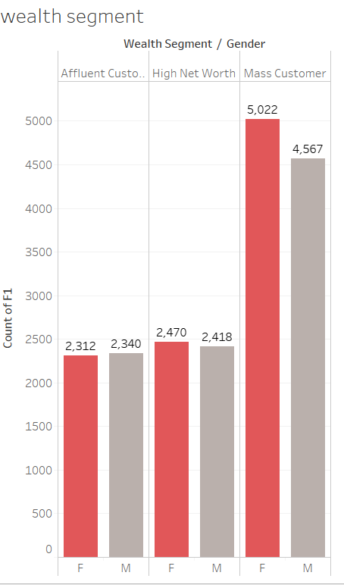
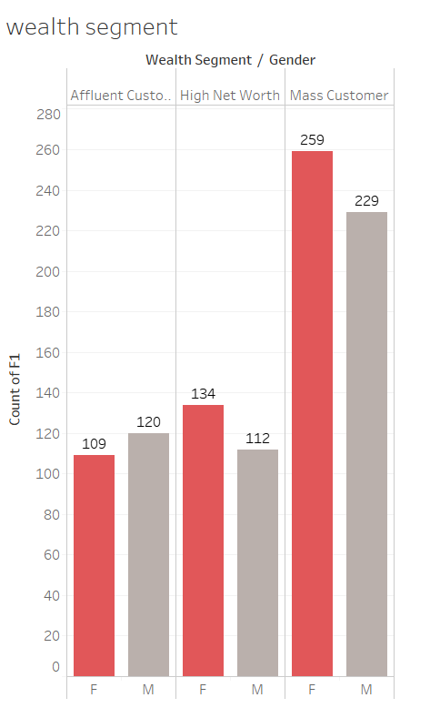
Data exploration 3
More than 50% of the customers are in mass customer wealth segment and we need to target people from this segment.
Among them females are higher than male.
old
new

Slide 6
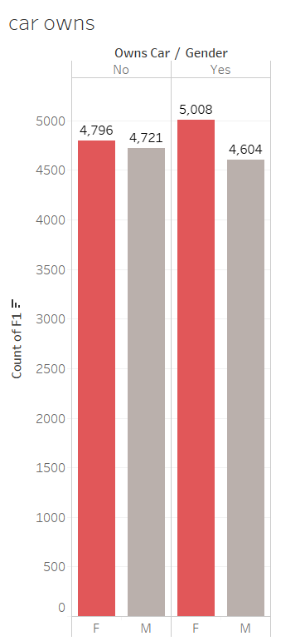
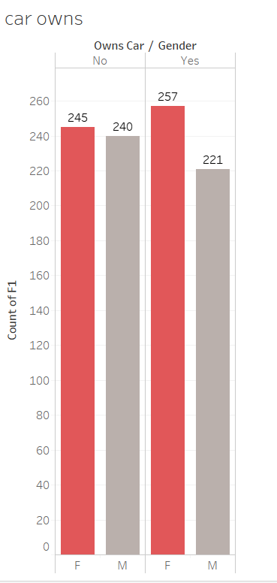
Data exploration 4
As we can see, more valuable customers are females who owns cars and they should be targeted well.
This means people who have cars are more likely to get a bicycle.
new
old

Slide 7
Conclusion
In order to target 1000 new customers, we have to focus on following areas:
People of age 40-50
Female gender
People who owns car
Who works in Manufacturing and financial departments
Who comes under Mass customer wealth segment

