Slide 1
Deep Learning Project
Group Members: Harshit Verma(2014042), Himanshu Sagar(2014046), Rajeev Nagarwal(2014084)
Team 5

Slide 2
Domain Shift in Semantic Segmentation Reference Paper: Unsupervised Pixel-Level Domain Adaption with GANs Conference: CVPR’17

Slide 3
Problem Statement
Reduce domain shift for the problem of Semantic Segmentation.
Goal is to inspire from state-of-the-art unsupervised domain adaptation techniques for performing well on real-world images.

Slide 4
Dataset
Source Domain: SYNTHIA RAND CVPR’2018
13,410 annotated images
Target Domain: CamVid
Sample frames from a video
12 classes
Class labels: void, sky, road, building, car etc.

Slide 5
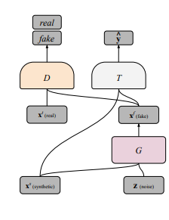
Approach

Slide 6



Loss function

Slide 7

Combined Loss

Slide 8
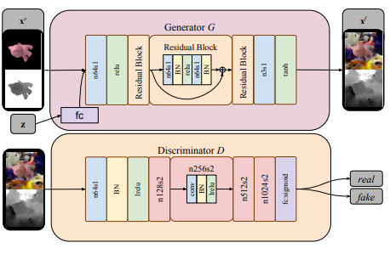
Architecture

Slide 9
Analysis
Segmentation accuracy on training data
Visual analysis on test data

