Slide 1
Domain: Machine Learning
Technology: Python
Hazard Identification and Detection using Machine Learning Approach
UNDER THE ESTEEMED GUIDENCE OF
G. GANGA BHAVANI
Assistant Professor
Cse Department
PRESENTED BY
Prasad Reddy GS 17E91A5A6
Y.Uma Maheswari 17E91A0585
K.Sri Naga Lakshmi 17E91A0568
A.Vasanth kumar 17E91A0587

Slide 2

Index
Abstract
Introduction
Literature review
Existing Method
Drawbacks
Proposed system
Advantages
Implementation
Applications
Hardware and Software Requirements
System design
Architecture
Results
Conclusion
References

Slide 3
Abstract
Internet surfing has become a vital part of our daily life. So to catch the attention of the users' different browser vendors compete to set up the new functionality and advanced features that become the source of attacks for the intruder and the websites are put at hazard. However, the existing approaches are not adequate to protect the surfers which require an expeditious and precise model that can be able to distinguish between the benign or malicious webpages

Slide 4
In this research article, we design a new classification system to analyse and detect the malicious web pages using machine learning classifiers such as, random forest, support vector machine. naïve Bayes, logistic regression and Some special URL (Uniform Resource Locator) based on extricated features the classifiers are trained to predict the malicious web pages. The experimental results have shown that the performance of the random forest classifier achieves better accuracy of 95% in comparison to other machine learning classifiers.

Slide 5
Introduction
With the rapid development of the web, more and more services like internet banking, e-commerce, social networking, shopping, making a bill payment, e-learning, etc. are available to users and they are surfing the internet via browsers [4] or web application.
malicious web sites which allows the invaders to detect the vulnerabilities on the web page and inject the payloads to get remote access to victim’s web page.

Slide 6
In this article, we explore a self-learning approach to classify the web page based on a small feature set.
We use four machine learning classifiers to classify the web site into two classes benign and malicious web page
The web pages were distinguished as malicious or not based upon features.
Blacklisting services were embedded in the browsers to face the challenges but it has several disadvantages like incorrect listing, [3]. In this article, we explore a self-learning approach to classify the web page based on a small feature set.

Slide 7
Literature review
"Context-sensitive and keyword density-based supervised machine learning techniques for malicious webpage detection.“
Conventional malicious webpage detection methods use blacklists in order to decide whether a webpage is malicious or not. The blacklists are generally maintained by third-party organizations.
The performance of proposed machine learning models is evaluated by using a benchmark data set which consists of one hundred thousand webpages.

Slide 8
"WebMon: ML-and YARA-based malicious webpage detection."
Attackers use the openness of the Internet to facilitate the dissemination of malware. Their attempts to infect target systems via the Web have increased with time and are unlikely to abate.
Most importantly, Web Môn’s focus on extracting malicious paths in a domain is a novel approach that has not been explored in previous studies.
WebMon effectively detects hidden exploit codes by tracing linked URLs to confirm whether the relevant websites are malicious.

Slide 9
"Detection of malicious web pages based on hybrid analysis."
Malicious web pages have become an increasingly serious threat to web security in recent years. In this paper, we propose a new detection method that consists of static and dynamic analyses for detecting malicious web pages.
The of the combination of static and dynamic analyses, the proposed detection method achieves high performance, and it has a light weight and is simple to use

Slide 10
"Detection of malicious web pages based on hybrid analysis."
Malicious web pages have become an increasingly serious threat to web security in recent years. In this paper, we propose a new detection method that consists of static and dynamic analyses for detecting malicious web pages.
The of the combination of static and dynamic analyses, the proposed detection method achieves high performance, and it has a light weight and is simple to use

Slide 11
"Detection of malicious web pages based on hybrid analysis."
Misuse detection method and anomaly detection method are widely used for the detection of malicious web pages. Both are based on machine learning. Misuse detection can detect known malicious web pages, but it cannot detect new ones. In contrast, anomaly detection can detect unknown malicious web pages, but it has a high false positive rate.
Anomaly detection, machine learning, malicious webpage, misuse detection

Slide 12
Existing method
Existing methods typically detect malicious URLs of a single attack type. In this paper, we propose method using machine learning to detect malicious URLs of all the popular attack types and identify the nature of attack a malicious URL attempts.

Slide 13
Drawbacks
More Expensive.
Difficult to scale up.
Time consuming.

Slide 14
Proposed system
Our method uses a variety of discriminative features including textual properties, link structures, webpage contents, DNS information, and network trafﬁc. Many of these features are novel and highly effective. Our experimental studies with 40,000 benign URLs and 32,000 malicious URLs obtained from real-life Internet
Wealsoreport our studies on the effectiveness of each group of discriminative features, and discuss their readability.

Slide 15
Advantages
Cheaper to operate.
It can be scaled up quickly.
accuracy is maximum
prediction results is accurate

Slide 16
Implementation:
Take dataset:
Take the dataset from the user.
View dataset:
The uploaded dataset is viewed by the user.
Train/test dataset
System can give training to the dataset

Slide 17
Implementation:
Model performance:
The three main metrics used to evaluate a classification model are accuracy, precision, and recall. Accuracy is defined as the percentage of correct predictions for the test data. It can be calculated easily by dividing the number of correct predictions by the number of total predictions.
Predictions:
Using the machine leaning algorithms, we can predict the result
Graphs:
Graphs can be generated by the system and the user can be view that graphs

Slide 18
Applications:
This application is helpful in cyber security issues
Users can be protected from the malicious websites
Organizations can use this application to secure their information from malicious websites

Slide 19
HARDWARE & SOFTWARE REQUIREMENTS
H/W Configuration:
Processor - I3/Intel Processor
Hard Disk -160GB
Key Board - Standard Windows Keyboard
Mouse - Two or Three Button Mouse
Monitor - SVGA
RAM - 8Gb

Slide 20
S/W Configuration:
Operating System : Windows 7/8/10
Server side Script : Python, Anaconda
IDE : Pharm
Libraries Used :Sklearn, Pandas, Numpy, matplotlib, random forest classifiers, naive bayes
Dataset : url dataset for benign and malicious web pages
Technology : Python 3.6+

Slide 21
Uml diagrams
Use case diagrams:
A use case diagram in the Unified Modeling Language (UML) is a type of behavioral diagram defined by and created from a Use-case analysis. Its purpose is to present a graphical overview of the functionality provided by a system in terms of actors, their goals (represented as use cases), and any dependencies between those use cases. The main purpose of a use case diagram is to show what system functions are performed for which actor. Roles of the actors in the system can be depicted.

Slide 22
Class diagrams:
In software engineering, a class diagram in the Unified Modelling Language (UML) is a type of static structure diagram that describes the structure of a system by showing the system's classes, their attributes, operations (or methods), and the relationships among the classes. It explains which class contains information

Slide 23
Sequence diagrams:
A sequence diagram in Unified Modeling Language (UML) is a kind of interaction diagram that shows how processes operate with one another and in what order. It is a construct of a Message Sequence Chart. Sequence diagrams are sometimes called event diagrams, event scenarios, and timing diagrams.

Slide 24
Collaboration diagram:
In collaboration diagram the method call sequence is indicated by some numbering technique as shown below. The number indicates how the methods are called one after another. We have taken the same order management system to describe the collaboration diagram. The method calls are similar to that of a sequence diagram. But the difference is that the sequence diagram does not describe the object organization whereas the collaboration diagram shows the object organization.

Slide 25
Deployment diagram:
Deployment diagram represents the deployment view of a system. It is related to the component diagram. Because the components are deployed using the deployment diagrams. A deployment diagram consists of nodes. Nodes are nothing but physical hardware’s used to deploy the application.

Slide 26
Activity diagram:
Activity diagrams are graphical representations of workflows of stepwise activities and actions with support for choice, iteration and concurrency. In the Unified Modeling Language, activity diagrams can be used to describe the business and operational step-by-step workflows of components in a system. An activity diagram shows the overall flow of control.

Slide 27
Component diagram:
A component diagram, also known as a UML component diagram, describes the organization and wiring of the physical components in a system. Component diagrams are often drawn to help model implementation details and double-check that every aspect of the system's required functions is covered by planned development.

Slide 28
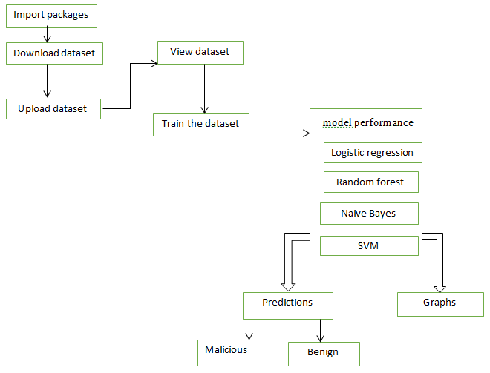
Architecture

Slide 29

Results

Slide 30
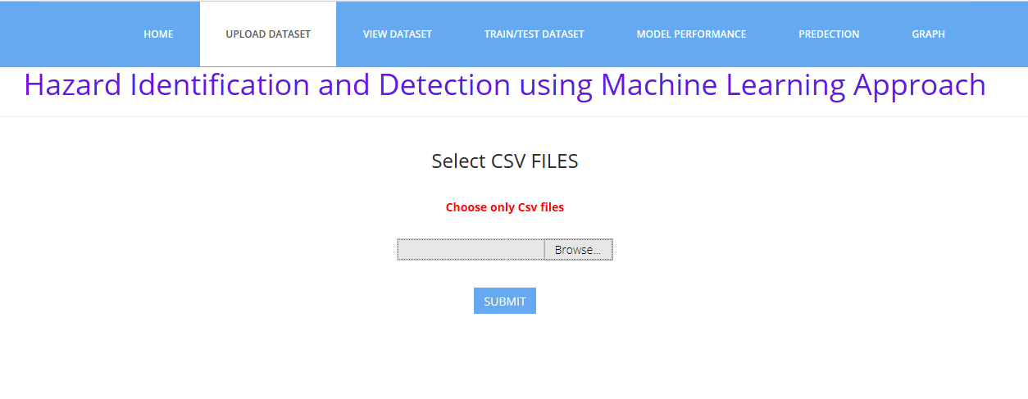
Upload dataset

Slide 31
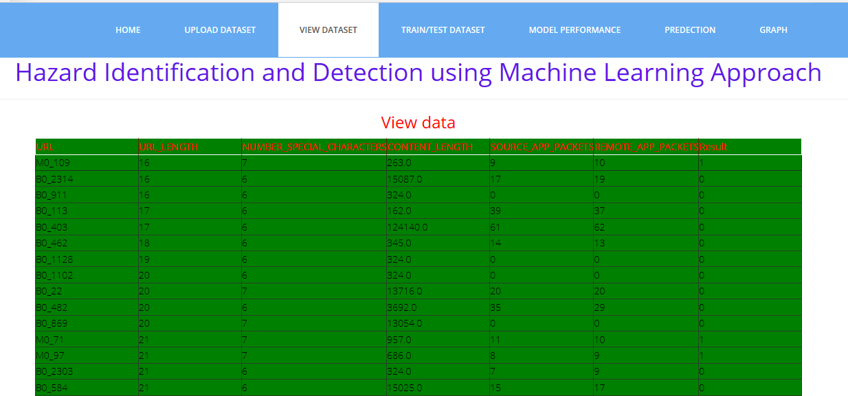
View dataset

Slide 32
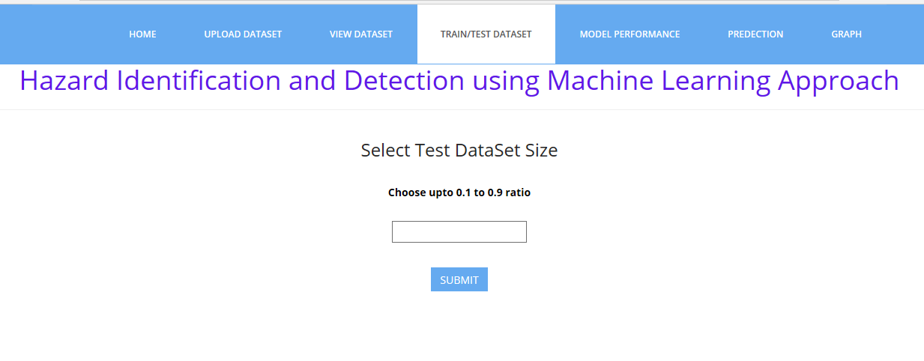
Train/test dataset size

Slide 33
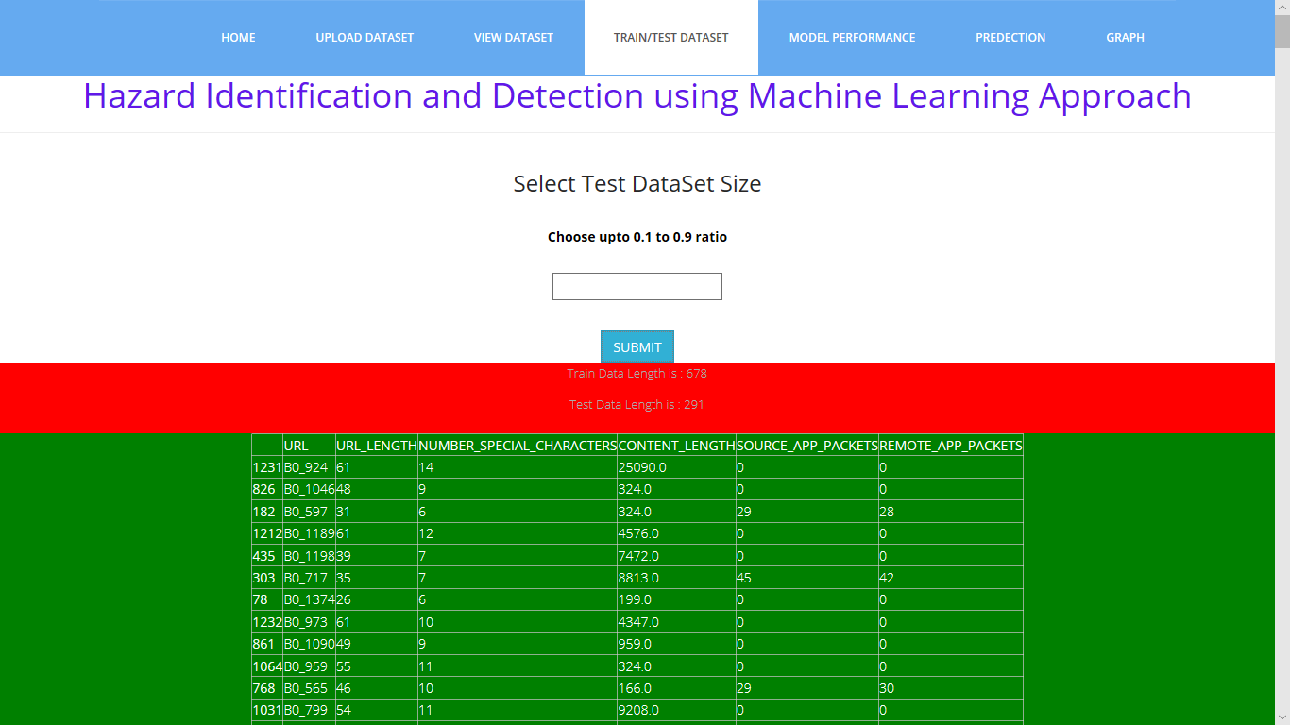
Train/test dataset:

Slide 34
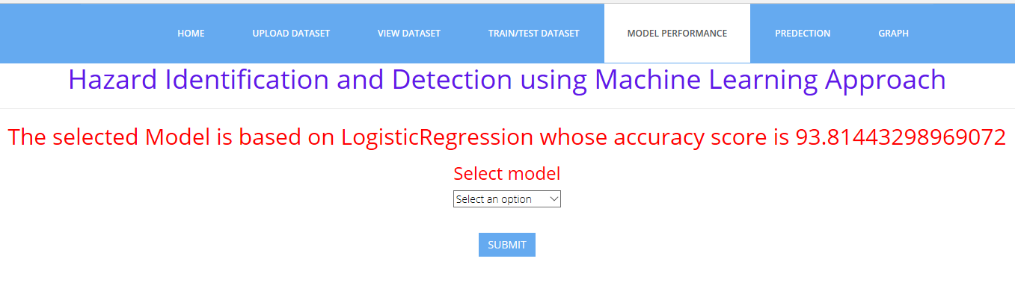
Model performance

Slide 35
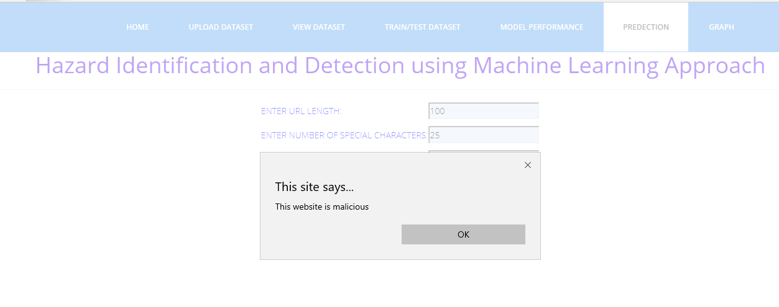
Prediction

Slide 36
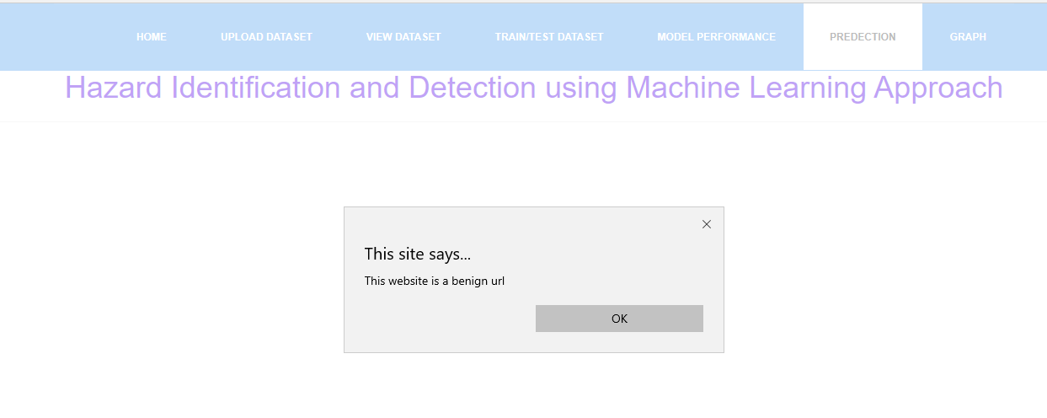

Slide 37
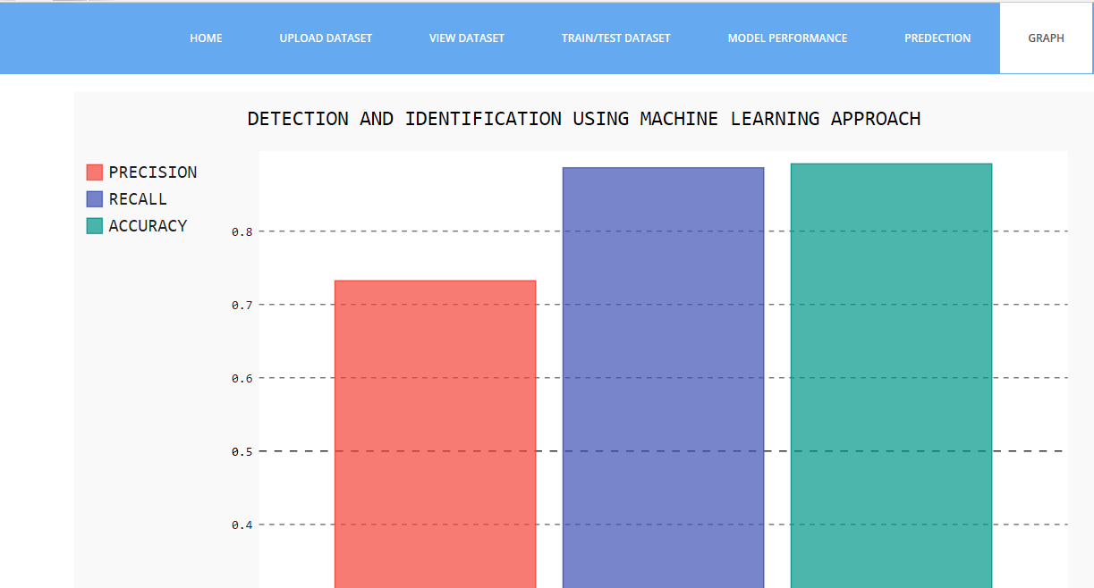
Graphs

Slide 38
Conclusion
Malicious web page identification is an emerging topic in cybersecurity. Though several research studies have been performed relating to the issues of malicious web page detection these are very costly as they consume more time and resources. In this research article, we employed a new web site classification system based on URL features to predict the web pages as malicious or benign using machine learning algorithms. The machine learning classifiers Random Forest(RF) achieves a higher accuracy of 95%. The experimental results have shown that our method can perform effectively for detecting the malicious web page

Slide 39
References
[1] Tao, Wang, Yu Shunzheng, and Xie Bailin. "A novel framework for learning to detect malicious web pages." In 2010 International Forum on Information Technology and Applications, vol. 2, pp. 353-357. Ieee, 2010.
[2] Eshete, Birhanu, Adolfo Villafiorita, and Komminist Weldemariam. "Malicious website detection: Effectiveness and efficiency issues." In 2011 First SysSec Workshop, pp. 123-126. IEEE, 2011..
[3] Aldwairi, Monther, and Rami Alsalman. "Malurls: A lightweight malicious website classification based on url features." Journal of Emerging Technologies in Web Intelligence 4, no. 2 (2012): 128-133..

Slide 40
[4] Yoo, Suyeon, Sehun Kim, Anil Choudhary, O. P. Roy, and T. Tuithung. "Two-phase malicious web page detection scheme using misuse and anomaly detection." International Journal of Reliable Information and Assurance 2, no. 1 (2014): 1-9.
[5] Hwang, Young Sup, Jin Baek Kwon, Jae Chan Moon, and Seong Je Cho. "Classifying malicious web pages by using an adaptive support vector machine." Journal of Information Processing Systems 9, no. 3 (2013): 395-404.
[6] Yue, Tao, Jianhua Sun, and Hao Chen. "Fine-grained mining and classification of malicious Web pages." In 2013 Fourth International Conference on Digital Manufacturing & Automation, pp. 616-619. IEEE, 2013..

Slide 41
[7] Krishnaveni, S., and K. Sathiyakumari. "SpiderNet: An interaction tool for predicting malicious web pages." In International Conference on Information Communication and Embedded Systems (ICICES2014), pp. 1-6. IEEE, 2014.
[8] Sun, Bo, Mitsuaki Akiyama, Takeshi Yagi, Mitsuhiro Hatada, and Tatsuya Mori. "Automating URL blacklist generation with similarity search approach." IEICE TRANSACTIONS on Information and Systems 99, no. 4 (2016): 873-882..
[9] Urcuqui, Christian, Andres Navarro, Jose Osorio, and Melisa García. "Machine Learning Classifiers to Detect Malicious Websites." In SSN, pp. 14-17. 2017.).

