Slide 1
Real Estate Hunting – Melbourne, AU
Rajeev Panwar

Slide 2
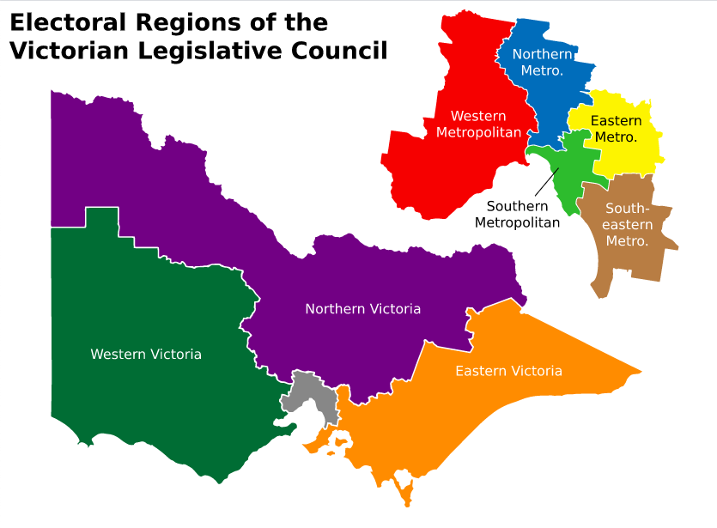
The big ’Q’s’ – You are an expat moving to Melbourne and want to know which region should you buy a house in – what should be your budget? which are your top 2 suburbs?
Findings
Recommendations

Slide 3
Market Overview (based on data set)
Region | Property Sales
Southern Metropolitan | 2591
Northern Metropolitan | 2577
Western Metropolitan | 2047
Eastern Metropolitan | 972
South-Eastern Metropolitan | 368
Northern Victoria | 62
Eastern Victoria | 51
Western Victoria | 43
Count of Observations | 8711
Mean | ~ A$ 1.05 Mn
Std Deviation | ~ A$ 576K
Minimum | ~ A$ 131K
25% (1st quartile) | ~ A$ 640K
50% (2nd Quartile) | ~ A$ 891K
75% (3rd Quartile) | ~ A$ 1.33 Mn
Maximum | ~ A$ 3.45 Mn

Slide 4
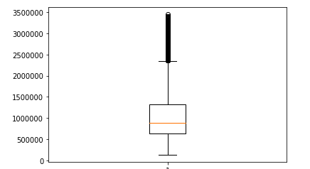
What should be your expected budget for the different regions (using .describe & .groupby on cleaned pricing data)
Region | Mean Pricing
Eastern Metro | ~ A$ 1.14 Mn
Eastern Victoria | ~ A$ 661K
Northern Metro | ~ A$ 878K
Northern Victoria | ~ A$ 599K
S-E Metro | ~ A$ 900K
Southern Metro | ~ A$ 1.39 Mn
Western Metro | ~ A$ 877K
Western Victoria | ~ A$ 445K

Slide 5
Southern Metro vs Northern Metro - are they the same/similar?
Ho: There is no difference in average price of houses in the two regions, Ha: There is a difference in average price of houses in the regions
Used a two sample t-test (Independent) to check if mean pricing is different between the two regions
Finding - There is difference in average price of houses in the two reasons

Slide 6
South Eastern Metro vs Northern Metro - are they similar?
Ho: There is no difference in average price of houses in the two regions, Ha: There is a difference in average price of houses in the regions
Plan to Use a Welch T-test since samples have different N (2577 vs 368)
Unable to conduct test due to issues with notebook (WIP)

Slide 7
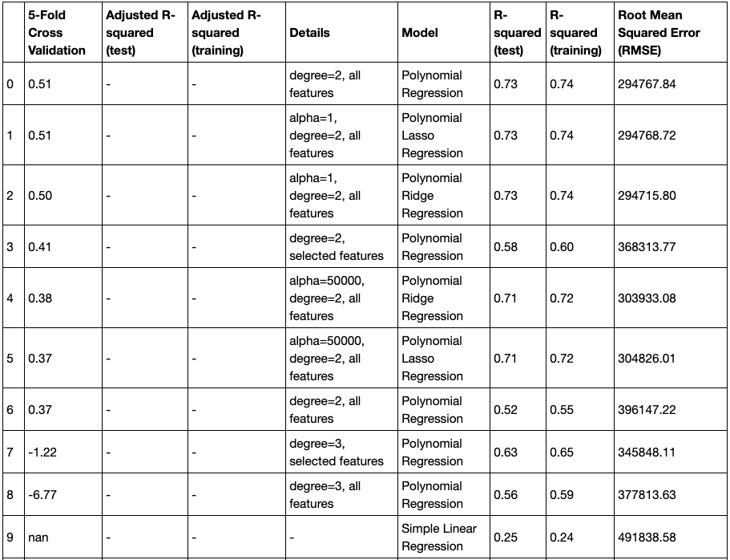
Pricing Model – Evaluation Summary
Started with a linear regression model with independent variable being building-area
Best fit found using a 2nd degree Polynomial Regression model explaining 73% (R^squared) of the variance in price
New features created – Age of Property & Benchmark Bond Yields

Slide 8
RECOMMENDATIONS
The most preferred regional markets (by sales volumes) in Melbourne are Southern, Western & Northern Metropolitan
Subject to findings of Welch T Test for Northern and South East Metro – it may be a wise choice to consider these two suburbs if the budget is under A$ 1 Mn
Price of real estate in Melbourne is most dependent on building area, number of rooms, age of property and distance from CBD (central business district)
Thank You!

