Slide 1
Bank Marketing Analysis
Rajeev Kumar

Slide 2
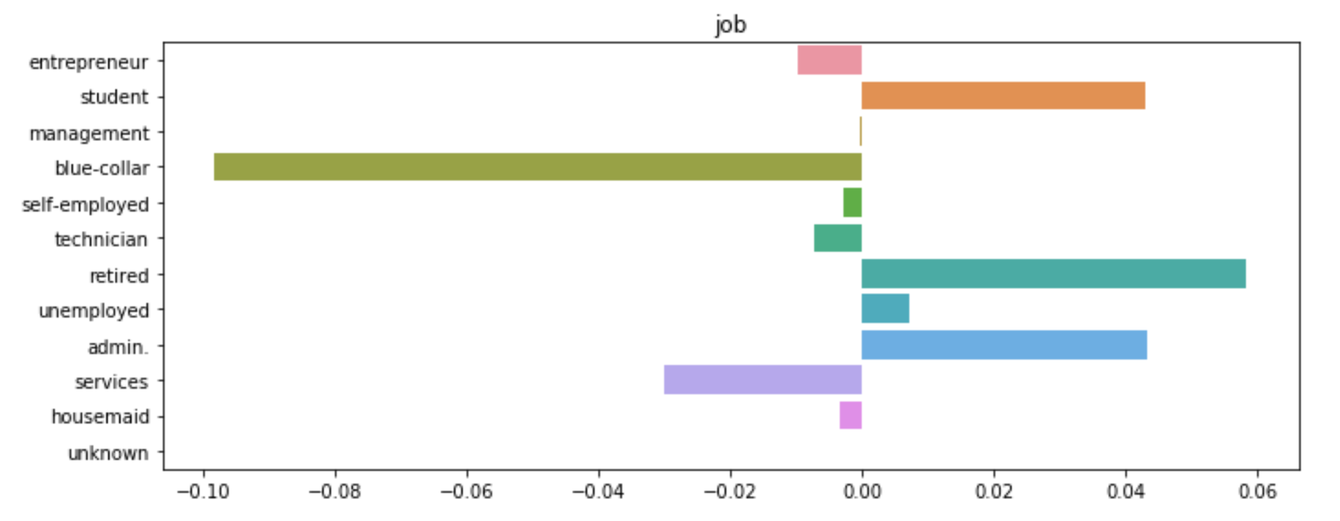
Probability of conversion by Job
Customer Segmentation
Students and Retired are most likely to subscribe.
Blue collar and Services are least likely to subscribe

Slide 3
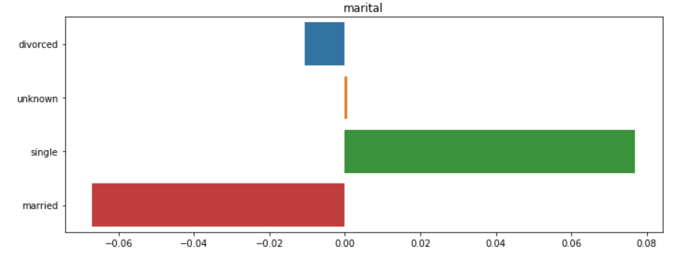
Probability of conversion by Marital Status
Customer Segmentation
Singles are most likely to subscribe.
Married and Divorced are least likely to subscribe

Slide 4
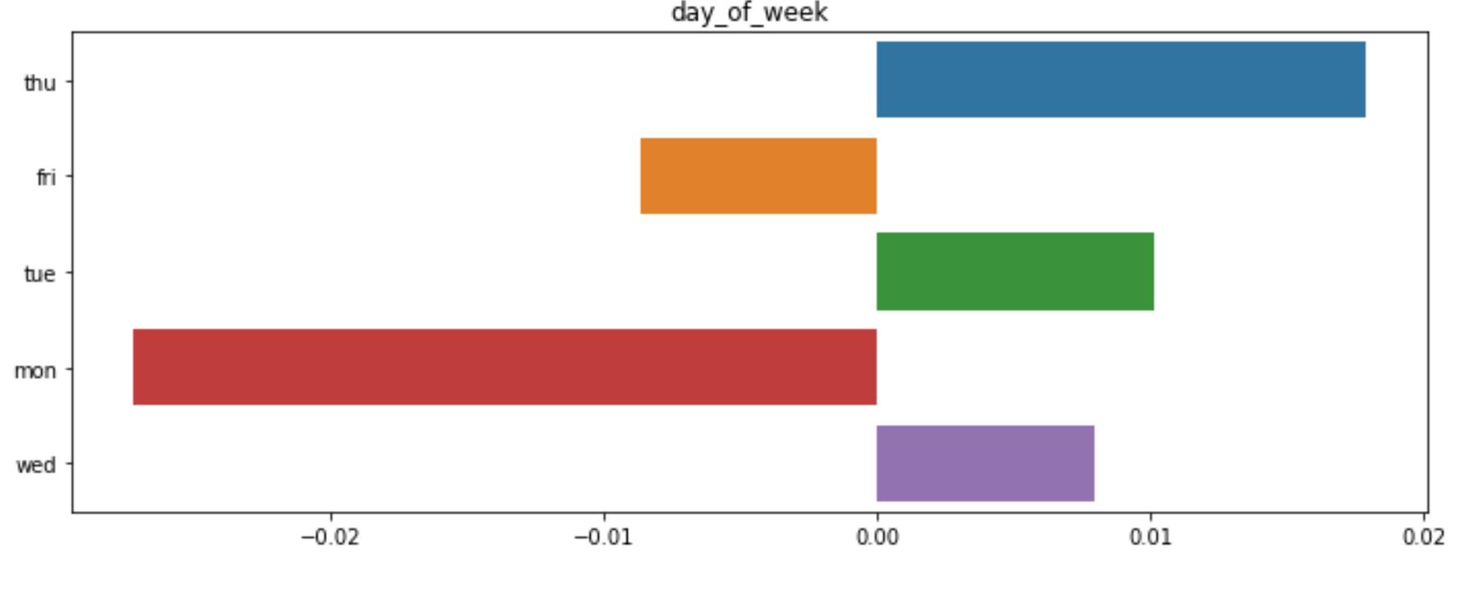
Probability of conversion by call on day of week
Customer Segmentation
Clients are likely to respond favourably is called in the middle of week rather than on Monday or Friday.

Slide 5
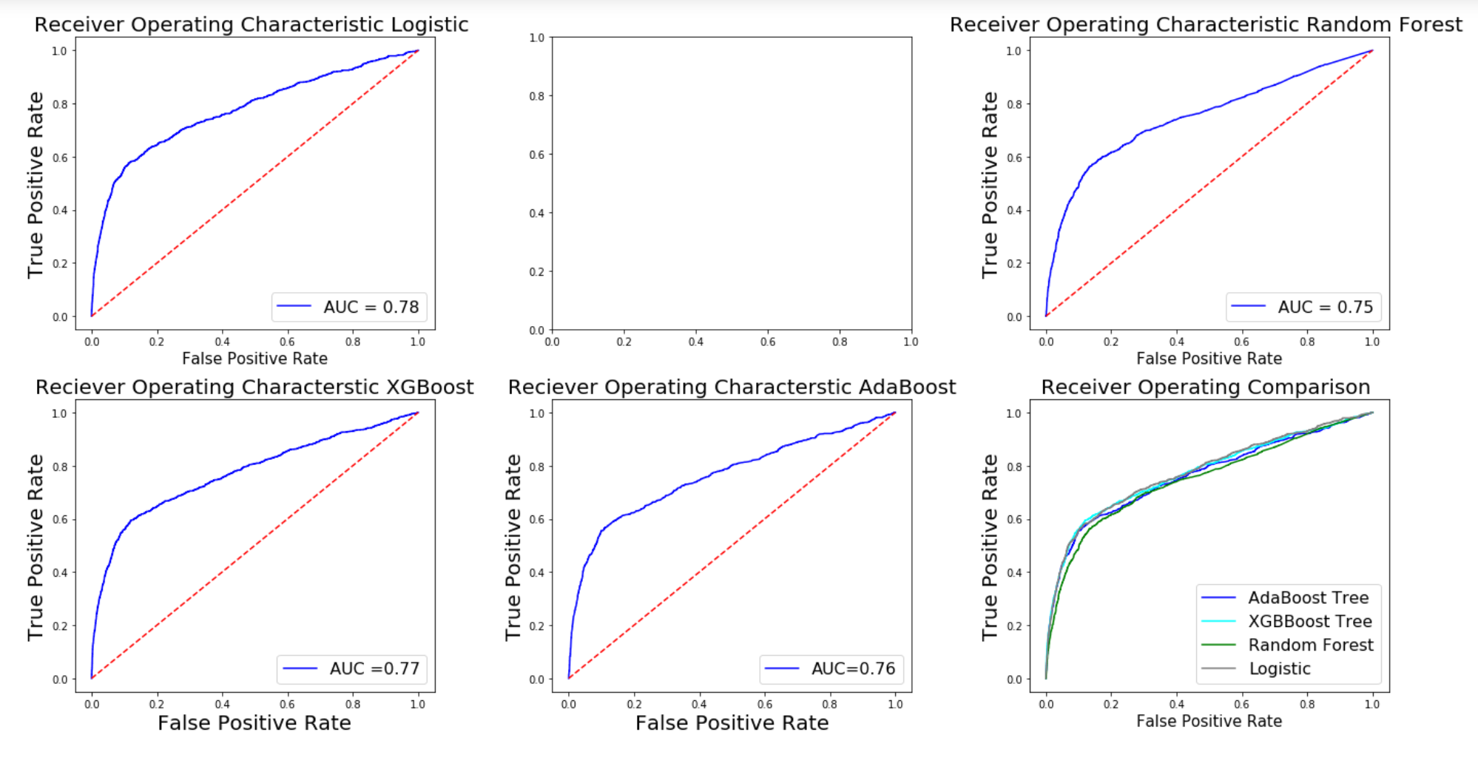
Models Tested with AUC
Best model Logistic & XGBoost

Slide 6
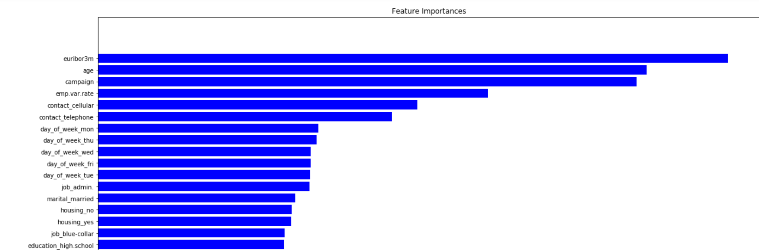
Feature importance chart
Analysis
Best model Logistic & XGBoost

Slide 7
Recommendations
Analysis
Sl.no | Variable of Importance | Recommended Action
1 | libor rate, con.Price.idx | Collaborate with economic experts
2 | Age | Target Old Age customers
3 | Duration, mode of contact | Engage customers and have longer calls
4 | Day of week | Call them during mid of week

