Slide 1
fMRI of speech and language
Rajeev Raizada
raizada@u.washington.edu
Institute for Learning and Brain Sciences, University of Washington

Slide 2
The human brain: now accessible to study
So far, you’ve learned a lot about behaviour
  Speech perception, speech production
The brain is what underlies behaviour
How does the human brain produce and perceive speech?
In the past…
  We could only study the brains of animals and dead people. They don’t talk much.
Within the last 10-15 years…
  New tools have allowed us to study the living human brain, while it is producing and perceiving speech

Slide 3
Aims of this lecture
  Give an broad overview of some of the recent tools that let us study the live human brain in action, in particular fMRI
  What questions can these new tools help us answer?
  What questions can we NOT answer?
  How can this help us to understand speech?
  Show one or two examples (Kim et al., Nature, 1997)
  Discuss questions you have about the brain (e.g. is it true that we only use 10%, etc.)

Slide 4
Speech and the brain:
What do we want to ask, what can we answer?
A few things it would be nice to know…
  How on earth does this piece of meat between my ears manage to talk? And understand?
  My patient’s language is impaired. What in his brain is causing the problem? Can I fix it?
  The brain can handle speech brilliantly. Can I build the brain’s tricks into a computer?
  How do we learn language? What changes occur in our brain when we learn language? Can neuroscience help us learn faster or better?

Slide 5
MRI
Magnetic Resonance Imaging
  Takes a 3D picture of the inside of body, completely non-invasively
  One picture, just shows the structure
http://www.coppit.org/brain/

Slide 6
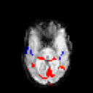
fMRI functional Magnetic Resonance Imaging
  Shows brain activity (indirectly)
  Takes a series of pictures over time, e.g. one every three seconds
  The “f” in fMRI means functional, i.e. you get a movie of brain function, not a still image of brain structure
http://www.fmrib.ox.ac.uk/image_gallery/av/

Slide 7
Language areas in the brain
Some brain areas are specialised for language
  Broca’s area: speech production
  Wernicke’s area: speech perception
  On the left side of the brain (in 95% of people)
  This is pretty much the only left-brain / right-brain saying that is actually true
What does “specialised for language” actually mean?
  If you lose these areas, you lose language
  When you use language, you use those areas
  BUT: That does not mean that they only do language
  E.g. Broca’s area may be involved in music perception

Slide 8
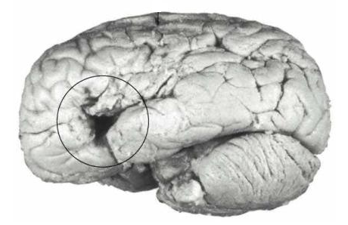
Broca’s area: crucial for speech production
Paul Broca (1861): patient "Tan”
  Severe deficit in speech production: could only say “tan”
  Good language comprehension
Tan’s brain: lesion (injury) in left frontal cortex

Slide 9
Auditory cortex and Wernicke’s area
Auditory cortex: all sounds pass into here
  Mostly specialised for low-level features, e.g. raw frequency
  Bilateral (on both left and right sides of the brain)
Wernicke’s area (Carl Wernicke, 1874)
  Patient with very poor speech comprehension
  Good speech production
  Lesion on left side, just behind auditory cortex
  Specialised for processing “higher level” sounds: speech

Slide 10
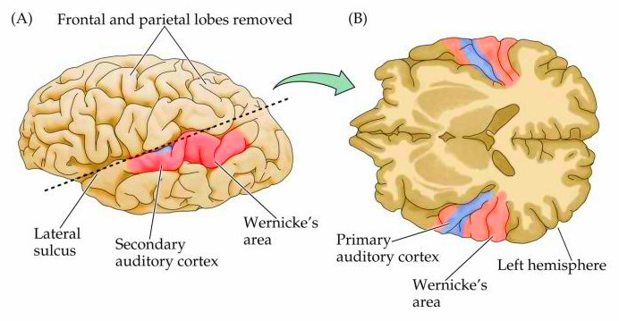
Auditory cortex and Wernicke’s area
From http://www.physiology.wisc.edu/neuro524/

Slide 11
Language areas in the brain
From University of Washington’s Digital Anatomist project

Slide 12
Broca’s and Wernicke’s:
Summary, some tentative conclusions
Lesion (injury) studies:
  Show that a brain area is necessary for a given task
  Without Broca’s area, you can’t produce speech
  Without Wernicke’s area, you can’t understand speech
Returning to same/different parts of brain question:
  Speech production and perception are centered in different areas, suggesting that different processes may underlie them
  But Broca’s and Wernicke’s are connected to each other
  Wernicke’s speech perception area is close to, but not inside of, primary auditory cortex
  Speech perception is not just plain old auditory processing

Slide 13
Broca’s and Wernicke’s:
Questions for possible fMRI studies?
Lesion studies leave a lot of questions open!
  Are other areas involved in these speech tasks?
  Are these areas involved in other language functions?
  How do these areas function in an intact, uninjured brain?
  What’s going on inside these areas?
  What kinds of representations of speech do they have?
Can fMRI address some of these questions?
  Measure brain activity while perceiving or producing speech
  But first need to know: what is fMRI actually measuring?

Slide 14
What are we actually measuring with fMRI?
  An MRI machine is just a big magnet (30,000 times stronger than Earth’s magnetic field)
  The only things it can measure are changes in the magnetic properties of things inside the magnet: in this case, your head
  When neurons are active, they make electrical activity, which in turns creates tiny magnetic fields
  BUT far too small for MRI to measure (100 million times smaller than Earth’s magnetic field)
  So, how can we measure neural activity with MRI?

Slide 15
What makes fMRI possible:
Don’t measure neurons, measure blood
Two lucky facts make fMRI possible
  When neurons in a brain area become active, extra oxygen-containing blood gets pumped to that area. Active cells need oxygen.
  Oxygenated blood has different magnetic properties than de-oxygenated blood. Oxygenated blood gives a bigger MRI signal
End result: neurons fire => MRI signal goes up
This fMRI method is known as BOLD imaging: Blood-Oxygenation Level Dependent imaging. Invented in 1992.

Slide 16
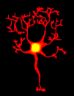
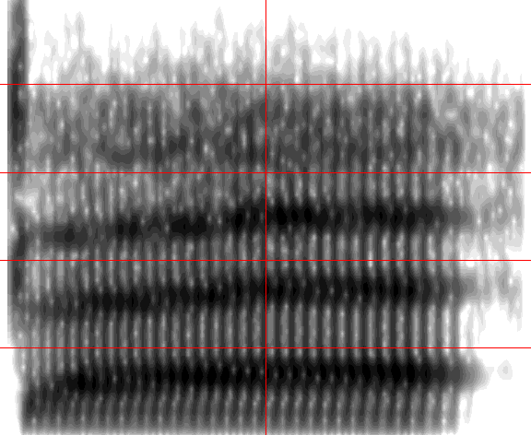
But neurons do the real work, not blood.
Neurons represent and process information
Individual nerve cells (neurons) represent information
  Sensitive to “preferred stimuli”, e.g. /ba/
  These stimuli make them active
  Firing activity: send electrical spikes to other neurons
/ba/
/ba/-sensitive neuron

Slide 17
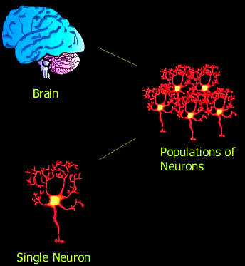
Populations of neurons process information together
Information is distributed across large populations of neurons, and across brain areas
There’s no “grandmother cell”: the one single cell that recognizes your grandmother
To really understand the brain, we’d need somehow to read the information from millions of individual neurons at once!

Slide 18
Problem 1:
Neurons are fast, blood is slow
  Neurons can send and receive signals in just a few milliseconds
  Important events in the world happen in tens of milliseconds, and neurons can handle them. e.g. duration of formant transitions
  The blood-flow response to neural firing takes around six seconds to get going, and around 18 seconds to finish

Slide 19
Problem 2:
Neurons are small, MRI measures are big
  100,000,000,000 neurons in the brain
  Each neuron around one hundredth of a millimeter
  Typical fMRI voxel size: 3mm x 3mm x 5mm
    A “voxel” is the 3D version of a pixel
  So, in fMRI, we are measuring average activity of literally millions of neurons
  Neighbouring neurons might be representing different things. E.g. we might be averaging together signals from /ba/ neurons and /da/ neurons

Slide 20
Don’t despair! fMRI experiments can answer meaningful questions about the brain…
But it’s not easy to come up with good designs
Some cases where fMRI activation can tell us about the brain’s mechanisms
  Different parts of brain active => Different mechanisms operating
  Same parts of brain active => Maybe same mechanisms operating
  Example from before: is speech processed just like any other sound?
  Example coming up: Is first-language processed same as second?
Presence of brain activation suggests operation of process
  Example: lipreading, with no sound. Auditory cortex lights up!
  Suggests that looking at lips doesn’t just feel like you’re trying to hear the speech, you really are invoking auditory processes (Calvert et al., Science, 1997)

Slide 21
Example relating brain to behaviour:
Remediating dyslexia
Several groups have shown that training programs for dyslexic children can improve their reading, and make their brain activation become more similar to activation in normal readers
  Including Virginia Berninger, Elizabeth Aylward, Todd Richards here at UW
BUT: not all kids improve in such training programs
Open question:
  Can we predict, using fMRI, which kids will benefit from training, and which will not? Maybe the two groups will have similar pre-training reading scores, but dissimilar patterns of brain activation?
  Can ask same question for, e.g. which patients will respond to this anti-depressant drug?

Slide 22
The basic design of an fMRI experiment
Aim:
  Find which brain areas are active during a given task
  E.g. discriminating speech sounds, producing speech
Typical design:
  Present blocks, e.g. 30s of task, 30s of rest
  Measure fMRI activity regularly every few seconds
  Look for brain areas which are more active during the task periods, compared to rest periods

Slide 23
Example time-courses
Time-course of task versus rest periods
Task
Task
Rest
Rest
Rest
MRI signal from voxel that correlates well with task: Active
Signal from voxel that does NOT correlate with task: Inactive
TIME

Slide 24
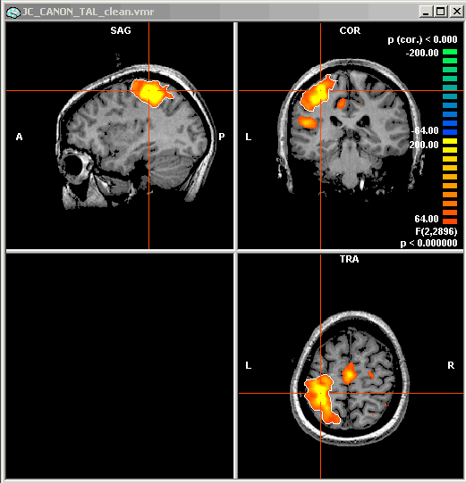
What are those little coloured blobs, actually?
Colour represents statistical significance of how well the voxel’s activation correlates with the task.
The hi-res grayscale anatomical picture underneath the coloured blobs is a completely different type of image, from a different type of scan. Shows the anatomy at the spot where the significant voxel’s time-course was recorded.

Slide 25
Case study:
Kim et al., Nature, 1997
Thanks to Tobey Nelson for the following slides

Slide 26
Introduction
Goal
  Examine cortical representations of native language (L1) and second language (L2) in bilinguals
Questions addressed
  How are multiple languages represented in the brain?
  Common or separated areas for L1 and L2?
  Same patterns for early and late bilinguals?
  Same patterns in Broca’s and Wernicke’s areas?

Slide 27
Method
Imaging technique: fMRI
Subjects
  6 “early” bilinguals – acquired two languages simultaneously as infants
  6 “late” bilinguals – exposed to L2 at 11, achieved conversational fluency at 19
Tasks
  Silent sentence-generation (internal speech) in L1 and in L2
Analysis
  Do the L1 and L2 activations overlap?
  Measure distance between L1 and L2 activation centers

Slide 28
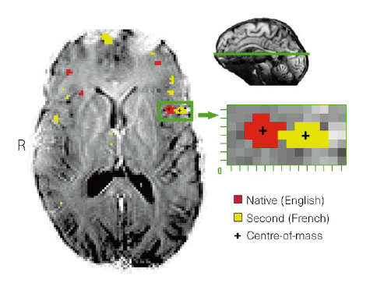
Results: Broca’s in a typical “late” bilingual
Broca’s area: spatially separated activations in for L1 and L2
NB:
Left side of brain is on right side in all these images

Slide 29
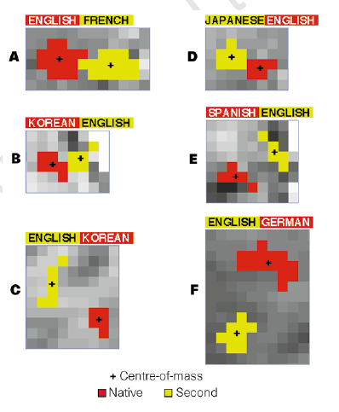
Results: Broca’s in all “late” bilinguals
Spatially different areas in Broca’s area for L1 and L2 in all “late” bilinguals, across languages

Slide 30
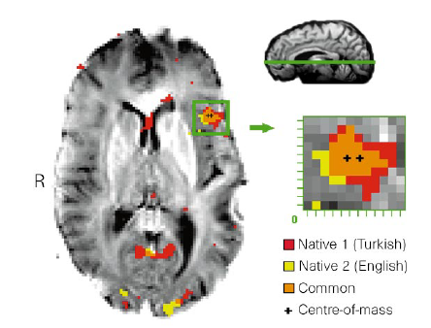
Results: in “early” bilinguals,
L1 and L2 overlap in Broca’s area

Slide 31
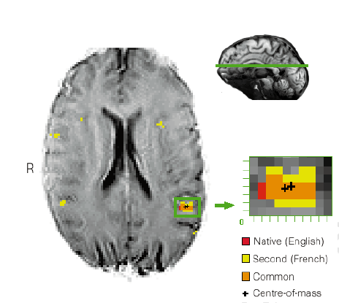
Results: L1 and L2 overlap in Wernicke’s, both for “early” and “late” bilinguals
L1 and L2 activate a shared region in Wernicke’s area

Slide 32
Summary of Kim et al. study
Conclusions
  If you learn a second language early, it can cohabit with your first language in Broca’s area
  But if you learn it late, the second language needs to find its own space
Possible interpretations:
  The brain is more plastic for language early in life
  Neural commitment: once Broca’s is committed to the first language, it’s hard to de-commit it
Questions:
  If L1 and L2 activate different areas, does that mean that they are being processed differently?
  If they activate the same area, does it mean that they are being processed in the same way? By the same neurons?

Slide 33
fMRI compared to other neuroimaging techniques (1)
fMRI
  Measures changes in blood oxygenation caused by changes in neural activation
  Big, expensive, loud. But lots of scanners
Magnetoencephalography (MEG)
  Measures tiny magnetic fields caused by neural activity
  Big, expensive, but at least not loud
  Not many scanners. Requires magnetically shielded room
Electro-encephalography (EEG), Event-Related Potentials (ERPs)
  Measures small electric fields on scalp caused by neural activity
  Fairly small, comparatively cheap
  Can attach electrodes to head in cap, works well with babies

Slide 34
fMRI compared to other neuroimaging techniques (2)
Big advantage of fMRI: good spatial resolution
  Can record from a specified voxel inside the head
  MEG and EEG record from outer surface of head, making it difficult to figure out where within the head the measured signals originated from
  Spatial smearing of signal is worse for EEG than MEG. Electric fields spread around through head and skin, magnetic fields don’t
  But even an fMRI voxel contains millions of neurons!
Big disadvantage of fMRI: poor time-resolution
  Blood is slow (seconds) but neurons are fast (milliseconds)
  MEG and EEG measure neural signals directly, millisecond resolution
Take-home message:
Different methods let you ask different questions

Slide 35
Varieties of neuroimaging
TMS
PET
EEG/ERPs
MEG
cm
mm
microns
Spatial
resolution
fMRI
MRI
Single-neuron
electrophys
ms seconds minutes
Temporal resolution

Slide 36
fMRI of language in 5-year-old children:
How does brain relate to behaviour?
5 year-olds are just about to start school and learn to read
Some interesting questions (most of which we don’t have answers to, yet)
  Peer into a child’s brain, peer into that child’s future?
  What are their language skills?
  How is their brain processing language?
  How big a factor is their environment (Socio-Economic Status) ?
  Which measures might predict subsequent language problems?

Slide 37
Measure brain, measure behaviour, see how they relate
Behavioural measures:
  Battery of standardised language and IQ tests
    Thank you to Anika for having led much of the testing!
  Peabody Picture Vocabulary Test
  Phonological Abilities Test (PAT)
  Clinical Evaluation of Language Fundamentals test (CELF)
  Wechsler Preschool and Primary Scale of Intelligence (WPPSI)
  Measure of Socio-Economic Status (SES): Hollingshead scale
Brain measures:
  fMRI of kids performing rhyme and tone judgments
  Rhyming task: hear two words, press a button if they rhyme

Slide 38
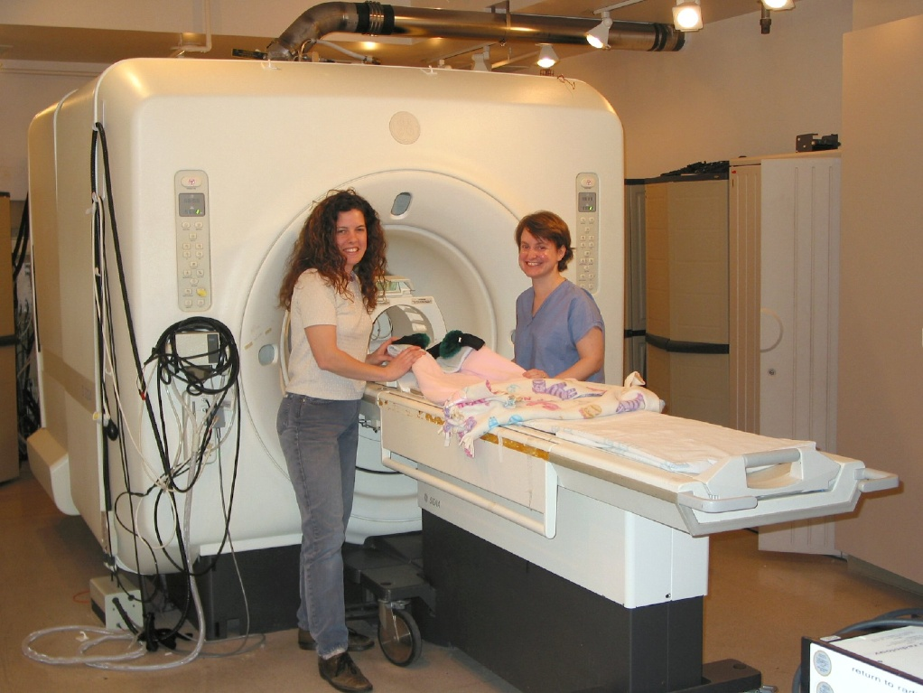
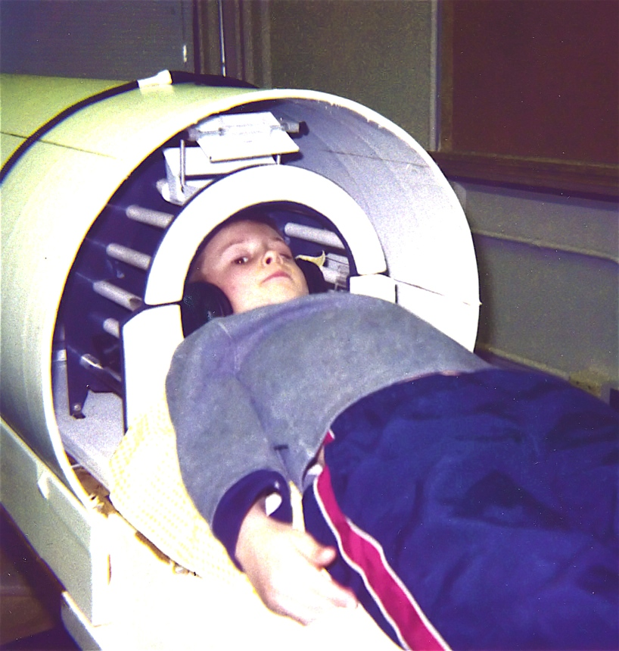
How to convince a small child to lie still inside a noisy metal tube
MRI scanners are big, noisy tubes. Kids need to keep heads still
  Secret weapon #1: Kids visit first to practice in simulated scanner
  Secret weapon #2: Katie and Sally’s calm and soothing manner
  Out of 30 kids: 14 successful scans with good quality images

Slide 39
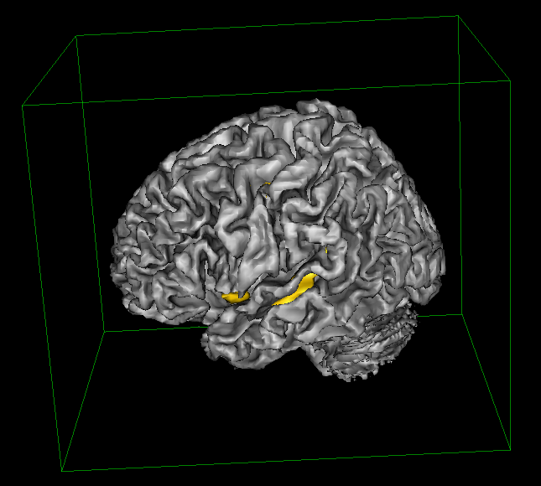
Results (Part 1):
Activation of language areas
Left inferior frontal cortex
Approx. location of Broca’s area
Shows activation during rhyming task
Surprisingly clean group-average activation, especially for kids
Left superior temporal cortex
Auditory cortex, Wernicke’s area

Slide 40
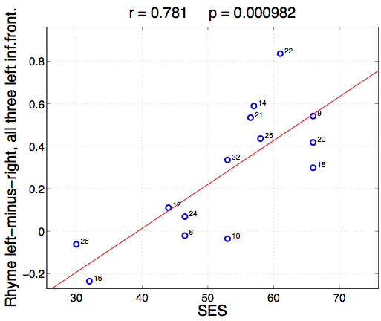
Results (Part 2):
Correlation between SES and Broca’s
Hemispheric specialisation
Language areas, including Broca’s area, are on the left side of brain
The more developed the language areas, the greater the left/right asymmetry
Measure of specialisation: activation difference between left and right sides

Slide 41
But what does it all mean?
What are the links between SES and language?
  Parental vocabulary and syntax
  Less exposure to reading, fewer books in the home
Environmental factors that impair cognition broadly:
  Nutrition, stress, health care etc.
Does low SES cause language problems?
How would you design a study to test for a causal link?

Slide 42
Some links
Eric Chudler, UW faculty, has a very interesting webpage about the myth that we use only ten percent of our brains
http://faculty.washington.edu/chudler/tenper.html
Jody Culham’s website: lectures from an excellent introductory course: “fMRI for Newbies”
http://psychology.uwo.ca/culhamlab/Jody_web/fmri4newbies.htm
The Digital Anatomist, from UW’s Dept. of Biological Structure. Lots of great brain pictures, with addable labels for the different structures
http://www9.biostr.washington.edu/da.html
Brain Voyager Brain Tutor: Free 3D brain tutorial, for Mac or Windows
http://www.brainvoyager.de/Downloads.html
This lecture: http://faculty.washington.edu/raizada/fMRI_speech_lecture_June2006/

