Slide 1

DataTypes in java
By Rajeev Ranjan

Slide 2
What is Data Types
Data types specify the different sizes and values that can be stored in the variable. There are two types of data types in Java:
Primitive data types: The primitive data types include boolean, char, byte, short, int, long, float and double.
Non-primitive data types: The non-primitive data types include Classes, Interfaces, and Arrays.

Slide 3
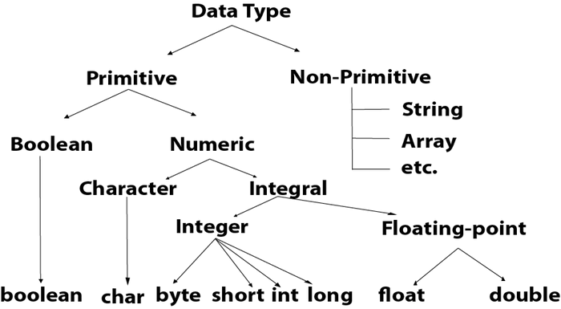

Slide 4
int myNum = 5; // Integer (whole number)
float myFloatNum = 5.99f; // Floating point number
char myLetter = 'D'; // Character
boolean myBool = true; // Boolean
String myText = "Hello"; // String

Slide 5
Data Type | Size | Description
byte | 1 byte | Stores whole numbers from -128 to 127
short | 2 bytes | Stores whole numbers from -32,768 to 32,767
int | 4 bytes | Stores whole numbers from -2,147,483,648 to 2,147,483,647
long | 8 bytes | Stores whole numbers from -9,223,372,036,854,775,808 to 9,223,372,036,854,775,807
float | 4 bytes | Stores fractional numbers. Sufficient for storing 6 to 7 decimal digits

Slide 6
double | 8 bytes | Stores fractional numbers. Sufficient for storing 15 decimal digits
boolean | 1 bit | Stores true or false values
char | 2 bytes | Stores a single character/letter or ASCII values

