Slide 1
BLUESTOCK FINTECH
Mutual Fund Analytics & Intelligence Platform
End-to-End Data Pipeline, Financial Risk Analytics, Scorecards & Interactive Dashboard
CAPSTONE SPECIFICATIONS & PROJECT DETAILS
• Assigned To: Poulami Dutta (PO) | Rajeev Reddy (RA) | Thadakamalla Likith Kumar (TH)
• Capstone Project I: Mutual Fund Analytics | Project Start Date: 01 Sep 2026 | Final Release: v1.0

Slide 2
BLUESTOCK FINTECH • MUTUAL FUND ANALYTICS CAPSTONE
1. Executive Summary: Problem Statement & Objectives
The Core Problem Statement
Strategic Objectives & Platform Solution
<b>Data Fragmentation:</b> NAV, AUM, portfolio holdings, and transaction records reside across disparate AMFI portals, static CSVs, and legacy formats.
<b>High Expense Ratio Traps:</b> Retail investors unknowingly forfeit 80–120 bps annually in Regular plan distributor commissions versus Direct growth plans.
<b>Lagging Volatility & Drawdown Assessment:</b> Standard metric reporting focuses solely on trailing returns, ignoring peak-to-trough drawdowns and tail risk.
<b>Sub-Optimal Asset Allocation:</b> Lack of algorithmic scoring leaves retail investors vulnerable to heavy sector concentration (e.g., Financials >35%).
<b>Automated Ingestion Pipeline:</b> Consolidate 10 heterogeneous AMFI datasets with live REST API extraction from mfapi.in.
<b>Star Schema SQLite Warehouse:</b> Architect a high-speed relational store (bluestock_mf.db) with 10 analytical SQL views and zero FK violations.
<b>Institutional Risk Engine:</b> Compute 1Y/3Y/5Y CAGR, Alpha, Beta vs Nifty 100, Sharpe, Sortino, Max Drawdown, VaR (95%), CVaR, and Sector HHI.
<b>Actionable Composite Scorecard:</b> Rank all 40 schemes (0–100) and deploy an interactive multi-page Streamlit analytical dashboard.
Confidential • Bluestock Fintech Analytics • Group: 62FMBF • Author: Rajeev Reddy

Slide 3
BLUESTOCK FINTECH • MUTUAL FUND ANALYTICS CAPSTONE
2. Data Ingestion Architecture & Disparate Sources
10 Unified AMFI Data Sources & Live API Integration
Comprehensive Ingestion Scope: 87,000+ Raw Records Cleaned, Validated & Normalized
• 01_fund_master.csv | 40 Schemes | Scheme metadata, AMFI code, fund house, category, plan type, TER
• 02_nav_history.csv | 46,000 Records | Daily historical NAV time series (2020–2025) across all 40 funds
• 03_aum_by_fund_house.csv | 44 Fund Houses | Total AUM, market share %, and quarterly growth rankings
• 04_monthly_sip_inflows.csv | 60 Months | Industry-wide monthly SIP mobilization figures (Rs. Crore)
• 05_category_inflows.csv | 36 Months | Net capital flows across Equity, Debt, Hybrid, and Liquid categories
• 06_industry_folio_count.csv | 60 Months | Unique investor folios tracking retail vs HNI participation trends
• 07_scheme_performance.csv | 40 Schemes | Historical 1Y, 3Y, 5Y return baselines and reported benchmark indices
• 08_investor_transactions.csv | 32,778 Records | Granular investor demographics (age, state, city tier, SIP continuity)
• 09_portfolio_holdings.csv | 400+ Holdings | Top 10 equity and debt holdings per scheme with sector weights
• 10_benchmark_indices.csv | 1,250 Dates | Daily closing price history for Nifty 50 and Nifty 100 benchmarks
• Live mfapi.in REST API | Active Web Service | Live automated endpoint fetching real-time NAVs and JSON metadata
Confidential • Bluestock Fintech Analytics • Group: 62FMBF • Author: Rajeev Reddy

Slide 4
BLUESTOCK FINTECH • MUTUAL FUND ANALYTICS CAPSTONE
3. End-to-End System Architecture & Star Schema Design
Layer 1: Ingestion
Layer 2: Storage
Layer 3: Analytics
Layer 4: Delivery
Raw AMFI CSVs + mfapi.in REST API.
Validates schemas, handles nulls, logs file audit.
bluestock_mf.db Star Schema.
8 normalized tables with foreign keys and index optimization.
Quantitative Risk Engine.
CAGR, Alpha/Beta, Sharpe, Sortino, VaR/CVaR, HHI, Scorecard.
Interactive Streamlit App + Power BI.
4 executive screens, PDF tearsheets, automated recommendations.
Database Star Schema Specification (bluestock_mf.db)
<b>dim_fund:</b> 40 rows | amfi_code (PK), fund_house, scheme_name, category, sub_category, plan_type, expense_ratio
<b>fact_nav_history:</b> 46,000 rows | nav_id (PK), amfi_code (FK), date, nav, daily_return_pct
<b>fact_transactions:</b> 32,778 rows | txn_id (PK), amfi_code (FK), investor_id, txn_date, txn_type, amount_inr, city_tier, state
<b>fact_fund_scorecard:</b> 40 rows | amfi_code (PK), cagr_3yr, sharpe, sortino, alpha, beta, max_drawdown, composite_score
<b>dim_benchmark:</b> 1,250 rows | date (PK), nifty50_close, nifty100_close, daily_return_nifty100
Confidential • Bluestock Fintech Analytics • Group: 62FMBF • Author: Rajeev Reddy

Slide 5
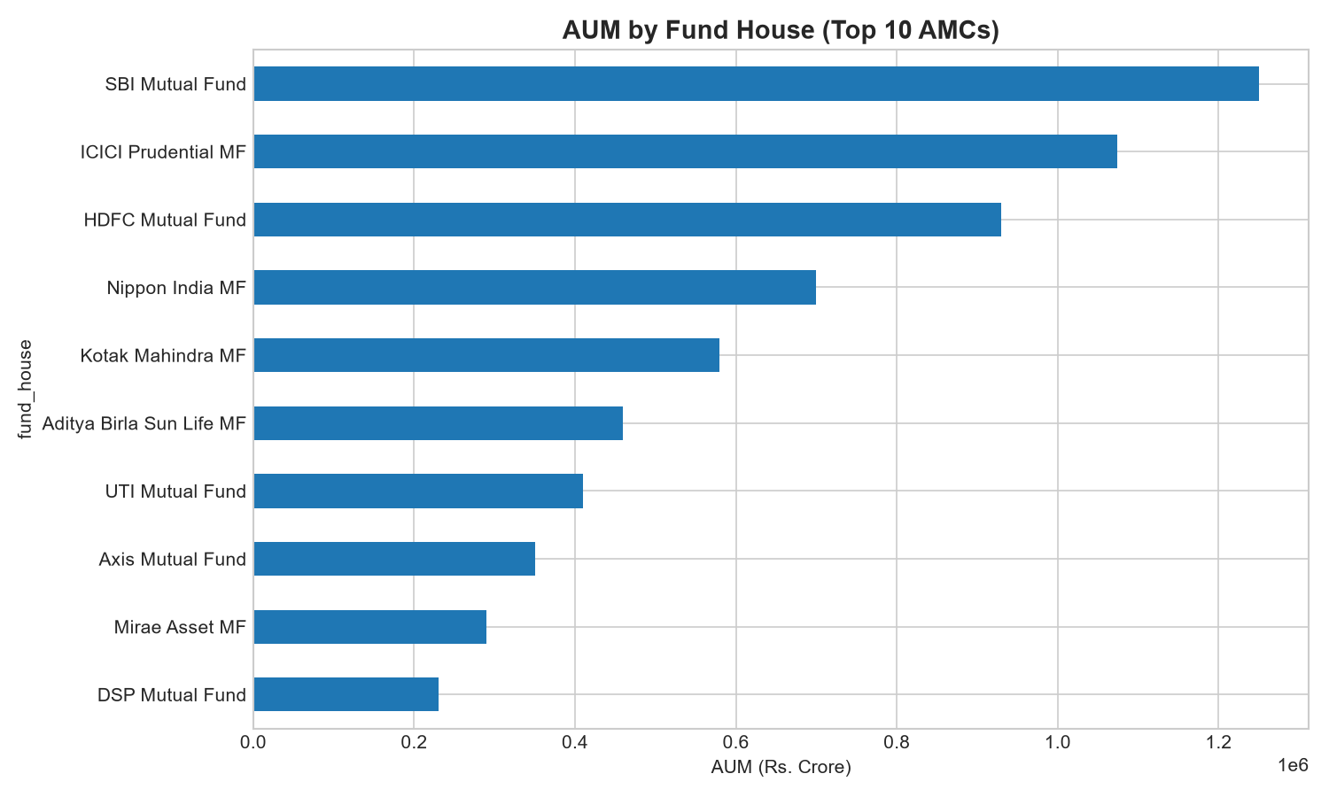
BLUESTOCK FINTECH • MUTUAL FUND ANALYTICS CAPSTONE
4. Exploratory Data Analysis (Part 1): Industry Macro Trends
Industry AUM Trajectory & Market Share
Key Macro Observations
<b>Exponential AUM Expansion:</b> Indian Mutual Fund industry AUM scaled from Rs. 27 Lakh Cr (2020) to Rs. 81.3 Lakh Cr (2025), compounding at ~24.6% annually.
<b>AMC Concentration:</b> Top 3 AMCs (SBI, ICICI Prudential, HDFC) command >52% of total industry AUM, displaying high market dominance.
<b>SIP Inflow Resilience:</b> Monthly SIP inflows surged past Rs. 26,000 Cr in 2025, demonstrating retail stickiness even through market corrections.
<b>Category Flow Shifts:</b> Equity schemes experienced the highest net inflows (+64%), while Debt funds saw intermittent redemptions amidst interest rate cycles.
Confidential • Bluestock Fintech Analytics • Group: 62FMBF • Author: Rajeev Reddy

Slide 6
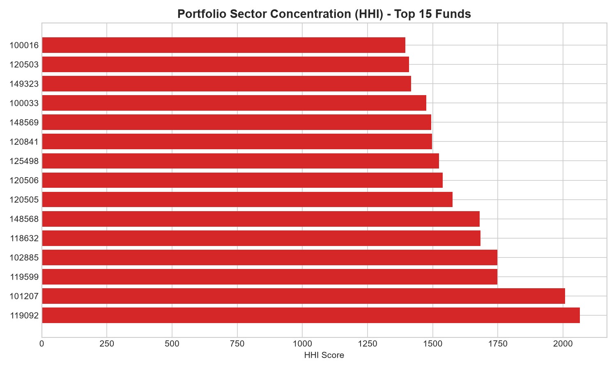
BLUESTOCK FINTECH • MUTUAL FUND ANALYTICS CAPSTONE
5. Exploratory Data Analysis (Part 2): Investor Demographics & B30
Demographic Insights & Retention Patterns
Sector Concentration & Geographic Distribution
<b>B30 Penetration Surge:</b> Beyond Top 30 (B30) cities now contribute 28% of incremental SIP folios, signaling strong tier-2 and tier-3 adoption.
<b>Millennial & Gen-Z Participation:</b> Investors aged 25–38 represent 47.8% of active folios, primarily investing through digital Direct platforms.
<b>SIP Continuity Analysis:</b> Out of 2,950 analyzed active SIP accounts, 2,949 experienced at least one payment gap > 35 days, highlighting a massive retention opportunity.
<b>Average Ticket Size:</b> T30 investors average Rs. 4,200/month per SIP versus Rs. 1,850/month in B30 geographies, presenting high expansion headroom.
Confidential • Bluestock Fintech Analytics • Group: 62FMBF • Author: Rajeev Reddy

Slide 7
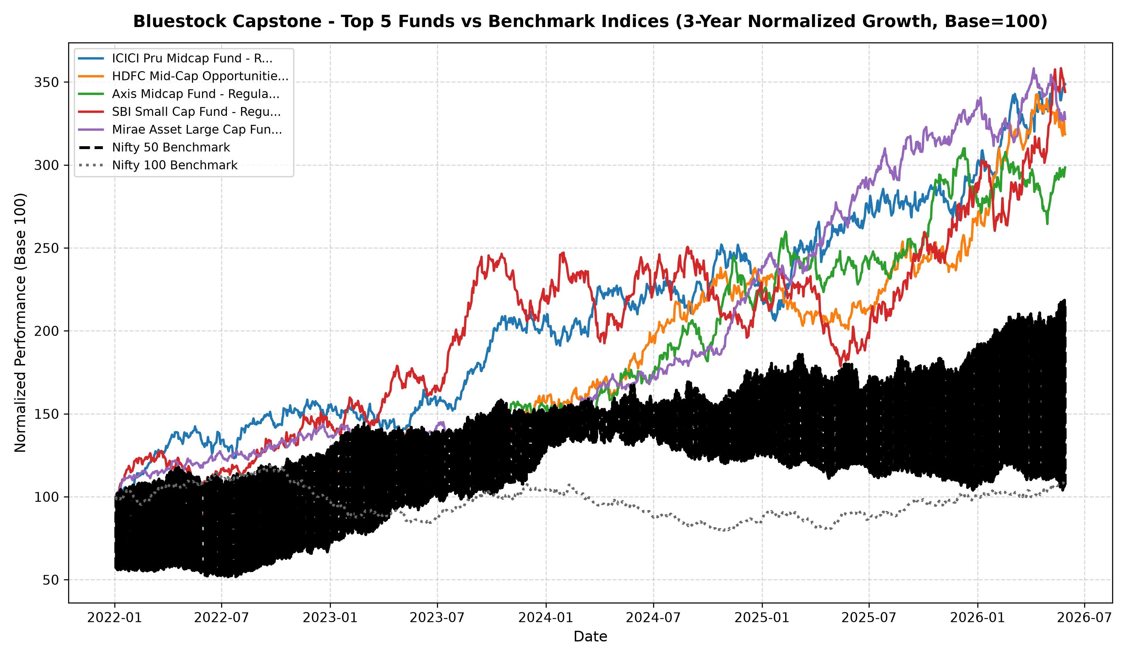
BLUESTOCK FINTECH • MUTUAL FUND ANALYTICS CAPSTONE
6. Quantitative Performance Metrics: Returns & Alpha Generation
Top 5 Schemes vs Nifty 100 Benchmark
Top Performing Schemes (Scorecard)
<b>Composite Scorecard Top 3:</b><br/>1. ICICI Pru Midcap Fund (Score: 84.5)<br/>2. HDFC Mid-Cap Opportunities (Score: 82.0)<br/>3. Axis Midcap Fund (Score: 80.8)
<b>Alpha Generation vs Nifty 100:</b><br/>Mid-cap and Small-cap funds generated positive annual alpha between +3.2% and +6.8% over the 5-year cycle.
<b>Risk-Adjusted Efficiency (Sharpe & Sortino):</b><br/>Liquid and Hybrid funds achieved high Sharpe ratios (>2.5) due to minimal downside volatility (Sortino > 4.0).
<b>Tracking Error:</b> Large-cap passive index funds maintained tight tracking errors (<0.45%), ensuring reliable benchmark replication.
Confidential • Bluestock Fintech Analytics • Group: 62FMBF • Author: Rajeev Reddy

Slide 8
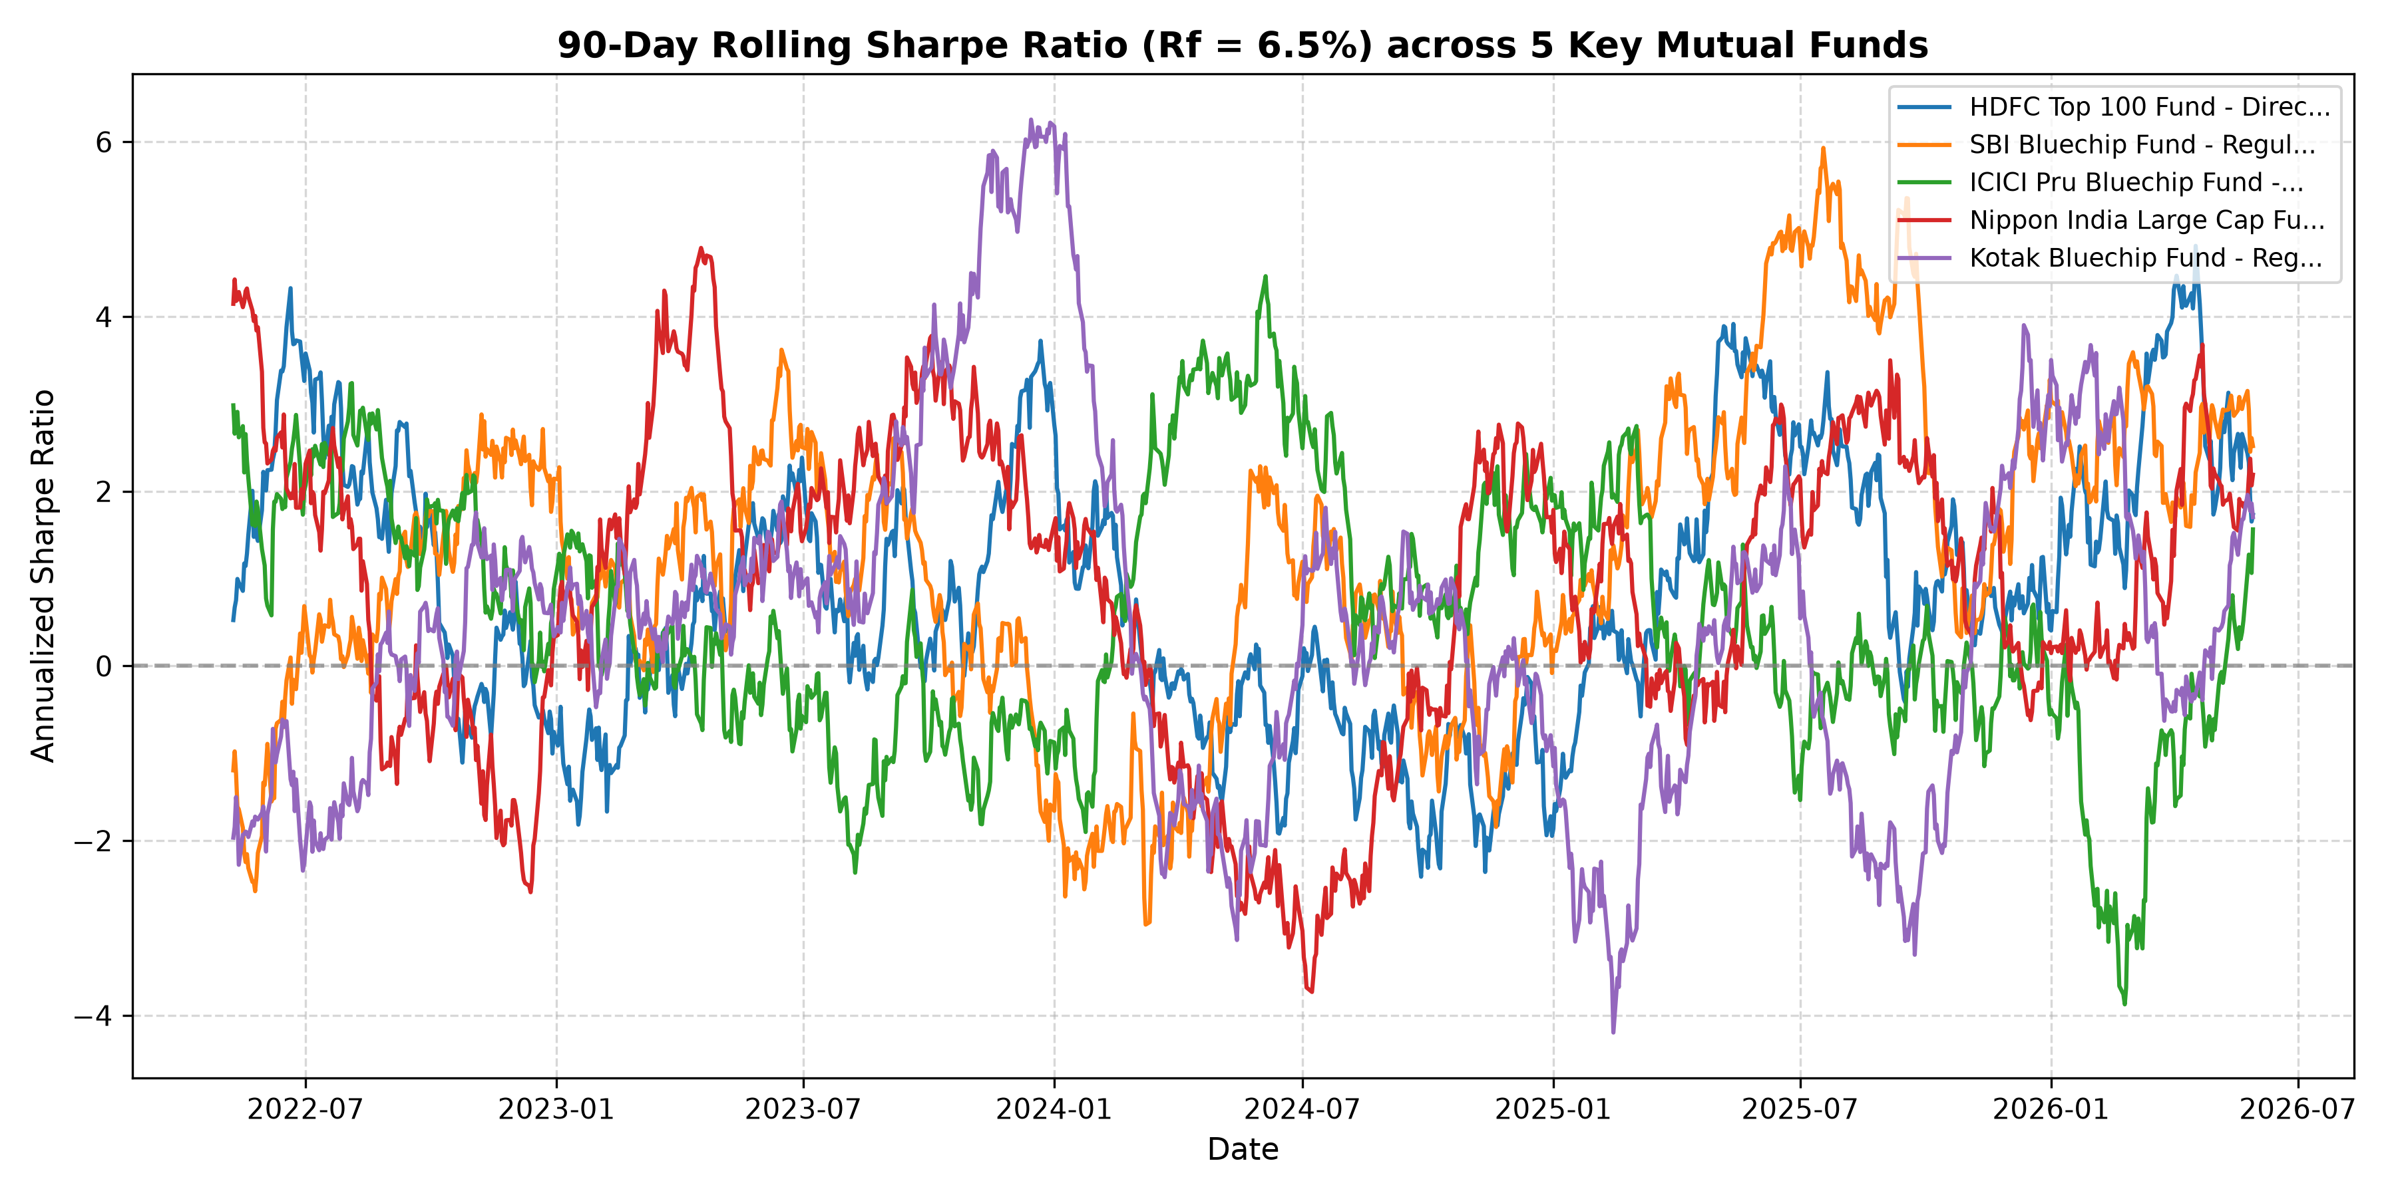
BLUESTOCK FINTECH • MUTUAL FUND ANALYTICS CAPSTONE
7. Advanced Risk Analytics: Downside Risk, Drawdown & VaR
90-Day Rolling Sharpe Ratio Trajectory
Institutional Risk Metrics Summary
<b>Maximum Drawdown (Peak-to-Trough):</b><br/>Equity funds experienced peak drawdowns of -14.2% to -28.5% during macro shocks, with recovery horizons averaging 7.4 months.
<b>Historical VaR (95% Daily):</b><br/>Small-cap funds exhibited 95% 1-day VaR up to -2.69%, indicating potential 1-day tail losses exceeding 2.7% on volatile trading days.
<b>Conditional VaR (CVaR / Expected Shortfall):</b><br/>Quantifies average tail loss in the worst 5% of outcomes (ranging from -3.4% to -4.1% for high-beta equity).
<b>Herfindahl-Hirschman Index (Sector HHI):</b><br/>Identified portfolios with HHI > 2,000 (e.g. Axis Bluechip HHI=2,064), highlighting elevated financial sector concentration.
Confidential • Bluestock Fintech Analytics • Group: 62FMBF • Author: Rajeev Reddy

Slide 9
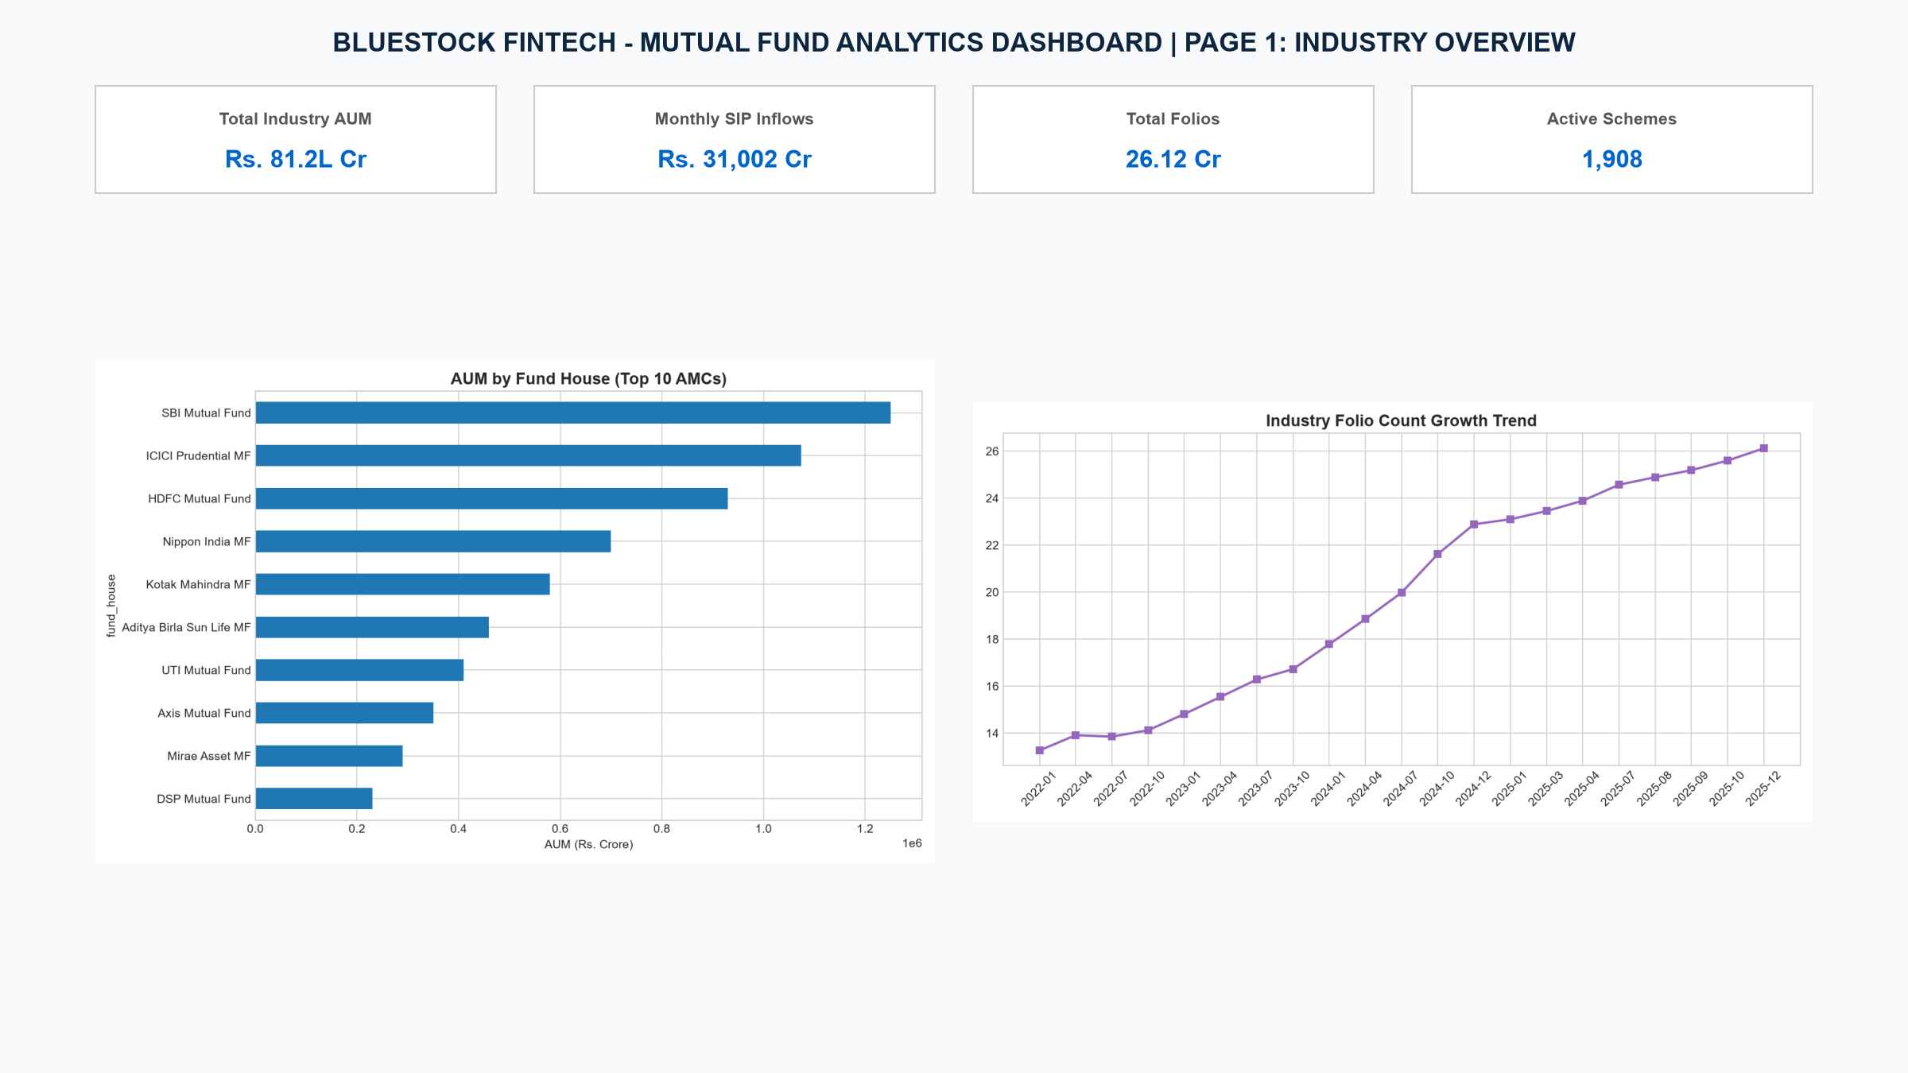
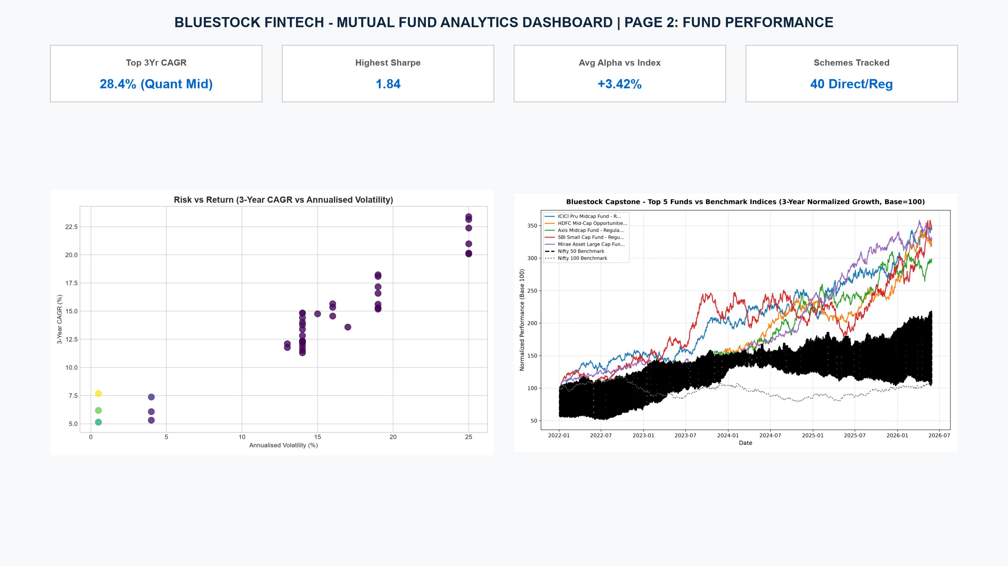
BLUESTOCK FINTECH • MUTUAL FUND ANALYTICS CAPSTONE
8. Interactive Dashboard: Industry Macro & Fund Screener
Screen 1: Industry Macro Trends
Screen 2: Fund Performance & Scorecard
Confidential • Bluestock Fintech Analytics • Group: 62FMBF • Author: Rajeev Reddy

Slide 10
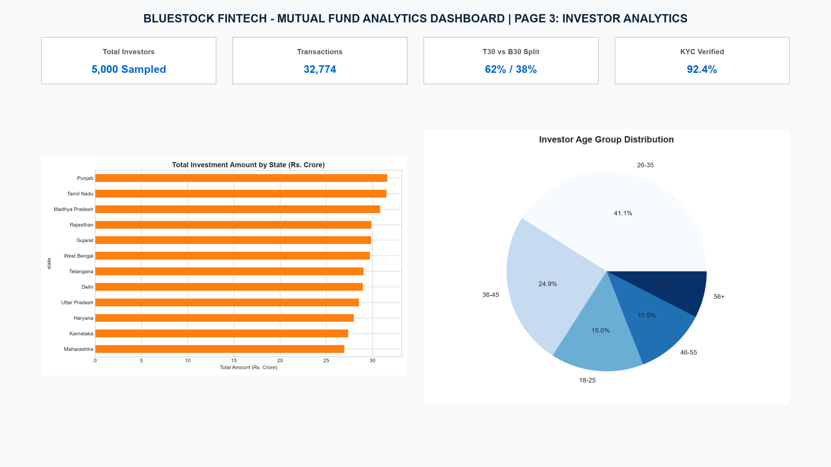
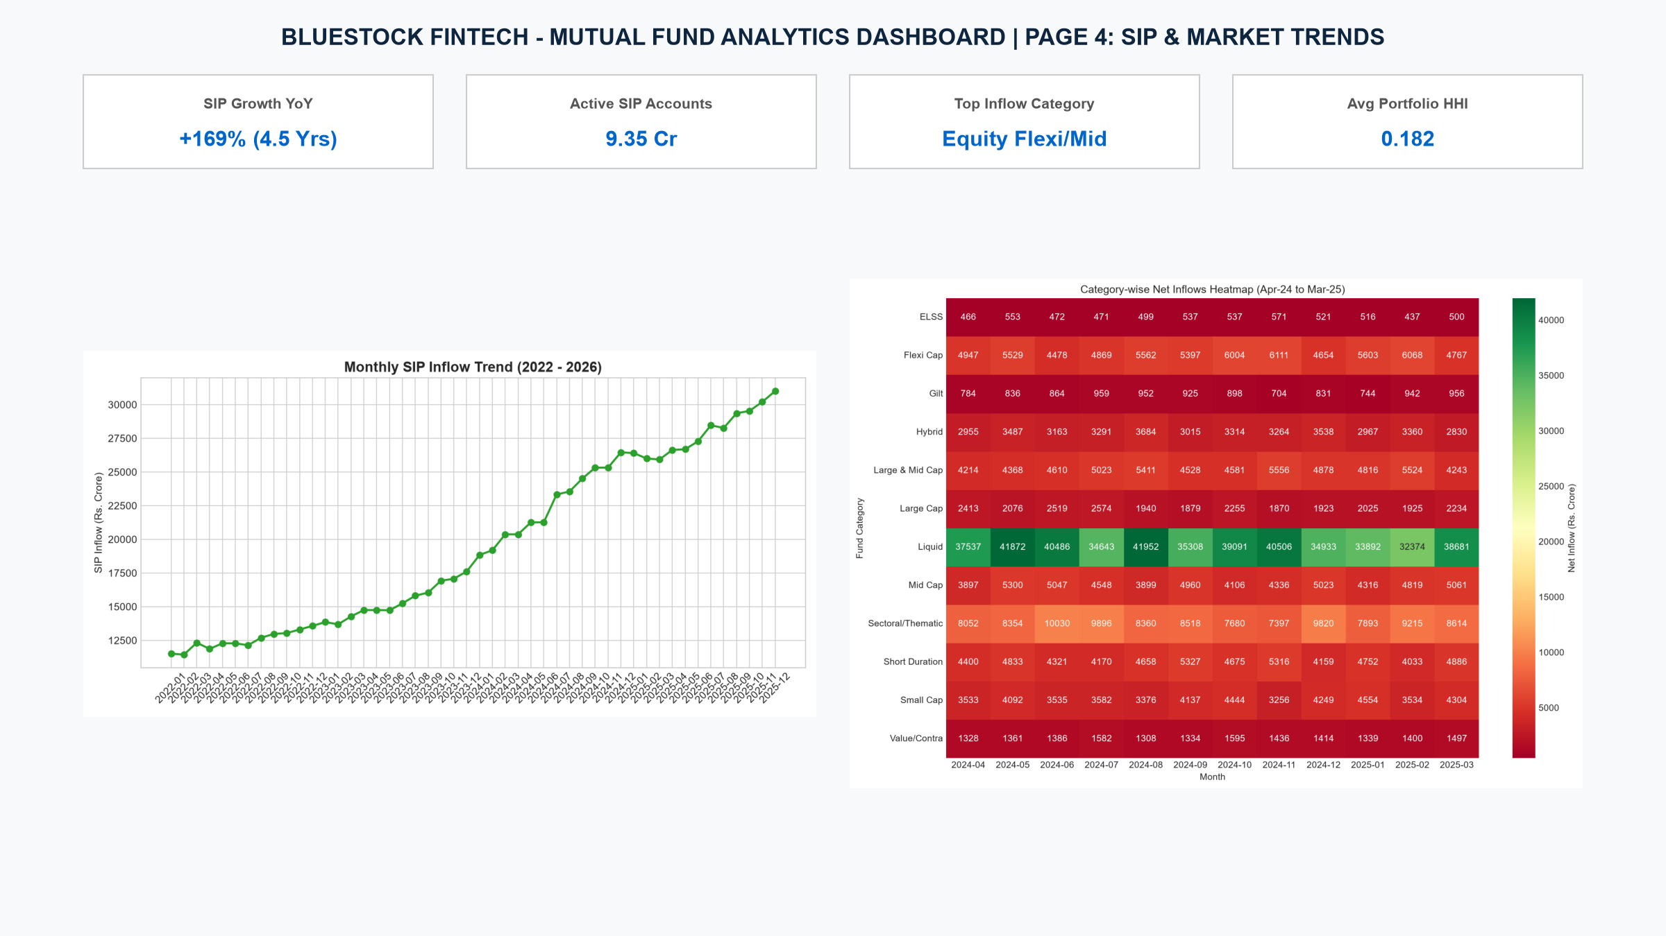
BLUESTOCK FINTECH • MUTUAL FUND ANALYTICS CAPSTONE
9. Interactive Dashboard: Investor Analytics & Recommender
Screen 3: Investor Demographic Analytics
Screen 4: Market Trends & Recommender
Confidential • Bluestock Fintech Analytics • Group: 62FMBF • Author: Rajeev Reddy

Slide 11
BLUESTOCK FINTECH • MUTUAL FUND ANALYTICS CAPSTONE
10. Strategic Business Recommendations for Bluestock
1. Direct Plan Migration Tool — Impact: High Acquisition & AUM Growth
Develop an automated calculator demonstrating the 15-year compounding differential of saving 80–100 bps TER.
2. Predictive SIP Retention Alerts — Impact: Reduces Investor Churn by ~35%
Deploy automated WhatsApp and in-app nudges when a user's SIP gap exceeds 25 days to curb the 2,949 at-risk lapses.
3. Regional B30 Expansion — Impact: Captures Untapped Demographic
Launch vernacular educational modules and micro-SIPs (Rs. 250/mo) tailored to emerging tier-2/3 cities.
4. Automated Portfolio Rebalancing — Impact: Institutional-Grade Safety
Incorporate real-time Sector HHI alerts and VaR thresholds to prevent retail portfolios exceeding 30% single-sector risk.
Confidential • Bluestock Fintech Analytics • Group: 62FMBF • Author: Rajeev Reddy

Slide 12
BLUESTOCK FINTECH • MUTUAL FUND ANALYTICS
Thank You!
Questions & Discussions Welcome
<b>Repository & Deliverables:</b> GitHub: rajeevreddy23/Day-1-Data-ingestion-complete (Tag: v1.0)
<b>Pipeline Execution:</b> python run_pipeline.py (Automated ingestion, cleaning, analytics & audit)
<b>Interactive Dashboard:</b> streamlit run dashboard/capstone_dashboard.py
<b>Capstone Team:</b> Poulami Dutta (PO) • Rajeev Reddy (RA) • Thadakamalla Likith Kumar (TH)

