Slide 1
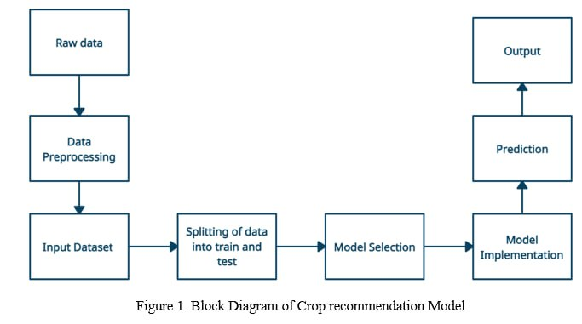
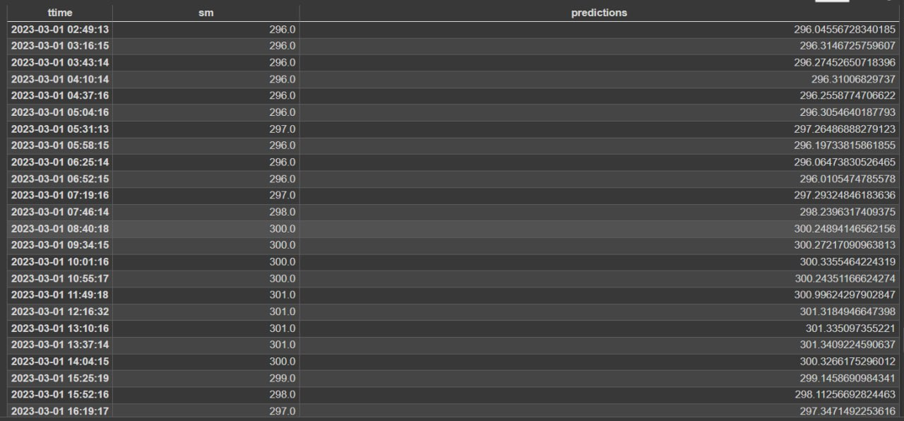
Soil moisture prediction
Email id: RAJEEVRM111@GMAIL.COM, vipulst.2002@gmail.com, varshasali14@gmail.com, soniaanvekar3002@gmail.com
Problem statement
Methodology
The system's first stage involves cleaning and processing raw data.
Crop data and fertilizer data are combined in this process to produce a final dataset.
This dataset is then separated into training and testing data and utilized as input to the system.
Model selection is the process of comparing various classification models in order to find the best appropriate one.
The most suited crops are predicted, and the output is used for the following.
Results
Predict soil moisture levels based on the previous 8 months of soil moisture data
To make the model accurate such that both expected and predicted values are same.
To reduce the loss and To increase accuracy of the model.
To predict the soil moisture level for the month of march 2023.
Objectives
Literature survey
Optimization details
"A Machine Learning Data Fusion Model for Soil Moisture Retrieval." Batchu, Vishal, Grey Nearing, and Varun Gulshan. (2022).
"Soil moisture estimation from Sentinel-1 interferometric observations over arid regions."Karamvasis, Kleanthis, and Vassilia Karathanassi.(2022).
"Fusion of hyper spectral and ground penetrating radar data to estimate soil moisture." Riese, Felix M., and Sina Keller. (WHISPERS). IEEE, 2018.
We have used gradient descent algorithm to vary the weights such that error or loss is minimized.
Conclusions
The predicted values are obtained as expected and the loss is 0.142. This model is used for predicting soil moisture level in a specific given time period.
Team Brain Cruzers

