Slide 1
Repeat Buyers prediction for e-commerce
CECS 550 Pattern Recognition
Rishikesh chava(029404386)
Rajeev Sai Nitturu (030823908)
Aashrith Racherla (030839755)

Slide 2
Contents
Background and goal
Data preparation
Data visualisation
Feature engineering
Dataset statistics and feature ranking
Prediction model
Model evaluation

Slide 3
Background and goal
Merchants gain new customers through promotions, but many are only interested in one-time deals.
To maximize ROI and reduce promotion costs, it's important to distinguish between one-time buyers and potential loyal customers.
The task is to design a system that predicts the probability of new buyers making another purchase within 6 months, reduces promotional costs, and identifies one-time buyers.
The dataset contains information on promotional shopping events from an e-commerce platform.

Slide 4
Data preparation
The dataset provided contains anonymized user shopping logs before and on the "Double 11" day (Promotional Event), along with the label information indicating whether they are repeated buyers.
As per the dataset allocation, our team needs to work on the item_id range from 1281-1440. So, we only used the records from the dataset that correspond to the items falling within this range. All the other records outside of this range are excluded from your analysis.
we performed tasks such as reading CSV files containing data related to user behavior logs, user profiles, and training data.
These datasets are merged into a single one based on the user_id and merchant_id fields.

Slide 5
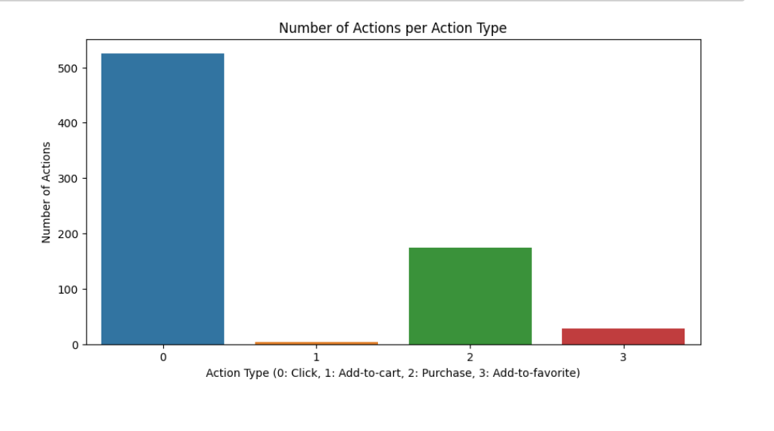
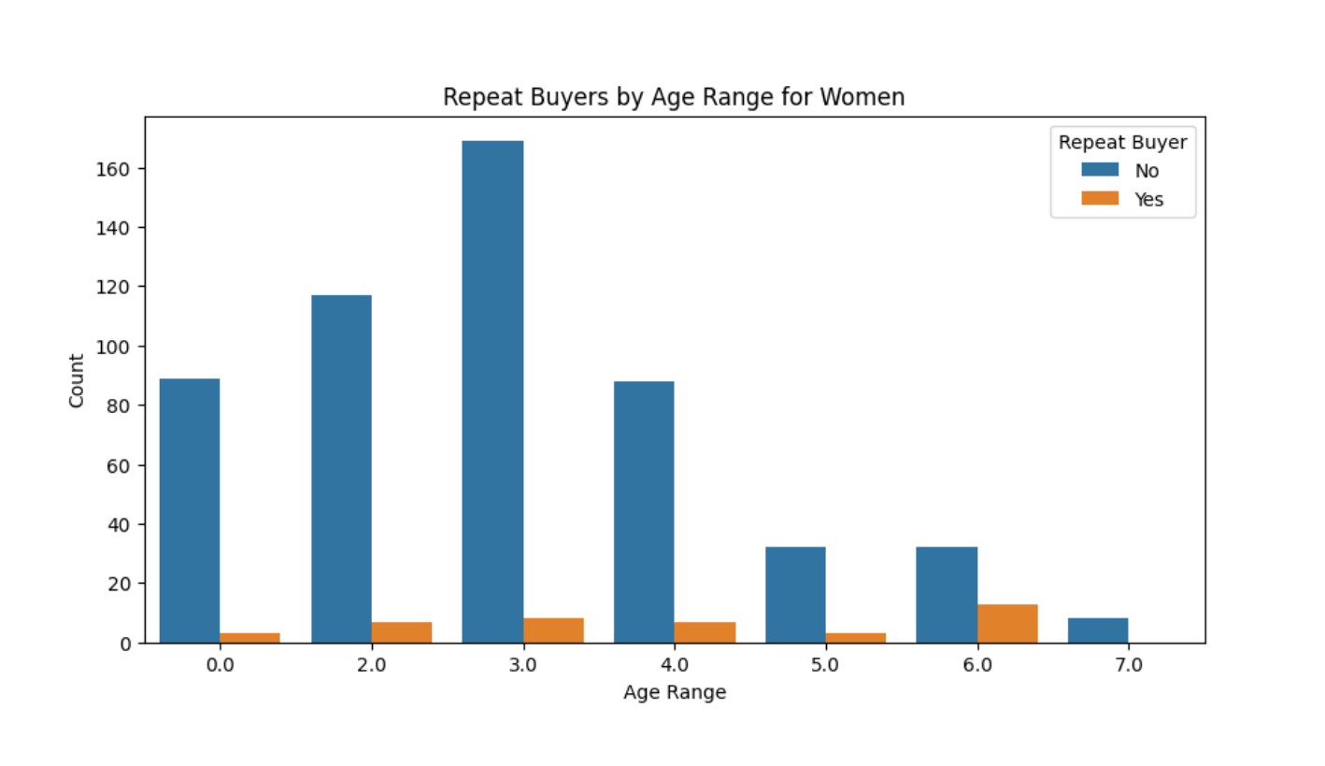
Data Visualisation

Slide 6
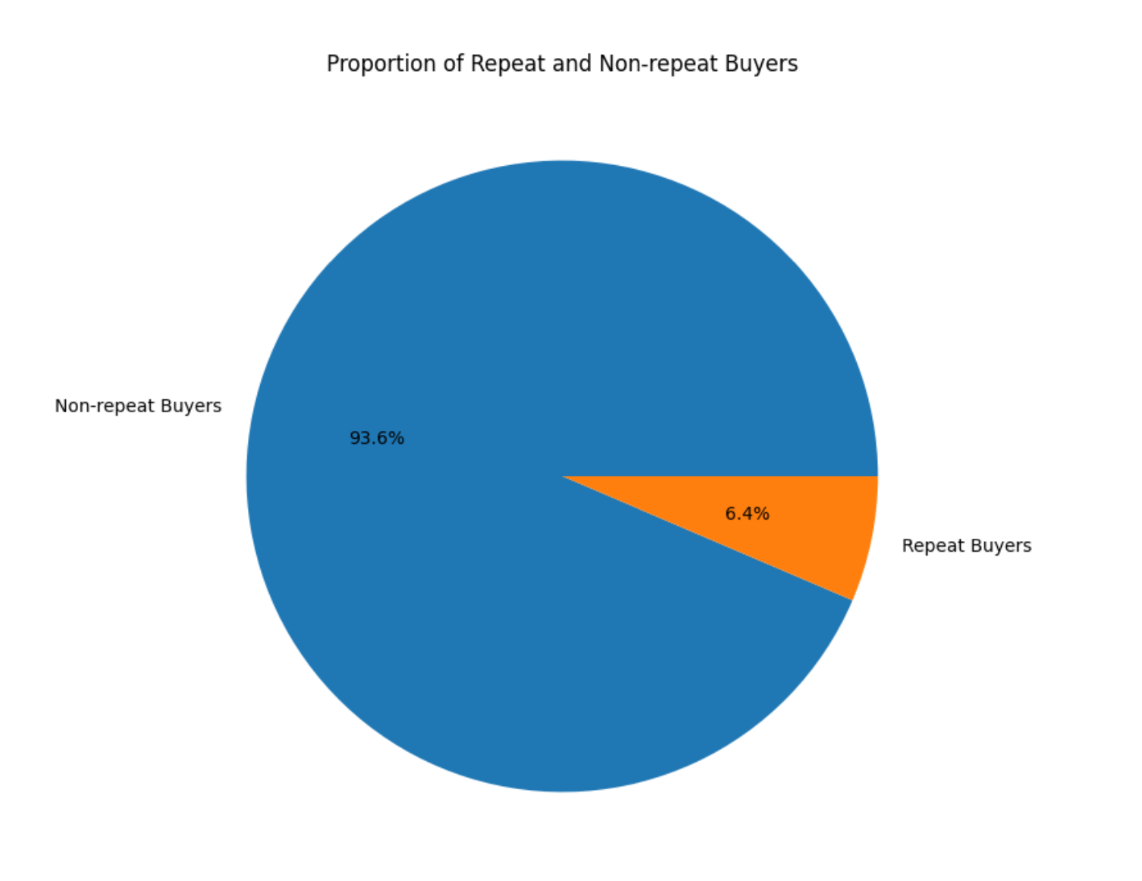
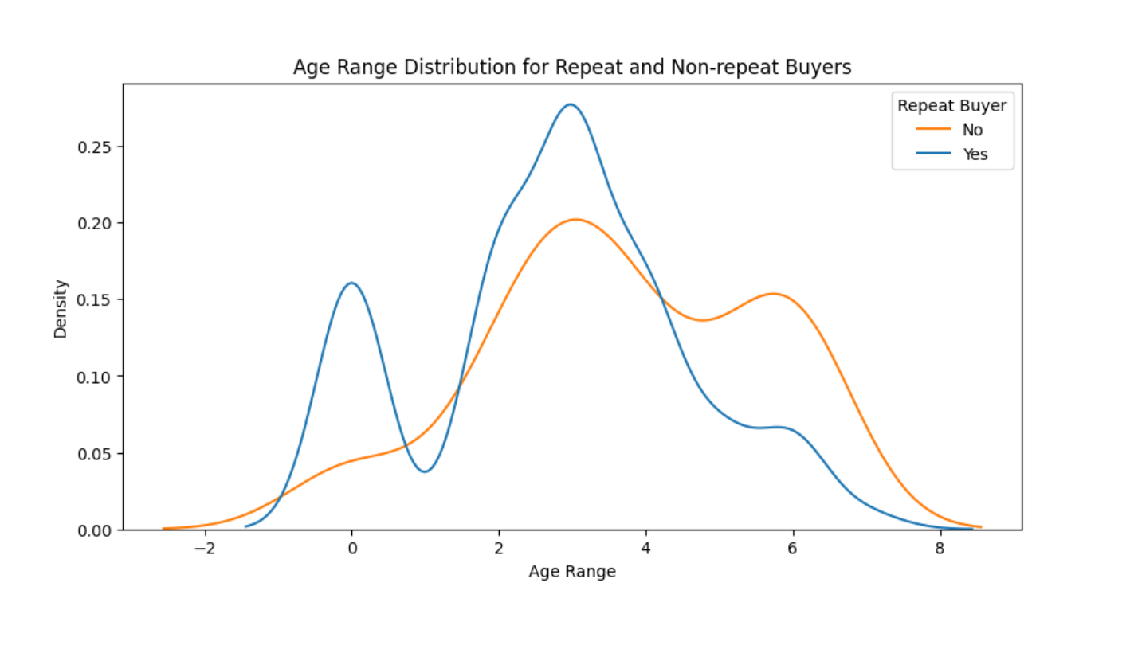
Data Visualisation

Slide 7
Feature engineering
We create new features that can be used to improve the performance of a machine learning model. The function create_new_features() takes in the main dataset and returns a new dataset that includes the original features and derived features.
The derived features include:
Total actions count
Count of each action type
Number of unique items and categories interacted with
Average action count per age_range
Average action count per gender

Slide 8
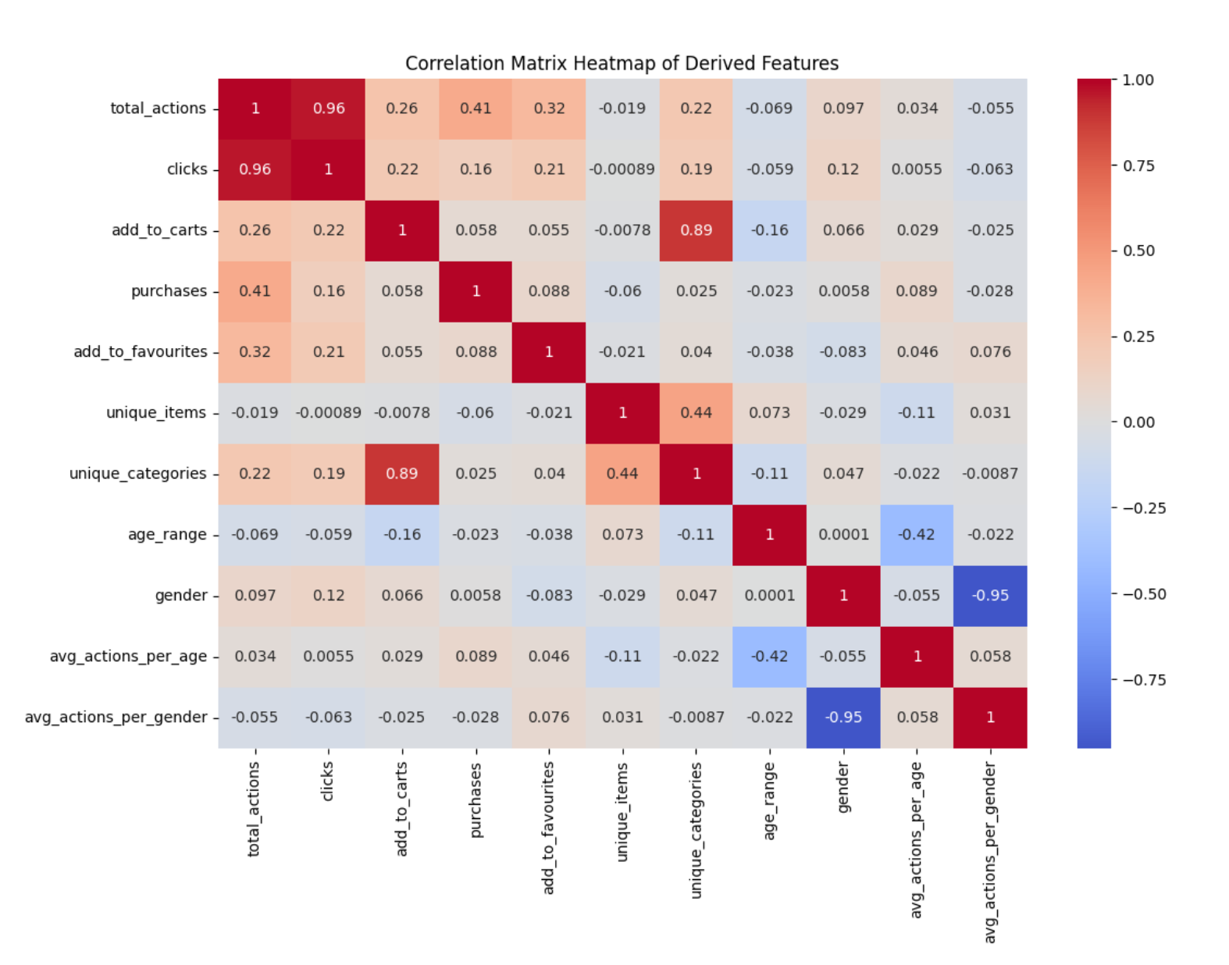
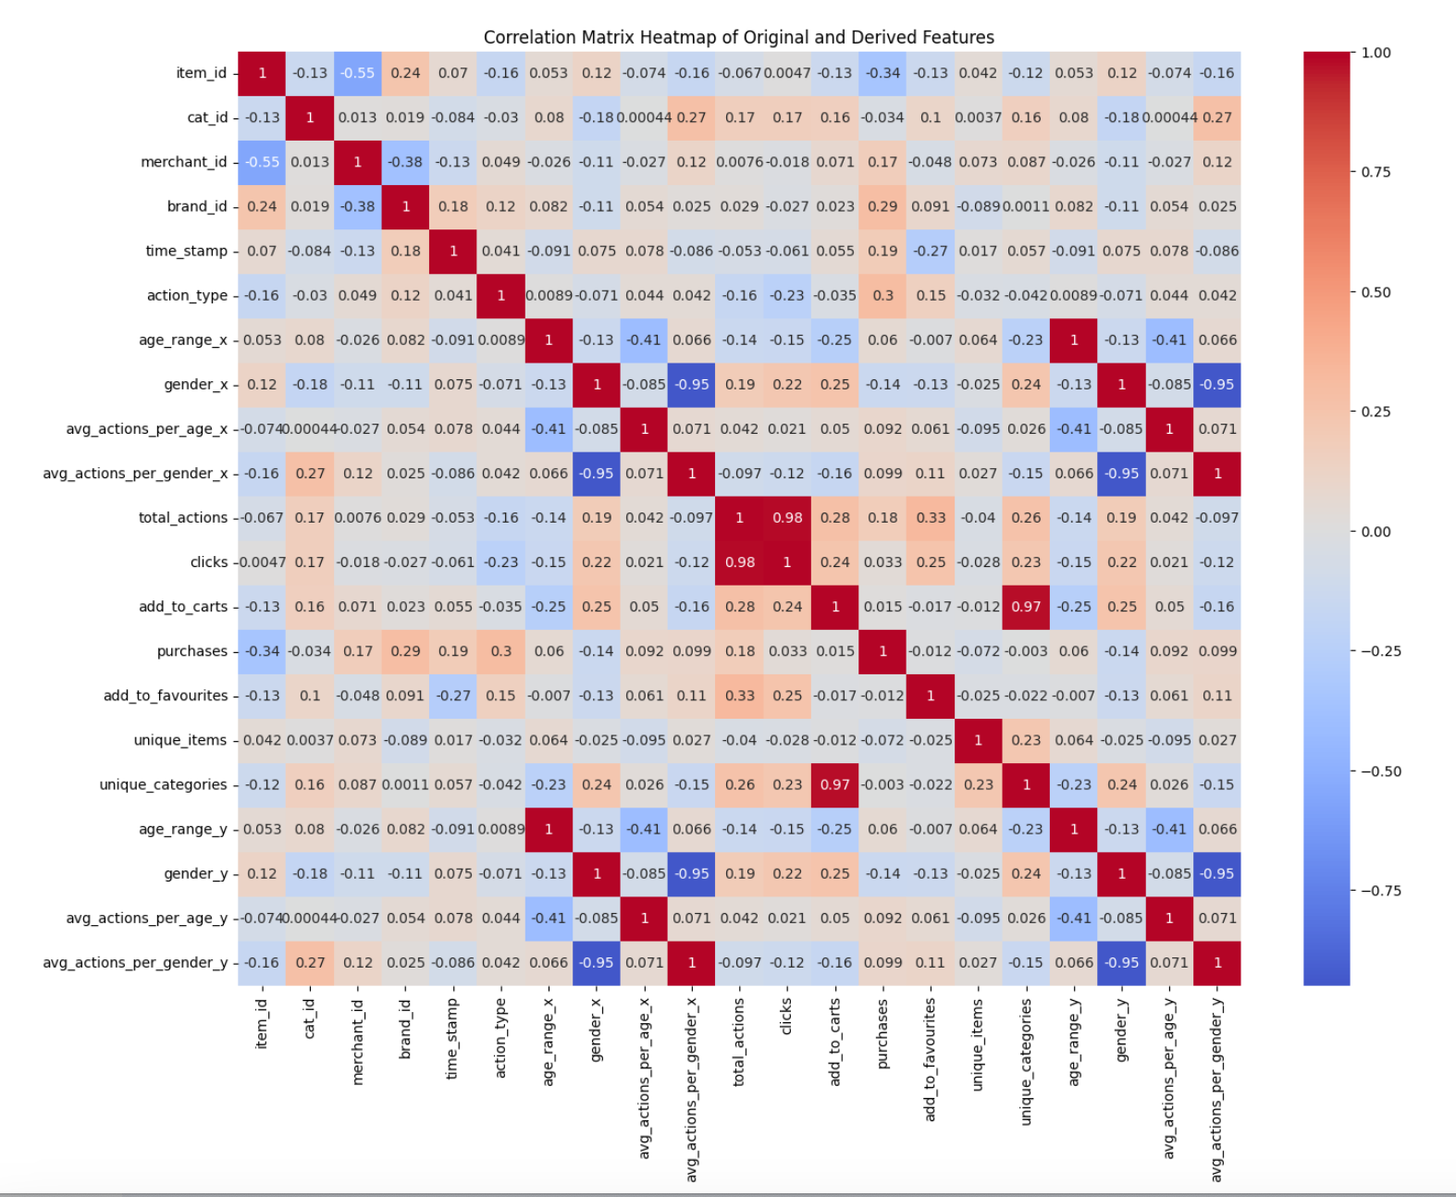
Correlation Matrix

Slide 9
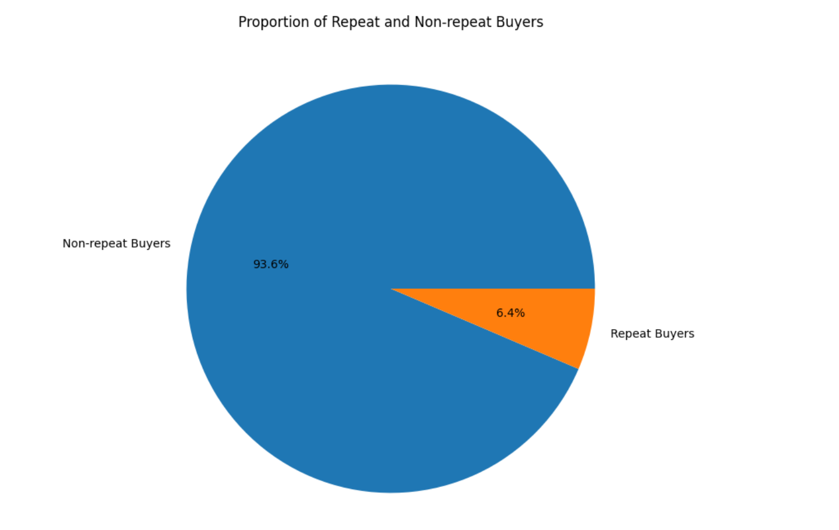
Visualisation of repeat and non repeat buyers
Since the dataset is imbalanced towards the class with a higher number of examples, we used the imblearn module to balance the dataset using the SMOTE function.
SMOTE works by creating synthetic points for minority class observations to increase their representation.

Slide 10
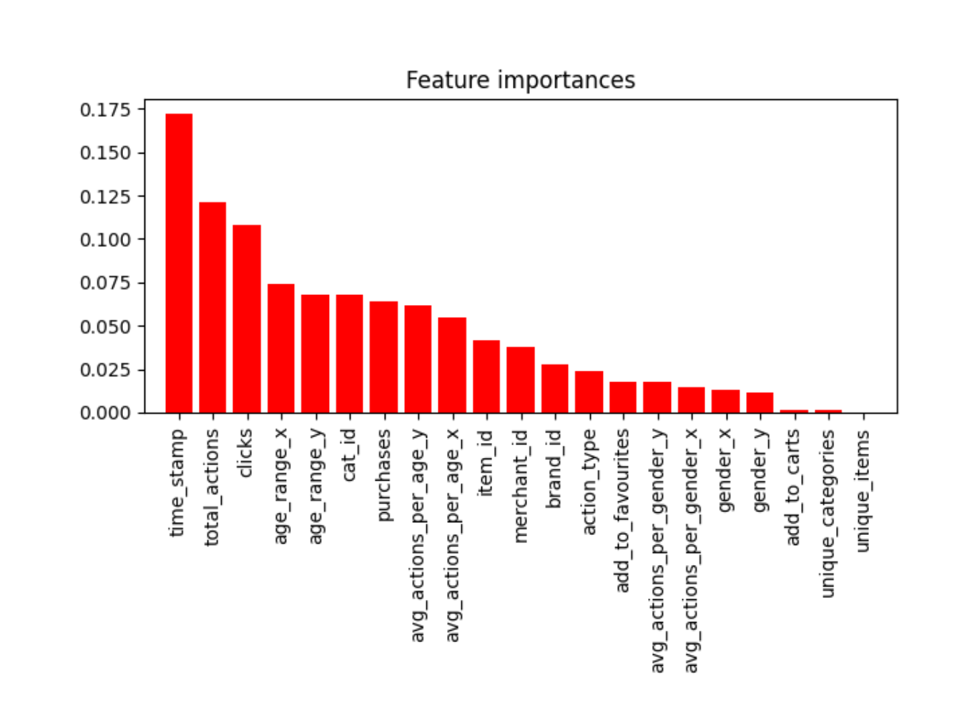
Feature Ranking
The method used in this code to perform feature ranking is the Random Forest feature importance method, which uses the mean decrease impurity measure to determine the importance of each feature.

Slide 11
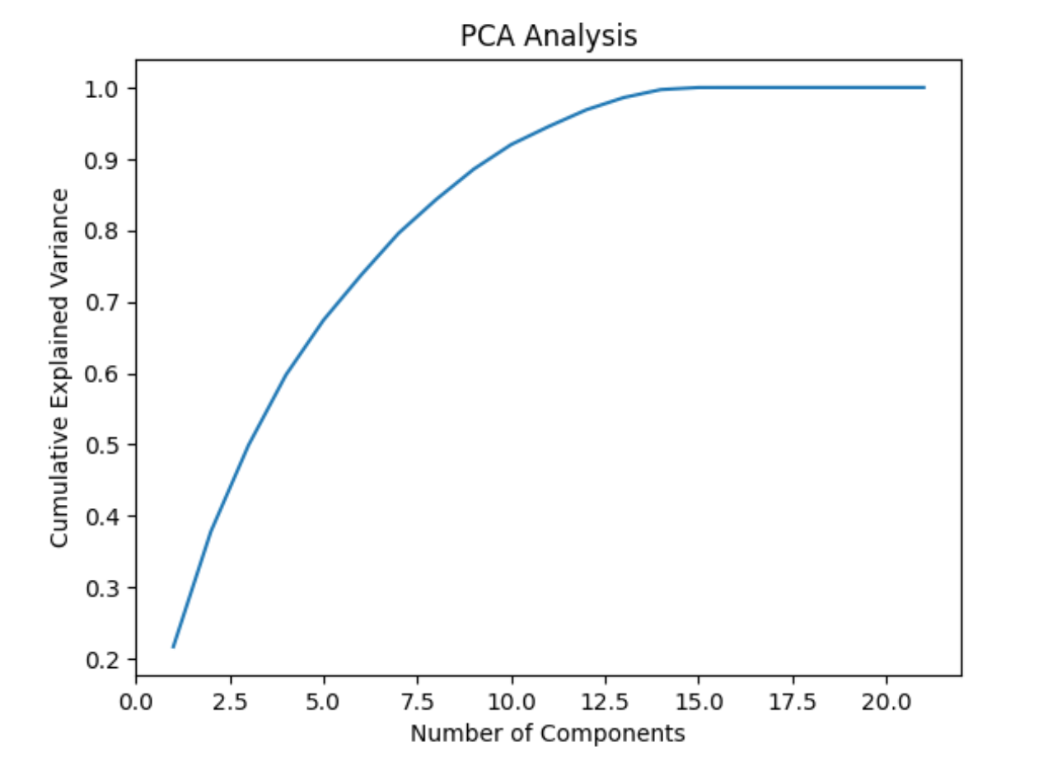
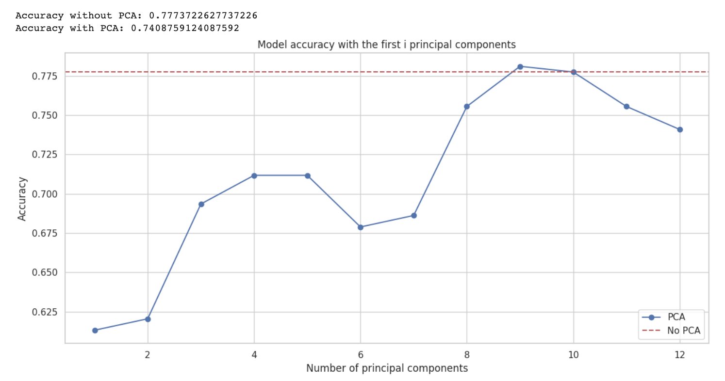
PCA for Feature reduction

Slide 12
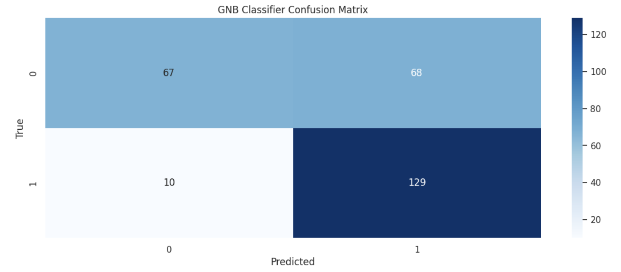
Model prediction
A Gaussian Naive Bayes classifier was created and fitted to the training data.
The labels for the test set were predicted using the classifier.
The classification report and confusion matrix were printed and visualized using a heatmap.

Slide 13
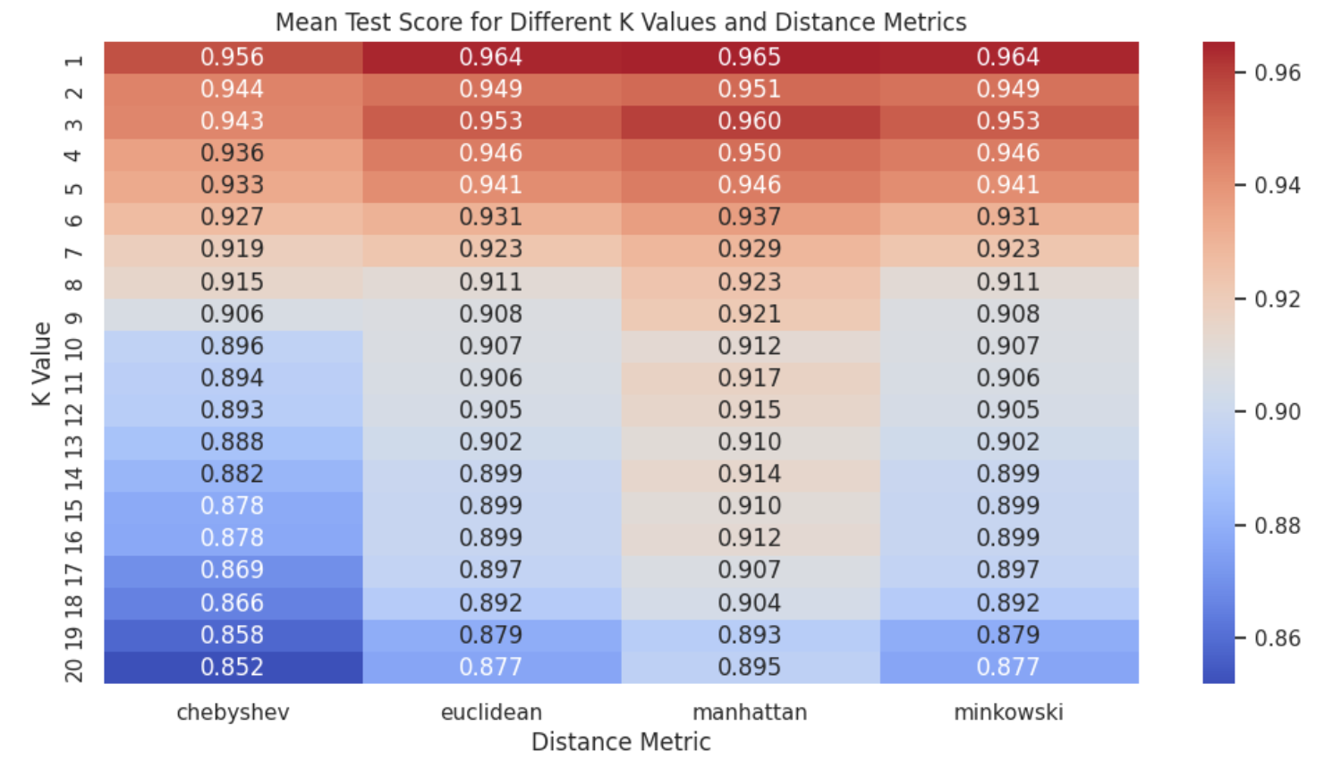
Nearest neighbhours and Parzen window for classification

Slide 14
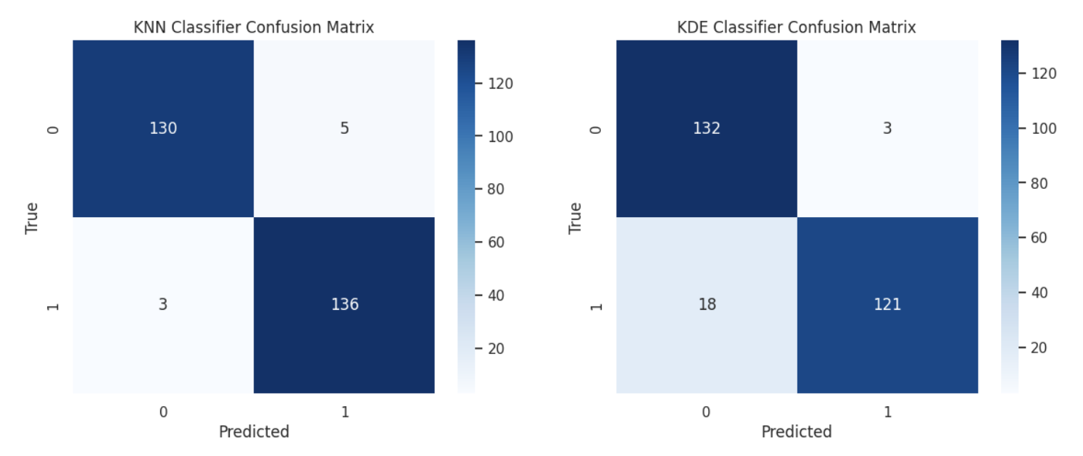
KNN and KDE classifier confusion matrix

Slide 15
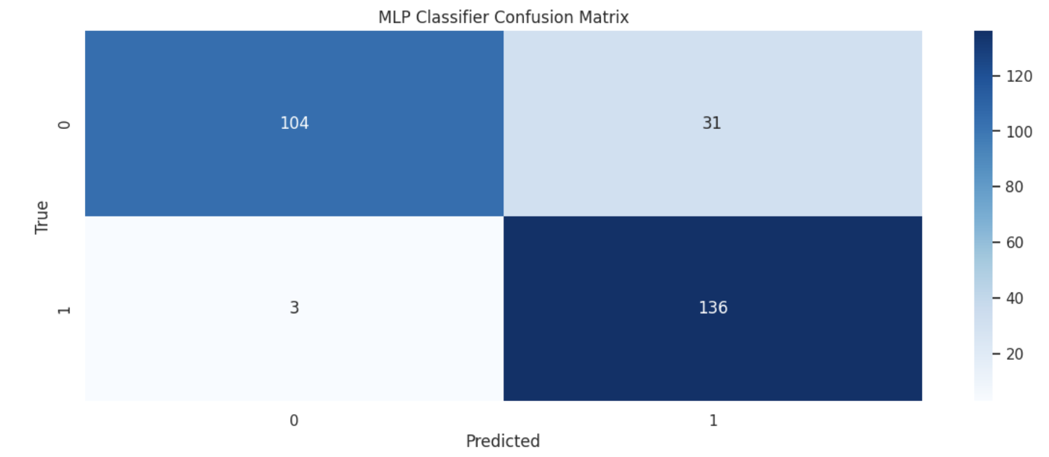
MLP classifier and confusion matrix
A feed-forward neural network model with early stopping was trained and tested on resampled data.
The performance of the model may vary depending on the specific use case and the desired trade-offs between precision and recall.

Slide 16
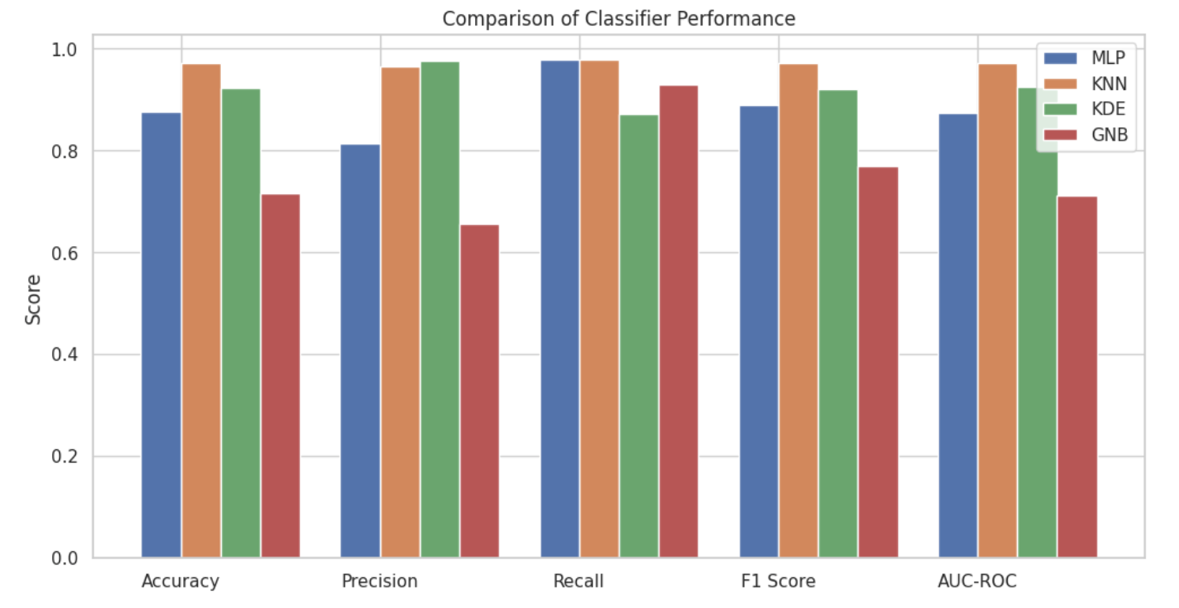
Comparison of classifier performance

Slide 17
Questions?

Slide 18
Thank you

