Slide 1
Introduction to UNIX

Slide 2
History of UNIX
UNIX was originally developed at Bell Laboratories as a private research project by a small group of people starting in 1969. This group had experience with a number of different operating systems research efforts in the 1970's. The goals of the group were to design an operating system to satisfy the following objectives:
Simple and elegant
Written in a high level language rather than assembly language
Allow re-use of code
Typical vendor operating systems of the time were extremely large and all written in assembly language. UNIX had a relatively small amount of code written in assembly language (this is called the kernel) and the remaining code for the operating system was written in a high level language called C.

Slide 3
Major variants of UNIX
There are two main versions of UNIX in user today:
System V and BSD. System V is the more popular of the two.
Types of System V: Types of BSD:
Solaris SUNOS 4.X
HP-UX FreeBSD
AIX NetBSD,etc
SCO-Unix
LINUX
IRIX, etc
From a user's perspective they are very similar and you are unlikely to have difficulty unless you use more than one type of system.

Slide 4
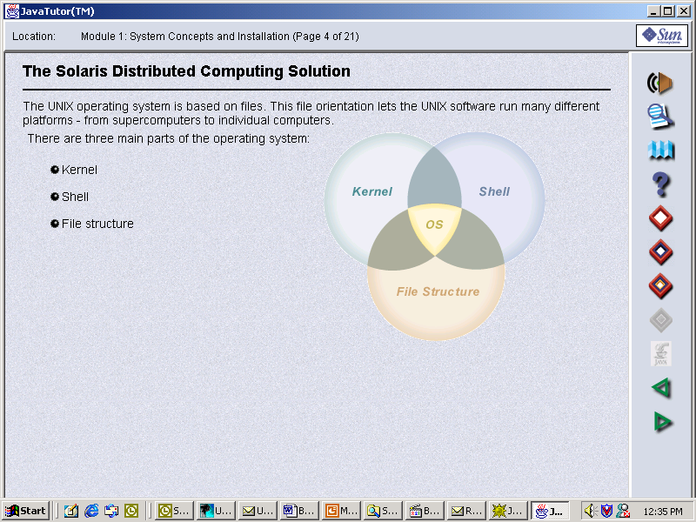
UNIX Architecture

Slide 5
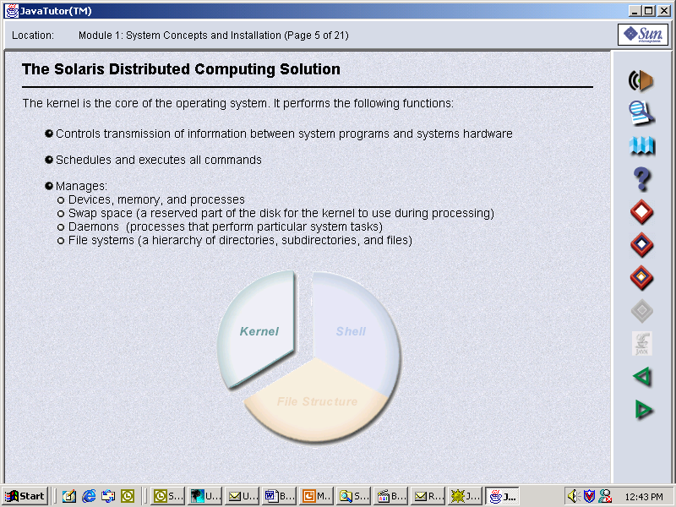

Slide 6
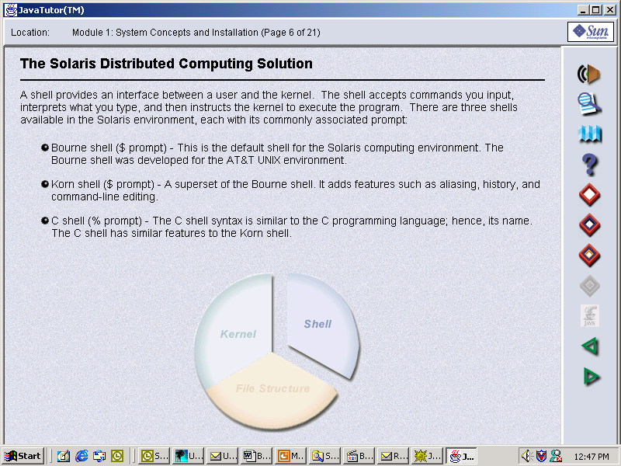

Slide 7
Filesystem & Directory Basics

Slide 8
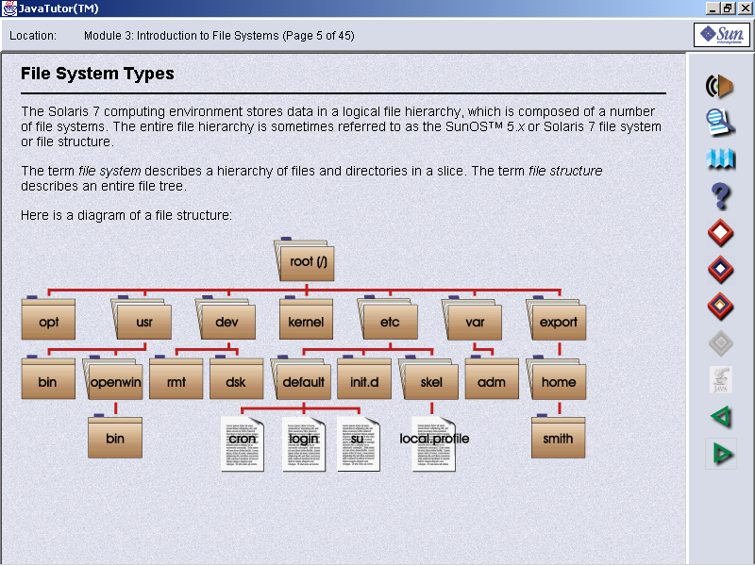
Directory Structure in UNIX

Slide 9
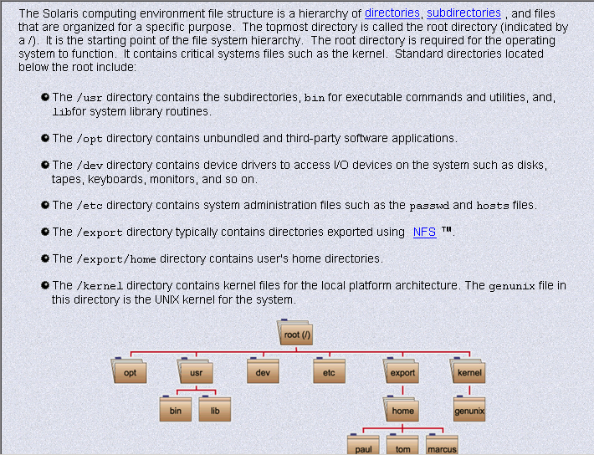

Slide 10
Different types of file
To the user, it appears as though there is only one type of file in UNIX - the file which is used to hold your information. In fact, the UNIX filesystem contains several types of file.
Ordinary files
Directories
Special files
Pipes

Slide 11
Ordinary files
This type of file is used to store your information, such as some text you have written or an image you have drawn. This is the type of file that you usually work with.
Files which you create belong to you - you are said to "own" them - and you can set access permissions to control which other users can have access to them. Any file is always contained within a directory.
e.g. text, binary, library, etc

Slide 12
Directories
A directory is a file that holds other files and other directories. You can create directories in your home directory to hold files and other sub-directories.
Having your own directory structure gives you a definable place to work from and allows you to structure your information in a way that makes best sense to you.
e.g /, /dev,/etc,/var,/usr, etc

Slide 13
Special files
This type of file is used to represent a real physical device such as a printer, tape drive or terminal.
It may seem unusual to think of a physical device as a file, but it allows you to send the output of a command to a device in the same way that you send it to a file. For example:
cat scream.au > /dev/audio
The directory /dev contains the special files which are used to represent devices on a UNIX system.

Slide 14
Pipes
UNIX allows you to link commands together using a pipe.
The pipe acts a temporary file which only exists to hold data from one command until it is read by another.
Connecting commands together by using Pipes
Unix allows you to link two or more commands together using a pipe. The pipe takes the standard output from one command and uses it as the standard input to another command.
command1 | command2 | command3

Slide 15
Text Processing & “vi” Editor

Slide 16
Text processing Tools
cat [concatenate & display file]
$ cat <filename>
head [display first few lines of the file]
$ head <filename>

Slide 17
Text processing Tools [contd.]
tail [deliver last few lines of the file]
$ tail <filename>
Sort [sort,merge or sequence check the text file]
$ sort [ -orf ] <filename>
-r sort in reverse order
-f sort in ASCII order
-o Save output of sort in new file

Slide 18
Text processing Tools [contd.]
grep [search a file for a pattern]
$grep –icv “search string” <filename>
-i ignore case
-c print only count of lines
-v print all line except pattern

Slide 19
“vi” Editor
“vi” is interactive screen editor
To invoke vi Editor:
$vi <filename>
where <filename> is the name of new or existing file.
It provides full functionality for text navigation and manipulation.

Slide 20
“vi” Editor
It operates essentially in two modes viz.
Command mode
Data entry mode
Command mode is mainly used for text manipulation & file operations
Data entry mode is only for data entry as the name suggests

Slide 21
“vi” Editor [contd.]
Cursor movement commands:
n h - left n characters
n j - down n lines
n k - up n lines
n l - right n characters
By default n is one.

Slide 22
“vi” Editor [contd.]
Switching from command mode to data entry:
i - insert at current cursor location
a - append at next cursor location
A - append at the end of line
o - insert one blank line below current location
O - insert one blank line above current location

Slide 23
“vi” Editor [contd.]
To switch from data entry mode to command press “Esc”
Text manipulation commands:
nyy - yank (copy) n lines from current location
p - paste at next line from current location

Slide 24
“vi” Editor [contd.]
ndd - Delete n lines from current location
ndw - Delete n words from current location
. - repeat last command
nx - delete n characters from current location

Slide 25
Common UNIX commands
logout end your UNIX session
passwd change password
date display the system date & time
cal Calendar for year or month
bc basic calculator

Slide 26
Common UNIX commands
ps display information about processes
-e every process running
-f Full information
-a all frequently running processes
env Display current environment

Slide 27
Common UNIX commands
ls list contents of directory
-l long listing
-a all files including hidden
-d directory entry
-t sort by timestamp
-r reverse sort order
-R recursively

Slide 28
Common UNIX commands
mv move or rename files
-i interactive
-f overwrite
cp copy files
-p preserve permissions
-r recursively

Slide 29
Common UNIX commands
rm remove files
-i interactive
-r recursively
mkdir make a directory
-p create directories recursively
rmdir remove a directory
-r remove directories recursively
cd change working directory

Slide 30
Common UNIX commands
pwd print working directory name
du summarize disk usage
-a all directories
-s summary only
-k output in Kb
chmod change mode (access permissions) of a file or directory
file determine the type of file
wc word count for file

Slide 31
UNIX Shell environment
Shell is interface between user & the kernel. It acts as command interpreter
Types of Shells
  Bourne shell
  Korn shell
  C shell

Slide 32
Bourne Shell
Bourne shell is the original command processor developed at AT&T. It is named after developer Stephen R. Bourne
This is the fastest command processor in UNIX & most widely used also.
Bourne Shell prompt is identified as $

Slide 33
K Shell
K shell is a combination of C shell & Bourne Shell.
K Shell was invented by David Korn.
It offers additional features such as aliasing, file name completion & command line editing
K Shell prompt is also identified as $

Slide 34
C Shell
This Shell was developed by William Joy. This Shell is developed in C programming language.
It offers command history & command line editing features.
C Shell prompt is identified as %

Slide 35
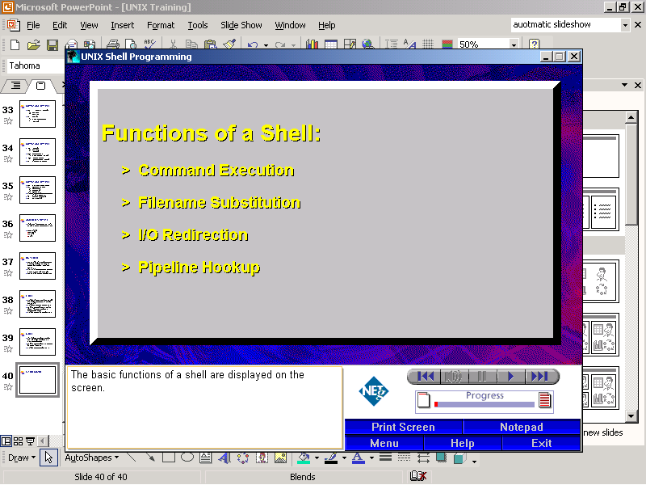
Working with Bourne Shell

Slide 36
Command Execution
Executing single command
$ pwd
Executing multiple commands
$ls;pwd;who
; is command terminator character in Bourne Shell which allows user to execute multiple commands on same line

Slide 37
File Name substitution
File handling becomes easy by using this feature.
File name substitution will be invoked by using the following wildcards.
* matches any string
?
[] Matches any one of the enclosed character

Slide 38
I/O redirection
I/O redirection is the process of changing the default Input or Output source.
I/O redirection operators & commands are
> redirecting output
>> append redirected output to target.
< redirect input instead of standard input

Slide 39
Pipeline hookup
Pipeline is one or more commands separated by pipe. Output of each command connected to pipe is input of next command
Example of Pipe command usage are:
$ who | wc -l

Slide 40
Shell variables
Shell variables are positional parameters which are assigned values at runtime.
Syntax for Shell variable declaration is:
VARIABLE=VALUE
e.g. TERM=vt100
PS1=$HOME

Slide 41
Regular expressions
Searching of regular expressions achieved by using pattern matching operators
Pattern matching operators are:
^ Beginning of the line
$ End of the line
* Matching any pattern

Slide 42
Regular expressions [Contd.]
Searching for pattern
The general syntax for pattern searching:
$grep [options] <pattern> <filename>
For searching list of employees in grade M1 from emp.dat file where grade is the first field, we can use the following command
$grep “^M1” emp.dat

Slide 43
Regular expressions [Contd.]
Removing blank lines from a file
To view the relevant data from a file containing blank lines, we can use pattern search operators as follows
$grep –v ‘^$’ <filename>

Slide 44
Shell scripting
Creating the shell script
To create a script use vi editor to create a new file containing the commands that you want the script to execute.

Slide 45
Shell scripting
Executing a shell script
Before using a file as a shell script you must change its access permissions
To give yourself execute permission for the file containing the script use the command:
$chmod u+rwx <filename>

Slide 46
Shell scripting
To run the shell script, simply type its name at the prompt.
$<filename>

Slide 47
Shell scripting
Conditional statements
if-then-else
case
for loop
while loop

Slide 48
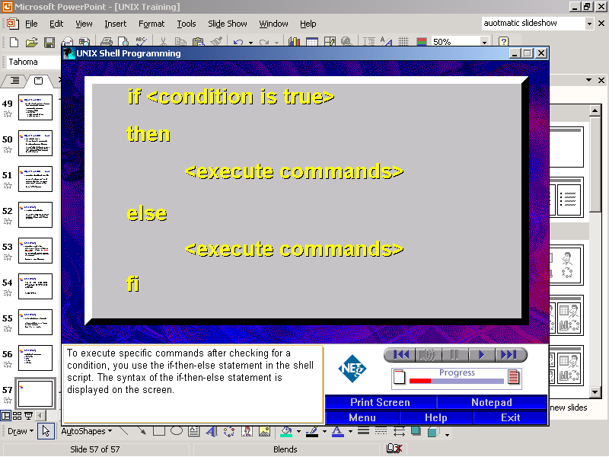
if-then-else construct

Slide 49
Example of using an if construct
To carry out a conditional action:
if who | grep -s trng > /dev/null
then
echo trng is logged in
else
echo trng not available
fi

Slide 50
Example of using an if construct
This lists who is currently logged on to the system and pipes the output through grep to search for the username trng.
The -s option causes grep to work silently and any error messages are directed to the file /dev/null instead of the standard output.

Slide 51
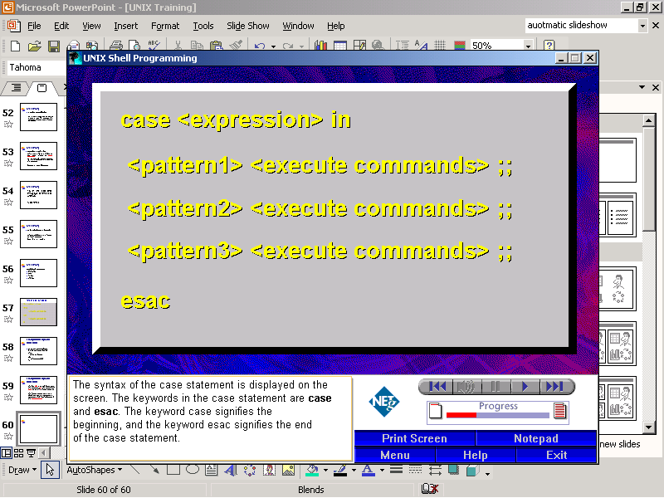
case construct

Slide 52
Example of using the case statement
To specify an action when a word matches the pattern:
$vi diary
#!/bin/sh
today=`date +%m/%d` #date format set to 08/31
case $today in
08/13) echo “1st batch basic commands" ;;
08/14) echo “1st batch shell scripting" ;;
08/02) echo "Buicheille Etive Mhor" ;;
08/03) echo "Slioch" ;;
*) echo “Welcome to UNIX training"
esac

Slide 53
Example of using the case statement
$chmod u+rwx diary
$diary
$ . diary
$ sh diary

Slide 54
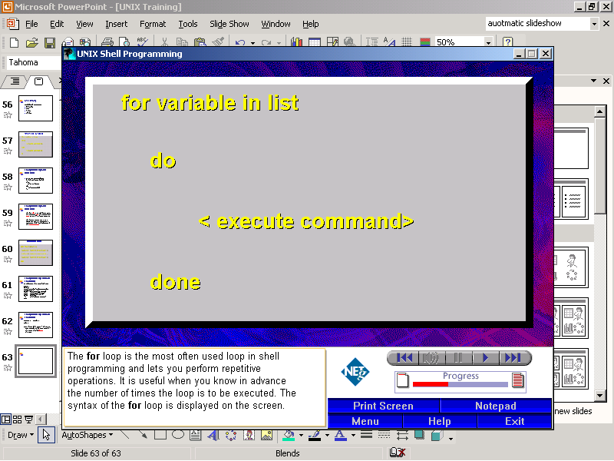
for construct

Slide 55
Example of using the for statement
To take each argument in turn and see if that person is logged onto the system.
#!/bin/sh
for i in $*
do
if who | grep -s $i > /dev/null
then
echo $i is logged in
else
echo $i not available
fi
done

Slide 56
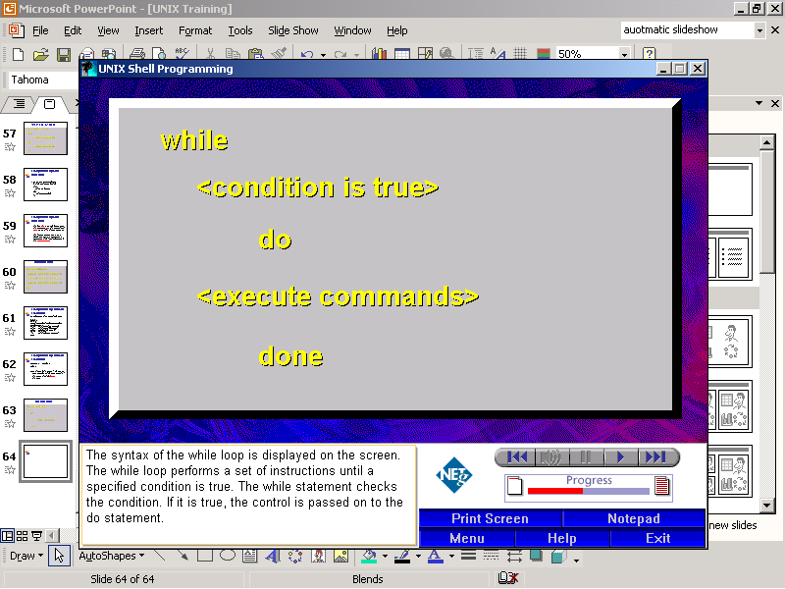
while construct

Slide 57
Examples of using the while statement
To wait for someone to logout:
#!/bin/sh
while
who |grep -s $1 >/dev/null
do
sleep 60
done
echo "$1 has logged out"

Slide 58
Thanks!!!!!!!!!!!!

