Slide 1


Virtual Medical Home
Guided By:
Prof. T.Hirwani
Presented By:
Pradeep Mehta
En.No.- 0103CA071062
Company:
Chaithanya IT Solutions
(Hyderabad)
College:
LNCT, Bhopal

Slide 2
Contents
Introduction
Purpose Of The Project
Problems Identification
Solutions For The Problems
Preferred Technologies
Hardware Requirements
Software Requirement Specification
Number Of Modules
E_R Diagram
DFD
Context Level Diagram
Use Case diagram
Screen Layouts
Conclusion
Future Enhancements
Bibliography

Slide 3
Introduction
Virtual Medical Home is committed to helping patients take control of their health.
Using secure, web-based technologies our health-care providers offer advice and treatment for a variety of conditions. Patients can communicate securely with our physicians throughout the treatment process using our messaging system.
This system is virtual, but our physicians and their dedication is real.

Slide 4
Purpose of the Project
Objective is to provide essential medical services online to everyone hardly matters you live in metro or a remotely located village. Users can connect through their home internet to get these services.

Slide 5
Problem Identification
The existing system is a manual system. Here the User of the system needs to save his information in the form of excel sheets or Disk Drives.
There is no online appointment facility.
The manual system gives us very less security for saving data.
There is no email facility.
Searching of particular information is very critical it takes lot of time.
There is no report generation facility.

Slide 6
Providing solution for the problem
Using this new system the patient can register for making online appointment with doctor.
In this new system for interaction between patient and doctor chatting and email has provided.
User Friendliness is provided in the application with Rich User Interface.
This system provides online appointment facility.
It provides search facility.
The user information files can be stored in centralized database which can be maintained by the system.
This can give the good security for user information because data is not in client machine.
Authentication is provided for this application only registered users can access.
Report generation features is provided to generate different kind of data reports.

Slide 7
Preferred Technologies
Windows XP Operating System
Microsoft Visual Studio-2008
(Asp.net 3.5+C# 3.0)
Visual Studio .Net Framework 3.5
Microsoft SQL Server-2005
IIS 5.0 Web Server
Internet Explorer 6 or 7

Slide 8
Hard Ware Requirements
Pentium IV System with 2.8 GHZ Processor
1 GB RAM
40 GB Hard Disk

Slide 9
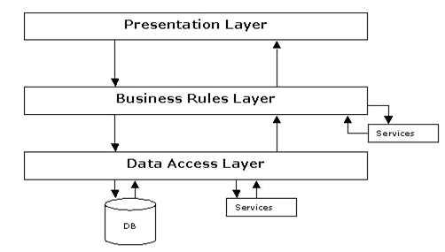
Software Requirement Specification
SDLC Methodologies
Spiral Model Explanation
N-tier Architecture

Slide 10
Number of Modules
Administrator
Managers
Doctors
Patients
General Public
Web Registration
Search
Reports
Authentication

Slide 11
E-R Diagram

Slide 12
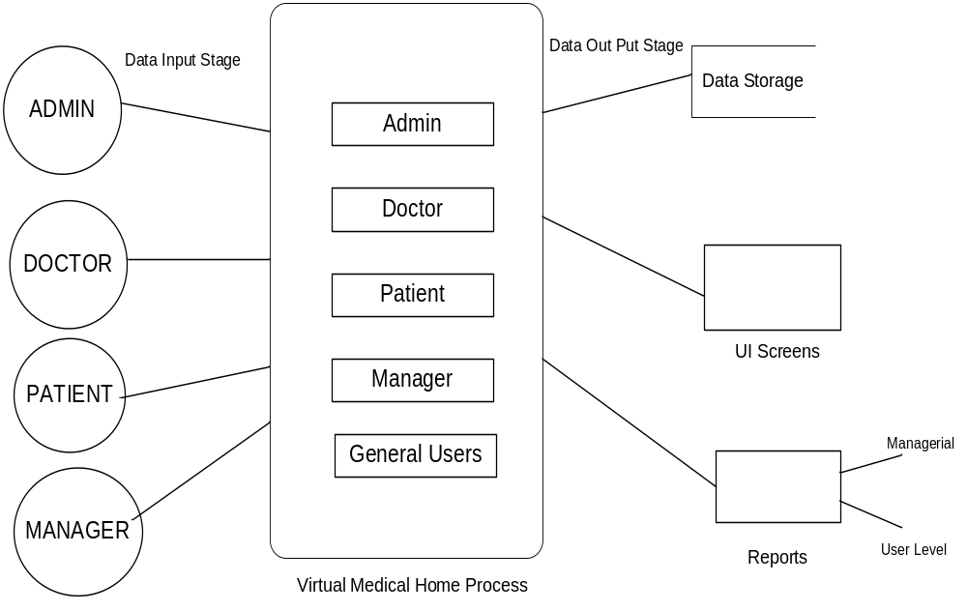
DFD’s
Context Level Diagram (O Level)

Slide 13
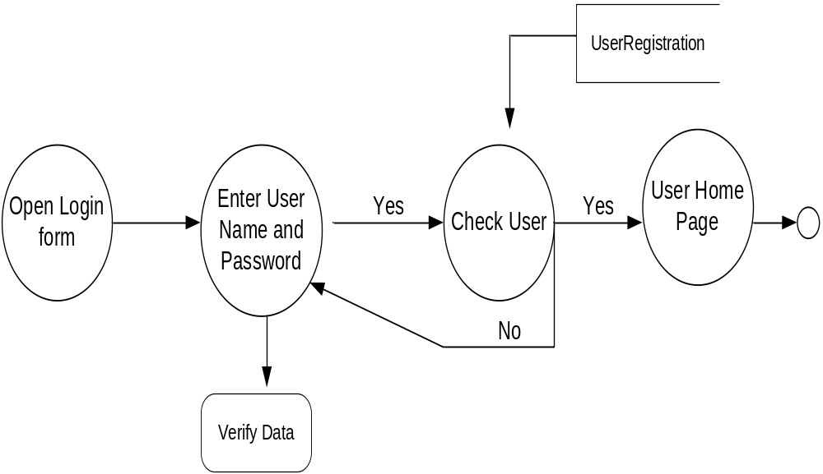
Login DFD

Slide 14
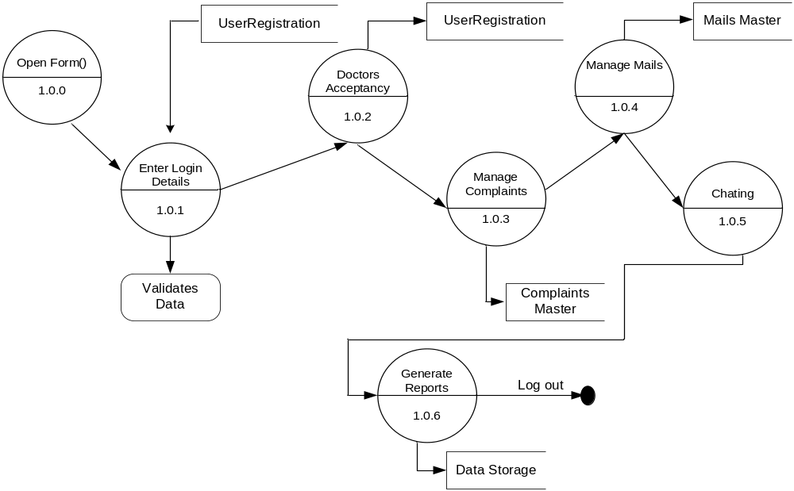
Admin Activities DFD (1st Level)

Slide 15
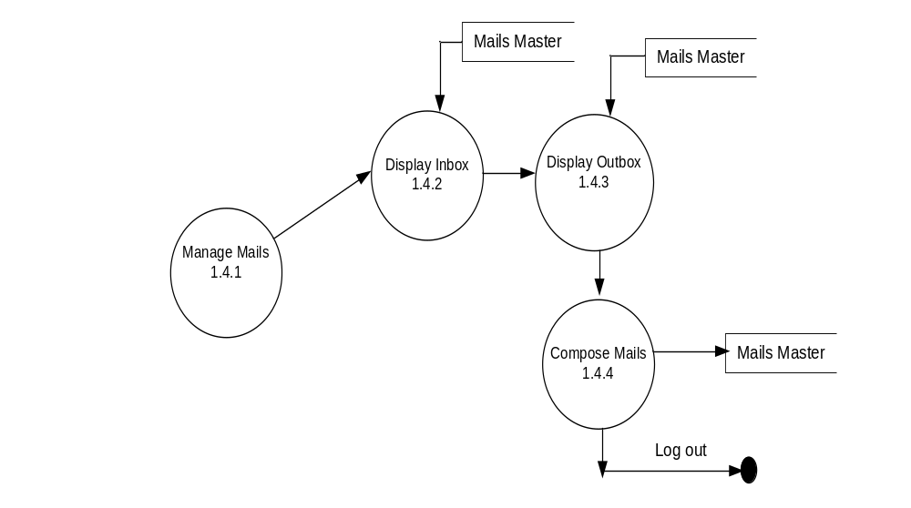
2nd Level

Slide 16
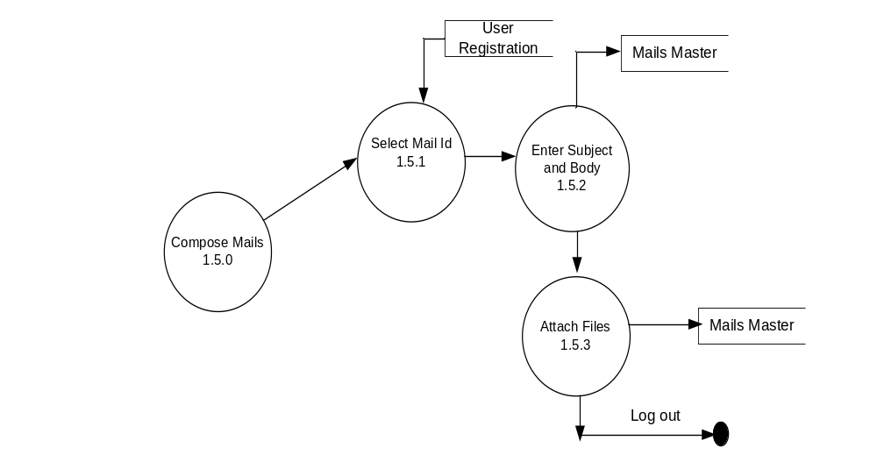
3rd Level

Slide 17
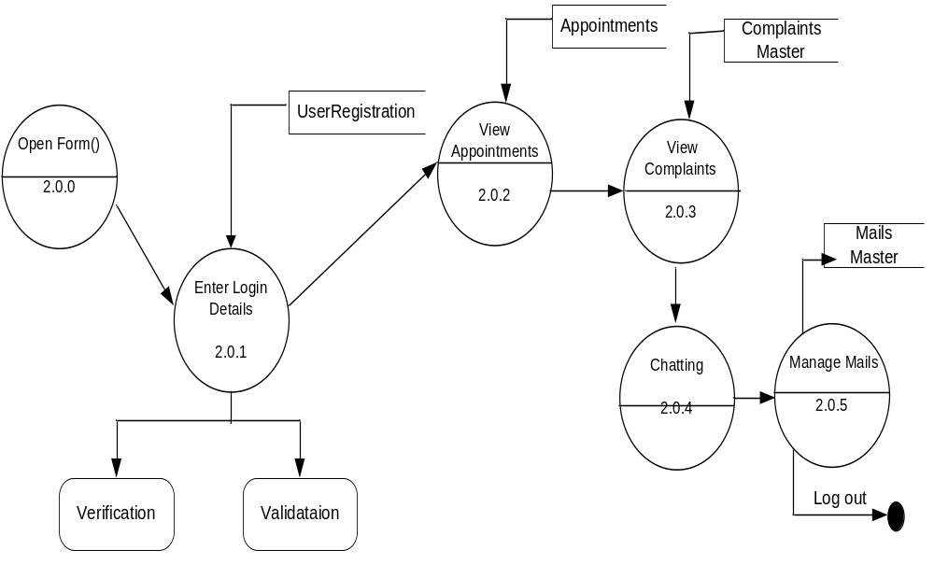
Doctor Activities(1st Level)

Slide 18
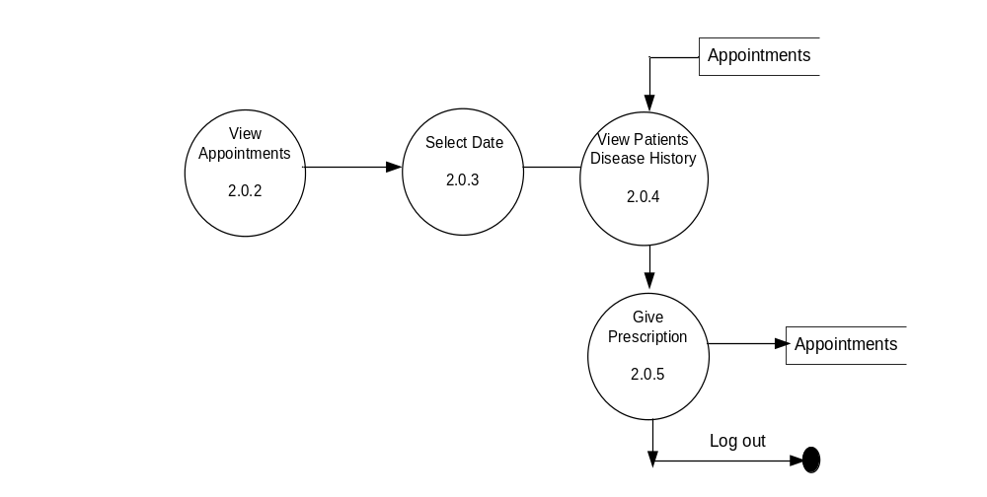
2nd Level

Slide 19
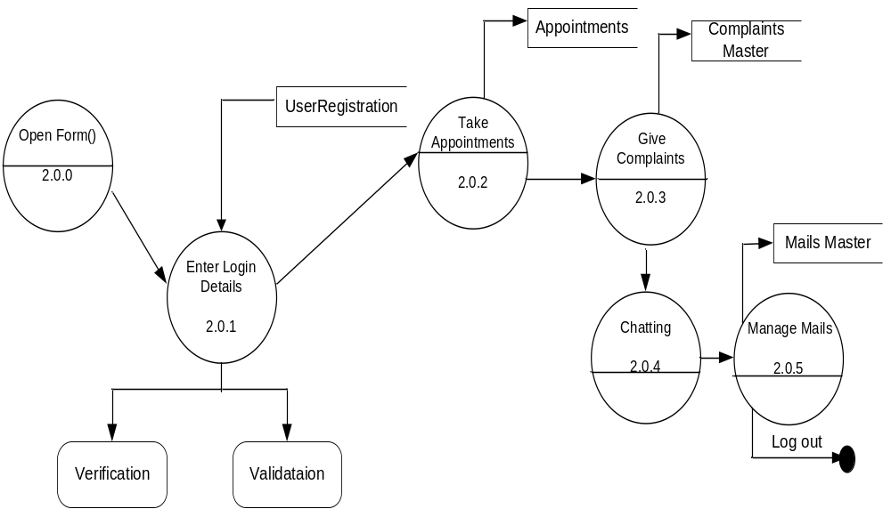
Patient Activities(1st Level)

Slide 20
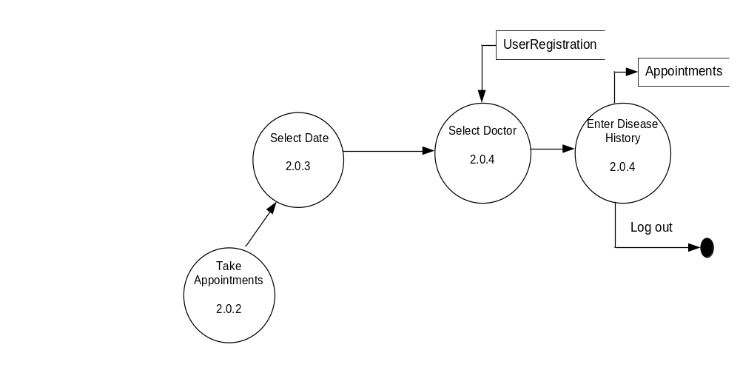
2nd Level

Slide 21
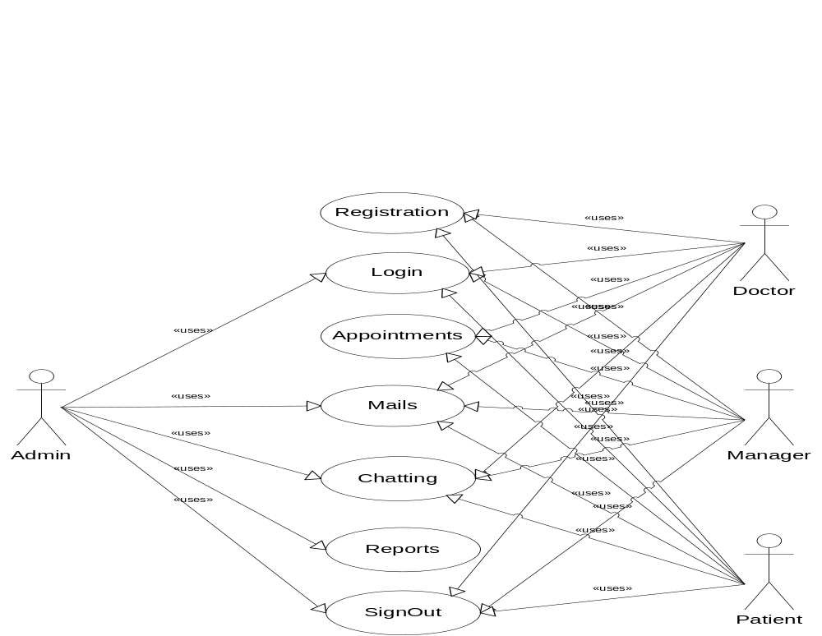
Use Case Diagram

Slide 22
Sequence Diagrams
User Registration Sequence
User
frmRegistration
BL:cls_User
DAL:cls_SqlHelper
Database
1 : Get Registration Form
2 : insertUserData ()
3 : ExecuteNonQuery ()
4 : ExecuteStoredProcedure()
6 : Response()
7 : Response for InsertUserData()

Slide 23
Login Sequence
User
LoginPage
Authentication Service()
DAL:SqlHelper()
Database
1 : Open Login Form
2 : ValidateUser()
3 : ExecuteNonQuery()
4 : ExecuteStoredProcedure()
5 : Return QueryResult()
6: ResponseForValidateUser()

Slide 24
Admin Sequence to Approve Doctors
Admin
frmDoctors Acceptacny
BAL:clsDoctor
DAL:clsSqlHelper
DataBase
1 : view Regd Doctors()
2 : Accept Doctors()
3 : ExecuteNonQuery()
4 : ExecuteStoredProcedure()
5 : Response()
6 : Show Result()

Slide 25
Doctors Sequence to View Appointments
Doctor
frmViewAppointments
BAL:clsDoctor
DAL:clsSqlHelper
DataBase
1 : Get Appointments()
2 : Get Patients Disease History()
3 : ExecuteDataset()
4 : ExecuteStoredProcedure()
5 : Response()
6 : Show Result()

Slide 26
Doctors Sequence to Manage Mails
Doctor
frmMails
BAL:clsMails
DAL:clsSqlHelper
DataBase
1 : View Inbox mails ()
2 : Compose Mails()
3 : ExecuteNonQuery()
4 : ExecuteStoredProcedure()
5 : Response()
6 : Show Result()

Slide 27
Patient Sequence to Take Appointment
Patient
frmAppointments
BAL:clsAppointment
DAL:clsSqlHelper
DataBase
1 : Enter Data
2 : Insert Appointment()
3 : ExecuteNonQuery()
4 : ExecuteStoredProcedure()
5 : Response()
6 : Show Result()

Slide 28
Patient Sequence to Give Complaints
Patient
frmComplaints
BAL:clsComplaints
DAL:clsSqlHelper
DataBase
1 : Enter Complaint
2 : Insert Complaint()
3 : ExecuteNonQuery()
4 : ExecuteStoredProcedure()
5 : Response()
6 : Show Result()

Slide 29
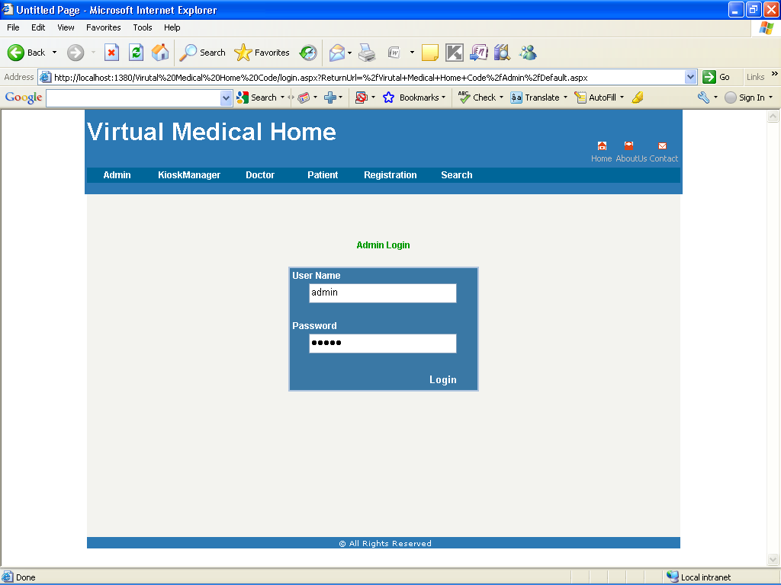
Screens
Login Form

Slide 30
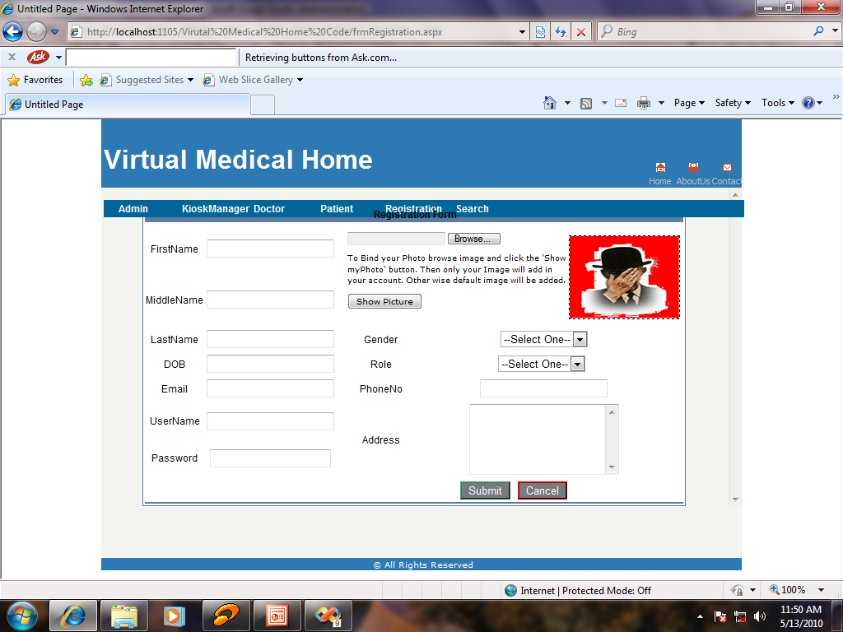
Registration Form

Slide 31
Conclusion
Virtual medical home, provide essential medical services online to everyone hardly matters you live in metro or a remotely located village.
Users can connect through their home internet to get these services
This system provides communication between Doctors, Patients, Manager and Admin through email and chatting
This system provides online appointment facility.
Data storage and retrieval will become faster and easier to maintain because data is stored in a systematic manner.
This system provides report generation features
It’s a web-enabled project

Slide 32

Future Enhancements
  There is no recovery management component, but we can add this facility in future. like Oracle ,MS Access etc.
  We can add web cam facility to use this project effectively.

Slide 33
Bibliography
www.support.mircosoft.com
www.developer.com
www.15seconds.com
www.msdn.microsoft.com
Asp.Net 3.5 Unleashed
www.asp.net
www.asptoday.com
www.aspfree.com
Software Engineering (Roger’s Pressman)

Slide 34
Thank you!

