Slide 1
Introduction:
The business world is increasingly data driven.
Small and large businesses alike use data to make decisions about sales, hiring, goals, and all areas for which they have data.
While most businesses have access to data of one type or another, it can be intimidating to try to understand without a background in data analytics or statistics.
Even if you do understand the data, a challenge may arise in displaying the data in an easy to understand way and communicating it to other relevant people.
Power BI takes the intimidation and hassle out of data analysis and visualization.
By connecting to one or more of the hundreds of existing data sources and using a secure, easy to understand interface, you can quickly and simply interact with and understand your data to influence all business systems.

Slide 2
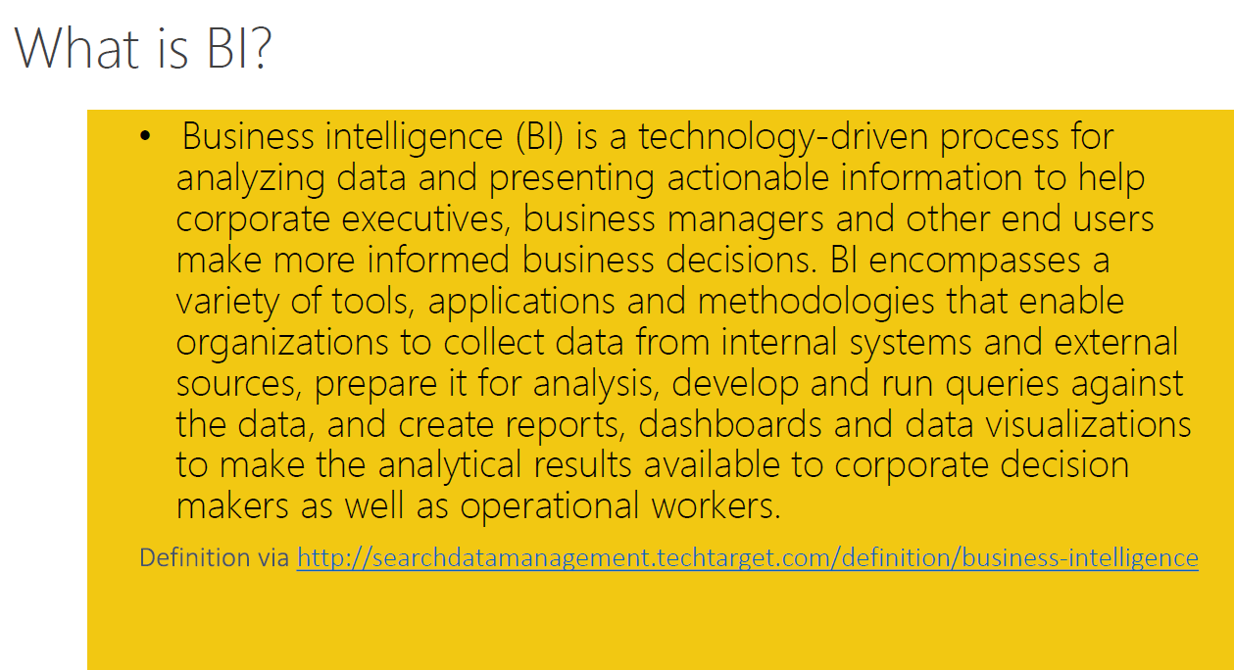

Slide 3
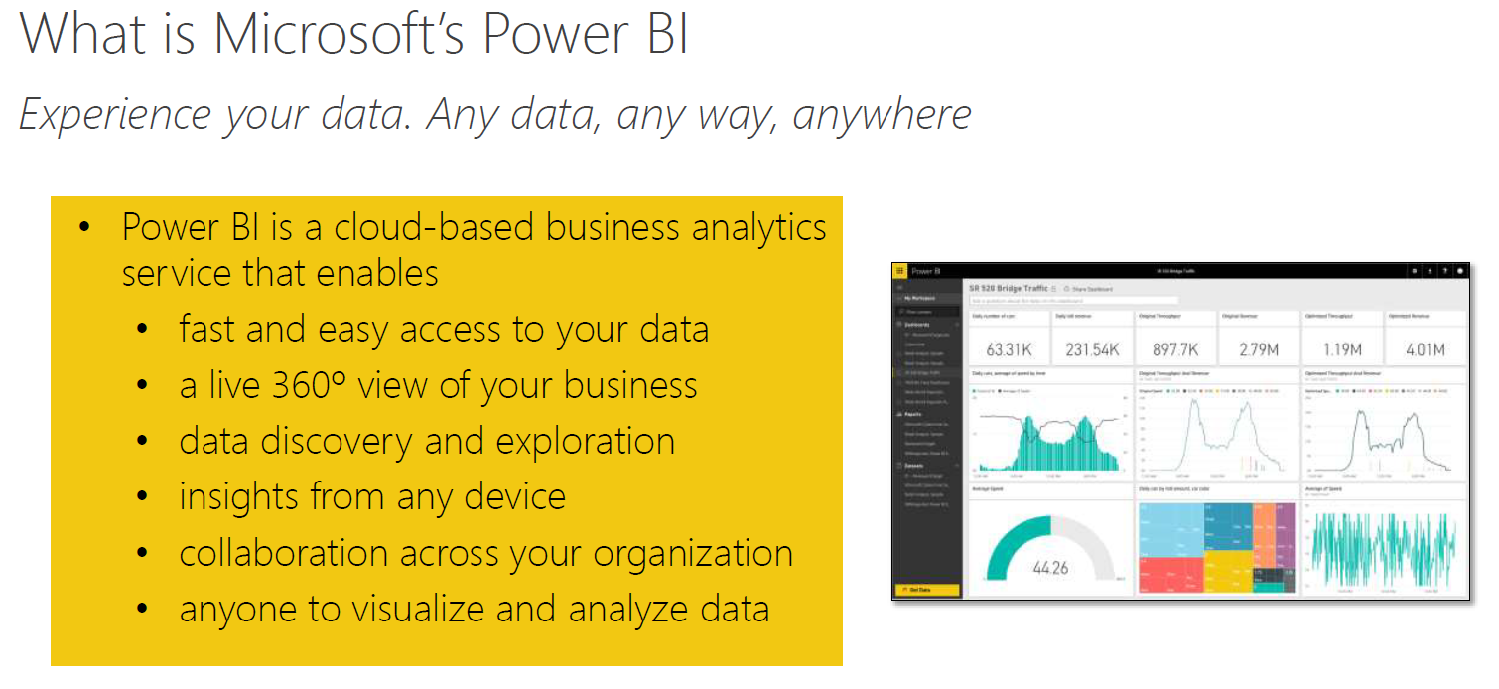

Slide 4
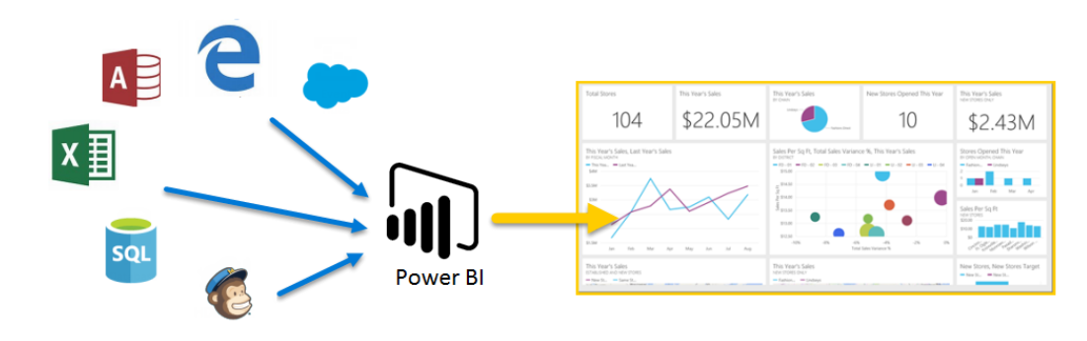
Microsoft Power BI is a collection of software services, apps, and connectors that work together to turn your unrelated sources of data into coherent, visually immersive, and interactive insights. Whether your data is a simple Microsoft Excel workbook, or a collection of cloud-based and on-premises hybrid data warehouses, Power BI lets you easily connect to your data sources, clean, and model your data without affecting the underlying source, visualize (or discover) what's important, and share that with anyone or everyone you want.

Slide 5
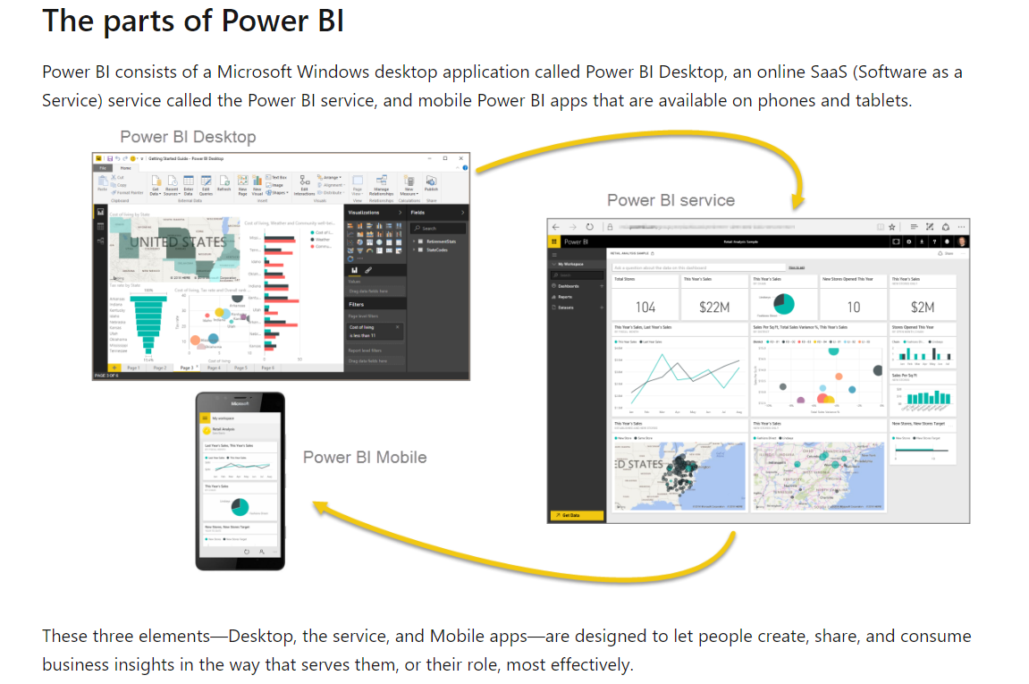
The parts of Power BI
Power BI consists of:
A Windows desktop application called Power BI Desktop.
An online SaaS (Software as a Service) service called the Power BI service.
Power BI mobile apps for Windows, iOS, and Android devices.
A fourth element, Power BI Report Server, allows you to publish Power BI reports to an on-premises report server, after creating them in Power BI Desktop.

Slide 6

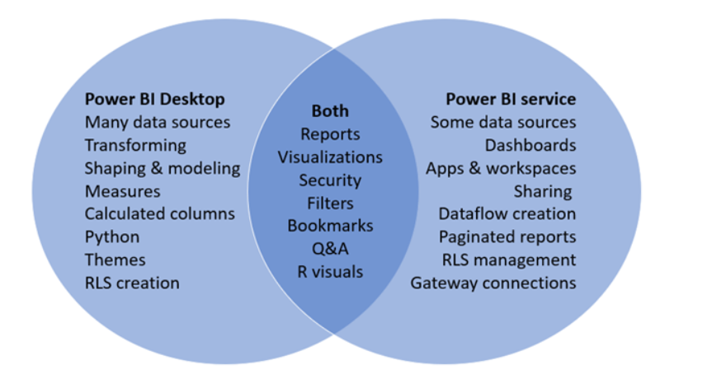
Power BI Desktop is a complete data analysis and report creation tool that you install for free application on your local computer. It includes the Query Editor, in which you can connect to many different sources of data, and combine them (often called modelling) into a data model. Then you design a report based on that data model.
The Power BI service is a cloud-based service. It supports light report editing and collaboration for teams and organizations. You can connect to data sources in the Power BI service, too, but modelling is limited.
Most report designers who work on business intelligence projects use Power BI Desktop to create reports, and then use the Power BI service to distribute their reports with others.

Slide 7
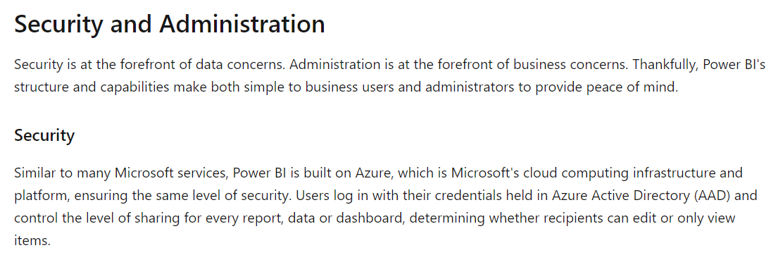

Slide 8
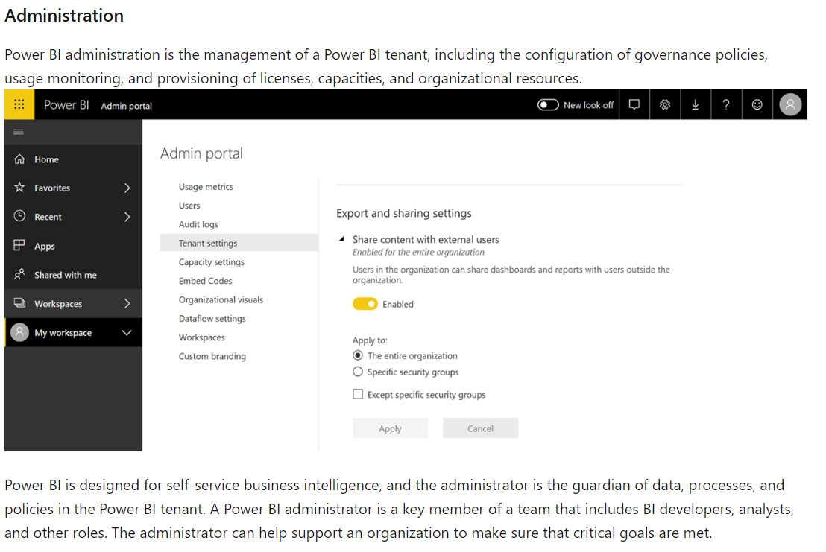

Slide 9

