Slide 1

MAULANA AZAD NATIONAL INSTITUTE OF TECHNOLOGY
BHOPAL
COMPUTER SCIENCE AND ENGINEERING
PREDICTION AND CLASSIFICATION OF CARDIAC ARRHYTHMIA

Slide 2



Prediction and classification of cardiac arrhythmia
Submitted by:
Sarthak 161112003 saraswat
Sudhanshu Ranjan 161112046
Rajendra sisodiya 161112094
Praveen Tiwari 161112084
Project Guide:
Prof.Dhirendra Pratap Singh

Slide 3
In India, a death is recorded every 33 seconds due to heart attack. In the past few decades, coronary heart disease, hypertension and other cardiovascular disease have become a global threat to human life. In our country, this phenomenon is getting increasingly severe due to the aging of population, living environment and unhealthy food consumption.
ECG provides the information which is needed to identify the problems and hence it becomes important when developing an advanced diagnostic system.
1.Introduction

Slide 4
Our objective is to classify a patient into one of the Arrhythmia classes like Tachycardia and Bradycardia based on his ECG measurements and help us in understanding the application of machine learning in medical domain.
2.Objective:--

Slide 5
3. Literature Review
A. Performance Analysis of Artificial Neural Networks for
Cardiac Arrhythmia Detection
The paper takes in an ECG signal and converts the analog signal to a digital signal. The system has extracted 8 beats from each ECG signal sampled at 2223 samples per second and classified these beats. The next step was signal pre-processing which was denoising of loaded raw ECG signal.
The system then extracts just three features from the signal; QRS complex duration, RR interval both normal and the one averaged over 8 beats. These features were further used by ANN classifiers such as Naive Bayes and Multiclass SVM to predict the class of the arrhythmia. The results were compared and the accuracy of each of the algorithm is calculated.

Slide 6
4. Proposed Work and Methodology 1.1 Classification
1.>FEATURE SELECTION
From the dataset, out of the 279 features present, it was infeasible to extract all the features. This is because many features used some information that is not accessible to the doctors while analysing ECG reports of patient. Hence, the dataset was narrowed with the help of Principal Component Analysis (PCA).
2.>PRINCIPAL COMPONENT ANALYSIS
The aim of PCA in this paper is to reduce the dataset containing large amount of dimensions and find out features with low dimensions.

Slide 7
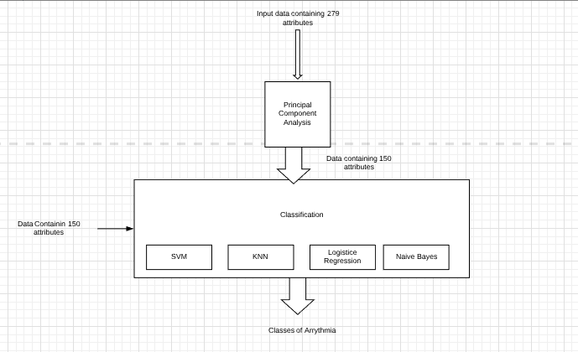
5.MODEL:--

Slide 8
6.ALGORITHM USED:-
1.>SVM(SUPPORT VECTOR MACHINE)
2.>NAIVE BAYES
3.>LOGISTIC REGRESSION
4.>KNN(K NEAREST NEIGHBOUR)

Slide 9
We used KNN because it is simple to implement & very straight forward.
Here, an object is classified by a majority vote of its neighbours, with the object being assigned to the class most common among its k nearest neighbours.
This is done by measuring distances between the object and its neighbours.
7.KNN(K nearest neighbour)

Slide 10
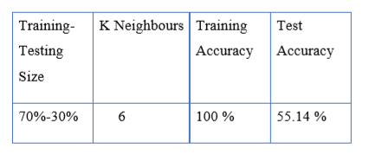
KNN ACCURACY RESULT

Slide 11
In SVM our aim is to maximize the margin of hyperplane from the points. For this purpose we have Support vectors, this are the points closer to hyperplane and influence
its position.
8.SVM(Support Vector Machine)

Slide 12
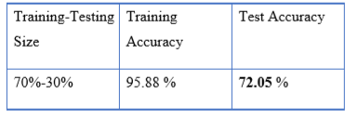
SVM accuracy result

Slide 13
Logistic regression hypothesis uses a sigmoid function. We need to maximize the probability by minimizing loss function .Decreasing the cost will increase the maximum likelihood. Values of Coefficients (beta) that minimize the error in the
probabilities predicted by the model to those in data.
Logistic regression hypothesis gives the output as a estimated probability .A threshold value is set to and based upon a this threshold a estimated probability can be classified into class. For ex. let us threshold value is 0.5 then a 0.6 estimated probability then input is considered as in class 1 whereas a input with estimated probability 0.3 is considered as in class 0.
9.LOGISTIC REGRESSION

Slide 14
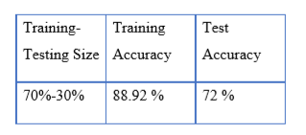
LOGISTIC REGRESSION ACCURACY RESULT

Slide 15
10.NAÏVE BAYES
In Naive Bayes algorithm we assumes that predictors are independent and uses the bays theorem for classification purpose. We calculate posterior probability and a class with highest posterior probability is outcomes.
This algorithms convert input into frequency tables and then with the help of calculated prior probabilities , we calculate posterior probabilities and consider a highest among them as outcome.

Slide 16
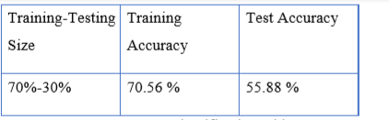
NAÏVE BAYES ACCURACY RESULT

Slide 17
11.TOOLS AND TECHNOLOGY USED:--
SOFTWARE:-ANACONDA,WEKA,JUPITER,MATLAB….
HARDWARE:-WINDOWS,RAM(at least 4GB),PROCESSORS(I5,7TH GEN)

Slide 18
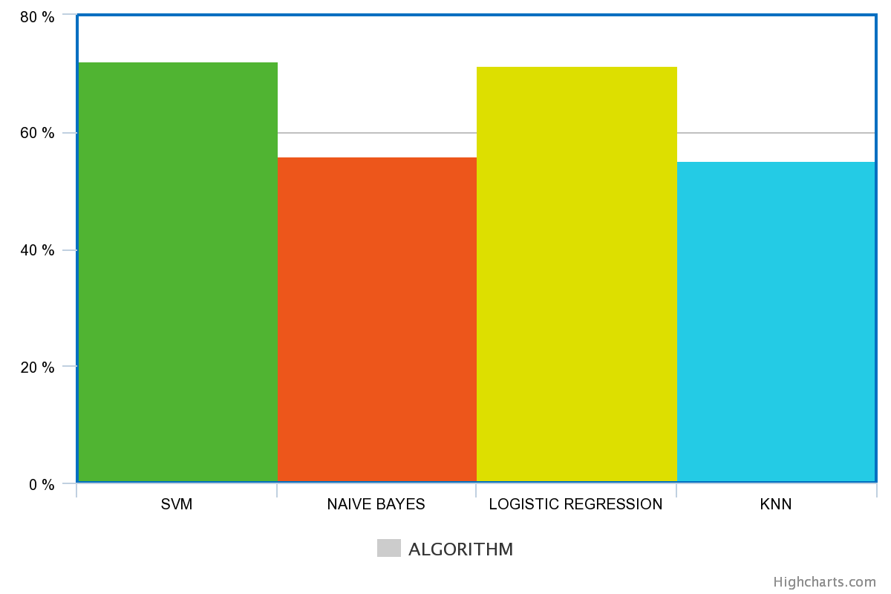
12. RESULT:--

Slide 19
>>>We obtained best result in
SVM with 72.05 accuracy,
Logistic regression gives accuracy 71.42,
KNN gives accuracy 55.14 and
naïve Bayes gives accuracy 55.88.
13.RESULT

Slide 20
We used 4 classifiers for the classification of cardiac arrhythmia. These were Naive Bayes Algorithms, Support Vector Machine, Logistic Regression and KNN classifier.
When the dataset was cross-validated and tested, the maximum accuracy was found to be obtained by Support Vector Machine Classifier. The accuracy obtained was 72.05%.
Thus in our approach, we have used the Support Vector Machine Classifier to obtain the best possible results for classifying arrhythmia.
14. CONCLUSION:--

Slide 21
15.REFERENCES:--
[1] "UCI machine learning repository: Arrhythmia data set," 1998. [Online].
Available: https://archive.ics.uci.edu/ml/datasets/Arrhythmia. Accessed:Feb. 10, 2017.
[2] "Heart attack kills one person every 33 seconds in India - Times of India", The Times of India, 2017. [Online]. Available: http://timesofindia.indiatimes.com/life-style/healthfitness/healthnews/ Heart-attack-kills-one-person-every-33-seconds-in-
India/articleshow/52339891.cms. [Accessed: 09- Mar- 2017].
[3] S. Xue, X. Chen, Z. Fang, and S. Xia, "An ECG arrhythmia classification and heart rate variability analysis system based on android platform," 2015 2nd International Symposium on Future Information Proceedings of the IEEE 2017 International Conference on Computing Methodologies and Communication (ICCMC) and Communication Technologies for Ubiquitous HealthCare (Ubi- HealthTech), May 2015.

Slide 22
[4] Nir Kalkstein, Yaron Kinar, Michael Na’aman, Nir Neumark, and Pini Akiva, "Using Machine Learning to Detect Problems in ECG Data Collection," in Computing in Cardiology, IEEE, 2011.
[5] O. Valenzuela, F. Rojas, L. J. Herrera, F. Ortuno, H. Pomares, and I. Rojas, "Comparison of different computational intelligent classifier to autonomously detect cardiac pathologies diagnosed by ECG," 2013 13th International Conference on Intelligent Systems Design and
Applications, Dec. 2013.
[6] Desai, Usha et al. "Machine Intelligent Diagnosis Of ECG For Arrhythmia Classification Using DWT, ICA And SVM Techniques". 2015 Annual IEEE India Conference (INDICON) (2015): n. pag. Web.4 Sept. 2016

Slide 23
[7] Deselaers, Thomas, Lexi Pimenidis, and Hermann Ney. "Bag-of- visual words models for adult image classification and filtering." Pattern Recognition, 2008. ICPR 2008. 19th International Conference on. IEEE,
2008.
[8] https://ieeexplore.ieee.org/document/8282537

