Slide 1
Topics
JSF Lifecycle
<f:ajax/>
<f:viewParam/>
<f:viewAction/>

Slide 2
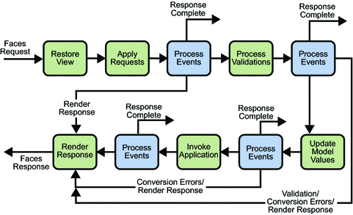
JSF Lifecycle

Slide 3
<f:viewParam/> and <f:viewAction/>
<f:metadata>
<f:viewParam name="id" value="#{bean.id}" />
</f:metadata>
Get the request parameter value by name id.
Convert and validate it if necessary (you can use required, validator and converter)
If conversion and validation succeeds, then set it as a bean property represented by #{bean.id} value, or if the value attribute is absent, then set it as request attribtue on name id so that it's available by #{id} in the view.
So when you open the page as page1.xhtml?id=10 then the parameter value 10 get set in the bean this way, right before the view is rendered.

Slide 4
Performing business action on GET parameters
You can use the <f:viewAction> for this.
<f:metadata>
<f:viewParam id="id" name="id" value="#{bean.id}" required="true">
<f:validateLongRange minimum="10" maximum="20" />
</f:viewParam>
<f:viewAction action="#{bean.onload}" />
</f:metadata>
<h:message for="id" />

