Slide 1


Slide 2
Limitations of Map-Reduce
Performance bottlenecks, specifically for small batch not fitting the use cases
Many categories of algorithms not supported (e.g. iterative algorithms, asynchronous algorithms etc.)

Slide 3
What is Spark?
Apache Spark is a general-purpose cluster in-memory computing system
It is used for fast data analytics
It abstracts APIs in Java, Scala, Python and R
Provides various high level tools like Spark SQL for structured data processing, Mlib for Machine Learning

Slide 4
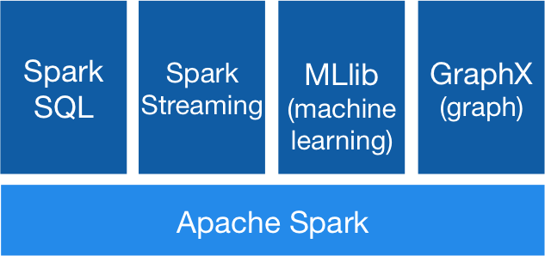
Spark Ecosystem
Enables analytical and interactive app for live streaming data
Graph computation engine
(Similar to Graph)
Used for structured data. Can run unmodified hive queries on existing Hadoop deployment
Machine learning library being built on top of spark. Provision of support to many ML algorithms with speeds upto 100 times faster than Map – Reduce

Slide 5
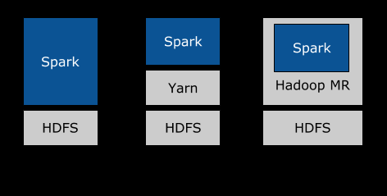
Various modes of Spark

Slide 6
Why Spark?

Slide 7
How is spark used?
Spark in Standalone mode - 48%
Spark on YARN - 40%
Spark on MESOS - 11%

Slide 8
Spark Architecture
Worker Node
Executor
Task
Task
Driver Program
Cluster Manager
SparkContext
Worker Node
Executor
Task
Task

Slide 9
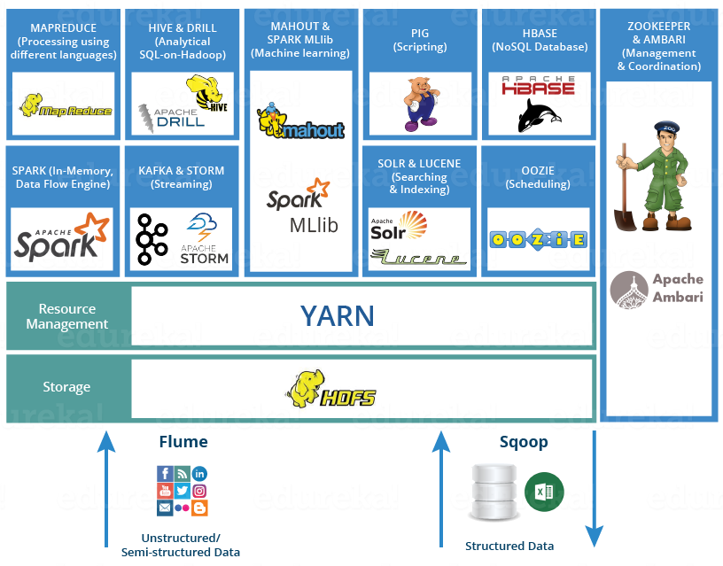
Spark in Hadoop Ecosystem

Slide 10
Using Hadoop as a Storage
Spark can use Hadoop as storage
  Spark is not limited to HDFS only for its storage.
  HDFS provides distributed storage for large datasets.
  High availability is assured natively through HDFS.
  No extra software installation is required.
  Compatible with Hadoop 1.x also.
  Data loss during configuration can be handled by HDFS itself.

Slide 11
Using Hadoop as Execution engine
Spark can use Hadoop as execution engine
  Spark can be integrated with Yarn for its execution.
  Spark can be used with other engines like Mesos, Spark cluster manager.
  Yarn integration services automatically provide processing scalability to Spark.
  Spark needs Hadoop 2.0 + versions in order to use it for execution
  Every node in Hadoop cluster need Spark to be installed.

Slide 12
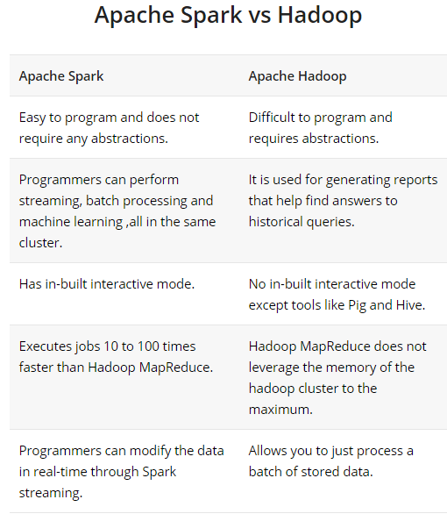

Slide 13
Thank You

