Slide 1
Topics
Introduction
Third-party UI Components
Environment Setup
Components of JSF Application
How JSF works
Hello world Application

Slide 2
Introduction
Framework for building web applications in Java
Standard of Java Enterprise Edition
Based on MVC design pattern
JSF framework includes large number of UI components

Slide 3
Third-party UI Components
Additional to the core UI components provided by JSF Framework we can use these below third-party UI components for rich look and feel.
  RichFaces : richfaces.jboss.org
  Prime Faces: www.primefaces.org

Slide 4
Environment setup
Required softwares
  JDK Installed.
  Web Server / Application Server
  Java Development IDE
  JSF Jars files (optional if we use Appl. server)

Slide 5
JSF Versions
JSF Version | Release Date | Java EE Version
JSF 1.0 | 2004 | J2EE 1.4
JSF 1.2 | 2006 | Java EE 5
JSF 2.0 | 2009 | Java EE 6
JSF 2.2 | 2013 | Java EE 7

Slide 6
Components of JSF Appl.
A set of web pages to layout UI Components
A set of Managed Beans
web.xml (deployment descriptor)
Optionally
  Application configuration files (faces-config.xml)
  Custom objects, components, listeners, validators, custom tags

Slide 7
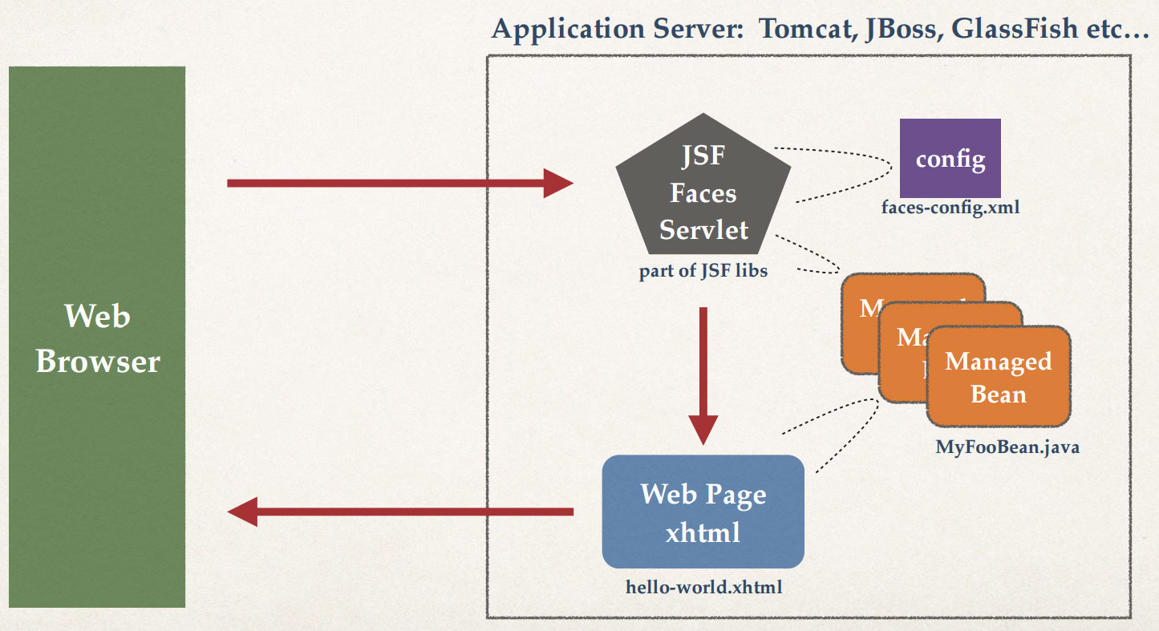
How JSF Works

Slide 8
Helloworld Appl.

