Slide 1
DA546: Introduction to statistical Learning regression analysis on factors affecting life expectancy
Submitted To
Rhythm grover
Assistant professor
Mehta family school of data science and ai
Submitted by
Rajendra kujur (214161008)
M.Tech data Science

Slide 2
Motivation
Should a country having a lower life expectancy value(<65) increase its healthcare expenditure in order to improve its average lifespan?
How does Infant and Adult mortality rates affect life expectancy?
Does Life Expectancy has positive or negative correlation with eating habits, lifestyle, exercise.
Does Life Expectancy have positive or negative relationship with drinking alcohol?
Do densely populated countries tend to have lower life expectancy?

Slide 3
Source of dataset
The Global Health Observatory (GHO) data repository under World Health Organization (WHO) keeps track of the health status as well as many other related factors for all countries The data sets are made available to public for the purpose of health data analysis. The data set related to life expectancy, health factors for 193 countries has been collected from the same WHO data repository website and its corresponding economic data was collected from United Nation website

Slide 4
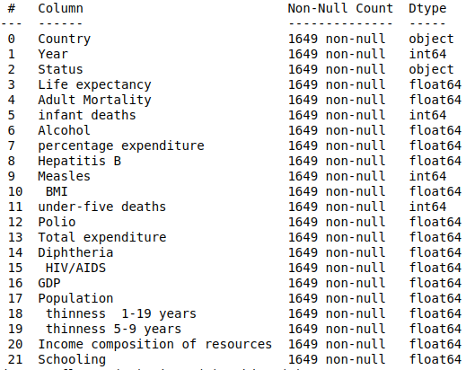
About Data set
We have total 22 features, out of which one feature is Life expectancy (target variable), rest features (independent variables)

Slide 5
Data pre-processing
Removed the missing value rows
Categorical Values updated to numeric values
Status: 0(Developing), 1(Developed)
Country Values: 0, 1, 2 …. N
Which reduced our dataset from 2938 x 22 to 1649 x 22

Slide 6
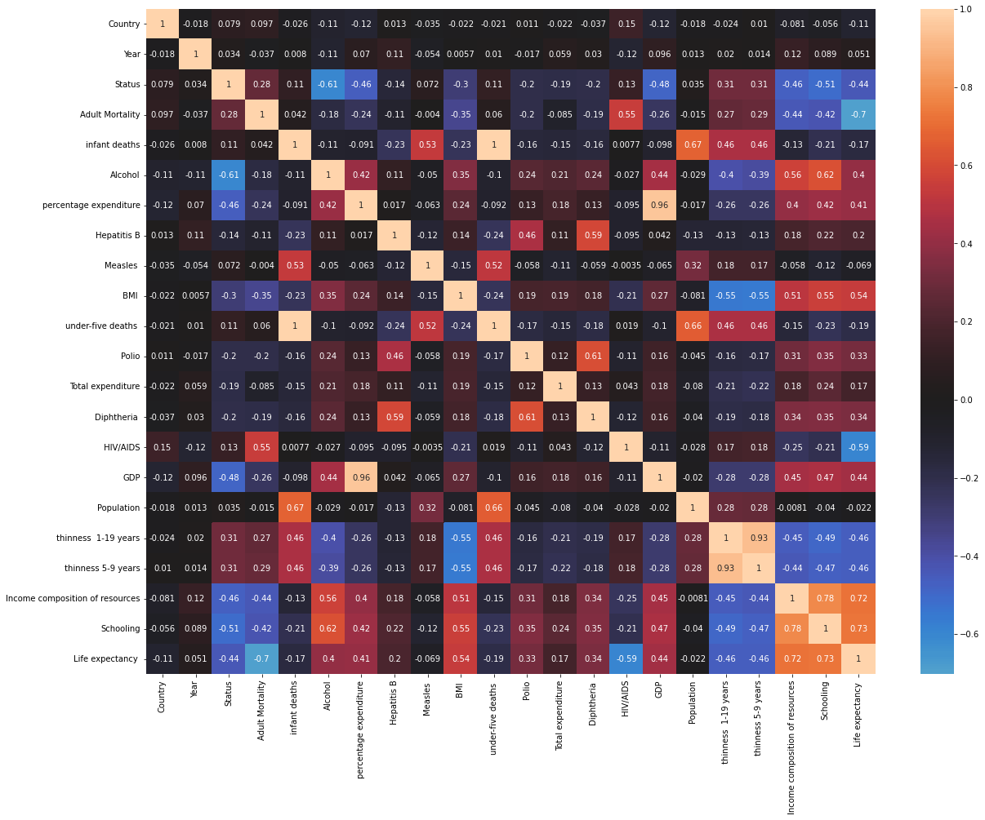
Correlation between all the all the features
Higher the correlation value, better the linear association-ship between two features
Schooling
Income composition of resources
Adult Mortality
HIV/AIDS
BMI

Slide 7
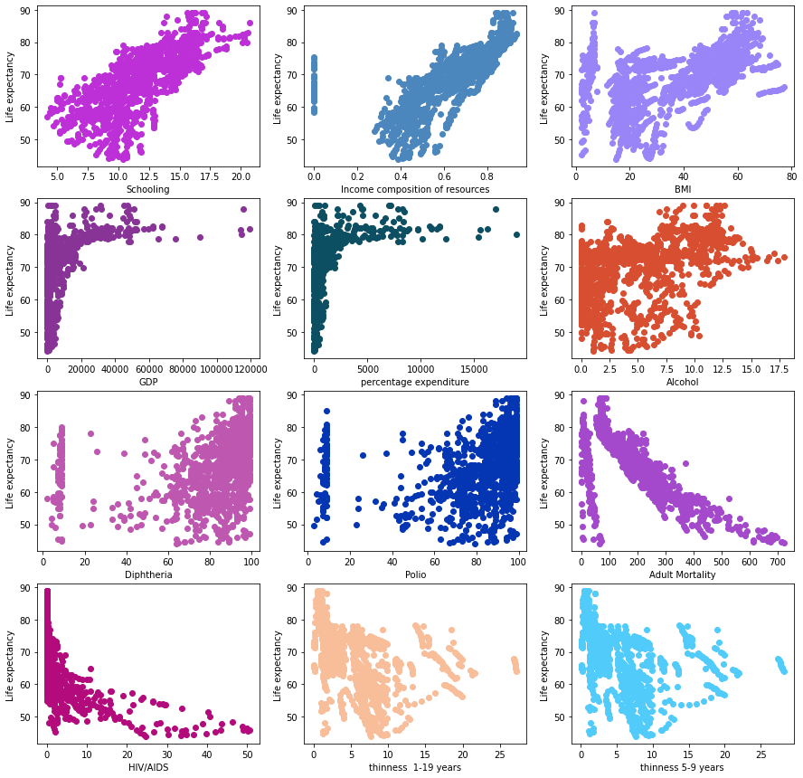
SCATTER PLOT WITH THE HIGHLY CO-RRELATED FEATURES
Features in decreasing order of correlation coefficient

Slide 8
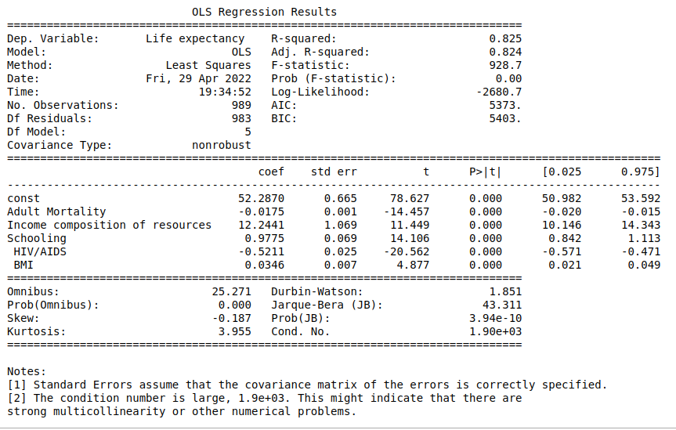
Final output model
Life Expectancy = β0 + β1*(Adult Morta-lity) + β2*(Income composition of reso-urces) + β3*Schooling + β4*HIV/AIDS + β5*BMI
Life Expectancy = 52.28 - 0.01*Adult Mortality +12.24*Income + 0.97*Sch-ooling - 0.52*HIV/AIDS + 0.03*BMI

Slide 9
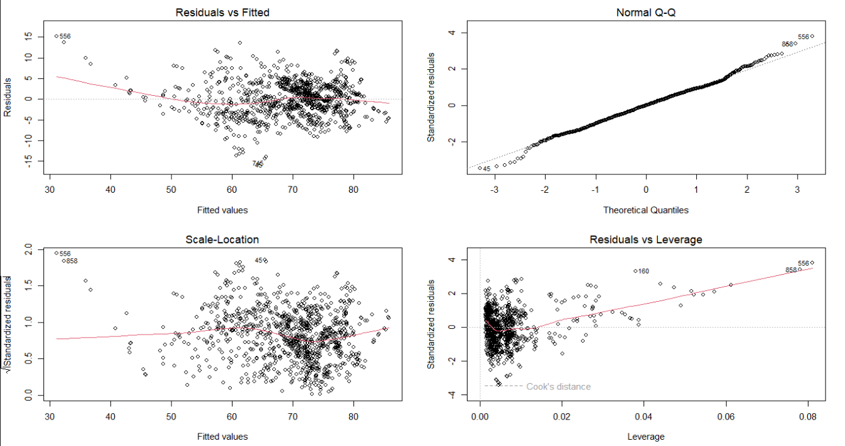
Residual diagnostics

Slide 10
Conclusion
Adult Morality significantly affects the expected life expectancy.
Income Composition of Resources affects the Life expectancy
Yes, we know alchohol affects the health in a bad manner, but it is not our final predicted model, so we can say on an average its effect tends to go down.
Model doesn't mention about the country origin so it can be concluded that density of population has nothing to do with life expectancy
Better health leads to higher life expectancy.

