Slide 1
Quantative Simulation (QuantSim) Stock Market Simulation and Risk Intelligence Platform
This project is essentially a Quantitative Research + Simulation Engine for equity markets.
It reflects:
Quantitative finance
Simulation
Physics-based modeling
Intelligence-driven analytics

Slide 2
Project Overview
“QuantSim” is a research-driven stock market simulation and analytics platform that combines finance, statistics, and physics-based modeling to evaluate, simulate, rank, and visualize stocks.
It combines market microstructure, statistical inference, stochastic processes, and computational finance into one extensible framework.
The goal is to build an extensible quantitative framework capable of analyzing market behavior beyond conventional technical analysis.
It integrates broker APIs like Zerodha for historical and live market data, enabling both research and potential real-time deployment.
The system focuses on NIFTY 50 stocks initially but is designed to scale to broader markets, derivatives, and multi-asset classes.
It applies statistical analysis, technical indicators, stochastic processes, and Monte Carlo simulations to generate probabilistic insights.
Risk management modules such as Value at Risk, CVaR, and stress testing evaluate downside exposure.
A ranking engine consolidates all analytical outputs into a multi-factor score for stock selection.
Finally, a Streamlit dashboard provides interactive visualizations for exploration and decision-making.

Slide 3
Core Objective
The project aims to create a quantitative research framework where stock behavior can be studied using:
Statistical inference
Stochastic simulations
Risk modeling
Technical signals
Physics-inspired market dynamics
Rather than relying solely on historical charts, the system forecasts possible future price paths and evaluates stocks based on probability-adjusted performance and risk.

Slide 4
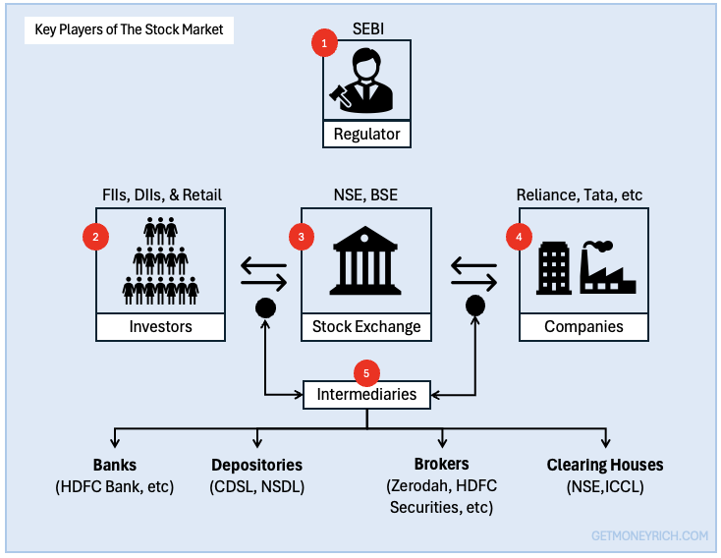
Domain Model
Stock market participants are the individuals, institutions, and entities that buy, sell, or facilitate trading. They are categorized into five core groups:
investors and traders (the buyers and sellers), listed companies (the issuers), brokers and exchanges (the intermediaries), clearing agencies, and regulatory authorities.
Investors and TradersThese are the primary buyers and sellers driving daily trading volumes, capital formation, and market liquidity.Retail Investors: Individual participants who trade securities using personal capital. They usually trade in smaller volumes based on long-term goals, news, or trends.High-Net-Worth Individuals (HNIs): Wealthy individuals who manage substantial capital and take sizable positions, which can influence short-term price movements.Institutional Investors: Professionals who manage large pools of capital on behalf of others. This includes mutual funds, insurance companies, hedge funds, and pension funds. They have the most significant impact on broader market trends.Foreign Institutional Investors (FIIs): Non-domestic entities (such as foreign funds) that inject global capital, increasing market depth.Day Traders & Arbitrageurs: Short-term players who capitalize on rapid price fluctuations or price differentials across different exchanges to lock in quick profits
Listed Companies (Issuers) - These are the corporate or governmental entities that issue financial instruments. They participate in the primary market to raise capital for business expansion, research, or infrastructure by offering stocks, bonds, or IPOs.
Intermediaries - Intermediaries connect buyers and sellers, ensuring trades are executed smoothly and efficiently.Stock Exchanges: Platforms like the ⁠National Stock Exchange or the BSE Limited in India that provide the digital infrastructure for secure and transparent trading. Stockbrokers: Registered members or broker-dealers who facilitate the buying and selling of securities on behalf of the investors.
Clearing Agencies - These are financial intermediaries that act as a bridge between buyers and sellers. Entities like clearing corporations manage the risk of default and ensure the secure transfer of securities and funds upon trade completion.
RegulatorsRegulators oversee the entire market ecosystem to enforce fair practices, prevent fraud, and protect investors. In India, the governing body is the ⁠Securities and Exchange Board of India (SEBI).

Slide 5

Journey

Slide 6
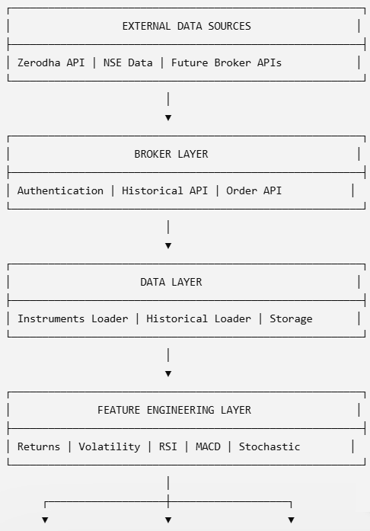
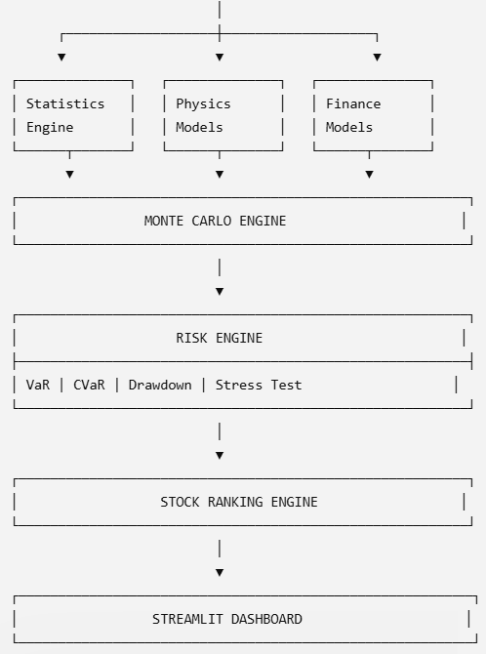
E2E Architecture

Slide 7
Main System Components
1. Broker Integration Layer
Connects to Zerodha for authentication, historical data retrieval, and future trading support. It abstracts broker-specific logic so additional brokers can be integrated later.
2. Data Layer
Downloads and manages instrument master files and historical OHLCV datasets. It forms the raw market data foundation for all analytics.
3. Feature Engineering Layer
Generates derived market signals such as returns, volatility, momentum, and technical indicators like Relative Strength Index and Moving Average Convergence Divergence.
4. Statistical Engine
Performs quantitative analysis including return distribution profiling, skewness, kurtosis, and volatility measurement.
5. Physics-Based Modeling Layer
Uses stochastic processes like:
Brownian Motion
Random Walk
Geometric Brownian Motion
to model future market behavior.

Slide 8
Main System Components
6. Monte Carlo Simulation Engine
Runs thousands of simulated price paths to estimate future price distributions, probability bands, and expected outcomes.
7. Risk Engine
Measures downside risk through:
VaR
CVaR
Drawdowns
Stress testing
to ensure robust stock evaluation.
8. Stock Ranking Engine
Combines statistical strength, technical momentum, simulation confidence, and risk-adjusted returns into a unified score.
9. Visualization Layer
Provides dashboards for:
Price trends
Indicator charts
Return distributions
Simulation paths
Risk dashboards
through Streamlit and Excel.

Slide 9
Technology & Architecture Principles
Technology Stack
Python - Core development language
Zerodha Kite API – Broker & Market data integration
NumPy - Numerical computing
Pandas - Data handling
SciPy - Statistical functions
StatsModels - Advanced time-series models
TA-Lib / ta - Technical indicators
Matplotlib / Plotly – Visualization, Graphs
Streamlit - Dashboard Web Frontend
MS Excel, XLWings - Visualization
pytest – Testing framework
Architecture Design Principles
This architecture will follow:
SOLID principles
Plug-and-play model architecture
Broker abstraction
Expandable stock universe
Testability
Scalability & Performance
Security

Slide 10
Key Strengths of the Project
Modular and production-ready architecture
Easy addition of new stocks, brokers, and models
Strong focus on mathematical and statistical rigor
Physics-based experimentation framework
Simulation-driven stock forecasting
Research-grade extensibility

Slide 11
Expected Outcome
By the end of development, QuantSim system will function as:
A stock screening engine
A probabilistic forecasting engine
A risk intelligence system
A quantitative research platform
A simulation laboratory for financial experimentation
In short, it is designed to bridge the gap between traditional stock analysis and institutional quantitative research systems, making it a strong platform for research, and advanced trading strategy development.

Slide 12
Future Expansion Possibilities
Our current system covers:
statistical analysis
stochastic simulations
technical indicators
Monte-Carlo
risk engines
QuantSim In the next stage, it can transition into institutional-grade quantitative research platform, where finance intersects with:
nonlinear physics
information theory
complexity science
machine learning
probabilistic modeling
market microstructure
QuantSim can further evolve into more complex capabilities:
Options analytics (Greeks, IV surface)
Ornstein-Uhlenbeck Process
GARCH models
Hidden Markov Model regime switching
Kalman Filter trend filtering
AI forecasting with Long Short-Term Memory and Transformers
Agent-based market simulations
Portfolio optimization, Strategy Optimizer
Live trading automation, Websocket
Reinforcement Learning

Slide 13
Architecture Walk-thru
Each architecture layer is detailed in terms of:
Purpose
Flow
Internal logic
Data movement
Code responsibilities
Outputs
Extensibility
Why it matters

Slide 14
1. Broker Layer
Flow
User Credentials → Authentication → Session Creation → API Access
Description
This layer is the gateway to the financial market.
It handles secure communication with the Zerodha ecosystem and ensures all downstream modules can fetch reliable market data.
The authentication module creates and validates sessions, while the client module abstracts API calls like historical data fetch, quote retrieval, and order placement.
By separating broker logic, the rest of the system remains broker-independent.
If you later integrate Interactive Brokers or Upstox, only this layer changes.
It acts as the foundation for both research and live deployment.
This design keeps credentials isolated and minimizes system-wide API dependency.
It is the root of the full execution pipeline.

Slide 15
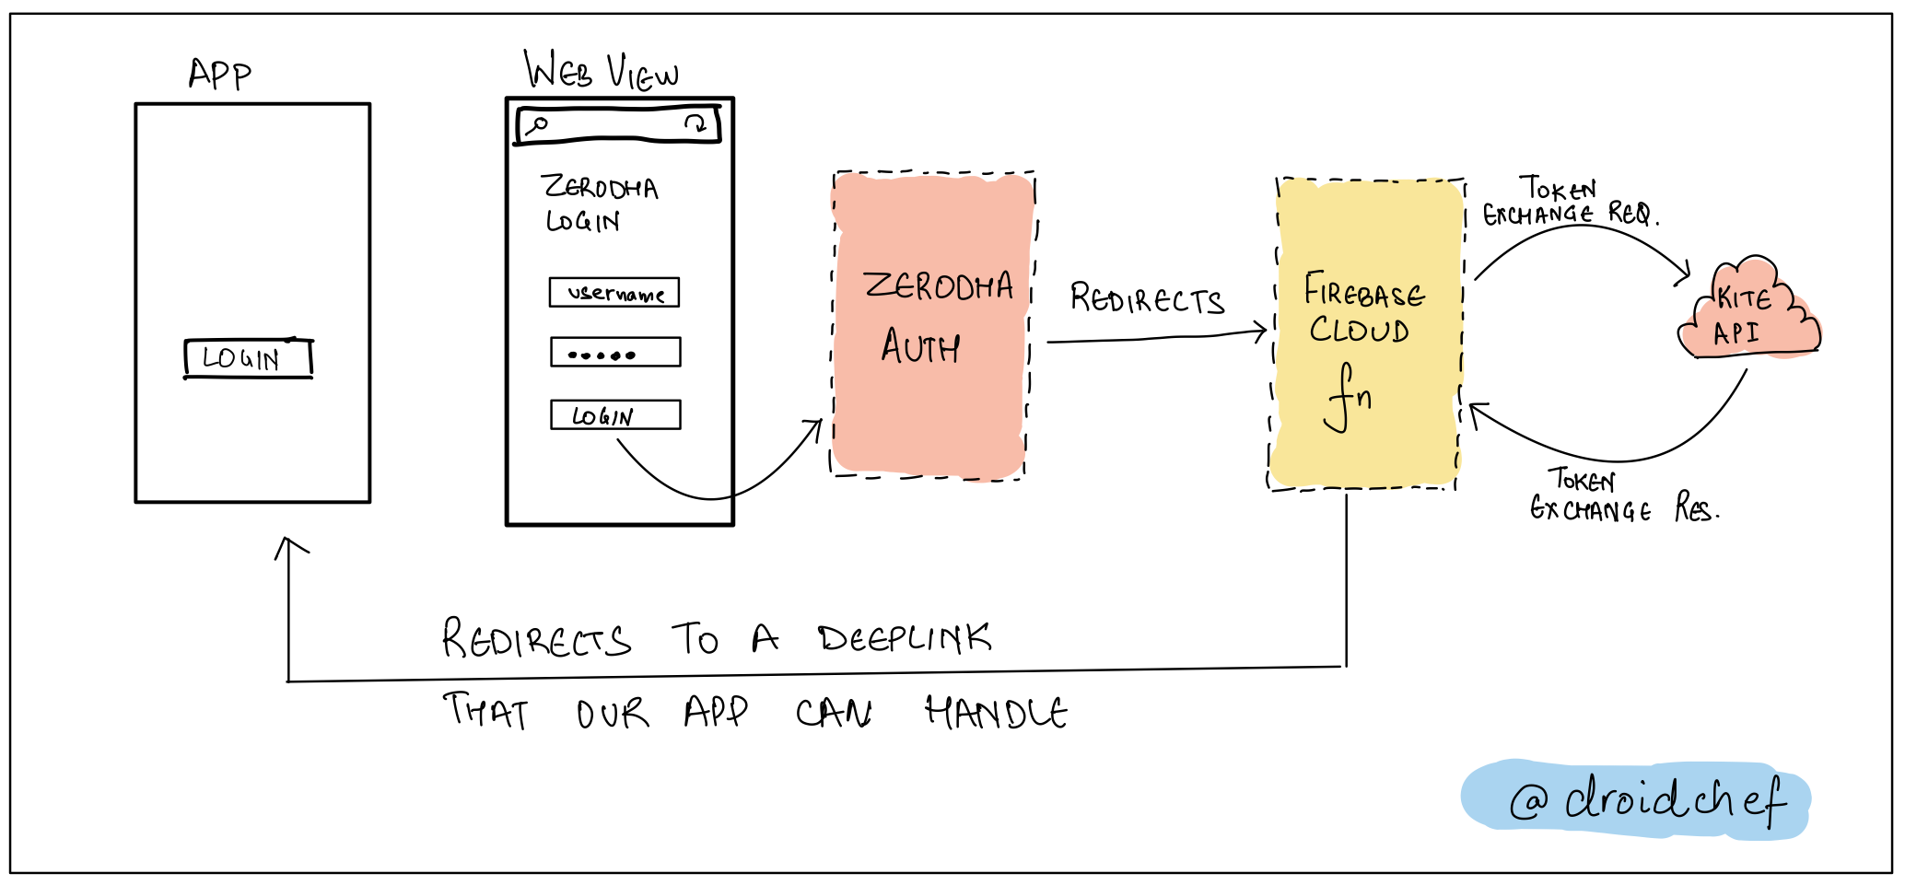
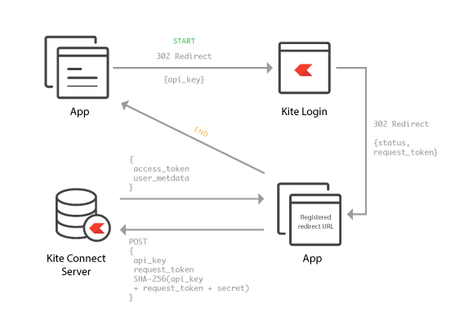
1.1 Authentication Flow

Slide 16
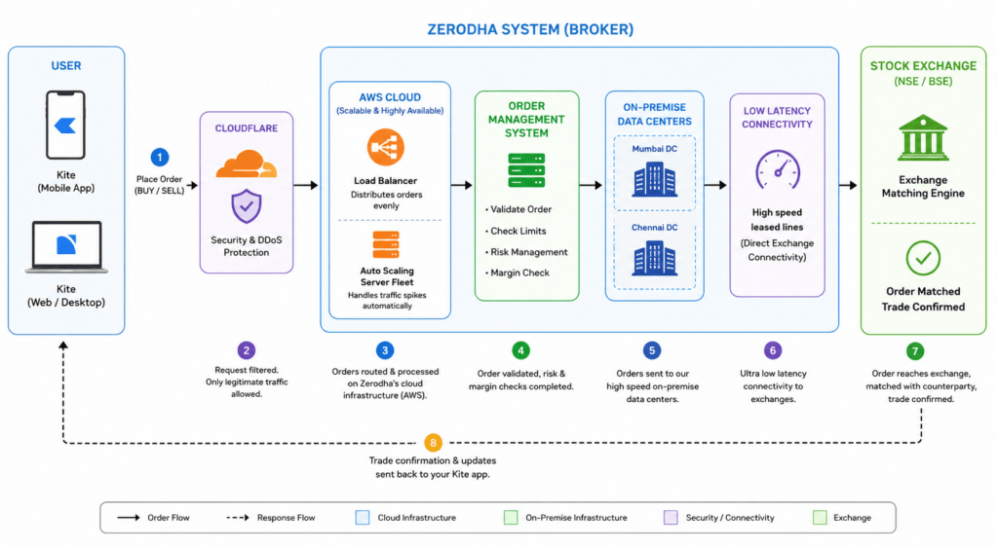
1.2 Zerodha Ecosystem

Slide 17
2. Instrument Master Layer
Flow
Broker API → Instruments Dump → Token Mapping → Local Dictionary
Description
Every stock in Zerodha has a unique instrument token.
This layer downloads the master instrument list and creates symbol-to-token mappings.
It serves as the market index registry for the system.
Without it, historical or live fetches cannot be performed.
This design makes the system scalable because adding new stocks is as simple as appending symbols.
It supports future expansion into F&O, ETFs, commodities, and currency markets.
The mapping structure acts as a lookup cache for ultra-fast access.
This layer removes hardcoding from downstream modules.

Slide 18
3. Historical Data Engine
Flow
Token → API Fetch → OHLCV DataFrame → Local Processing
Description
This engine downloads 1 year of historical OHLCV data for each stock.
It is the raw material for the analytics pipeline.
Every model downstream depends on this standardized structure.
It normalizes time series into a pandas DataFrame for consistent access.
Missing data handling and return calculations begin here.
This layer can later be extended for intraday candles.
It creates reproducible datasets for research and simulation.
It is the first transformation point from external data into internal analytics.

Slide 19
4. Feature Engineering Layer
Flow
OHLCV → Derived Features → Analytical Signals
Description
This layer converts raw market data into meaningful quantitative signals.
It creates statistical descriptors and technical indicators.
This is where market behavior becomes measurable.
Returns measure profitability, volatility measures uncertainty, RSI measures momentum, and MACD measures trend persistence.
These features become the inputs for ranking and simulation.
It acts as the feature factory of the entire platform.
A strong feature layer directly improves model quality.
It is one of the most critical research layers.

Slide 20
5. Statistics Engine
Flow
Returns → Statistical Functions → Distribution Profile
Description
This engine analyzes return distributions mathematically.
It calculates mean returns, volatility, skewness, and kurtosis.
These describe the shape and risk profile of each stock.
Skewness helps identify asymmetry in returns, while kurtosis identifies fat-tail risk.
These metrics determine if a stock behaves normally or exhibits extreme event tendencies.
This is essential because financial data rarely follows perfect Gaussian behavior.
The output is a statistical fingerprint for every stock.
It provides the basis for simulation parameterization.

Slide 21
6. Technical Indicator Engine
Flow
Momentum + trend extraction.
Description
This engine computes technical indicators from price data.
These indicators provide short-term behavioral insights.
RSI identifies overbought and oversold zones.
MACD captures trend acceleration and deceleration.
Stochastic oscillator detects price positioning relative to recent ranges.
These indicators complement statistical metrics by adding directional context.
While statistics describe historical behavior, indicators describe present market state.
This combination improves stock scoring quality.
It makes the system hybrid instead of purely statistical.

Slide 22
7. Physics Layer
Flow
Statistical Parameters → Stochastic Models → Price Path Generation
Description
This layer applies mathematical physics to model stock price behavior.
It transforms historical statistics into simulated future dynamics.
Brownian Motion models noise diffusion, Random Walk tests unpredictability, and GBM simulates multiplicative price growth.
These models are the mathematical heart of modern quantitative finance.
They provide synthetic future scenarios for stress analysis.
They also allow experimentation beyond historical limitations.
This layer makes the system research-grade.
It is where finance meets stochastic calculus.

Slide 23
8. Brownian Motion Engine
Equation
dX = μdt + σdW
Description
Brownian motion models continuous random movement.
In finance, it represents market noise.
Each increment is normally distributed.
The model assumes no memory.
It is useful for understanding baseline randomness.
It is the foundation of GBM and Black-Scholes style pricing.
This model is ideal for diffusion analysis.
It provides the simplest continuous stochastic framework

Slide 24
9. GBM Engine
Equation
dS = μSdt + σSdW
Description
Gradient Boosting Machine (GBM) improves Brownian motion by making price changes proportional to current price.
This reflects real market behavior better.
It preserves positivity, unlike standard Brownian motion.
It is widely used in derivatives pricing.
Drift controls expected growth.
Volatility controls uncertainty.
This makes it ideal for forecasting future price distributions.
It is the main simulation model for Monte Carlo.

Slide 25
10. Monte Carlo Engine
Flow
GBM → Thousands of Paths → Future Distribution
Description
Monte Carlo repeats GBM thousands of times to generate future probability distributions.
Instead of one forecast, it creates many possible futures.
This helps estimate upside probability, downside probability, and confidence intervals.
It is probabilistic forecasting rather than deterministic forecasting.
Institutions use this heavily in portfolio management.
It quantifies uncertainty explicitly.
It is one of the strongest forecasting tools.
This is the probabilistic intelligence engine.

Slide 26
11. Risk Engine
Flow
Returns → Risk Metrics → Tail Analysis
Description
This engine quantifies loss.
VaR estimates maximum expected loss under confidence assumptions.
CVaR estimates average loss beyond VaR.
Stress testing applies synthetic crashes.
This helps evaluate stock robustness.
Risk is as important as return.
A stock with high returns but extreme tail risk should rank lower.
This engine ensures risk-adjusted intelligence.
It converts volatility into actionable loss estimates.

Slide 27
12. Ranking Engine
Flow
Statistical Parameters → Stochastic Models → Price Path Generation
Description
This is the decision engine.
It aggregates all analytical outputs into one score.
Each factor is weighted according to importance.
Momentum, volatility, returns, and simulation confidence all influence ranking.
This allows multi-factor stock comparison.
It transforms raw analytics into actionable insights.
It acts like a hedge-fund screening engine.
This layer is where intelligence becomes usable.

Slide 28
13. Streamlit Dashboard
Flow
Analytics Output → Visualization → User Decisions
Description
This layer converts quantitative outputs into human-readable visuals.
Charts make patterns easier to interpret.
Histograms reveal return distributions.
Simulation plots show future uncertainty bands.
Risk dashboards display VaR and drawdowns.
Ranking tables provide actionable screening.
This layer makes the research engine interactive.
It acts as the user’s cockpit.
It is the final presentation layer of the system.

Slide 29
System Flow
SYSTEM FLOW
Login ↓
Load Instruments ↓
Map Tokens ↓
Download Historical Data ↓
Compute Returns ↓
Generate Indicators ↓
Run Statistical Analysis ↓
Run Physics Models ↓
Run Monte Carlo ↓
Compute Risk ↓
Rank Stocks ↓
Visualize Results ↓
Decision Making

Slide 30
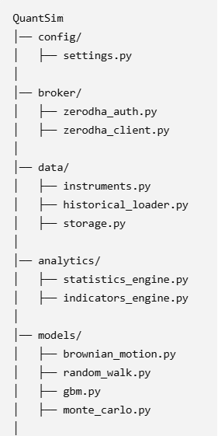
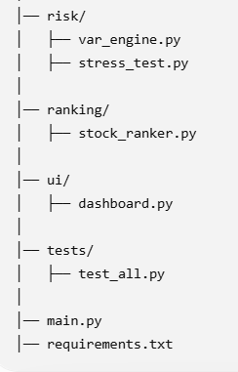
Project Structure & Code Components

Slide 31
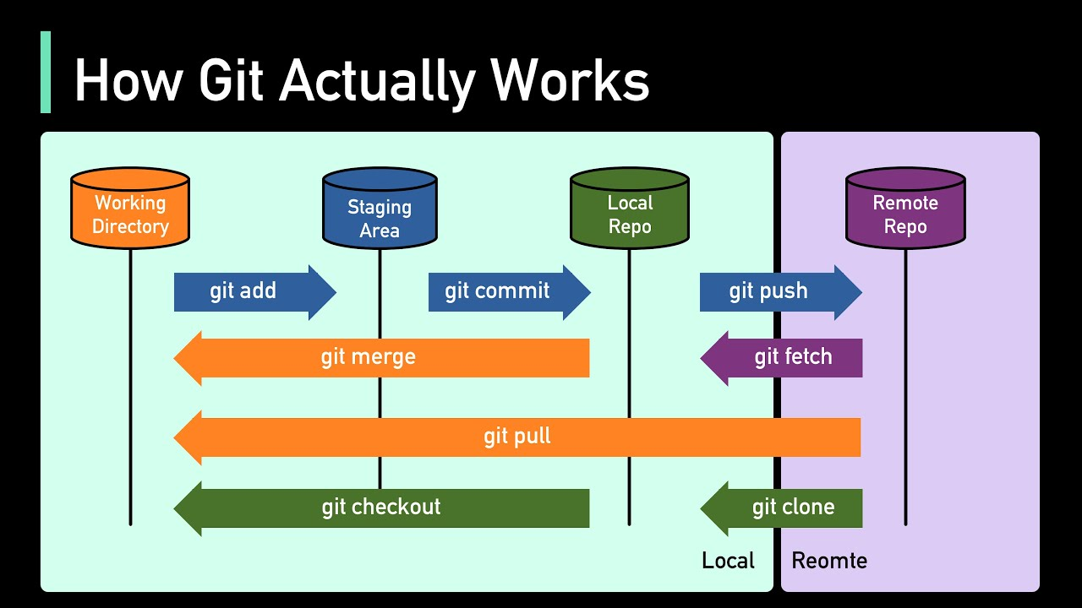
Version Control, GIT & PyCharm
Git is a distributed version control system that tracks changes in computer files and coordinates work among multiple people. Seamless Collaboration with multiple teams.
It allows developers to record every modification to a codebase, safely experiment with new features, and easily revert to previous versions if mistakes happen.
GIT with PYCHARM
Connect Your GitHub Account
Clone (Initialize) and Checkout Repository (One time activity)
It downloads changes from a remote repository and immediately integrates them into your current local branch
Track, Commit & Push code changes
Once Git is enabled, PyCharm uses color coding for your files:
Red means un-versioned
Green means newly added, and
Blue means modified.
Steps
Add files:
Right-click any red file and choose Git > Add (Shortcut: Ctrl + Alt + A or Cmd + Option + A).
Commit changes:
Open the Commit tool window on the left side (Alt + 0 / Cmd + 0). Check the files you want to save, write your commit message, and click Commit.
Push to a remote server:
Go to Git > Push (Shortcut: Ctrl + Shift + K or Cmd + Shift + K) to send your local changes to GitHub.
4. Pull
5. Branching and Merging

Slide 32
Core Daily Git Workflow
Real Daily Flow (what devs actually do)
1. Check status
git status
👉 Shows: changed files, staged files, branch info
2. Add changes
git add file.py git add .
👉 Move changes to staging area
3. Commit
git commit -m "Fix login bug«
👉 Save snapshot with message
4. Pull latest changes
git pull
👉 Always do this before pushing (very important!)
5. Push your code
git push
👉 Send your changes to remote (GitHub, GitLab, etc.)
🔍 Inspect & Debug
6. See commit history
git log git log –oneline
7. See changes
git diff

Slide 33
Cloud & Deployment
…

Slide 34
Agile & Scrum Methodologies
…

Slide 35
Any Questions?

