Slide 1
Fetal Distress classification based on Cardiotocography using machine learning
T.Rajendra Prasad, S. Samaya Naveen
Velammal College of Engineering and technology, Viraganoor, Madurai-625009

Slide 2
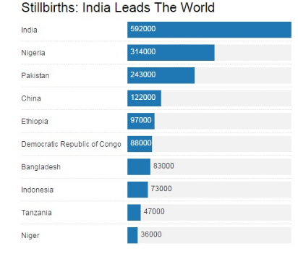
Introduction
Worldwide in there were about 2.6 million stillbirths that occurred after 28 weeks of pregnancy.
Fetal distress is also one of the main reason for still birth.

Slide 3

objective
To predict the fetal distress using Machine Learning Techniques.
Visualization of data with various parameters.
To analyze which algorithm will be most suitable to predict the fetal distress.

Slide 4
Parameters
Fetal movement
Urinary contractions
Percentage of time with abnormal short term variability
Mean value of short term variability
Percentage of time with abnormal long term variability
Mean value of long term variability
Light decelerations
Severe decelerations
Prolongued decelerations
Repetitive decelerations
Histogram Mean, Median, Mode, Variance, Width

Slide 5
Various Algorithm Analysed
Decision tree
Naive Bayes
K-Mean
Logistic Regression
SVM(Support Vector Machine)

Slide 6
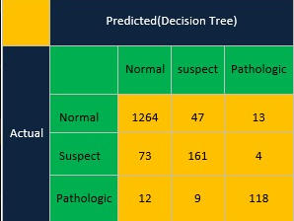
Confusion matrix(Decision Tree)

Slide 7
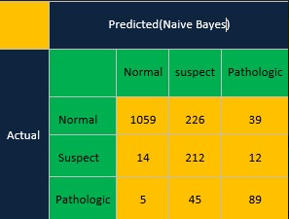
Confusion matrix(Naive Bayes)

Slide 8

Confusion Matrix(K-Mean)

Slide 9

Confusion Matrix(Logistic Regression)

Slide 10
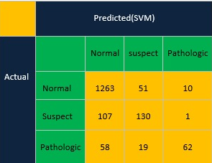
Confusion Matrix(SVM)

Slide 11
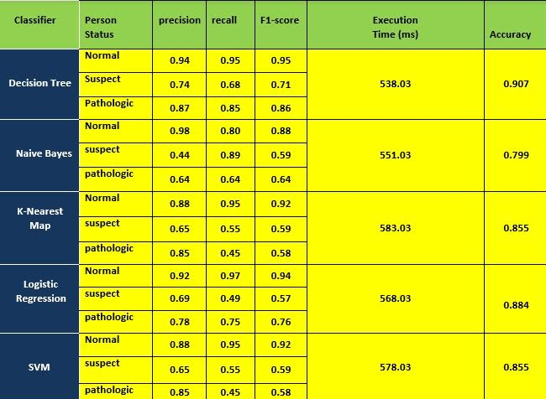
Overall Analysation

Slide 12
Accuracy Graph

Slide 13
Execution Time Graph

Slide 14
Future Work
To Preprocess the wave from the cardiotocography machine.
To Predict the output by giving the input via Mobile application or Software.
To improve Accuracy higher than 95%

Slide 15
Conclusion
The accuracy derived from the DT model is higher than the other algorithms and it shows the concise and effective decision rules to classify the situation of fetus.
Those decision rules could support obstetrician determine whether the fetus is suffering fetal distress effectively and efficiently.

