Slide 1
DeepBipolar: Identifying Genomic Mutations for
Bipolar Disorder via Deep Learning
Rajendra Rana Bhat

Slide 2
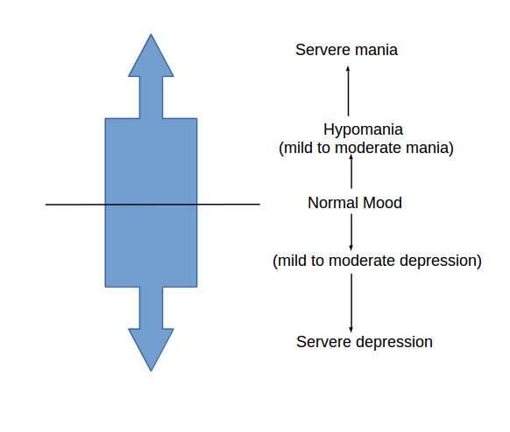
Introduction
Bipolar Disorder(BD) affects mental state.
Symptoms: mood swings from overly high to sad and hopelessness.
Results into severe episodes of mania and depression.
Affects close to 5.3 million adult in US.
Suicide kill 15-17% of BD patient.
BD similar to Schizophrenia and it is difficult to distinguish them.
Now-a-days genome wide study done for BD.

Slide 3
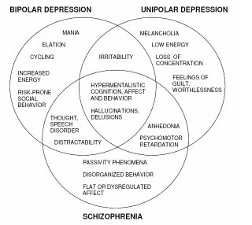
Symptom Classification

Slide 4
Data-Preprocessing
Datasets provided as per CAGI competition from Univ. of California, John Hopkins.
Datasets consists of 1000 samples with 500 labeled.
Per CAGI, for target capture and sampling 60 genes used.
Only high quality variant included in the sample.
Data represent exome sequencing of Bipolar Disorder.
Exome is protein coding region of the human genome and represents 2% of the whole genome.
85% of the disease is related to variant contain in exome.
Data contained in VCF(Variant Call Format ) file.

Slide 5
Data-Preprocessing
Genotype encoded as allele value with separator '/' e.g.
0/0, 0/1,1/1,./. where 0,1 are reference and alternate allele.
AD(Allile depth), Phred Quality.
Onehot encoding of the genotype i.e. 0/0->0100, 0/1->0010 etc
Onehot encoding ensures categorical value equidistant.
Same approach taken in the paper*.
*Predicting effects of noncoding variants with deep learning–based sequence model.
*DanQ: a hybrid convolutional and recurrent deep neural network for quantifying the function of DNA sequences.

Slide 6
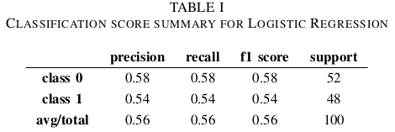
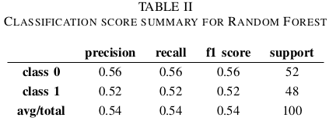
Model (Machine Learning)
Logistic Regression(56%), Random Forest(54% with 500 para)
AUC for LR(0.567) and RF(0.57)
Classification Metrics Summary.

Slide 7
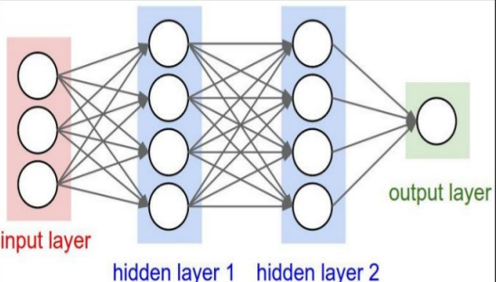
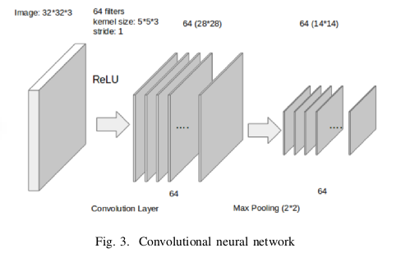
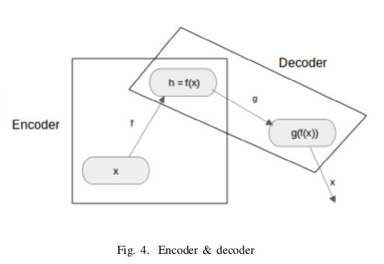
Model (Deep Learning)
Deep Neural Network(DNN)
Convolution AutoEncoder
Convolution Neural Network(CNN)

Slide 8
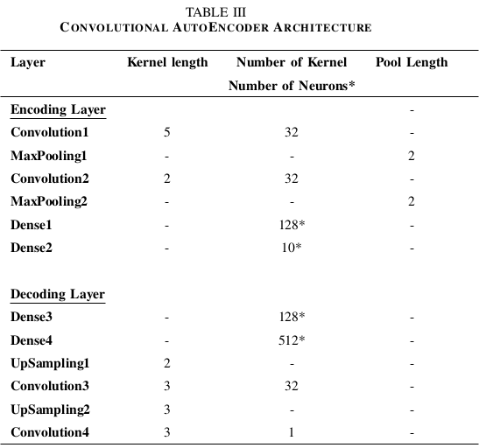
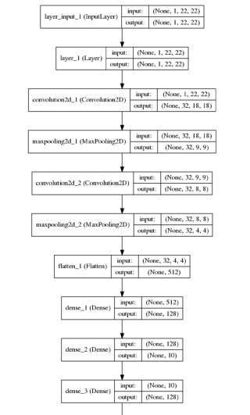
Model (Deep Learning)
CNN Autoencoder Architecture
Final Model Architecture

Slide 9
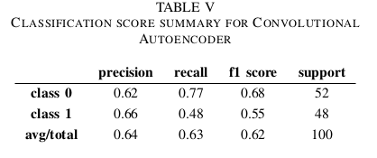
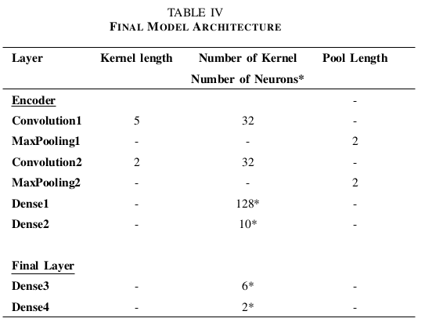
Model (Deep Learning)
Metrics

Slide 10
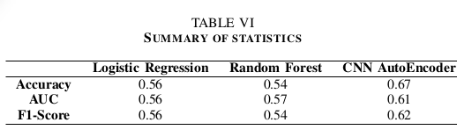
Summary

Slide 11






Thank You!
http://www.s3lab.ece.ufl.edu

