Slide 1
DeepBipolar: Identifying Genomic Mutations for Bipolar Disorder via Deep Learning
Scalable Software Systems Laboratory
University of Florida
http://www.s3lab.ece.ufl.edu/

Slide 2
Introduction
Bipolar Disorder(BD) affects mental state.
Symptoms: mood swings from overly high to
sad and hopelessness.
Results into severe episodes of mania and
depression.
Affects close to 5.3 million adults in US.
Suicide kills 15-17% of BD patient.
BD similar to Schizophrenia and it is difficult to distinguish between them.
Now-a-days Genome wide study done for BD.

Slide 3
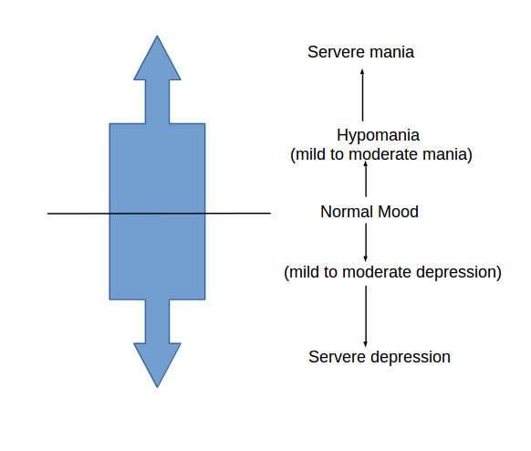
Symptom stage

Slide 4
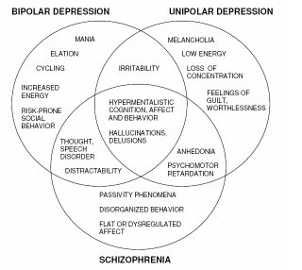
Symptom classification

Slide 5
Data
DataSets*.
1000 individual's exome sequencing of BD.
For target capture and sampling, 60 genes were used which was associated with BD previously
Only high quality variant included.
500 labeled sets and 500 unlabeled sets.
Labeled sets, unaffected(BD)=0 & affected(BD)=1
* “Bipolar Exomes” challenge in Critical Assessment of Genomics Interpretation competition(CAGI)

Slide 6
Preprocessing
Data represent exome sequencing of Bipolar Disorder.
VCF file consists of 5 level of genotype fields i.e. GT:AD:DP:GQ:PL
Genotype represented as 0/0, 0/1, 1/1, ./.
Categorical genotype mapped to one-hot-encoding before feeding to deep learning.
Train/Test split (400/100)

Slide 7
Methods
Machine Learning:
1. Logistic Regression
2. Random Forest
Deep Learning:
1. Convolutional Autoencoder
2. Convolutional Neural Network
3. Fully Connected Layer

Slide 8
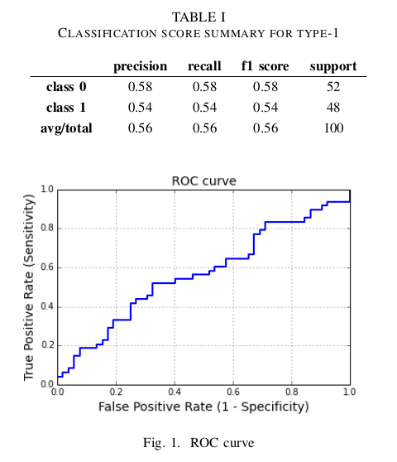
Logistic Regression
Accuracy: 56%, AUC: 0.567

Slide 9
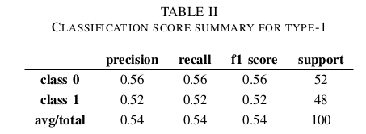
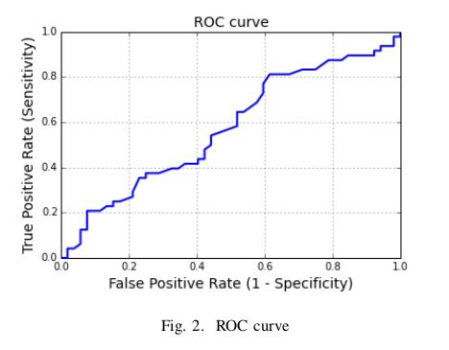
Random Forest
Accuracy: 54%, AUC: 0.57

Slide 10
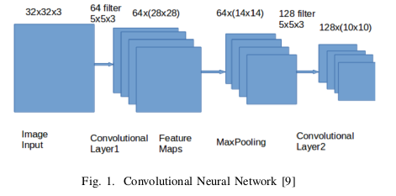
Convolutional Neural Network
Consists of 3 layers i.e. Convolutional Layer, Pooling Layer & Fully Connected Layer.

Slide 11
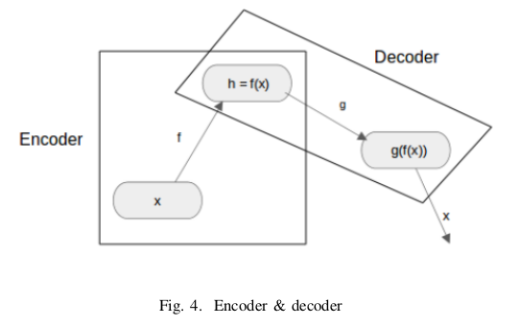
AutoEncoder
Consists of Encoder and Decoder. Used to compress/expand information and fine tune weights.

Slide 12
AutoEncoder
Consists of Encoder and Decoder. Used to compress/expand information and fine tune weights.

Slide 13
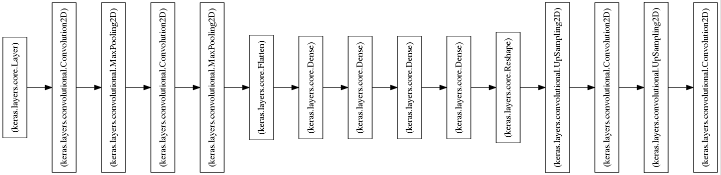
Convolutional AutoEncoder
We used Convolutional AutoEncoder to reduce the dimension and finetune the weights of Decoder. We used Keras.

Slide 14
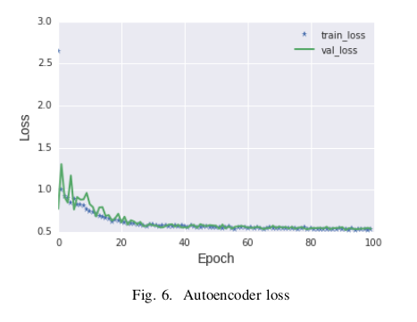
AutoEncoder loss function
With Encoder+2 FC layer we got accuracy:
67%

Slide 15
THANK YOU
15

