Slide 1
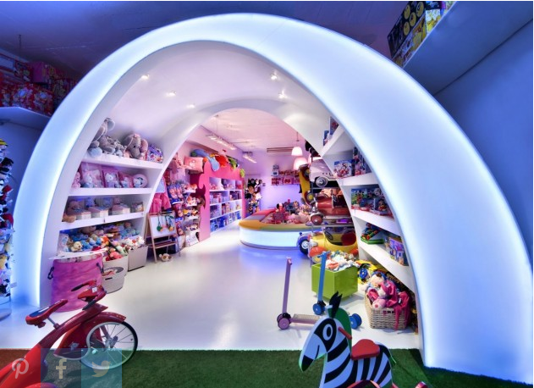
Toy Store Sales Dashboard
by Rajendra Solleti

Slide 2
Data Analysis
This is the sales data of a toy dealer between Jan 2003 and May 2005.
The Distributor is making sales in 19 different countries with 99K orders and close to 8.2 million sales are done over this 2.5-year span.
There was no column indicating the actual value of the order per row, hence created total price column by multiplying quantity ordered and price each.
Product Code was split to get sub category code of which s18 and s24 are making highest sales which could correlate them to being the product codes of classic and vintage cars, respectively.

Slide 3
Interesting Observations
Classic car toys and vintage cars are the highest sold product types with maximum sales happening during thanksgiving month of November. These two product types sales combined are almost 5 times the sales of the next highest sold product motorcycle.
USA is the country with the maximum sales but when we compare the regions EMEA region orders more than 40% of the orders from USA and Canada.
The least amount of sales are happening in the countries of Ireland, Philippines and Switzerland.

Slide 4
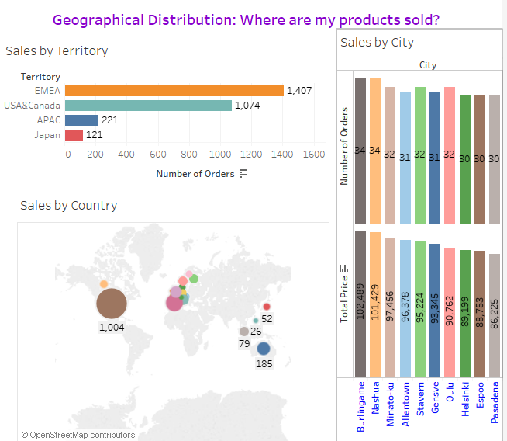
Our products are mostly sold in the Europe region with USA selling the highest when split based on countries.
New Bredford and Brickhaven are the cities which are registering the highest sales.

Slide 5
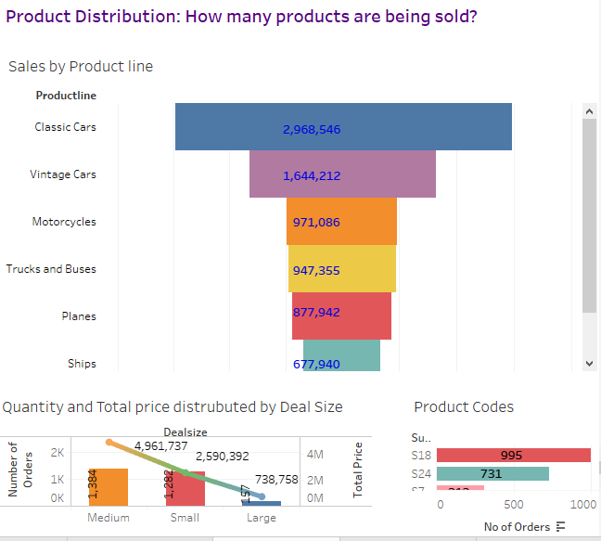
Classic Cars are my highest sold product type almost double that of the second highest sold Vintage cars.
Large Contributes to almost one thirds of the medium orders value by just having one tenth of the no of orders

Slide 6
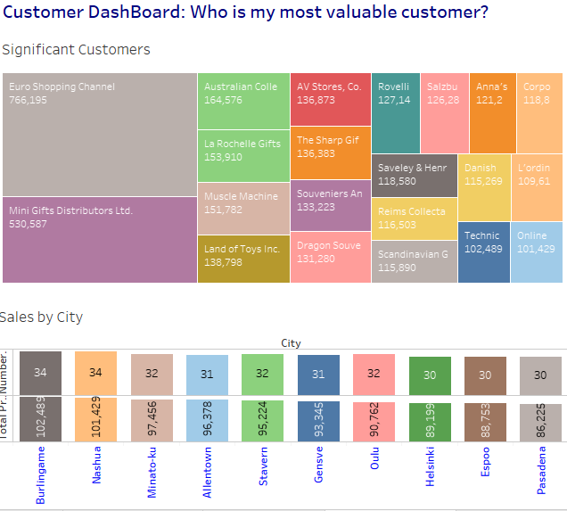
Euro Shopping Channel from Madrid and Mini gifts distributors from San Rafael are the two most valuable customers accounting for more than 10 times the sales of the next highest customer

Slide 7
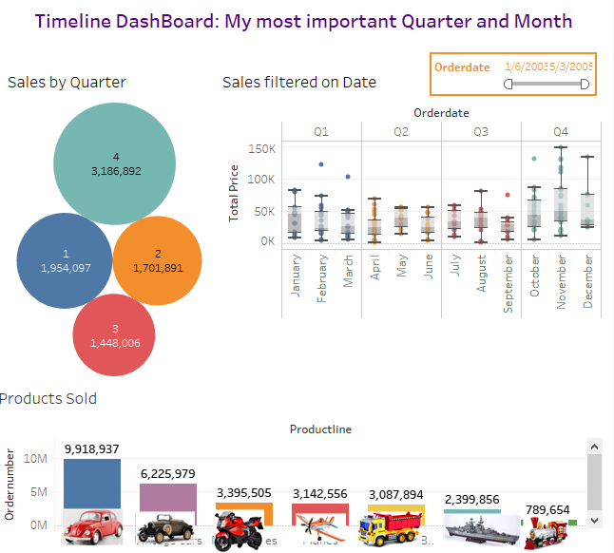
November and Q4 are the month and Quarter where maximum sales happen, Alternatively September and Q3 are where sales slag.

Slide 8
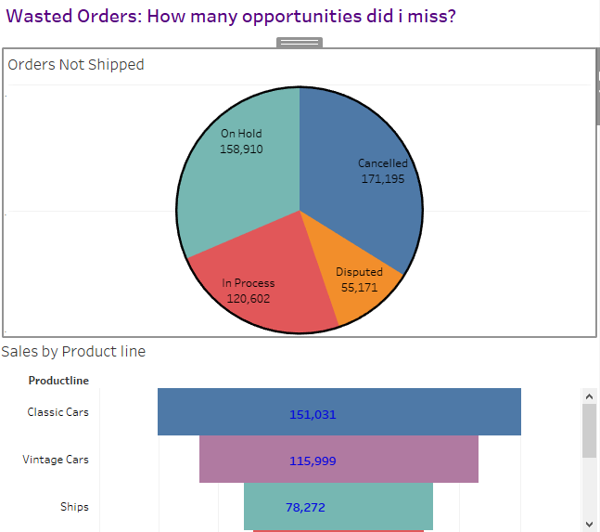
We have lost close to 500k due to various cancellations and disputes.
Anomalies noted are ships being the highest number of cancelled orders and bikes being the highest number of disputed orders.

Slide 9
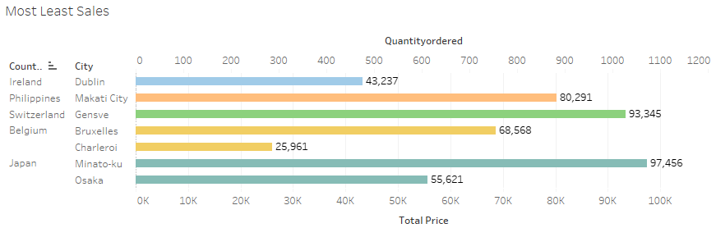
Ireland, Philippines and Switzerland are the countries with the least amount of sales.

Slide 10
Conclusions
We can open a local distribution center in Europe to cater to the vast orders we are receiving from this region which also could reduce the shipping costs and lead time.
1
We can discontinue trains and introduce more models of classic cars and vintage cars as train toy sales are not even accounting for 5% of the sales of car toys.
2
Provide 5% discount by default on the orders placed by Euro Shopping channel and Mini Gifts Distributors as a token of appreciation for the business they are providing to us.
3

Slide 11

Conclusions
Arrange for a Team outing in the month of September our lowest sales month to boost the morale of the employees for heavy work that is coming in November.
5
Arrange a team to analyze what is wrong with the ships and bike toys that are being disputed and cancelled.
6
Analyze the total cost of shipping goods and the profit we make on goods shipped to countries like Ireland, Philippines and cease operations to be more streamlined

