Slide 1
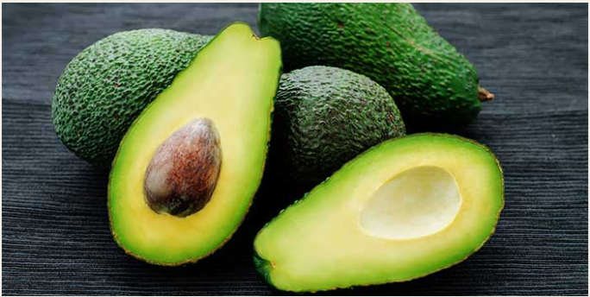


Avocado Price Prediction
by Rajendra Solleti

Slide 2
Data Analysis
This is the sales data of the Avocadoes from Jan 2015 to Mar 2018.
Out of all the columns present columns 4046, 4225, 4770 and bag sizes like Small bags, large bags and x large bags are insignificant because they are highly correlated to Total volume and total bags respectively.
The data seems to be collected properly as there are no null values as well.

Slide 3
Interesting Observations
The data collected is only of Sundays.
The price of the Avocadoes is mostly weighed between $1 and $1.7
February is the month where Avocado is produced the maximum hence the price remains the lowest during this month. Alternately in October very low produce of avocadoes is observed and price is at it highest during this time.
Hartford Springfield and San Francisco seems to be the regions having the highest price for avocadoes while Southcentral and Houston seem to have the lowest price.

Slide 4
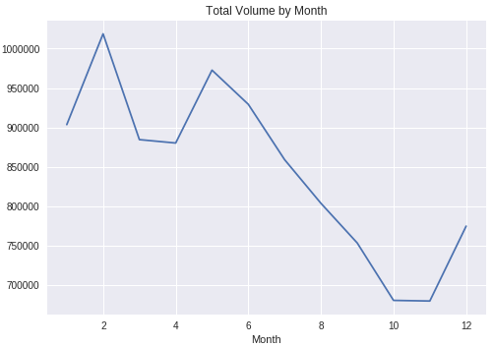
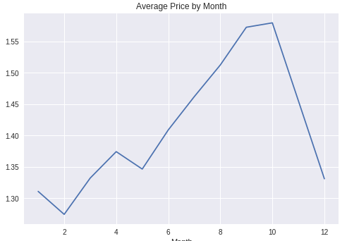
Average Price and Total Volume by Month
We could observe from this graph that September and October are the months where the price seems to be at its highest and volume at its lowest
February is the month where the price seems to be the lowest and volume highest.
We could conclude that price and volume are inversely proportional.

Slide 5
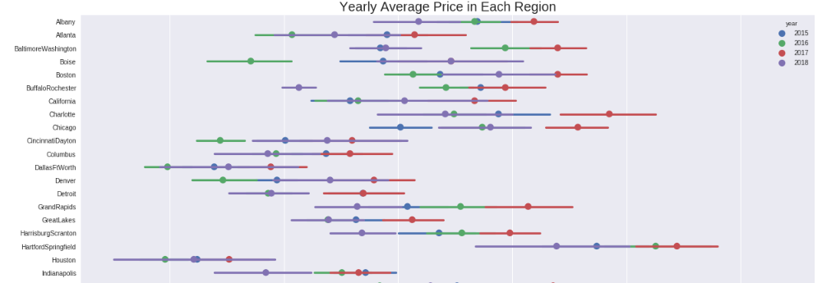
Yearly average price per region
Hartford Springfield and San Francisco seems to be the costliest states while southcentral and Houston remains to be the cheapest.

Slide 6
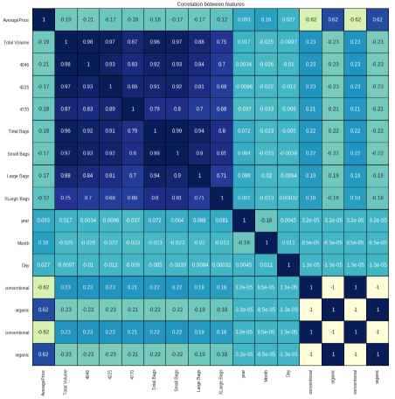
Correlation Matrix
Avocado Type is the feature that is most closely correlated with price
Volume is highly correlated with different bag sizes and PlU codes

Slide 7
Linear Regression
As we are trying to predict the price of Avocadoes this becomes a regression problem and not classification.
In the following slides we will be evaluating different algorithms to select the model which provides the highest accuracy.
Linear Regression only has two parameters available for tuning fit intercept and normalize. Copy and njobs are ignored.
We got a maximum accuracy of 44.27% when fit intercept was set to false this setting ignores the normalize parameter as well.

Slide 8
K-fold Nearest Neighbor Regressor
We have used gridsearchCV which automatically selects the best parameters.
We can tune the number of neighbors and the folds to improve accuracy of model. Increase in the number of neighbors is just increasing the computation time with very marginal gain in accuracy.
We got a maximum accuracy of 67.77% when 9 nearest neighbors are selected and with 3 fold validation

Slide 9
Random Forest Regressor
This uses a number of classifying decision trees and various sub samples to improve predictive accuracy and control overfitting
N_estimators and bootstrap are the parameters that are affecting the score maximum.
We have achieved a maximum accuracy of 89.55% using this model with a setting of 50 estimators and setting bootstrapping to true..

Slide 10
Conclusions
Avocadoes are seasonal fruits which are produced in high numbers during February and least during October. Correspondingly price remains at its lowest during February and highest during October.
Random forest regressor is the best suited method for predicting the price as it an ensemble of multiple classification models providing us with very high level of accuracy and minimum overfitting.

